Slide 1




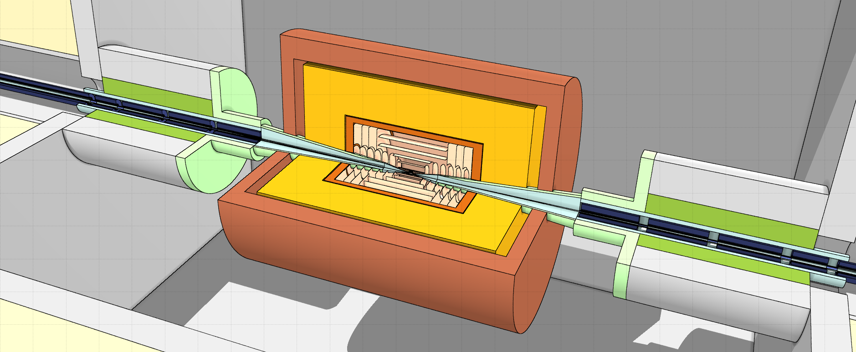

Funded by the European Union (EU). Views and opinions expressed are however those of the author only and do not necessarily reflect those of the EU or European Research Executive Agency (REA). Neither the EU nor the REA can be held responsible for them.
MDI design: open points and next steps
July 28, 2025

Slide 2
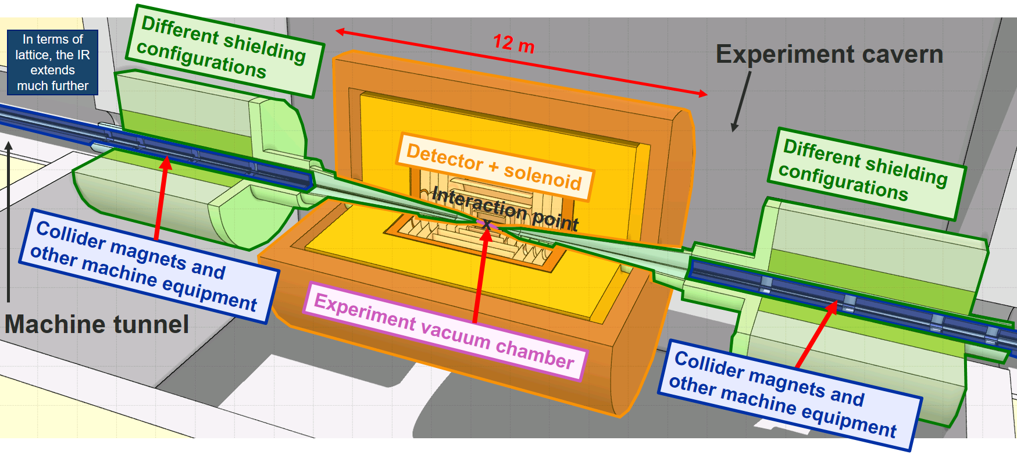
Introduction
Have a conceptual MDI layout for 10 TeV, which needs to be developed into a more realistic MDI design
Key topics (some of which are not yet addressed):
Interaction region lattice design under consideration of various constraints (technical limits for magnets, heat load)
Beam-induced background simulation, conceptual shielding design (incl. nozzle) and other background mitigation measures
Engineering design of nozzle, central vacuum chamber, etc.
Luminosity monitoring and beam instrumentation
Integration of accelerator, infrastructure, shielding and detector, including support structures (+ civil-engineering requirements)

Slide 3
Beam-induced background
Muon decay
The decay-induced background has been studied in much detail for 3 TeV and 10 TeV, source term can be described with good accuracy (sampling from matched beam-phase space distribution)
Not all correlations between background distributions and detector occupancies are yet understood → needs further work - close collaboration between MDI and detector experts essential
For the moment, there is no obvious solution to suppress the decay background much further (nozzle and lattice optimization not a game changer); nevertheless, the idea is to adapt the nozzle further
It is imperative to continue decay background studies as the IR and MDI layout evolves → close collaboration with detector experts remains essential
Incoherent e-/e+ pair production
First distributions from GuineaPig showed that the pair background is not negligible for a 10 TeV collider
Solenoid field is the main handle to control this background source
Need some maintenance of the event generator → further improvements for µ beams? (no dedicated workforce at the moment)

Slide 4
Beam-induced background
Beam halo losses
Very difficult to predict the expected beam halo losses (in absolute terms); can we get a better understanding through beam dynamics studies?
Have first very preliminary studies of background spectra (per lost muon), which need to be refined → would need (multi-turn) tracking studies to get more realistic beam loss distributions in the IR (no dedicated workforce at the moment)
Design of a halo cleaning/extraction system might be necessary (no dedicated workforce at the moment)
Other sources
Not expected to give a major contribution to the beam-induced background
No detailed studies foreseen at the moment

Slide 5
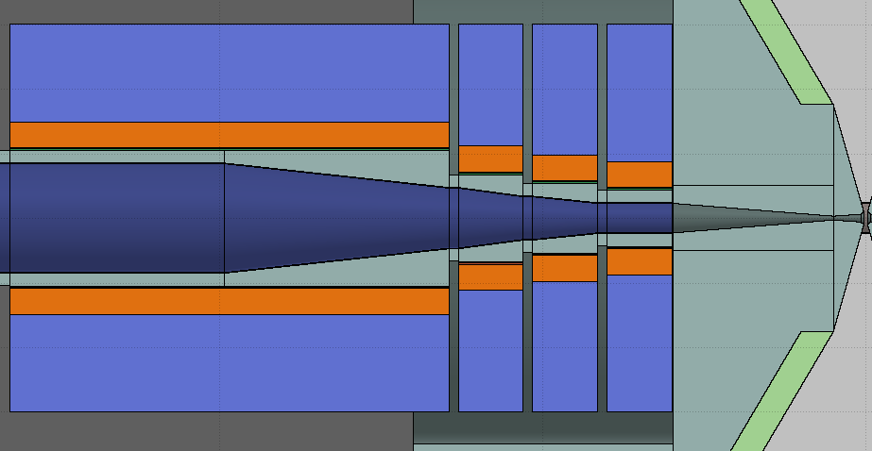
IR layout and lattice
Several topics require follow-up:
Beam aperture in IR region
The assumption concerning the IR vacuum aperture (5σ) still dates back to MAP
Is it acceptable in terms of beam stability (impedance) and beam background (halo losses)?
Requires more studies which will take more time → suggest to maintain 5σ until we find a showstopper
Internal shielding of IR magnets and magnet apertures
Decay-induced heat load to cold mass: the present liners inside the IR magnets and the shielding of interconnects are probably not yet sufficient (discussion at annual meeting) → need to add shielding which will increase magnet aperture requirements
Larger aperture means smaller gradients, which will increase the length of the final focus
Conical liners inside FF magnets
Follow 5σ beam envelope

Slide 6
IR layout and lattice
Presently no space between magnet and nozzle
Several (more) topics require follow-up:
Realistic space requirements for nozzle-magnet interconnect
Presently, there is no space included in the present layout
Need to account for cryostat end cap, cold-warm transition, flanges, BPMs? + routing of services (e.g. nozzle cooling circuits);
Also depends on how the nozzle will be supported and if we need a support structure outside of the detector
In order to account for the necessary space, likely have to increase L* which in turn will increase the length of the final focus
Realistic space requirements for magnet-magnet interconnects in IR
The presently assumed interconnect lengths are probably not sufficient (discussion at annual meeting)
Possibly need to increase the interconnect length, which will increase the length of the final focus

Slide 7
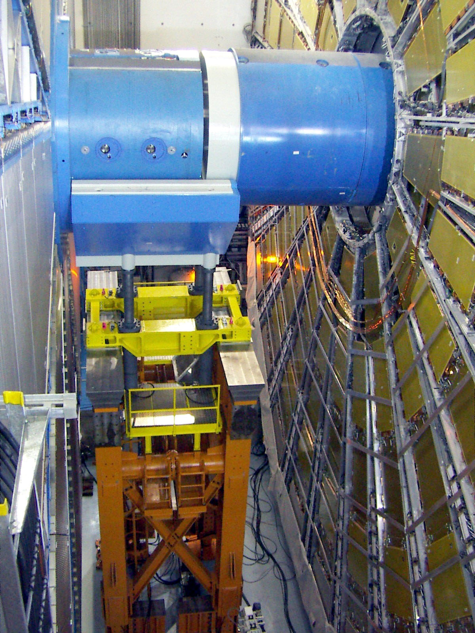
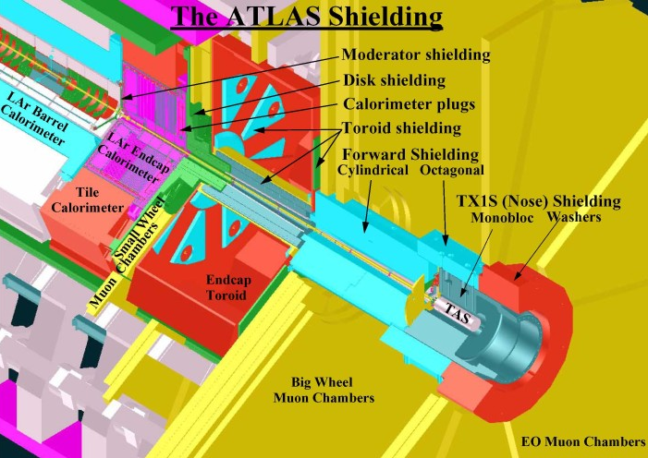
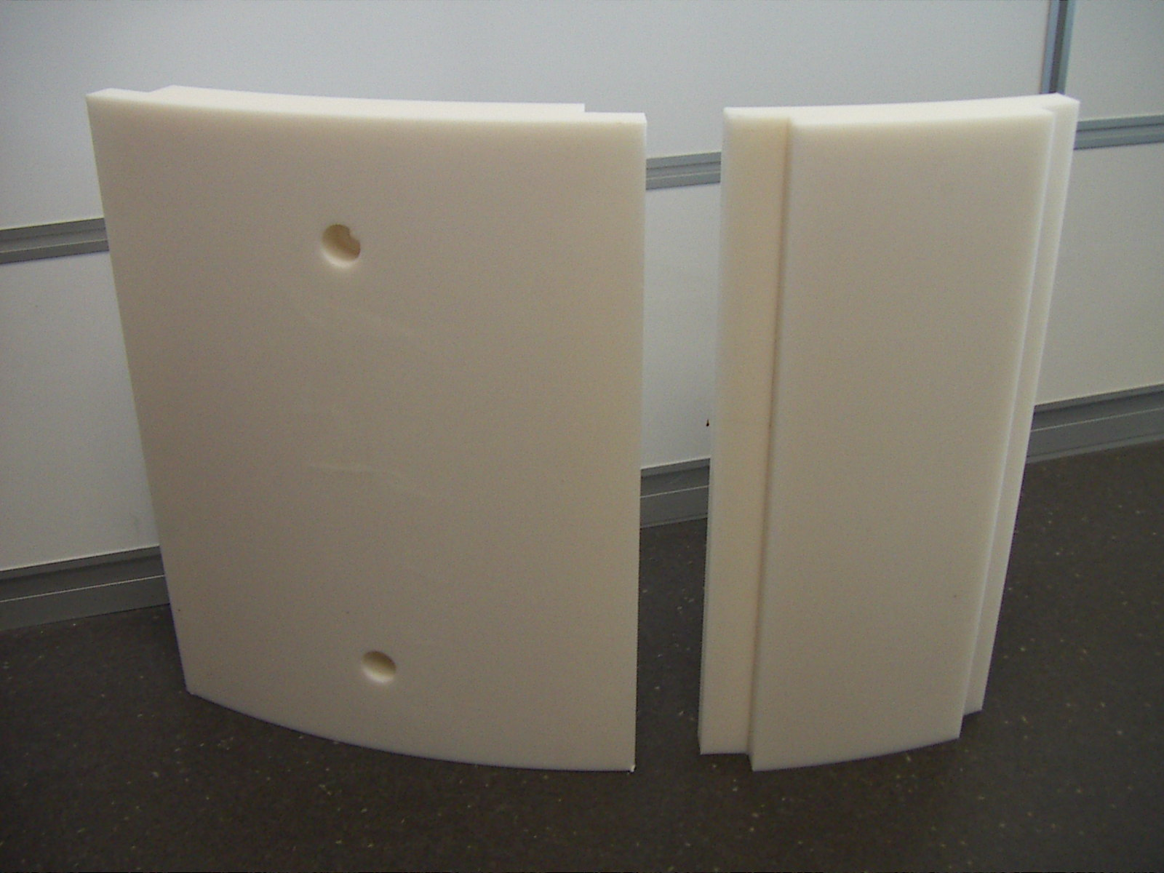
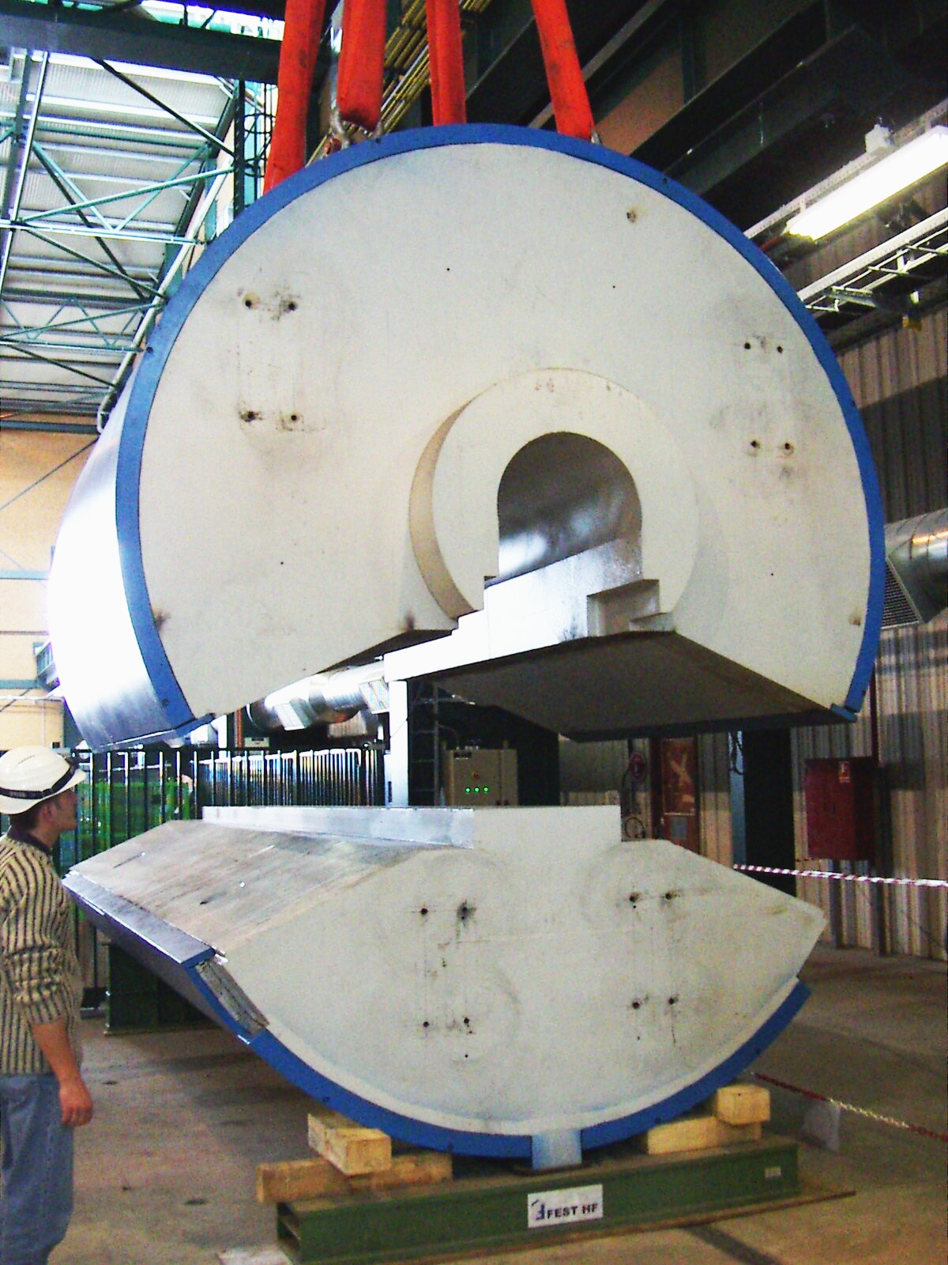
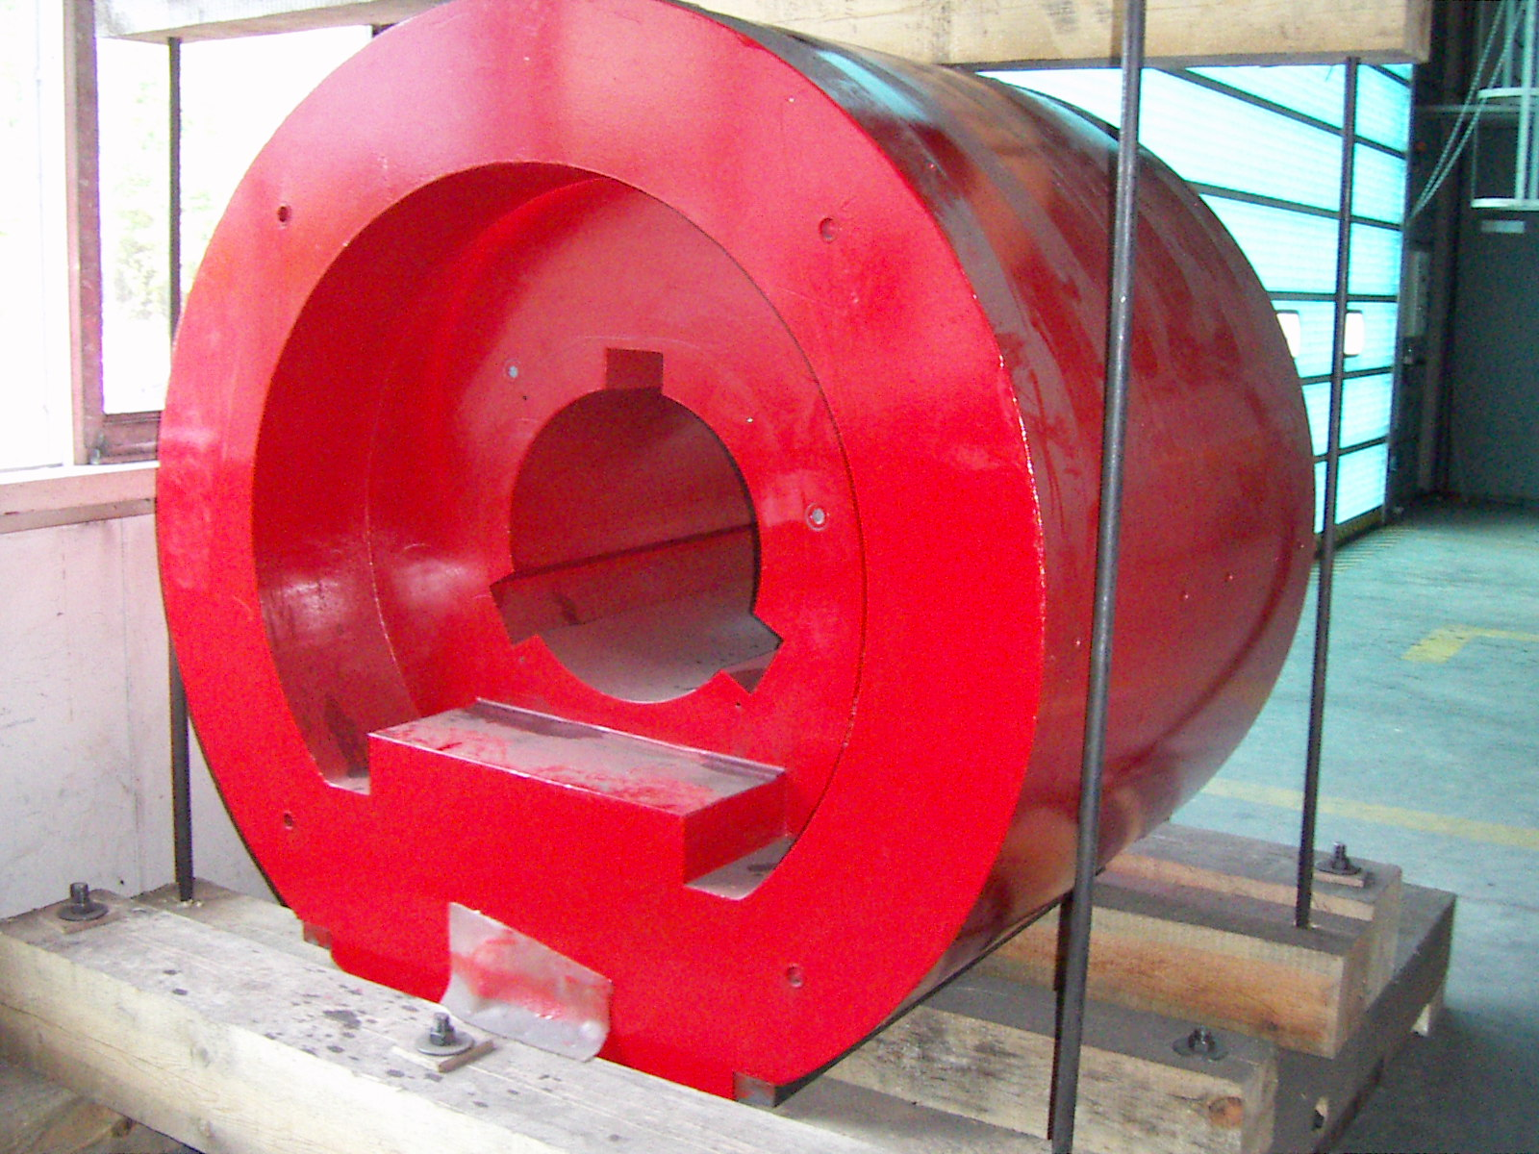
Nozzle and central beam chamber
Several topics require follow-up:
ATLAS shielding*:
Technical nozzle design:
Integration and support inside detector
Shielding segmentation and assembly
Selection of specific material (tungsten heavy alloy) → machining is an important aspect
Heat extraction (cooling) → thermo-mechanical studies
Alignment, vibrations, tolerances, etc.
Dedicated vacuum chamber inside nozzle?
Integration of instrumentation?
Technical chamber design:
Material budget, support, cooling, integration, …
ATLAS forward shielding:
775 tonnes of cast iron,
50 tonnes of steel plates
11 tonnes of borated polyethylene
ATLAS toroid shielding:
110 tonnes of cast iron,
2.6 tonnes of borated polyethylene
*Pictures/info from https://atlas-shielding.web.cern.ch

Slide 8
MDI integration
Need to start working on an overall MDI integration model. As a starting point needs some basic input:
Detector and solenoid integration
What are the envelopes for the detector + solenoid?
What are the space requirements for opening the detector?
Nozzle integration
How is the nozzle supported?
Final focus magnet integration and surrounding shielding
Are the final focus magnets and the surrounding shielding elements located on a support structure inside the detector cavern or does the collider tunnel extend until the detector?
What are the space requirements for the FF magnet cryostats and required services (cryogenic lines, cables, etc.)? What are access requirements for installation/handling/maintenance for the magnets? How tight can the surrounding shielding enclose the magnets?

Slide 9
Other topics
Luminosity measurement
Concepts for luminosity monitoring and associated detectors?
Integration of luminosity detectors in the forward region (in the nozzle?)
Forward muon detectors
Specs for forward muon detectors?
Possible integration of in the beam line

