Slide 1

Iron blocs cutting with a diamond wire Diamond Pauber visit at CERN
WP 4 Stefano Marzari 30.7.2025

Slide 2
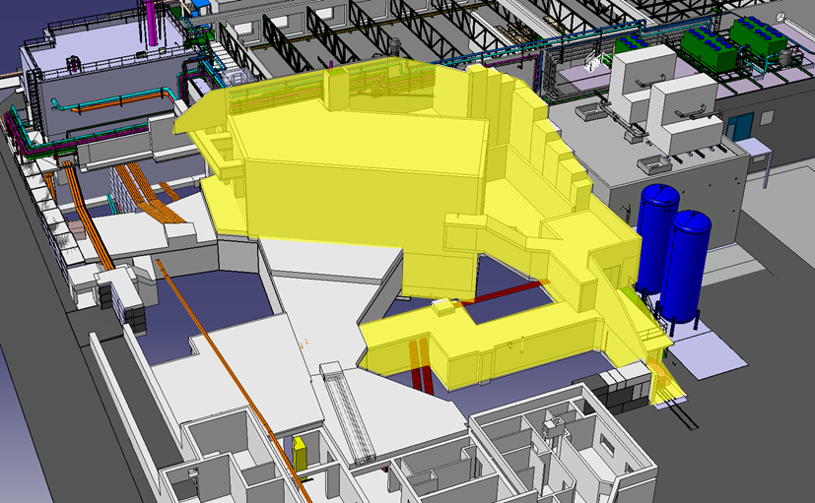
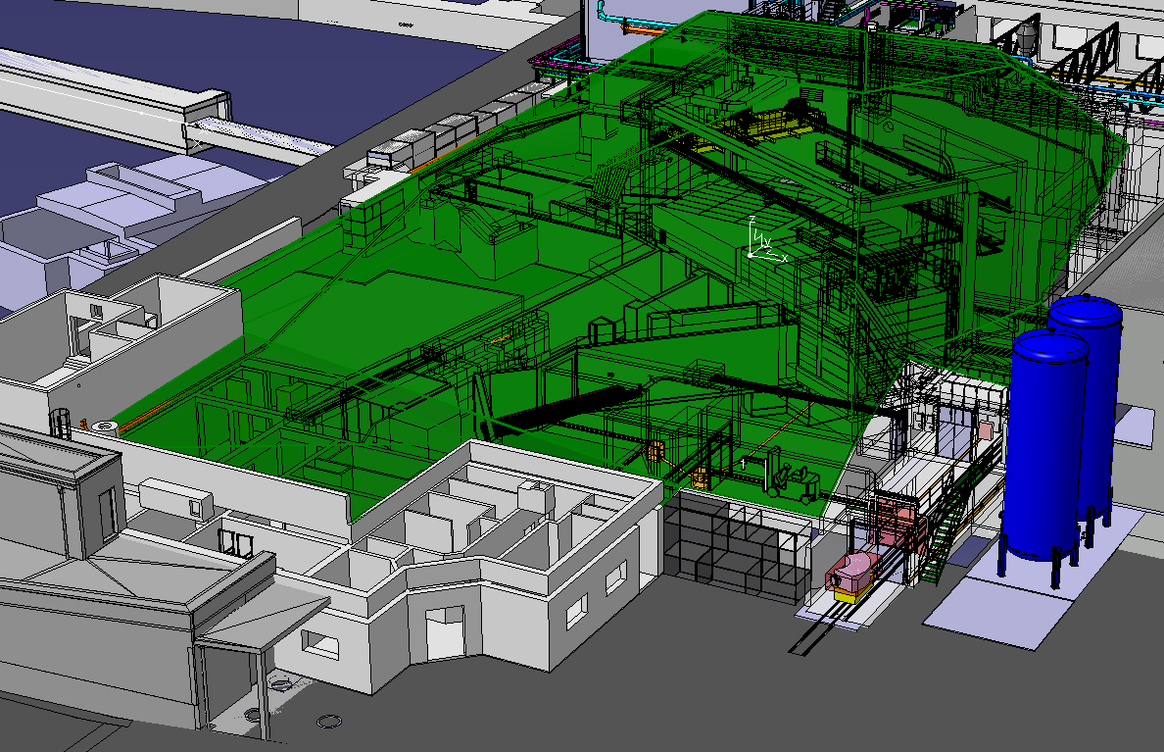
Our needs for the project IBDRS:
Introduction:
During LS3 (2026-2028) we must replace the ISOLDE facility dumps
A new building on top of the present target area will be constructed
New construction

Slide 3
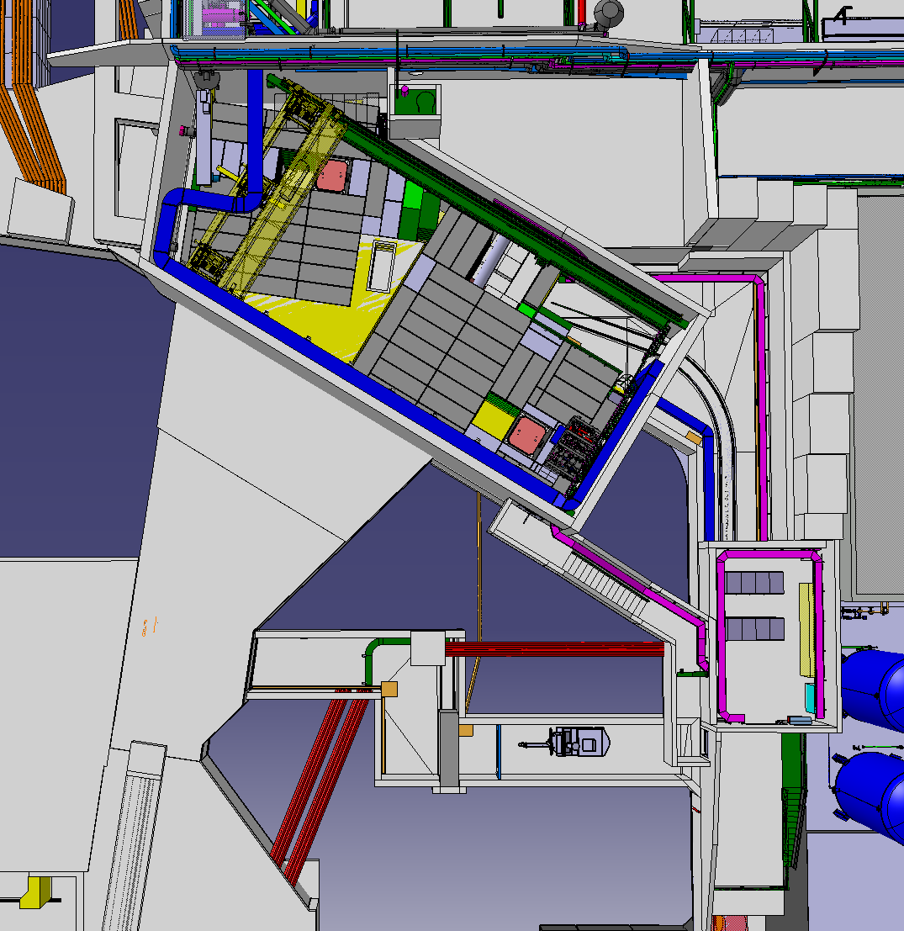
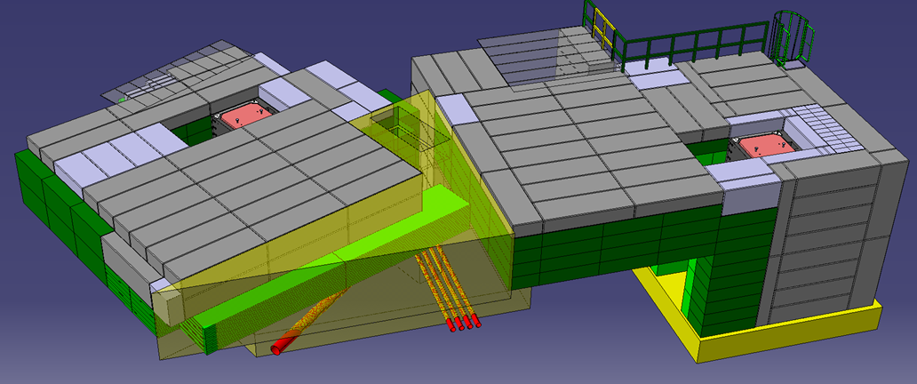
Introduction:
The new building will host the new dumps and the new shielding
282 m3 of iron will be needed
protons
Dump
Dump
Dump
Dump
Iron shielding blocs
Concrete shielding blocs
Poured concrete

Slide 4
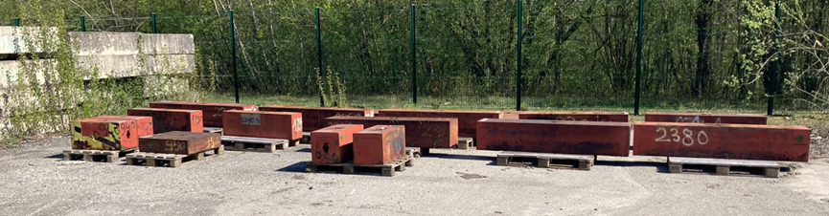
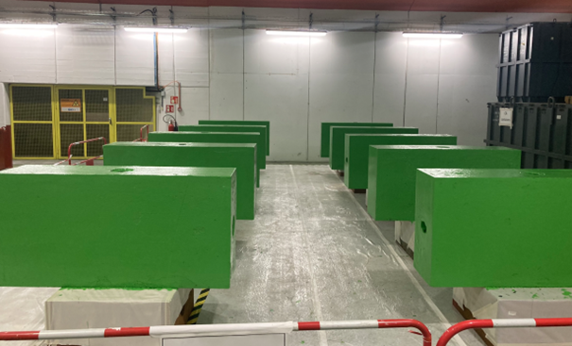
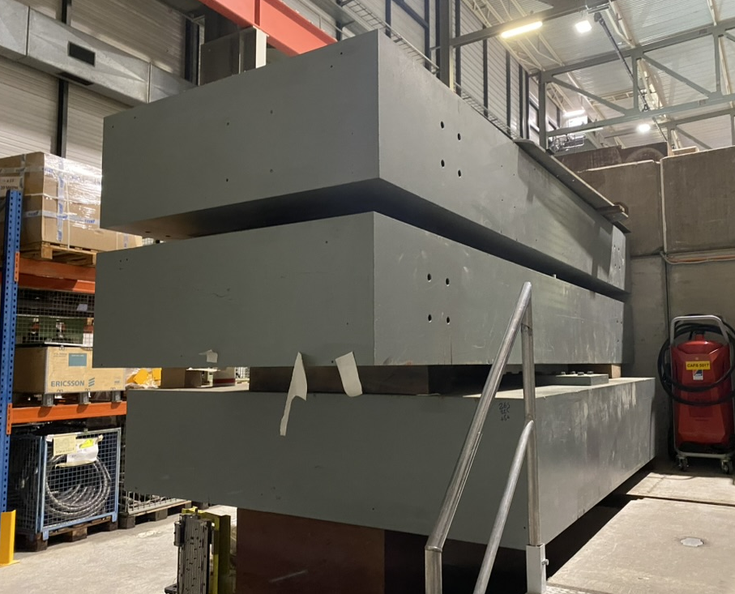
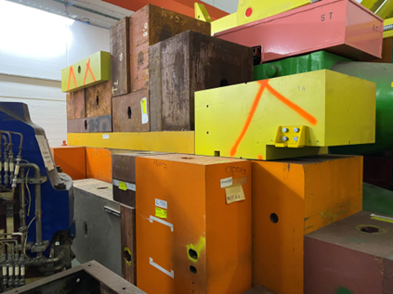
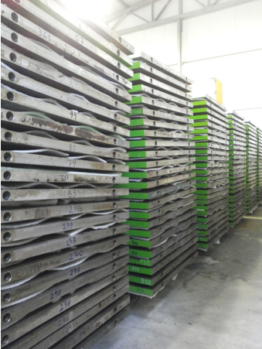
Our iron needs for IBDRS:
We intend to reuse 80% of iron already present at CERN
Some are in good conditions (only to be painted)
Others have not standard dimension and are difficult to integrate
«exotic shape» => to be cut
«good shape» 160x80x40 cm
Opera plates

Slide 5
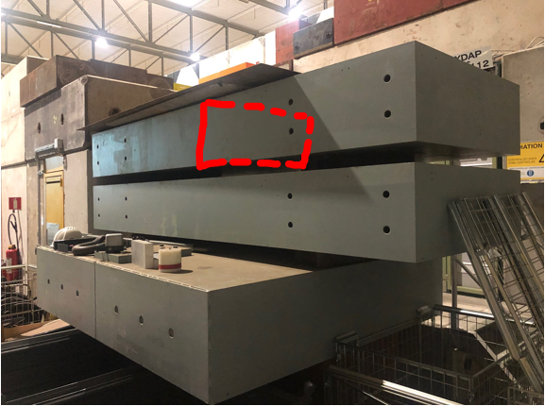
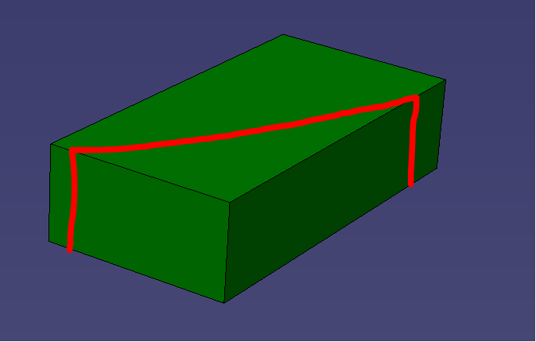
Our iron needs for IBDRS:
We need mostly perpendicular cuts
But also, with an angle
Perpendicular cut
Diagonal cut

Slide 6
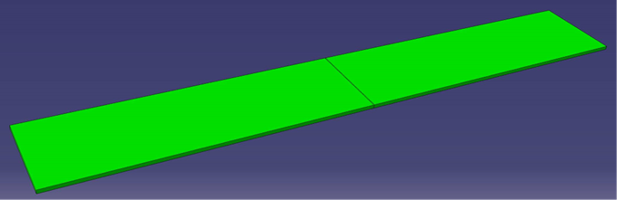
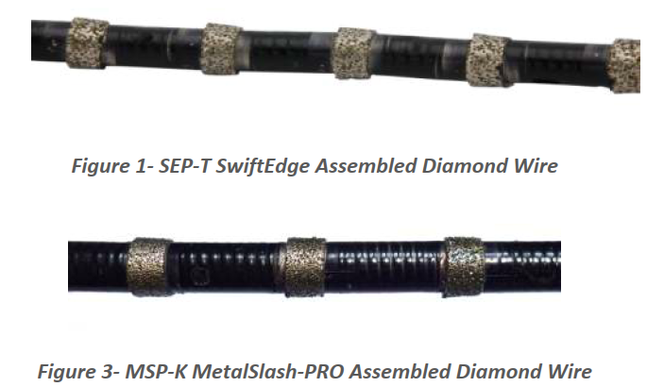
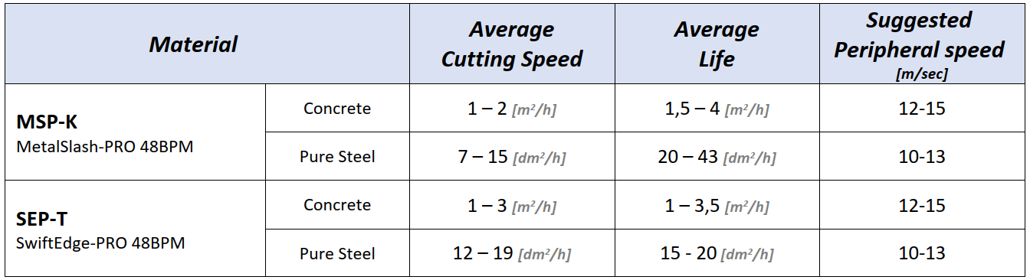
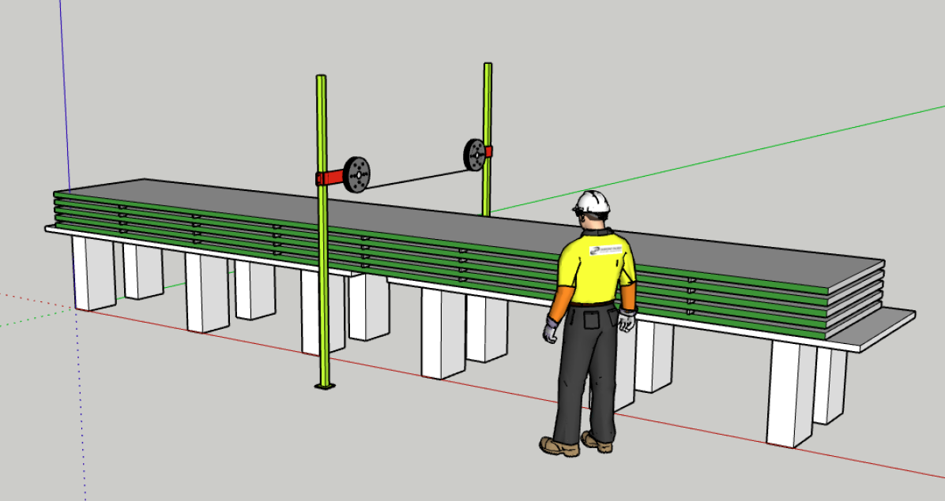
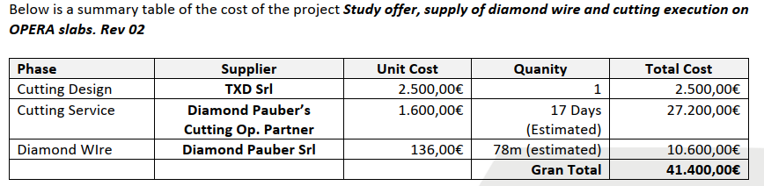
Diamond Pauber preliminary quotation:
Cutting speed for “standard” steel : 7…19 dm2/h
Opera plates
Diamond Pauber proposal : for 250 Opera plates
Cut in 5 by 5 batches
2,5 batches by day => 12.5 plates by day
Cutting speed 17 dm2 /h
~25 days to cup 250 plates
Included:
Workers, supports, water cooling installation ?
Work at CERN
Cutting precision +/- 2.5mm
Cutting width 10mm
Non included:
Plates handling
400 Eur/day for TXD (not all the days ?)

Slide 7
JD cutting
Raphael Vuillermet,

Slide 8
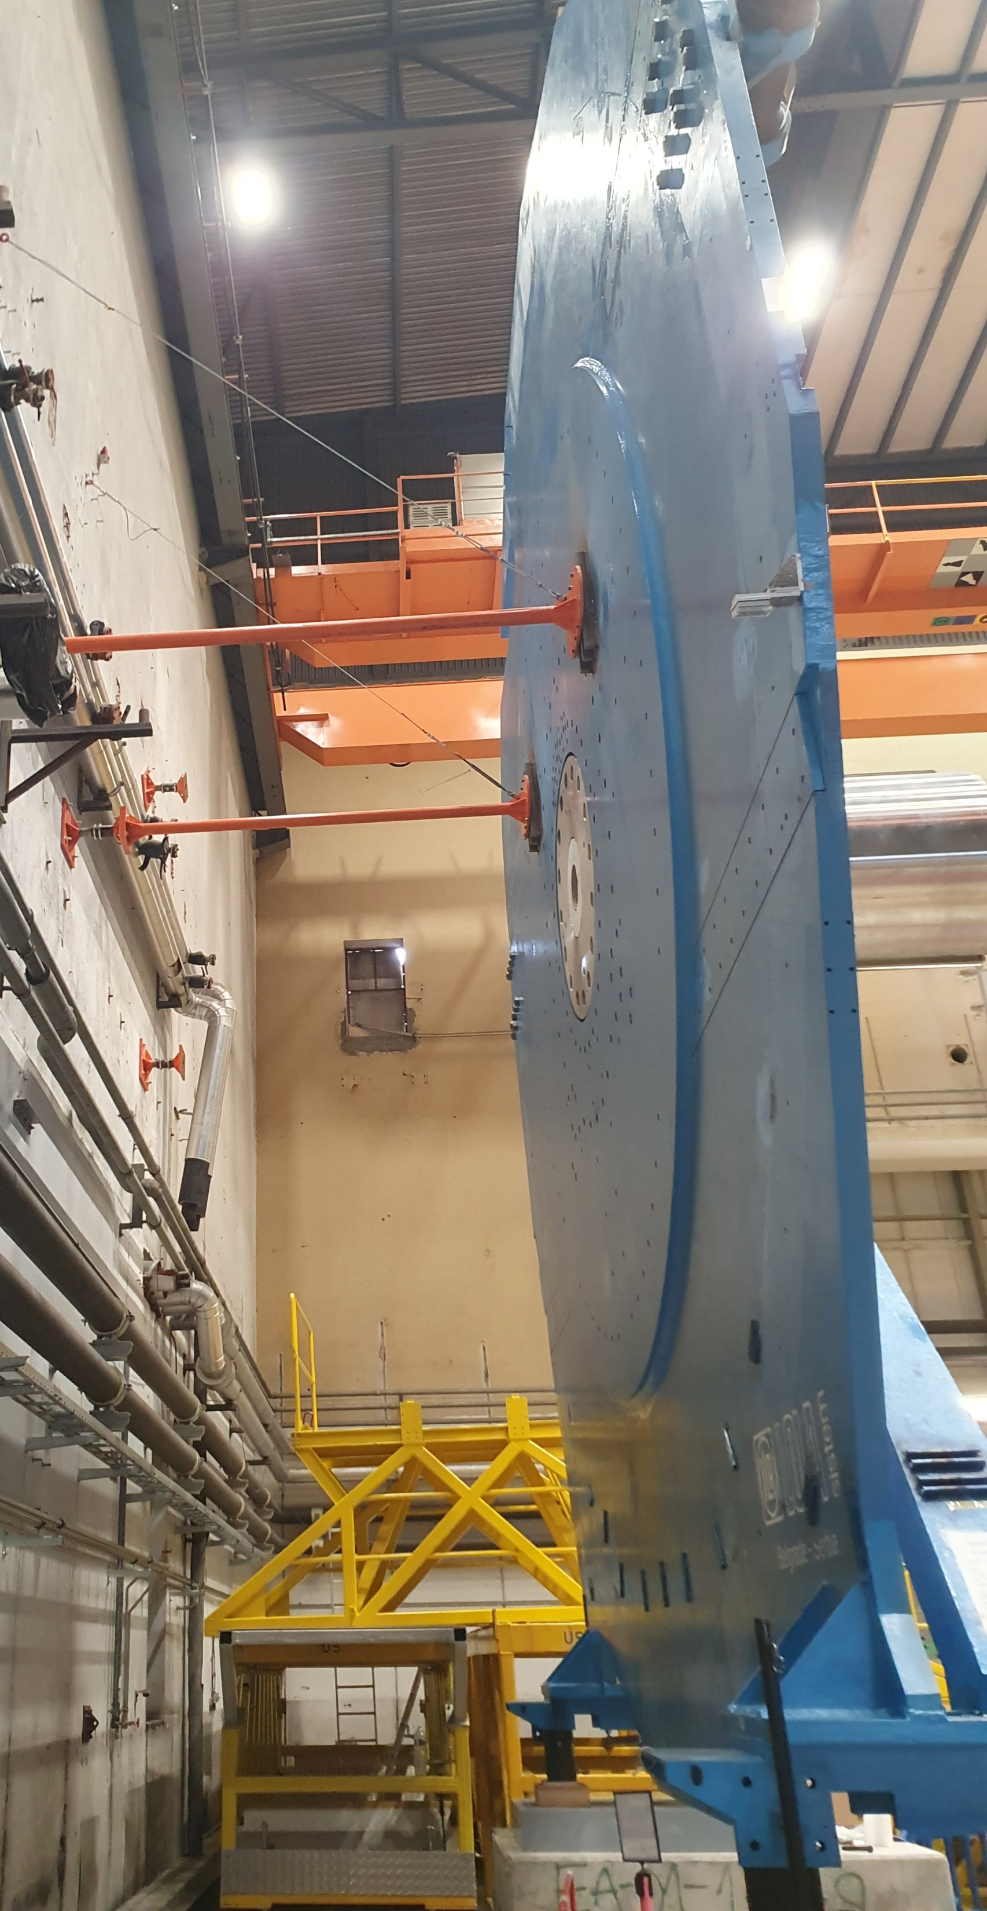
Introduction
In the context of the dismantling of the muon Small Wheels, splitting the shielding disk in several pieces is mandatory to dispose and transport the material.
The shielding disk is now laying horizontally.

Slide 9
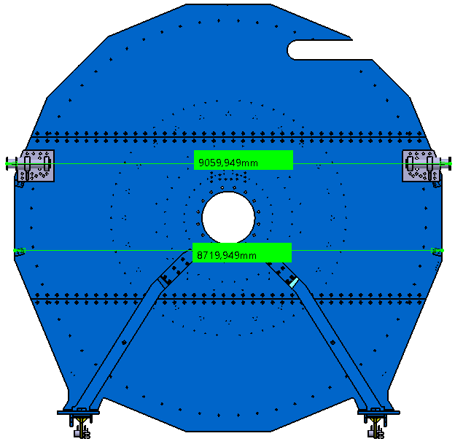
Characteristics
Material : steel EN 10 025-S275. JR
Maximum thickness : 80mm + 50mm = 120mm
Dimension : Ø 9000mm
Availability of the material : end of August - September 2025
Location : either inside the building 191 or just outside the building.
Masse : 54t

Slide 10
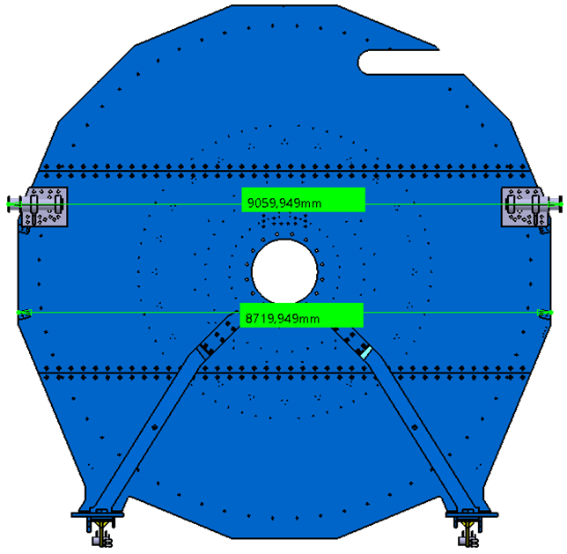
Possible cutting scheme (to be discuss with the company)
I guess that wire cutting in only possible on straight line … if curve trajectories are possible, please let me know…

