Slide 1



Adapting the Coffea Framework for FCC
Eglė Lenkaitytė
Mentors: David Lange, Prayag Yadav

Slide 2
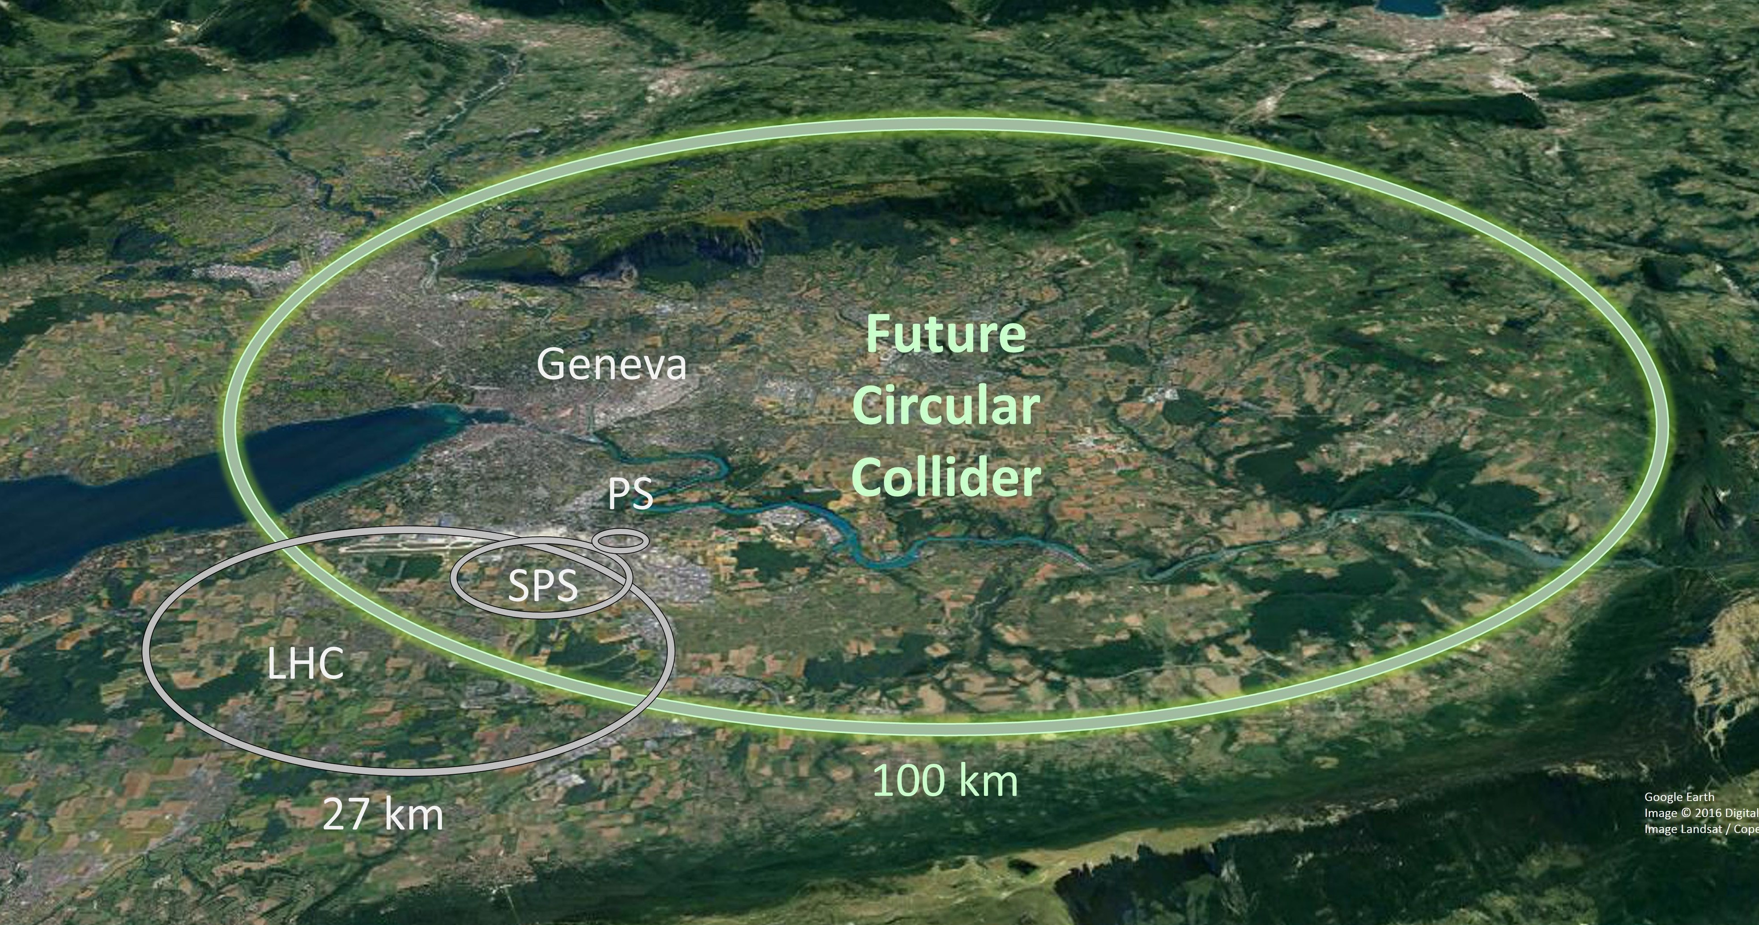
FCC
The Future Circular Collider (FCC) is a planned next-generation particle accelerator at CERN. With a potential to reach 100 TeV collision energies, increased data rates and more precision, FCC will open the way to greater understanding of fundamentals and the search for new physics beyond the Standard Model.
Notes:
The Future Circular Collider is a proposed next-generation particle accelerator at CERN. It aims to reach up to 100 TeV collision energies, significantly higher than the LHC. With greater precision and data rates, the FCC could open the door to a deeper understanding of the Standard Model and potentially uncover new physics.
Even though the FCC is not to start running for the next 15-20 years, it is crucial to develop robust data analysis infrastructure now to ensure good preparation for when the real data begins to flow

Slide 3
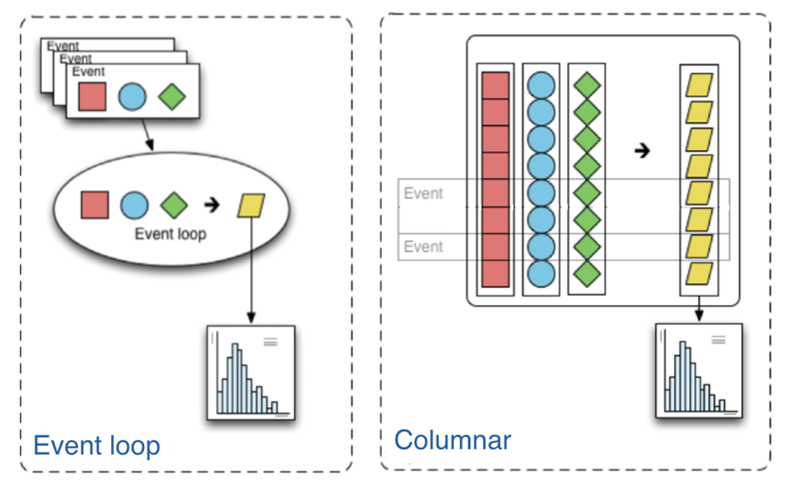
Coffea
The Columnar Object Framework For Effective Analysis (COFFEA) is a Python-based unified analysis toolkit for High Energy Physics (HEP) data. Coffea provides tools and components that simplify data analysis, enabling streamlined and reproducible HEP workflows.
Notes:
Coffea stands for the Columnar Object Framework For Effective Analysis. It’s a Python-based toolkit designed to streamline data analysis in high energy physics. Coffea simplifies workflows and improves reproducibility, making it ideal for analyzing large datasets like those expected from FCC.
Coffea has already been successfully deployed in CMS (Compact Muon Solenoid). However, its application to FCC data, which is based on Key4hep and FCC-specific software ecosystem (FCCSW), is still being developed. This will allow for Coffea to work smoothly and be compatible with data formats and workflows used in FCC environment.

Slide 4
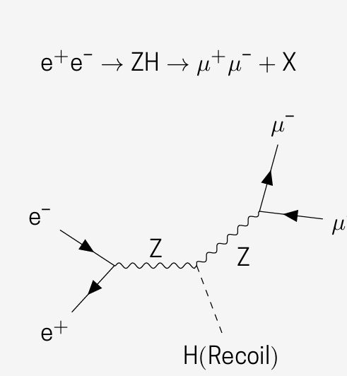
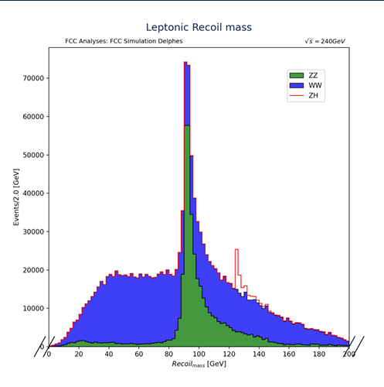
FCC ZH analysis using 4 lepton channel implemented in Coffea
Notes:
One key application I looked into was the ZH production channel, where both the Z and the Higgs bosons decay to leptons. This clean four-lepton final state makes it a useful benchmark for FCC analyses using Coffea.

Slide 5
Goal, progress and plans
Goal: create documented examples of using the Coffea analysis framework with FCC simulated data. This includes ensuring compatibility with the FCC software ecosystem (Key4hep and FCCSW) via the recently developed FCC schemas.
Progress: spent time learning NumPy, Awkward Array and Coffea, reviewed and analysed previous Coffea-based FCC analysis codes, successfully ran the analysis codes after setup, fixed errors encountered during execution.
Plans for now: start creating my own Coffea based FCC analysis code examples.
Notes:
My goal was to build documented examples showing how FCC simulated data can be analysed using Coffea. This also meant ensuring compatibility with FCC software tools like Key4hep and FCCSW. So far, I’ve spent time learning key libraries like NumPy and Awkward Array, reviewing existing Coffea-based analyses, and successfully running and fixing those codebases. Going forward, I’ll focus on developing my own analysis examples using Coffea, tailored for the FCC environment.

