Slide 1
Status of the Inner vertex layout for FCC-ee
^{Gherardo Ammirabile}
Filippo Bosi, Andrea Moggi, Maurizio Massa,
^{Fabrizio Palla}
INFN Pisa
CERN, DRD8 Collaboration Meeting
14/10/2025

Slide 2

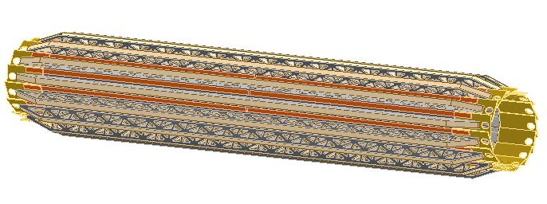
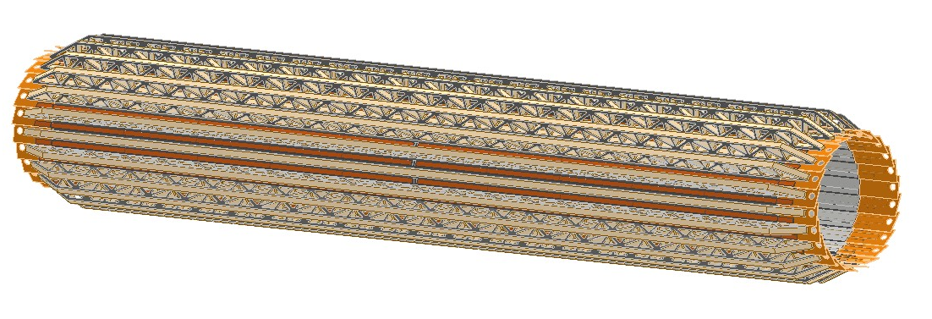
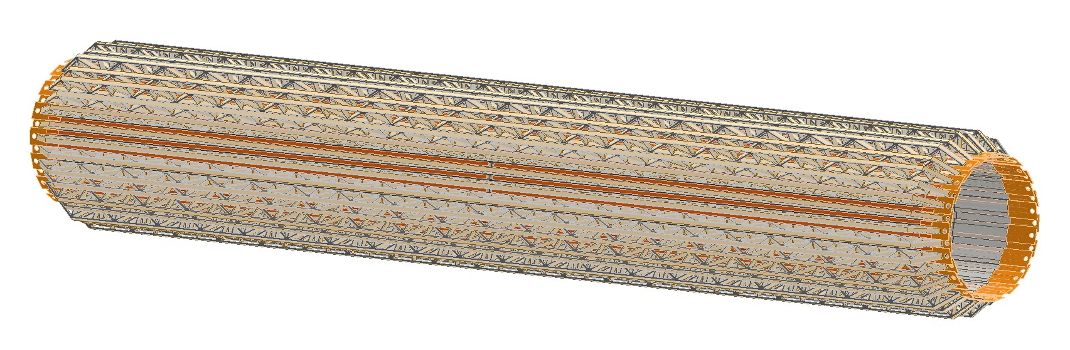
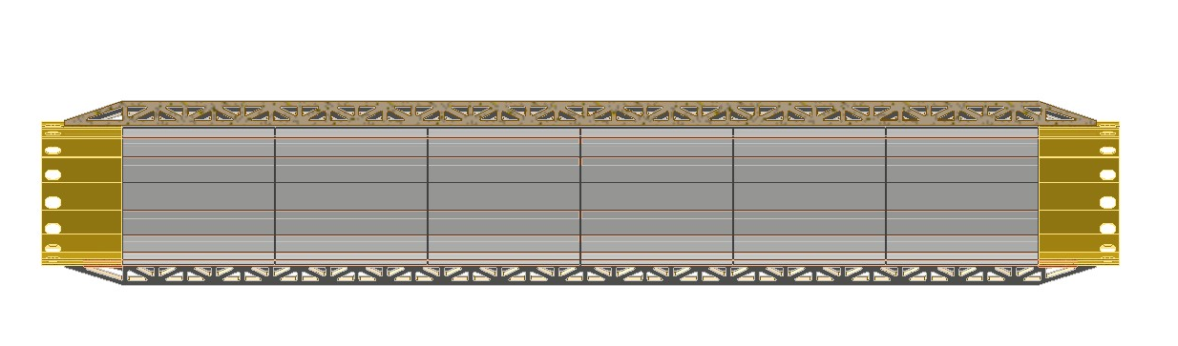
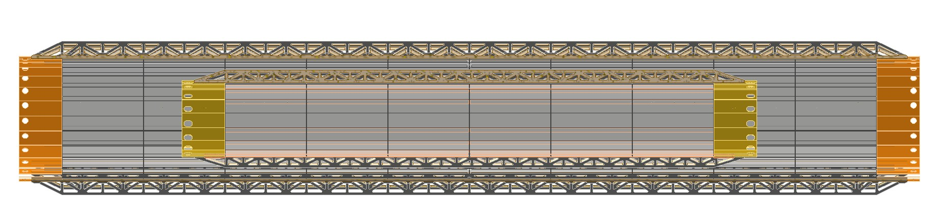
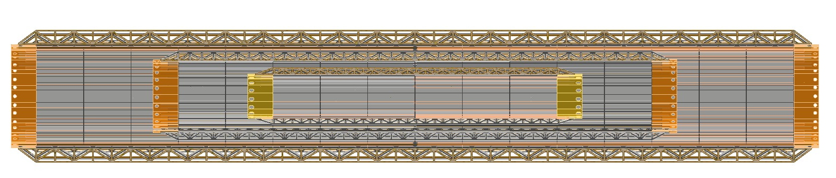
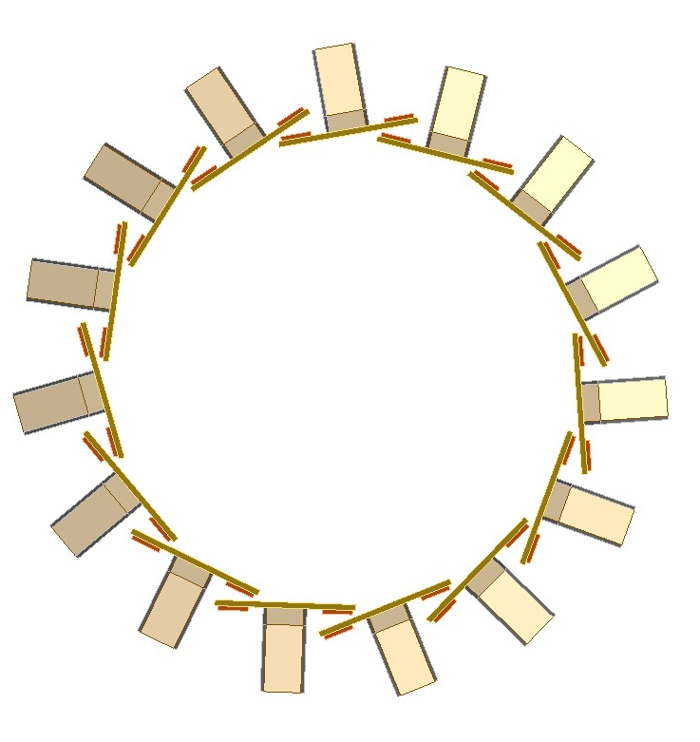
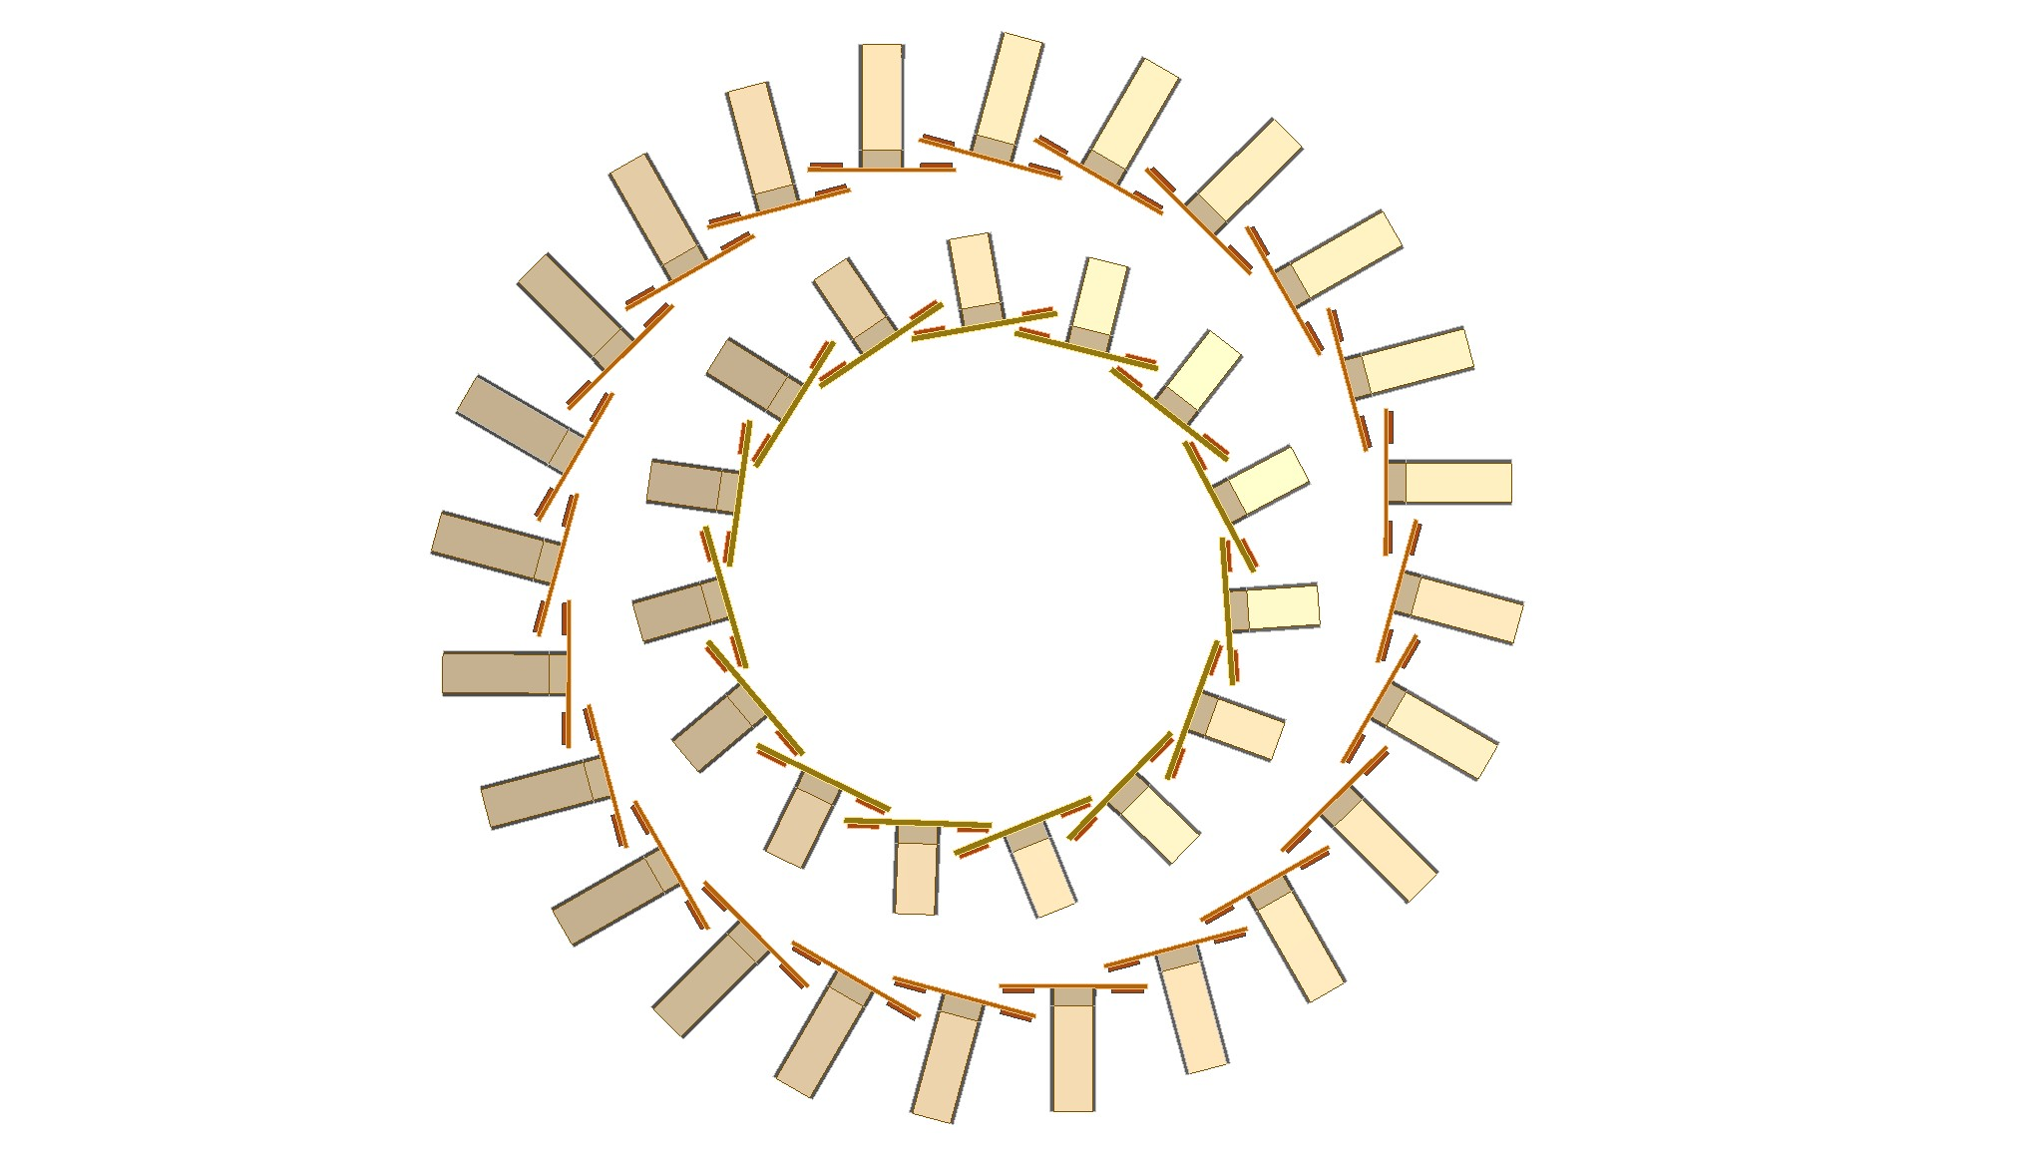
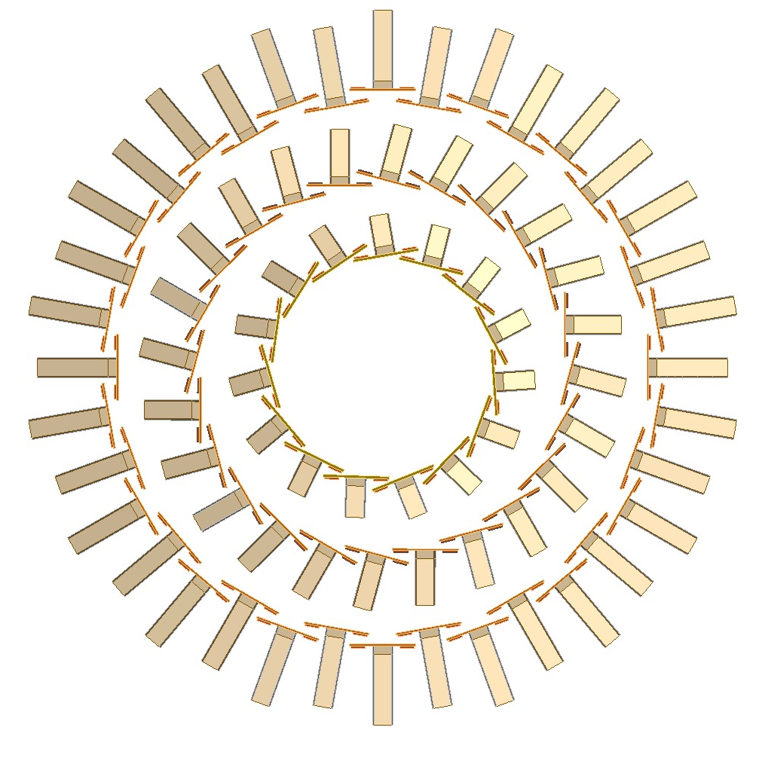
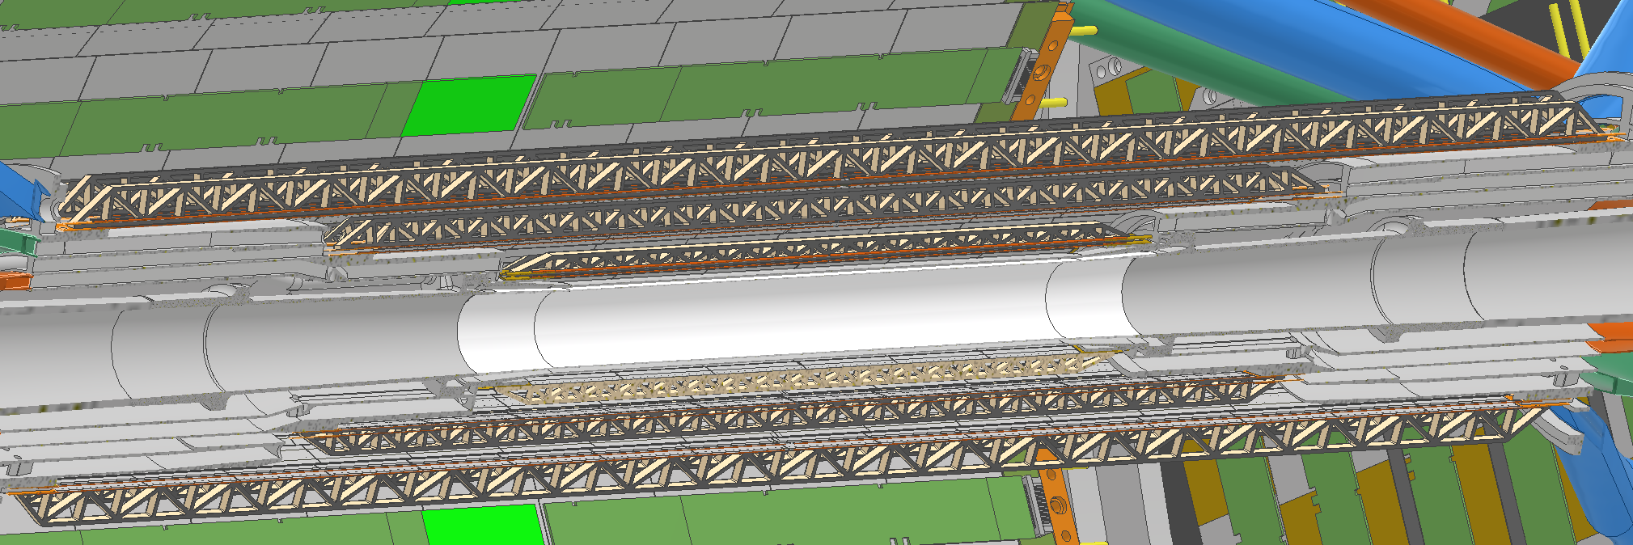
DRD8-Collaboration meeting
Gherardo Ammirabile, INFN Pisa
Inner vertex
Layer 1:
15 staves of 6 modules each
Power budget ≈ 12 W
Layer 2:
24 staves of 10 modules each
Power budget ≈ 32 W
Layer 3:
36 staves of 16 modules each
Power budget ≈ 77 W
227.4 mm
356.2 mm
549.4 mm
13.7
23.7
35.6

Slide 3
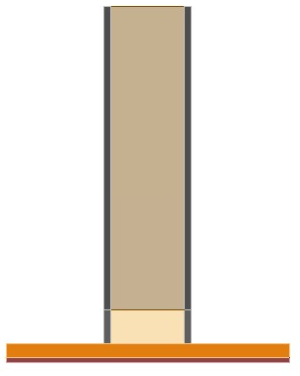
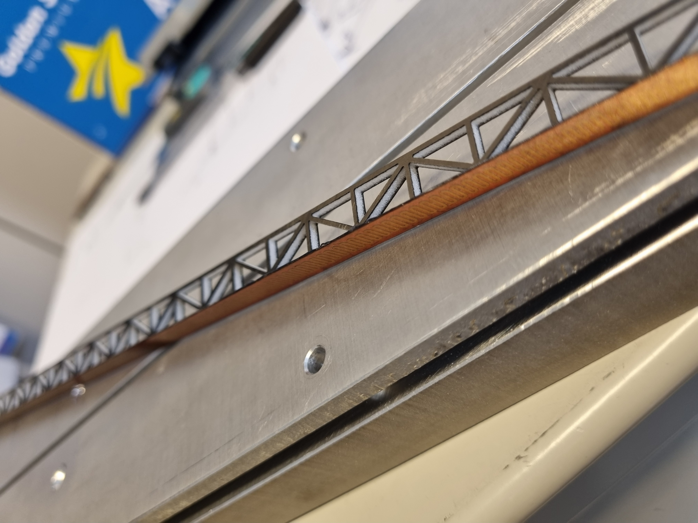
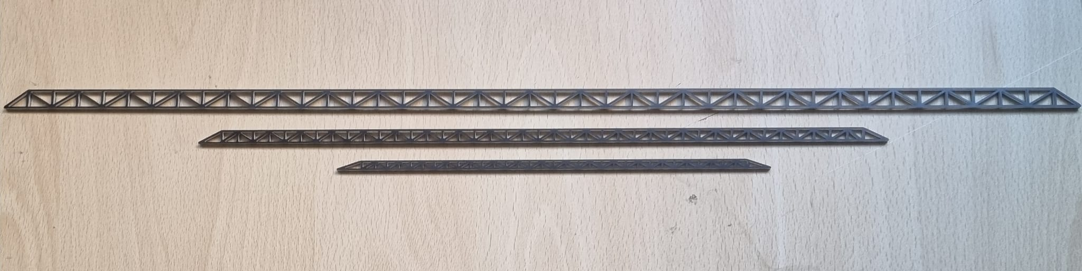
DRD8-Collaboration meeting
Gherardo Ammirabile, INFN Pisa
Mockup of the vertex detector
Silicon modules replaced by a brass strip with the same thickness = 50 μm
Thermal load created by a bonded heater
W
H
CF strip = 360 μm
Glue ~ 90 μm
Stave dimensions (mm)
 | H | W
Design | 10.5 | 1.4
Real | 10.8 | 2.6*
Brass strip = 50 μm
Heater = 150 μm
* increase in thickness of Rohacell (best compromise between cost & manufacturing)
R
E
S
U
L
T

Slide 4
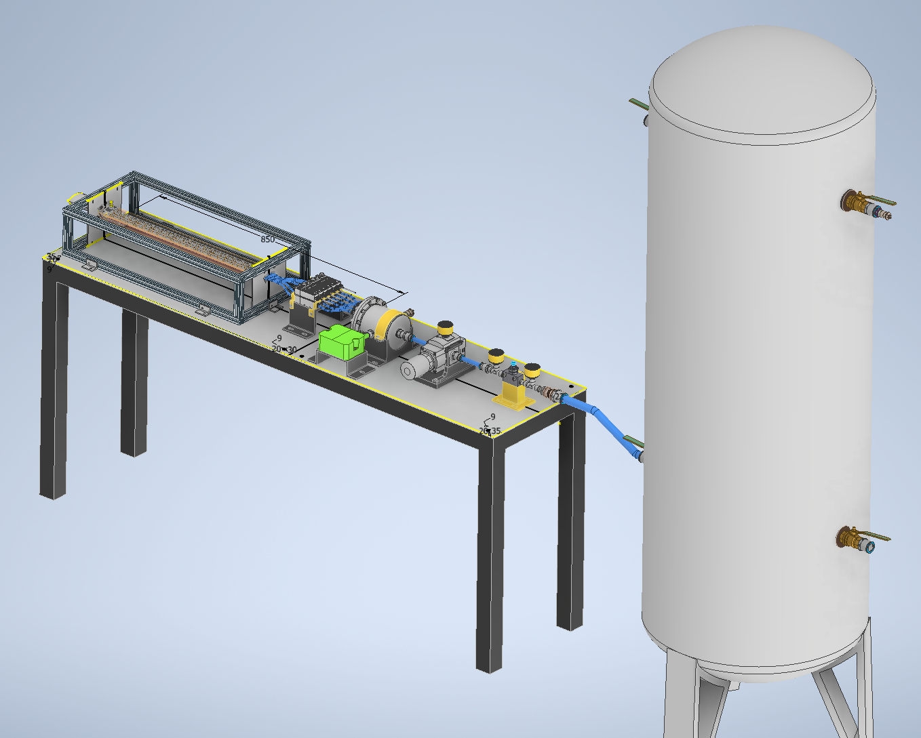
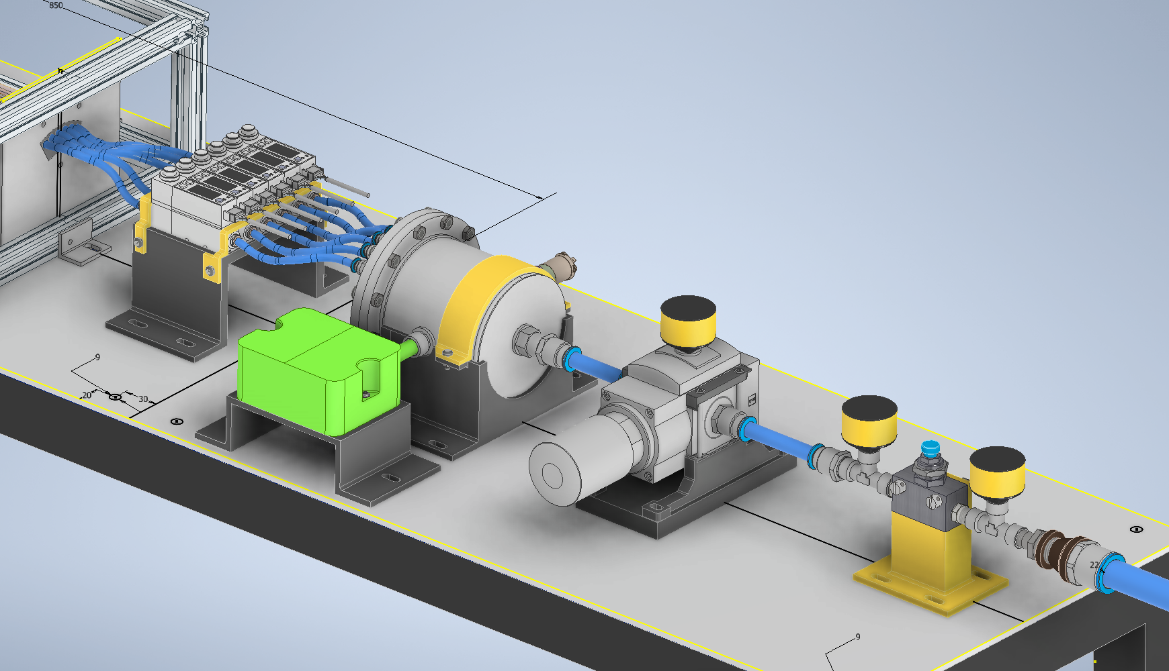
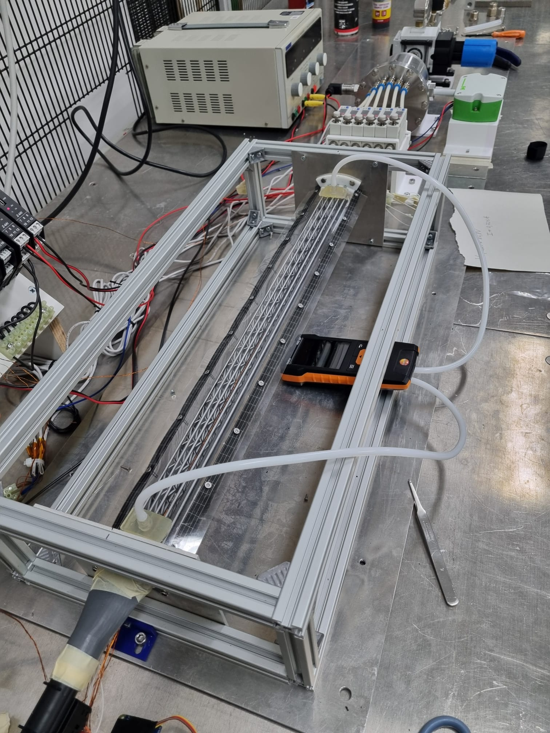
DRD8-Collaboration meeting
Gherardo Ammirabile, INFN Pisa
Compressed air system
Flowmeters
Serbatoio
6 bar
0.5 m³
Absolute Pressure sensor
Test section
Settling chamber
Diffuser
Drier
Temperature/Humidity sensor
Valve group
RTD
380 mm
Test section
1600 mm
Designed to:
Be adaptable
Be controlled
Allow CFD result verification

Slide 5
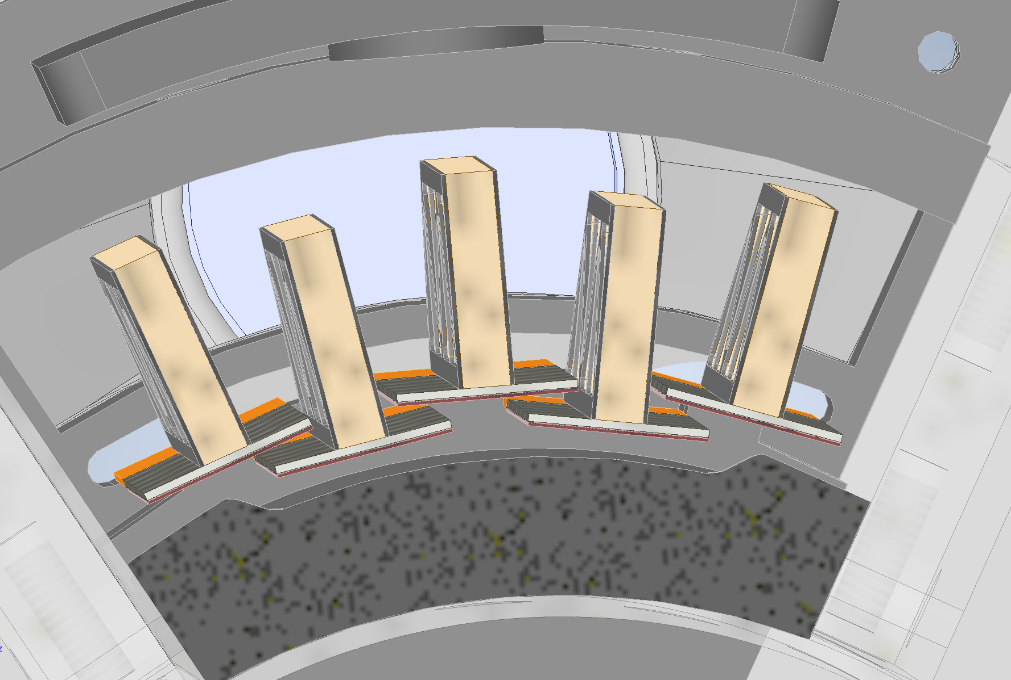
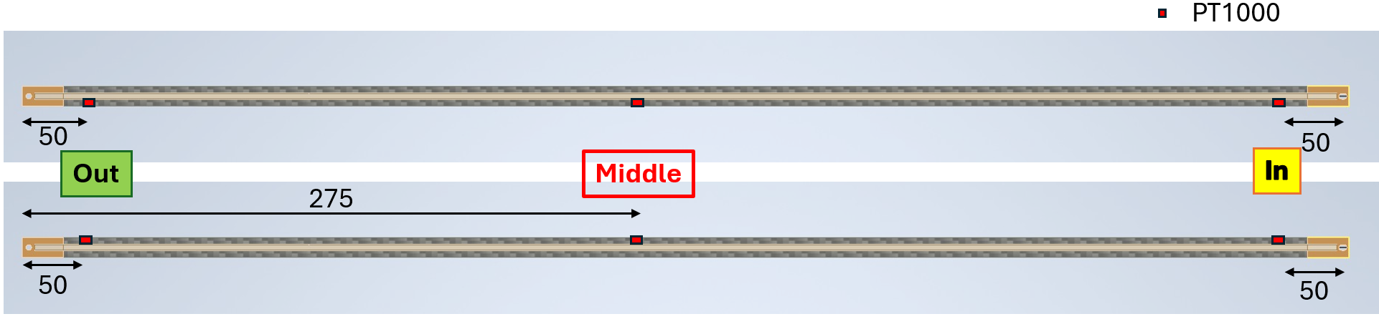
DRD8-Collaboration meeting
Gherardo Ammirabile, INFN Pisa
First test: 60° angular sector of only layer 3
Stave 5
5
6
Stave 6
Staves under thermal testing
Top view
Power density (sensor) = 50 mW/cm²
Total power (each stave) = 2.2 W
The Middle section has the highest temperature
Without cooling > 65°C
With cooling < 40°C

Slide 6
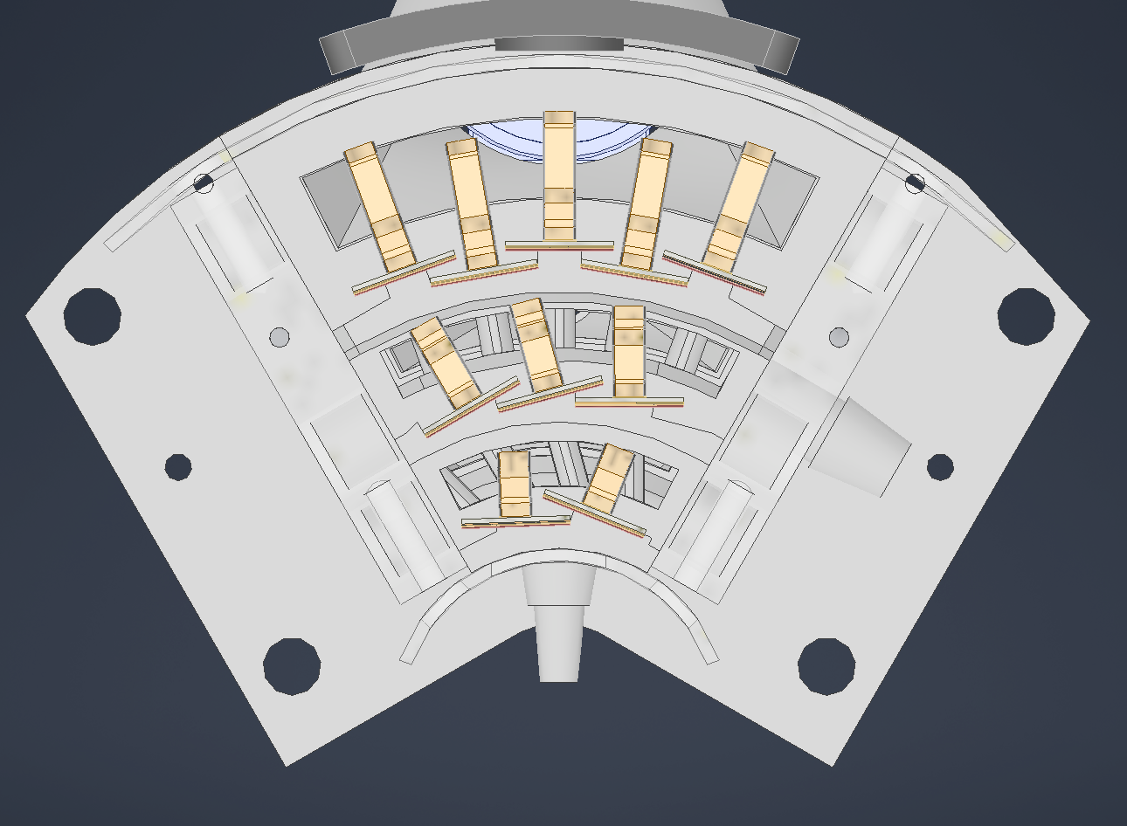
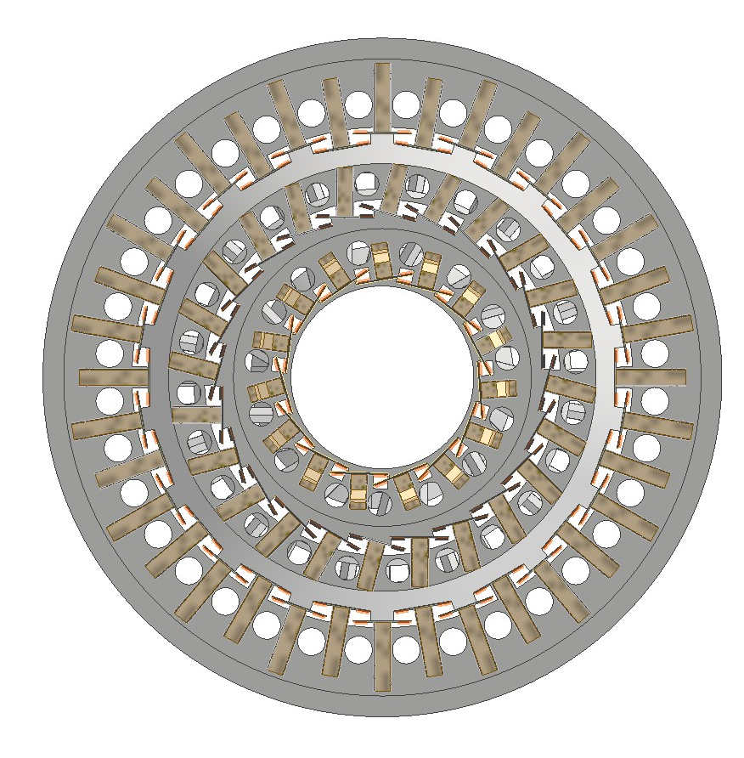
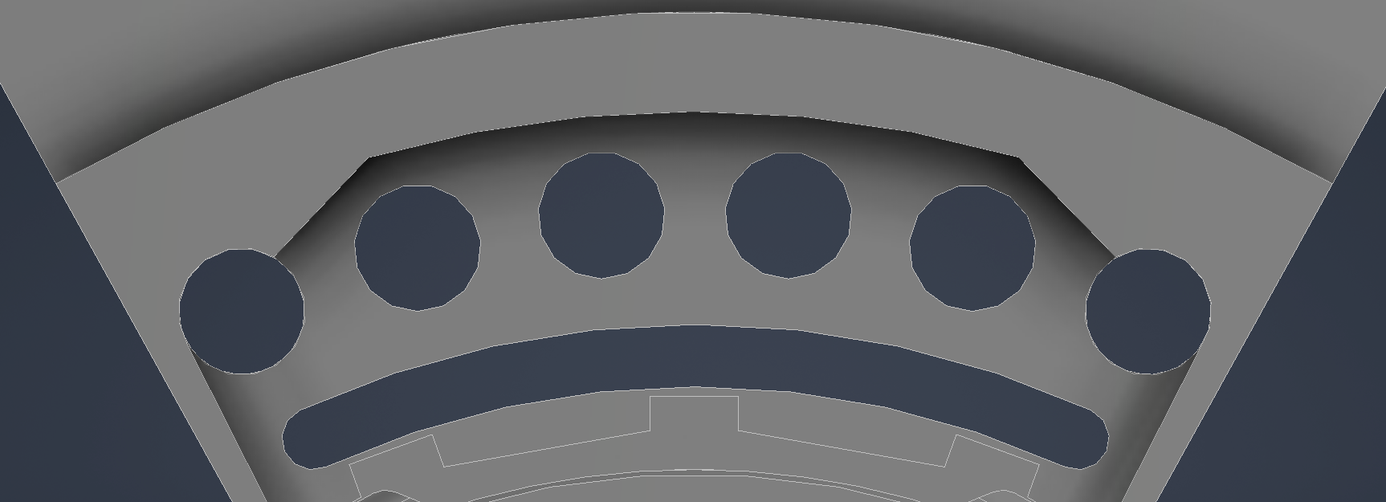
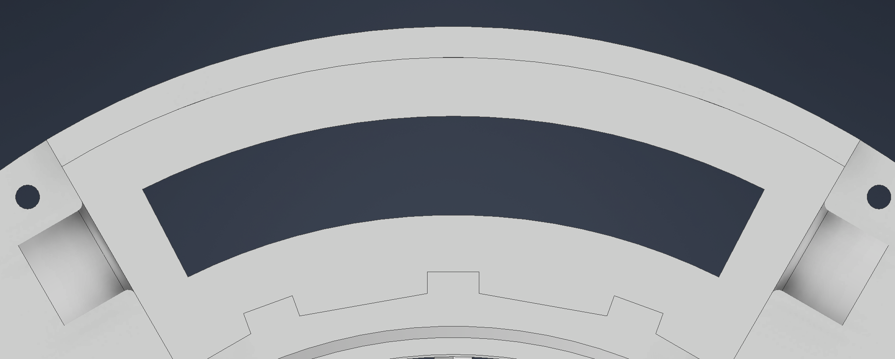
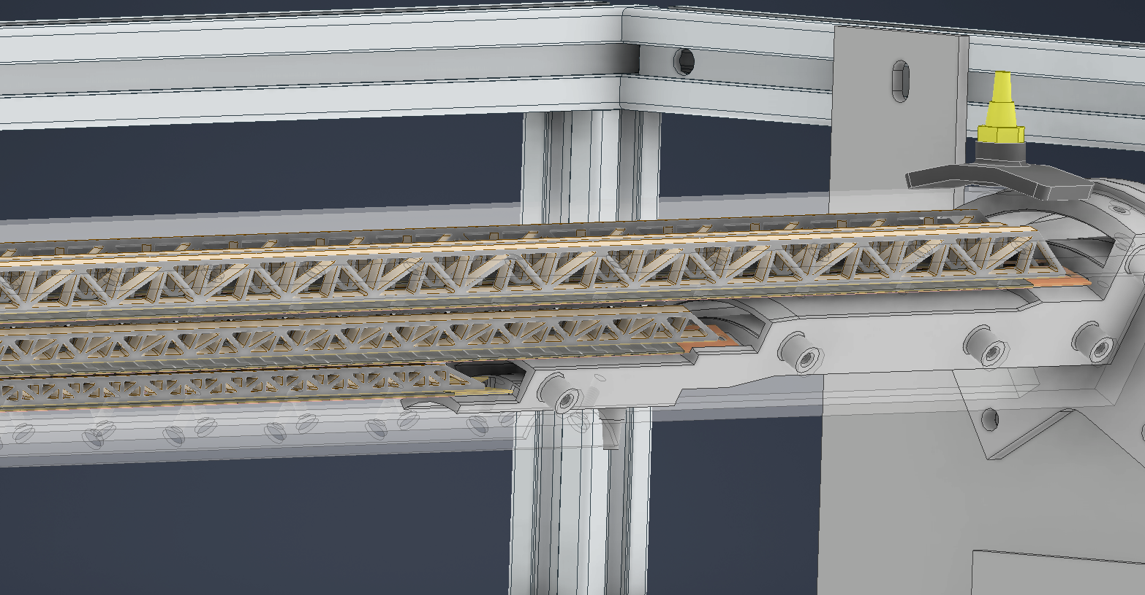
DRD8-Collaboration meeting
Gherardo Ammirabile, INFN Pisa
Staves:
5 for Layer 3
3 for Layer 2
2 for Layer 1
Timeline for next steps:
Assembly on the same 60°angular sector of the staves of Layer 2 and Layer 1
Details to study:
Air induced vibrations with optical instrument
Inlet shape:
Circular Slotted
60°
Targets:
Flow rate to cool each layer
Pressure drop
Thermal connection between them
Expected results: by the end of the year
Advantage:
The compressed air system offers versatility, enabling specific testing for single and multi layer solution

Slide 7
Thank you for your attention!

