Slide 1
sCO2 results DRD8: 2nd Collaboration Meeting WP3
Camila Pedano-Medina
14th of October, 2025

Slide 2
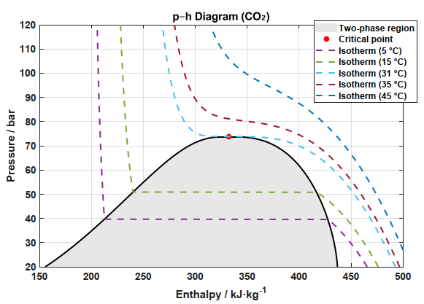
The critical point
Critical point of CO2 is 73.8 bar and 31.1 ºC
For any substance, it is the point at which there is no distinction between liquid and vapour phase
Below the critical point:
An isobaric increase in enthalpy brings us to vapor-liquid equilibrium
Phase change
Above the critical point,
Phase change does not occur
The liquid-like fluid continuously transitions into a vapor-like fluid

Slide 3
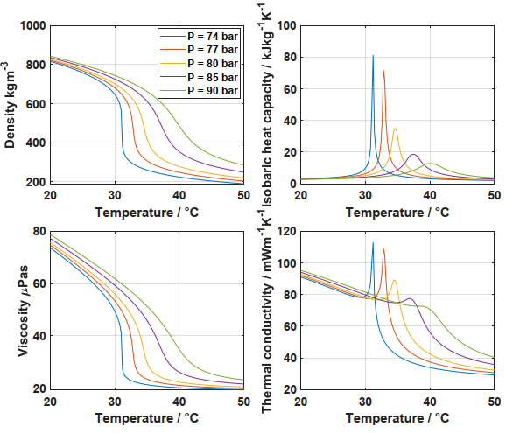
Above the critical point: properties of interest
Density drops from liquid-like density to vapour-like
Heat capacity (Cp) peaks at so-called pseudocritical point (Tm): particularly interesting
Viscosity drops similarly to density
Thermal conductivity peaks and drops
Tm(P)

Slide 4
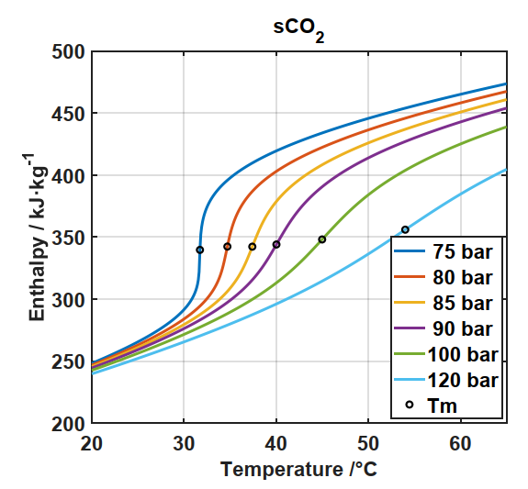
Above the critical point
When we approach Tm at a given pressure, the slope of the enthalpy with temperature increases sharply
This means that the enthalpy varies with a small change in temperature
For us, this can mean that we could reach isothermal operation if staying around this region
As we increase pressure, we lose this capability of isothermal operation <> variation of enthalpy with temperature flattens
31.7 ºC

Slide 5
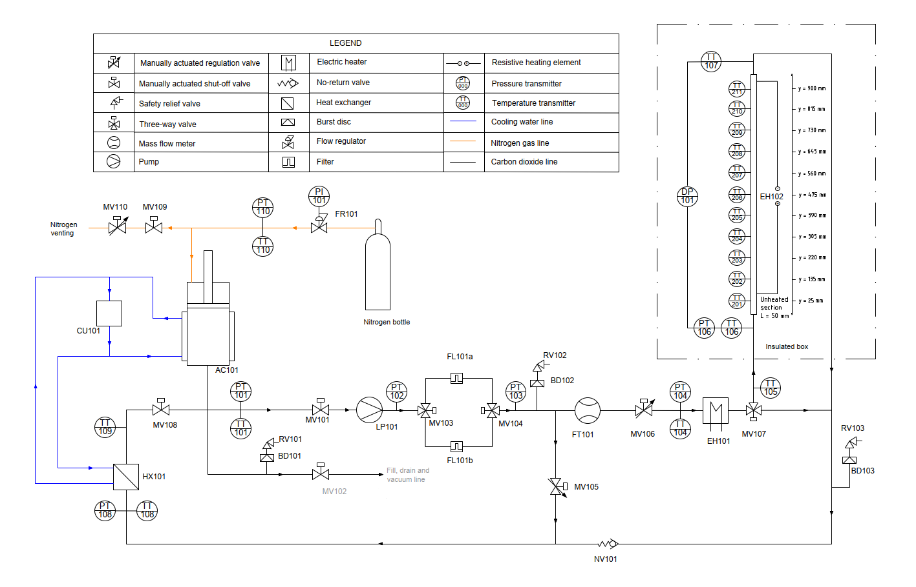
The sCO2 experimental rig
Operating conditions:
P = 50 - 120 bar
T = 5 – 100 °C
ID = 1 – 3 mm
m = 1 – 11 g/s
Test section
Pressure setpoint
Pumping
Temperature setpoint
Return

Slide 6
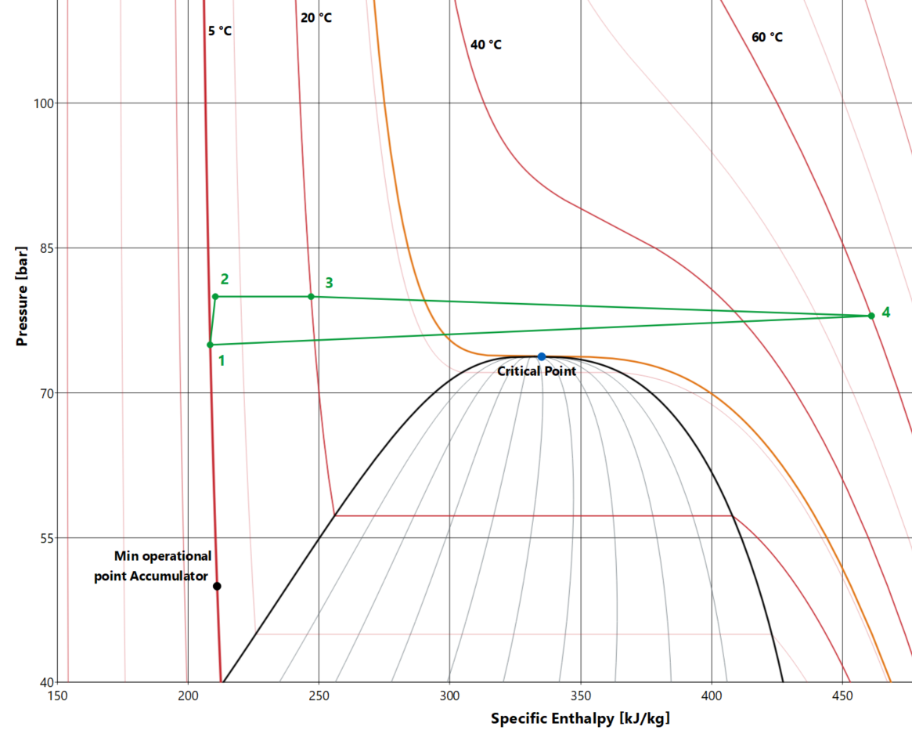
The sCO2 experimental rig
1
3
4
Accumulator – pressure control
2
Pump – flow through the rig
Preheater for desired inlet condition

Slide 7
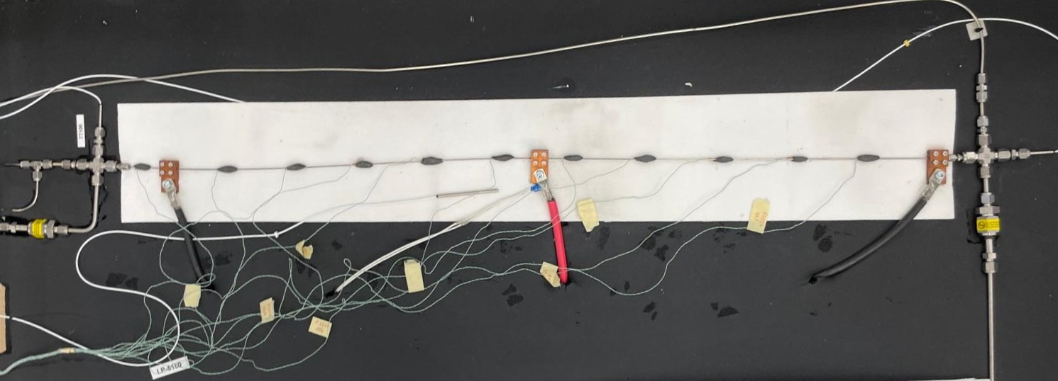
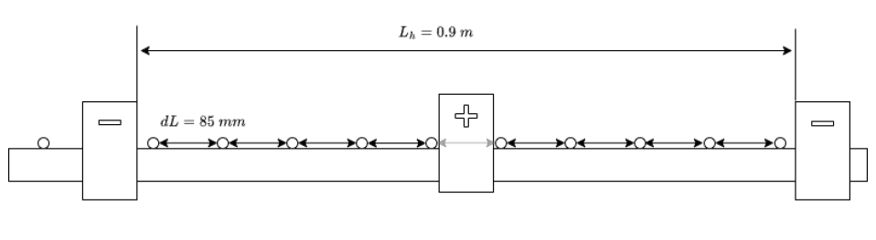



Indirect measurement of heat transfer coefficient
Inlet fluid temperature PT100
Outlet fluid temperature PT100
Thermocouples
evenly spaced
1 mm ID pipe
$$q=\frac{Q}{A};$$
$$HTC(α)=\frac{q}{T_{w,i}−T_{b}}$$
Data reduction
$$Q=m\left(h_{i+1}−h_{i}\right);$$

Slide 8
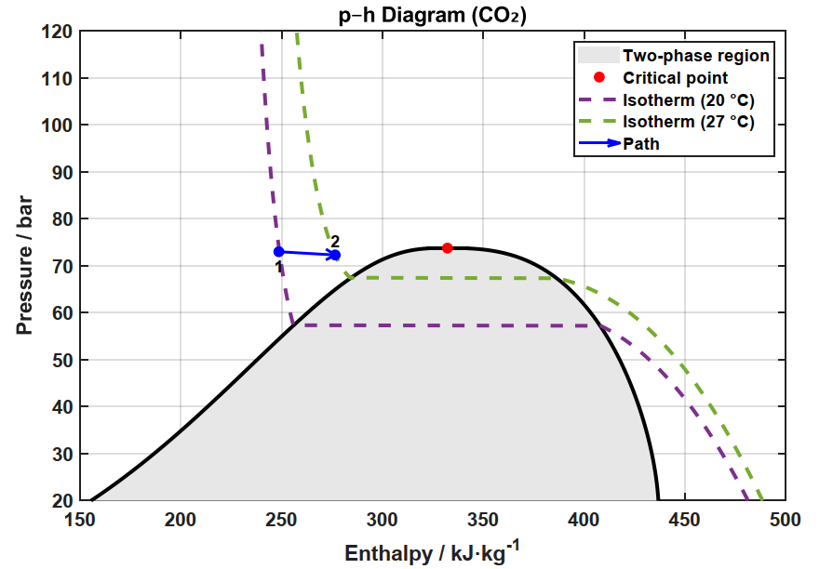
Results (1 mm pipe)
Operating point: below critical point, subcooled liquid
Q = 50 W
m = 1.8 g/s
L = 1 m
Lheated = 0.9 m
72 bar
dp = 0.7 bar
Tin = 20 °C
Tout = 27 °C

Slide 9
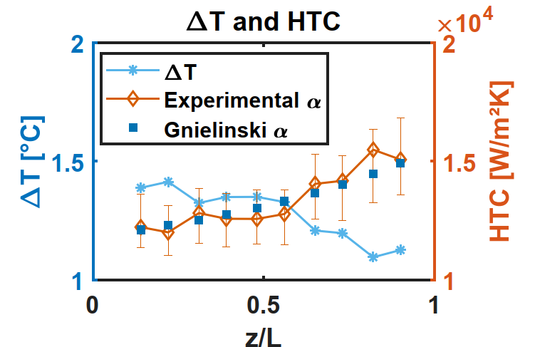
Results (1 mm pipe)
Data at subcooled liquid conditions shows rather high heat transfer coefficients
Q = 50 W
m = 1.8 g/s
L = 1 m
Lheated = 0.9 m
dp = 0.7 bar
Heat transfer coefficients along the pipe 12-15E3 W/m2K
Considerable temperature increase in pipe of 7 K
Data evaluated at bulk conditions (Gnielinski)

Slide 10
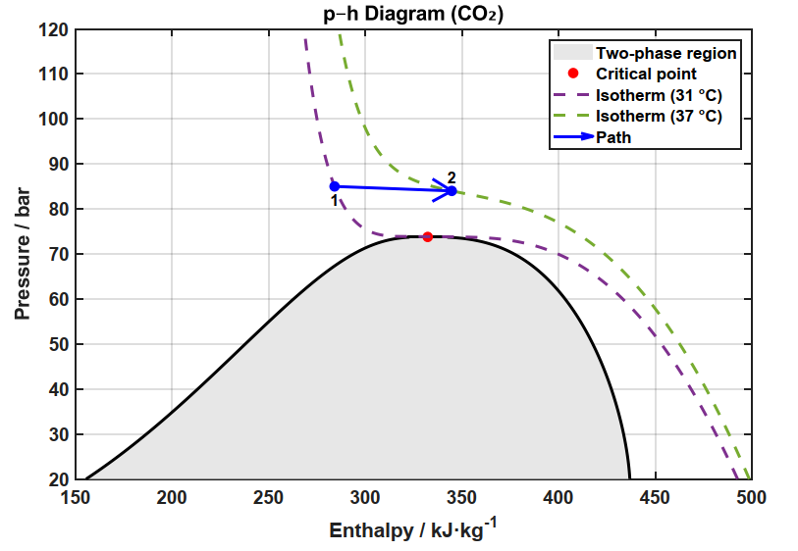
Results (1 mm pipe)
Moving up in pressure and heading towards Tm
Q = 100 W
m = 1.8 g/s
L = 1 m
Lheated = 0.9 m
85 bar
dp = 0.8 bar
Tin = 31 °C
Tout = 37 °C
Tm(85 bar) = 37.5 °C

Slide 11
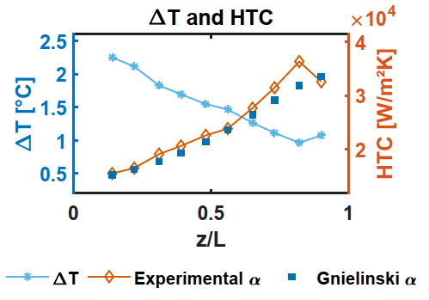
Results (1 mm pipe)
On the left of Tm our HT is similar to that of a subcooled liquid until we really approach the pseudocritical point
Normal Heat Transfer (NHT) regime predictable with D-B type correlation (Gnielinski)
Q = 100 W
m = 1.8 g/s
L = 1 m
Lheated = 0.9 m
dp = 0.9 bar
Heat transfer coefficients along the pipe 15-30E3 W/m2K
Temperature increase along the pipe of 6 K

Slide 12
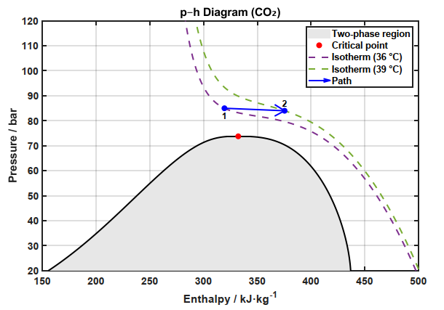
Results (1 mm pipe)
Moving to the right and crossing Tm
Q = 100 W
m = 1.8 g/s
L = 1 m
Lheated = 0.9 m
85 bar
dp = 1.4 bar
Tin = 36 °C
Tout = 39 °C
Tm(85 bar) = 37.5 °C

Slide 13
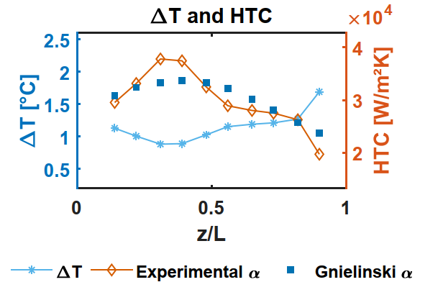
Results (1 mm pipe)
When moving to the right in temperature and passing by Tm
Heat transfer coefficient peaks and drops after passing by pseudocritical point
Q = 100 W
m = 1.8 g/s
L = 1 m
Lheated = 0.9 m
dp = 1.4 bar
Heat transfer coefficients along the pipe 20-40E3 W/m2K
Temperature increase along the pipe of 3 K

Slide 14
Results (1 mm pipe) conclusions
85 bar, 1 m long
50W
Below critical pressure – subcooled liquid
Local heat transfer coefficients 12-15E3 W/m2K
Temperature increase along the pipe of 7 K
Low dp = 0.7 bar
Above critical pressure and on the left of the pseudocritical point
100W
Local heat transfer coefficient is enhanced to 20-35E3 W/m2K
Temperature increase along the pipe of 6 K
Still low dp = 0.9 bar
100W
Above critical pressure and passing by the pseudocritical point
Local heat transfer coefficient 20-40E3 W/m2K
Temperature increase along the pipe of 3 K
Higher dp = 1.4 bar

Slide 15
37.5 ºC
32 ºC

Slide 16

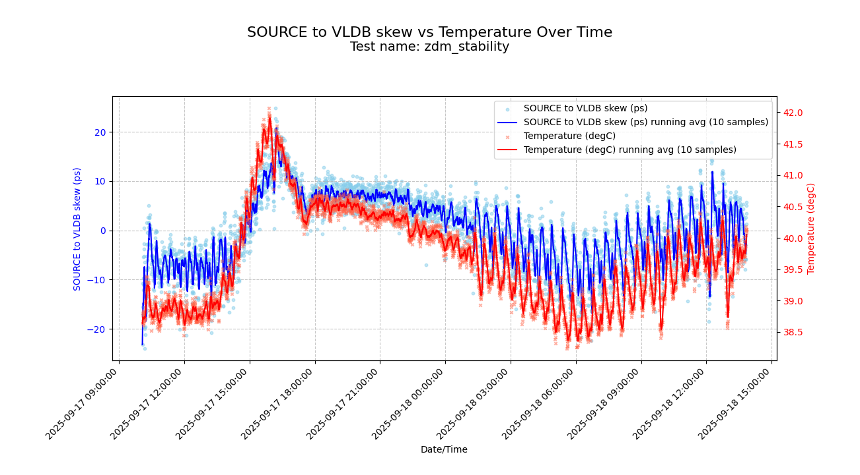
Applications in microelectronics
Transcievers
In collaboration with DRD7, we will be investigating cold plates for FPGA and other components in the card PCIe40
Current technology uses air cooling (fans won’t be enough soon) and the only commercial option uses water/glycol mixture
Expected power consumption in FPGA = 70 W
No big constraints on temperature
Because of strong dependency of clock speed with temperature, thermal stability should remain within +-0.5K
To achieve such stability in single phase, we must operate near pseudocritical point <> high heat capacity
FPGA
45x45mm

Slide 17
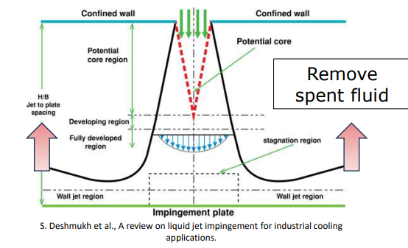
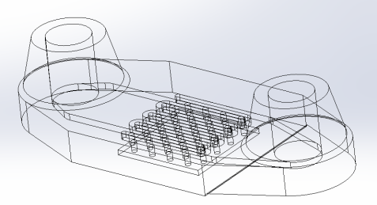
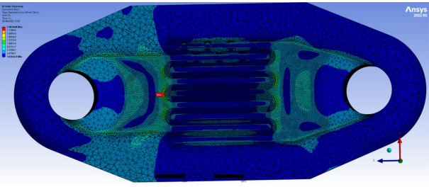
Applications in microelectronics
Jet impingement cooling enhances heat transfer by directing high-velocity jets onto a surface, creating a stagnation region with developing boundary layers and very high local heat transfer coefficients.
Ben Pulver has been designing, testing planned in the coming months
More information in Ben’s talk
https://indico.cern.ch/event/1583882

Slide 18
Forecast
Further data acquisition at other system pressures
Further exploration of the isothermal operation concept
Direct comparison of sub-supercritical test conditions in the same rig
Proof of concept in different microelectronics scenarios – synergy with DRD7 (Direct Liquid Cooling)
Jet Impingement

Slide 19
Thank you

