Slide 1



Workshop Muon Collider Cooling Cell Demonstrator
Milan, 5-7 November 2025
Main Auditorium: Room C03 at Via Mangiagalli 25 Milan
Work classroom: Room “Polvani” at the Department of Physics, Via Celoria 16 Milan
Start: 5.11.25 14:00
End: 7.11.25 13:00
Transportation:
Metrò Milan M2 (green line) Stop: Piola [7 minutes walk]
Metrò Milan M4 (blu line) Stop: Argonne [10 minutes walk] (direct from Linate Airport)
Book the Hotels as soon as you can

Slide 2
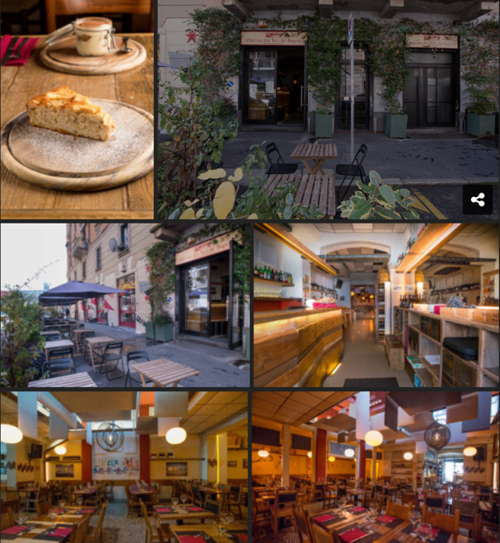

First infos about the organization
We will have a definitive feedback from INFN about a lot of details within the 10.9.2025 (in Italy August is an null month)
The basic idea is to try to avoid any cost to register
The social dinner has been booked for a tentative number of 90/100 people
at a restaurant in Milan at 5 metro stops from the workshop site. The expected cost
will be of 55 Euro/person. Each one will pay at the end of the dinner.
A 30 people room has been reserved at LASA for the 4.11.25 to host a preliminary
meeting (more info about the way to reach LASA will be shared later)
A very informal visit of the LASA lab may be organized
during the 4.11.2025

