Slide 1


SMC
EuCARD WP7 HFM
Status update meeting
October 2011
J.C. Perez on behalf of SMC collaboration team
J.C. Perez
on behalf of SMC collaboration team
M. Bajko, B. Bordini, S. Canfer, G. Ellwood, J. Feuvrier, M. Guinchard,
C. Kokkinos, P. Manil, A. Milanese, L. Oberli, F. Regis, G. De Rijk

Slide 2
OUTLINE
Introduction
SMC configuration
SMC1 assembly & cold tests results
Coil fabrication at CEA-Saclay for SMC2
SMC3_a assembly & cold tests results
Future planed activities

Slide 3
SMC Introduction
The SMC project started in 2007 as a CERN-CEA-RAL-LBNL collaboration (NED 1.5).
A way to test Nb₃Sn cables in a small racetrack magnet and reach 12 T on the cable.
SMC started as a copy-paste of the LBNL subscale model.
SMC has been used to cross-check results using different codes formulations(CAST3M, ANSYS, ROXIE, Vector fields OPERA)
The fabrication of the initial mechanical parts has been followed by CEA
Several coil configurations should be produced in the different laboratories and cold tested in the common structure at CERN
SMC is a tool to test and validate different types of cable, cable insulation , electrical insulation methods for central post and end-spacers, impregnation methods, winding procedures…

Slide 4
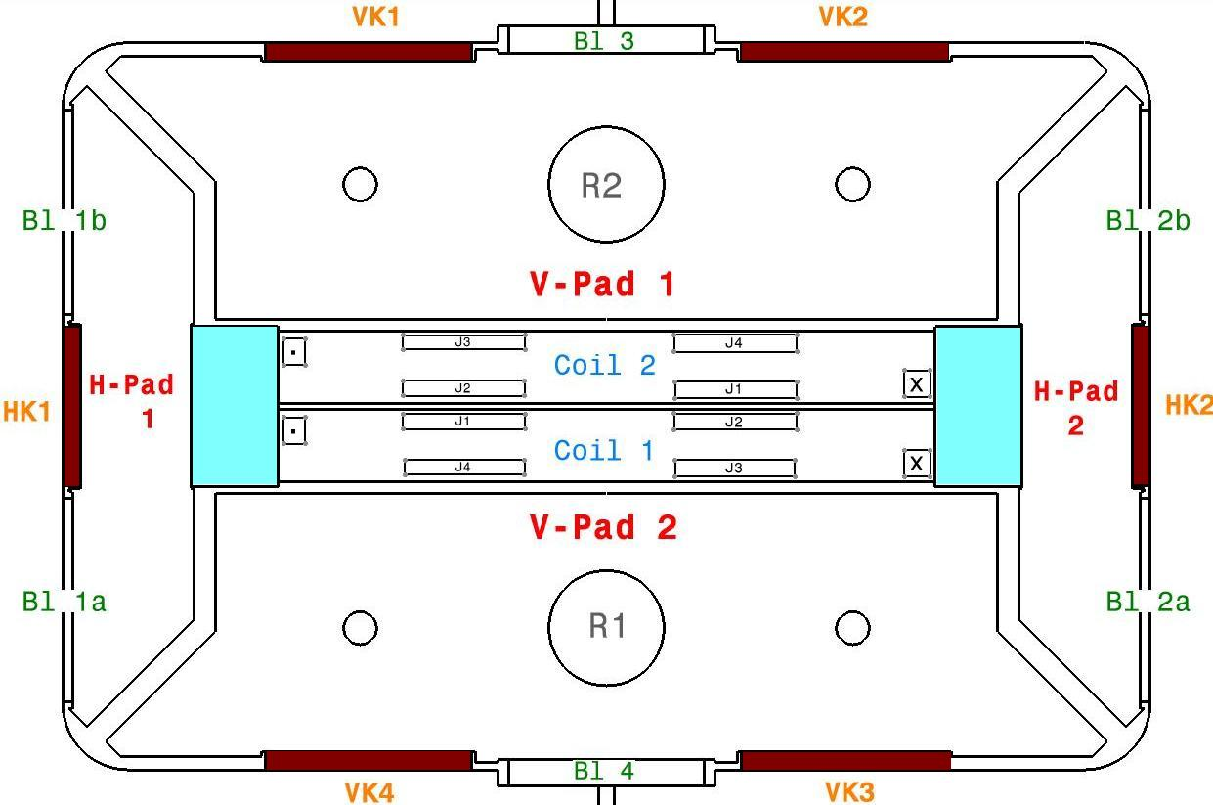
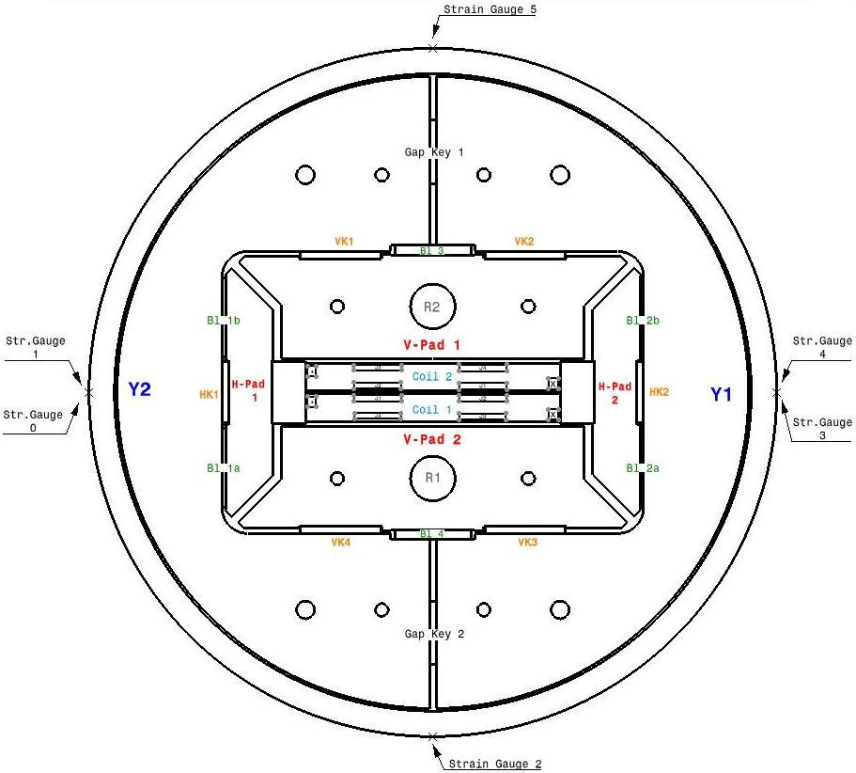
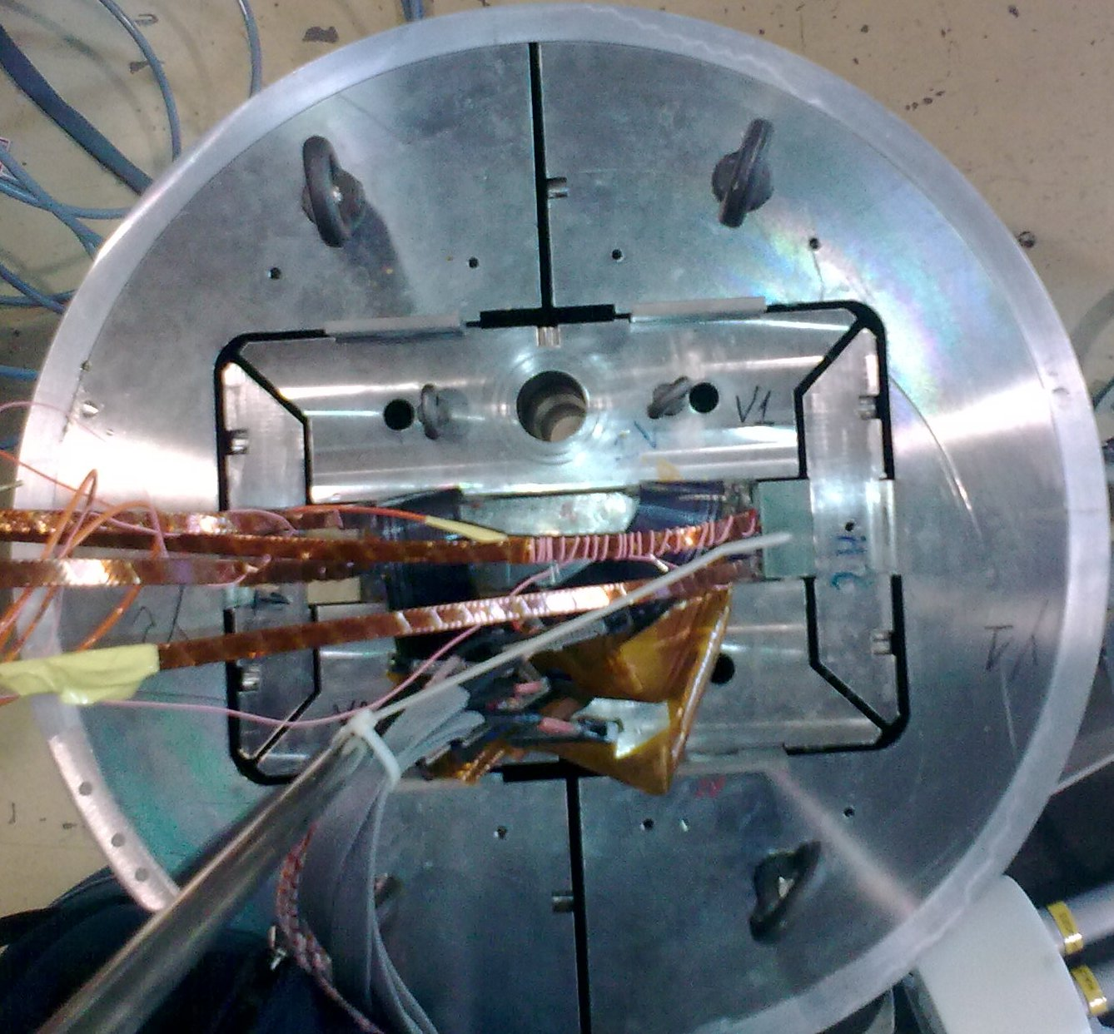
Assembly Configuration
Overview- Assembly Parts
Acronyms Explanation
J | Strain Gauges @ Coil Packs Connectors
V-Pad | Vertical Pad
H-Pad | Horizontal Pad
VK | Vertical Keys
HK | Horizontal Keys
Bl | Bladders
R | Rods
Y | Half Yoke
Gap Keys | Gap Keys @ Yoke
. x | Current Flow Direction

Slide 5
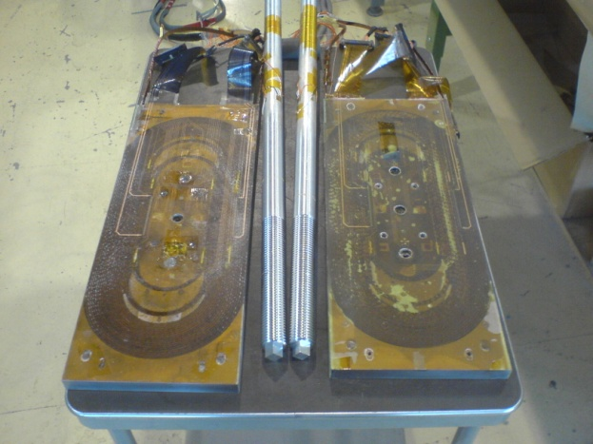
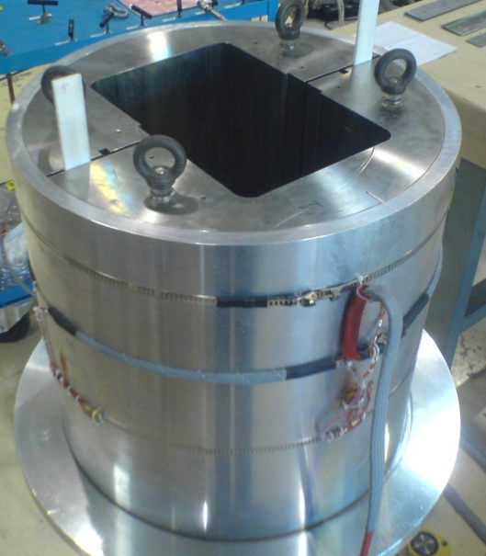
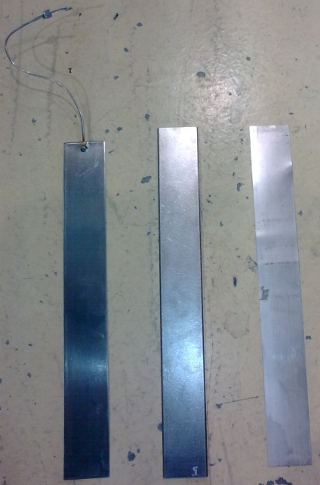
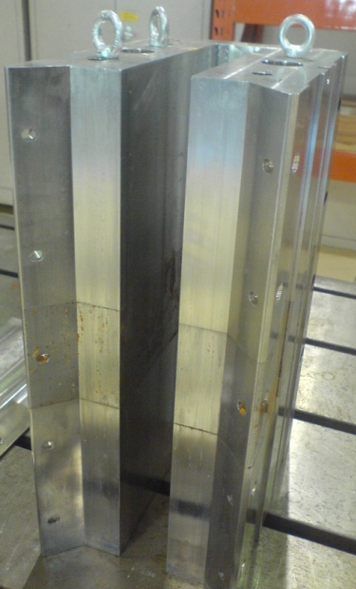
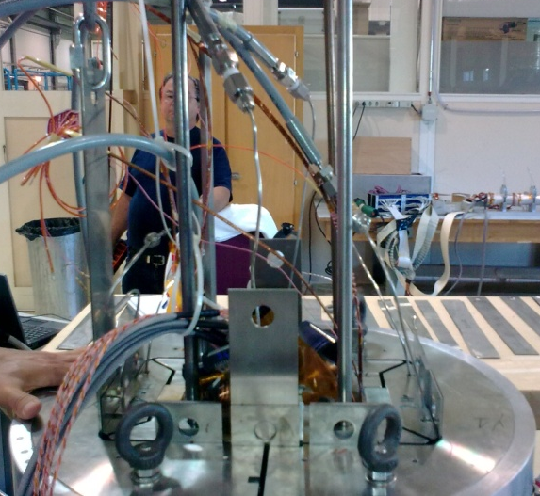
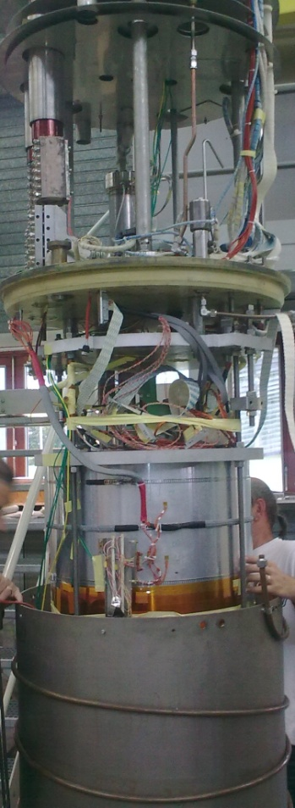
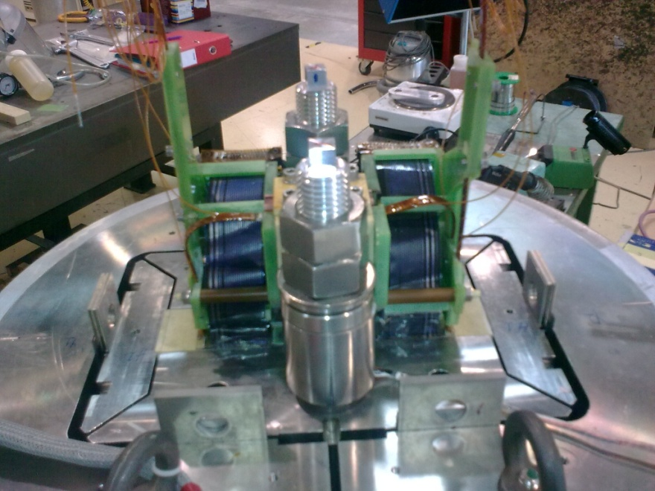
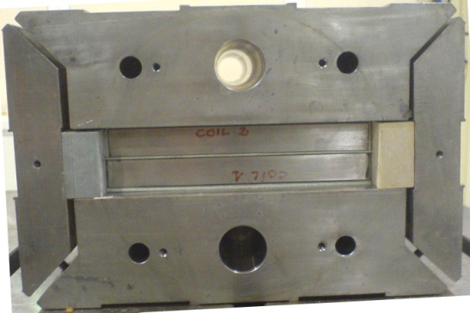
SMC1 Assembly Parts
Assembly Parts
Coils & Rods
Shell & Yoke
Pads
Bladders
Keys
Shims
Assembly Overview
Connection Side
Non-Connection Side

Slide 6
Coil fabrication for SMC1
2 double pancakes wound @ CERN in collaboration with RAL using “Low performance” cable (14 x Ø1.25 mm Alstom IT with low Jc from NED)
Cables insulated with S2-Glass tape wrapped with 50% overlap
Coils reacted @ RAL in
Coils instrumented and potted @ RAL in collaboration with CERN
Coil #1 made in November 2009. Coil #2 made in March 2010

Slide 8
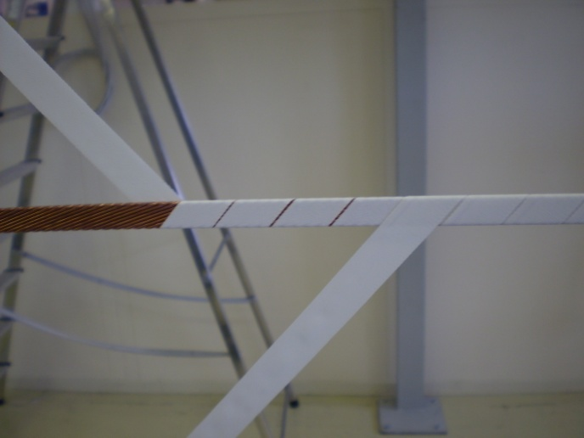
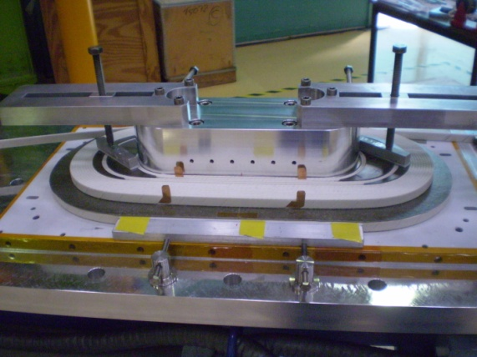
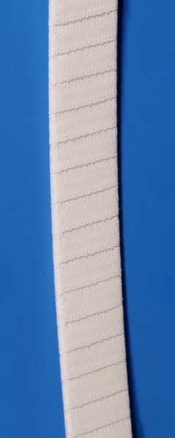
Coil Fabrication at CEA-SACLAY for SMC2
Coils wound with PIT EAS 14 x Ø1.25 mm strand
Cable insulation made of 2 layers of Hiltex S2-Glass tape + ceramic precursor (CEA formulation).
Cable wrapped at CERN in June 2010 and first coil wound at CEA in July
Construction abandoned: ceramic insulation too brittle

Slide 9
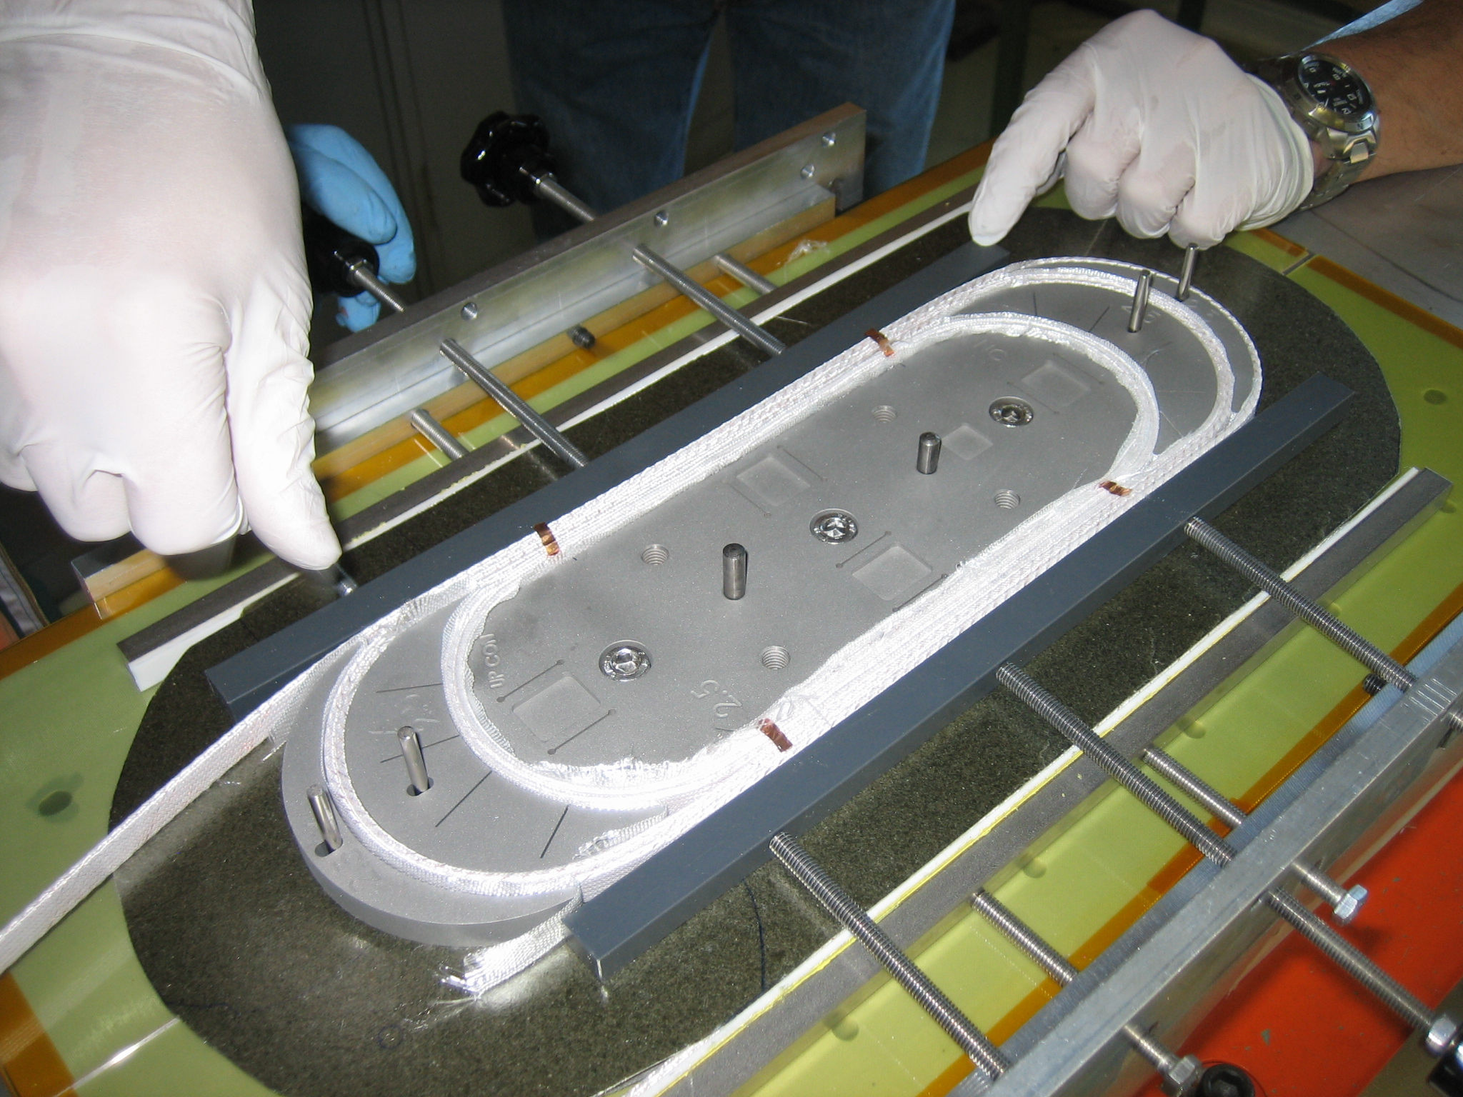
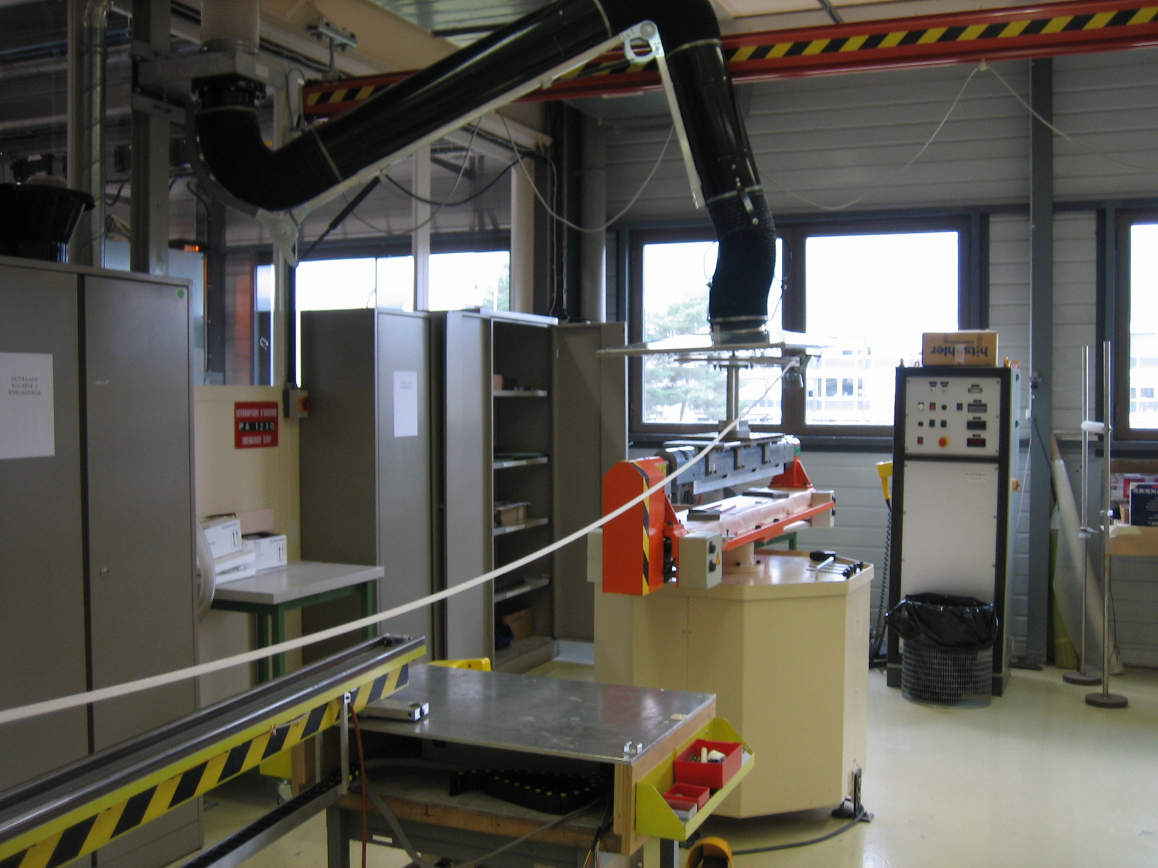
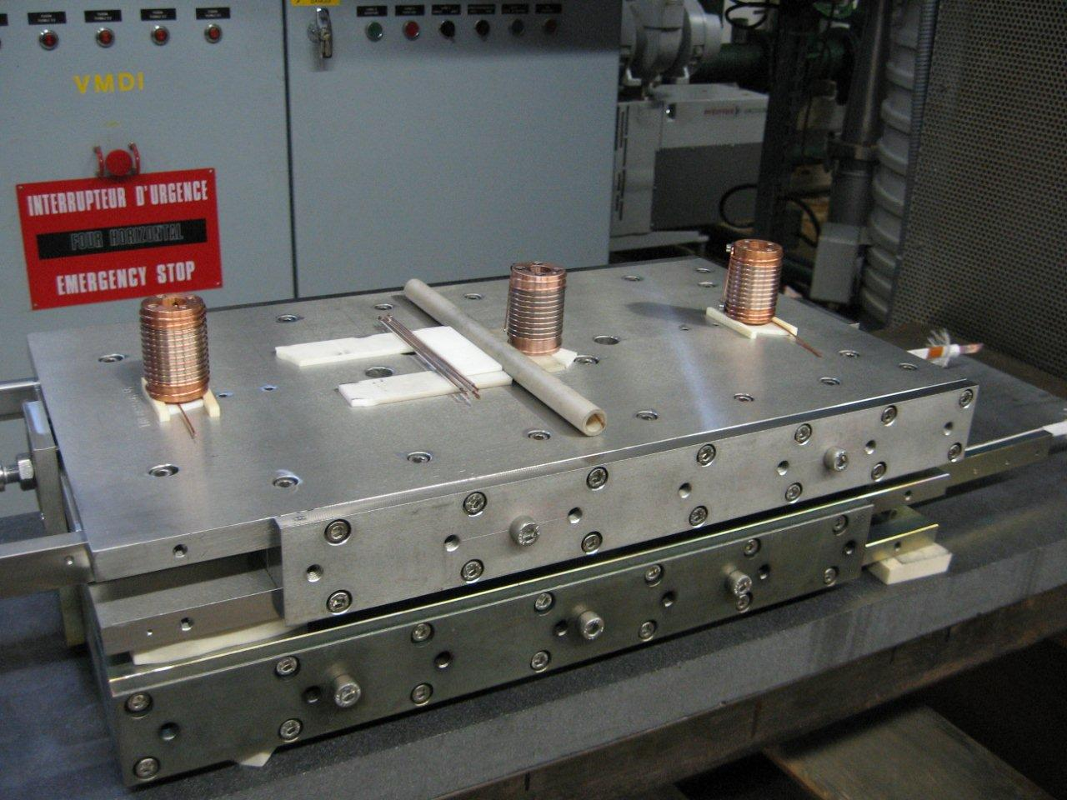
Coil Fabrication at CERN for SMC3_a
2 coils for SMC3 with PIT 14 x Ø1.25 mm strand with Ti- islands and spacers wound in November 2010
Cable insulated with S2-Glass sleeve (FNAL type)
Electrical insulation of the central island on the layer jump area with ceramic 989F
Heat treatment in a vacuum furnace @ CERN
Coils potted using Epoxy MY 750 & Jeffamine D-400
Magnet assembled in May 2011
Cold powering tests performed in the new vertical test station (SM18) in June 2011

Slide 10
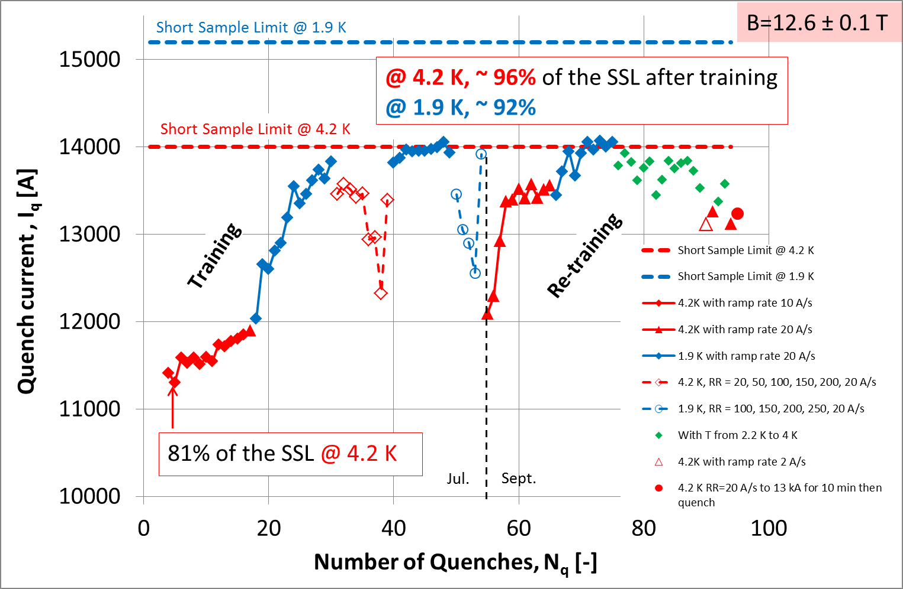
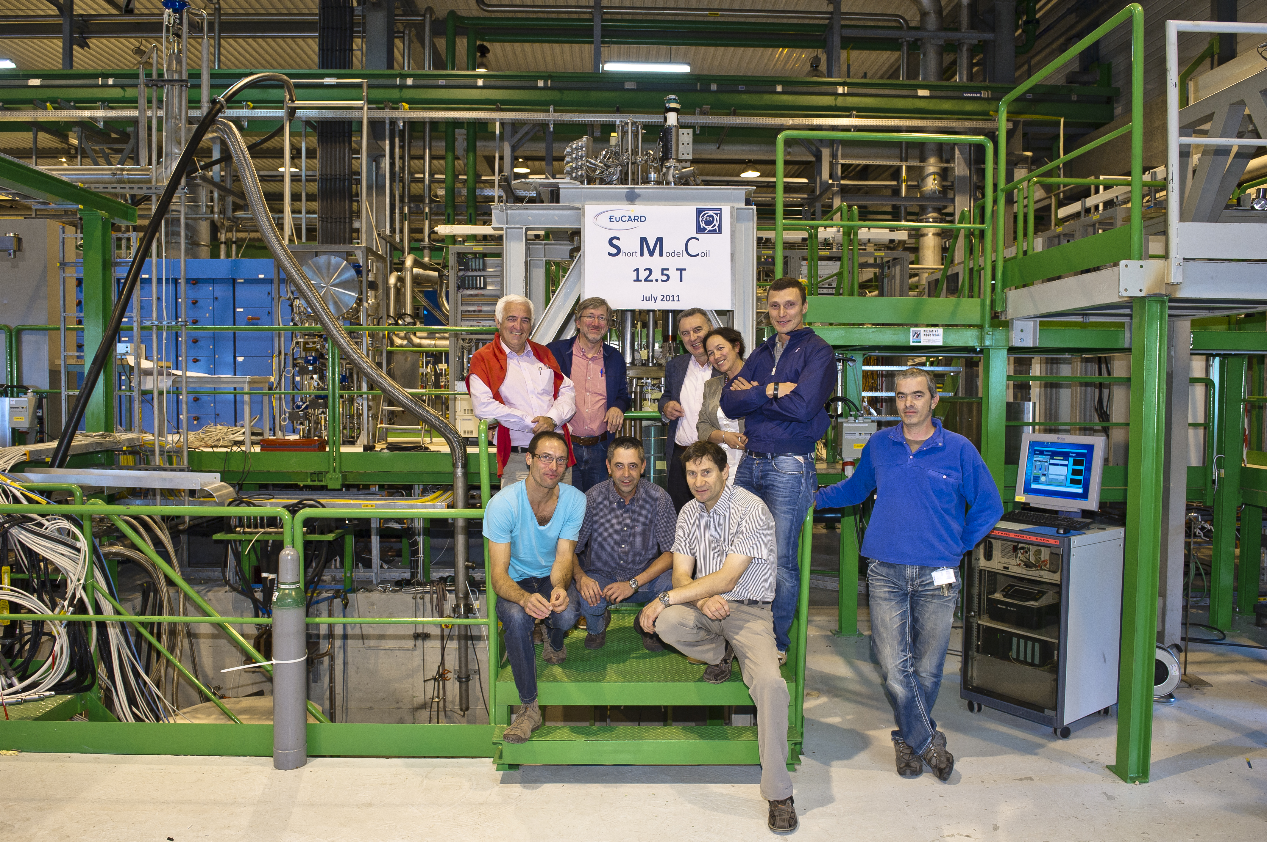
SMC3_a Cold Tests Results
Courtesy of M. Bajko

Slide 12
Future Activities
Coil fabrication
2 coils for SMC3_b with PIT 14 x Ø1.25 mm strand and coated end-spacers(Q3_2011)
1 coil for SMC7_a with OST RRP 40 x Ø0.7 mm strand 11 Tesla dipole type (Q1_2012) Outside EuCARD
2 coils for SMC4 with PIT 18 x Ø1.0 mm strand to be wound at CERN (Q1_2012)
1 coil for SMC5_a with PIT 40 x Ø1.0 mm strand, FRESCA2- type cable (Q2_2012) SMC5_b in case 5_a is unsatisfactory
1 coil for SMC6_a with PIT 40 x Ø1.0 mm strand (FRESCA2- type cable) to be wound in collaboration CERN/RAL (using coated islands, braided glass fibre, Cyanate Esther, Q3_2012)
SMC_5 & SMC_6: necessity for a new structure under study

Slide 13
Future Activities
Electrical insulation method for central islands and end spacers to be investigated
Cable insulation to be improved: S2-Glass tape, braided glass fibre, S2 Glass sleeve...
Cyanate Esther impregnation to be tried
Coil fabrication using “ceramic binder” to be tried
FRESCA2-type cable (SMC5) using final cable, insulation and impregnation method to be used for the real magnet to be built
Thanks for your attention

