Slide 1

Very Forward Region and
Polarisation
Konrad Elsener (CERN)
CDR Review Manchester
18-20 October 2011

Slide 2
Part I. Very Forward Region
(closely linked to the Machine Detector Interface sections of CDR Vol. 1)

Slide 3
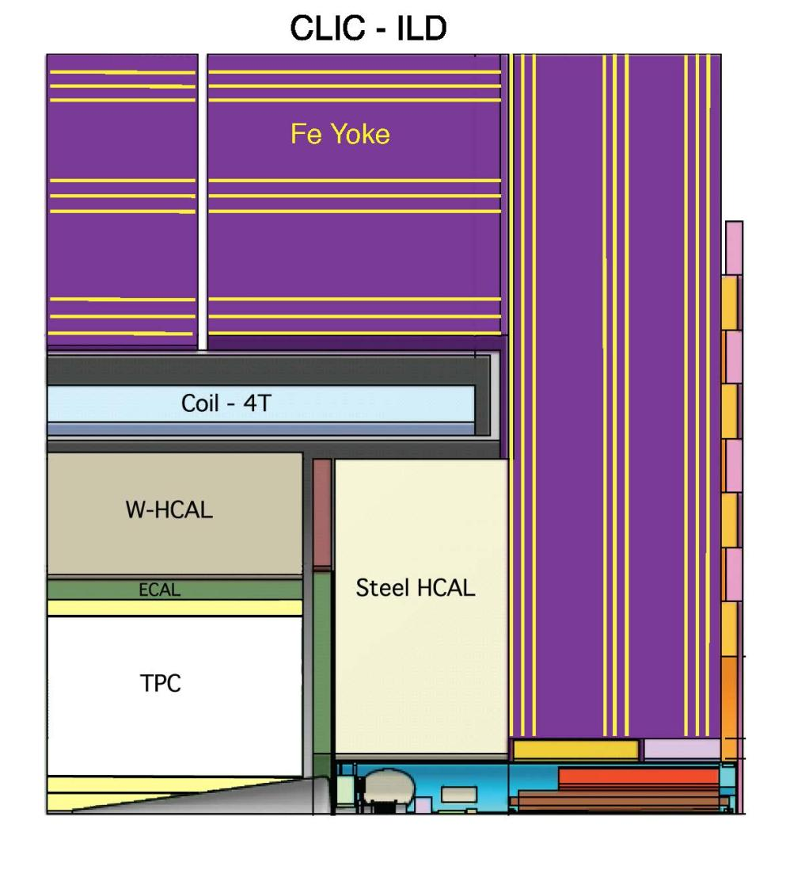
Fig. 3.1

Slide 4
Part I. Very Forward Region
Physics and Detector Aspects
-> close the forward detector acceptance
(ECal endcap -> LumiCal -> BeamCal)
110->38 46->10 mrad
centred on outgoing beam axis
-> precision luminosity measurement
(LumiCal)

Slide 5
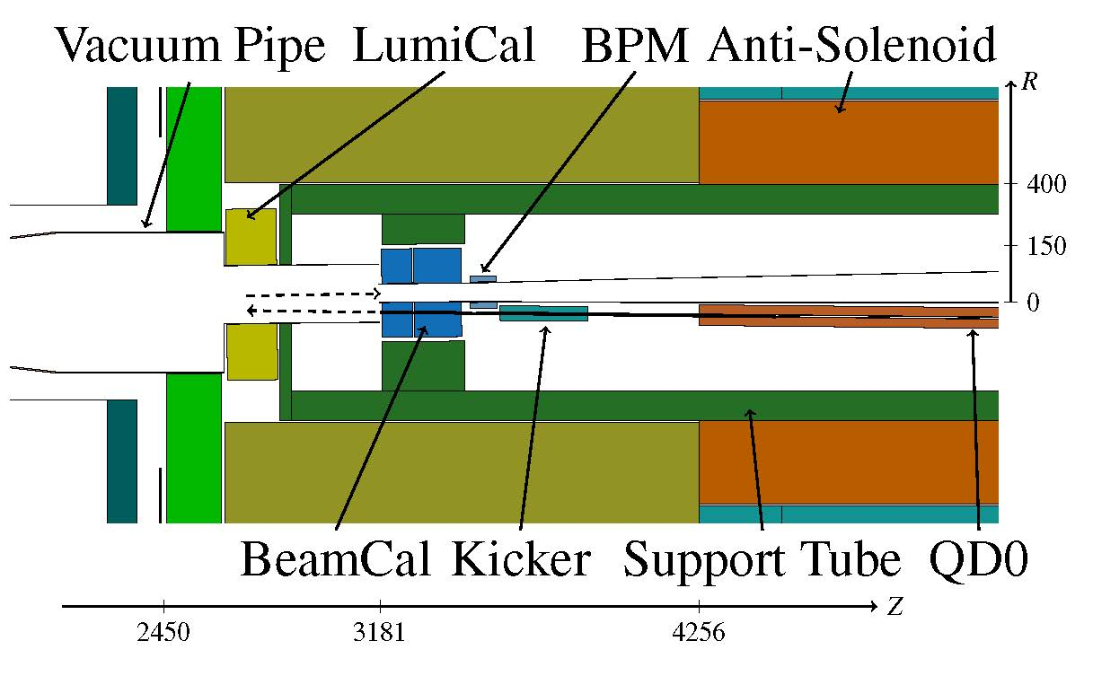
Part I. Very Forward Region
Fig. 3.3 – very forward region as in the GEANT4 simulation (CLIC_ILD)

Slide 6
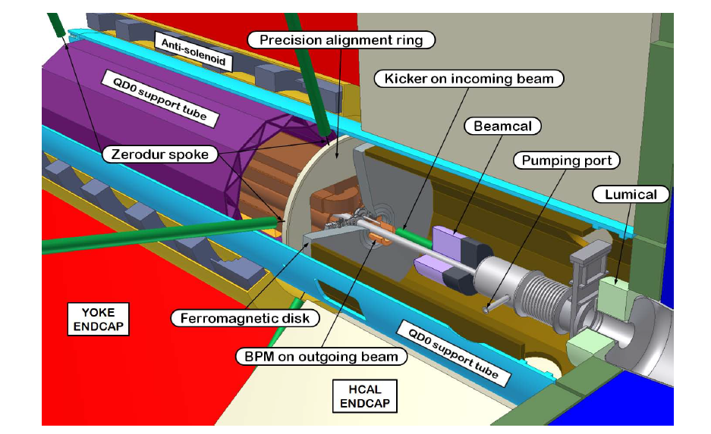
Part I. Very Forward Region
Fig. 11.13 – very forward region as in the engineering model (CLIC_SiD)

Slide 7
Part I. Very Forward Region
Beam / Accelerator Aspects -> cf. CDR Vol. 1
-> final focusing and orbit – alignment, stability
(QD0 and anti-solenoid;
QD0 mechanical support)
-> intra train feedback
(mostly) not in the scope of the present CDR review

Slide 8
Part I. Very Forward Region
QD0 stabilisation - 0.15 nm at 4 Hz
compact detector/tunnel design (cf. H. Gerwig)
ring chicane shielding (cf. H. Gerwig)
-> CDR Vol. 1
support QD0 from a pre-isolator in the accelerator tunnel
choose hybrid solution for QD0 (perm. magnet, little cooling)
two-in-one support tube for QD0 and very forward calorimeters
active stabilisation system below QD0

Slide 9
LumiCal and BeamCal
Synergies with ILC, collaboration in FCAL

Slide 10
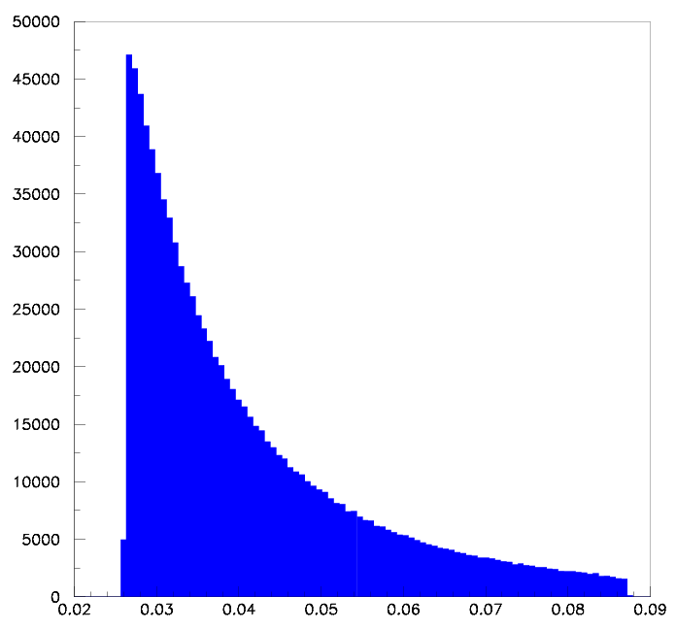
Part I. Very Forward Region
LumiCal – measure luminosity using Bhabha events
(NB. luminosity spectrum measurement using large-angle Bhabha scattering, not treated here)
located at z=2.6 m
geometrical acceptance: 38-110 mrad
fiducial acceptance: 44 – 80 mrad
-> 62 pb at 3 TeV
-> statistical accuracy
for 500 fb⁻¹: 1.8x10⁻⁴
Events
e⁺
e⁺
IP
e⁻
e⁻
Θ, (rad)

Slide 11
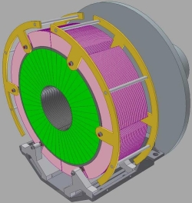
Part I. Very Forward Region
LumiCal – preliminary design (FCAL collaboration)
In CLIC_ILD:
located at z=2.6 m
total depth: 171 mm
inner radius: 100 mm
outer radius: 290 mm
40 layers:
3.5 mm W plates
320 μm Si sensors
550 μm connectivity
readout electronics
at outer radius
Fig. 9.3

Slide 12
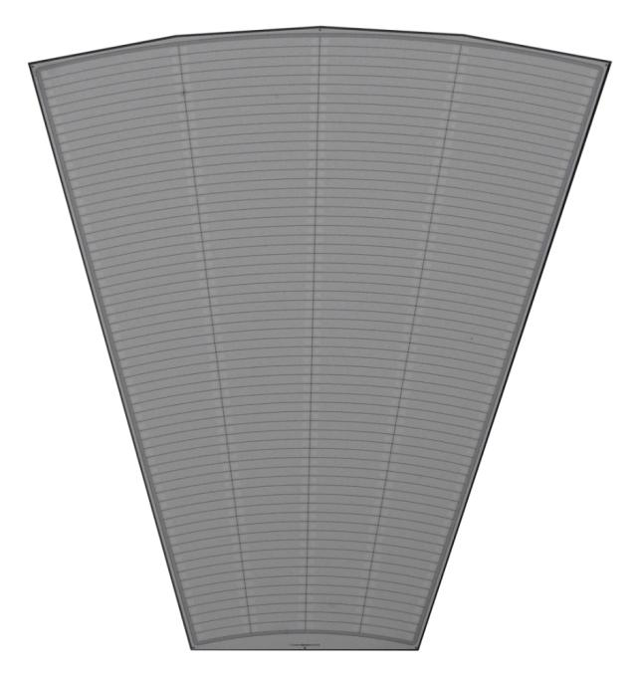
Part I. Very Forward Region
LumiCal – sensors (FCAL collaboration)
Sensors pads CLIC:
(preliminary)
48 divisions azimuthally
50 divisions radially (ILC: 64)
(prototype silicon sensors
From Hamamatsu)
115 mm

Slide 13
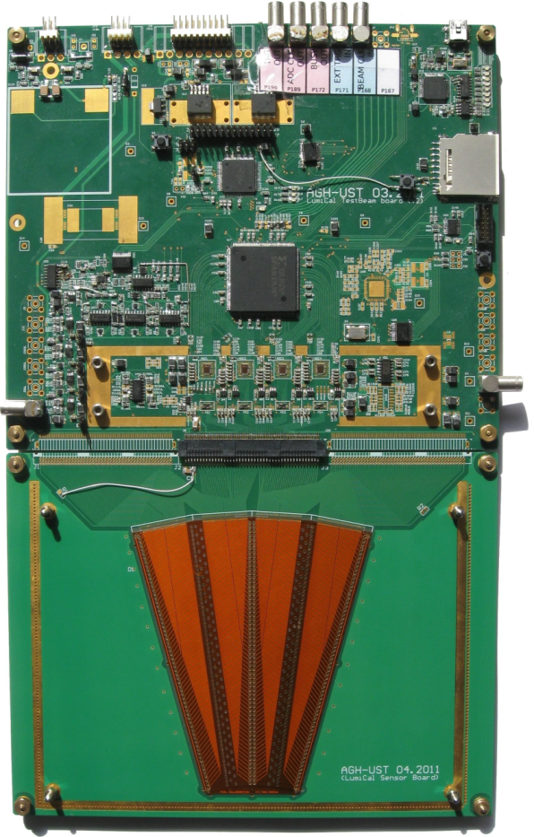
Part I. Very Forward Region
LumiCal – sensors (FCAL collaboration)
Sensors pads CLIC:
(preliminary)
48 divisions azimuthally
50 divisions radially (ILC 64)
(ILC LumiCal sensor:
testbeam set-up
August 2011)

Slide 14
Part I. Very Forward Region
LumiCal – accuracy (systematics!)
ILC at 500 GeV: requiring 0.1% accuracy
high statistics physics channels at 500 GeV, e.g. e+e- -> WW or f f
yield approx. 10⁶ events for 500 fb⁻¹
-> statistical error 10⁻³
-> LumiCal accuracy should be the same or better
CLIC at 3 TeV: requiring 1% accuracy
decided in February 2009, at start of first simulations studies
considered sufficient (?) w.r.t. statistics in typical physics processes
considered realistic for CLIC (higher background!)

Slide 15
Part I. Very Forward Region
LumiCal – issues
Background -> cf. A. Sailer’s talk
systematic errors -> studies in progress
several contributions “ok.”, similar to ILC;
background and beam-beam effects: pending
very compact design, ambitious -> connectivity ?
NB. LumiCal simulation studies to be repeated after CDR, review
required accuracy, pad sizes, 40 layer depth etc.

Slide 16
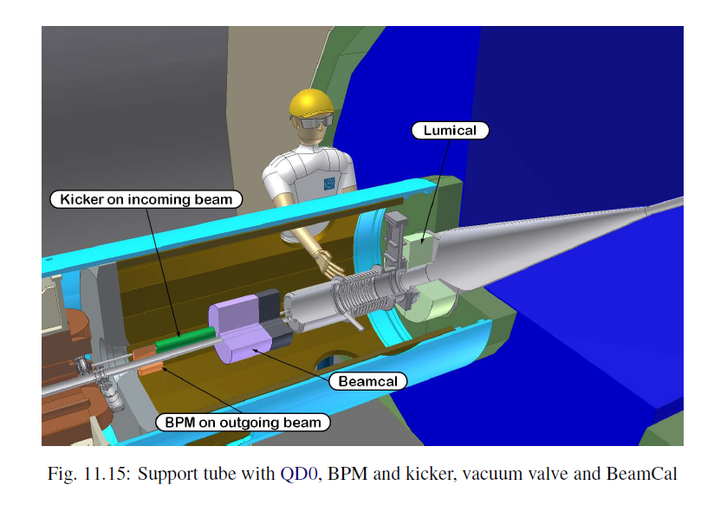
Part I. Very Forward Region

Slide 17
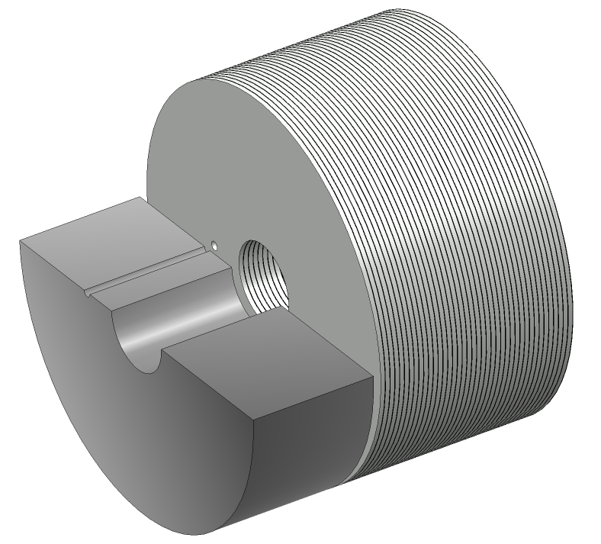
Part I. Very Forward Region
BeamCal – tag h.e. electrons at small angles
(possibly used to give feedback to beam steering – not studied)
In CLIC_ILD:
located at z=3.1m
total depth: 260 mm (w/graphite)
inner radius: 32 mm
outer radius: 150 mm
40 layers:
3.5 mm W plates
+ sensors
incoming beam
spent beam
40 layers W-Si
10 cm graphite

Slide 18
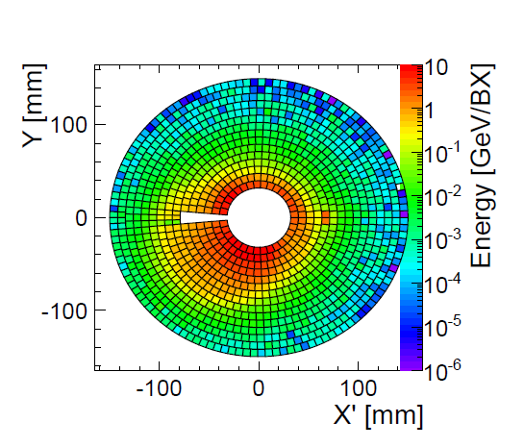
Part I. Very Forward Region
BeamCal – a single h.e. electron and 10 BX of bg.
(shown here: energy deposition in the 10th layer)
Fig. 9.6

Slide 19
Part I. Very Forward Region
BeamCal – issues
radiation damage to sensors
-> cf. FCAL work on GaAs, diamond sensors
very high occupancy (-> readout electronics)
efficiency to tag h.e. electrons w/background:
simulation studies pending

Slide 20
Part II. Polarisation
(not yet in CDR Vol. 2)

Slide 21
Part II. Polarisation
From CLIC CDR Vol. 1 (Accelerator):
Polarisation as produced, transported to the IP:
CLIC baseline design:
-> electrons polarised, 80%
-> positrons unpolarised
CLIC possible upgrade:
-> positrons polarised

Slide 22
Part II. Polarisation
From CLIC CDR Vol. 1 (Accelerator):
Polarisation measurement in the BDS and beyond:
CLIC baseline design:
-> analogous to ILC: Compton backscattering from laser beam
(polarimeter in BDS);
assume polarimeter accuracy of 0.3% (cf. ILC)
No polarimeter in the post-collision line (ie. after IP) !
(strong beam-beam effects -> 3x10⁸ coherent pairs / BX
-> too much background after the IP)
-> rely on spin tracking calculations through 700m of BDS

Slide 23
Part II. Polarisation
Depolarisation at the IP – important at 3 TeV:
various recent papers –
luminosity weighted depolarisation found to be
approx. 3 - 5%
What is the uncertainty of such a calculated depolarisation ?
Cf. D. Schulte:
depolarisation is less pronounced at the high-energy end of the luminosity spectrum

Slide 24
Part II. Polarisation
Plans for CDR Vol. 2:
Insert a section into chapter 1 (physics potential)
describing the benefits of polarisation in
a) chargino-neutralino benchmark channel
b) Z’ at 10 TeV
assuming “ad hoc” accuracy of polarisation
longer term:
assess accuracy of polarisation (vs. depolarisation);
investigate measuring the “effective polarisation”
via physics channels, e.g. WW production, single W prod.

Slide 25
Spare Slides Part I (VF)

Slide 26
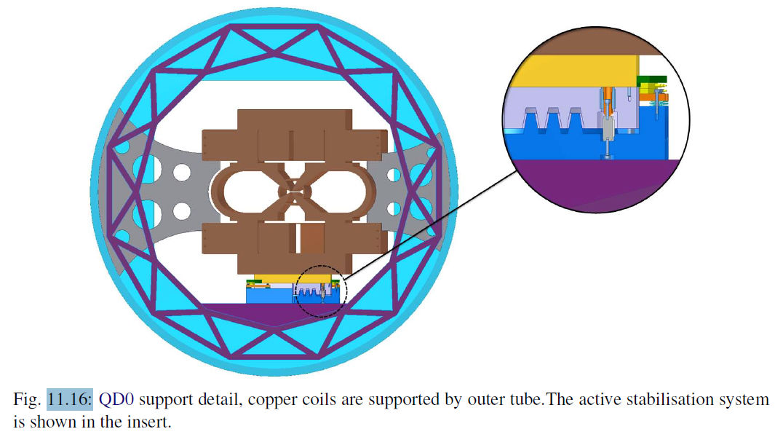
Part I. Very Forward Region

Slide 27
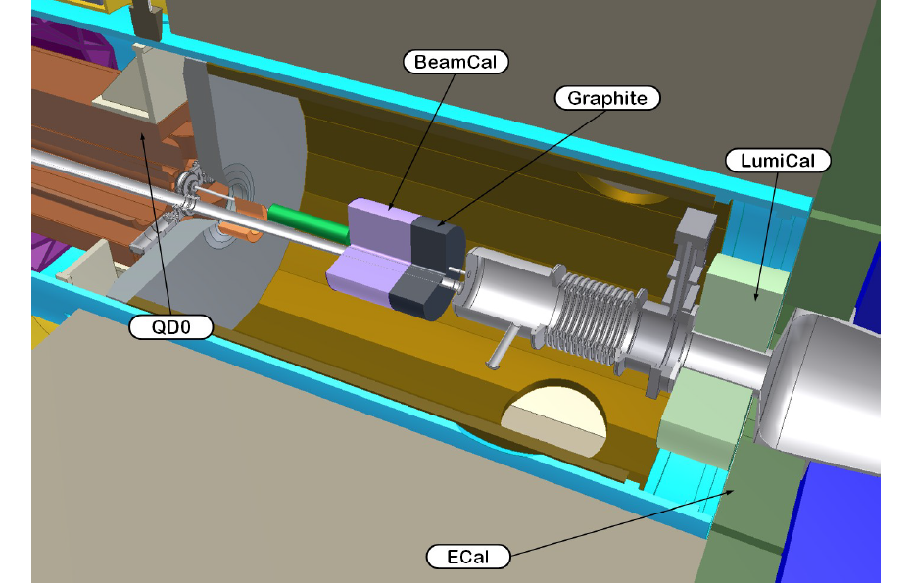
Part I. Very Forward Region
Fig. 9.3

Slide 28
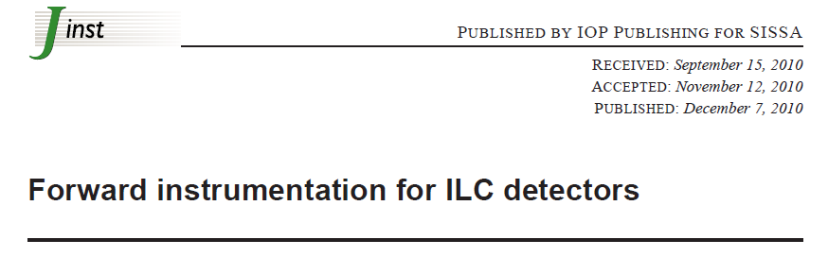
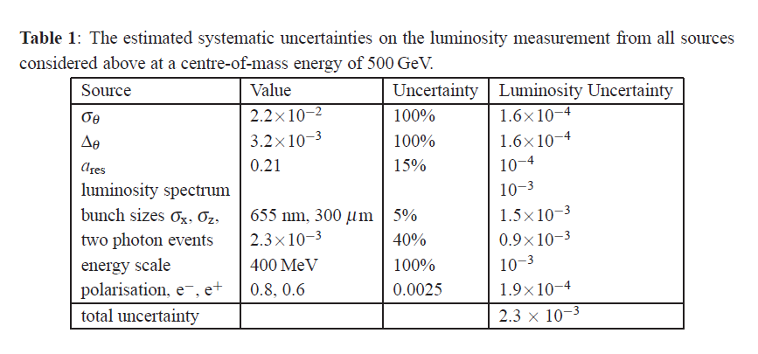
Part I. Very Forward Region
Notes:
Polar angle resolution
Polar angle bias

Slide 29
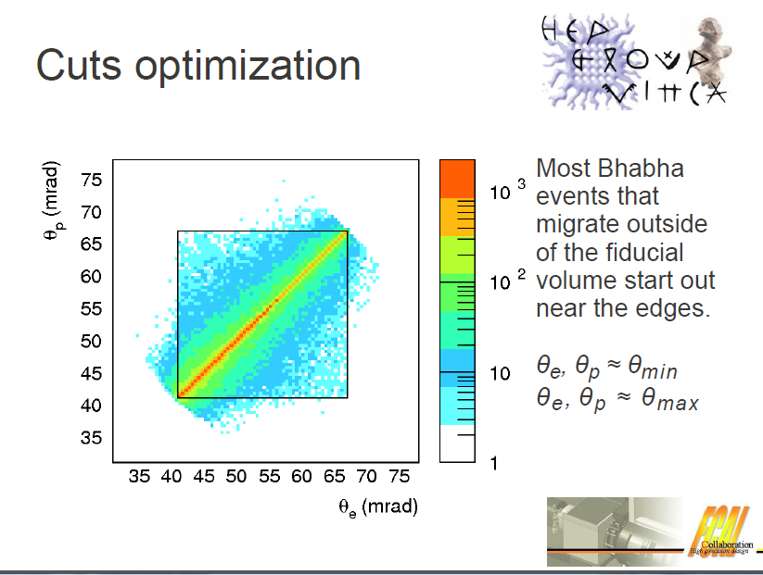
Part I. Very Forward Region
ILC 500 GeV
S. Lukic, VINCA, Belgrade

Slide 30
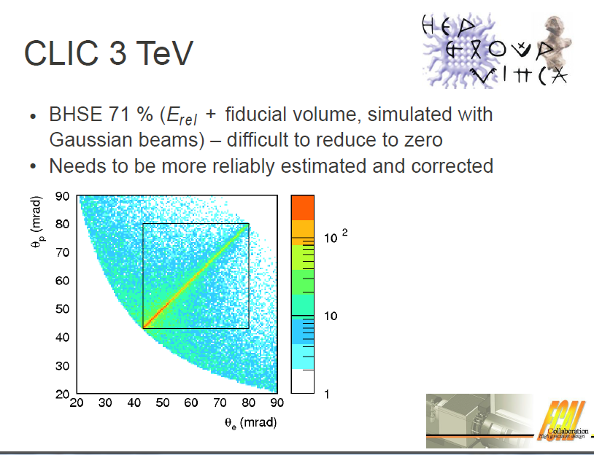
very first look
S. Lukic, VINCA, Belgrade

Slide 31
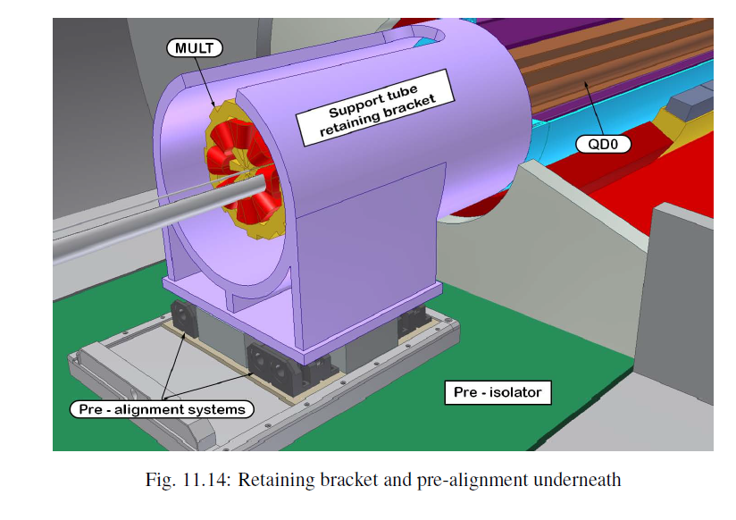
Part I. Very Forward Region

Slide 32
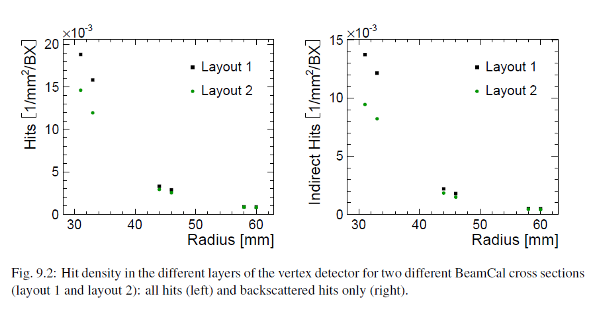
Part I. Very Forward Region
Andre Sailer

Slide 33
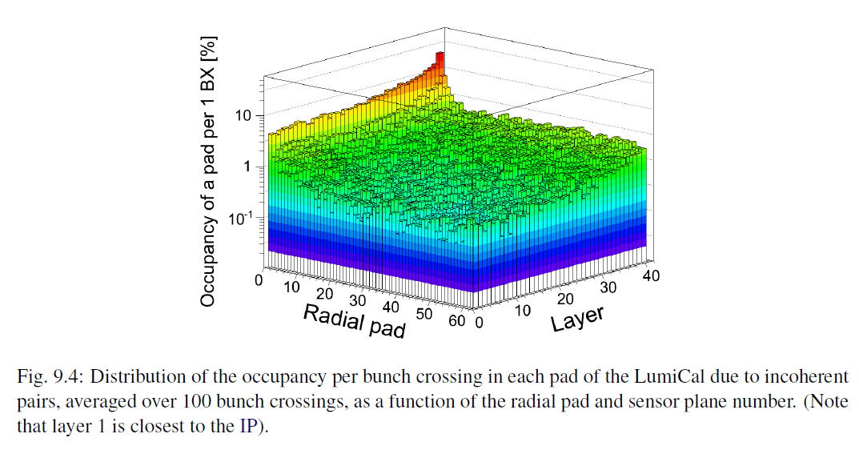
Part I. Very Forward Region
Andre Sailer

Slide 34
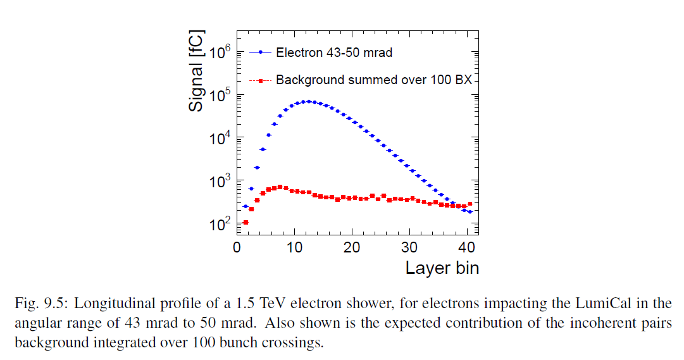
Part I. Very Forward Region
Andre Sailer

Slide 35
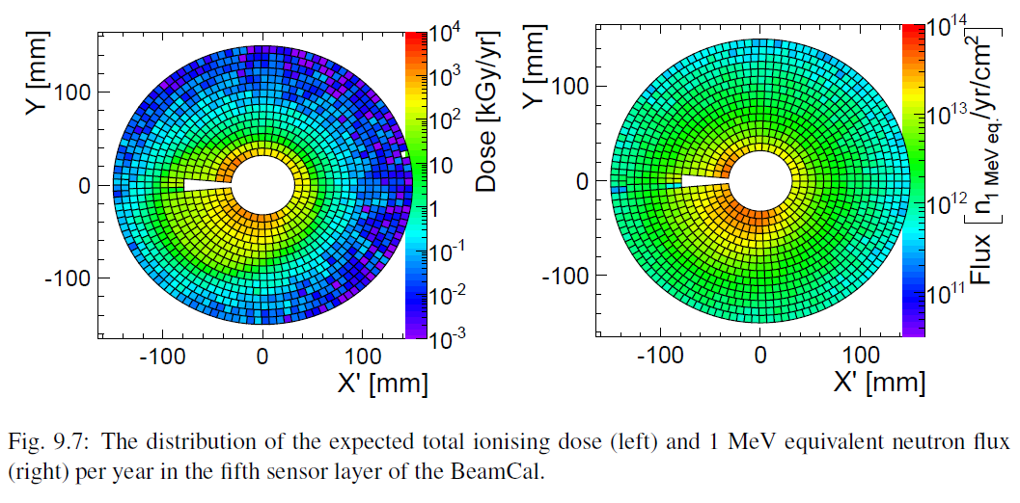
Part I. Very Forward Region
Andre Sailer

Slide 36
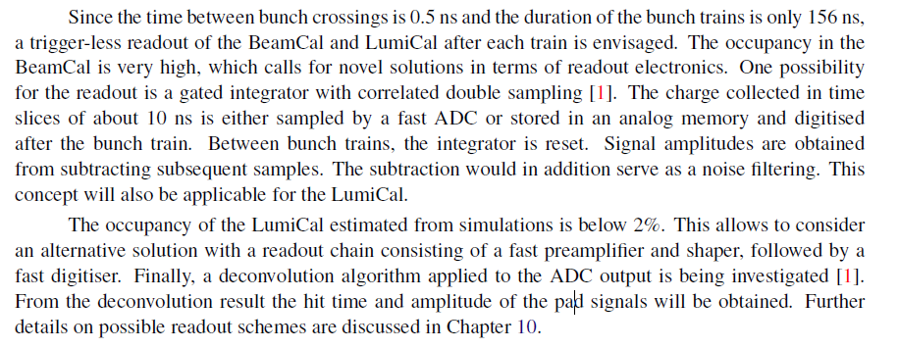
Part I. Very Forward Region

Slide 37
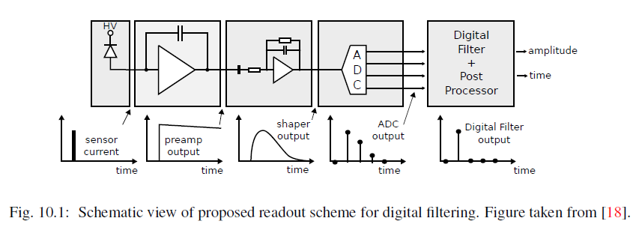
Part I. Very Forward Region

Slide 38
Spare Slides Part II (Pol.)

Slide 39
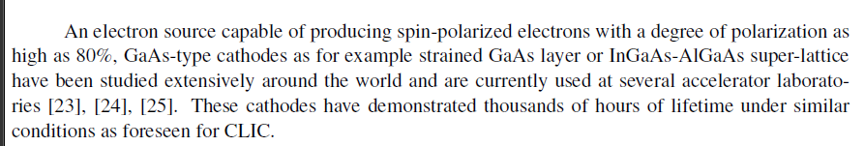
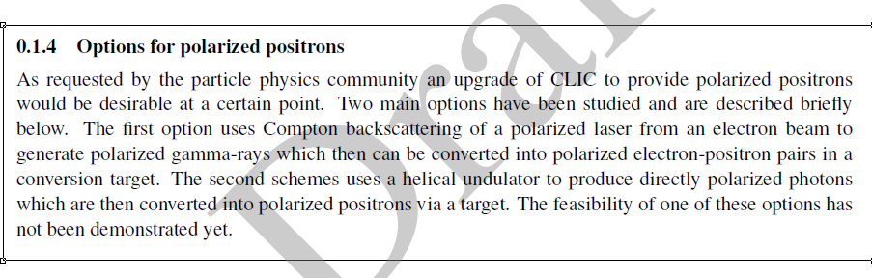
From CDR Vol. 1, DRAFT section on “Main Beam Injectors”
39

Slide 40
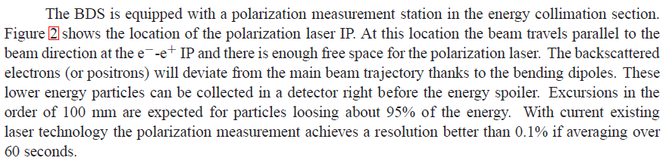
From CDR Vol. 1, DRAFT section on “Beam Delivery System”
Note: this is the statistical accuracy
40

Slide 41
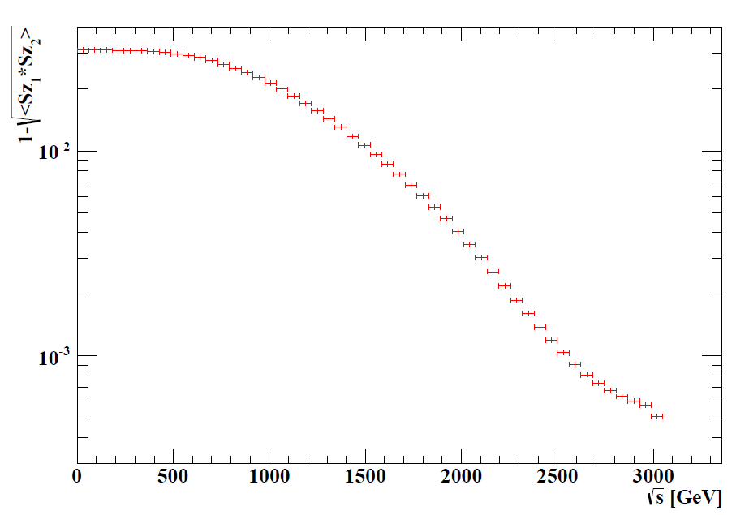
How different is the depolarisation for different “slices” of the luminosity spectrum ?
Jakob Esberg, Aarhus University
VERY PRELIMINARY RESULT

Slide 42
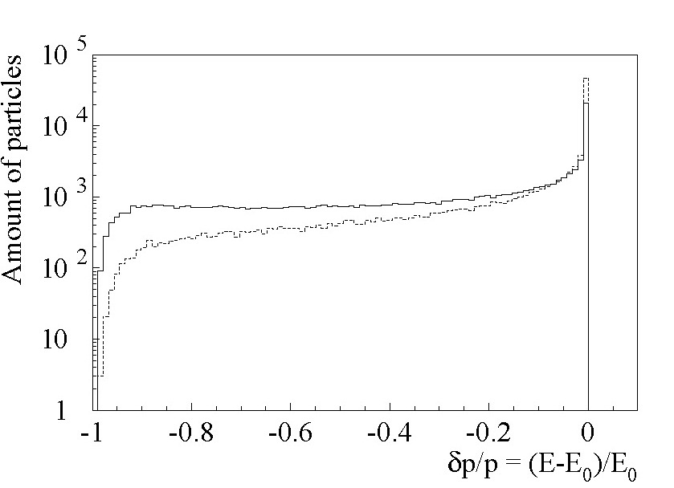
disrupted beam at interaction point
Arnaud Ferrari
EUROTEV-Report
2008-021

Slide 43
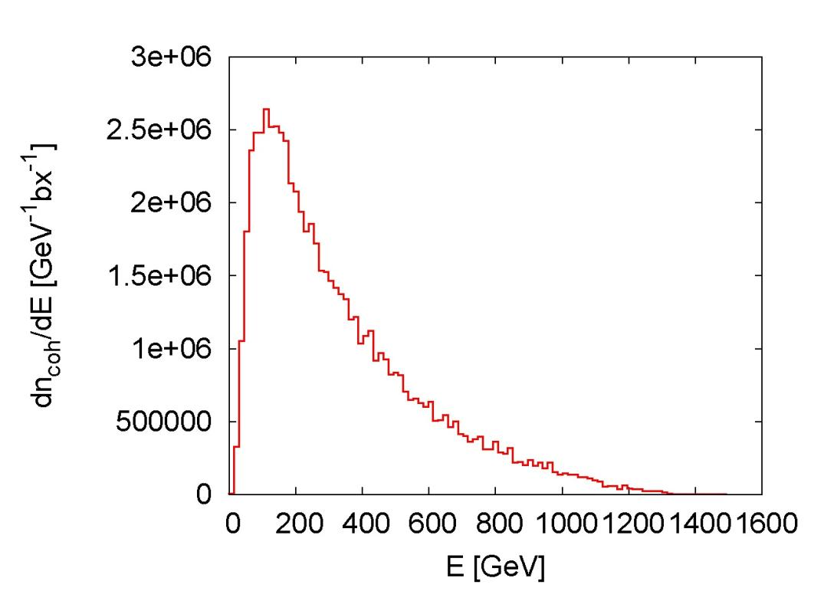
coherent pairs at interaction point
Daniel Schulte
Sendai, March 2008

Slide 44
Schematic of the CLIC postcollision line (side view)

Slide 45
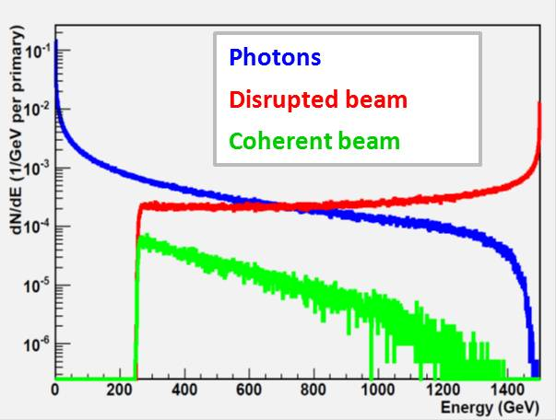
Particles after the Intermediate Dump of the PC line – nominal 3 TeV CLIC

Slide 47
Spare Slides CDR Volume 1

Slide 48
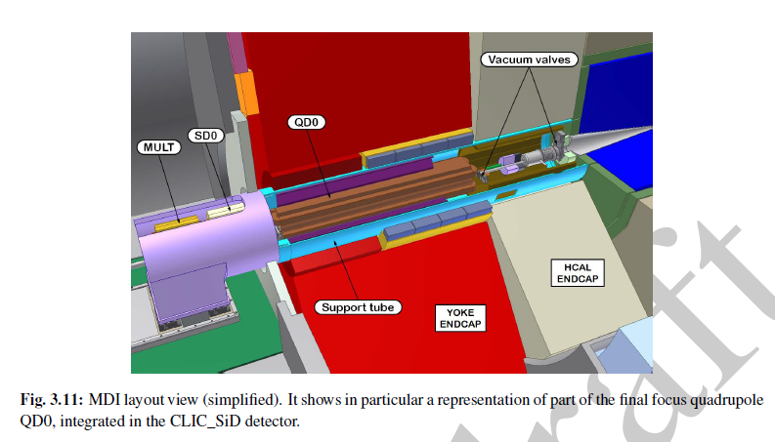
from CDR Volume 1 (Accelerator)

Slide 49
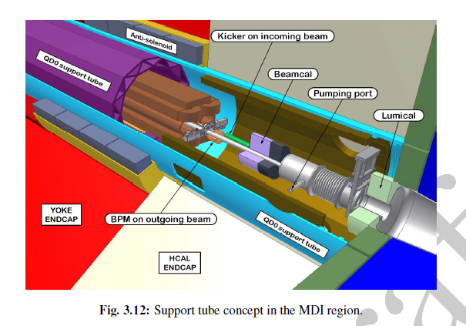
from CDR Volume 1 (Accelerator)

Slide 50
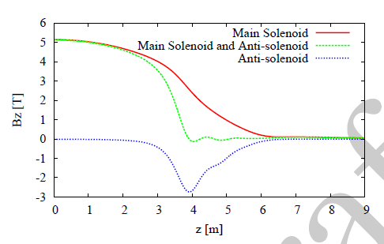
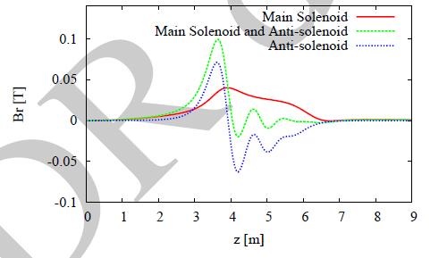
from CDR Volume 1 (Accelerator)

Slide 51
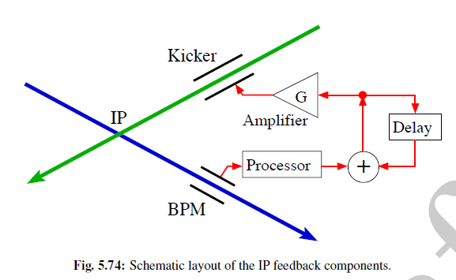
from CDR Volume 1 (Accelerator)

Slide 52
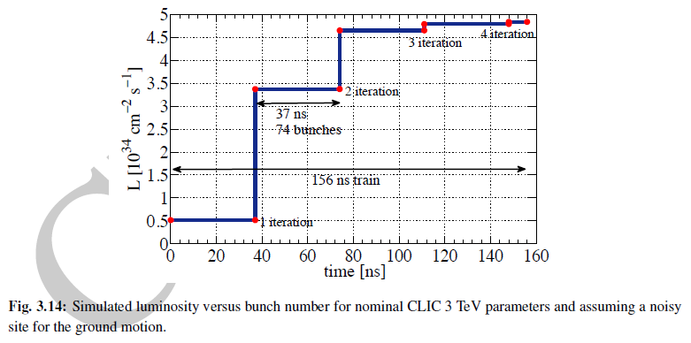
from CDR Volume 1 (Accelerator)

Slide 53
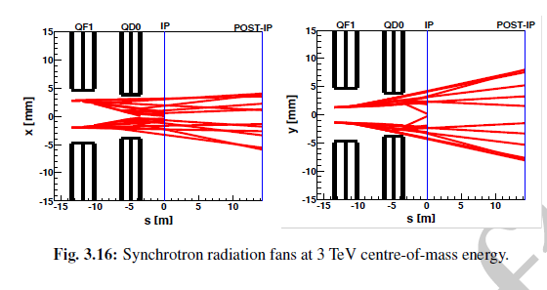
from CDR Volume 1 (Accelerator)

Slide 54
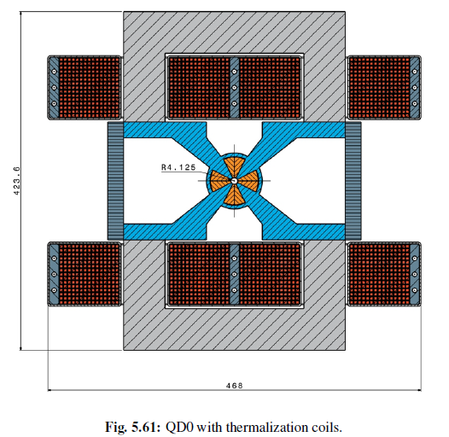
from CDR Volume 1 (Accelerator)

Slide 55
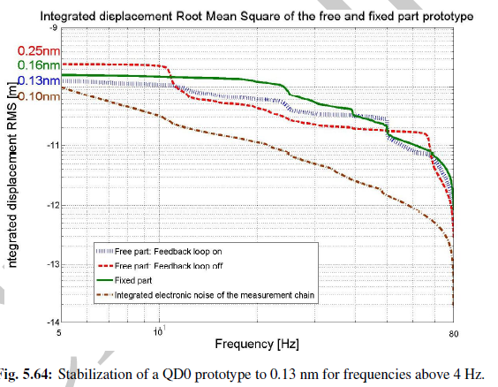
from CDR Volume 1 (Accelerator)

Slide 56
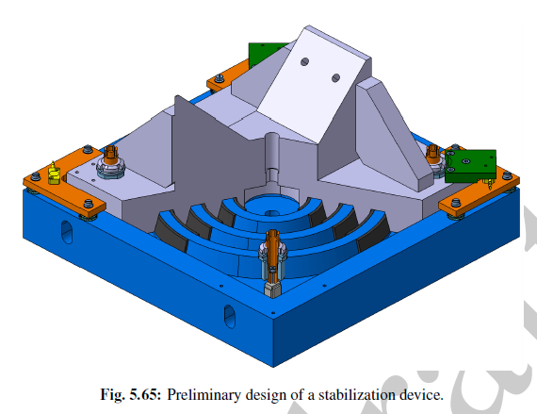
from CDR Volume 1 (Accelerator)

Slide 57
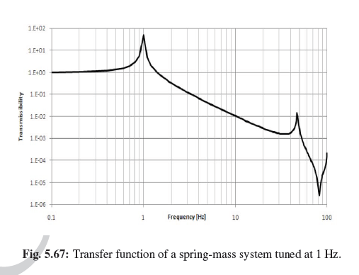
from CDR Volume 1 (Accelerator)

Slide 58
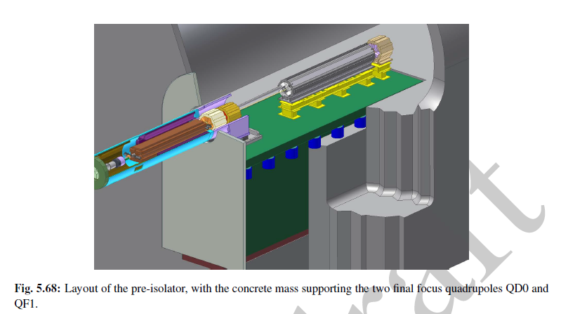
from CDR Volume 1 (Accelerator)

Slide 59
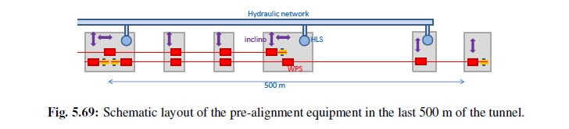
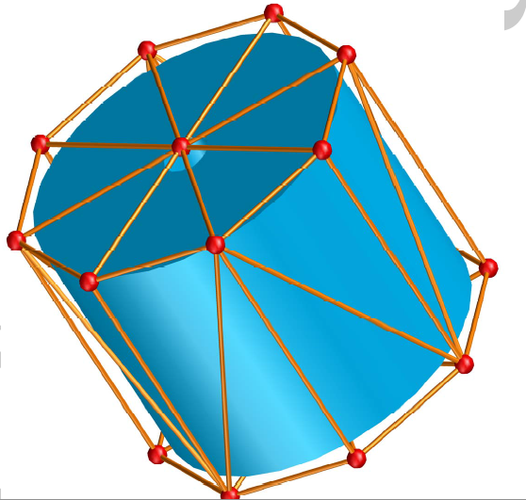
from CDR Volume 1 (Accelerator)

Slide 60
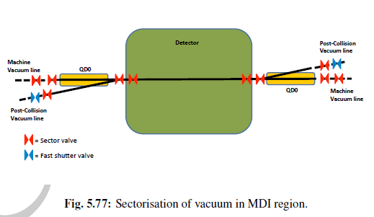
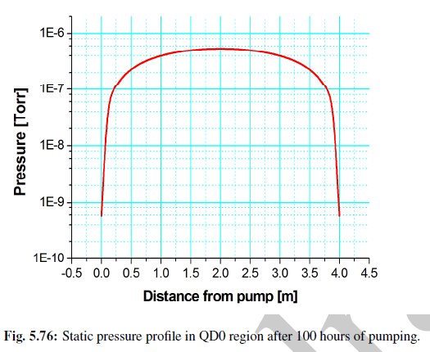
from CDR Volume 1 (Accelerator)

