Slide 1
CLIC CDR
What are the next steps ?
Lucie Linssen
on behalf of the CLIC physics and detector study

Slide 2
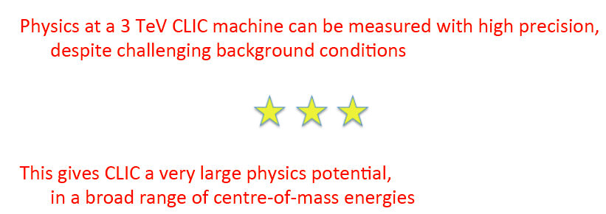
The main message from the CDR
The CLIC CDR studies allowed to extract the principal message.
Lots of work ahead, in simulation studies and hardware R&D, to bring this to a fully mature level for a future implementation.

Slide 3
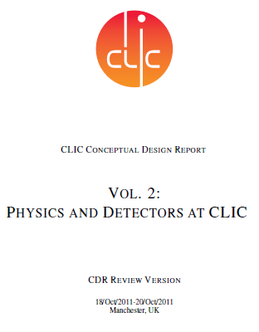
CDR status and short-term plans
The CDR contents will be finalised before the end of 2011.
During the ~8 weeks between the Review and the final publishing,
the CDR will be complemented with:
** Inclusion of Review comments and correction of errors.
  Small modifications, otherwise adaptations of future plans
** CLIC physics potential with polarised beams
  A few examples, Work in progress => additional section in chapter 1
** Measurement of the luminosity spectrum using bhabha scattering.
  Work in progress
The CLIC physics&detector CDR will be presented to the CERN Scientific Policy Committee, December 12+13th, 2011
Publication of the CDR in the form of a CERN yellow report

Slide 4
Continuation of CDR work in 2012
There will be some continuation of CLIC CDR work in 2012
Summary document for accelerator, physics and detectors (Volume 3)
Volume 3 will comprise:
summary of Vol. 1&2 on accelerator and physics/detector
  staged energy approach for CLIC
  cost estimate
  future plans: 2012-2016 and beyond
  .
  .
And also: preparation for the update of the European Strategy for Particle Physics
Including a common LC physics document
Vol. 3:
SUMMARY, COST AND STRATEGY

Slide 5
After the CDR….
Studies foreseen on the Medium-term => covering a ~5-year period
(see chapter 13 of the CDR, and detailed backup slides of this talk)
In a nutshell:
Detector simulation studies and physics studies
    Further detector optimisation
    Explore physics potential with a machine built in stages
    Adaptation to LHC results
LC detector R&D (many common activities between ILC and CLIC)
CLIC-specific detector R&D
The next slides illustrate a few of the upcoming studies
The slides focus mostly on CLIC-specific items
There is also a lot of work in common with ILC

Slide 6
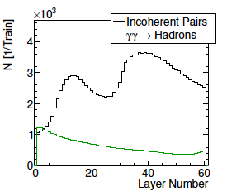
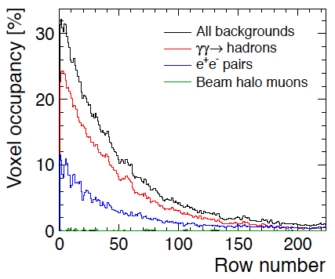
Detector simulation studies
Examples of high occupancy regions requiring further study at 3 TeV
TPC
Talk A. Sailer
Fig. 5.9
High occupancy due to incoherent pairs in the high-z regions of the HCAL end cap. This points to inadequate shielding from the very forward calorimetry region
can be solved
High occupancies in the TPC, mostly due to yy=>hadrons. One may consider pixelised readout for the TPC in this region or suppress the inner pad rows.
requires technology/layout changes

Slide 7
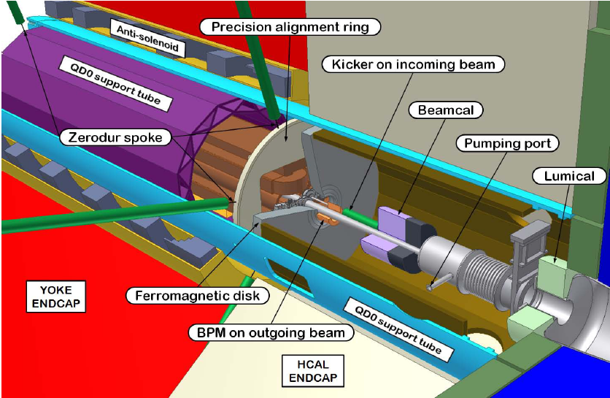
Simulation+engineering studies
1.3 m diam.
Fig. 11.13
The QD0 and its stability requirements at CLIC have a significant impact on the detector layout and acceptance in the forward region. More study is needed to quantify the impact on the physics and to make a balance between pros and cons of having QD0 inside the detector. QD0 in or out of the detector?

Slide 8
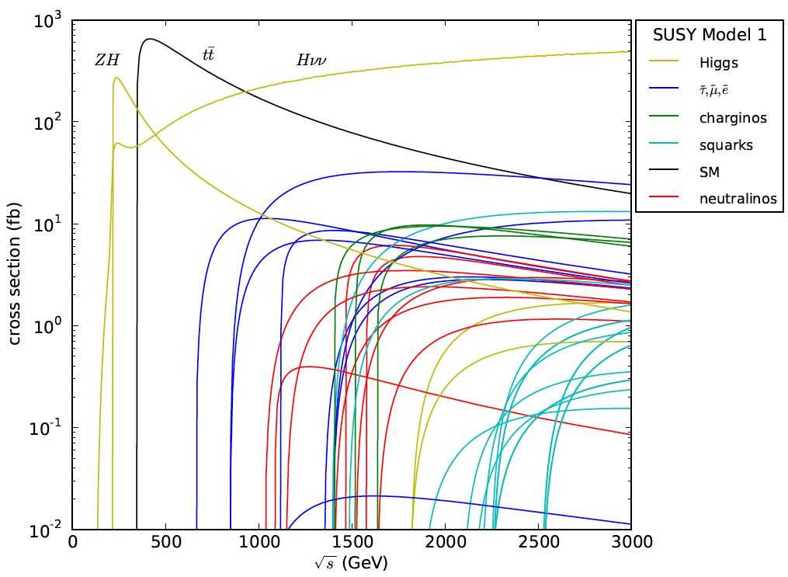
Physics at CLIC, staged √s energy
Like Fig 1.9,
but Model I
Use a single SUSY model + SM physics as an example to study how a LC built and operated in energy stages could explore new physics, including the gradual accumulation of knowledge on e.g. EW symmetry breaking, DM relic abundance, GUT scale unification
Study in close collaboration with CLIC accelerator

Slide 9
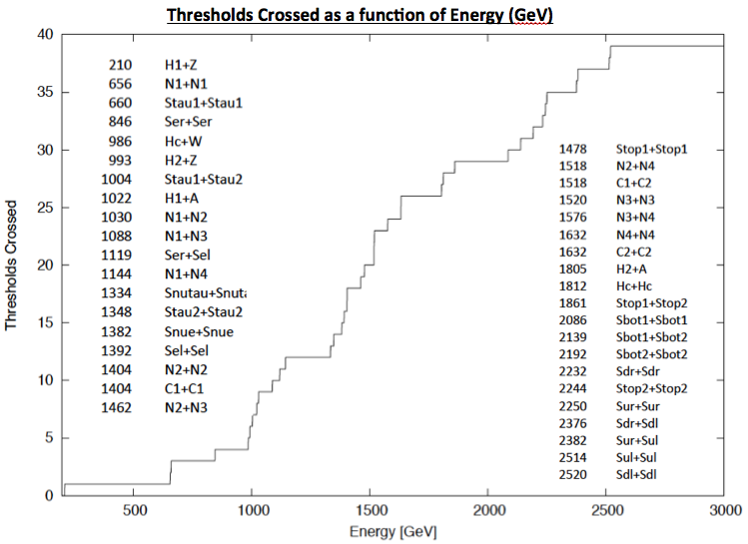
Physics at CLIC, staged energy

Slide 10
Software development
Quite some overhead to work with two frameworks (each having their advantages and drawbacks)
For the CDR used:
Mokka/Marlin framework
SLIC / org.lcsim framework
Fortunately, for the CDR, we also made use of common tools:
LCIO
Event generation (WHIZARD + PYTHIA)
ILCDIRAC grid production
PandoraPFA / SLICPandora fo particle flow analysis
LCFI for flavour tagging
In a next phase:
Further improvement of simulation tools => continuation of trend to have common tools

Slide 11
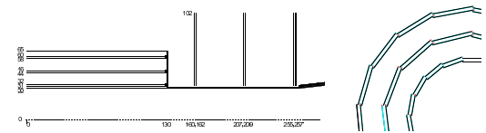
Vertex detector
Vertex detector
pixel technology with small pixel sizes of O(20 μm)
hit time resolution of O(5 ns);
O(0.2% X0) material per layer;
  high-density interconnect, thinning of wafers, ASICs or tiers;
  low-mass construction and services
  Advanced power reduction, power delivery, power pulsing and cooling developments
The CLIC timing requirements have a large impact on the vertex detector R&D =>
very challenging R&D
Fig. 4.1

Slide 12
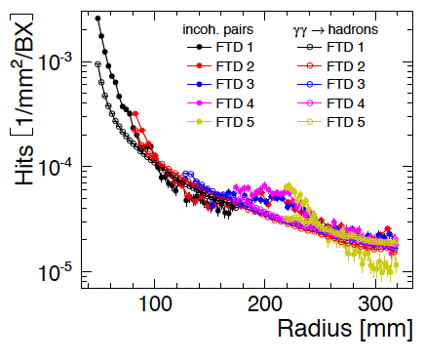
Silicon strip tracking
High occupancies per bunch train in inner strip tracking layers
Fig. 5.8
~2.9 hits/strip per 156 ns bunch train in FTD2, including safety factor
Similar situation in most inner barrel strip layers
=> Requires technology choices and hardware R&D

Slide 13
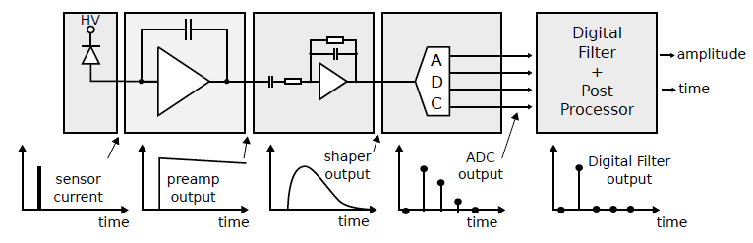
Electronics and power delivery
Many challenges in electronics. This is just an example.
Fig. 10.1
Calorimeter electronics at 3 TeV requires:
12-14 bit pulseheight measurement
~1 ns time resolution for hits
Up to 5 hits per 156 ns bunchtrain
Very low power consumption, and power pulsing in addition
Requires electronics R&D, going beyond ILC requirements in a few domains (e.g.timing, multihit)

Slide 14
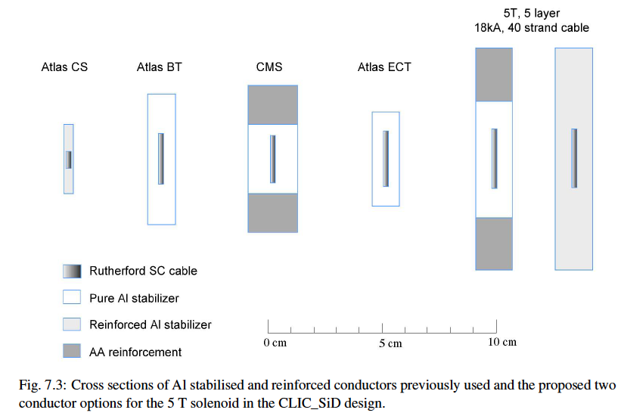
Magnet and ancillary systems
Fig. 7.3
Requires hardware R&D on reinforced conductors, and movable services for push-pull

Slide 15
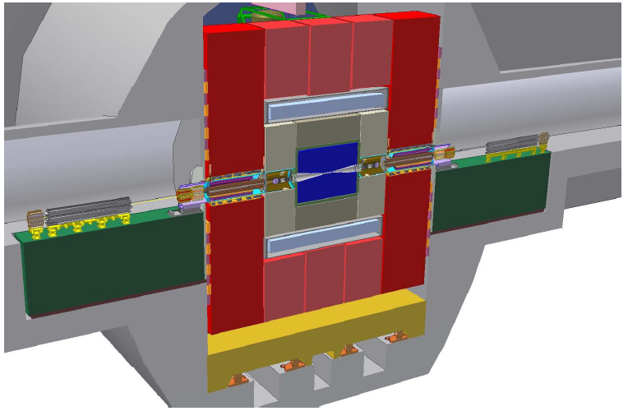
Engineering and Integration
Tungsten HCAL
End coils
Short detector length in z
Push-pull
Fig. 11.9
e.g. development of short detector length (z), detector movements, alignment, construction methods for tungsten HCAL, etc…

Slide 16
Summary/outlook
CLIC detector CDR were only possible thanks to years of ILC detector optimisation studies and R&D.
Synergy with ILC will continue during the next project phase.
Huge thank you to the reviewers for their careful investigation of our work.
In case you would like to give your support to the physics case and R&D towards a future linear collider based in CLIC technology, you are invited to sign up here:
https://indico.cern.ch/conferenceDisplay.py?confId=136364
Does not imply any formal commitment.

Slide 17
SPARE SLIDES
With detailed plans for next 5 years

Slide 18

Detector simulation studies
Simulation Studies and Detector Optimisation
Origin and mitigation of high occupancies in low-angle region of endcap calorimetry;
Location of QD0 inside or outside the detector and impact on the physics;
Origin and mitigation of high TPC occupancies;
Occupancies in inner tracking regions and related technology choices;
Detector optimisation and background suppression at intermediate centre-of-mass energies;
Simulation studies in support of detector development and beam tests;
Implementation of the response of various detector readout technologies in the full-detector simulations.

Slide 19
Physics at CLIC
Physics at CLIC
Monitor the developments at the LHC and report on their implications for the physics potential of CLIC; <= preferable in broad LC context
Investigate the physics opportunities and challenges of a staged approach to reaching the highest energy of the CLIC machine;
Investigate the relative merits of electron polarisation versus electron and positron combined polarisation;
Study a supersymmetric benchmark model point in full detail to determine all the masses and mixings that can be measured, and investigate how well these measurements can lead us to answers to fundamental questions such as the verification of supersymmetry, the origin and mediation of supersymmetry breaking, the relic abundance of the lightest neutralino, and the compatibility of the model to various approaches to explaining the baryon asymmetry of the universe. <= could be done in collaboration with a similar study for ILC

Slide 20
Software development
Software development
Roadmap towards common software tools for both experiments;
Improved and well-maintained tracking codes;
Improved software tools for geometry descriptions;
More advanced reconstruction methods, making use of the granularity in space and time.

Slide 21
Vertex detector
Vertex detector
Developments towards a thin hybrid or integrated CMOS or multi-tier (SOI, 3D or other) pixel technology with small pixel sizes of O(20 μm) and a hit time resolution of O(5 ns);
Development of high-density interconnect technologies towards maximum detector integration and seamless tiling;
Thinning of wafers, ASICs or tiers and development of low-mass construction and services materials to reach O(0.2% X0) material per layer;
Advanced power reduction, power delivery, power pulsing and cooling developments to reach O(0.2% X0) material per layer.
The CLIC timing requirements have a large impact on the vertex detector R&D =>
very challenging R&D

Slide 22
Silicon tracking
Silicon tracking
Study of technology choices to mitigate high occupancies in the inner tracking regions;
Development and beam tests of low-mass silicon strip detectors with time stamping functionalities, low-power electronics, power pulsing, air cooling and low-mass supports.
The main challenge for ILC and CLIC is to make very thin silicon strip trackers.

Slide 23
TPC-based tracking
TPC-based tracking
Continued TPC prototype tests (GEM, Micromegas, pad, pixel, ion backflow);
TPC endplate integration and cooling.
no clear sign yet of TPC hardware R&D needed for CLIC, which goes beyond what is currently developed for ILC

Slide 24
Calorimetry
Calorimetry
Beam tests of fine-grained ECAL, HCAL and forward calorimeter modules based on different active and passive layers (including tungsten for HCAL) and accompanying validation of GEANT4 modelling;
Engineering designs and technological prototypes of ECAL, HCAL and forward calorimetry;
Electronics developments for calorimetry at CLIC, including power delivery and power pulsing tests at the system level.
In addition to R&D for ILC, a tungsten barrel HCAL and very precise timing are required for CLIC

Slide 25
Electronics and power delivery
Electronics and power delivery
Qualification of deep sub-micron technologies for the integration of advanced functionalities in compact detector ASICs;
Studies and prototyping of core front-end functionalities with low power consumption, in particular: pulse height and time measurements, in some cases (silicon tracking and calorimetry) combined with multi-hit functionality within the 156 ns bunch train, as well as on-chip power pulsing features;
Power delivery and power pulsing at the system level, including system tests in a 4 to 5 T magnetic field;
Interconnect technologies for front-end electronics and low-mass services.

Slide 26
Magnet and Ancillary Systems
Magnet and Ancillary Systems
Extrusion tests and characterisation of a large re-inforced superconductor;
Material studies and tests of new conductor re-inforcement materials;
Winding technique for a large conductor;
Flexible high-temperature power line;
Prototyping of safety elements, e.g. a water-cooled dump resistor.

Slide 27
Engineering and Integration
Engineering and Detector Integration
Design and integration of the detector concepts in gradually increasing detail;
Construction and joining techniques with tungsten;
Engineering and layout studies for a short detector length including end-coils;
Detector movements and push-pull operation;
Alignment techniques and deformation measurements;
Engineering and production techniques of a beryllium with steel beam pipe.

