Slide 1
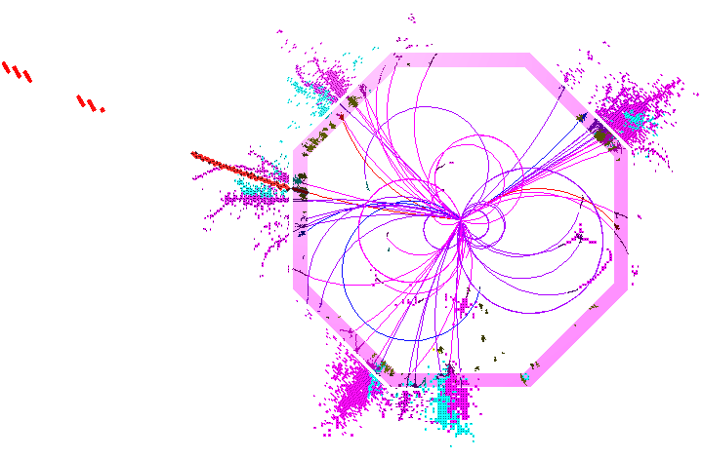
Particle flow performance at CLIC
J.S. Marshall
A. Muennich, M.A. Thomson
CLIC CDR Review, Manchester, October 19 2011

Slide 2
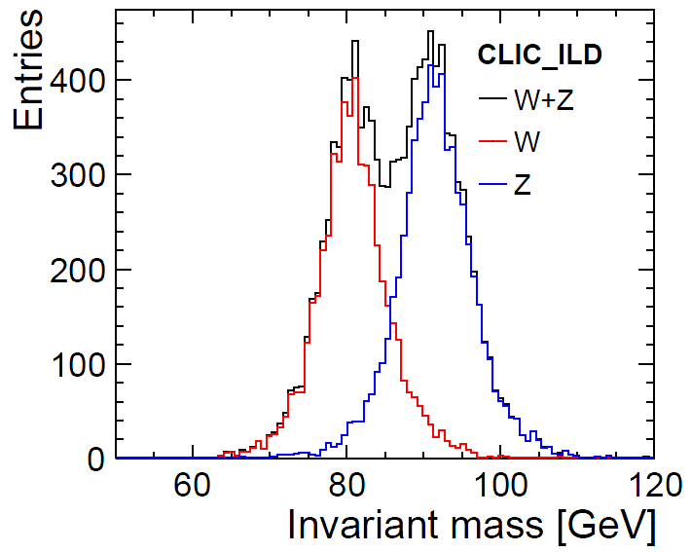
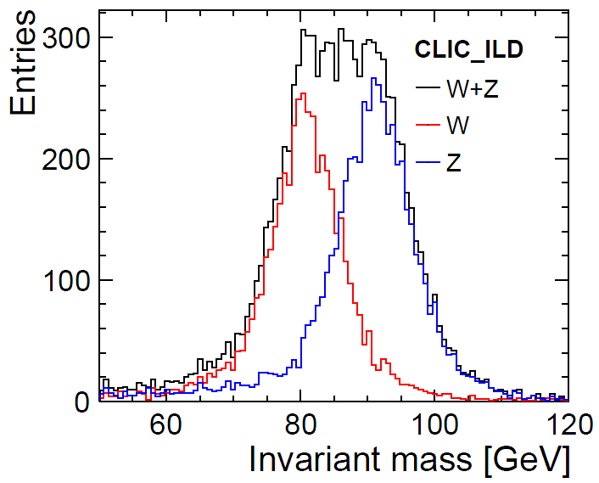
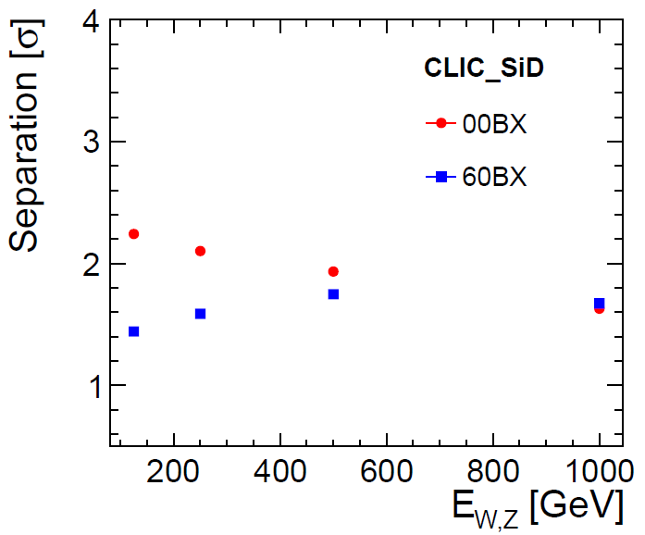
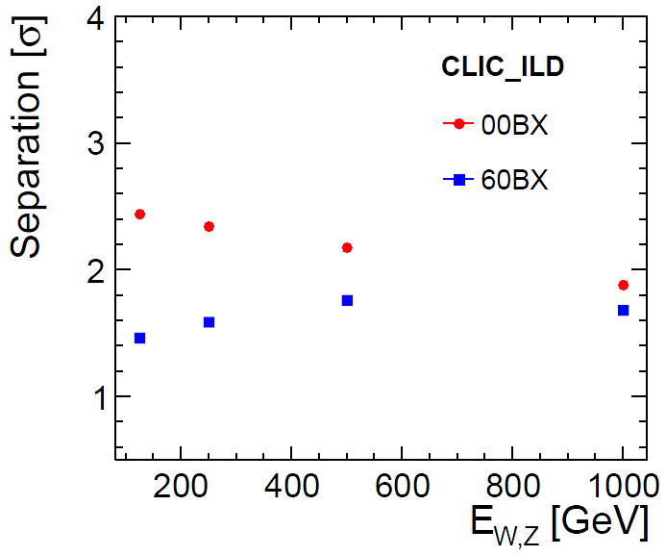
Deviations from CDR
Inclusion of W/Z separation study, presented in LCD-NOTE-2011-028.
Understand that this material would have been included in CDR if it had been available at the time.
00BX
60BX

Slide 3
Overview
The particle flow paradigm.
Introduction to Pandora particle flow algorithms.
Technical performance study:
  Jet energy resolution as a function of jet energy and angle,
  Influence of timing cuts on jet energy resolution.
Physics performance study:
  W energy and mass reconstruction,
  W and Z separation,
  Separation of gaugino pair production final states.

Slide 4
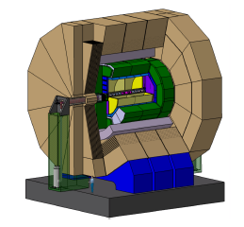
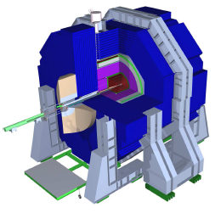
Particle Flow Calorimetry
γ
n
  Measure charged particle energies (60% of jet) in tracker.
  Measure photon energies (30%) in ECAL, σE/E < 20%/√E(GeV)
  Measure only neutral hadron energies (10%) in HCAL.
π⁺
E_{JET} = E_{ECAL} + E_{HCAL}
E_{JET} = E_{TRACK} + E_{γ} + E_{n}
Reconstruction implemented in Pandora, allowing reuse of same particle flow algorithms for ILD/SiD:
Pandora Client Apps
Pandora Algorithms
Pandora APIs
Pandora APIs
Clustering Algs
Particle Id Algs
Library of 60+ reusable Algs...
Pandora Framework
CLIC_ILD/Marlin
CLIC_SiD/org.lcsim

Slide 5
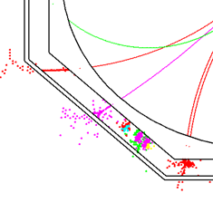
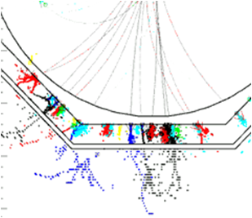
PandoraPFA
Topological Association Algorithms
Track-Cluster Association Algorithms
Reclustering Algorithms
Fragment Removal Algorithms
PFO Construction Algorithms
ConeClustering Algorithm
Cone
associations
Back-scattered tracks
Looping tracks
38 GeV
18 GeV
Cluster first
layer position
Projected track position
12 GeV
32 GeV
30 GeV Track
3 GeV
3 GeV
6 GeV
6 GeV
9 GeV
9 GeV
Layers in close
contact
Fraction of energy
in cone
Neutral hadron
Photon
Charged hadron

Slide 6
Technical Study
Particle flow performance has been assessed using fully simulated and reconstructed events with Zs at different energies (91GeV to 3TeV) decaying at rest into light quarks.
Backgrounds are not included and no jet reconstruction is carried out. The full energy deposited in the detector, E_{jj}, is analysed to avoid any bias from jet reconstruction.
Performance is evaluated by examining resolution of the jet energy, E_{j}:
RMS₉₀(E_{jj}) and mean₉₀(E_{jj}) are calculated from the reconstructed total energy distribution.

Slide 7
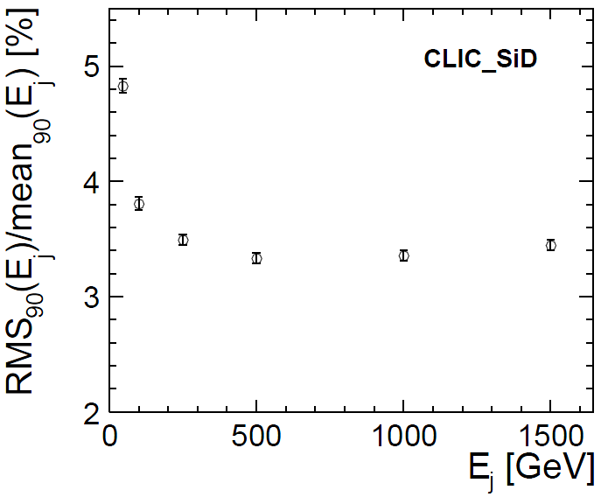
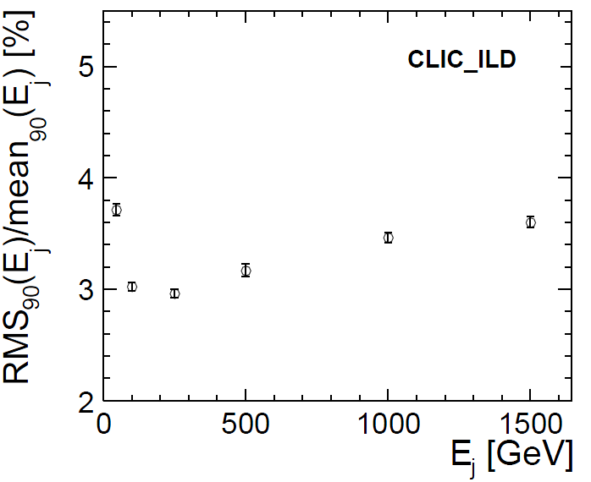
Resolution vs. Jet Energy
Barrel region |cos θ| < 0.7, no background, no jet reconstruction:
At lower energies, CLIC_ILD benefits from its larger radius.
At higher energies, particle separation becomes more difficult; confusion term dominates energy resolution; particle flow can become energy flow. Both detectors show similar performance.

Slide 8
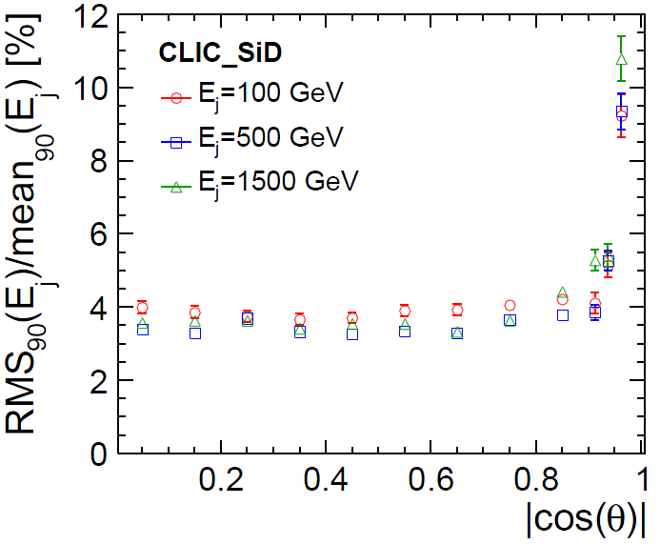
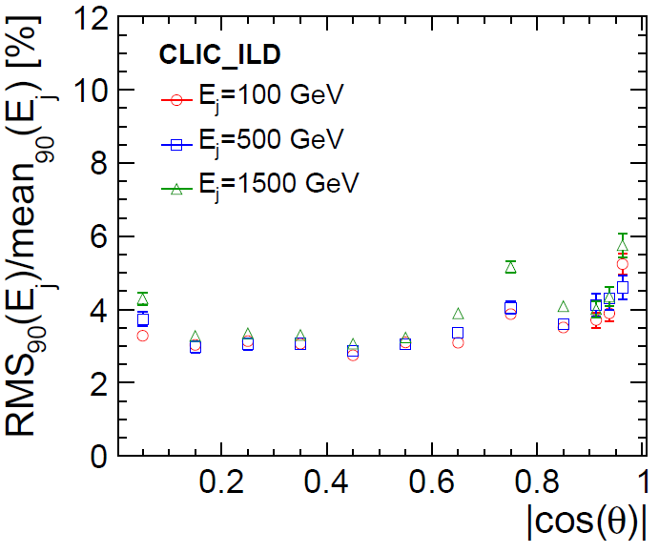
Resolution vs. Angle
No background, no jet reconstruction:
Resolution for CLIC_SiD is worse in the forward region, due to reduced angular coverage. There is no HCAL coverage below θ = 15.5°.
Resolution for CLIC_ILD dips in barrel/endcap overlap region, due to gap between ECAL barrel and endcap. Leakage effects due to this gap are more pronounced at higher energies.
Notes:
In barrel region, both detectors show only small variation with jet angle.

Slide 9
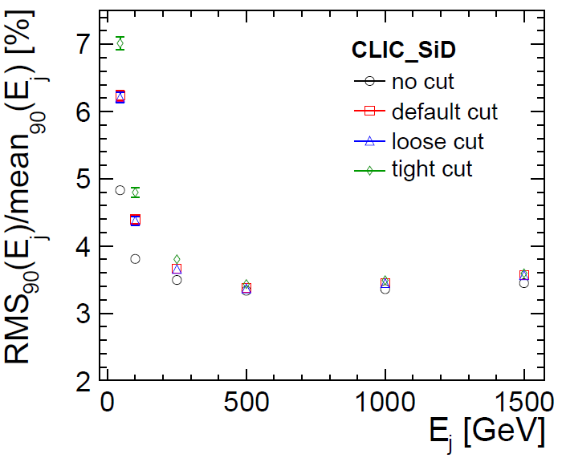
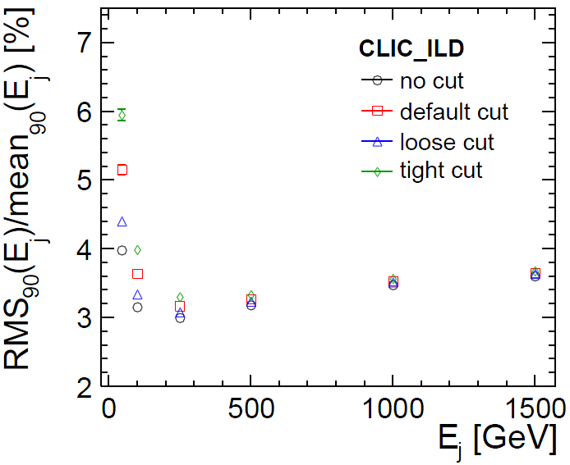
Timing Cuts
No background, no jet reconstruction:
Impact of CLICPfoSelector timing cuts on the physics event is studied by applying the cuts without overlaying any background.
Whilst timing cuts result in degradation of jet energy resolution for low energy jets, the impact is small for jets above 500GeV.

Slide 10
PFA Physics Performance
Study of PFA physics performance carried out by A. Muennich. Event sample contains two Ws, one decaying into muon and neutrino, the other decaying into quarks:
  e⁺e⁻→WW → μνqq
  W energies: 125, 250, 500 and 1000GeV
  Each energy available without background and with 60BX γγ→hadrons background.
Reconstruction was performed in two steps:
  Lepton removal. Muon and every particle around it within tight cone removed, leaving only hadronic decaying W in the event.
  Jet reconstruction. Without background, ee_kt algorithm used. In presence of background, kt algorithm performed best. Algorithms used in exclusive mode, forcing event into two jets.
The analysis used PFOs passing tight timing cuts (found minimal performance difference between timing cuts). Results are shown for jets in the region |cos θ| < 0.9

Slide 11
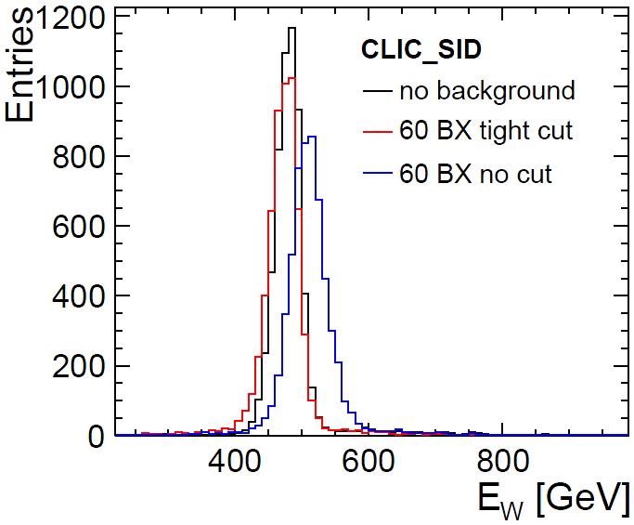
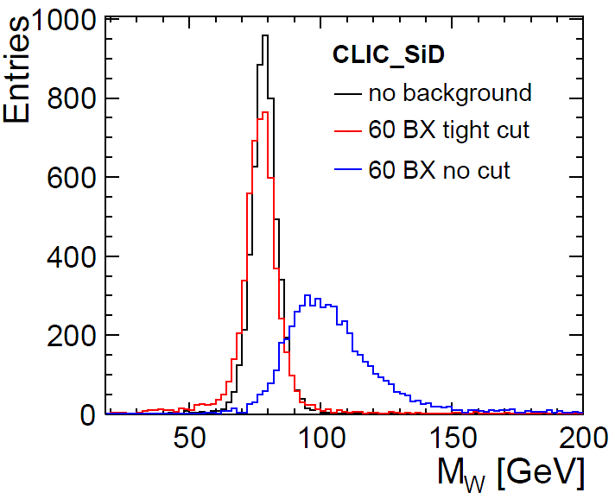
W Reconstruction
Energy and mass distributions for the reconstructed W, with energy of 500GeV:
Without background, the energy resolution is comparable to that obtained in the technical study, without jet reconstruction.
With background, and without timing cuts, many background particles remain in the event and are reconstructed as part of the jet, shifting the energy and mass distributions to higher values.

Slide 12
W/Z Separation
One of the goals of PFA and fine granularity calorimetry is separation of W and Z particles.
  To study this separation, used W samples already described and samples of e⁺e⁻→ZZ →ννqq
Mass distributions of the reconstructed W and Z for CLIC_ILD at E_{W/Z} = 500GeV:
00BX
60BX
Without background, the two peaks remain clearly separated. With 60BX, see significant overlap.

Slide 13
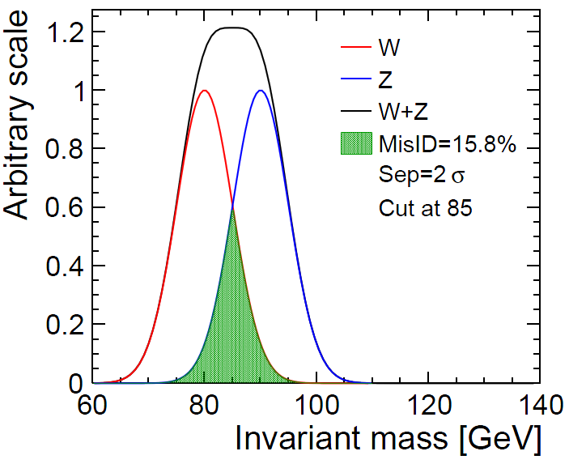
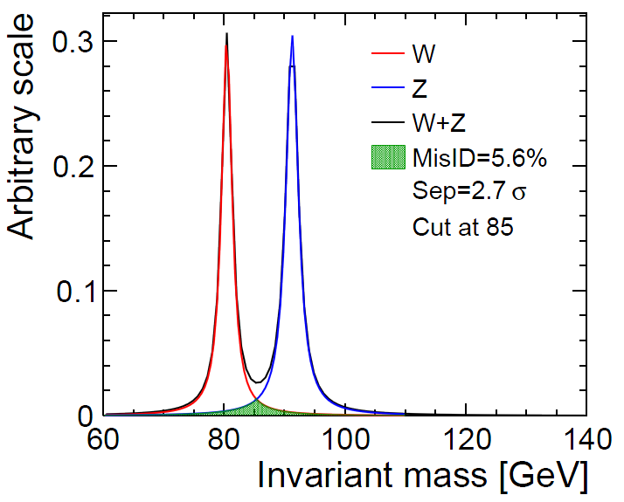
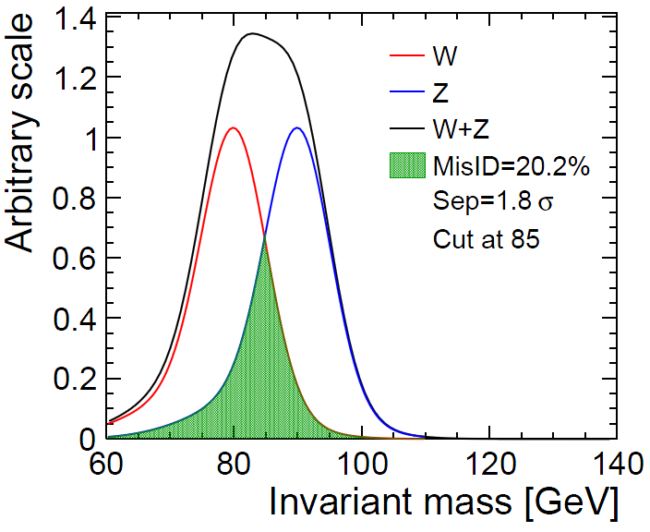
W/Z Separation
Separation calculated by applying optimal cut, minimising number of misidentified events.
For ideal Gaussian distributions, misidentification of 15.8% corresponds to 2σ separation.
If tails present in distribution, separation drops below 2σ even if main peaks remain 2σ apart.
Obtainable separation limited by natural width of W and Z to identification efficiency of 94%.

Slide 14
W/Z Separation
Separation between W and Z peaks with no background and with 60BX of background:

Slide 15
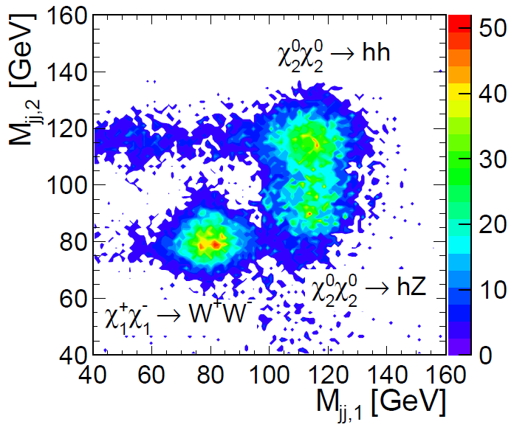
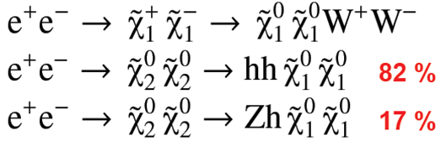
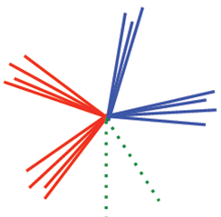
Gaugino Pair Production
Test particle flow reconstruction of boosted low mass (EW scale) states in presence of background:
Pair production and decay:
Largest BR decay has same topology for
all final states:
Use kt jet-finder and tight PFO collection.
Separate using di-jet invariant mass.

Slide 16
Summary
Technical performance study shows that PandoraPFA provides impressive jet energy resolution at CLIC. The behaviour of the reconstruction is well-understood.
Physics performance study reveals that it is possible to separate final states (with identical topologies) based on invariant mass reconstruction.
Background from γγ→hadrons can be addressed using timing cuts at PFO level.
Influence of background on reconstructed energy and mass resolutions is evident, but decreases at higher jet energies.
CLIC_ILD and CLIC_SiD show similar performance in the presence of background.

Slide 17
Backup

Slide 18
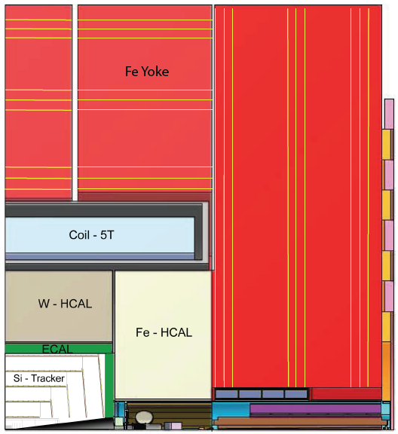
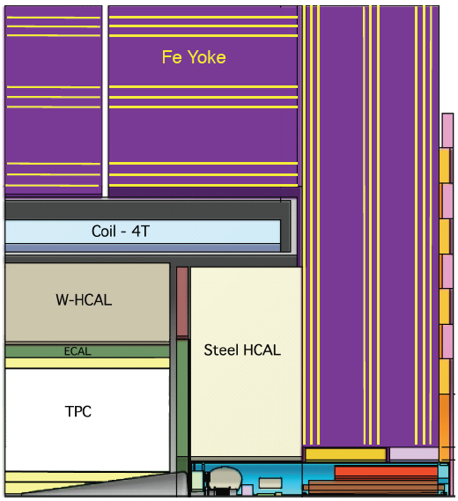
Detector Concepts
CLIC_SiD
CLIC_ILD

Slide 19
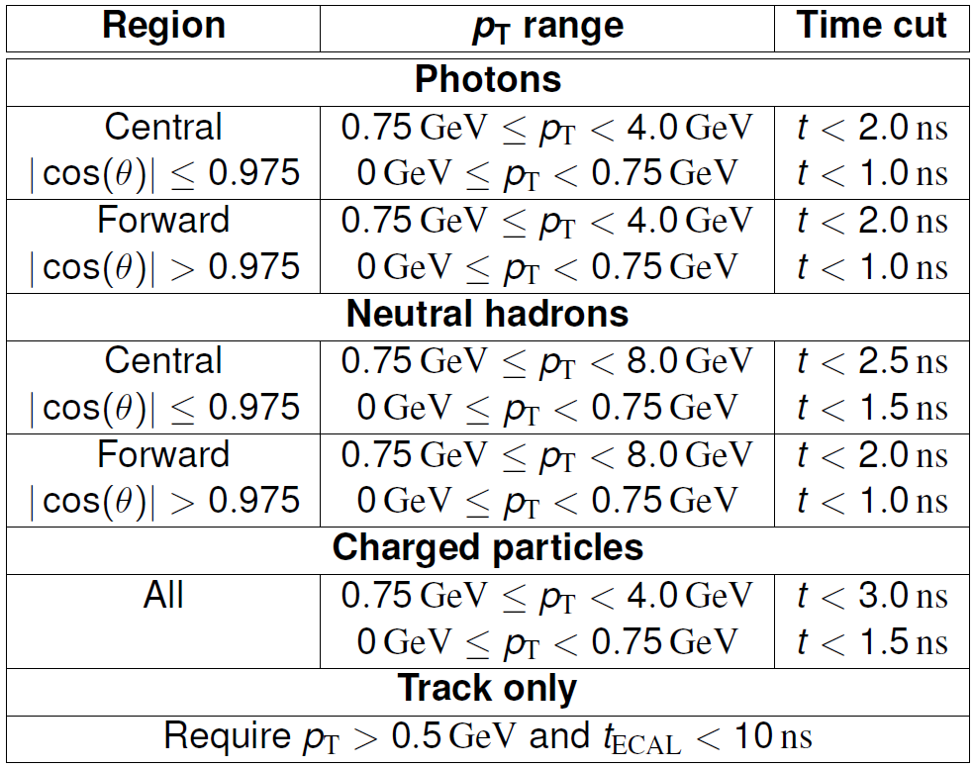
Default PFO Selection

Slide 20
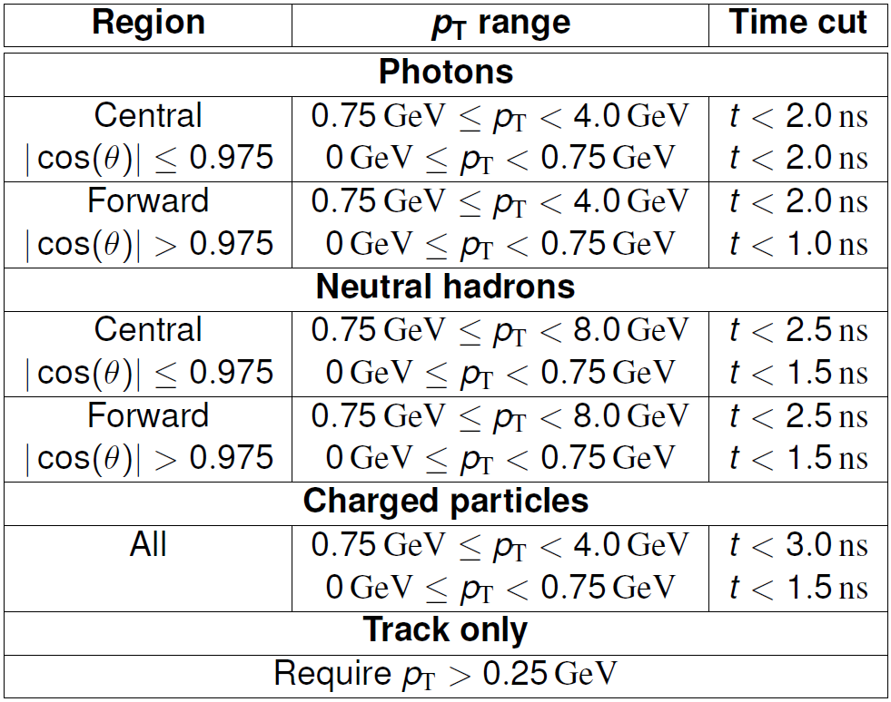
Loose PFO Selection

Slide 21
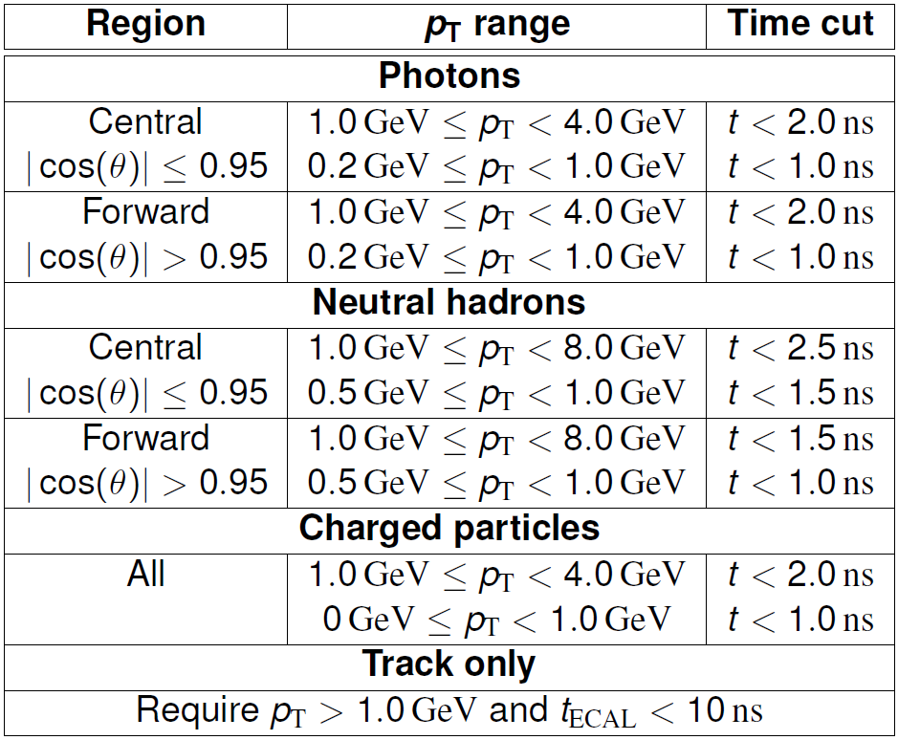
Tight PFO Selection

Slide 22
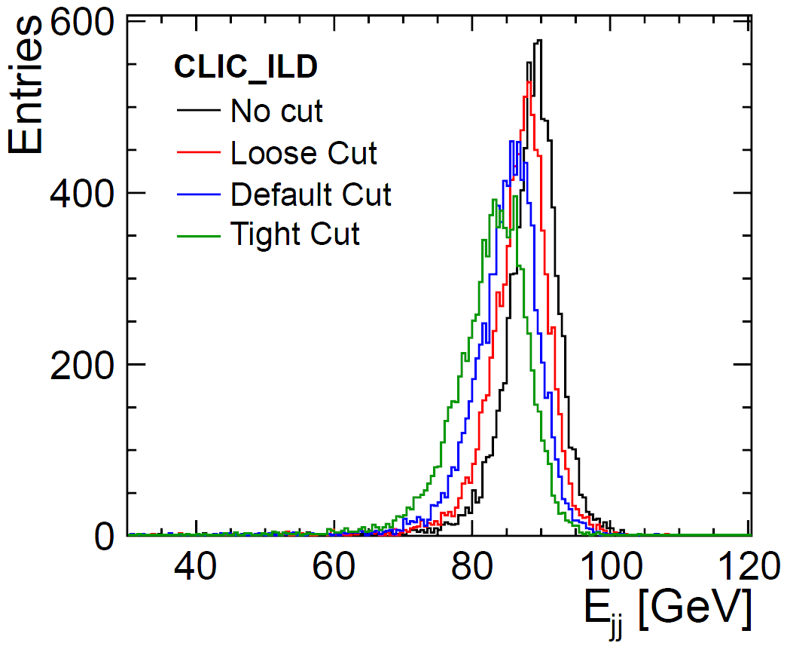
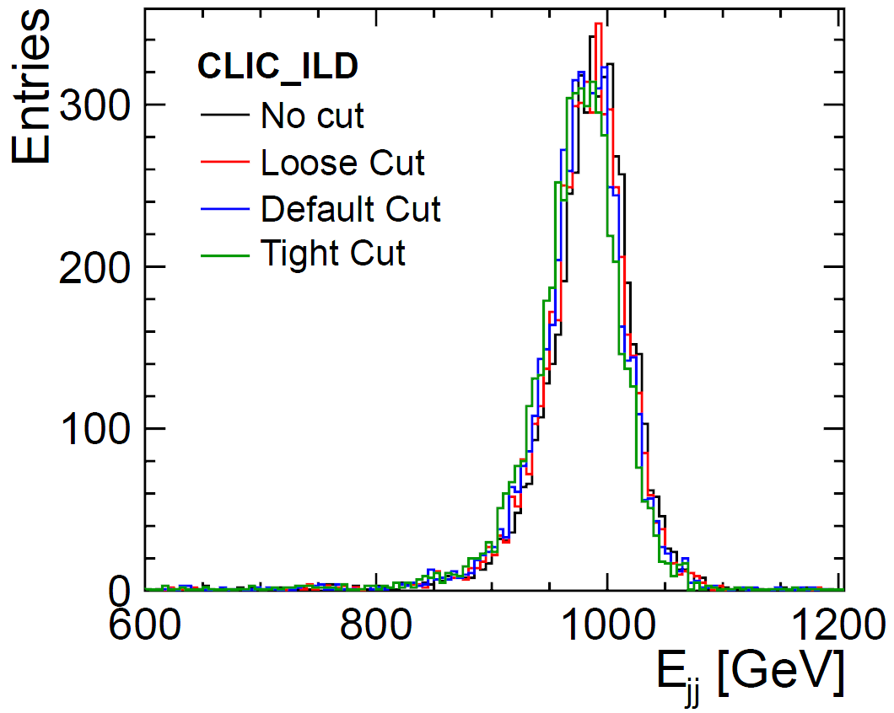
Timing cuts: energy distributions
91GeV
1TeV

Slide 23
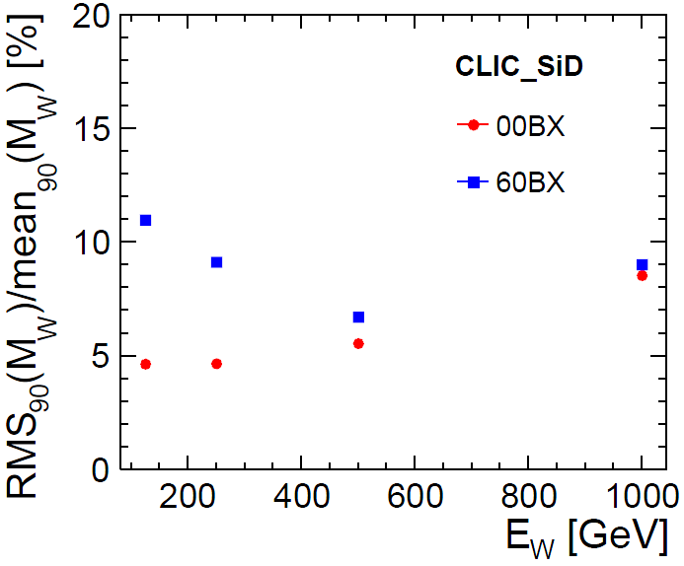

W Mass Resolution

Slide 24
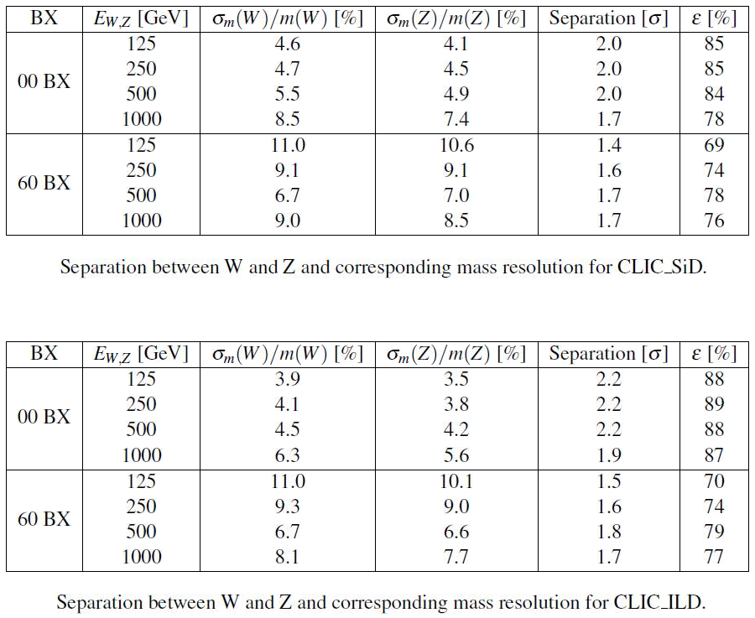
W/Z Separation

