Slide 1
CLIC_ILD tracking
(technology + performance)
Review of CLIC physics/detector CDR
Jan Timmermans

Slide 2
CLIC_ILD tracking
Large TPC (329 < R < 1808 mm)
for highly redundant continuous
tracking (~ 200 measured points)
  Particle ID through dE/dx
  Little material in tracking volume (5% X₀); <25% X₀ in endcap
Complemented by silicon tracking
system:
  Independent tracking at low angles (FTD)
  Silicon tracking layers surrounding TPC for timing and precision points (SIT, SET, ETD)
TPC acceptance (10 measurement points) down to 12⁰
SIT acceptance down to 25⁰
FTD acceptance down to 7⁰

Slide 3
TPC design parameters & performance goals
Dimensions: R_{in} = 329 mm; R_{out} = 1808 mm; Z_{max} = 2250 mm
Solid angle coverage: 12º < θ < 168º (10 pad rows)
TPC material budget: to ECAL R ~ 0.05 X₀ ; endcaps ~0.20-0.25 X₀
Momentum resolution (B=4T):
  TPC only : δ(1/p_{T}) ~ 8. 10⁻⁵ /GeV
  SET+TPC+SIT+VTX: δ(1/p_{T}) ~ 2. 10⁻⁵ /GeV
#pads/padrows: ~2.10⁶ / 1000 per endcap
Pad size/#pad rows: ~1 mm x 4-6 mm / ~200 (standard readout)
Point resolution: in rφ: < 100 μm ; in rz: ~ 0.5 mm
2-hit resolution: in rφ: ~ 2 mm ; in rz: ~ 6 mm
dE/dx resolution: ~ 5%

Slide 4
TPC design (1)
Lightweight fieldcage with resistor chain for potential rings: drift field homogeneity ΔE/E ~ 10⁻⁴
Central HV cathode (up to 100 kV)
2 endcaps each with some 240 Micropattern Gas Detector (MPGD) modules: Micromegas or GEMs
TPC integrates charge over full CLIC bunch train -> foresee ion gate
Use gas mixture like (T2K gas) Ar/CF₄/iC₄H₁₀ (95/3/2%) for large suppression of transverse diffusion with B=4T
B field has to be mapped out to relative precision of 10⁻⁴
Laser system for monitoring calibrations/distortions

Slide 5
TPC design (2)
Endcaps made with spaceframes
Allows stable positioning of detector modules to <50 μm
Deflection under 2.1 mbar over- pressure is 0.22 mm
Mass is 136 kg/endplate
10 m² per endcap
8 rows of MPGD detector modules; module size ~ 17 x 22 cm²
240 modules per endcap
Endplate is 8% X₀
Readout modules+electronics 7% X₀
Power cables 10% X₀

Slide 6
TPC design (3): fieldcage wall
Lightweight fieldcage
  1% X₀ inner wall
  3% X₀ outer wall
  1% X₀ gas
Large Prototype (LPTPC):
Radius ≈ inner radius CLIC TPC
1.21% X₀
Material samples tested up to 30 kV
(simple) extrapolation would allow 70 kV

Slide 7
TPC design (4): modules + electronics
Double and triple GEM stack modules
Bulk Micromegas with resistive anode modules
Extensively tested at LPTPC, with similar resolution (at zero drift distance) of ~60 μm
Resolution at larger drift distance (up to 60 cm) follows expected diffusion
Smaller prototypes in B=5T field show ≤ 100 μm resolution when extrapolated to 2.25 m drift
Deep-submicron electronics integration of 16-channels of full Alice chain under test; 64-ch ASIC under investigation
Power-pulsing will be needed (gain factor 25-50)
New concept of combined gas-amplification + pixelised readout (Ingrid)under further development; needed(?) in high-occupancy regions

Slide 8
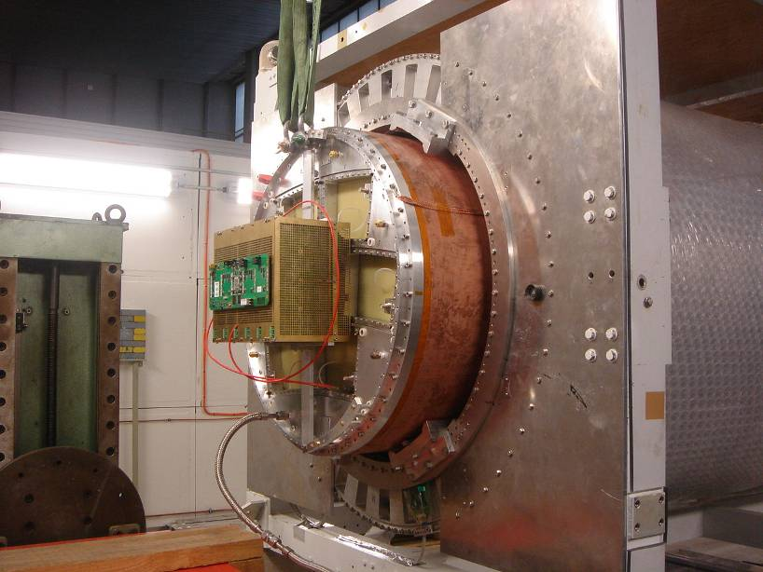
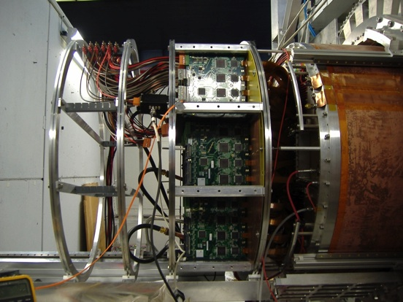
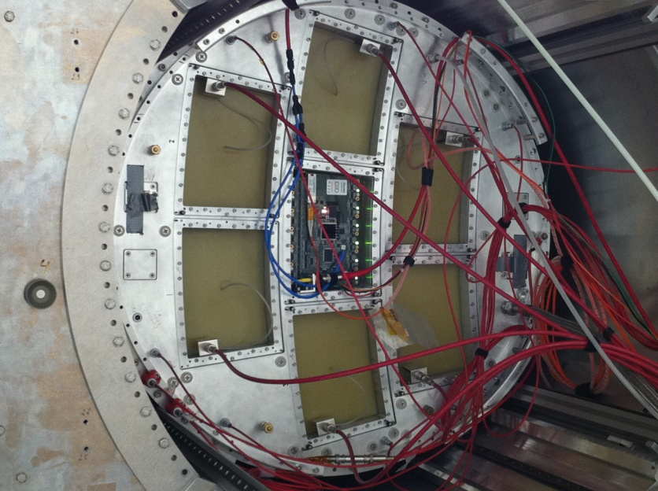
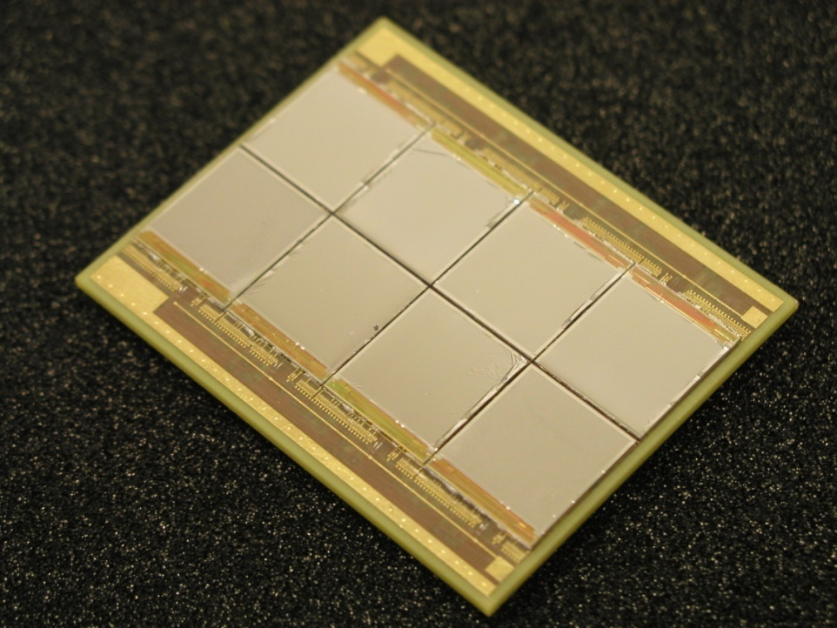
Several beam tests at DESY with LP (2008-2011)
Micromegas (T2K readout) GEMs (Altro readout)
Integrated version
8-chip Ingrid module

Slide 9
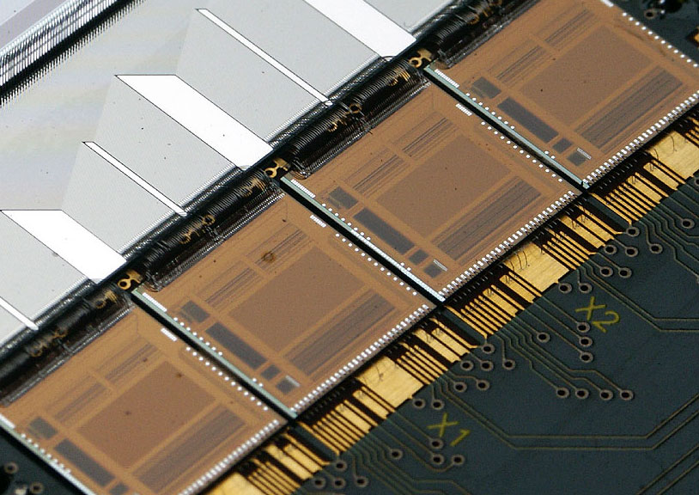
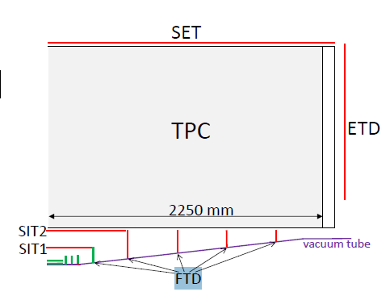
Silicon Tracking at CLIC
- same performance requirements as ILC ILD:
Δ(1/pT) = 8x10⁻⁵ (TPC only)
Δ(1/pT) = 2x10⁻⁵ (TPC + Si)
(H->μμ takes over from Higgs-strahlung recoil mas analysis, high pT leptons BSM sources)
In a harsher environment → differences of CLIC_ILD with respect to ILC design:
Forward region becomes more important (many-fermion final states, t-channel, ISR)
γγ → hadrons yields less steep background density vs. radius. Outer tracker design must be more robust.
Barrel vertex detector coverage extends down to “only” 26 degrees
Standard micro-strip detectors are no longer capable of single BX time stamping

Slide 10
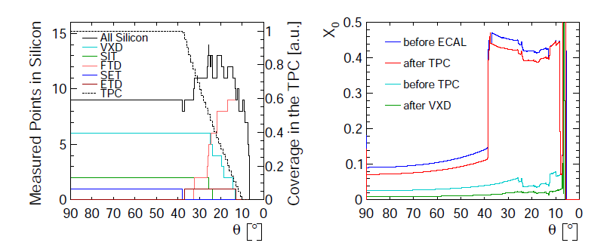
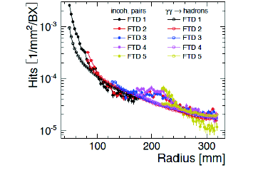
Forward Tracking
TPC has full coverage down to 40 degrees.
Barrel VXD and SIT down to 25 degrees. Below that:
- VXD-endcap (see, talk by Dominik Dannheim in this workshop.
- Forward Tracking Disks.
At least 8 silicon hits down to 10 degrees.
Relatively little material in Silicon tracking
#hits vs. polar angle.
Note that here VXD-EC is accounted for in FTD)
Inner rim of FTD tracking disks see a lot of background, more than a “standard” micro-strip detector can cope with → Replace with pixels or μ-strips with ns-level time stamp and multi-hit storage capability.

Slide 11

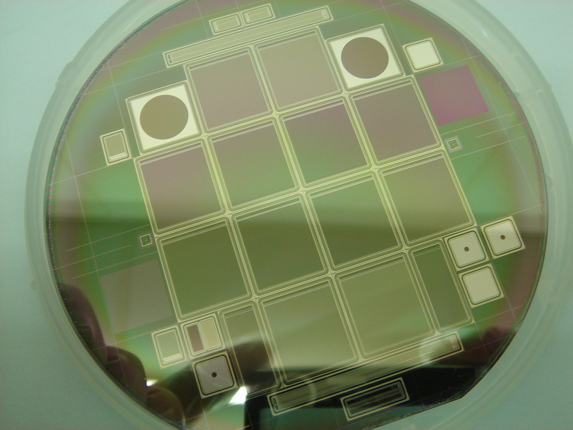

Silicon Tracking R&D
Silicon μ-strip detector R&D
Interconnection: integrate pitch adapter on second metal layer
New ways to bring in power: serial or DC/DC (in common with LHC)
New ways to remove power: gas-cooled systems (in common with ILC)
Interesting development on use of charge sharing to measure coordinate along the strip
New planar single sided strips technology, large sensors (6’’), edgeless and high transmittance (IR laser alignment) options
CLIC specific R&D (faster FE electronics!)
New edgeless sensors
High transmittance sensors
Goal: T~70%; Already now: 50%

Slide 12
Beam-induced backgrounds
I should NOT do “occupancies”
Should I do “radiation damage”?
  I am not an expert
  There is a “typo” (= factor 10) in the tekst of 5.3.4 in the “total” number of n_{eq} for ETD: should be 15x10⁹ instead of 1.5x10⁹
  Concluding sentence(s) are missing whether there is a problem or not
So what to do with this topic?

Slide 13
Ion space charge effects in TPC
(needs to be ‘last minute’ updated if possible)
Distortion studies due to ions:
  Ion disks suppressed with gating device
  Distortions from ions between gate and anode negligible
  Prel. calculations distortions due to volume charge density: ’small’ at ILC ( < 12 μm)
  NO ESTIMATE YET AT CLIC, maybe still before Manchester

Slide 14
Tracking performance CLIC_ILD (1)
TPC allows robust pattern recognition even with large background (but what is “large”?)
Tracking done in 3 steps:
  Pattern recognition + fitting in TPC alone (time of track few ns)
  Same in silicon detectors
  “FullLDC tracking”: matching between the two and re-fit
Tracking efficiency studied without and with 60 BX of γγ -> hadrons background (full bunch train of 312 BX background for TPC was not possible in (‘old’) software)

Slide 15
Tracking performance CLIC_ILD (2): efficiencies
ttbar events:
Efficiency (no BG) >99% for p_{T}>2 GeV and >97% for p_{T} > 0.4 GeV
With BG eff. drops down to 87% mainly below 1 GeV
Dependence on polar angle is weak for p_{T} > 2 GeV
Efficiency stays above 97% down to θ = 8º even with BG

Slide 16
Tracking performance CLIC_ILD (3): “bad” rates
ttbar events: “bad” track fails quality cut of > 96% correctly assigned hits
For p_{T} > 1 GeV “bad” track fraction not affected by background

Slide 17
Tracking performance CLIC_ILD (4): p_{T} resolution
Single muons:
  p_{T} resolution reaches expected asymptotic values
ttbar events:
  p_{T} resolution reaches same asymptotic values for p_{T} > 100 GeV

Slide 18
Backup slides

