Slide 1
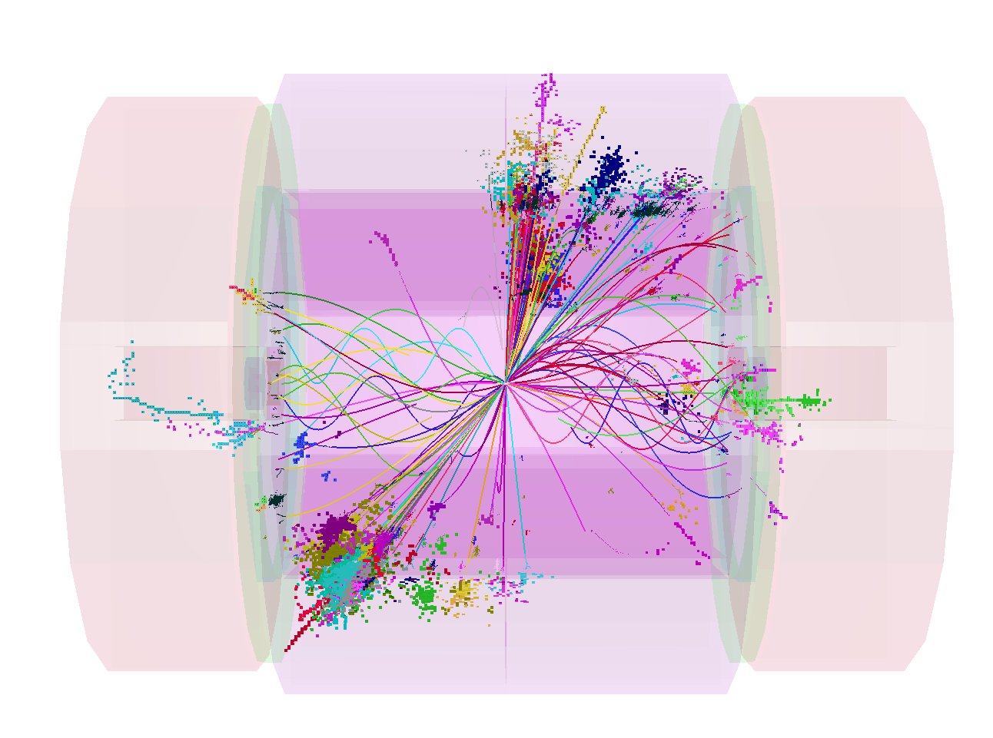
Background Suppression
Mark Thomson
University of Cambridge
on behalf of CLIC Physics and Detector Study
This Talk:
Introduction
Simulation/Reconstruction
Backgrounds and Timing
Jet Finding
Beam Halo Muons
Conclusions

Slide 2
Introduction
CLIC provides the potential for e⁺e⁻ collisions up to √s = 3 TeV
  But machine environment is much more challenging than ILC
    Background levels are high
    0.5 ns bunch-structure ➡ integrate over multiple bunch
    crossings of background
  One of the main aims of the CDR was to demonstrate possibility
  of precision physics measurements in this environment
  A second aim was to understand the requirements for the
  detector readout – guide future R&D direction
Both aims require detailed simulation and reconstruction
  Including pile-up from background is essential
  Significant software challenge
  Fortunately, not starting from scratch
    builds on existing work developed for the ILC

Slide 3
Simulation and Reconstruction

Slide 4
Simulation
Both ILD and SiD have developed full GEANT 4 based detector simulations:
  Mokka (ILD) : already quite detailed, e.g. realistic gaps between detector
  elements for support/services
  SLIC (SiD): fairly detailed and very flexible
Extensively validated/used for the ILD and SiD LoI documents
For CDR defined two GEANT 4 detector models: CLIC_ILD and CLIC_SiD
 | CLIC_ILD | CLIC_SiD
Tracker | TPC, r = 1.8 m | Silicon, r = 1.2 m
B-field | 4 T | 5 T
ECAL | SiW | SiW
HCAL barrel | W-Scint | W-Scint
HCAL endcap | Steel-Scint | Steel-Scint
Main modifications to existing detector models
  Thicker HCAL + Tungsten absorber for HCAL barrel
  Design of forward region + location of inner detectors

Slide 5
Reconstruction
All studies use full event reconstruction
  Highly non-trivial exercise
    Need full reconstruction chain - developed for ILC (twice)
    Needs to be able to cope with CLIC environment
    Ideally would have common framework for CLIC_ILD and CLIC_SiD
      but only had common data format (nevertheless important)
ILC LoIs:
ILD:Mokka/Marlin
SiD:SLIC/org.lcsim
Simulation:
Mokka
SLIC
JAVA
Tracking:
TPC Tracking
Silicon Tracking
Particle Flow:
PandoraPFA
IowaPFA
Vertex Reco.:
LCFIVertex

Slide 6
Reconstruction
All studies use full event reconstruction
  Highly non-trivial exercise
    Need full reconstruction chain - developed for ILC (twice)
    Needs to be able to cope with CLIC environment
    Ideally would have common framework for CLIC_ILD and CLIC_SiD
      but only had common data format (nevertheless important)
CLIC CDR:
ILD:Mokka/Marlin
SiD:SLIC/org.lcsim
Simulation:
Mokka
SLIC
Overlay:
Overlay
Overlay
JAVA
Tracking:
TPC Tracking
Silicon Tracking
Particle Flow:
MarlinPandora
PandoraPFA
SLICPandora
Vertex Reco.:
LCFIVertex

Slide 7
Software Challenges
Major effort to develop and validate software for CLIC CDR
  + two parallel software frameworks
Fig. 5.9
A number of significant challenges
  Tracking work in high occupancy
  environment
  High hit multiplicities in
  calorimeters
  Reconstruction times/memory
  footprint
  GRID production with background
  overlay
Despite challenges and a few remaining rough edges …
  All studies in CDR use full reconstruction including overlay from
  most significant background γγ→ hadrons

Slide 8
Backgrounds and
Timing Requirements

Slide 9
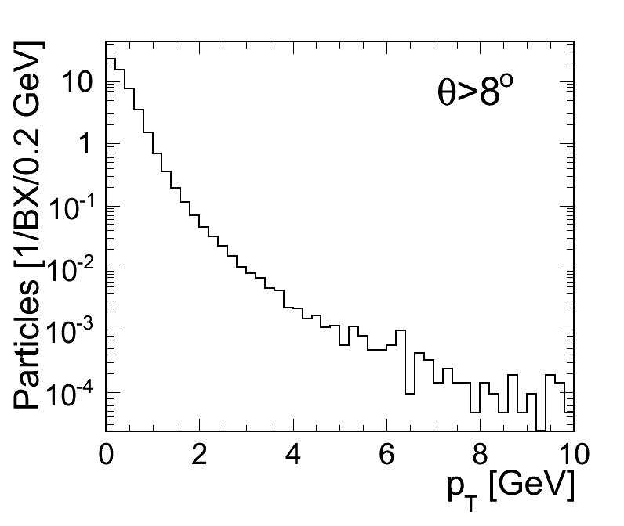
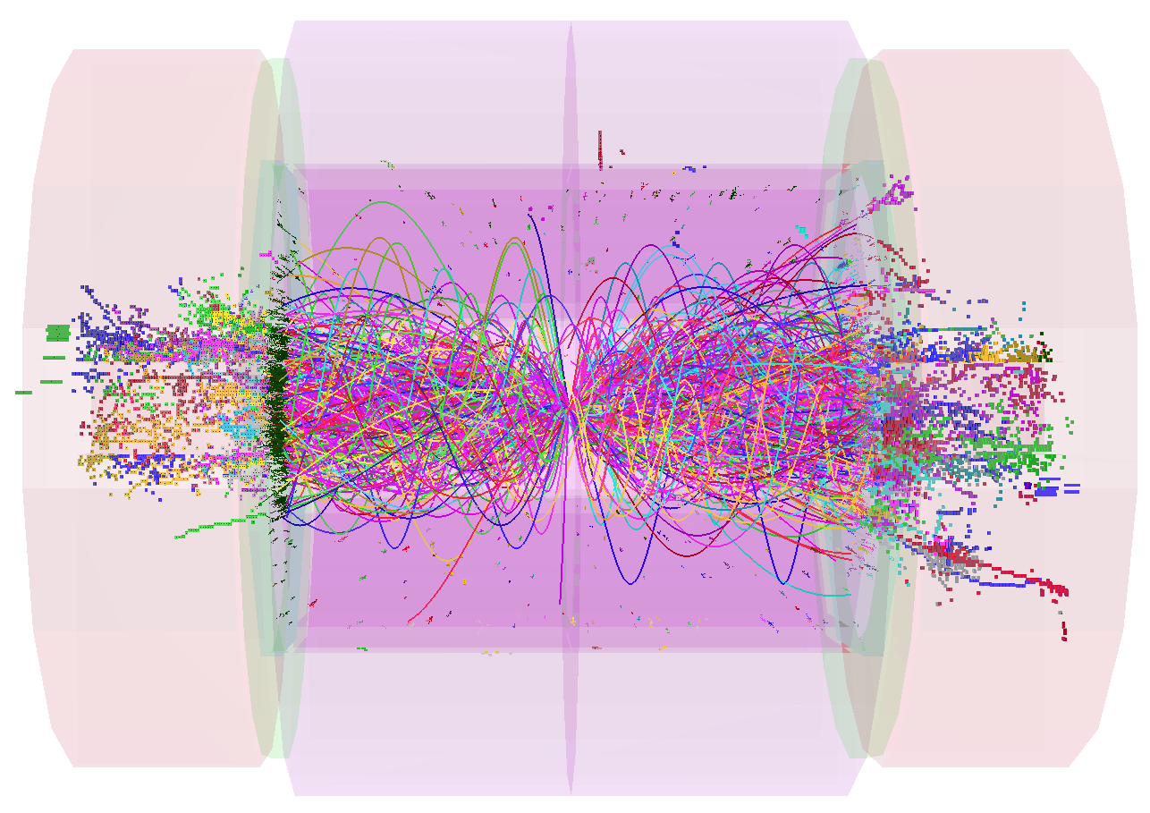
Background from γγ→ hadrons
Pair Background largely affects very low angle region
Background in calorimeters, central tracker dominated by γγ→ hadrons “mini-jets”
At 3 TeV, average 3.2 events per BX (approximately 5 tracks per event)
For entire bunch-train (312 BXs)
  5000 tracks (mean momentum 1.5 GeV) giving total track momentum : 7.3 TeV
  Total calorimetric energy (ECAL + HCAL) : 19 TeV
Largely low p_{T} particles
Fig. 2.3
20 BXs
Irreducible background – it is physics

Slide 10
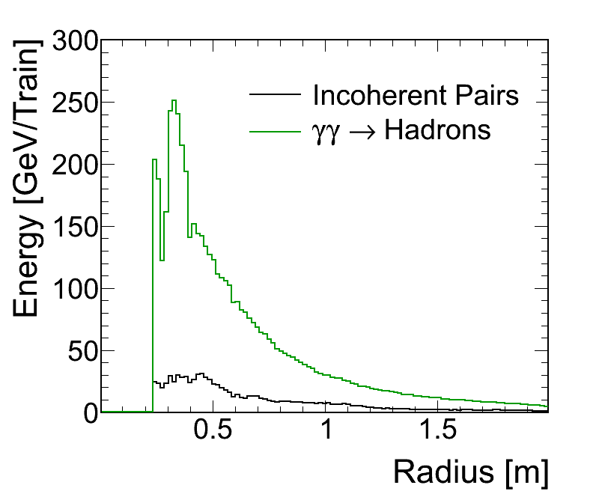
Backgrounds in the Calorimeters
Calorimeter backgrounds per bunch-train (3 TeV)
Fig. 2.8
Detector | γγ→ hadrons
ECAL endcaps | 11 TeV
ECAL barrel | 1.5 TeV
HCAL endcaps | 6 TeV
HCAL barrel | 0.3 TeV
Total | 19 TeV
ECAL
Calorimeter backgrounds per bunch-crossing are manageable, ~ 60 GeV
Hence want to integrate over as few as possible BXs
Tight timing requirements – O(ns) !
….
….
0.5 ns

Slide 11
Calorimeter Timing
But at ns timescale there are issues…
Can’t just “assume” arbitrarily short time-stamping capability
Time needed to accumulate all calorimetric energy (due to low energy
particles, nuclear break-up etc.) significant compared to 0.5 ns Bx
HCAL resolution depends on time window
Fig. 6.3
Fig. 6.3
Steel (Endcap): ~10 ns
Tungsten (Barrel): ~100 ns

Slide 12
CLIC Timing cont.
Tension between calorimeter integration time and desire
to minimize number of BXs of γγ → hadrons background
e.g di-jet mass resolution from isolated
decays
Fig. 2.10
< 10 BX

Slide 13
CLIC Timing cont.
Similar conclusions for reconstruction of high mass states
  e.g. reconstructed di-jet mass in
Fig. 2.10
< 10 BX
But < 2.5 ns not long
enough for calorimetry

Slide 14
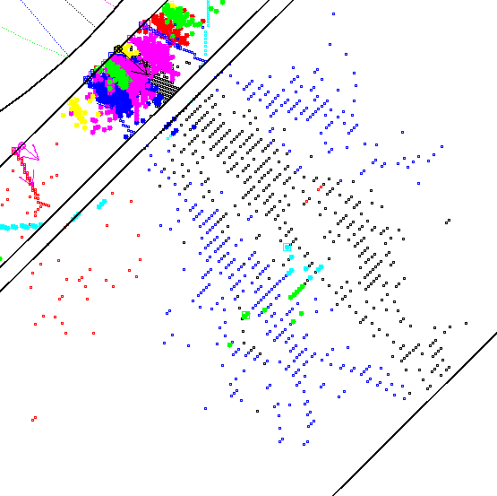
Timing Requirements:
  integrate over > 20 BXs to accumulate calorimetric signals
  integrate over < 5 BXs for acceptable γγ → hadrons backgrounds
  …
The Solution - a combination of:
  excellent time resolution
  high granularity calorimetry
  sophisticated reconstruction

Slide 15
CLIC Timing Strategy
Based on trigger-free readout of detector hits all with time-stamps
  assume multi-hit capability of 5 hits per bunch train
Assume can identify t0 of physics event in offline trigger/event filter
  define “reconstruction” window around t0
….
….
Hits within window passed to track and particle flow reconstruction
Subdetector | Reco Window | Hit Resolution
ECAL | 10 ns | 1 ns
HCAL Endcap | 10 ns | 1 ns
HCAL Barrel | 100 ns | 1 ns
Silicon Detectors | 10 ns | 10/√12
TPC (CLIC_ILD) | Entire train | n/a
Sufficient calorimeter
integration window
CLIC hardware
requirements

Slide 16
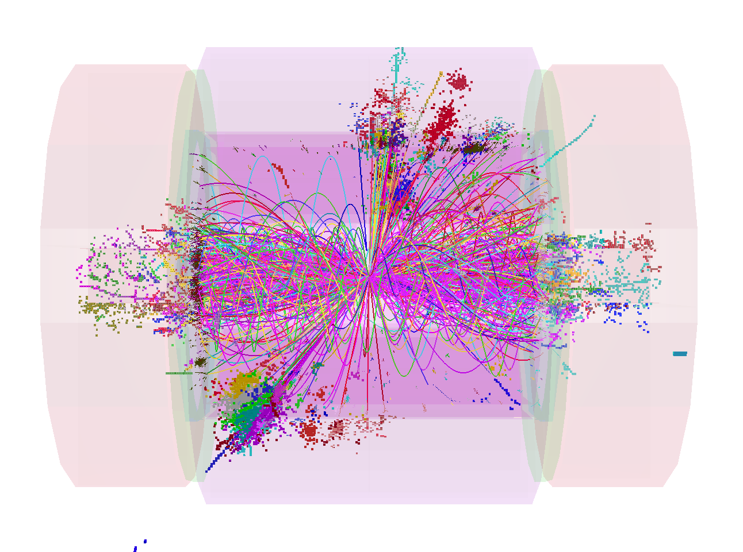
Reconstruction in Time
Input to reco:
TPC : 30 ns*
Tracking
Si trackers : 10 ns
“10 ns of tracks”
Sufficient time
window for
calorimetry
ECAL: 10 ns
HCAL (End): 10 ns
PandoraPFA
HCAL (Barrel): 100 ns
γγ → hadrons
1.2 TeV
Additional background rejection still required post reconstruction
*TPC readout integrates over whole train – only 60 BXs used due to limitations in heritage (LEP ) tracking software

Slide 17
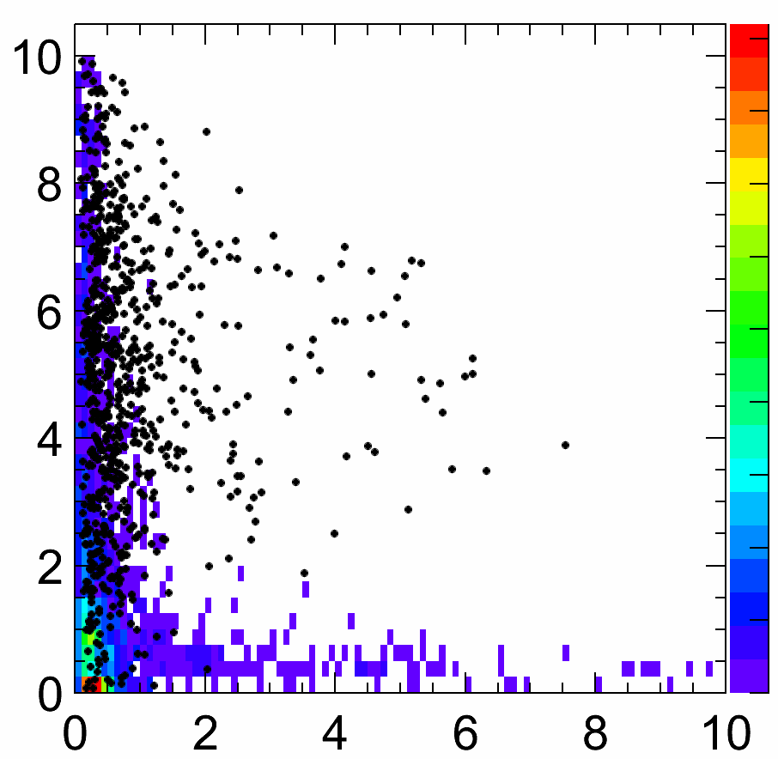
Reconstruction in Time
After reconstruction have a list of particles (PFOs):
  charged particles – mostly matched to clusters
  photons – EM clusters
  neutral hadrons – clusters
High granularity calorimeter - even low energy clusters have many hits
  calculate energy weighted truncated mean time of each cluster
    calo hit times corrected for time-of-flight (straight-line)
    sub-ns resolution
  use times to reject clusters
  also can reject associated tracks
    account for helical propagation time
Neutral hadrons
tCluster
Reject PFOs from background
  e.g. neutral hadrons in Endcap

Slide 18
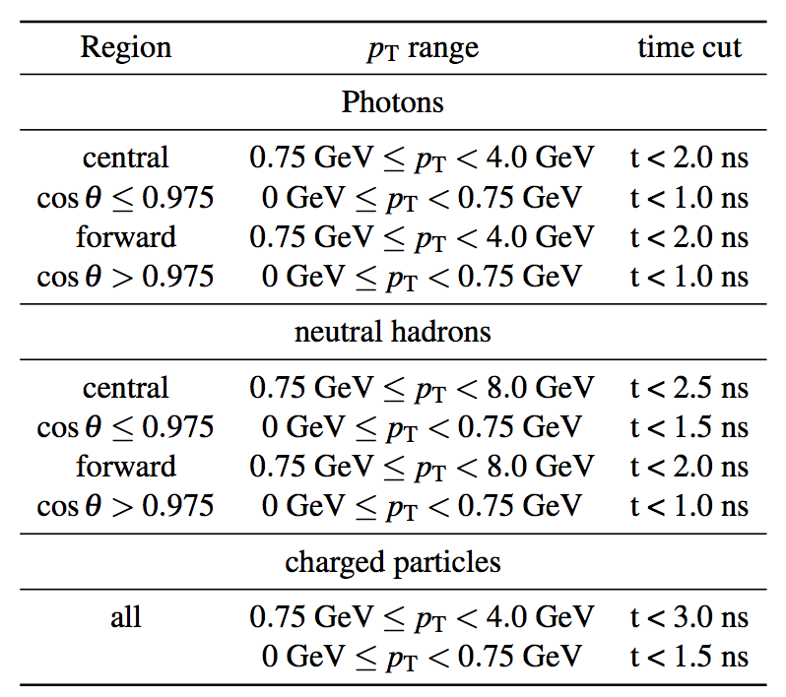
PFOSelection
Only apply to “low” p_{T} PFOs
Three sets of timing cuts applied in reconstruction
  Loose, Default, Tight
Table B.2

Slide 19
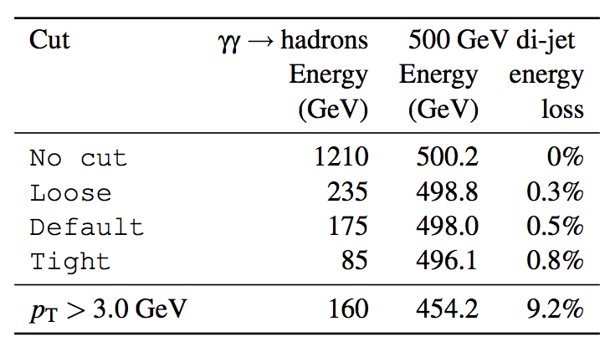
Impact of Timing Cuts
1.2 TeV
Table 12.1

Slide 20
Impact of Timing Cuts
1.2 TeV
85 GeV
Table 12.1
Reject 93 % of background energy and < 1% of physics event
  much more effective than simple p_{T} cut

Slide 21
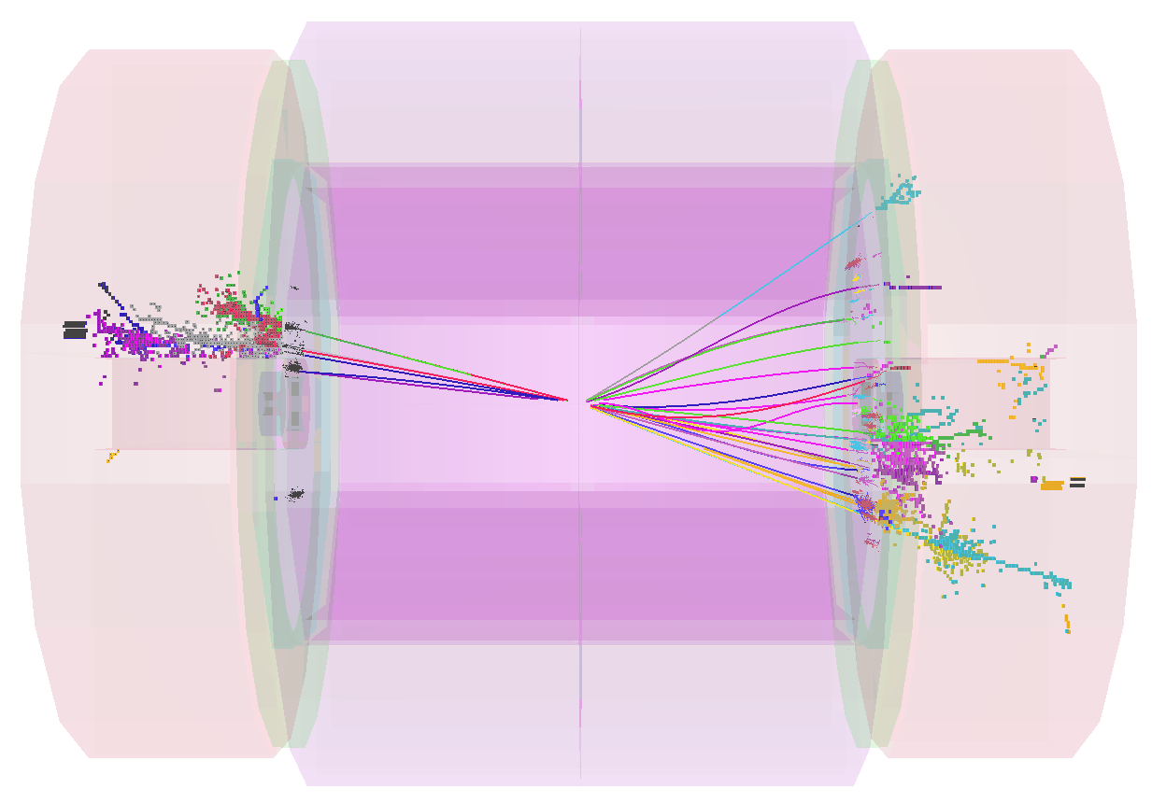
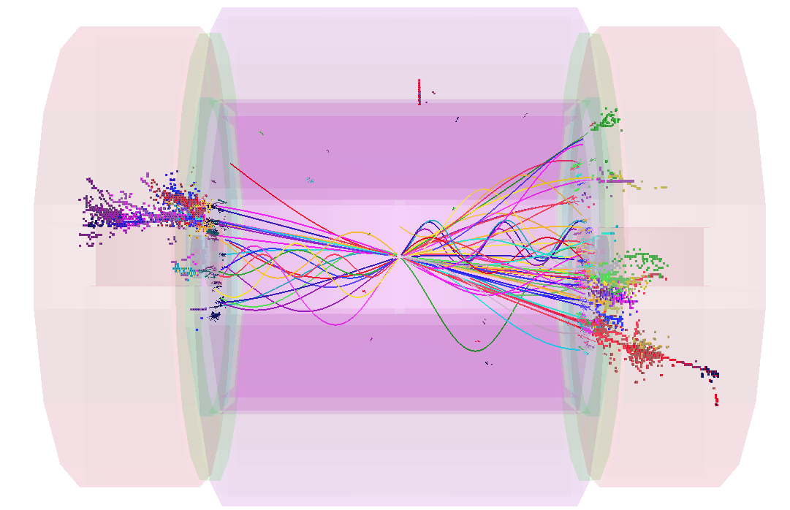
Forward Events
Also effective in forward region
  qualitative example for hard case,
  3 TeV
+
TightSelectedPFOs

Slide 22
Jet Finding

Slide 23
Jet Finding at CLIC
At LEP, preferred jet-finding algorithm: Durham k_{T}
  all particles in event clustered into the jets
  not appropriate for CLIC
Events at CLIC
  significant background from forward-peaked γγ → hadrons
  events are often boosted along beam axis (beamstrahlung)
  “hadron collider” type algorithms more appropriate
Jet finding at CLIC
  studied for benchmark physics analyses (FASTJET package)
  preferred option “k_{T}” with distance measure
    invariant under longitudinal boosts
  particles either combined with existing jet or beam axis
    reduces sensitivity to γγ → hadrons

Slide 24
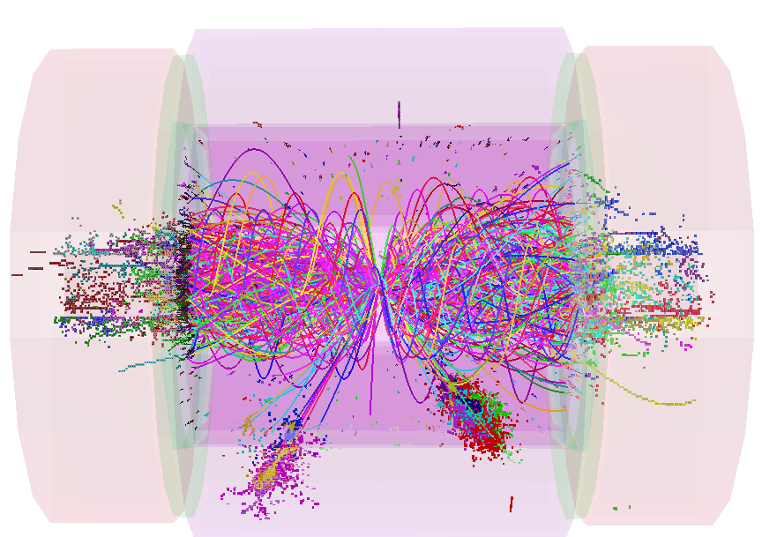
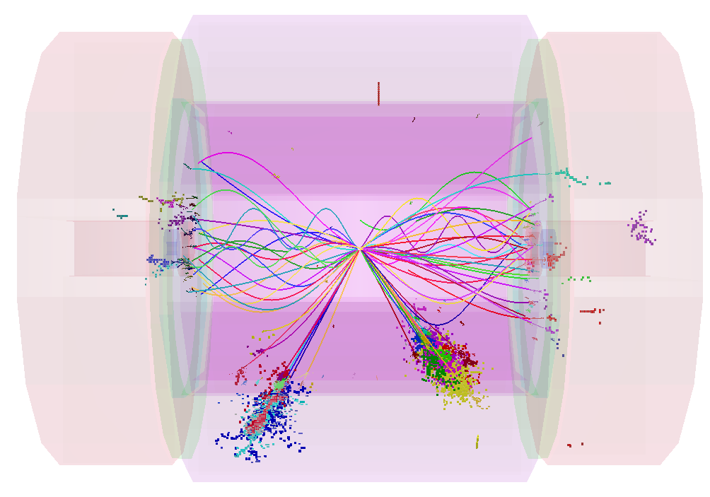
Jet Finding at CLIC
e.g.
  two jets + missing energy
TIGHT
timing
Fig. 12.7
Using Durham k_{T} à la LEP
  all particles clustered
  timing cuts are
  effective

Slide 25
Jet Finding at CLIC
e.g.
  two jets + missing energy
TIGHT
timing
“hadron collider” k_{T} : R = 0.7
  much of background
  clustered with beam axis
  timing cuts do less work
  relative impact of timing
  and jet-finding depends
  on event topology
Fig. 12.7
Two “weapons” against background: timing cuts + jet finding

Slide 26
Does it all work ?
Aim was to show that can make precise measurements in CLIC environment
  topic of talk by Frank Simon (quantitative results)
Here - just a taster (a particularly challenging case)
Fig. 12.9
Pair production and decay:
Full Simulation with background
82 %
17 %
Test of di-jet mass reconstruction
Separate using di-jet invariant masses (test of PFA)

Slide 27
Take a close look at the reconstructed W mass in
  here the timing cuts do most of the work…
  jet finding alone gives broad peak at 100 GeV
  with timing cuts not too far from ideal no background case
Fig. 12.25
k_{T} + PFO sel.
k_{T} alone

Slide 28
Beam Halo Muons

Slide 29
Beam Halo Muons
Most work for CDR concentrated on impact of
  also looked at beam halo muons
γγ → hadrons
Simulated events with entire bunch train of beam halo muons
  for study assumed a bad case: 5 muons/BX crossing detector
In 150 ns from start of bunchtrain:
  ECAL
    Total = 1.5 TeV (54k hits)
    Barrel = 0.8 TeV (18k)
    Endcap = 0.7 TeV (36k)
  HCAL
    Total = 10.8 TeV (128k hits)
    Barrel = 5.3 TeV (32k)
    Endcap = 5.5 TeV (96k)
For this very conservative
level of background:
12 TeV

Slide 30
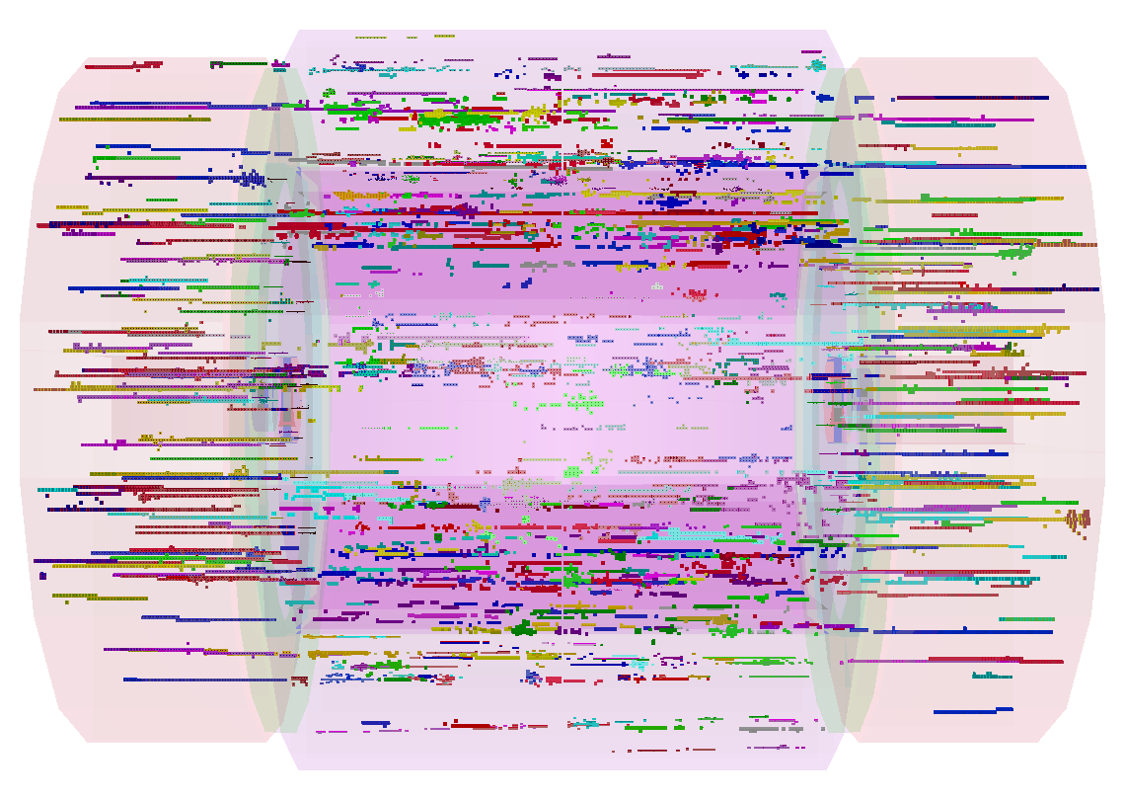
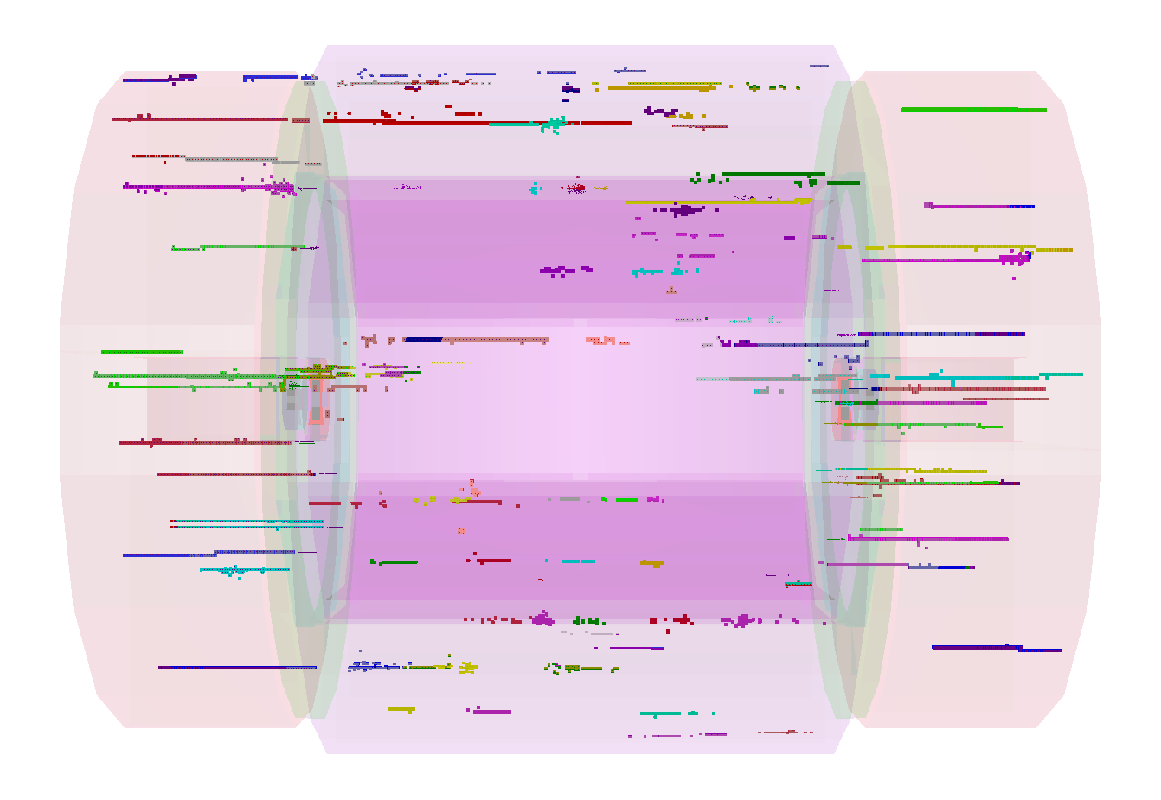
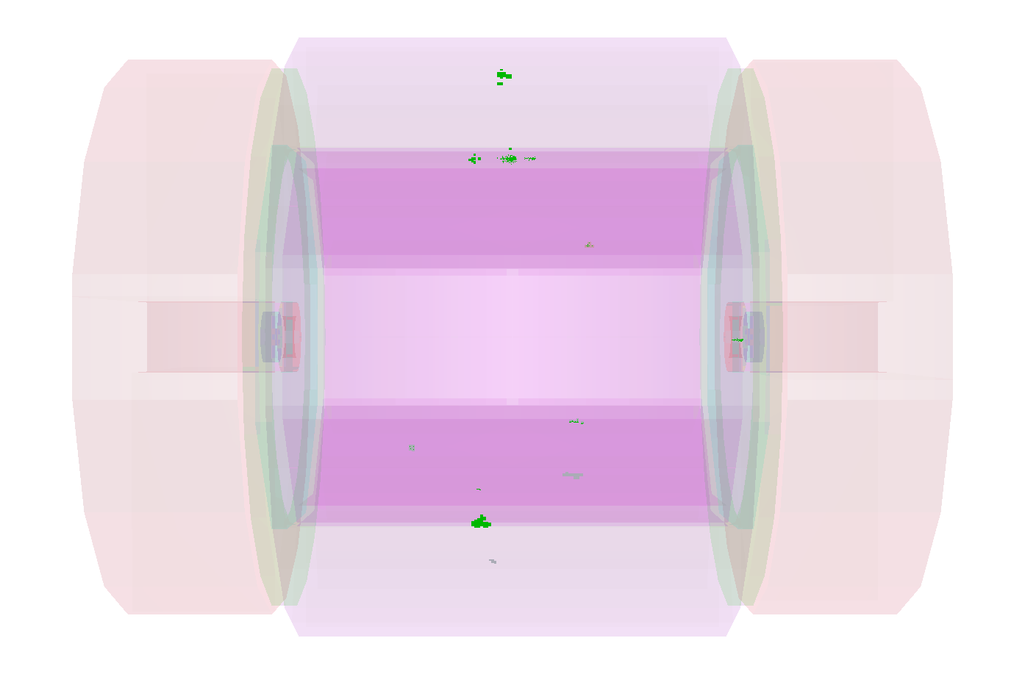
Software Mitigation
Three steps of background reduction
  Initial reconstruction window of 10 ns (50 ns in HCAL barrel)
  Timing cuts at cluster level (TightPFOSelection)
  Build in beam halo muon rejection into particle flow reconstruction
For very conservative assumption of 5 muons per BX
Readout window
TightPFOSelection
+ dedicated reco. Alg.
2.2 TeV
420 GeV
30 GeV
Background rejection very effective: due to high granularity of calorimeters

Slide 31
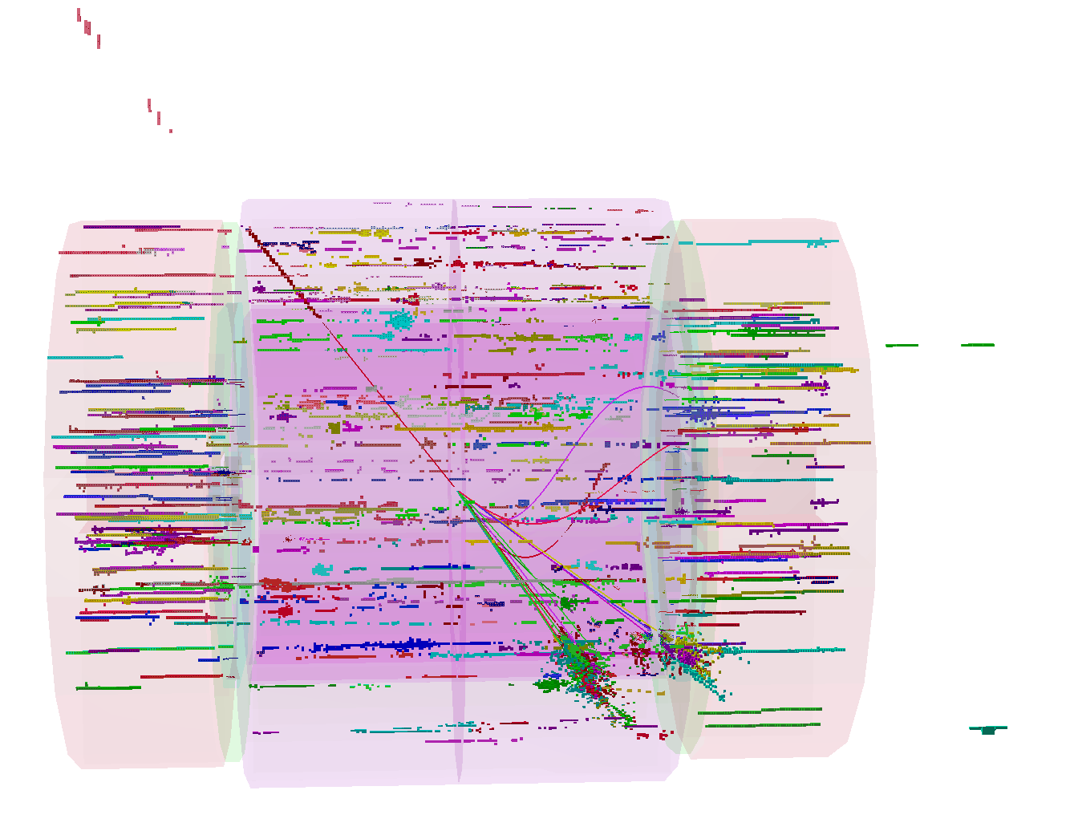
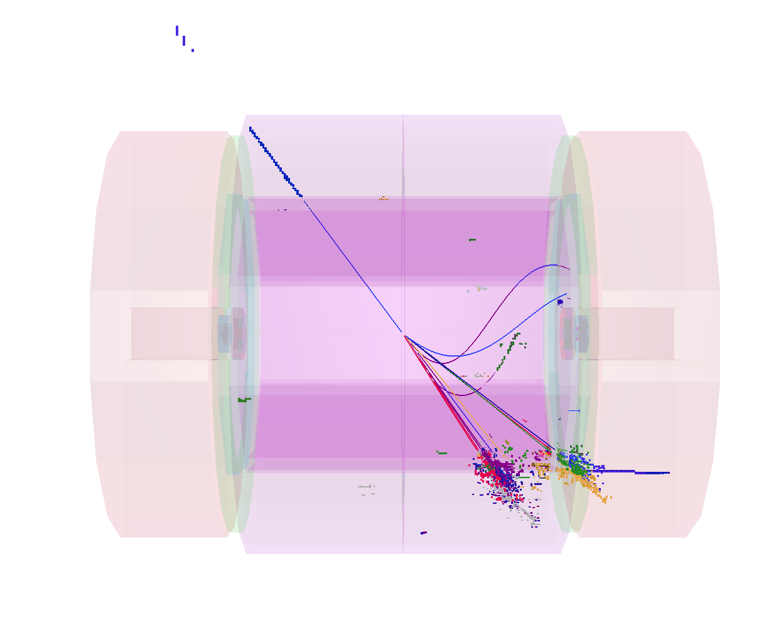
Impact on Physics
Tested in by looking at W reconstruction in
  Sample of 500 GeV hadronic W decays
  Again very conservative assumptions (5 muons/BX)
Two effects observed
  Extra energy from clusters from beam halo muons: 30 GeV
  Energy of reconstructed jets also biased “pick” up hits from muons: 30 GeV
Readout window
TightPFOSelection + reco. alg.

Slide 32
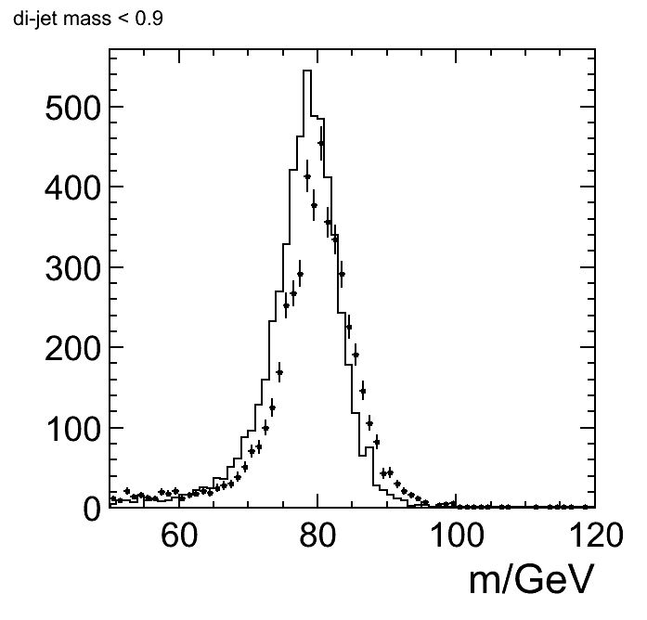
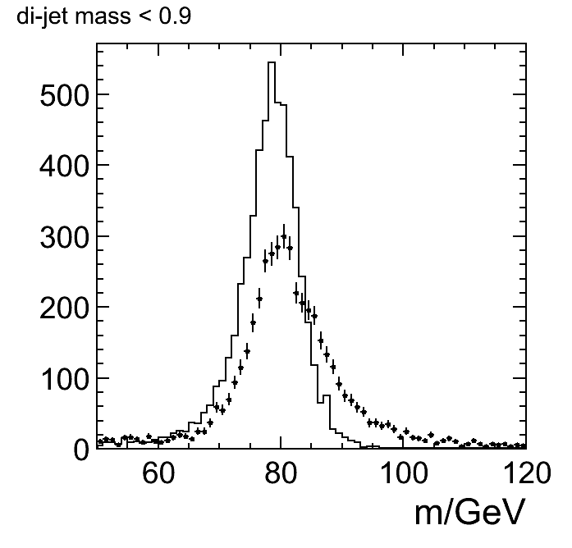
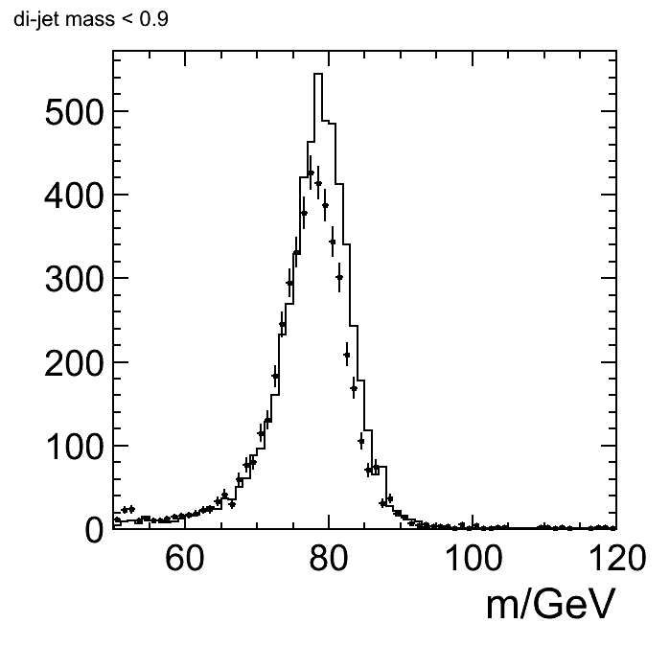
Impact on W Reconstruction
Compare W mass reconstruction
  no background
  γγ → hadrons
  5 muons per BX (very conservative)
  1 muon per BX (conservative)
Worst case as pattern recognition not optimal
γγ → hadrons
muon halo (5/BX)
muon halo (1/BX)
Conclude: a beam halo muon background of 1 muon/BX is acceptable
  Machine background likely to be much lower than this

Slide 33
Conclusions
Understanding of impact of background studied in detail
  Full GEANT 4 simulation + full reconstruction
  Developed strategy to mitigate effects of background
    requires high granularity in space and time
  Defines detector timing requirements - guide future R&D
I believe we have achieved the initial goal
  Demonstrated ability to perform high precision physics
  measurements in CLIC machine environment
  [More in Frank Simon’s talk on physics benchmarks]

