Slide 1
Performance Requirements
Outline
CLIC Operation versus the Physics program assumptions
CLIC Luminosity Spectrum Impact on Physics and Analysis
Physics Analysis <-> Observables accuracy <->Requirements
Performance Requirements on:
  Track momentum resolution
  Jet energy resolution and Particle Flow
  Particle Identification and Jet Flavour Tagging
Overview: CLIC_ILD and CLIC_SiD Detector Concepts, 3 TeV

Slide 2
CLIC Operation vs Physics Program
CLIC will be staged in energy and should be able to operate over a range of centre-of-mass energies: √s from ~ 0.5 to 3 TeV.
The energy will be chosen according to the physics program, eg:
Precision physics: Higgs, top studies, … at low √s ~< 0.5 TeV
BSM physics measurements : eg
New particles production cross sections, masses, couplings
measurements at √s close to the threshold of the particles or at the
highest √s value, 3 TeV.
Detectors must allow to perform physics at sub-TeV and multi-TeV energies taking into account the CLIC bunch structure and the beam induced background.

Slide 3
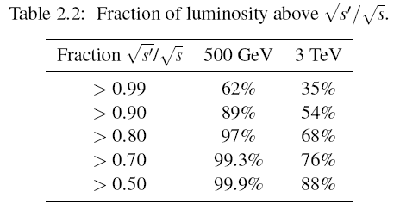
CLIC Luminosity Spectrum vs Analysis
0.5 TeV
3.0 TeV
Beamstrahlung implies
Only a fraction of collisions at nominal energy
At 0.5 TeV: 62% of collisions have √s’/√s> 0.99
At 3 TeV : 35% of collisions have √s’/√s> 0.99
Impact on physics: Reduced peak luminosity
It is relevant for a resonance study, less for the study of a process above threshold.
At √s=3 TeV, for a process with 2 TeV threshold, 75% of the luminosity is useful.
But it requires, in the analysis, eg, slepton mass determination fit, to take into account the energy dependence of the luminosity spectrum (as well as ISR).

Slide 4
Analysis <-> Observables Accuracy
<-> Requirements
Physics analysis require accurate reconstruction of multi-lepton and
multi-jet final states. The basic observables which are relevant for reconstruction of leptons and jets are:
Track momentum resolution
Jet energy resolution
Particle identification and jet flavour tagging
The physics measurement accuracy (on cross sections, masses, …), taking into account the √s spread, define the measurement accuracy on tracks, jets, … and lead to the basic detector requirements.
But the performances are affected by the beam-induced background.
This leads to additional requirements essential to maintain the measurement accuracy of the basic observables.

Slide 5
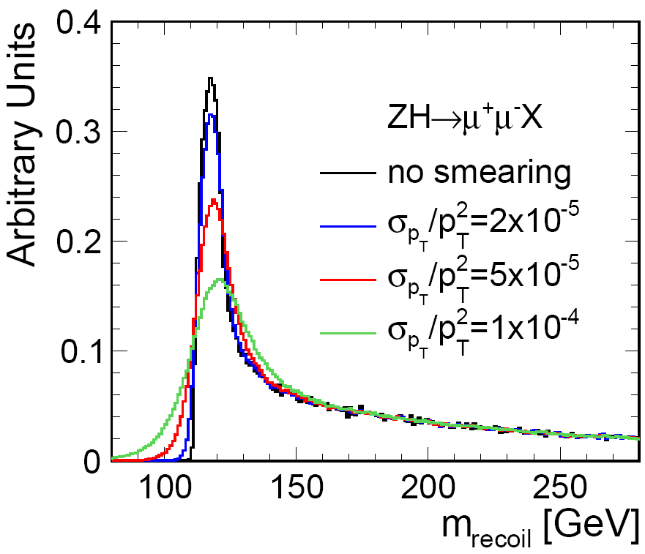
Track Momentum Resolution (1)
SM Higgs Recoil mass (500 GeV)
Fig 2.4:Recoil mass distribution
For the SM Higgs-strahlung process e⁺e⁻->Zh⁰->μ⁺μ̄X, the Higgs mass is measured using the recoil mass to the Z, m²=s+m²z-2.Ez.√s.
The recoil mass width depends on the beam-spread and on the momentum resolution (plot: peak +tail.bs). The width is dominated by the beam-spread if σ(1/Pt) ~ < 2.10⁻⁵ (GeV⁻¹), beyond, the momentum resolution increases the width [at LHC: σ(1/Pt) ~ 2. 10⁻⁴].

Slide 6
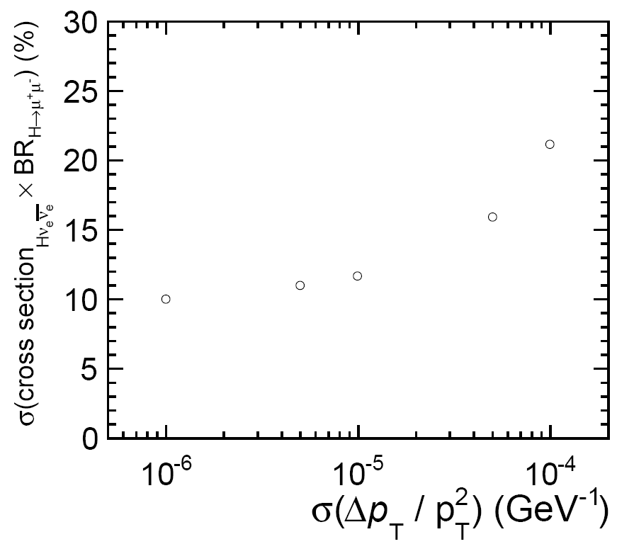
Track Momentum Resolution (2)
BR(h⁰->μ⁺μ⁻) (3 TeV)
Cross section x Branching ration error vs σ(1/pt) : ∫L=2ab¯¹
The error on the measurement of the cross section x BR(h⁰->μ⁺μ⁻) is function of the momentum resolution (plot). The error on the cross section x BR measurement increases significantly if σ(1/Pt) > 5.10⁻⁵.

Slide 7
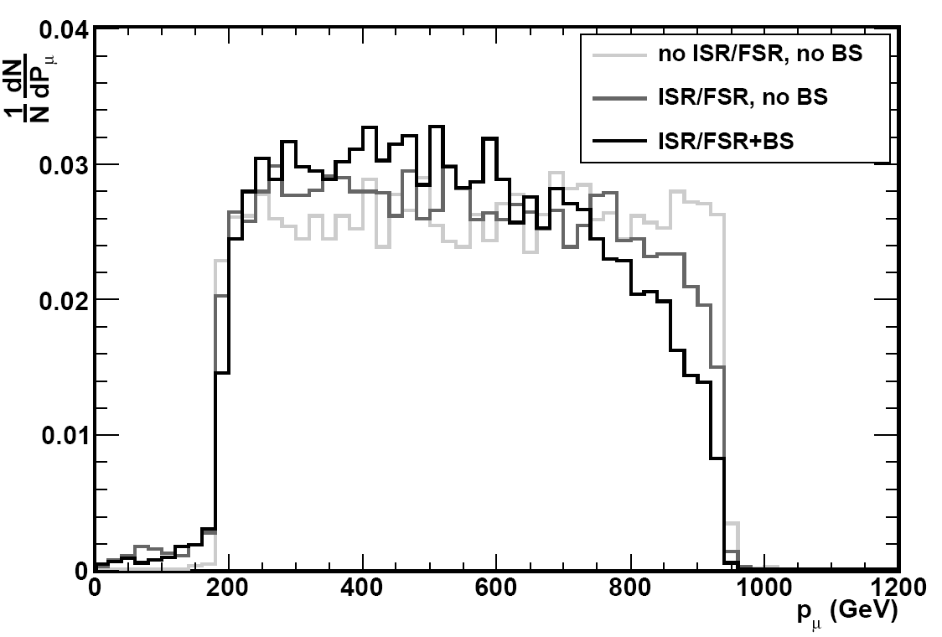
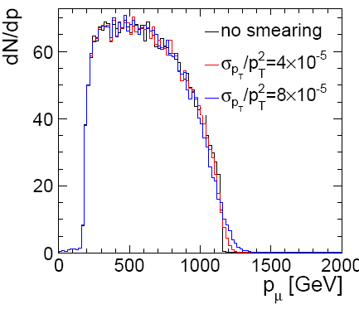
Track Momentum Resolution (3)
Slepton Mass Determination (3 TeV)
Muon dN/dP; σ/(1/Pt)=0
Fig 2.5: Muon dN/dP; with bs, σ/(1/Pt)=0, 4, 8x10⁻⁵
The end points of the lepton momentum distribution allow to determine the Slepton an Gauginos masses. They are affected by ISR beam-spread (left) and momentum resolution (right). The higher end of the distribution is most affected by σ(P). Detailed study: σm dominated by beam spread if σ(1/Pt)< 4.10⁻⁵.

Slide 8
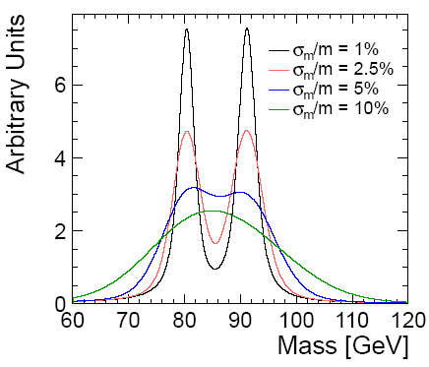
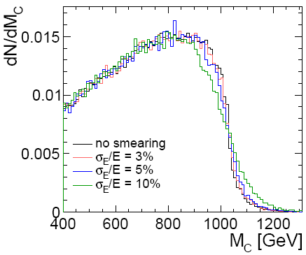
Jet Energy Resolution
Good jet energy resolution is essential to discriminate hadronic decays of W± and Z⁰/h⁰; eg to distinguish between χ̃₁± and χ̃₂⁰ production:
e⁺e⁻->χ̃₁±χ̃₁±-> W⁺W⁻χ̃₁⁰χ̃₁⁰ and e⁺e⁻->χ̃₂⁰χ̃₂⁰->h(Z)h(Z)χ̃₁⁰χ̃₁⁰.
Fig 2.6: W and Z mass for various σm/m values
Contravariant mass Mc for various σE/E
2.5 σ W/Z separation requires σE/E=3.5%, for Ej up to 1 TeV.
Gauginos or squark masses are measured using the end points of the boson energy distributions or contravariant mass Mc. Detailed study: σm dominated by beam-spread if σE/E<5% [for LHC: σE/E ~ 10% at 100 GeV].

Slide 9
Particle Flow
To reach such energy resolution, studies done in context of ILC have shown that high granularity particle flow calorimetry is well suited.

Slide 10
Particle Flow
Energy deposit identification => Electron, muon, photon, pion identification is part of PFA

Slide 11
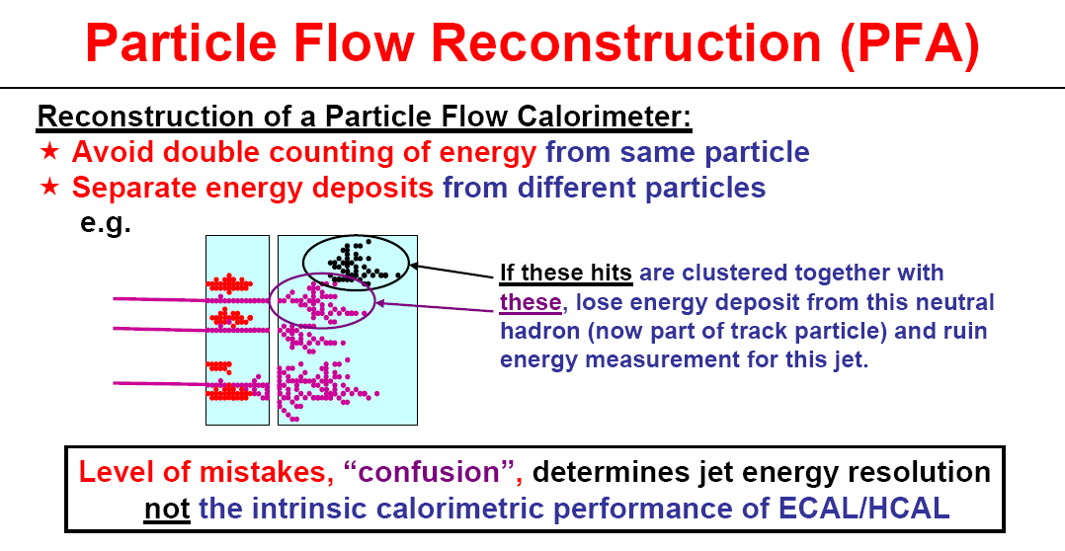
Particle Flow Challenge
The confusion, is closely correlated with the detector granularity , it sets strong requirements on ECAL, HCAL granularity. (more in PFA talk: John Marshall)

Slide 12
PFA challenge with γγ->hadrons
CLIC bunch train composed of 312 bunches with 0.5 ns separation.
γγ->hadrons produce ~ 5000 particles, <P>=1.5 GeV, <Pt>=0.9 GeV,
total calorimetric energy deposit 19 TeV
Jet structure and jet energy resolution spoiled by these hadrons
To remove them requires:
Detector hits time stamping
Multi-hit storage/readout
After reconstruction Pt/timing cuts applied to eliminate hits which do not belong to the physics event. (background reduction talk:
M. Thomson).
e⁺e⁻->H⁺H⁻->tb̄bt̄

Slide 13

Particle ID and Jet Flavour Tagging
All analysis require lepton identification or/and jet flavour tagging to define the event topology.
High event selection efficiency requires:
High particle ID efficiency over the full momentum range, ε(ID)>95%
High efficiency/purity b and c tagging to identify Z⁰/h⁰ : => good
impact parameter resolution
ILC requirements + CLIC studies: (Talk D. Dannheim)
a < 5 μm :depends on the VTX point resolution
b < 15 μm/GeV :depends on the VTX layout and material budget
[at LHC : a=20 and b=100 μm/GeV]
Physics performances: (Talk J. Strube)

Slide 14
Basic Requirements Summary
Accurate lepton and multi-jet final states reconstruction require:
Track momentum resolution σ(1/Pt) ~ 2.10⁻⁵
Good calorimeter coverage, with minimum leakage
Jet energy resolution allowing to separate W and Z⁰/h⁰ Di-jets:
σE/E ~ 3.5 – 5 % over the range 1 TeV to 50 GeV.
Lepton ID efficiency, > 95 % over full energy range
Good jet flavour tagging efficiency, it implies:
impact parameter resolution: a< 5 μm, b< 15 μm /GeV.
Performance must be maintained in presence of beam-induced background => additional requirements:
Detector hits time stamping
Multi-hit storage/readout capability.

Slide 15
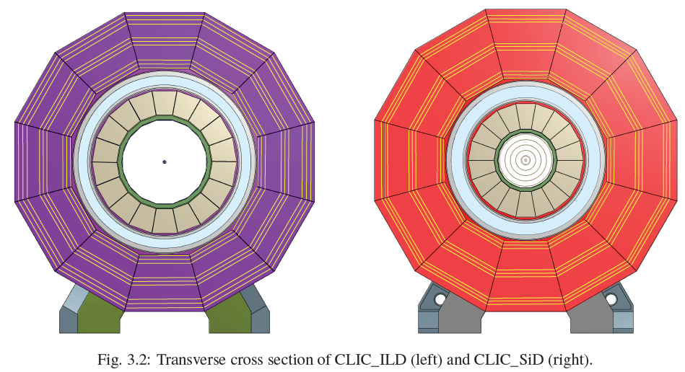
CLIC Detector Concepts
Overview
System | CLIC_ILD | CLIC_SID
VTX+Tracker | TPC, Radius=1.8m | Silicon, Radius=1.2m
ECAL | W/Si | W/Si
HCAL Barrel | W/Scint | W/Scint
HCAL Endcap | Steel/scint | Steel/Scint
Solenoid: B-Field | 4 T | 5 T

Slide 16
CLIC Detector Concepts
Overview
CLIC detector requirements:
At ~ 0.5 TeV, same as for ILC + modifications to mitigate the
effects of the CLIC bunch structure. Beam induced backgrounds
much smaller than at 3 TeV
At 3 TeV, need optimization to take into account the increase in
energy and the effects of the CLIC bunch structure and
beam induced background.
Start with ILD/SiD LoI validated detectors + modifications (3 TeV):
Beam pipe and vertex detector layout and location to account for
increased background.
Increased HCAL depth to account for increased jet energies.
Forward region layout to cope with increased background,
20 mrad crossing angle and QD0 location.
Solenoid design modified to account for larger HCAL

Slide 17
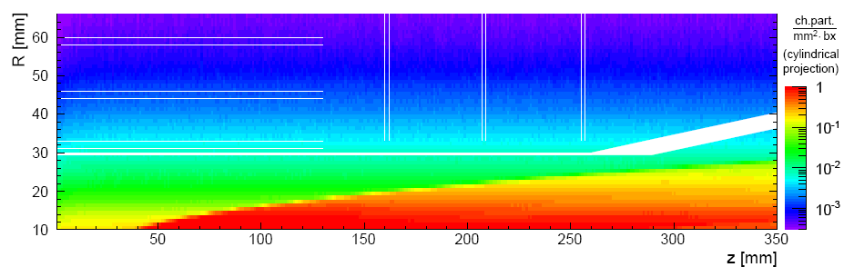
CLIC Detector Concepts
Beam Pipe and VTX
VTX elements layout designed to match impact parameter requirements:
Remain outside the incoherent pair background region, but as close to the
beam line as possible (Fig 4.8: Density of hits from incoherent pairs)
Low occupancy: Not > 3.10¯² at R=31mm for 20x20 μm pixels
Low number of radiation length
CLIC_ILD VTX
BP
Main parameters | CLIC_ILD ( B=4T ) | CLIC_SID (B=5T )
Inner radius (mm) | 31 | 27
Outer radius (mm) | 60 | 77(barrel), 169 (disks)
Max. Z (mm) | 125(barrel) 257(disks) | 99(barrel), 830(disks)
Barrel layers | 3 double layers | 5 single layers
Forward layers | 3 double layers | 7 single layers
VTX layout
Talk D.Dannheim

Slide 18
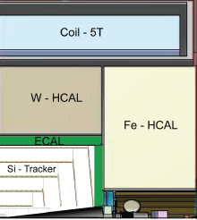
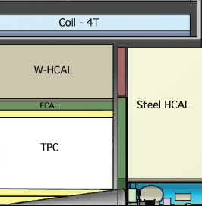
CLIC Detector Concepts
Tracking System
Barrel Tracker | CLIC_ILD | CLIC_SiD
Technology | TPC+Silicon strips | Silicon strips
Inner radius | 329 | 230
Outer radius | 1808 | 1239
Max. Z | 2250 | 578 to 1536
Max. samples | 2(Si), 224(TPC),1(Si) | 5
Forward Tracker | CLIC_ILD | CLIC_SiD
Technology | Silicon strips | Silicon strips
Inner radius | 47 to 218 | 207 to 1162
Outer radius | 320 | 1252
Max. Z | 1868 | 1556
Max. samples | 5 | 4
Technology and performance talks : M. Stanitzki (SiD) and J. Timmermans (ILD)

Slide 19
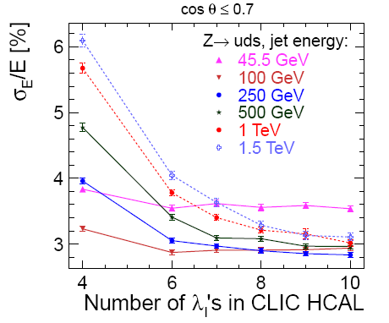
CLIC Detector Concepts
ECAL and HCAL in High B Field
ECAL | CLIC_ILD, B=4 T | CLIC_SiD, B=5 T
Absorber/Active elements | Tungsten/Si pads | Tungsten/Si Pads
Sampling layers | 30 (20 × 2.1, 10 × 4.2) | 30 (20 × 2.5, 10 × 5)
Cell size | 5.1x5.1 | 2.5x2.5
X0 and λI | 23 and 1 | 26 and 1
To minimize leakage HCAL depth increased:
Jet energy resolution studies => 7.5 λI
To maintain reasonable solenoid radius
Tungsten used as absorber in barrel
HCAL | CLIC_ILD | CLIC_SiD
Absorber(B/F) | Tungsten/Steel | Tungsten/Steel
Sampling layers(B/F) | 75x10mm/60x20 | 75x10mm/60x20
Cell size | 30x30/30x30 | 30x30
λI (B/F) | 7.5/7.5 | 7.5/7.5
Technology and Performance talk: F. Sefkow
Fig 6.2

Slide 20
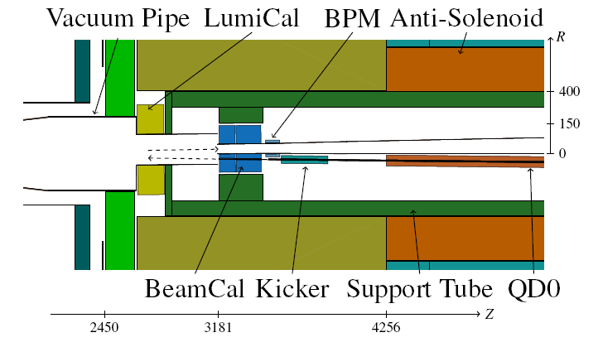
CLIC Detector Concepts
Very Forward Region
CLIC beam crossing angle is 20 mrad, (ILC: 14 mrad) => modifications of the design of the very forward region components:
LumiCal (40-100 mrad) : luminosity measurement
BeamCal (10- 40 mrad) : electron detection
Beam position monitor
Beam Kicker: intra train feedback
Final focus quadrupole: QD0
Anti-Solenoid: field compensation
Shielding masks: protect
upstream detectors and
BPM, Kicker, …
Details in talk: K. Elsener
Fig 3.3

Slide 21
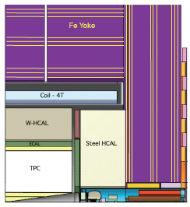
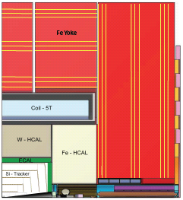
CLIC Detector Concepts
Solenoid and Muon System
Coil+cryostat | CLIC_ILD | CLIC_SiD
Field | 4T | 5T
Coil Free bore/Thickness | 3426/864 mm | 2744/966 mm
Yoke material/thickness | Steel/2586 mm | Steel/3086 mm
Muon layers | 9 | 9
Technology talk: H. Gerwig
For the CDR two GEANT4 models defined
Physics benchmark
studies with full reconstruction and overlaid beam induced background
what else ?

Slide 22
Thanks

Slide 23
Impact of Beam Induced Backgrounds (Daniel)
Coherent pairs : produced at small angle, end up in beam pipe
Incoherent pairs : produced at larger angle, affect VTX inner layers
γγ->hadrons : affect tracking, calorimeters and observables
Beam halo muons: impact on physics observables << γγ->hadrons
pt>5 GeV cut removes γγ->hadrons; ok for physics with leptons, not with jets, because it would bias the jet energy resolution.
γγ->hadrons
<pt>=0.9 GeV

Slide 24
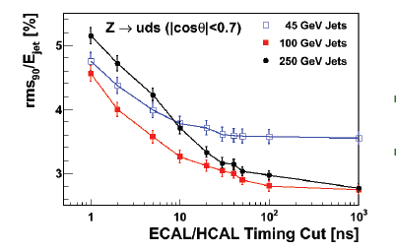
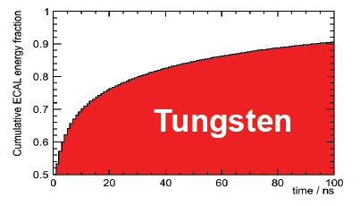
Particle Flow
To reduce the background requires to:
time stamp the detector hits and to apply timing cuts to eliminate the hits which do not belong to physics event.
But there is a basic limitation to the time stamping window related to the time for the showers to develop and to the signal integration.

