Slide 1
Visit to Microlan: Series Production Meeting Vacuum Connection Tools
August 4th , 2025
Laura Hannemann & Luisa Puddu

Slide 2
Agenda - Series Production Status Meeting
Luisa and I visited Microlan on July 31st to review the status of the series production of vacuum connection tools manufactured there.
Agenda Points:
Feedback from Pre-series production and taken actions
Status of Series Production & Delivery Schedule
Metrology Reports

Slide 3
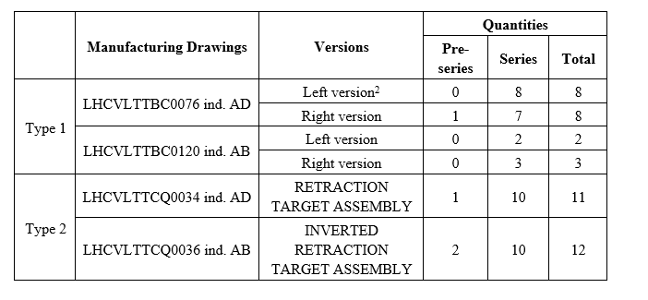

Series Content
Production of tools of two types.
The Series Production consists of:
→ 20 Retracting Flange Tools
20 Retraction Target Assemblies
Pre-Series Tools have been produced and validated for both types
The tools aligned with our requirements

Slide 4
Status of Series Production & Delivery Schedule
6 Units of Retraction Target Assemblies are finished
→ Documentation is being uploaded, regarding QC and FAT.
Once documentation approved, 6 units swill be shipped to CERN
2 weeks of closure between 11th of august and 22nd of August
6 more units send of August
Shipment of all units util beginning of September
Delivery within the expected time frame

Slide 5
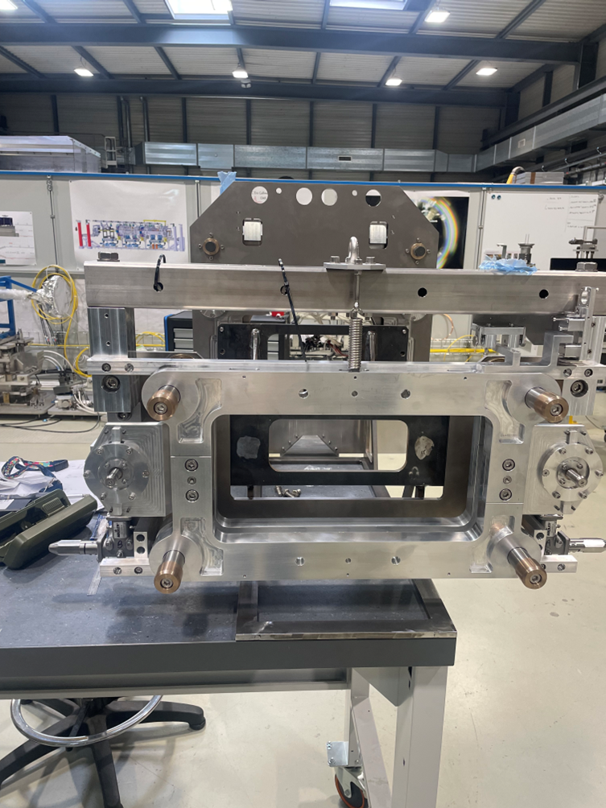
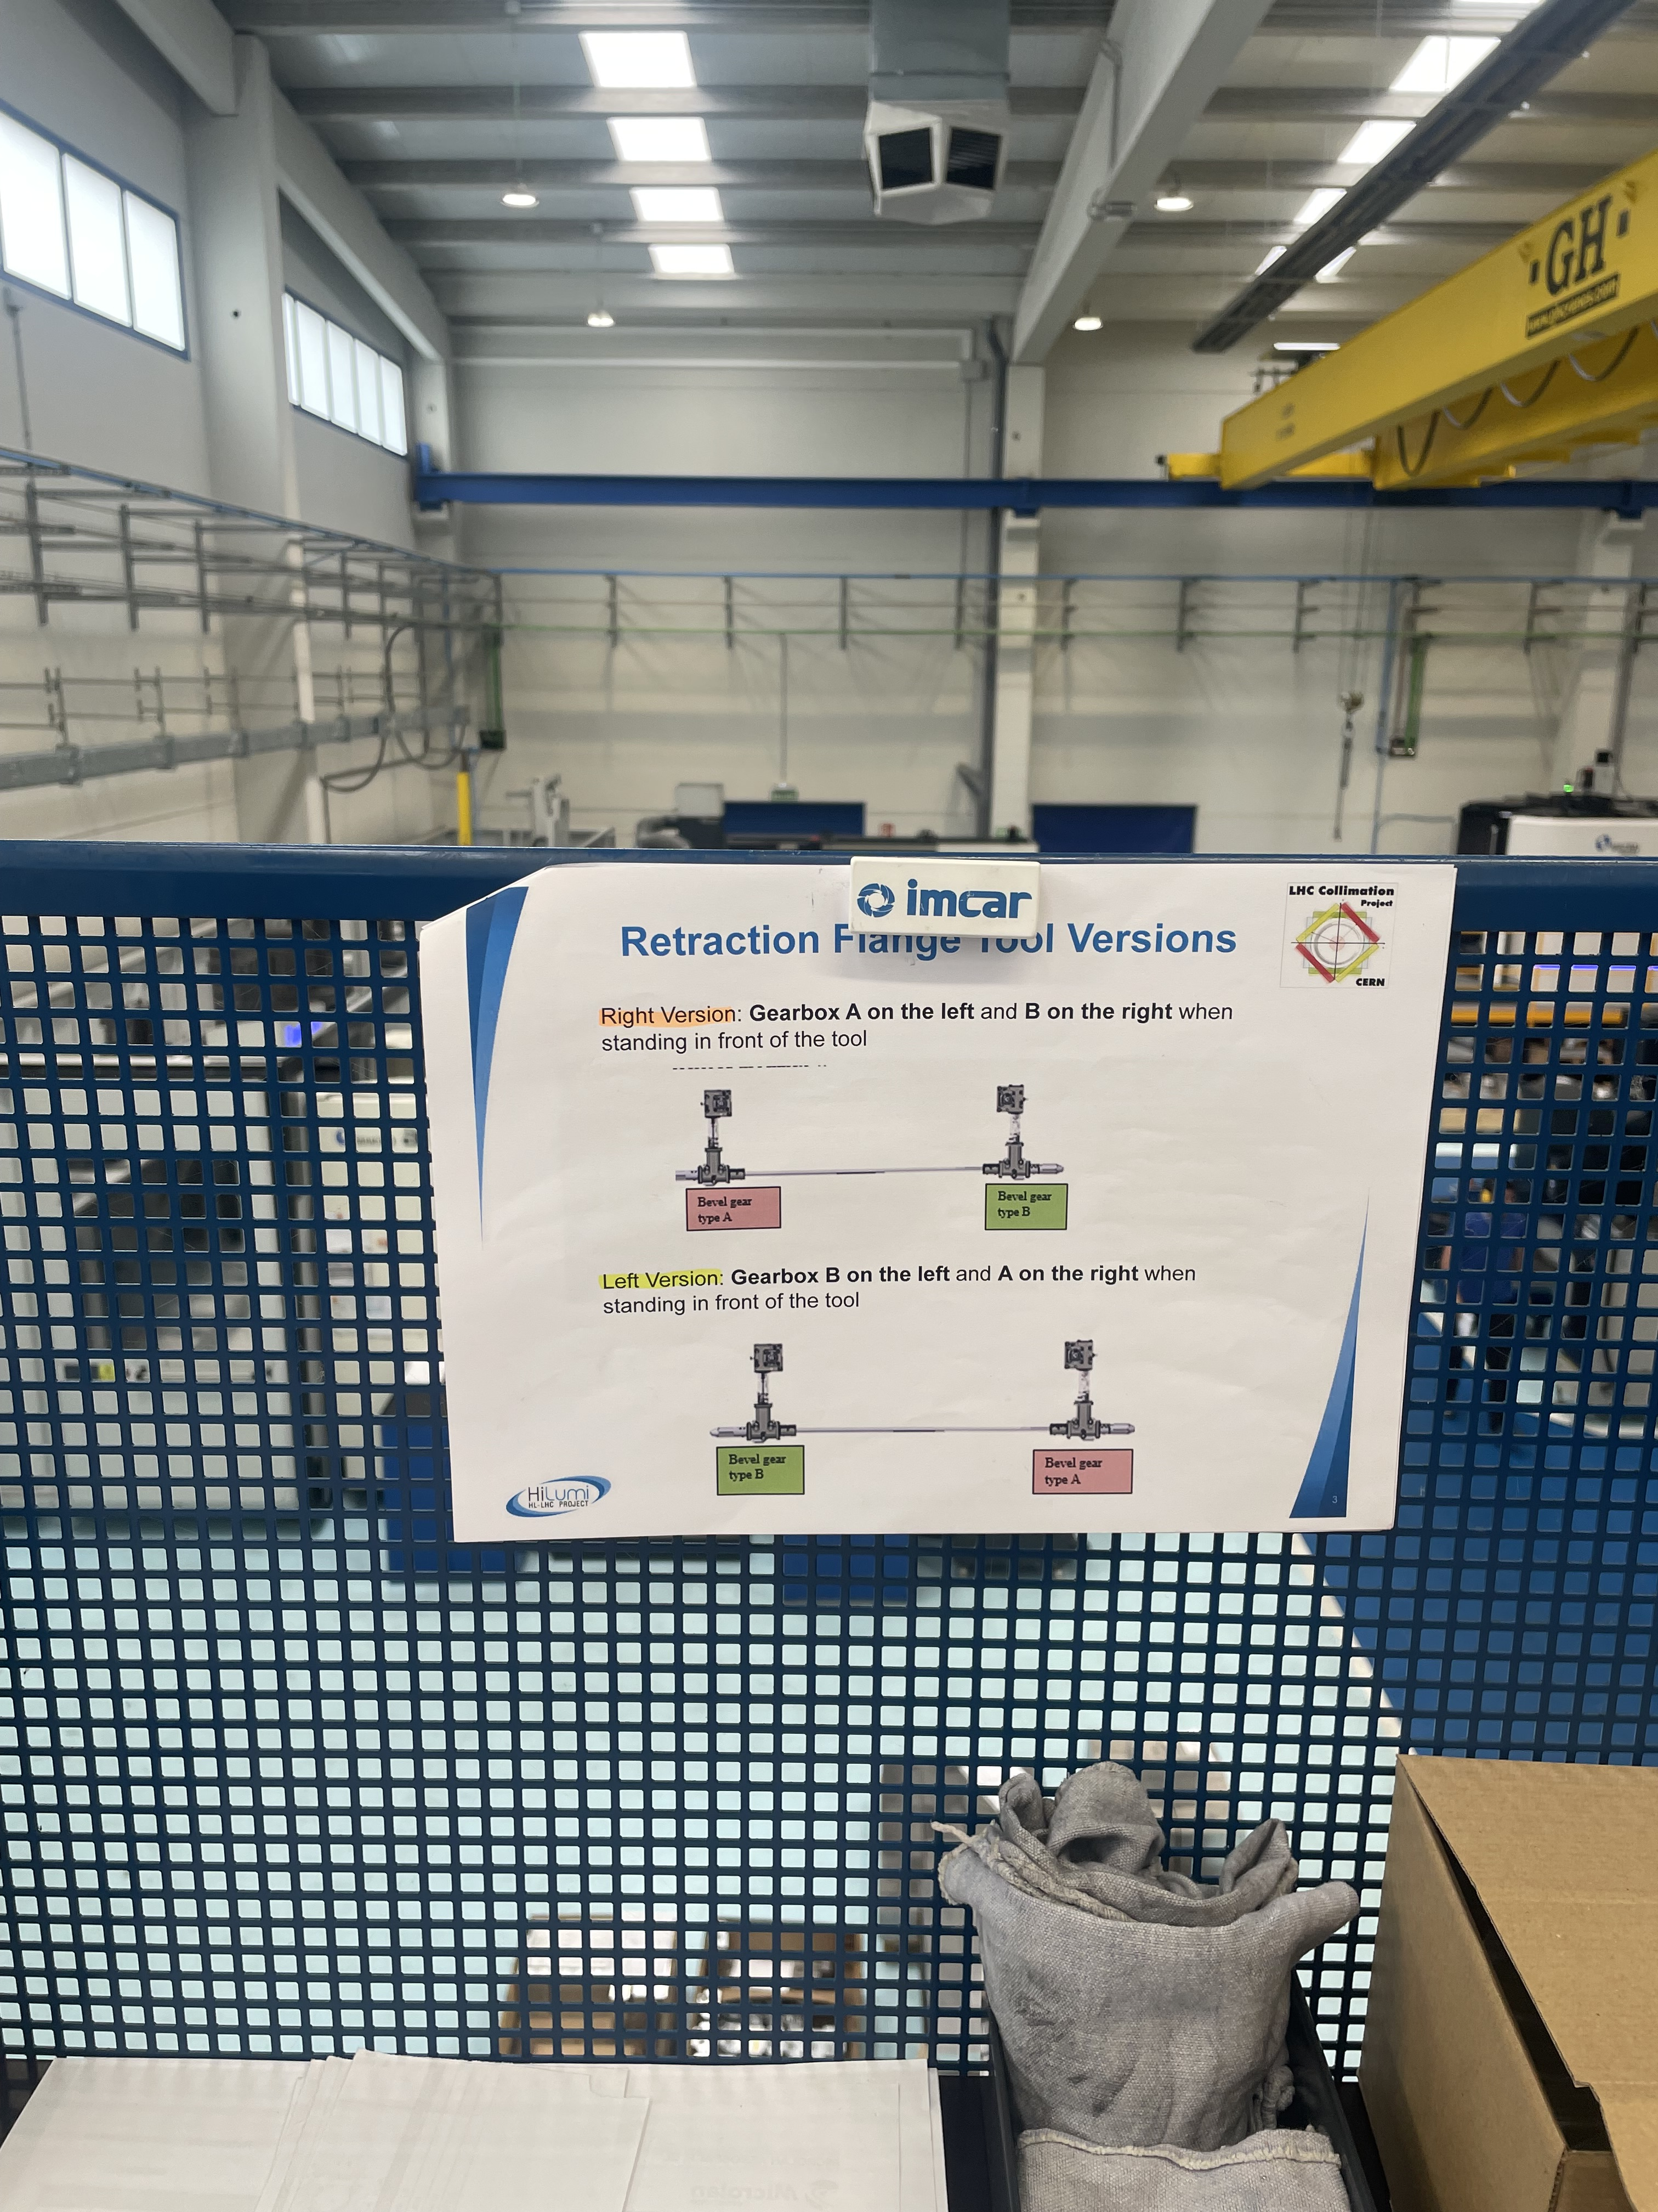
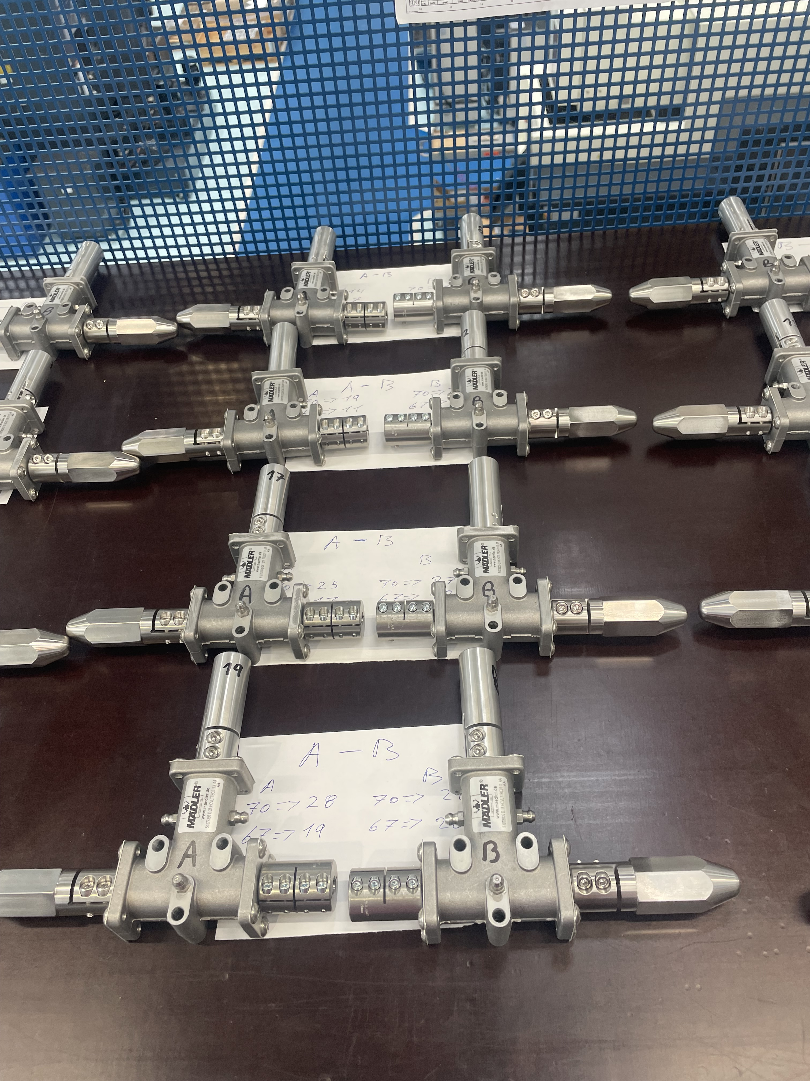
Feedback from Pre-Series FAT Gearbox Placement
🛠️ Issue Identified:
The pre-series tool was delivered with the gearbox configured as B–A.
However, for a right-side version, the required configuration is A–B.
The misplacement originated from a misinterpretation of the assembly table in the drawing.
Clarification:
The referenced table is intended for CERN technicians to assist with tool installation, not for supplier-side assembly configuration.
This distinction was discussed in the last technical meeting, where the correct configurations were clarified.
✅ Action Taken:
Prepare the gearbox units with the required configuration
Print out the picture of the tool versions left and right version with the gearbox configurations
B
A

Slide 6
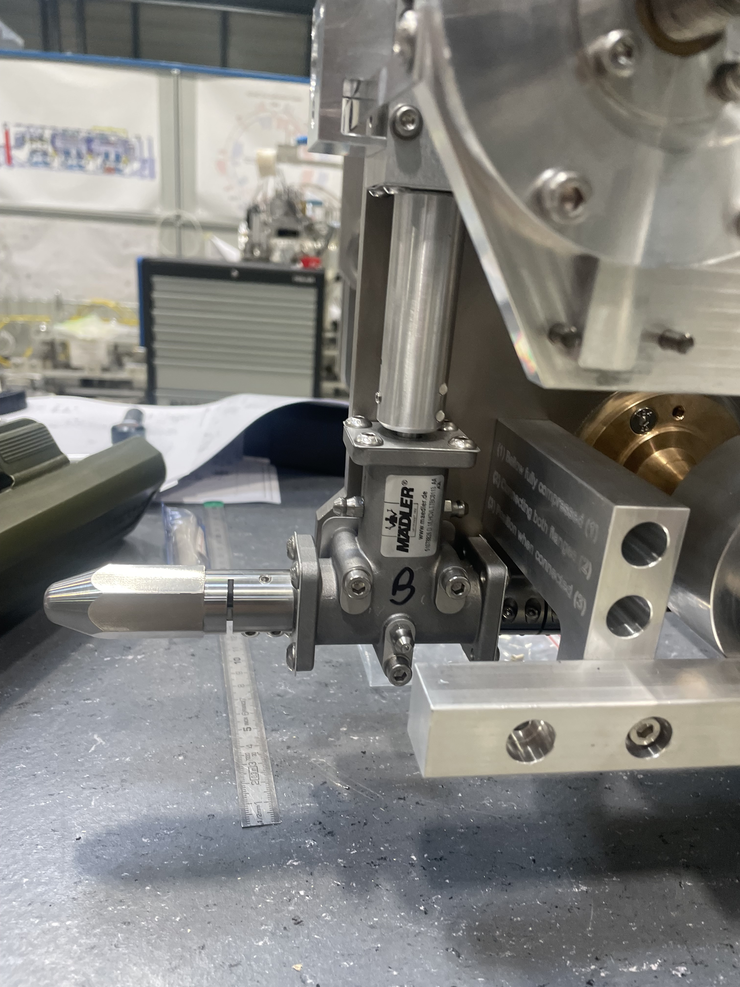
Feedback from Pre-Series FAT Gearbox Coupling Placement
🛠️ Issue Identified:
Coupling between gearbox shafts is rubbing against the top protection plate.
This causes friction and an audible scraping noise during operation.
Request: Ensure a minimum clearance is maintained between the coupling and the adjacent gearbox surface during assembly.
✅ Action Taken:
check for 1mm clearance on top and bottom with a feeler gauge

Slide 7
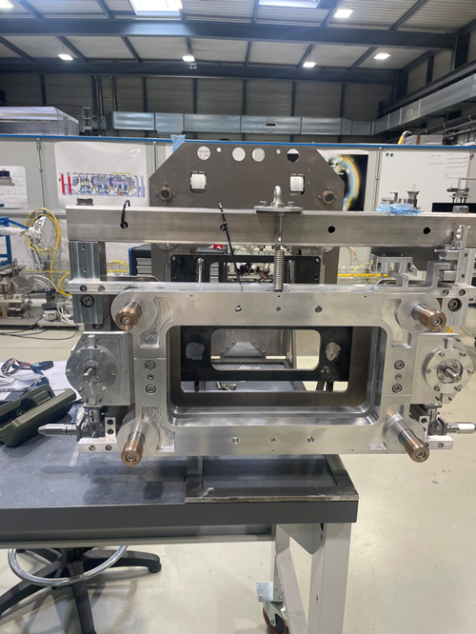
Feedback from Pre-Series FAT Screw Axle Length
LHCVLTTBC0061
Issue:
The screws were at different length
Note:
Issue has been previously communicated via email.
Request:
Ensure correct assembly of the screw axle in respect to the ball joint nut assembly.
✅ Action Taken:
Measurement o the screw length of each assembly.

Slide 8
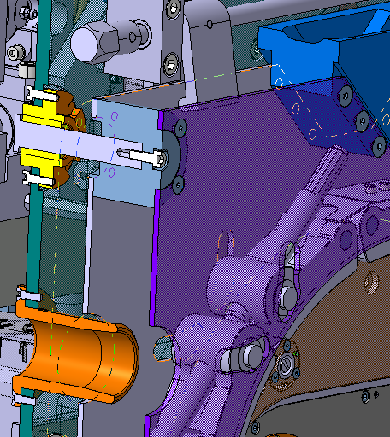
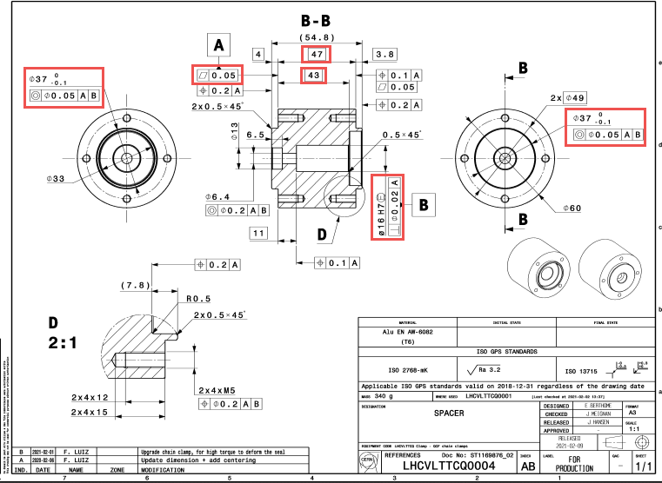
Feedback from Pre-Series FAT Axle and Spacer Fit
Issue:
Difficult disassembly due to tight fit.
Both axle (LHCVLTTCQ0008) (16h6) and hole (16H7) in the spacer (LHCVLTTCQ0004) have minimal clearance in one of the axles/ spacer assemblies
Discussion:
Possibility to modify hole tolerance to ease assembly & disassembly.
✅ Use 16G6 tolerance for spacer hole (LHCVLTTCQ0004).
✅ Keep current axle tolerance (LHCVLTTCQ0008) unchanged.
It was decided in the last meeting on the 15/05/2025 to change the tolerance from 16H7 to 16G7 → The part was adapted but metrology reports need to be updated.

Slide 9
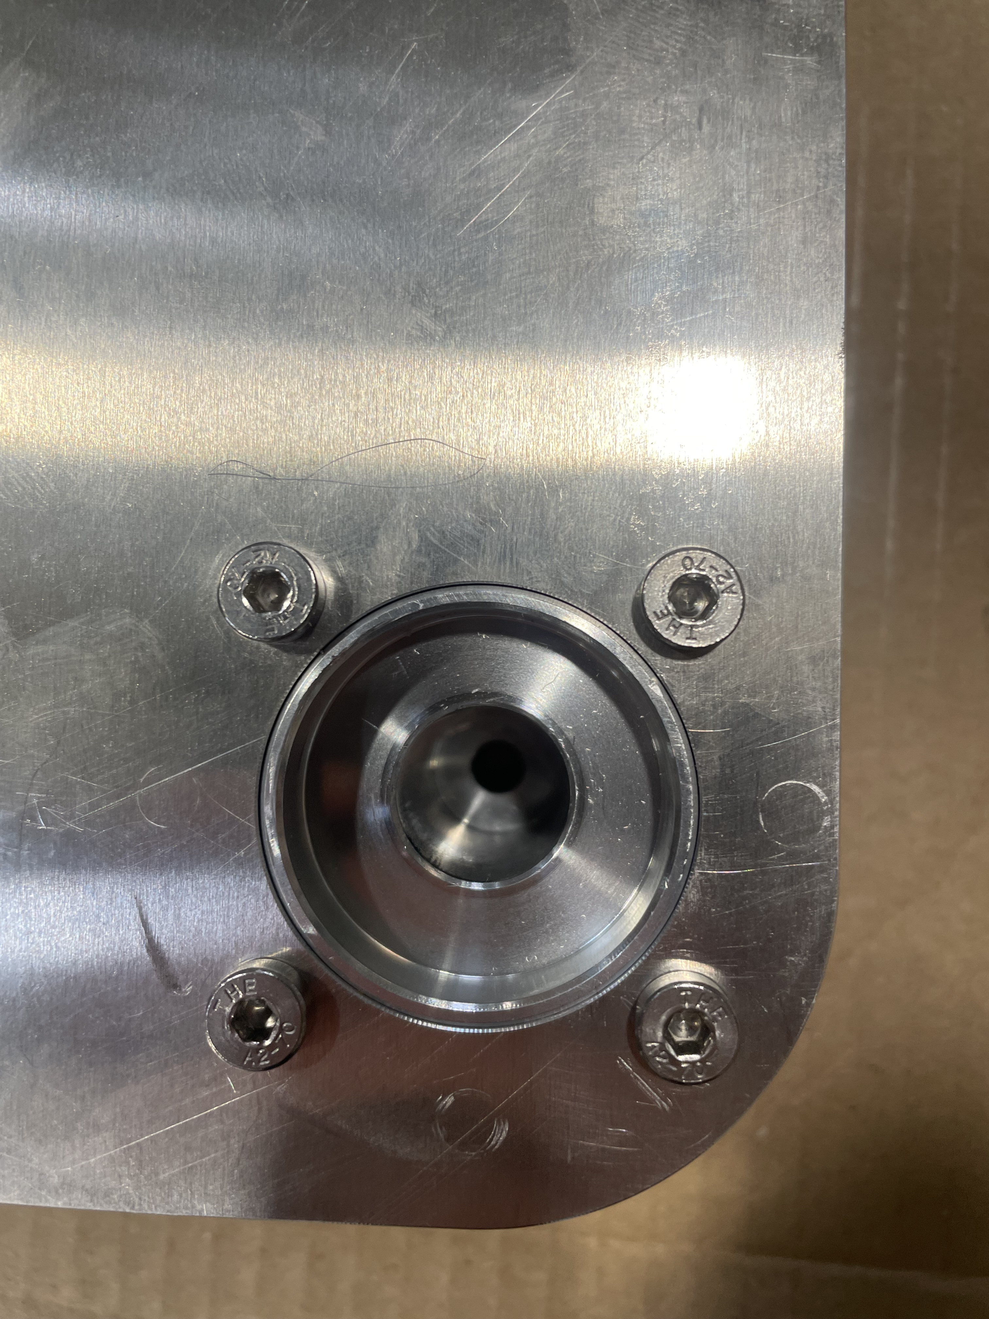
Feedback from Pre-Series FAT Worn M5 Screws – Assembly Concern
Problem:
M5 screw heads are worn out, likely due to overtightening during assembly.
Recommendations:
🔧 Apply correct torque specifications during installation.
A screw torque of 3.42 Nm should be applied. Microlan confirmed to use that torque for the series production.
Threads | Torque Steel | Torque bronze/aluminium
M3 | 1,26 | 0,76
M4 | 2,9 | 1,74
M5 | 5,7 | 3,42
M6 | 10 | 6,00
M8 | 24,1 | 14,46
M10 | 47,7 | 28,62
M12 | 50 | 50,00
M16 | 100 | 100,00

Slide 10
Status Documentation
Metrology reports: some are missing but are constantly being uploaded
Hardness tests: partially uploaded
Monthly reports: Monthly report of June missing.
Inventory reports: last ones by email
Go/ No-Go dimensions: still need to be uploaded

Slide 11
Status Metrology
Drawing | Quantity Provided | Quantity Needed | Status
LHCVLTTCQ0051 | 23 | 20 | Needs Updates
LHCVLTTCQ0054 | 23 | 20 | Received
LHCVLTTBC0020 | 84 | 80 | Received
LHCVLTTBC0105 | 44 | 40 | Received
LHCVLTTCQ0019 | 92 | 89 | Received
LHCVLTTBC0058 | 42 | 40 | Received
LHCVLTTCQ0047 | 25 | 20 | Received
LHCVLTTCQ0050 | 26 | 20 | Received
LHCVLTTCQ0007 | 49 | 40 | Received
LHCVLTTBC0071 | 51 | 40 | Received
LHCVLTTBC0061 | 47 | 40 | Received
LHCVLTTBC0063 | 44 | 40 | Received
LHCVLTTCQ0049 | 28 | 20 | Received
LHCVLTTCQ0004 | 48 | 40 | Received
LHCVLTTBC0103 | 40 | 40 | Received
LHCVLTTBC0116 | 82 | 80 | Received
LHCVLTTCQ0008 | 52 | 40 | Received
LHCVLTTBC0078 | 9 | 20 | In Review
LHCVLTTBC0079 | 10 | 20 | In Review
LHCVLTTBC0083 | 9 | 20 | In Review
LHCVLTTBC0084 | 10 | 40 | In Review
LHCVLTTBC0085 |  | 20 | Missing
LHCVLTTCQ0032 |  | 20 | Missing
LHCVLTTBC0080 | 10 | 40 | In Review
Missing information on Go/No-Go gauges used!

Slide 12
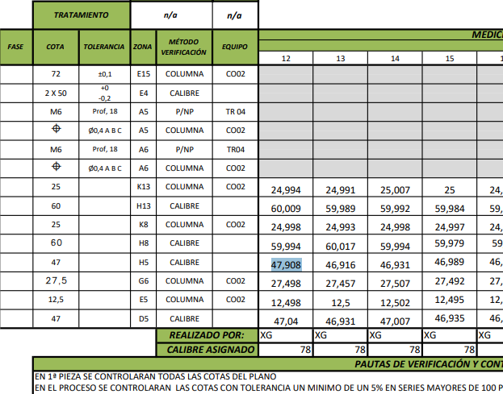
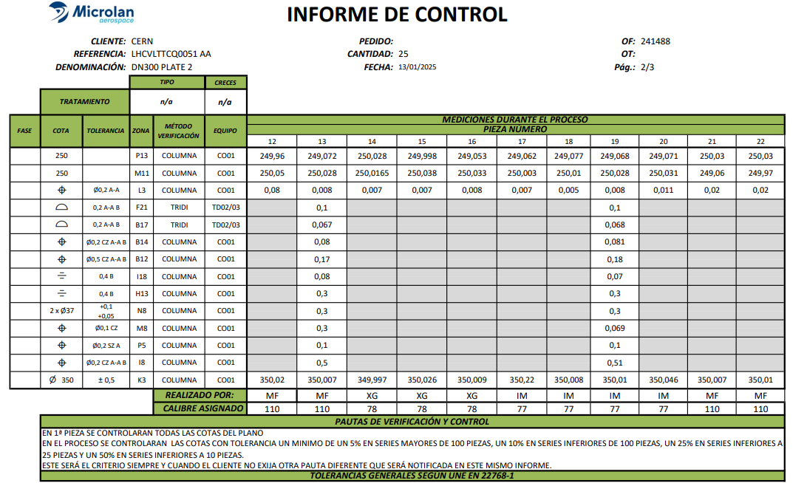
Issues with Metrology Reports
Typos in reports when transferring data from handwritten sheet.
Dimensions were out of tolerance: Parts in questions were re-measured with CMM during the visit. Parts are compliant and the reports will be updated
→ Solution: Implementation of rules in excel if values are out of tolerance,

Slide 13
The report includes measurements of additional contractual dimensions (not listed in Annex 2).
While it's appreciated that these were measured, we noticed that some of them are slightly out of tolerance.

Slide 14
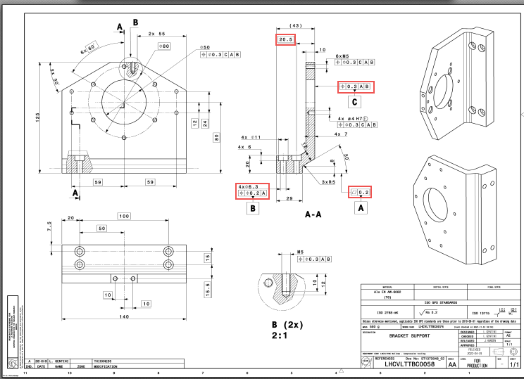
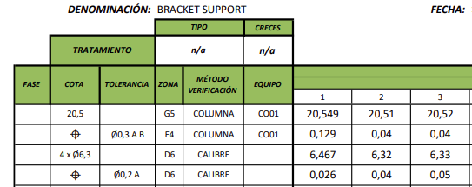
Metrology Questions LHCVLTTBC0058
General Tolerance and Measurement Method
Issue: Can you clarify the method proposed for verifying position tolerance (e.g., Ø0.2 mm to datum A) using a calliper?
Additionally, only one of the four holes was measured in diameter.

Slide 15
Feedback from Pre-Series FAT Screw Tightening Torque
Slide from our last discussion
Findings:
Overtightening detected during assembly:
M12 screws: >90 Nm (spec: 50 Nm)
M16 screws: >140 Nm (spec: 100 Nm)

Slide 16
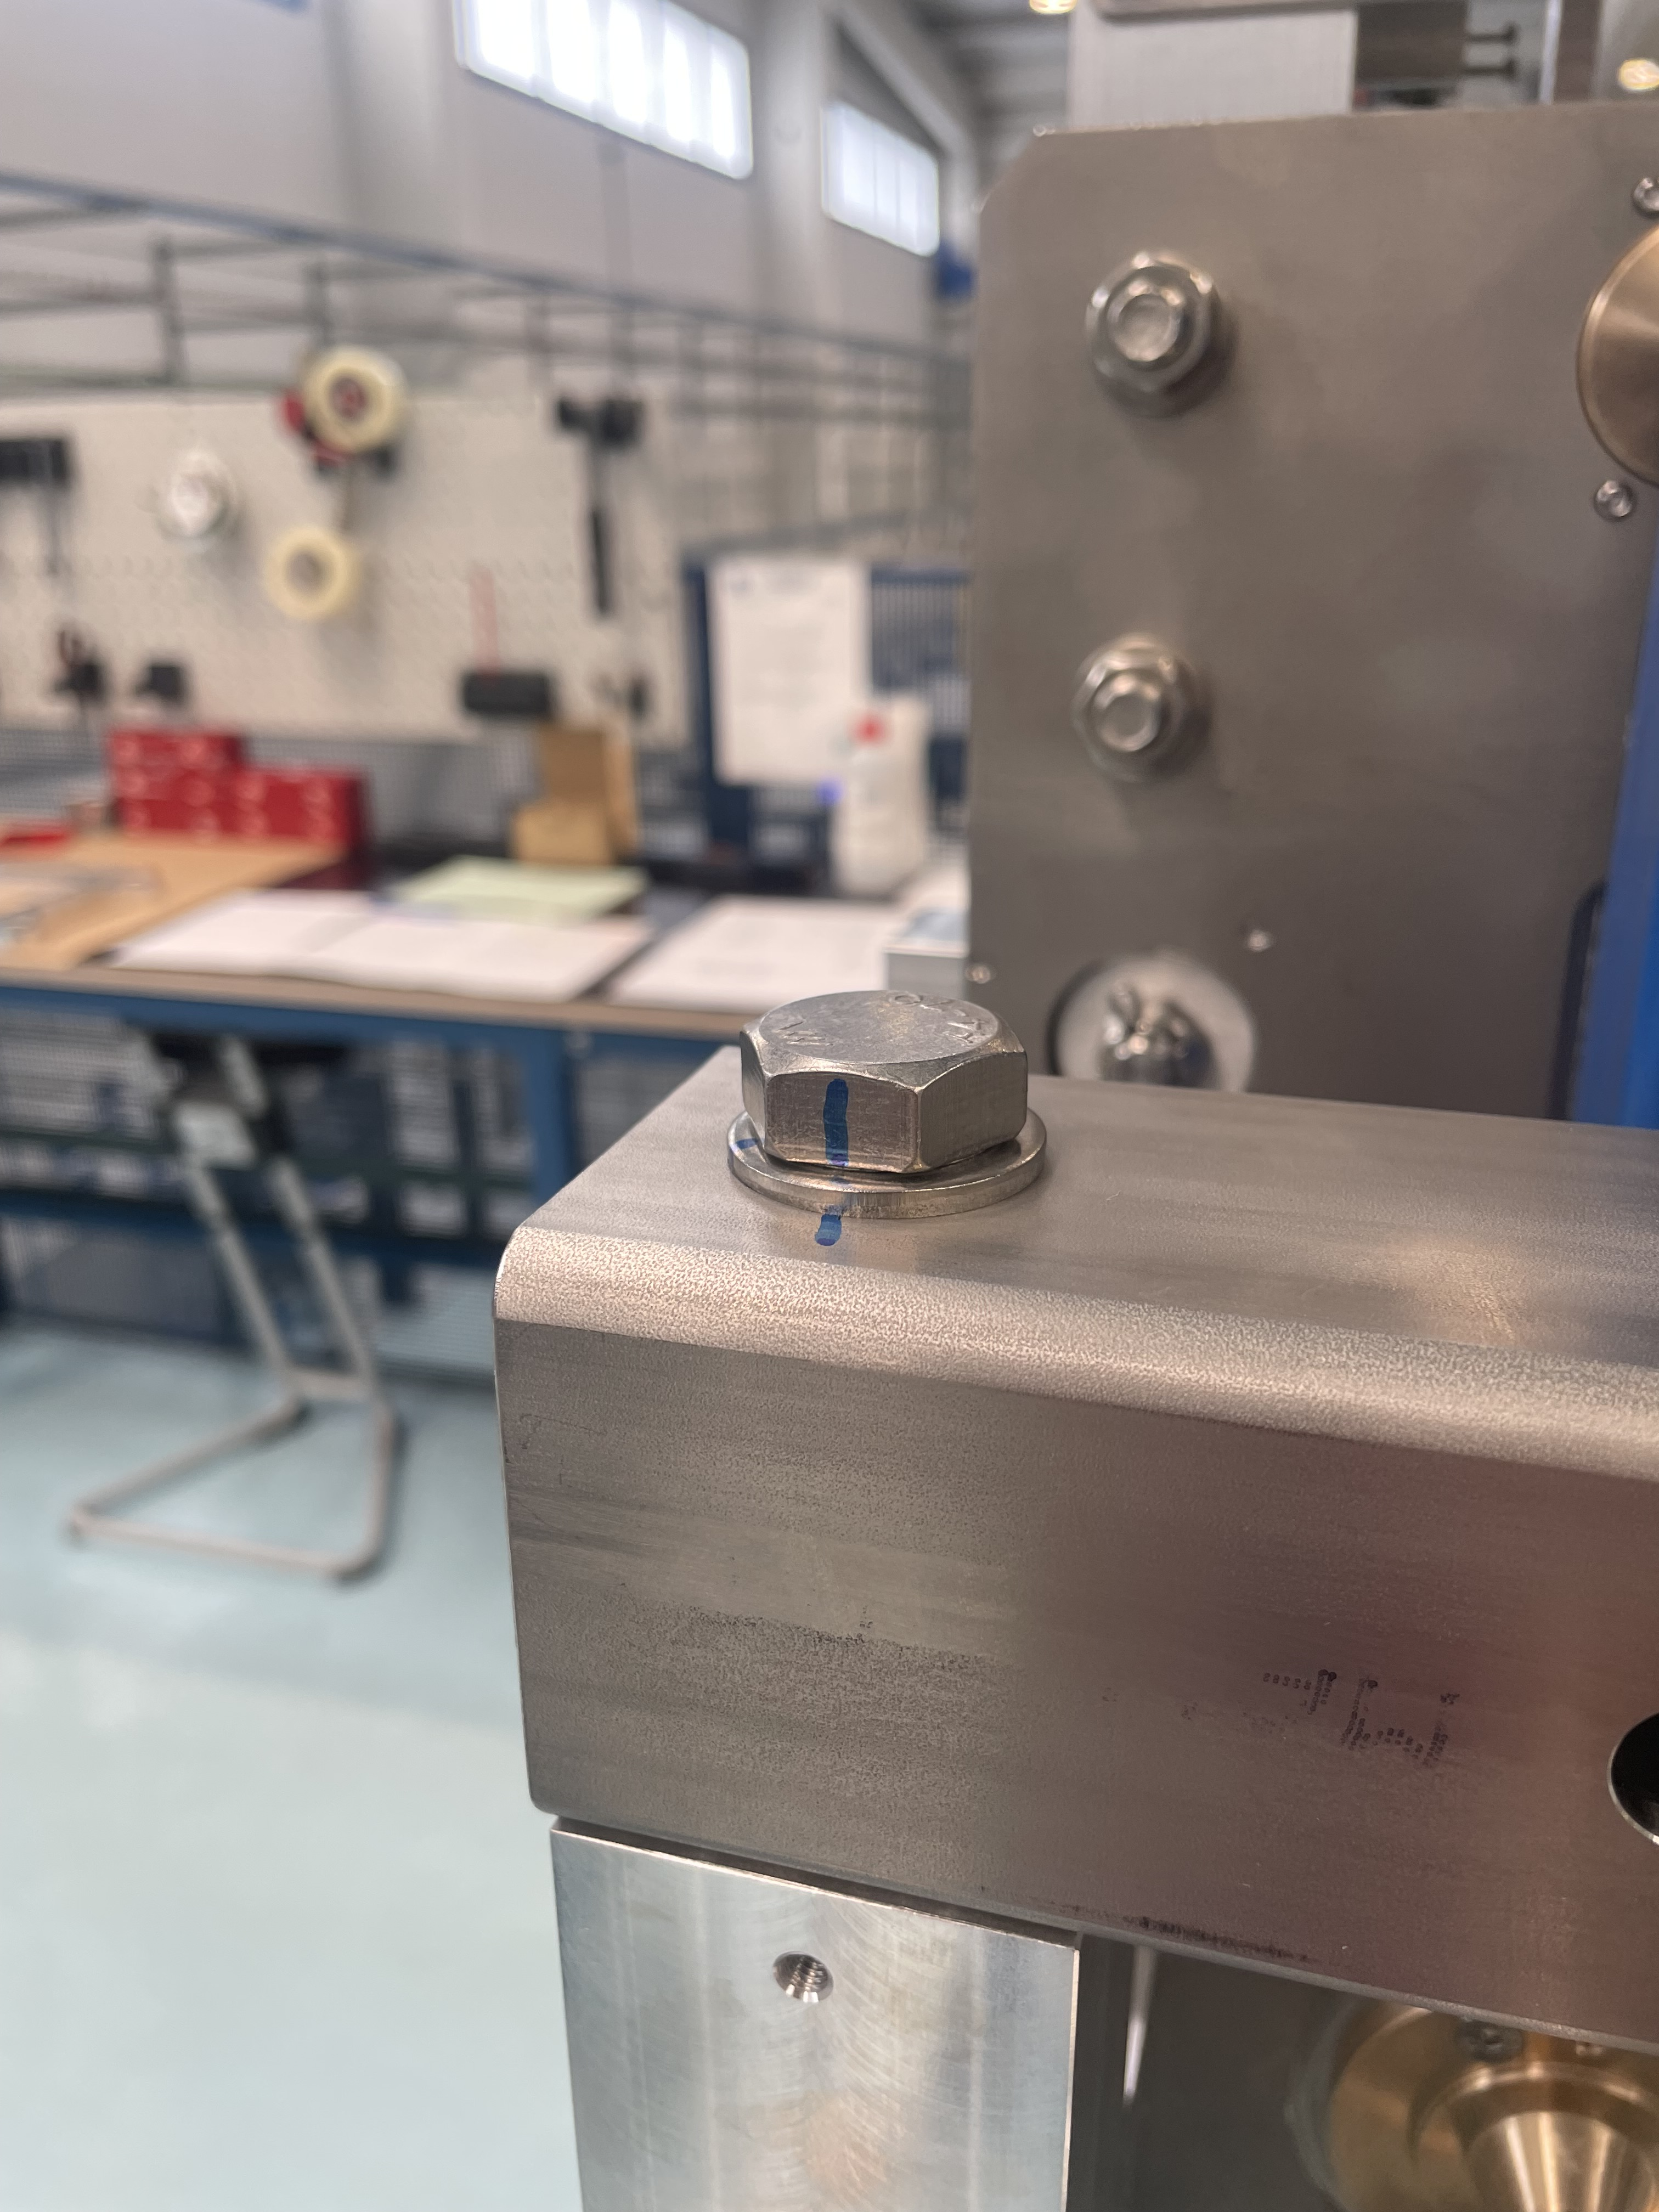
Measuring Screw Tightening Torques
Torque Verification Approach (Used at CERN)
Method: Mark the screw and surrounding part in the tightened position (as received from Microlan).
Procedure:
Slightly loosen (untighten) the screw.
Retighten it to the specified torque value:
M16 → 100 Nm
M12 → 50 Nm
Compare alignment of the original and new markings.
✅ If the lines align approximately, the original torque was likely correct.
✅Check was done on one tool and the results look acceptable.

Slide 17
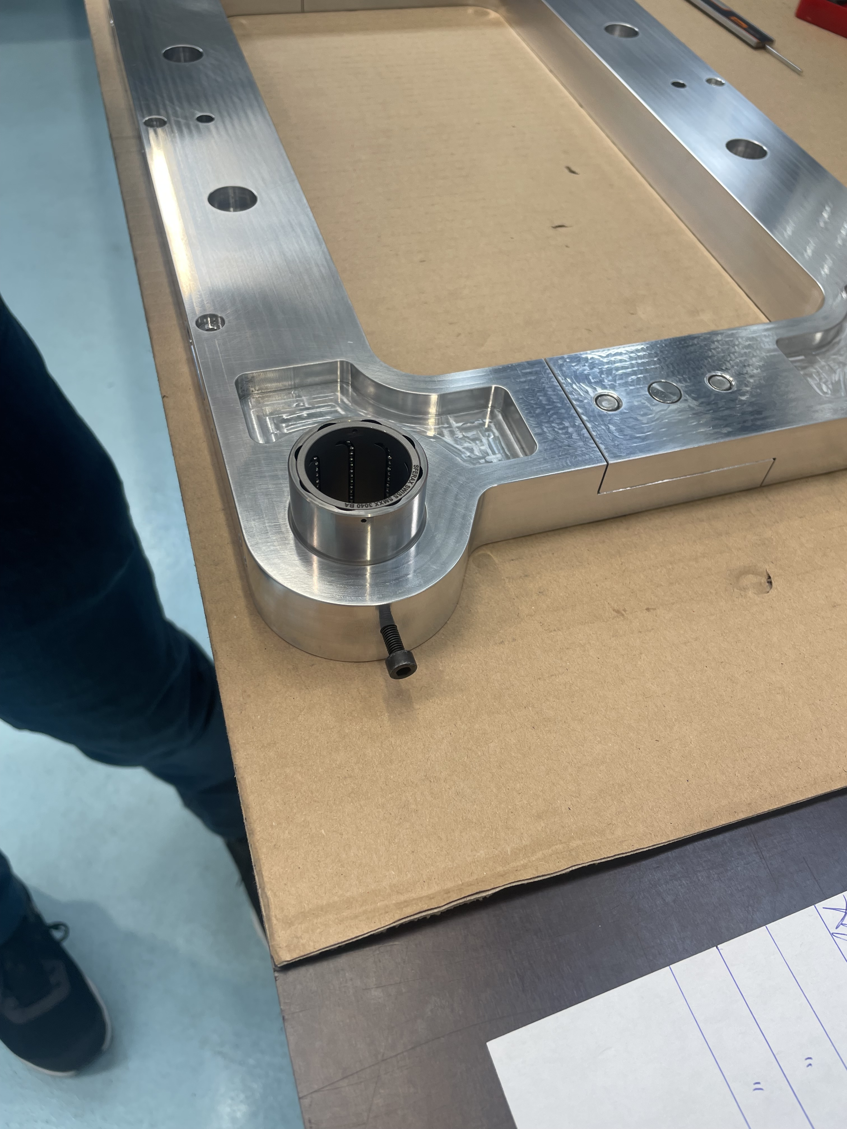
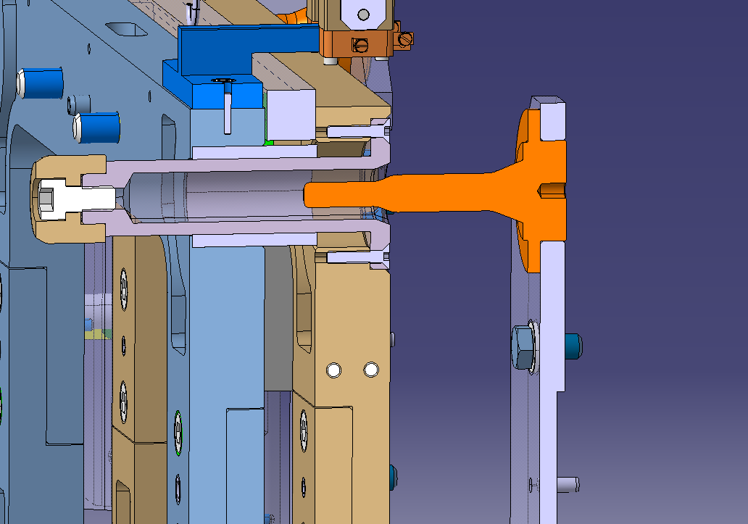
Bearing Fit
Bearing fit of the Sferax 2040 Ba in the coupled half frame LHCVLTTBC0079 is slightly loos om some parts
Microlan proposed the solution of adding a screw in the tapped holes on the side.
Our proposal to locally deform the bores to make the bearings fit

Slide 18
Thank you!

