Slide 1
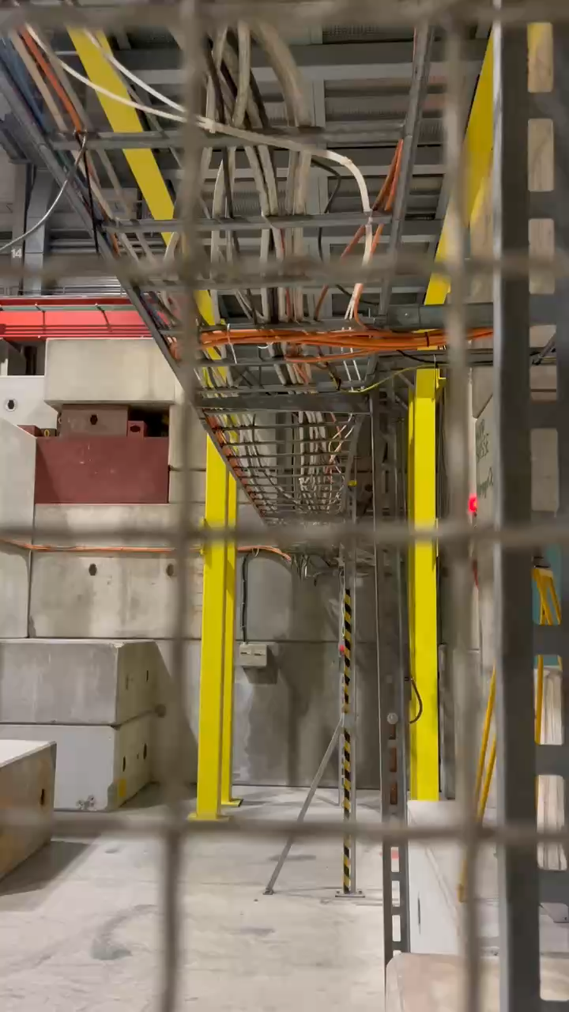


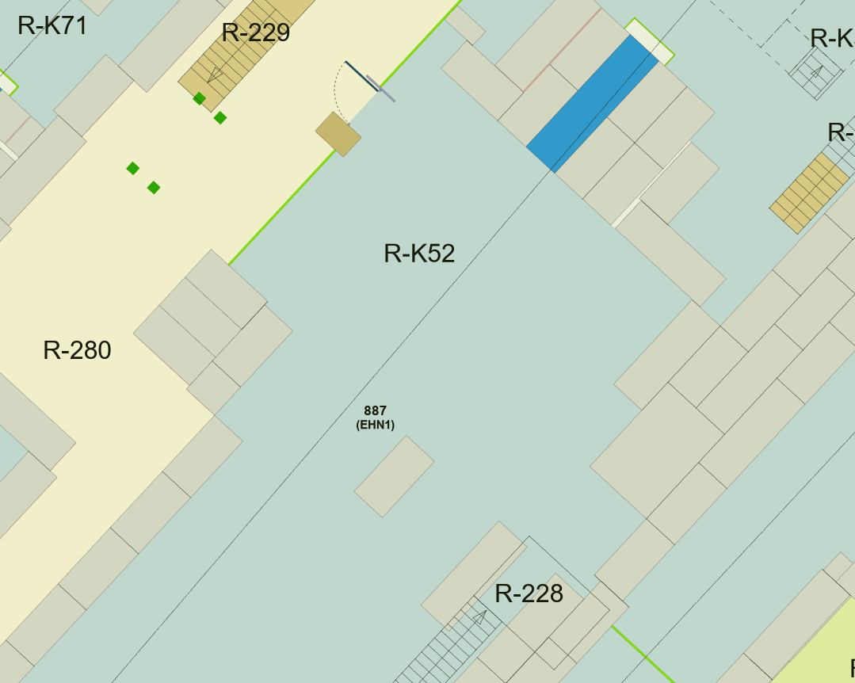
Incident Summary - Electrical Arc in EHN1
Last week users from HERD heard a noise while walking to their zone.
It was a live high voltage instrumentation cable that had been cut, arcing to a nearby earth cable.
The arc was clearly visible – see video.
The users reported the incident (well done!), and the immediate danger has been removed.

Slide 2

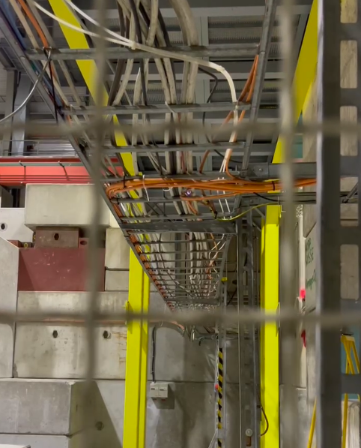
INCIDENT SUMMARY
Electrical Sparks
BE Safety Unit & EP Safety Office
Andreas Herty James Devine
Type of event | Gravity
Incident | Serious
EDMS 3330706
Location: 887/R-K52 (PPE146)
Date / Time: 30.07.2025, 20:30
IDF: EDH 11201903
III. CONSEQUENCES
Human injury: None
Property damage: None
Potential consequences:
electrical shock of persons in direct contact with cable.
Cable tray under high voltage.
Fire due to electrical sparks.
II. CAUSES
Cable cut and marked with violet tape, but not disconnected at both ends.
High voltage power supply connected to other end of cable, not found.
I. FACTS
The arcing of a cable on the cable tray inside PPE146 was observed by members of the HERD test beam team on the evening of the 30th July.
The issue was reported at the user meeting on the 31st July.
V. ACTIONS/RECOMMANDATIONS
Recommendation: From a safety point of view, there should be no work in the PPE146 zone until the issue is resolved.
Follow up required at earliest convenience, latest at beginning of YETS202/26 to trace, disconnect and completely remove cable if possible. Action: define intervention in planning / work notifications. BE-EA technical coordination team of the North Area.
The following of the cable will require lifting of false floor tiles which cannot be done during run periods. Action: see above.
The owner of the cable cannot be identified at present; this will be possible only when the cable has been fully traced.
Video of incident to be added to Electrical Safety – Working in EP experiments training course, as a reminder of why users are not permitted to install cables in existing cable trays. Action: EP Safety Office
IV. IMMEDIATE ACTIONS
The TSO was informed and closed the zone.
The EN/EL Piquet was called via TI who intervened to isolate the cable end with HV insulation tape. This eliminates the immediate danger; however, the cable remains live.
The cable could not be traced to its source as this requires opening false floor tiles, which can only be done during TS/YETS.
Arc
see video in incident declaration

Slide 3
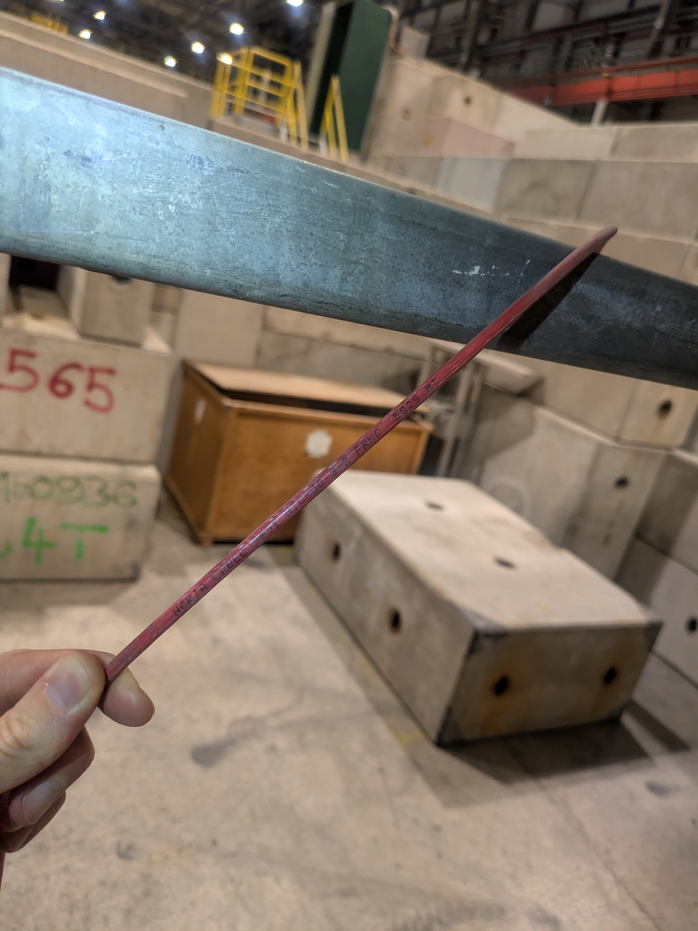
Remaining follow up actions:
The cable is still in place in PPE146 and still live.
It was not possible to trace it to the source without entering false floors -> This will be done with high priority at the start of YETS.
The cable end has been wrapped in Kapton, which will provide adequate protection until December.
The power source is most likely to be a rack mounted HV supply, which could belong to an experiment or to old EHN1 infrastructure.

Slide 4
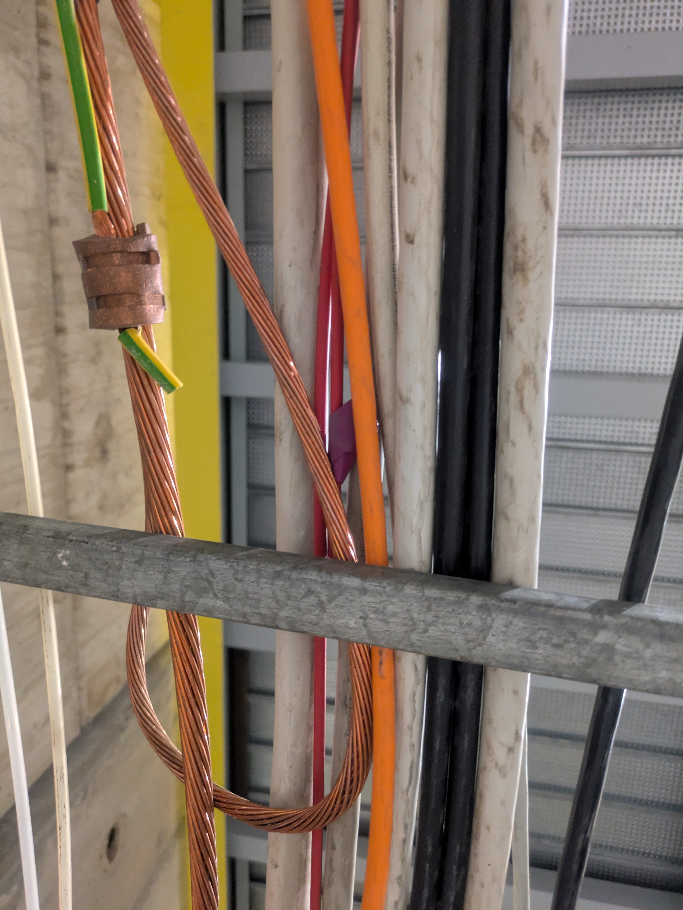
What can we learn from this incident?
Cables wrapped in purple tape can still be live!
This is why EP users are not authorised to install cables in existing cable trays (risk from live/unknown cables).
The relevant French standard, NF C 18 510 (§ 9.7.2.4.1) mandates gloves and face screens for work involving relocation of existing cables.
When marking cables for removal (purple tape) it is important to follow best practices:
Earth conductors if possible.
Fully cover all conductors if not.
Training: Electrical Safety – Working in EP Experiments

