Slide 1




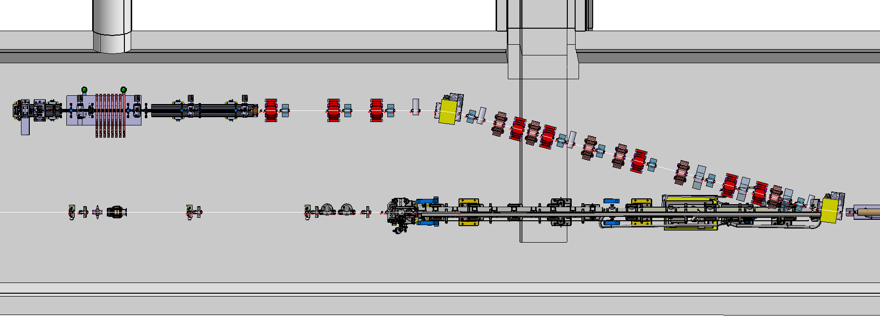
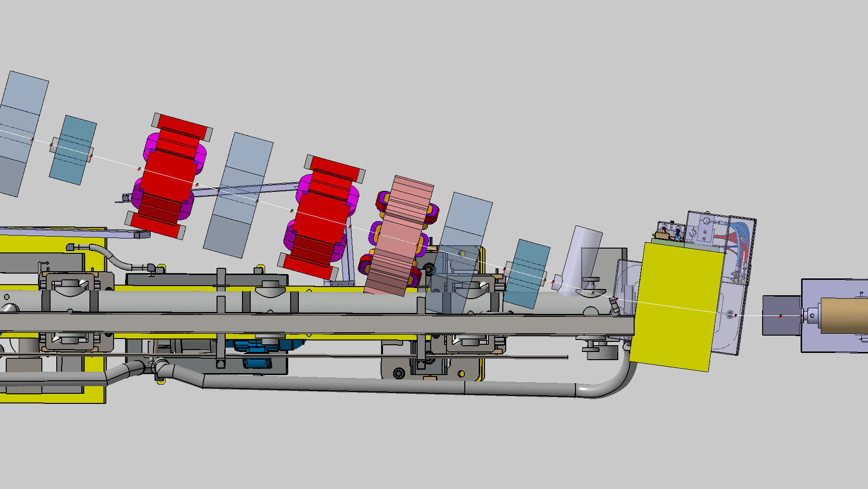
Initial layout
Sextupole
Octupole
BPM+Corrector
BTV
E. Belli – 150 MeV electron line : integration
Proton beam trajectory
Last elements close to injection region in conflict with proton trajectory
7.5 cm between proton trajectory and most external parts of components required for minimum pipe dimension + heating jacket
13

Slide 2
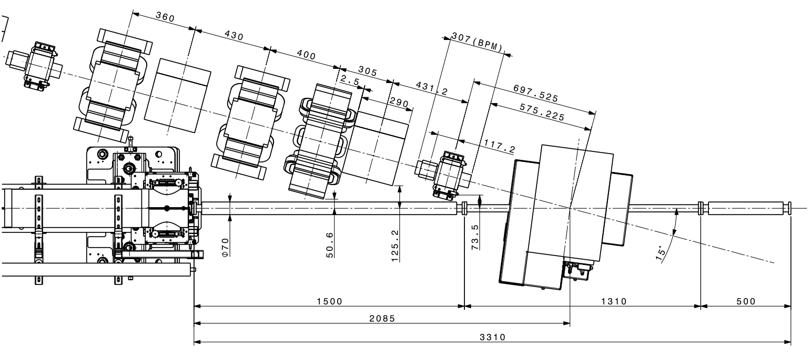
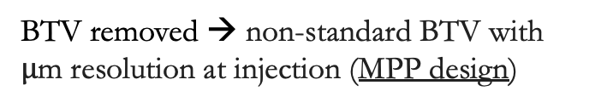

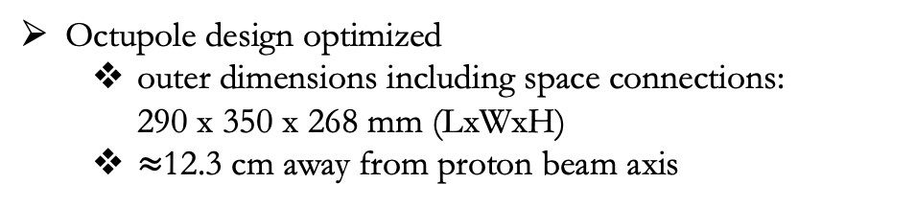
New proposed layout
Rb vapor from the entrance of the 1st plasma cell to the exit of the 2nd one → entire structure at 200$°$C
Gap between plasmas between the laser beam dump and the focal point → to be defined
BTV removed → non-standard BTV with $μ$m resolution at injection (MPP design)
E. Belli – 150 MeV electron line : IR design
Dipole
2nd plasma source
Additional
diagnostics
installation
1st plasma source
Sextupole too close to proton trajectory ($≈$ 4.8 cm distance)
Cutting the iron cannot ensure that magnet properties from the supplier are still satisfied
Functional specs provided to MSC for special design
Octupole design optimized
outer dimensions including space connections:
290 x 350 x 268 mm (LxWxH)
$≈$12.3 cm away from proton beam axis
14

Slide 3
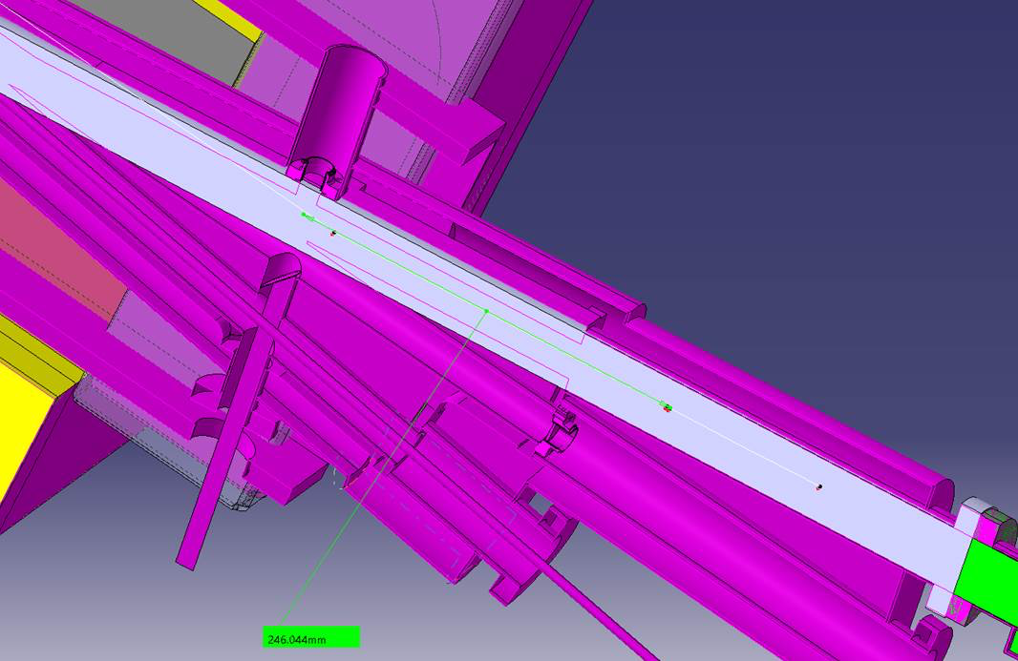
Beam waist position
In the proposed layout, the waist position is $≈$ 25 cm upstream the original position to minimise as much as possible the gap
The waist is inside the dipole coils → physically/mechanically feasible?
Is there an optics solution that meets experimental requirements without changing magnet locations?
Beam optics optimisation ongoing
Fringe fields effects to be further investigated (they extend over a length comparable to the dipole gap)
GWA waist
E. Belli
Design waist
1

Slide 4
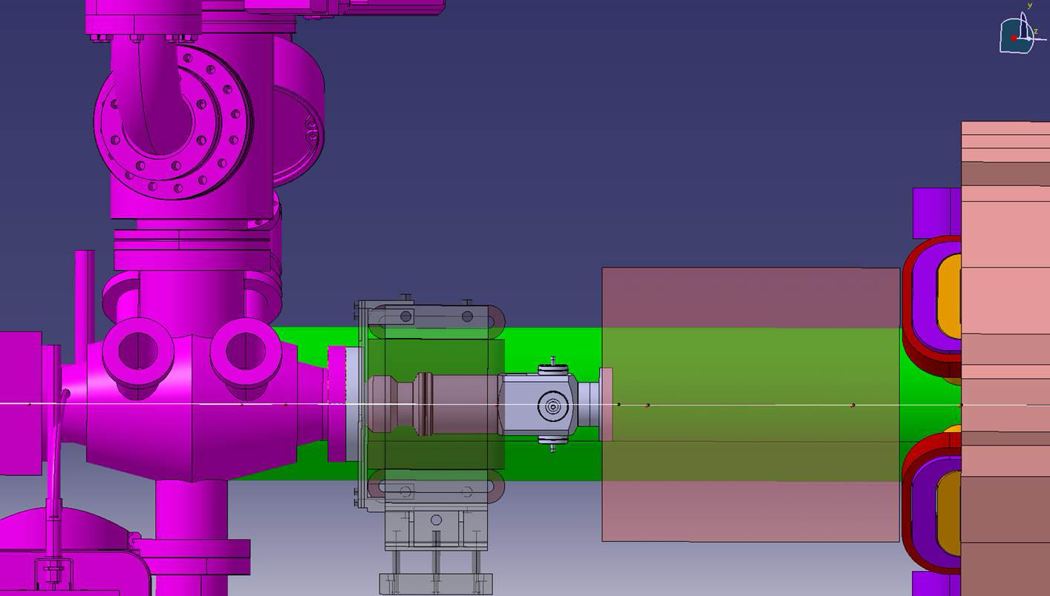
BPM+corrector
An expansion volume has been included in the last proposed layout, at a distance of 250 mm from the octupole
This space will host a BPM and a corrector
Proposal from Nicolas
Ø40 BPM with a bellows downstream
Approximate (but realistic) BPM length
Connection on the octupole side to be further investigated
Feedback from BI and BE-GM
Space required above and below the equipment to access the external reference point and the adjustment systems with alignment screws
In case of flange to flange assembly, the BPM will be connected rigidly to the expansion volume and alignment would not be possible → bellows required
E. Belli
2

