Slide 1

Blanket contracts
Each time you order one pump, valve or leak detector…

Slide 2
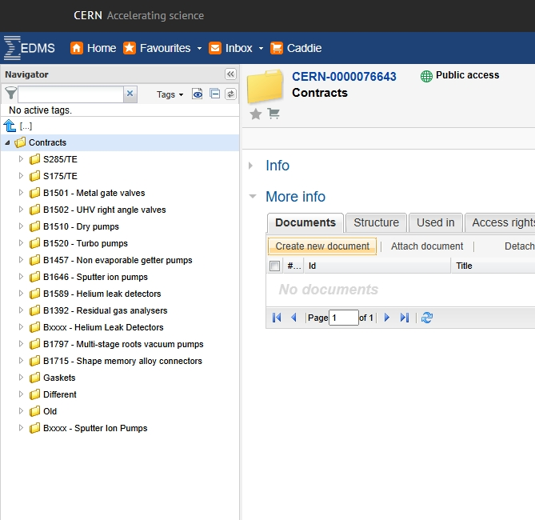
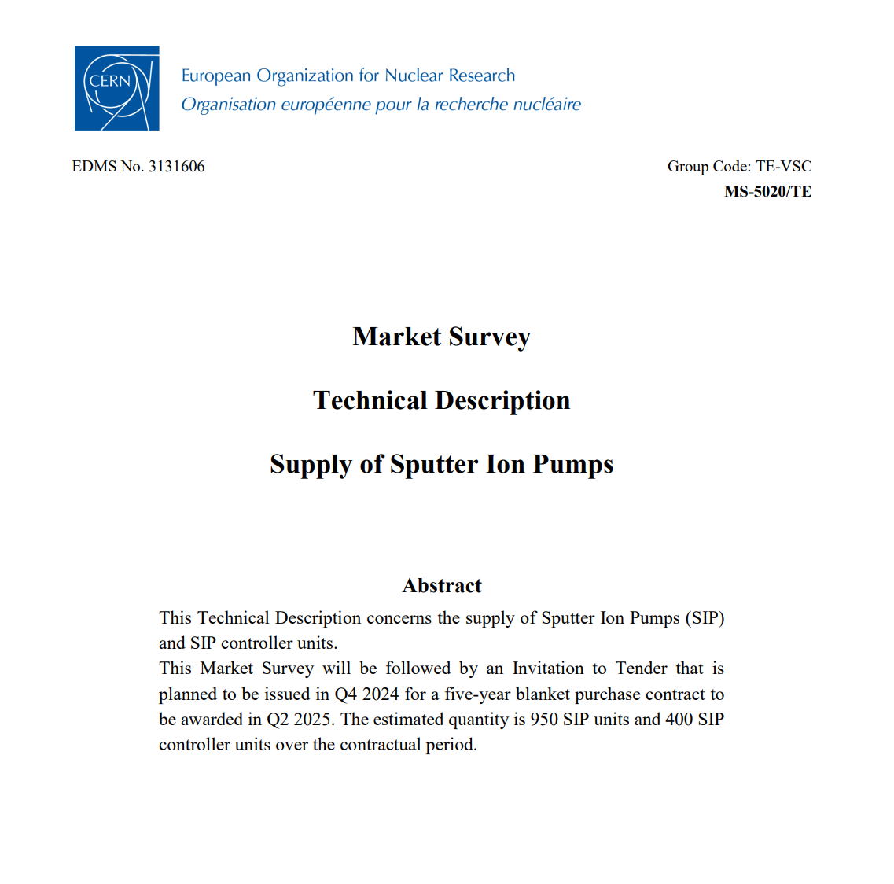
After Chiara left the group in 2023, on top of the Coordination of FSU activity and IS contracts, Nico took responsibility of the Coordination of VSC blanket contracts
Not sexy, but necessary work => Quickly he organized the documentation and launched the renewal of several contracts

Slide 3
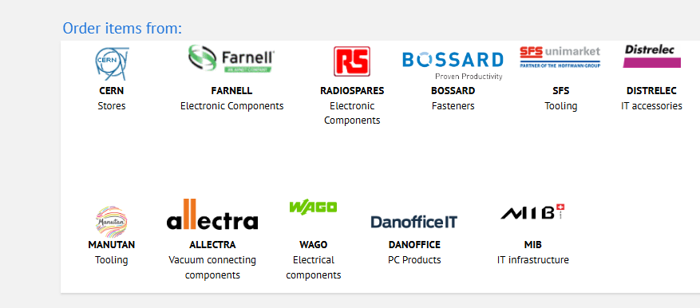
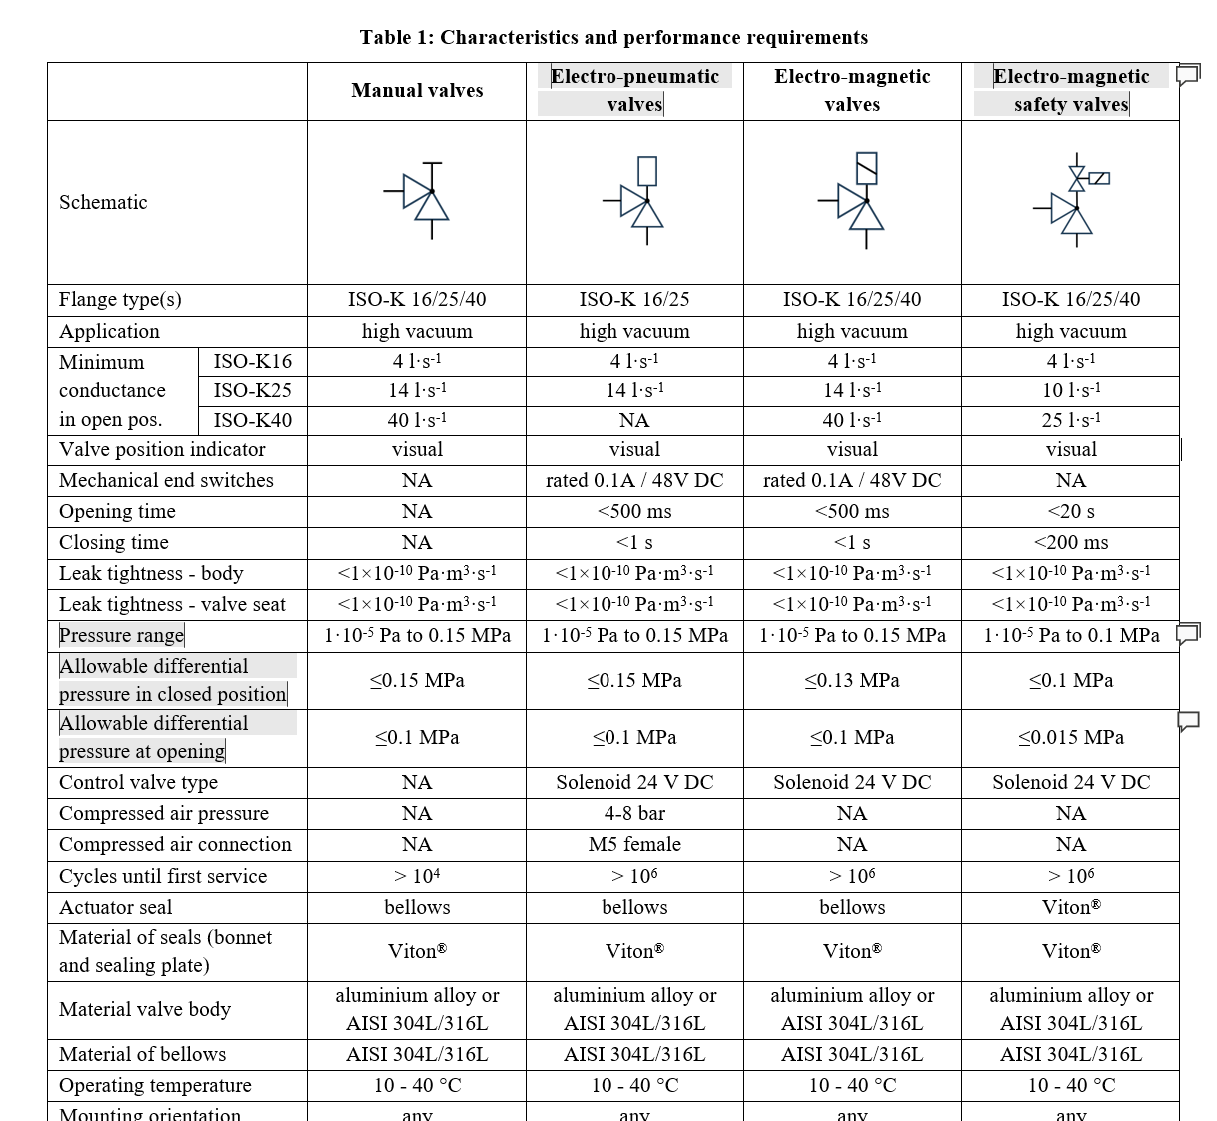
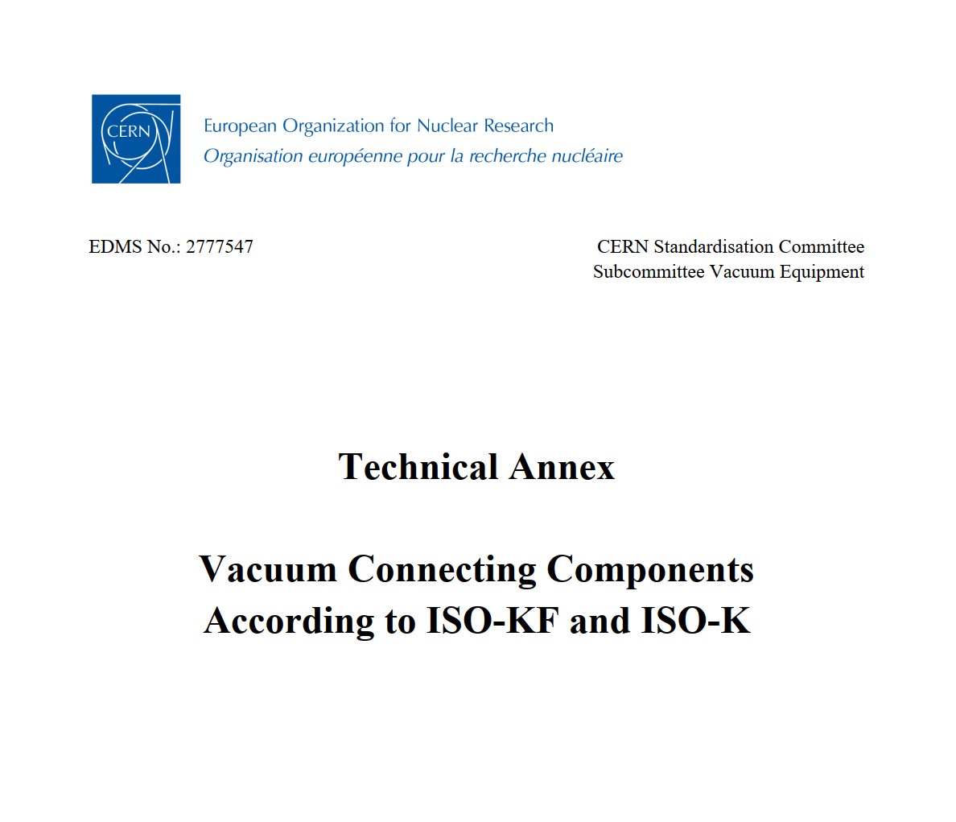
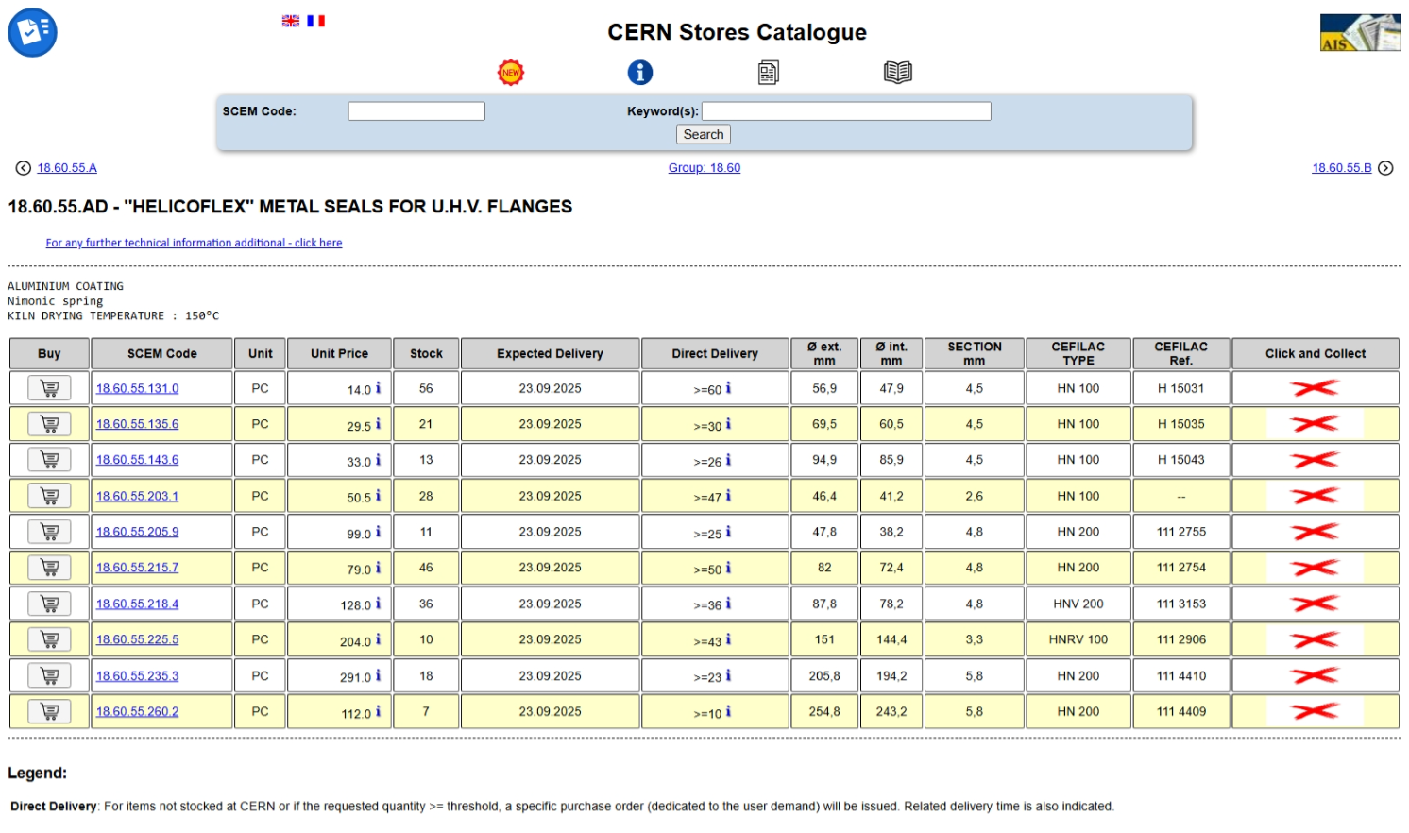
As coordinator of VSC blanket contracts and with his role as VSC representative at the CERN Standardisation Committee, he contributed to the rationalization of the vacuum components in the CERN stores and the update of the specs of old contracts managed by the stores.

Slide 4
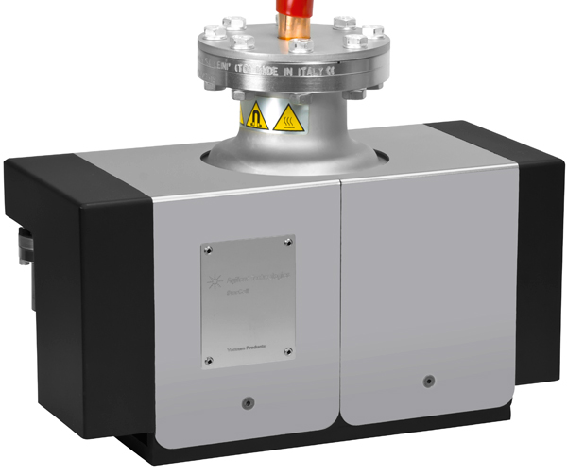
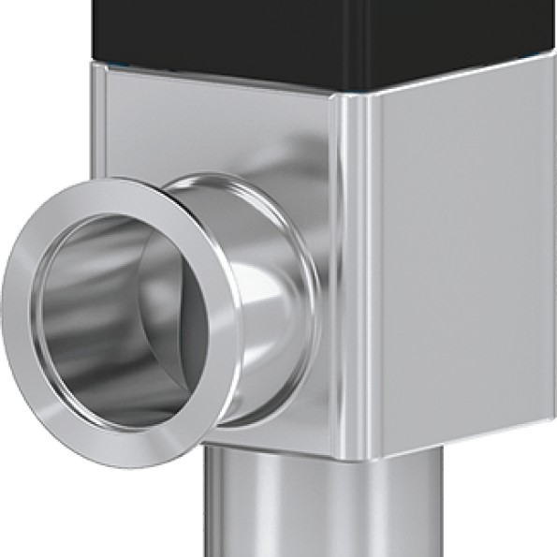
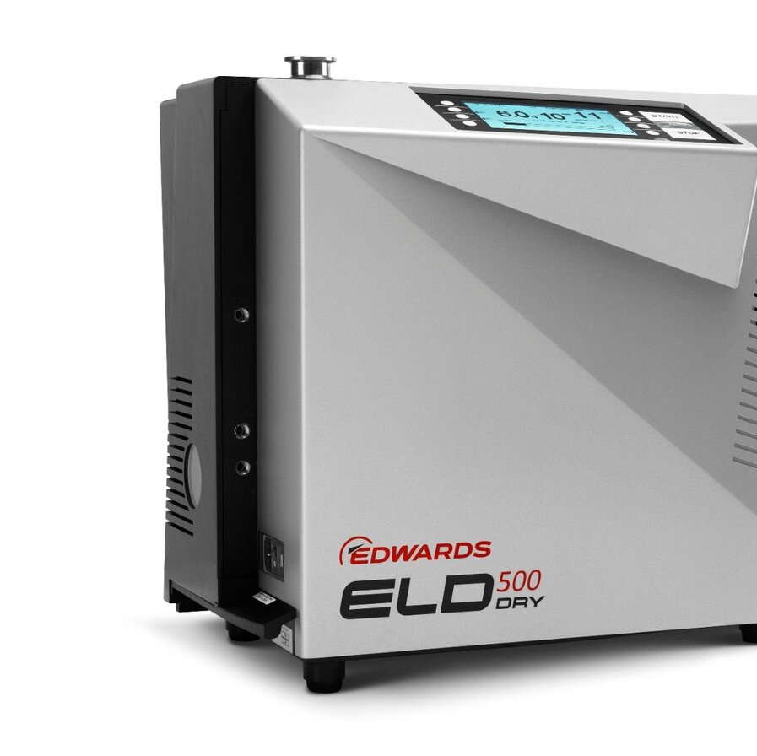
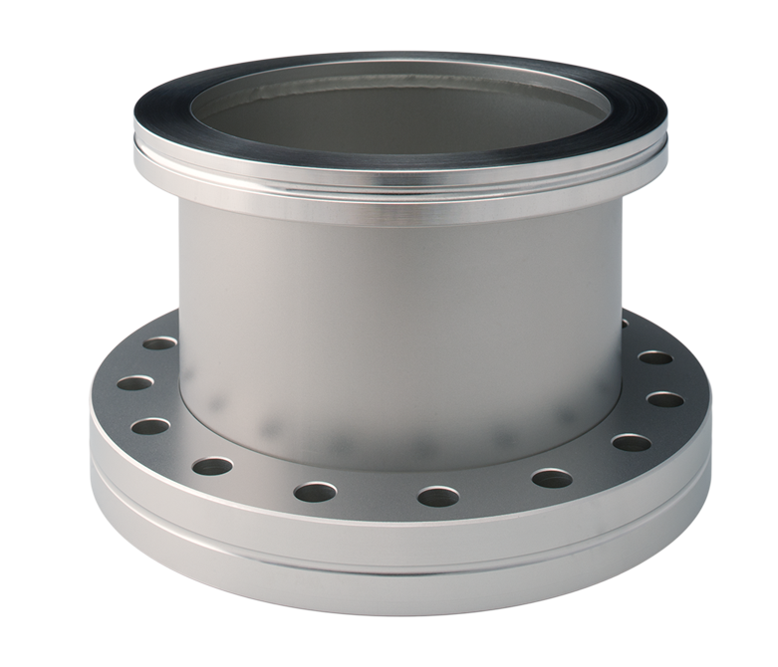
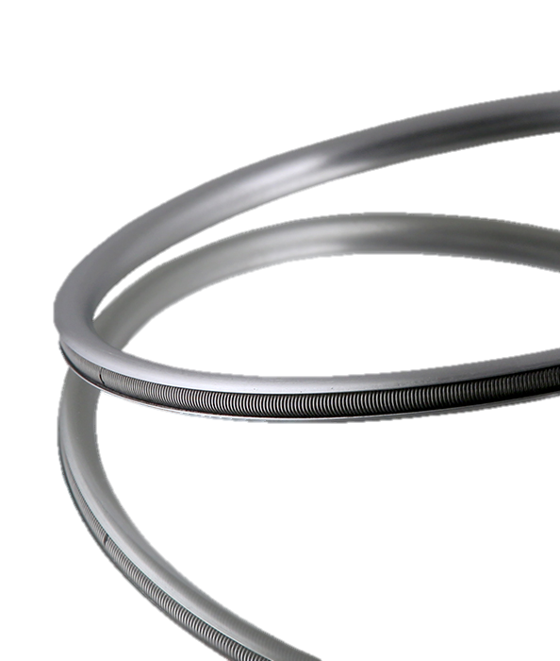
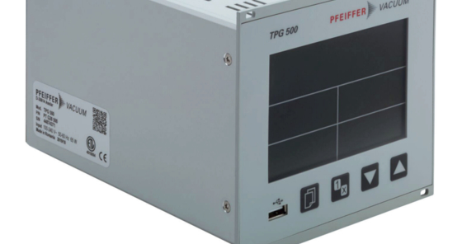
Each time you order one pump, valve or leak detector… Nico’s work made ours easier

