Slide 1
CERN’s web
Drupal
New core website
Common branding elements
Search
New top level domain

Slide 2

Drupal
Open source content management system
http://cern.ch/entice
Towards regulation?

Slide 3
New core website
Mark Boulton Design
public/, bulletin/, user/, press/
User research: surveys, interviews, testing
  Personas for public visitors
Prototype early, iterate
http://cern.ch/change

Slide 4
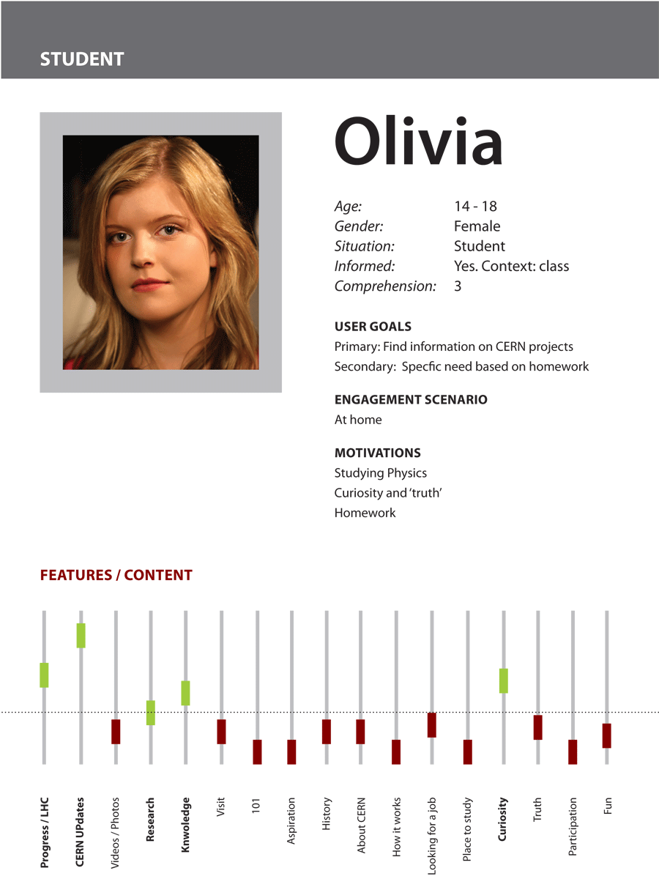

Slide 5
Common branding elements
CERN’s name – December Council
cern.ch/framework

Slide 6
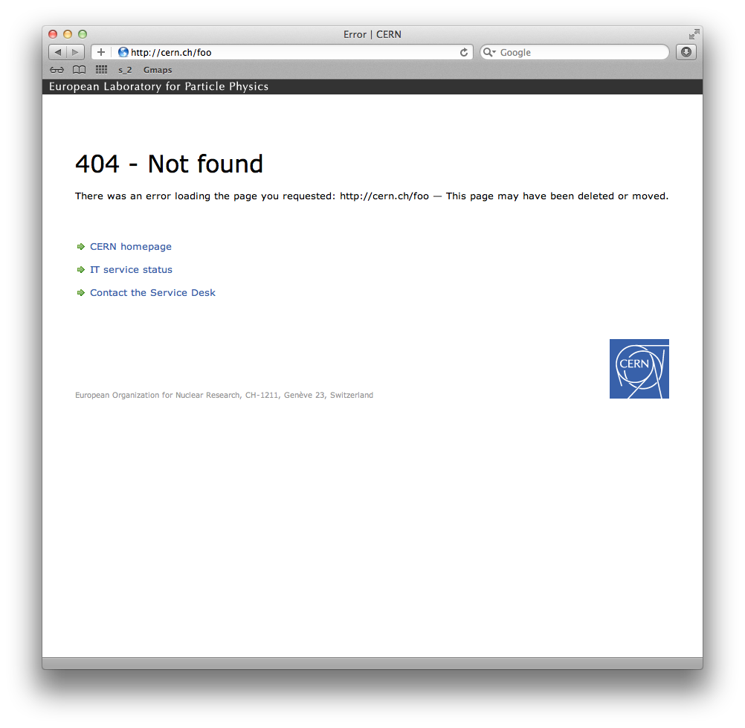

Slide 7
Search
Key feedback from users’ survey: CERN search isn’t good enough
IT working on new solution

Slide 8
New TLD
www.cern.ch
www.cern
lhc.cern
germany.council.cern
visit.cern

