Slide 1
Specification faux planché UR15/55
Stephane Maridor
CORRECTION LE 17/07/2025

Slide 2
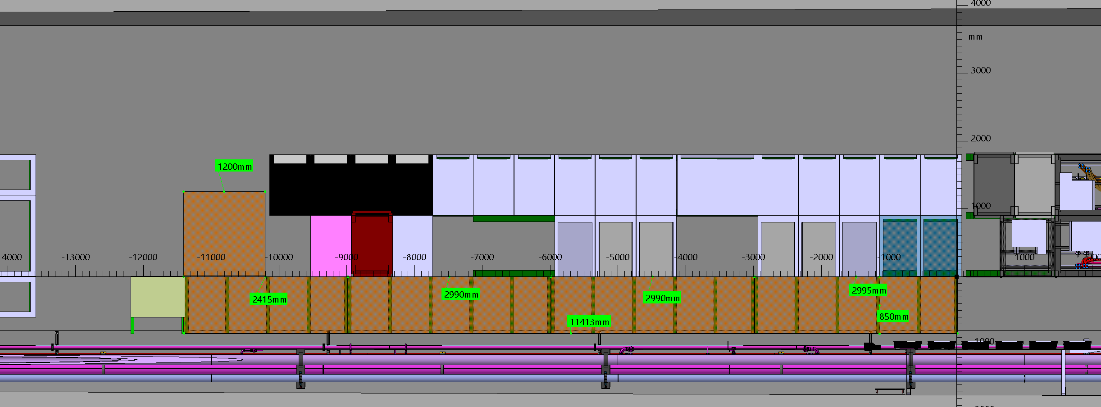
Faux planche DFHX B/J

Slide 3
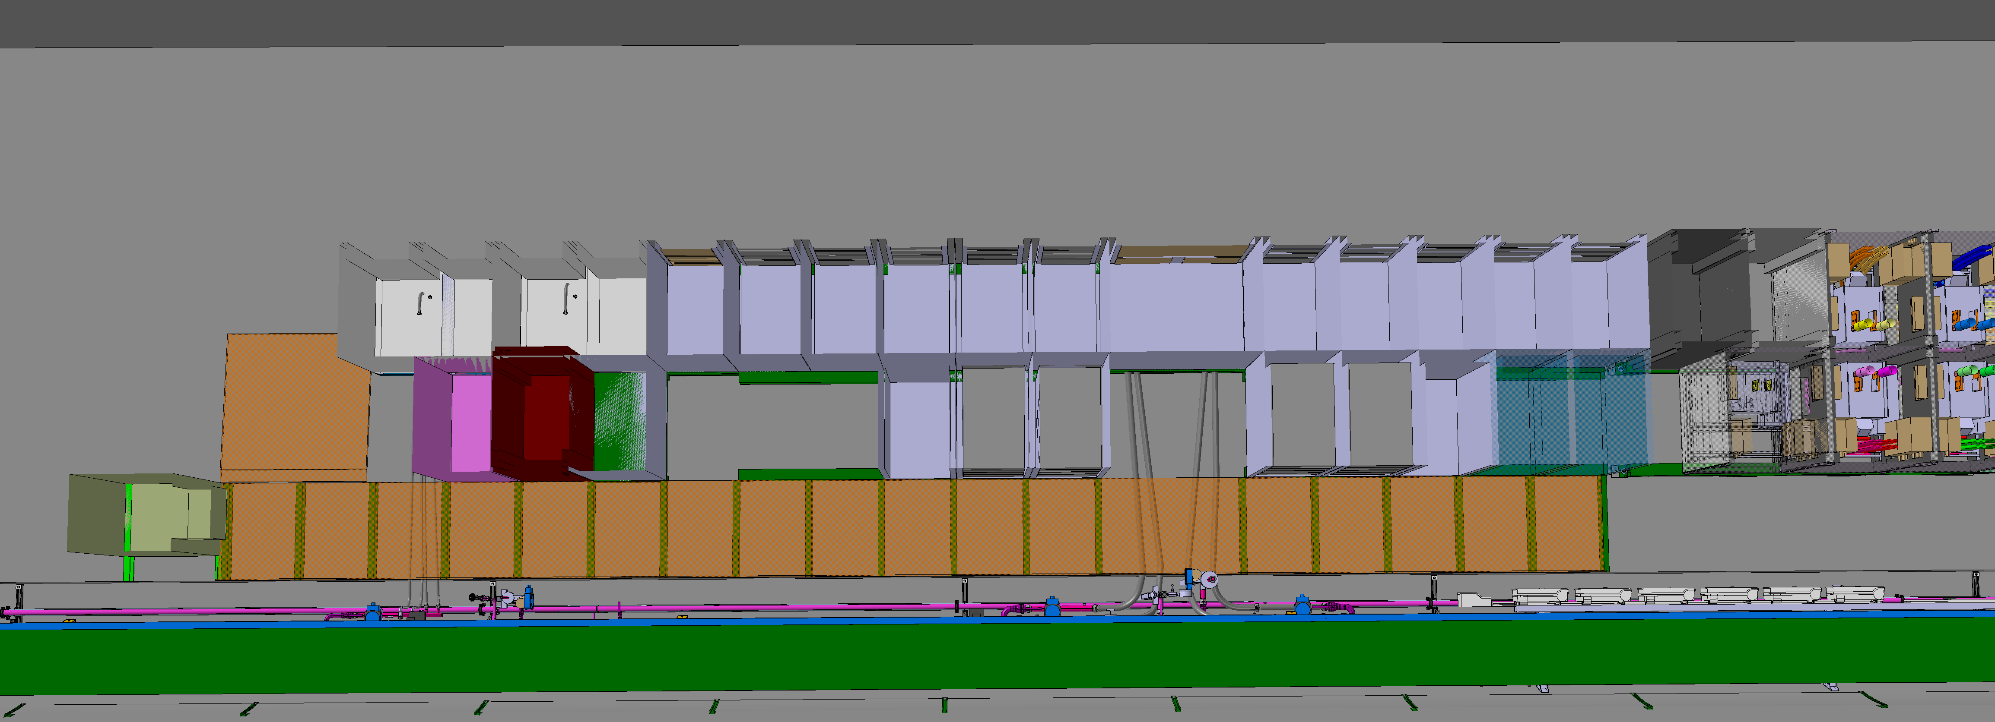
Faux planche DFHX B/J

Slide 4
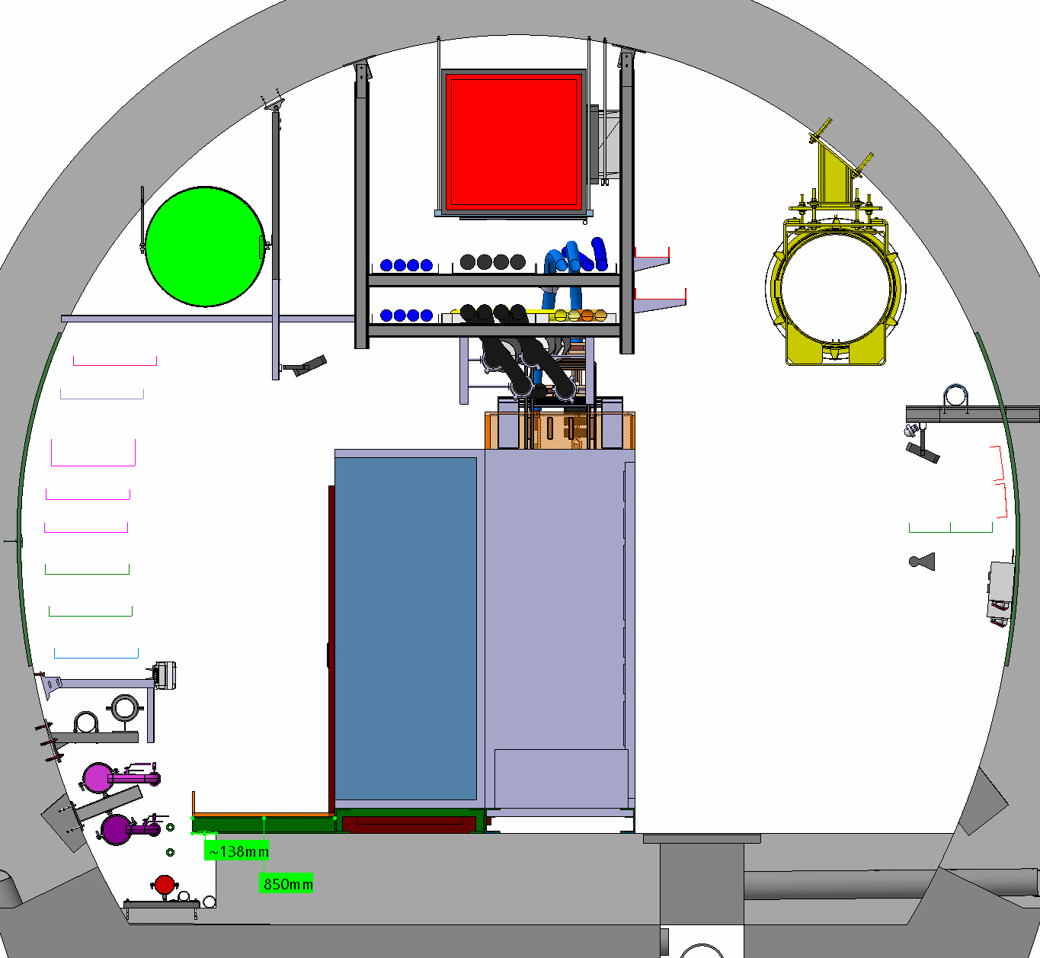
UR15

Slide 5
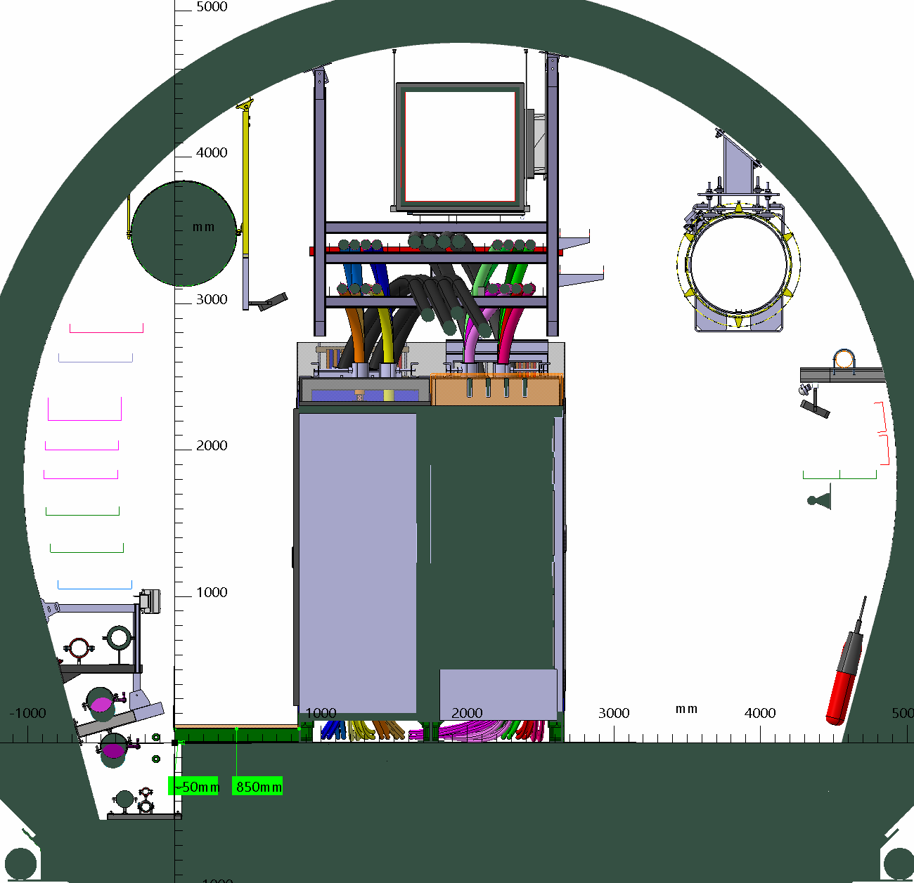
UR55

Slide 6
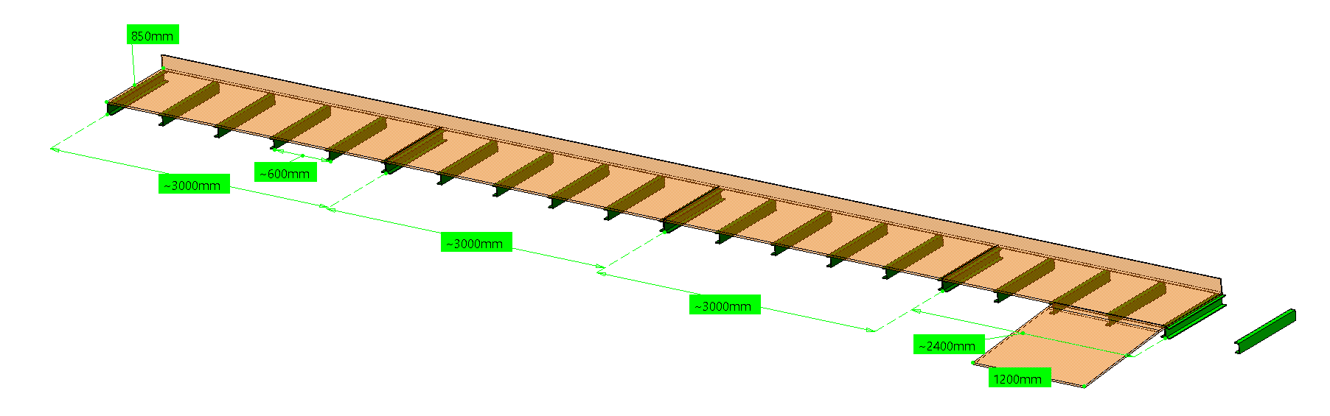
Faux planche DFHX B/J

Slide 7
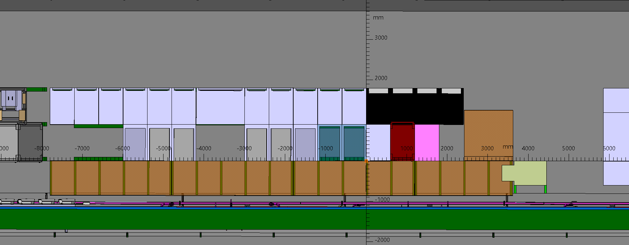
Faux planche DFHX A/I

Slide 8
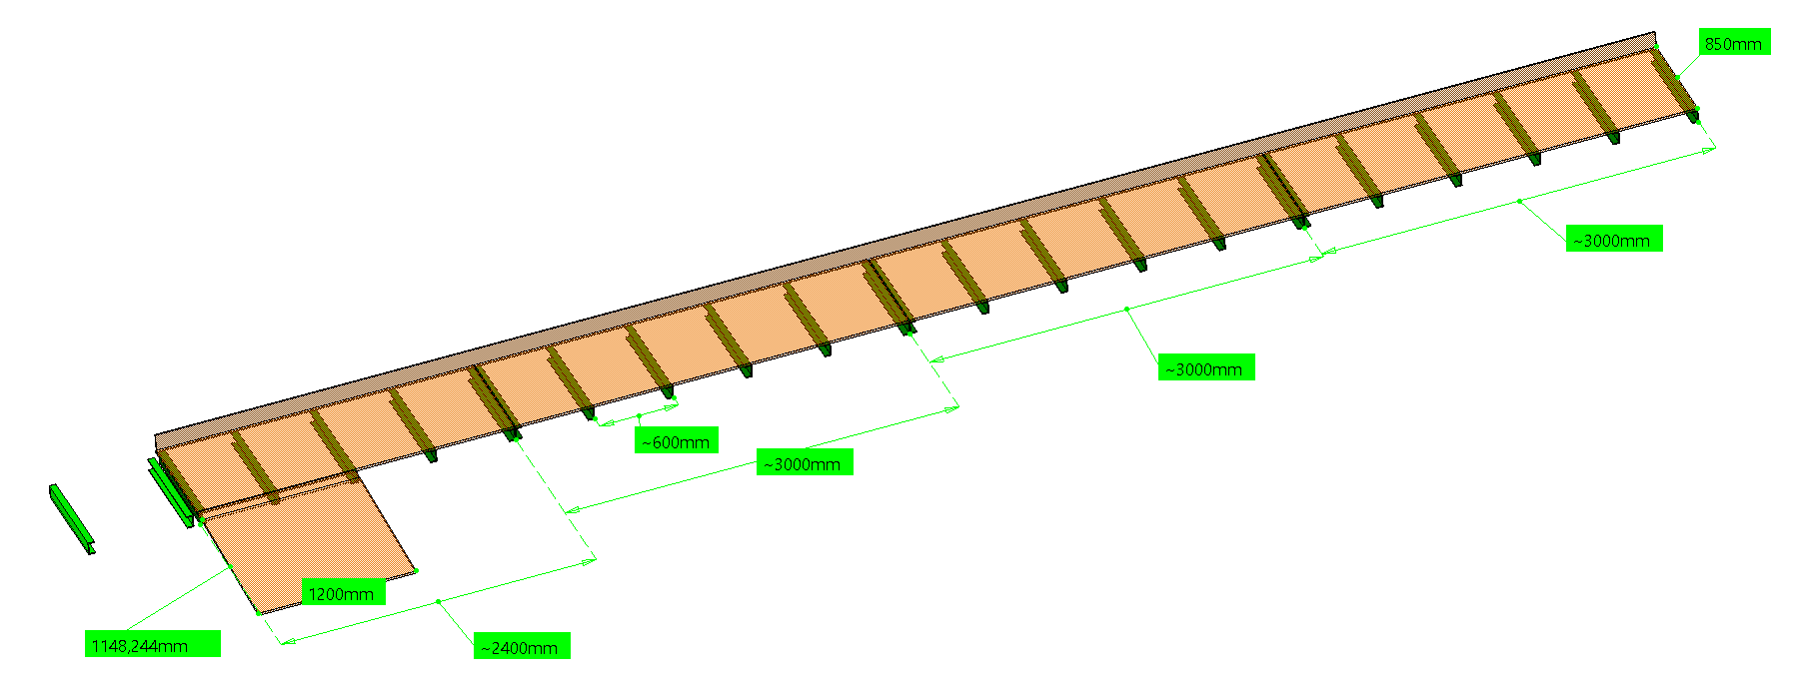
Faux planche DFHX A/I

Slide 9
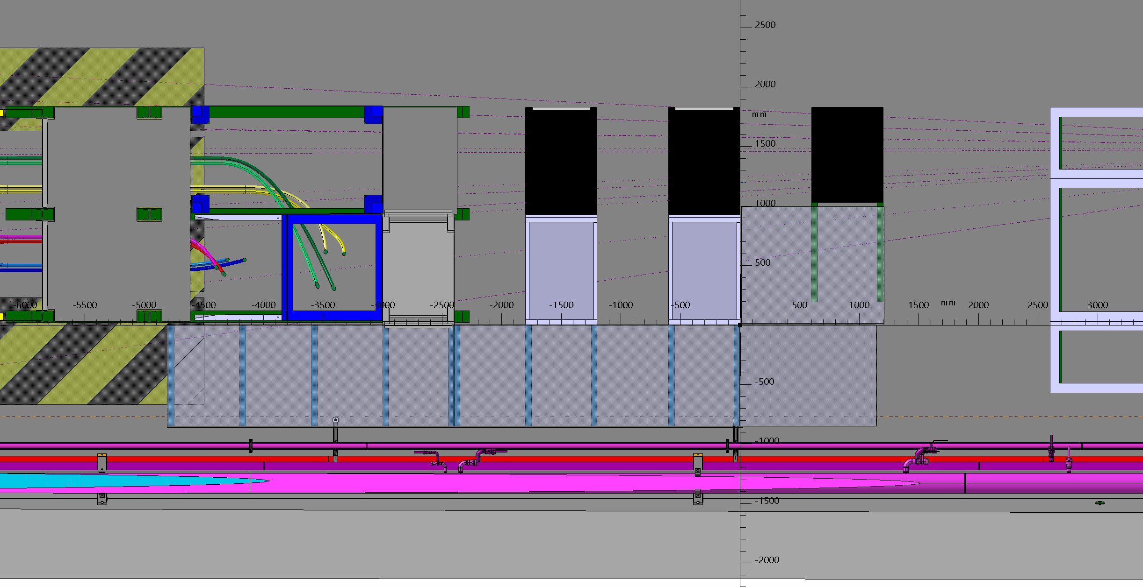
Faux planche DFHM B/J

Slide 10
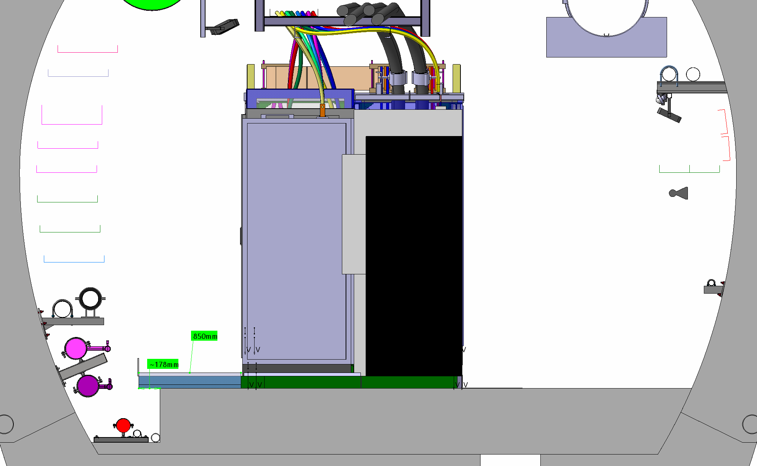
UR15

Slide 11
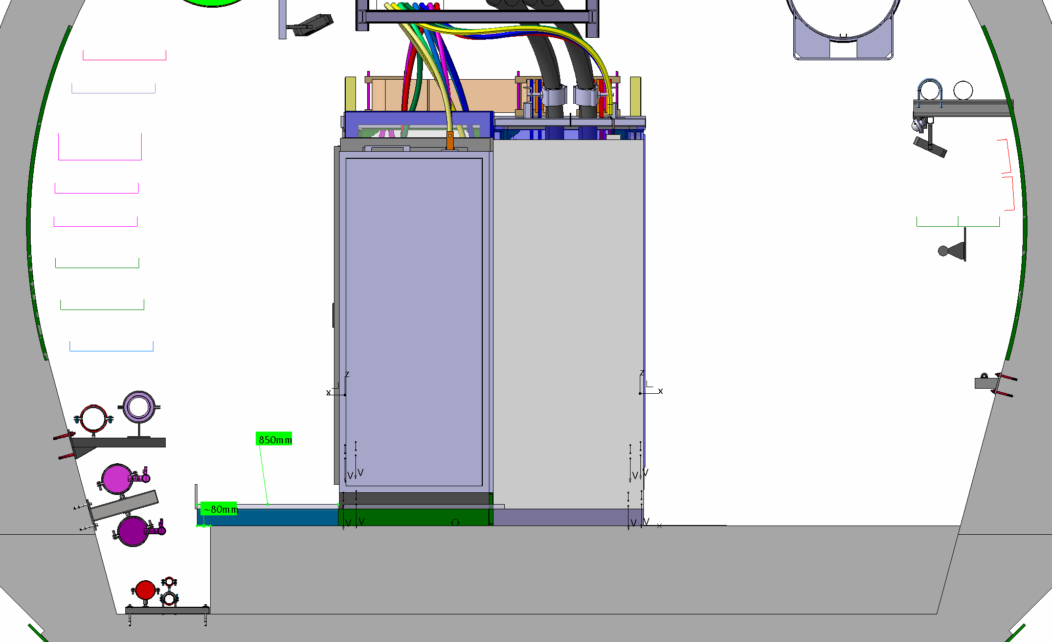
UR55

Slide 12
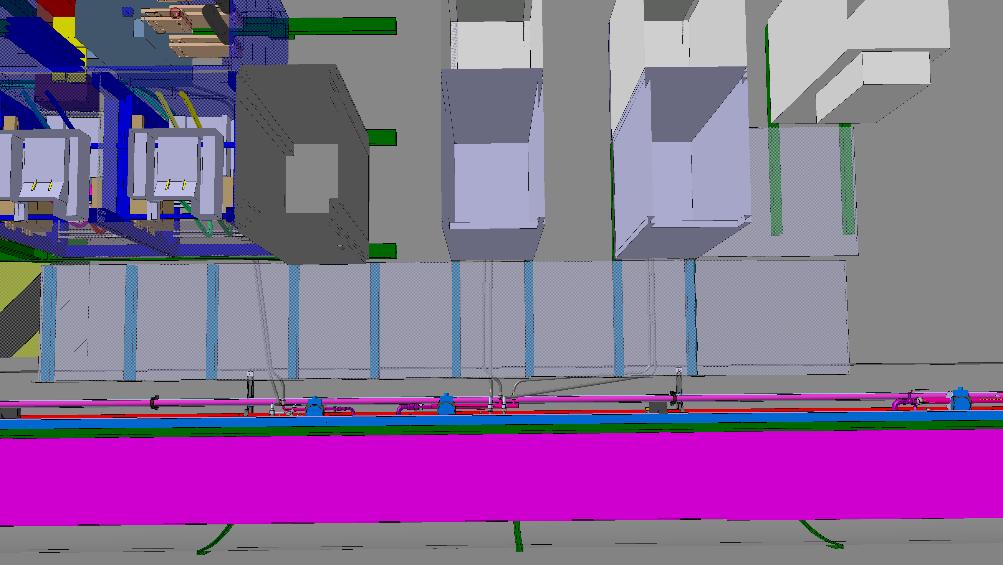
Faux planche DFHM B/J

Slide 13
Faux planche DFHM B/J

Slide 14
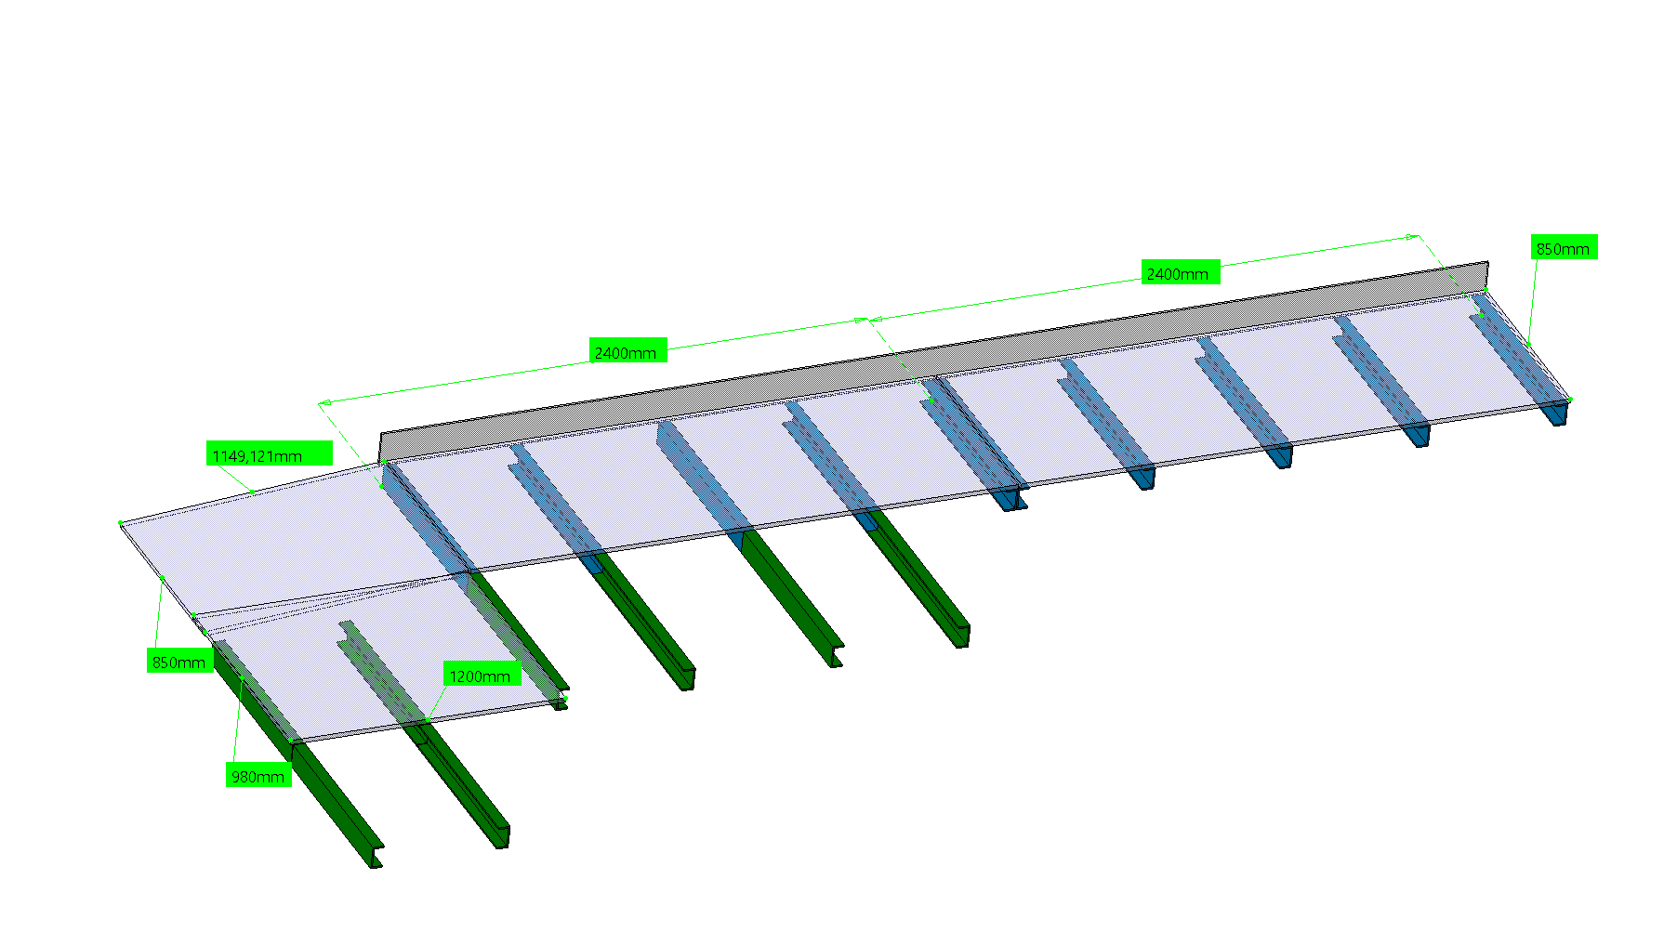
Faux planche DFHM B/J

Slide 15
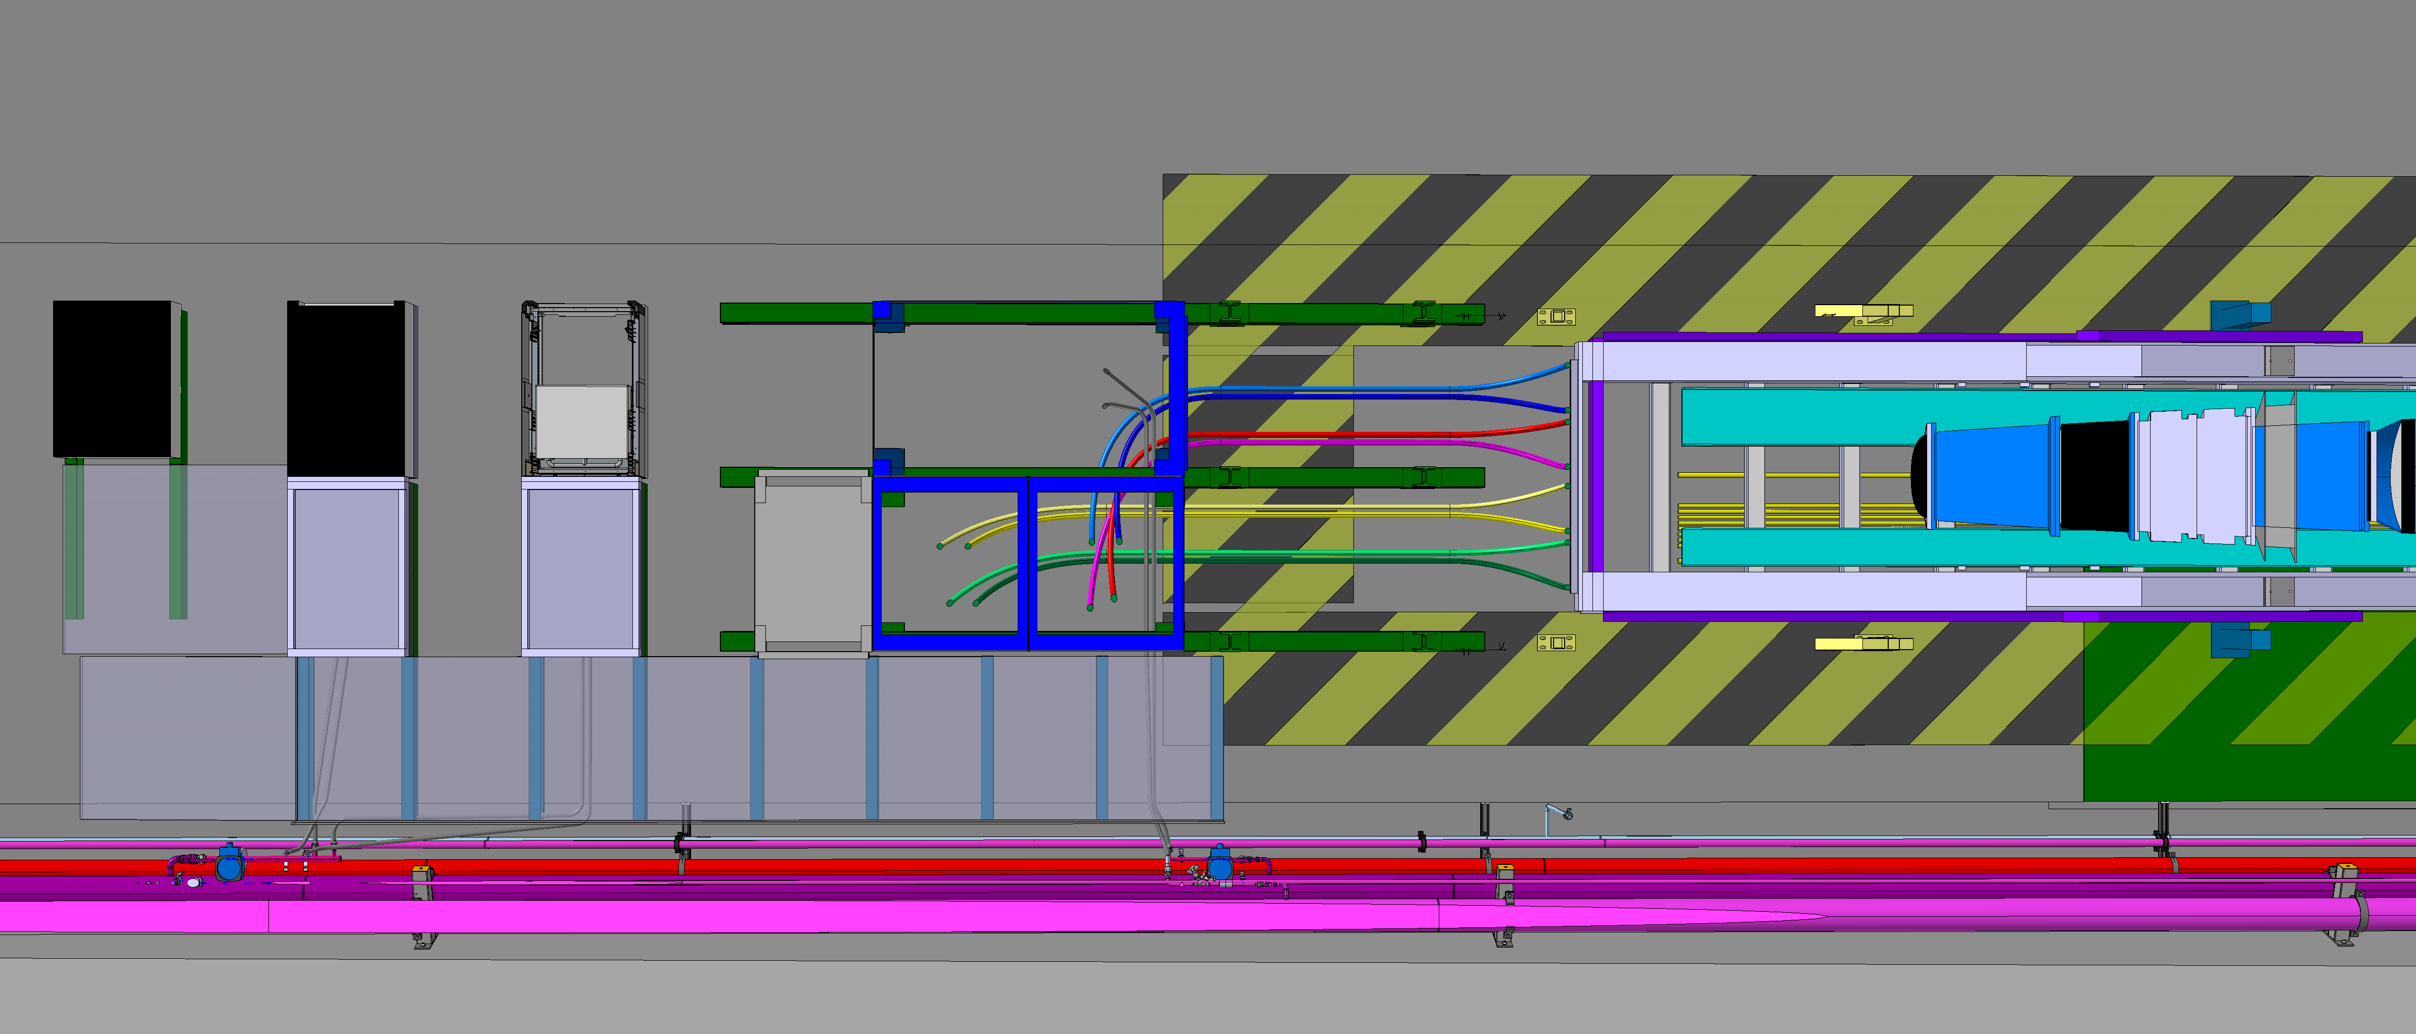
Faux planche DFHM A/I

Slide 16
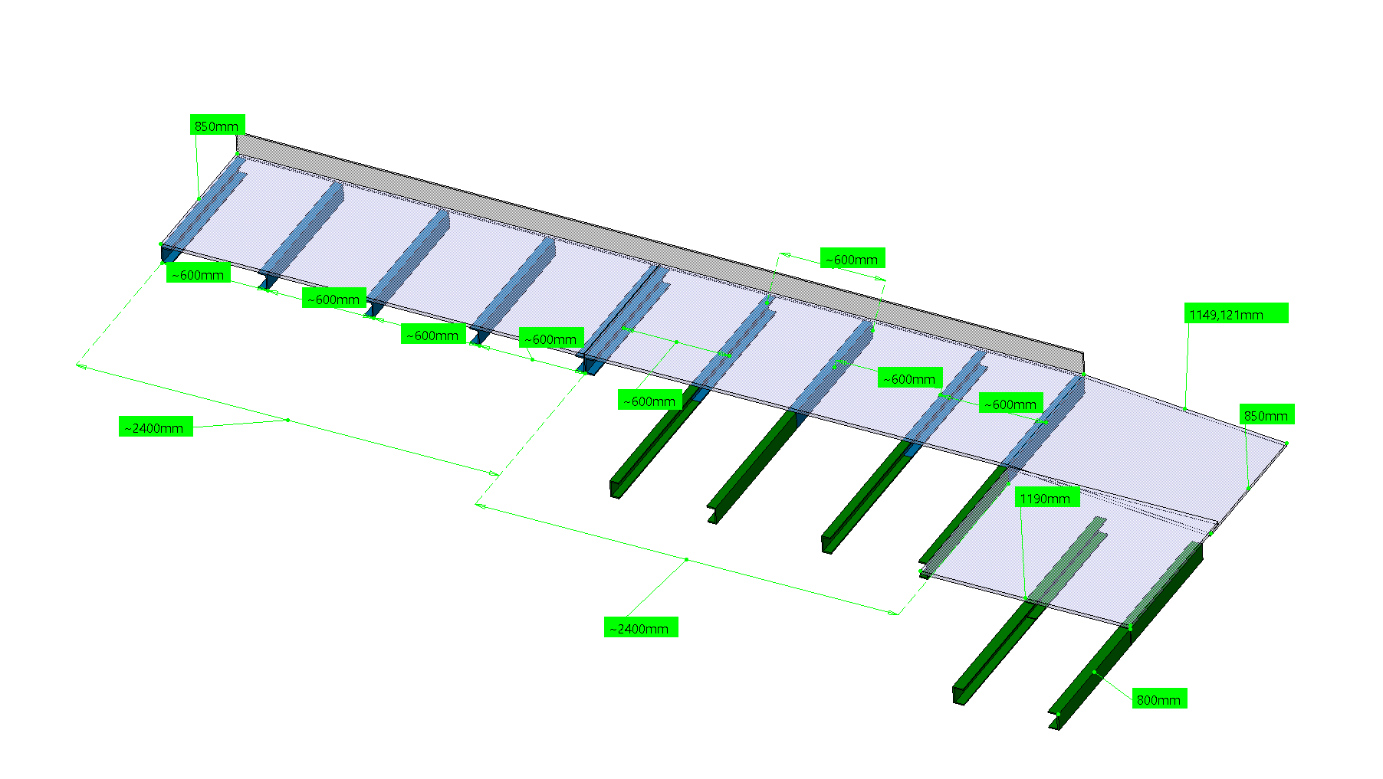
Faux planche DFHM A/I

