Slide 1
DRD 8 WP1 Introduction and Status Report
C. Gargiulo (CERN)
F. Palla (INFN Pisa)
CERN, 2 September 2025

Slide 2
DRD8 – WP1 projects
The Vertex Region of Future Particle Physics Experiments
Development of the next generation mechanics for advanced vertex layouts, including
Curved and tilted silicon sensors
Low radii vertex and retractable detectors
Ultra-light, high-vacuum leak tight beam pipes and vessels
Low mass hardware alignment systems for future vertex detectors
Machine Detector Interface and impact on Detector
Robots in the HEP Experimental Caverns
Development of robotic systems for inspection, monitoring, and first intervention in future high energy physics experiments even during the operation of beams
Legged ground robotic platform
Aerial robotic platform
Mini-robots swarm and mobile mesh network

Slide 3
DRD8 –WP1.3 (new!)
Will study the mechanics for a large gaseous central tracker.
It will simulate, design and build a prototype of a stereo drift chamber with unprecedented dimensions.
Study the carbon fibre based mechanical structure as well as the tension recovery system for the wires.
Careful selection of the wires with the help of a company for coating as light available wires are either electrically resistive, or prone to corrosion.
Current interested institutes
JCLAB Orsay (France)
INFN Bari and Lecce (Italy)
We will hear today

Slide 4
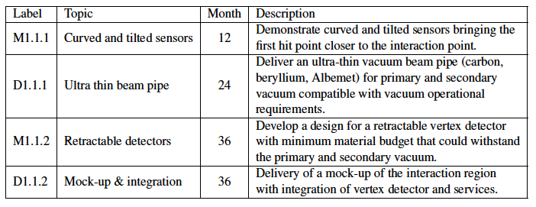
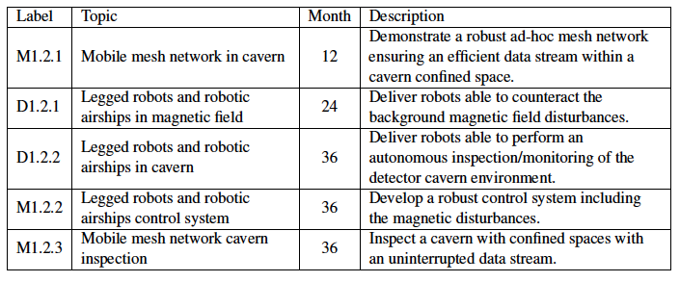
DRD8 – Deliverables and milestones

Slide 5
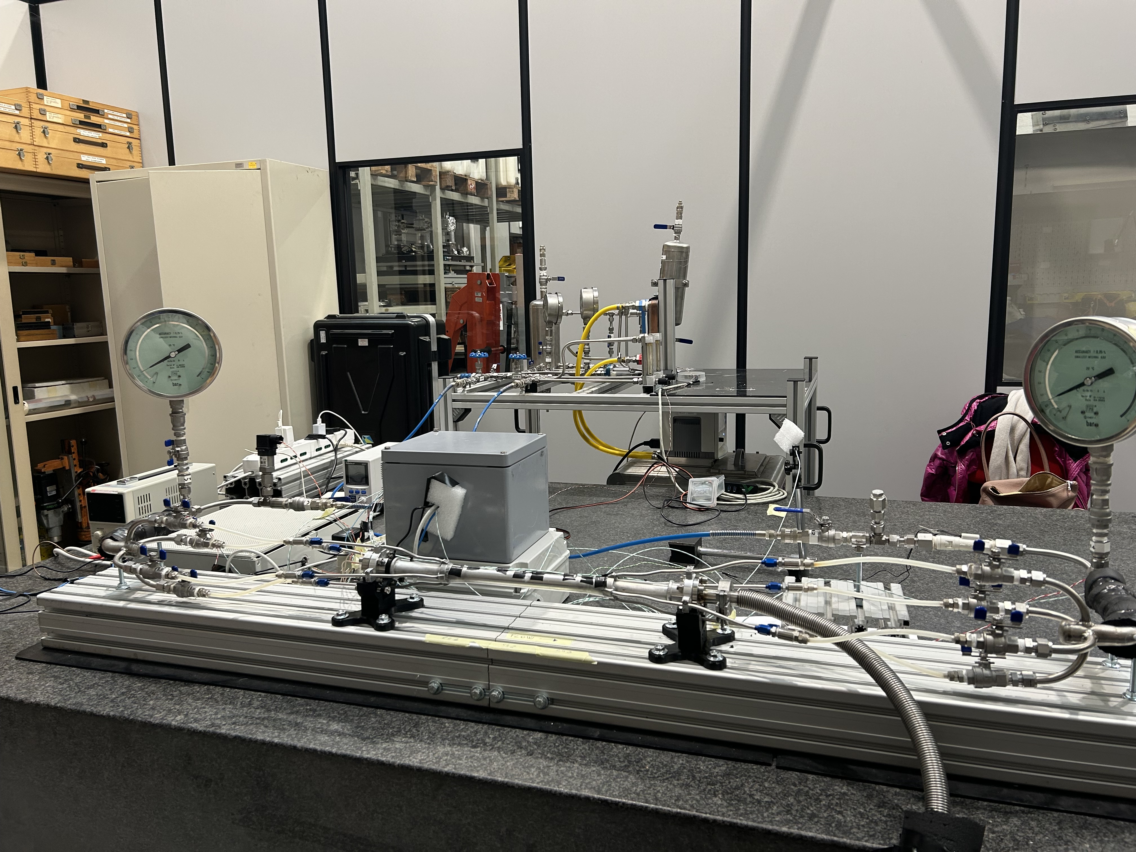
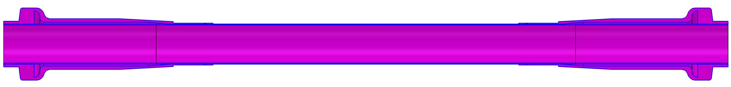
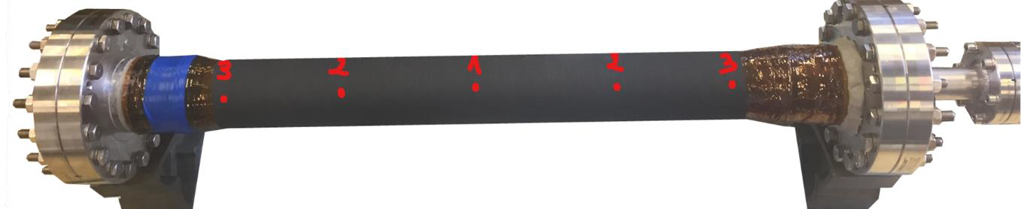
DRD8 – WP1.1
D1.1.1 Ultra-thin beam pipes
On track
IHEP: CepC
Design study done
To be fabricated
LNF: FCC-ee
Design study done
Prototypes delivered and under test (in aluminium)
Big differences
Started
CERN: Carbon fibre based for FCC-ee
IHEP
LNF
 | CepC | FCC-ee
Inner layer thickness (mm) | 0.20 | 0.35
Outer layer thickness (mm) | 0.15 | 0.35
Gap width (mm) | 0.2 | 1
Inner gold coating shield (µm) | 10 | 5

Slide 6
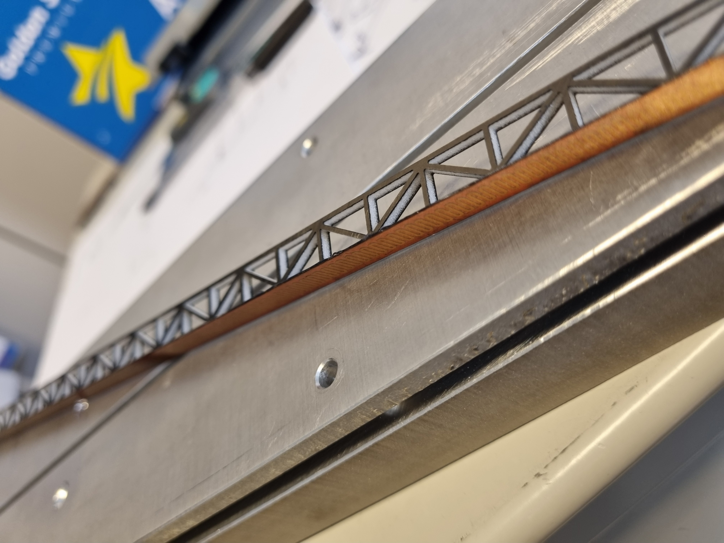
DRD8 – WP1.1
M1.1.1 & M1.1.2 Vertex detectors (curved and tilted detector mechanics)
On track:
CERN: Retractable and curved detectors mechanics
Retractable mechanic prototype in hand
Pisa: air cooled reinforced stave
Module mechanics designed and few prototypes done
Air cooling setup up and running

Slide 7
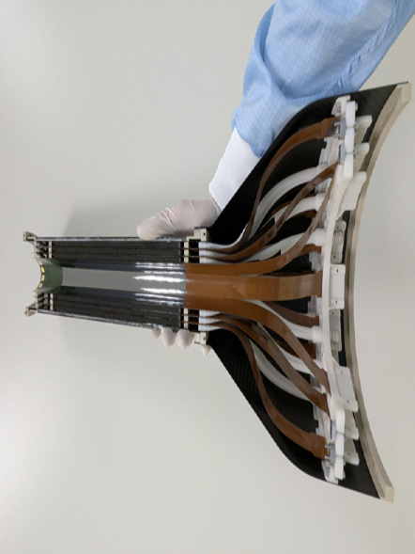
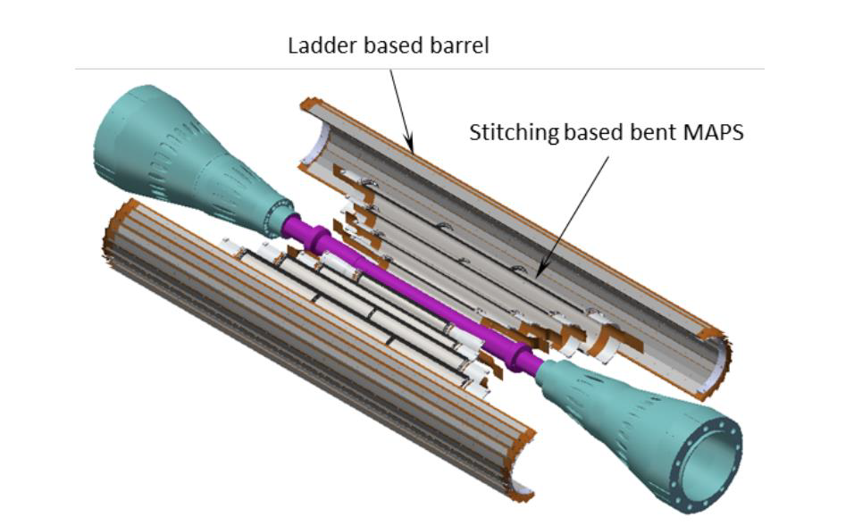
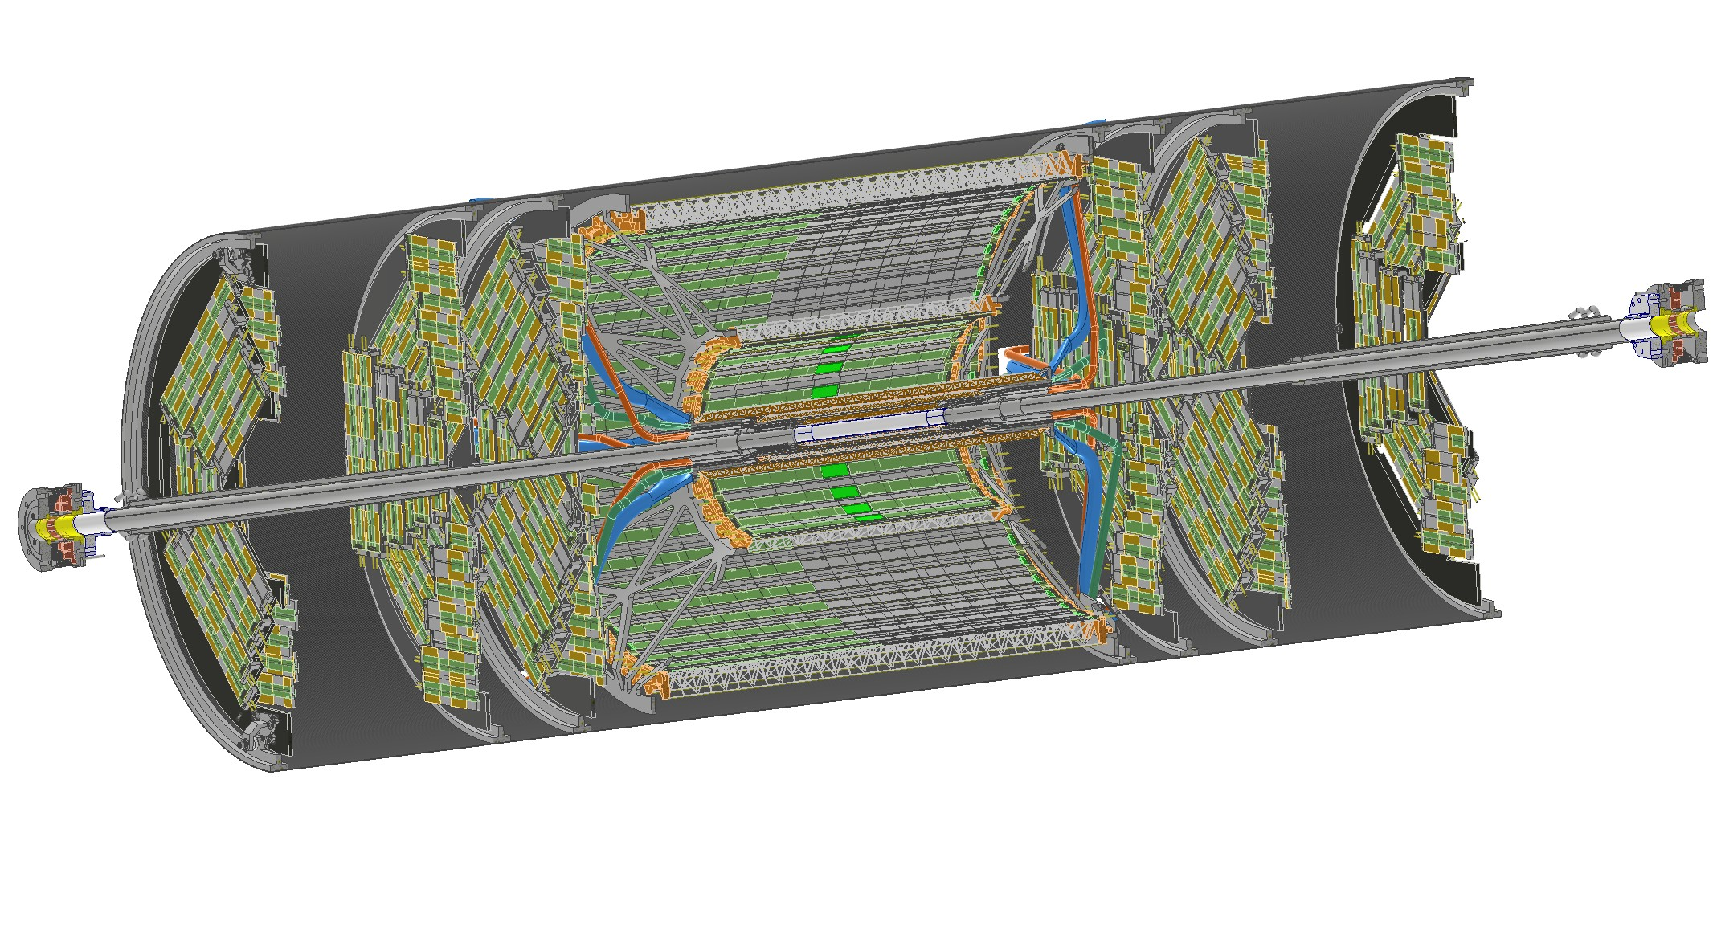
DRD8 – WP1.1
D1.1.2 Mock up and integration
On track
CERN: ALICE ITS3
Mechanics FPC for power/signals & wire bonds and dummy modules
IHEP: CepC
Design finished
Prototype to be built
LNF- Pisa & CERN: FCC-ee
Design finished
Prototype to be built
LNF
IHEP

Slide 8
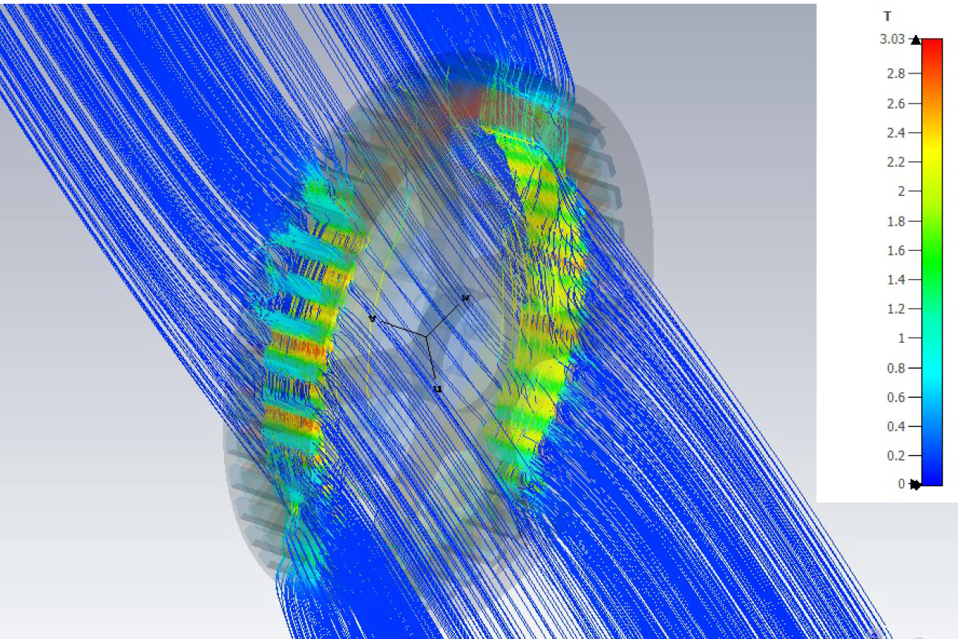
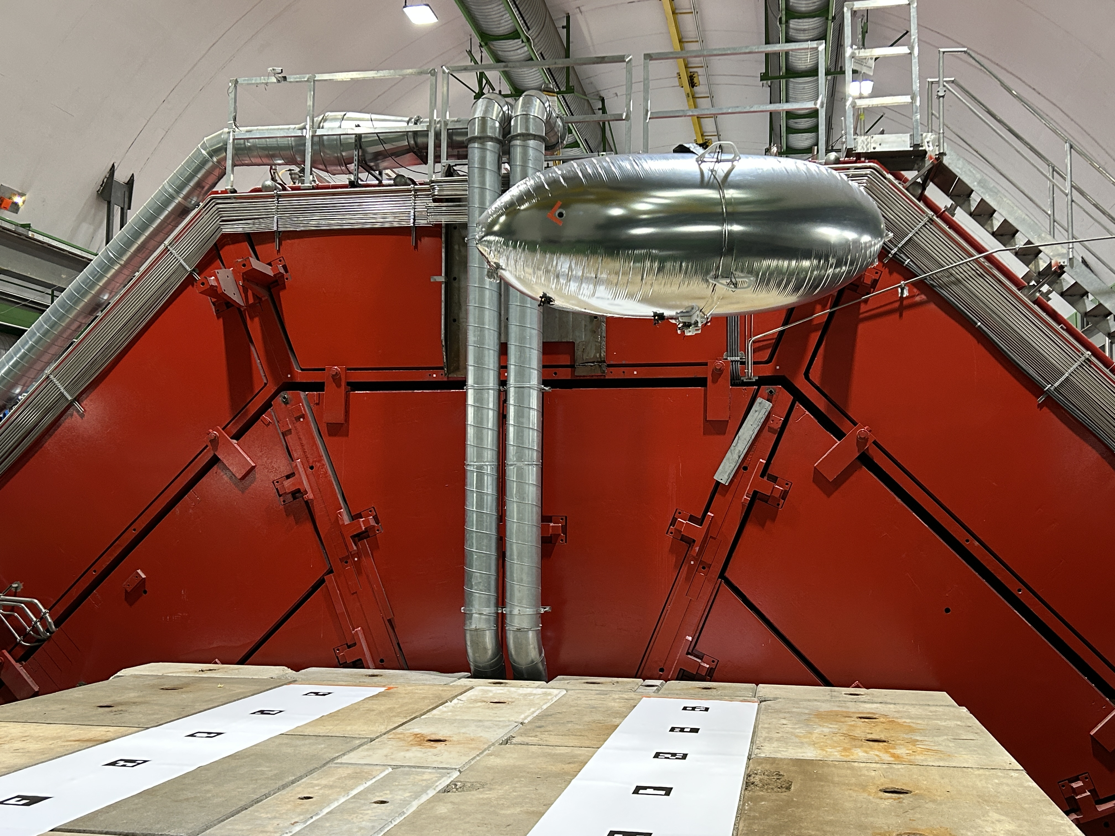
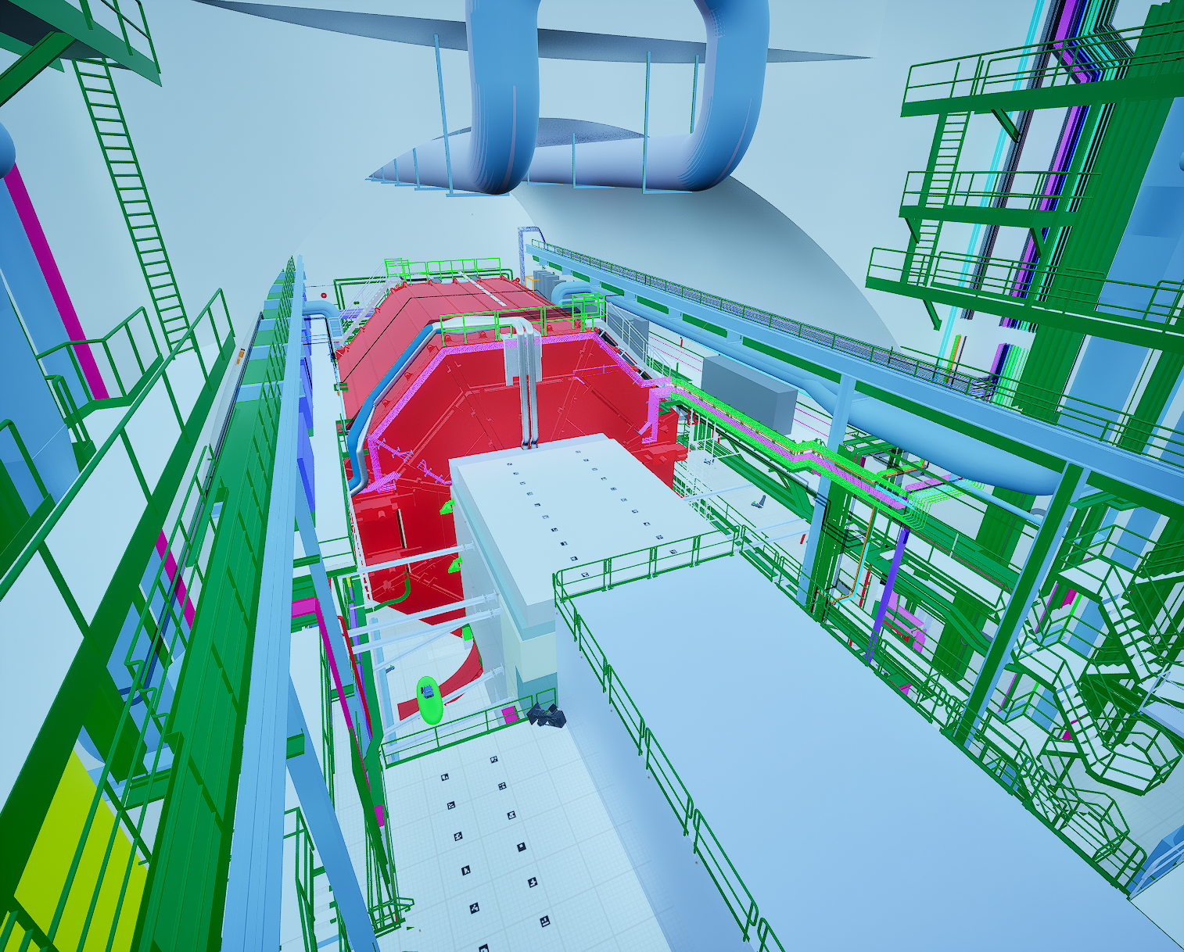
DRD8 – WP1.2
D1.2.1 & M1.2.2 Legged robots and robotic airships in magnetic field
On track:
CERN EP R&D and BE-CEM-MRO: Legged robots
Sensorless EM motor withstanding magnetic fields up to 100 mT
Model for estimation of mechanical disturbances induced by magnetic field on EM motors
Control system for rejection of magnetic disturbances on EM motors
CERN EP R&D: Blimp
Autonomous flight inside cavern background magnetic field
Virtual environment for control system validation

Slide 9
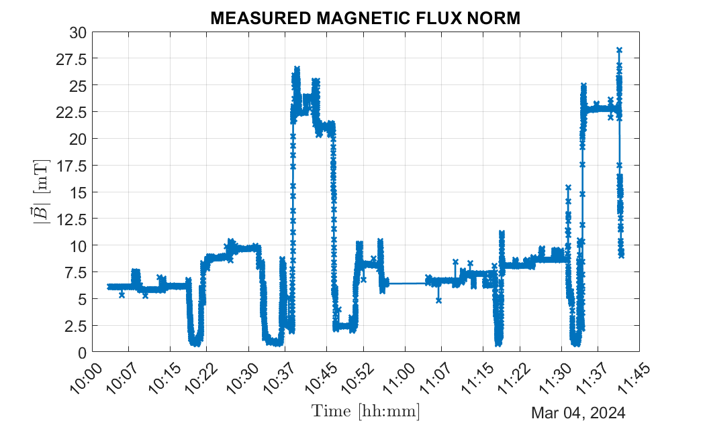
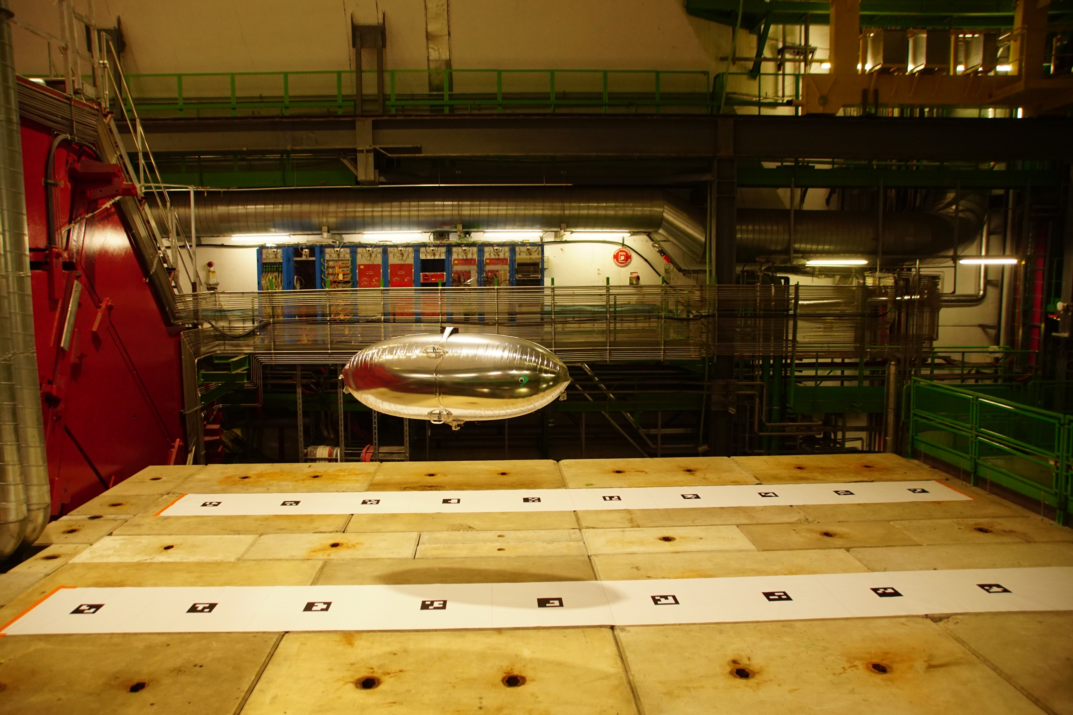
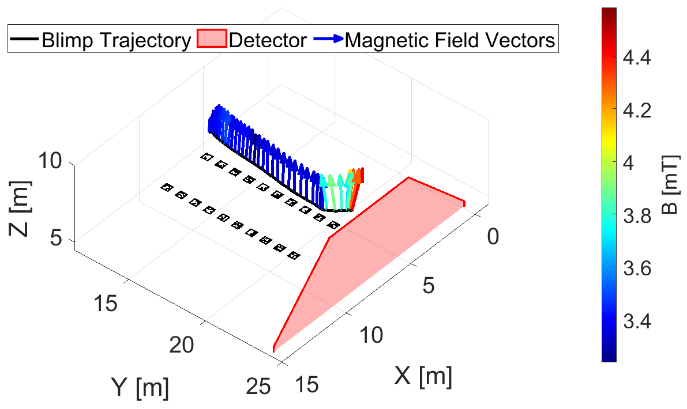
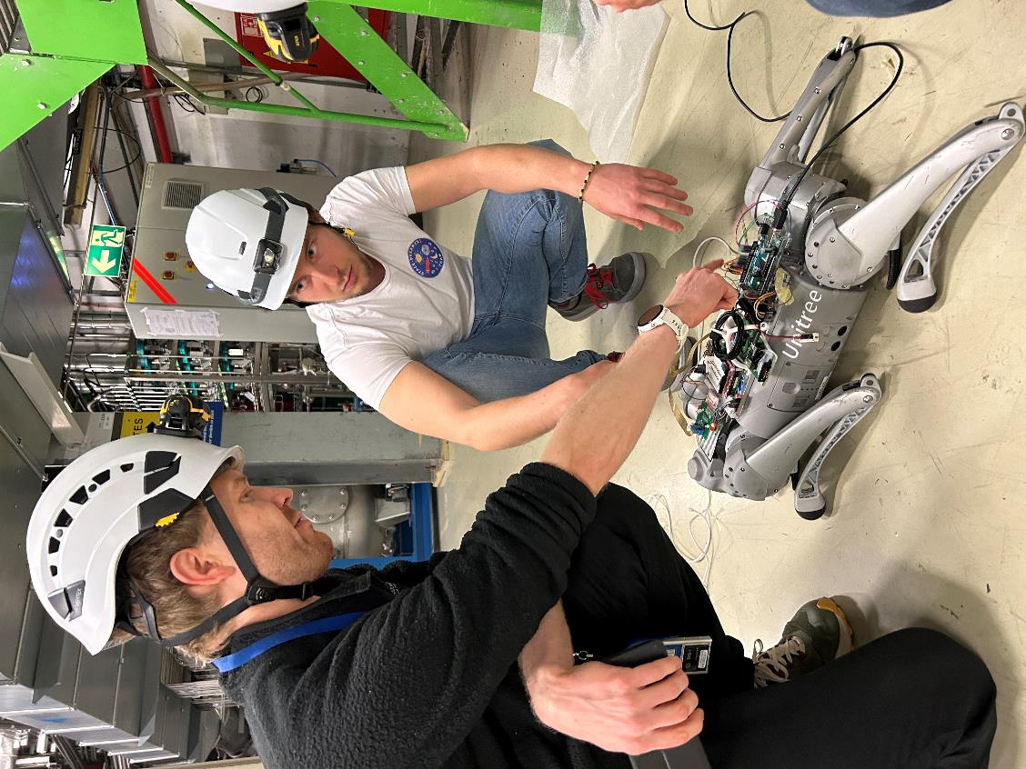
DRD8 – WP1.2
D1.2.2 Legged robots and robotic airships in cavern
On track:
CERN EP R&D and BE-CEM-MRO: Legged robots
Mobility test in the cavern (no magnetic field, no beam)
Test in the cavern background magnetic field monitoring the field intensity throughout the test
CERN EP R&D: Blimp
3D spatial mapping of the cavern background magnetic field

Slide 10

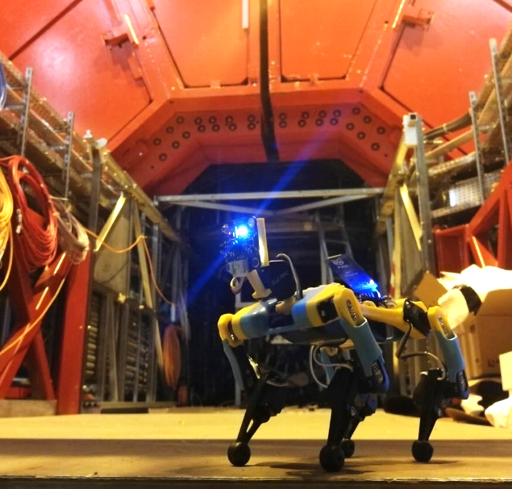
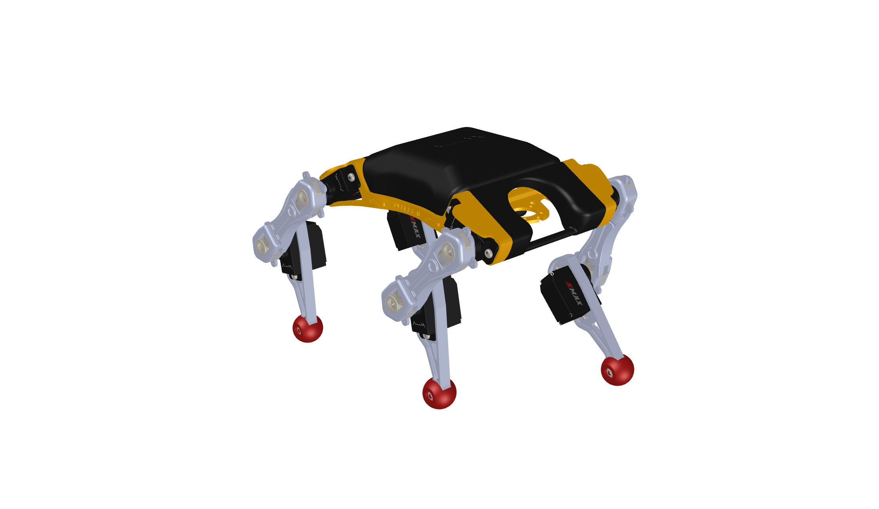





DRD8 – WP1.2
M1.2.1 & M1.2.3 Mobile mesh network
On track:
CERN EP R&D:
Developed a mobile mesh network
and tested it in a controlled environment
CERN Network
Remote Control Station
CERN Network Not Available

Slide 11
News
DRD8 Collaboration meeting
October 14 2025 at CERN
https://indico.cern.ch/event/1573561/
DRDC Jamboree
October 29 2025 at CERN
https://indico.cern.ch/event/1552124/

