Slide 2

An introduction to the High Intensity ECN3 Project: SPS Beam Dump Facility
M. Fraser (SY-ABT-BTP) presenting on behalf of the HI-ECN3 Project Team
Service cell preliminary design study, Bilfinger, Venissieux, France
1^{rst} September 2025
https://hiecn3.web.cern.ch

Slide 3

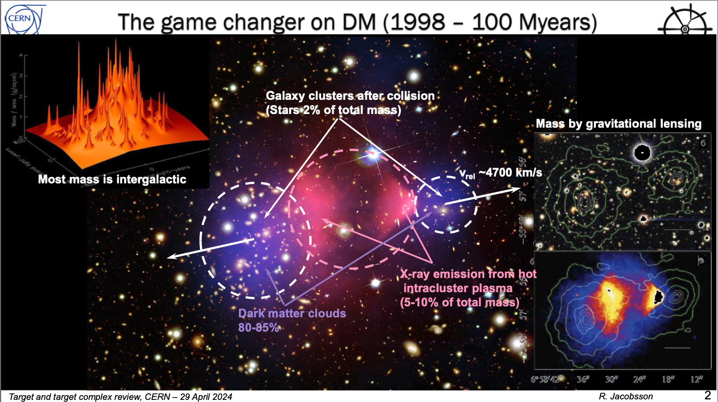
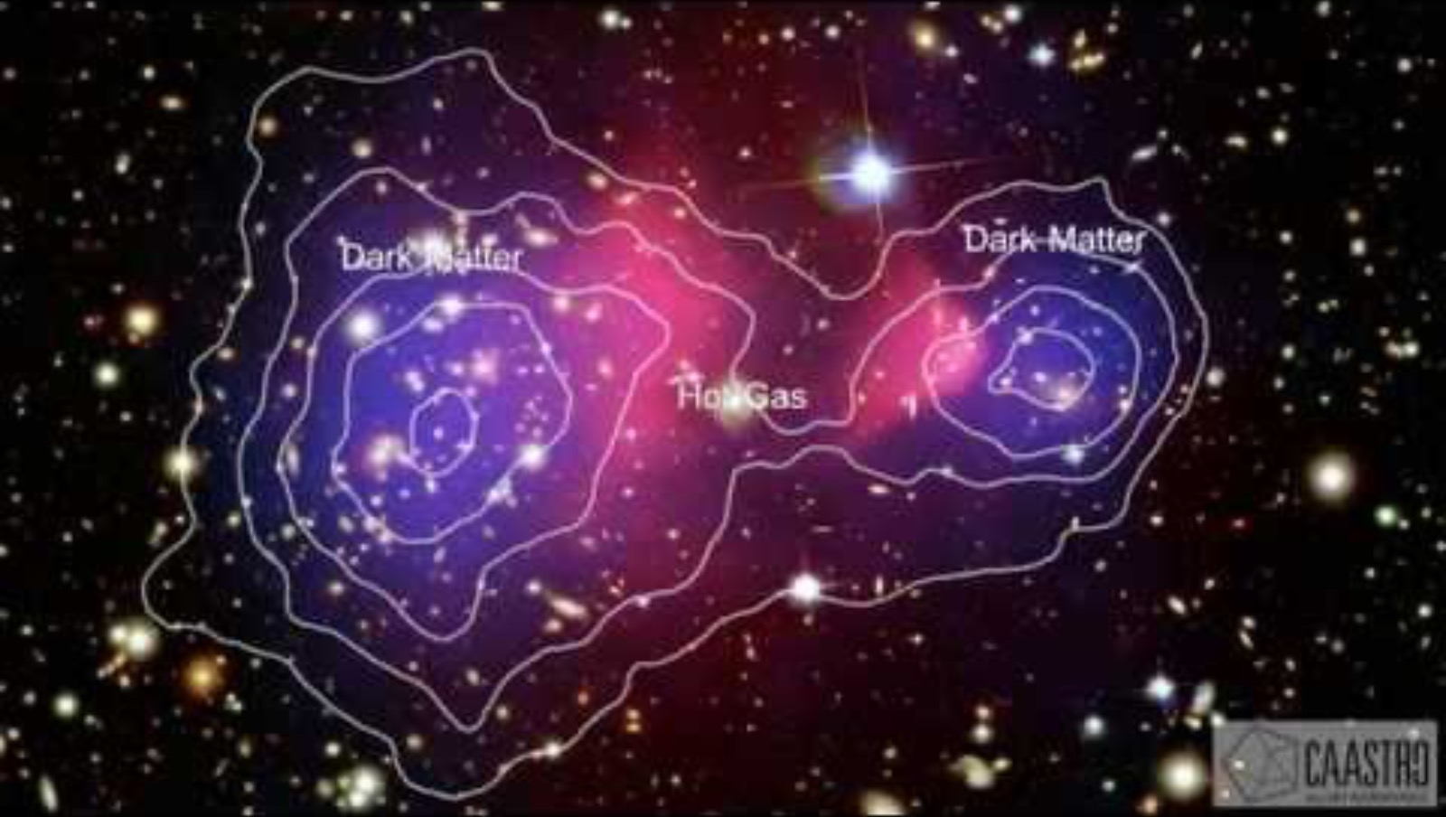
R. Jacobsson, Introduction to SHiP, presented at the HI-ECN3 BDF Target & Target Complex Initial Review, 29 April 2024
Matthew FRASER | HI-ECN3 and the BDF

Slide 4
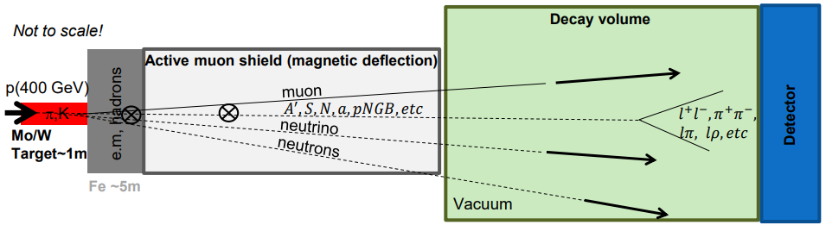
Beam Dump Facility (BDF) / SHiP
Direct search for Feebly Interacting Particles (FIPs) at a new Beam Dump Facility to be installed in ECN3 to exploit 4×10¹⁹ protons (400 GeV/c) per year for 6×10²⁰ POT over 15 years to overcome the small cross-section of ultra-rare events:
SHiP Physics Proposal: Rep. Prog. Phys. 79 (2016) 124201 published 2016
SPS Beam Dump Facility Comprehensive Design Study: CERN-2020-002 published 2020
High energy → production of charmed and beauty mesons
High ppp & POT → overcome small production cross-section of rare events of hidden particles
High ρ, Z & A → maximize p⁺ interaction
Shortest λ → force absorption of K & π to reduce muon & neutrino background
R. Jacobsson
Matthew FRASER | HI-ECN3 and the BDF

Slide 5


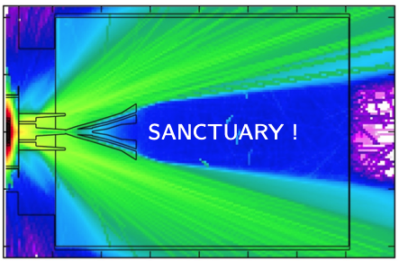



C. Ahdida et al., Findings of the Physics Beyond Colliders ECN3 Beam Delivery Task Force, CERN-PBC-REPORT-2023-001
SHiP’s bow wave is made of $μ$ & $\overline{μ}̅$ …
$$μ^{−}$$
Expected background:
< 1 event for 6×10²⁰ POT
$$μ^{+}$$
R. Jacobsson
Matthew FRASER | HI-ECN3 and the BDF

Slide 6
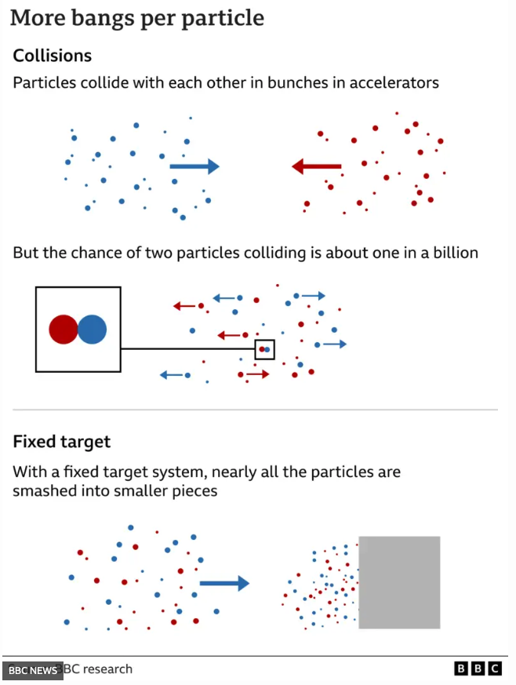
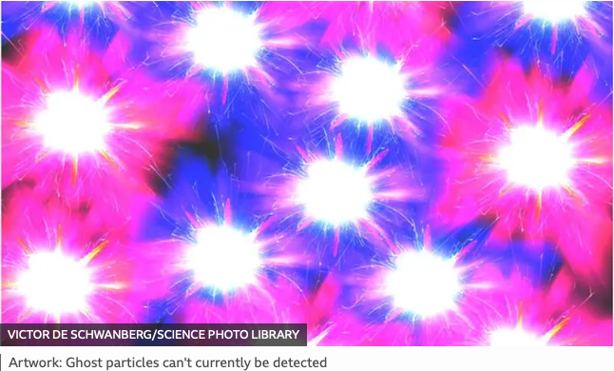
BBC News
Cern: Scientists search for mysterious ghost particles
By Pallab Ghosh
24 March 2024
Matthew FRASER | HI-ECN3 and the BDF

Slide 7

Study Project $→$ Approved Project
Upgrade of beam intensity at North Area and SHiP beam-dump (BDF/SHiP) experiment approved recently…
… with ~ 62 MCHF (over 7 years) reserved for the High Intensity upgrade of ECN3 (HI-ECN3) project in CERN’s Medium-Term Plan ratified by CERN Council in June 2024.
Approved together with ~ 170 MCHF for consolidation of the North Area (NA-CONS project)
The HI-ECN3 project is a part of CERN’s…
“…broad diverse scientific programme, complementary to the collider and carried out mainly at the injectors: continuously upgraded and expanded (e.g. recently the ECN3 beam intensity upgrade at the North Area).”
Fabiola Gianotti
For more information on the competitive ECN3 decision process:
C. Ahdida et al., Findings of the Physics Beyond Colliders ECN3 Beam Delivery Task Force, CERN-PBC-REPORT-2023-001
G. Arduini, C. Vallée, J. Jaeckel (eds.) Post-LS3 Experimental Options in ECN3, CERN-PBC-REPORT-2023-003
Matthew FRASER | HI-ECN3 and the BDF

Slide 8
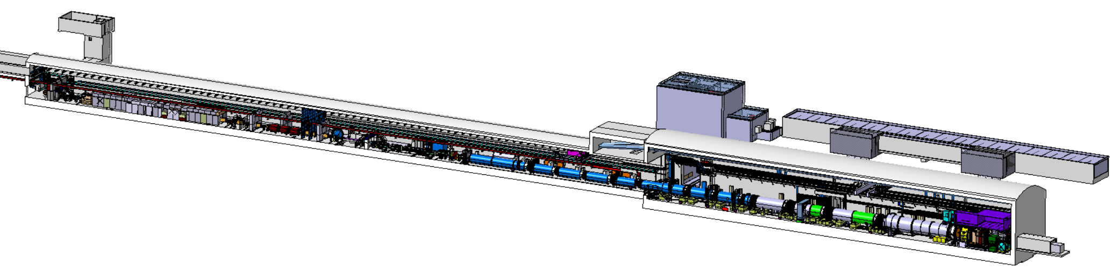
L. Krzempek, BDF-SHiP Integration in ECN3, EDMS #2936008
Today NA62 in ECN3
Beam from SPS
Existing
Access Shaft
B911
B918
TCC8
Existing
Target Complex to decommission
ECN3
Matthew FRASER | HI-ECN3 and the BDF

Slide 9
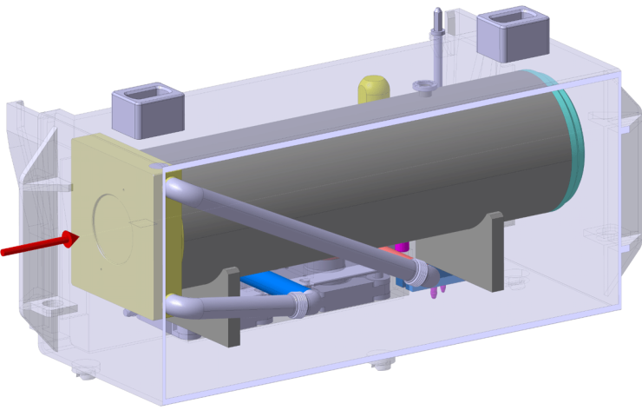
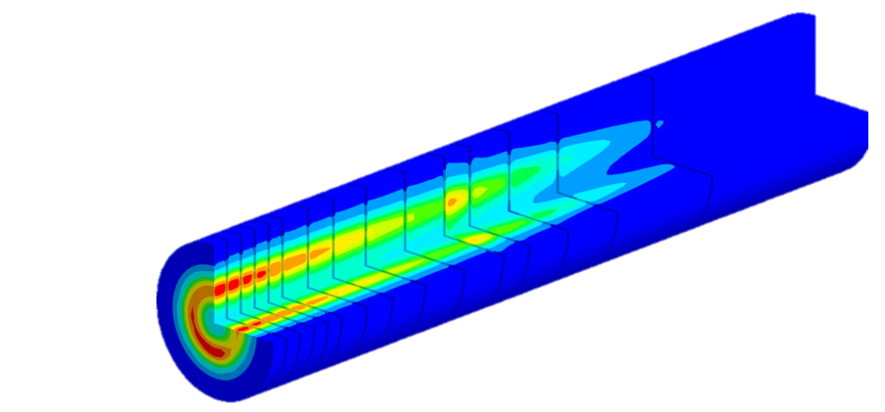
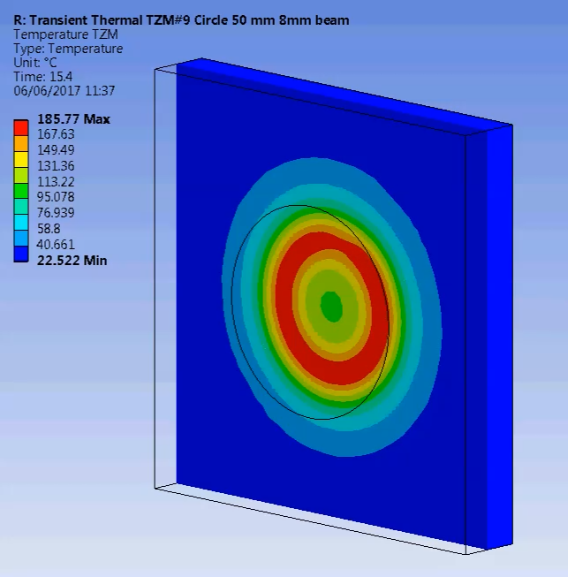
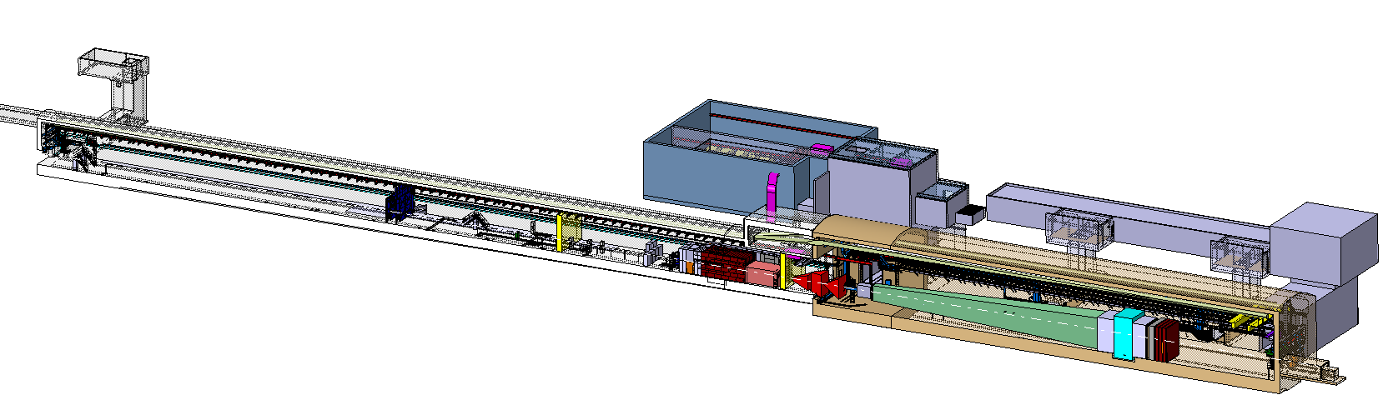
L. Krzempek, BDF-SHiP Integration in ECN3, EDMS #2936008
BDF/SHiP in ECN3
~ 300 kW (avg.)
~ 2.3 MW (spill)
1 second spill
15 years of operation!
Beam from SPS
New
Access
Shaft
New Target
Service Building
Existing
Access Shaft
B911
B918
Beam Dilution System
TCC8
BDF’s Target Complex
containing a “thick” high-Z target (Mo/W)
ECN3
SHiP experiment
Matthew FRASER | HI-ECN3 and the BDF

Slide 10
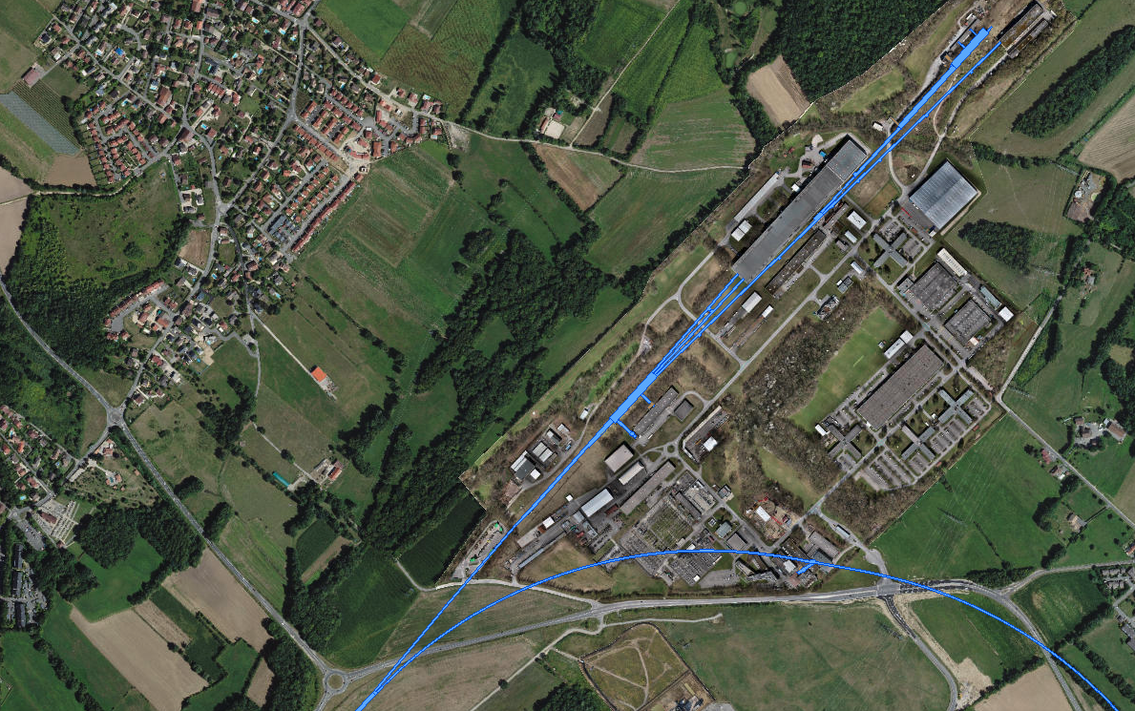
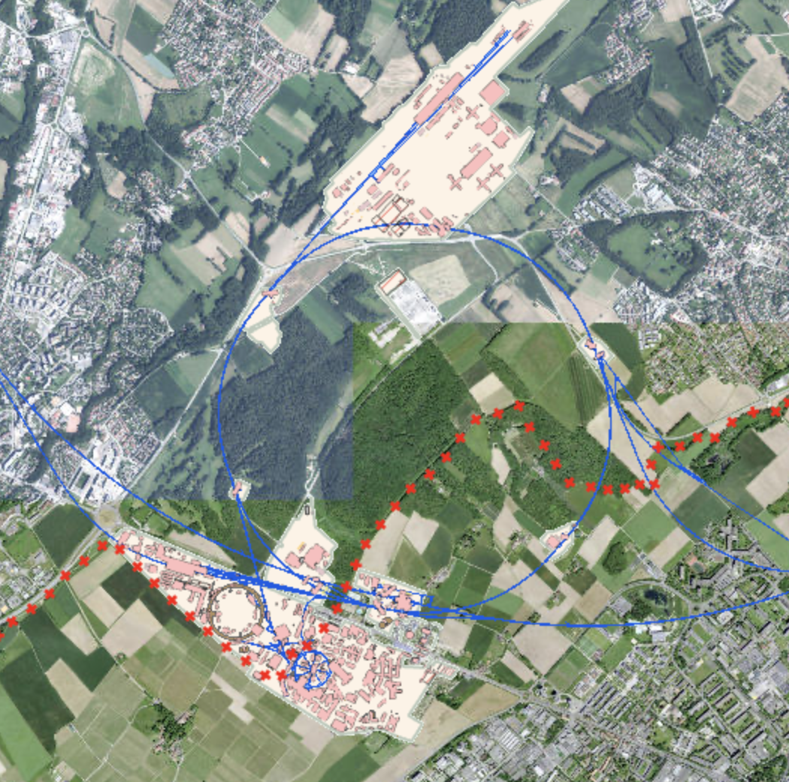
NA-CONS consolidation project
North Area Consolidation & Upgrade
HI-ECN3 project
ECN3
Timeline = completion in LS3 (2026-2029) and LS4
Timeline = completion after LS3
EHN2
EHN1
TCC8: T10 / TAX
→ BDF
TCC2 Targets:
T2 / T4 / T6
New Beam Dump (TIDVG4)
CERN Prévessin Site
TDC2: TT20 splitters
~ 1.7 km !
Transfer Tunnel (TT) 20:
inc. TT20 TED
SPS Slow Extraction from
Long Straight Section 2 (LSS2)
Matthew FRASER | HI-ECN3 and the BDF

Slide 11
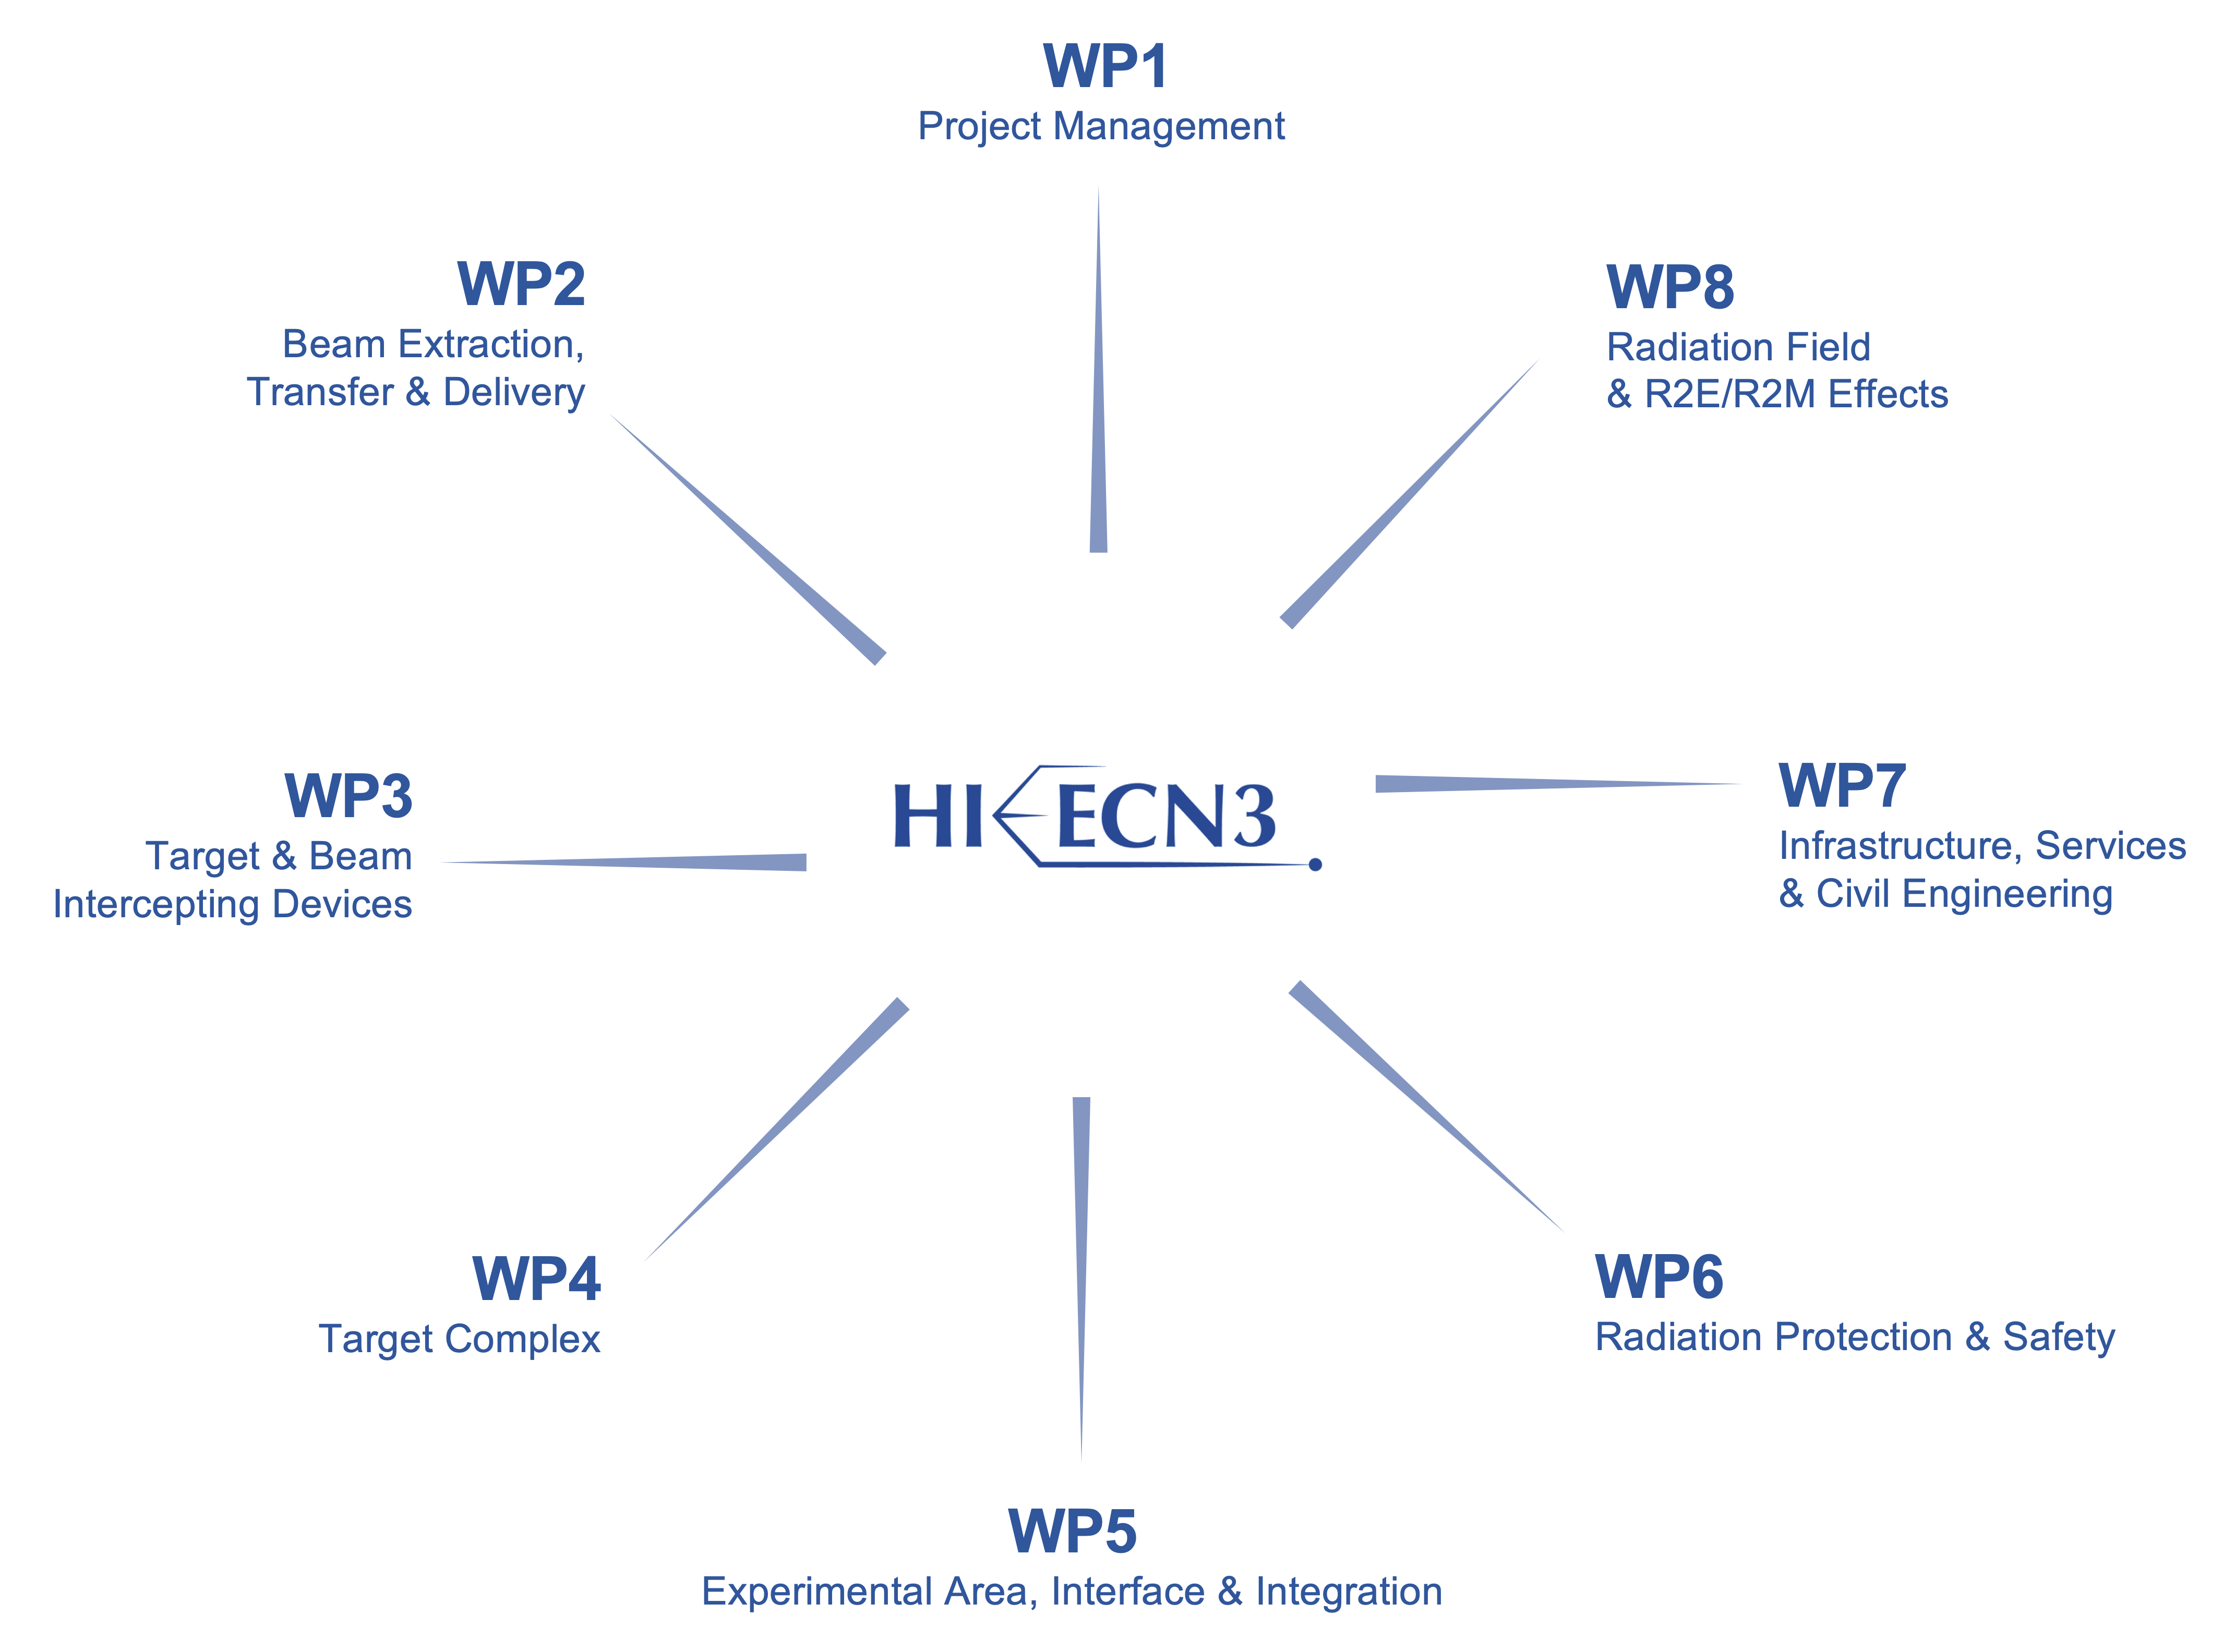
HI-ECN3 Project Structure
Experiment Project Leader: Richard JACOBSSON
SHiP Experiment Safety Correspondent: Letizia DI GIULIO
PL: Matthew FRASER
DPL: Claudia AHDIDA
Francesco VELOTTI & Laurie NEVAY
Luigi ESPOSITO
Rui FRANQUEIRA XIMENES
Fernando PEDROSA
Jean-Louis GRENARD
Claudia AHIDIDA
Project Safety Officer (PSO): Melania AVERNA
Project & Experiment Safety Support (PESS) Correspondent: Jamie CURRIE
Francois BUTIN
Matthew FRASER | HI-ECN3 and the BDF

Slide 12
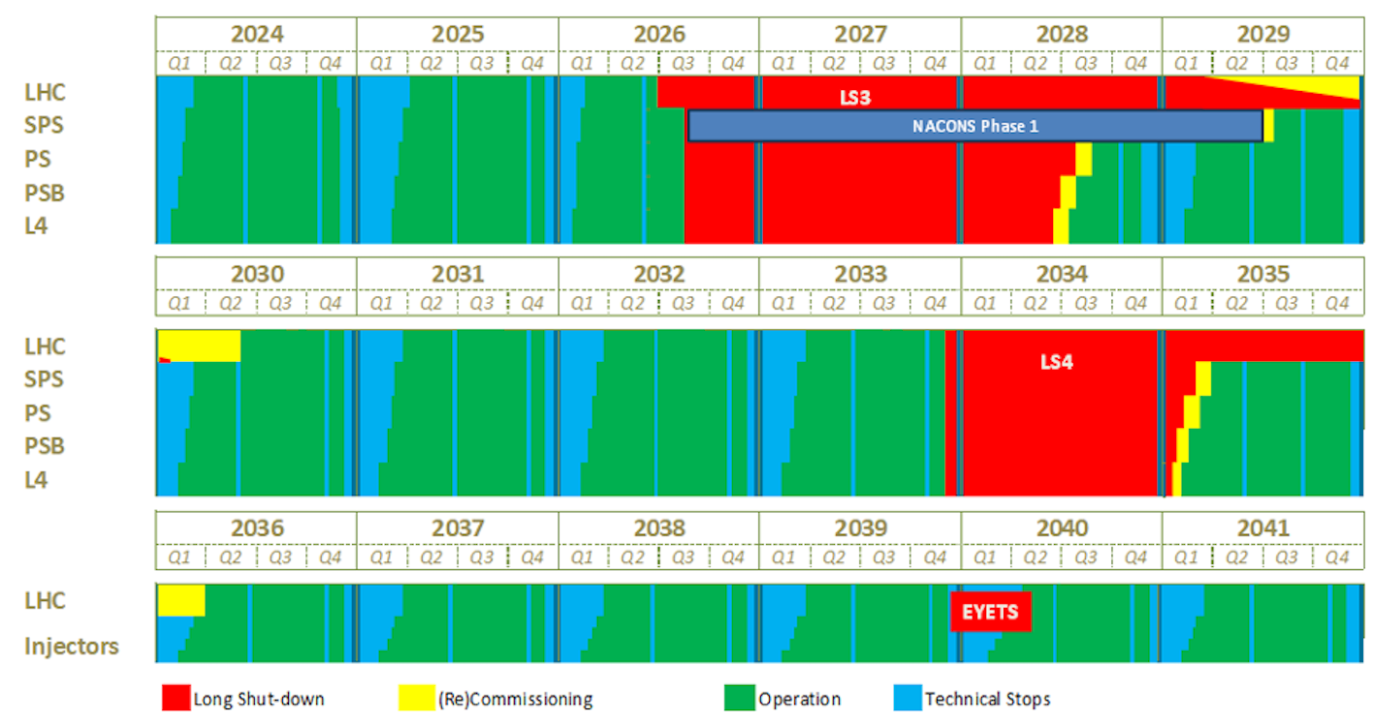
M. Lamont, Updated schedule for CERN’s accelerators, CERN Bulletin, 4 October 2024
CERN Accelerator Schedule
Today
Refurbishment of TCC8
crane needed early in LS3 to facilitate decommissioning of existing experiment
HI-ECN3
TDR Phase
NA-CONS Phase I
HI-ECN3
Commissioning
HI-ECN3
Operation
NA-CONS Phase II
(TBC)
Operation out to late 2040s:
beyond HL-LHC
(frequency & length of LS’s TBC)
NA-CONS
HI-ECN3 Operation
Matthew FRASER | HI-ECN3 and the BDF

Slide 14
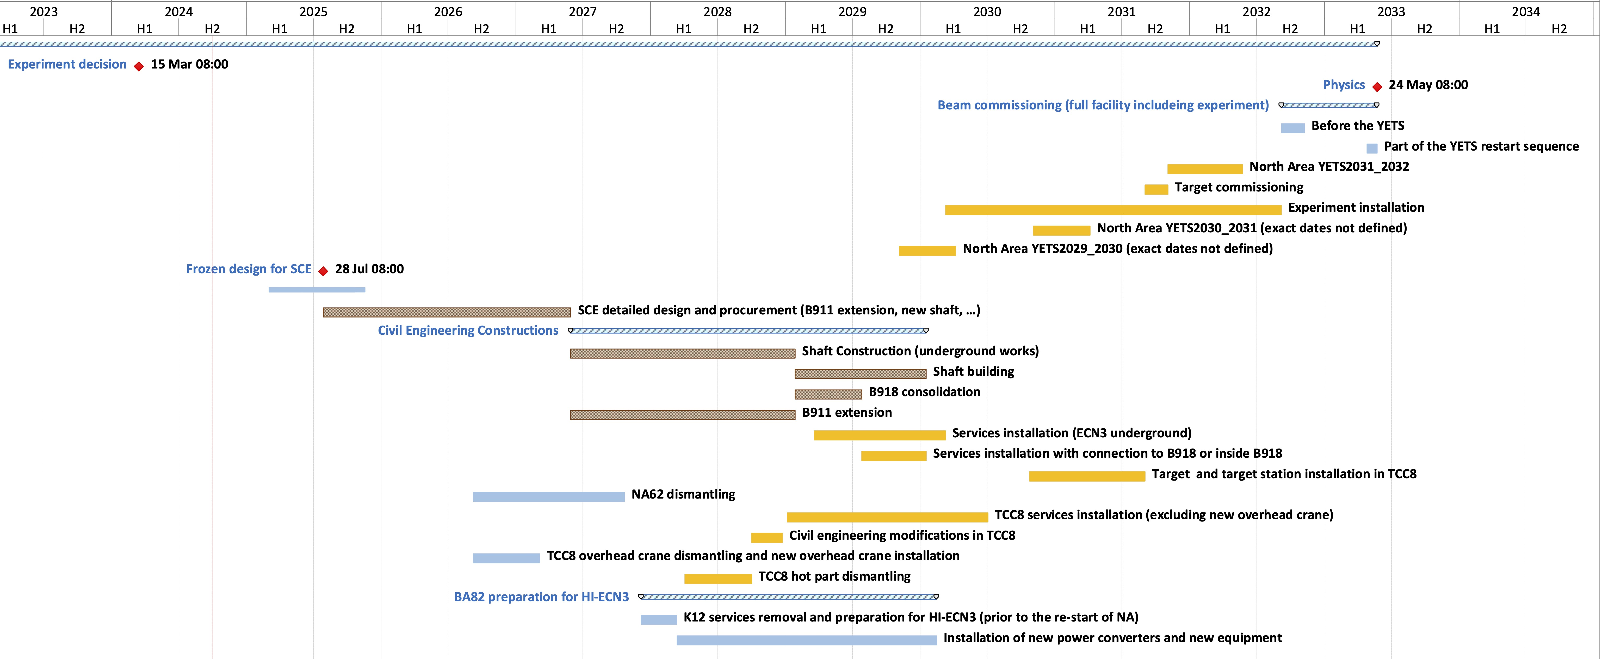
HI-ECN3 Project Timeline
Beam on BDF Target
Long Shutdown 3
Upgrades to NA with NA-CONS
TDR Phase
(Facility)
TDR extension?
Critical path:
CE procurement & works
LS4
Below freezing design for SCE!
(Detailed design for consultant before contractor Invitation to Tender)
July 2026
Dismantling

