Slide 1
PRELIMINARY DESIGN ANALYSIS
September 1st, 2025

Slide 2
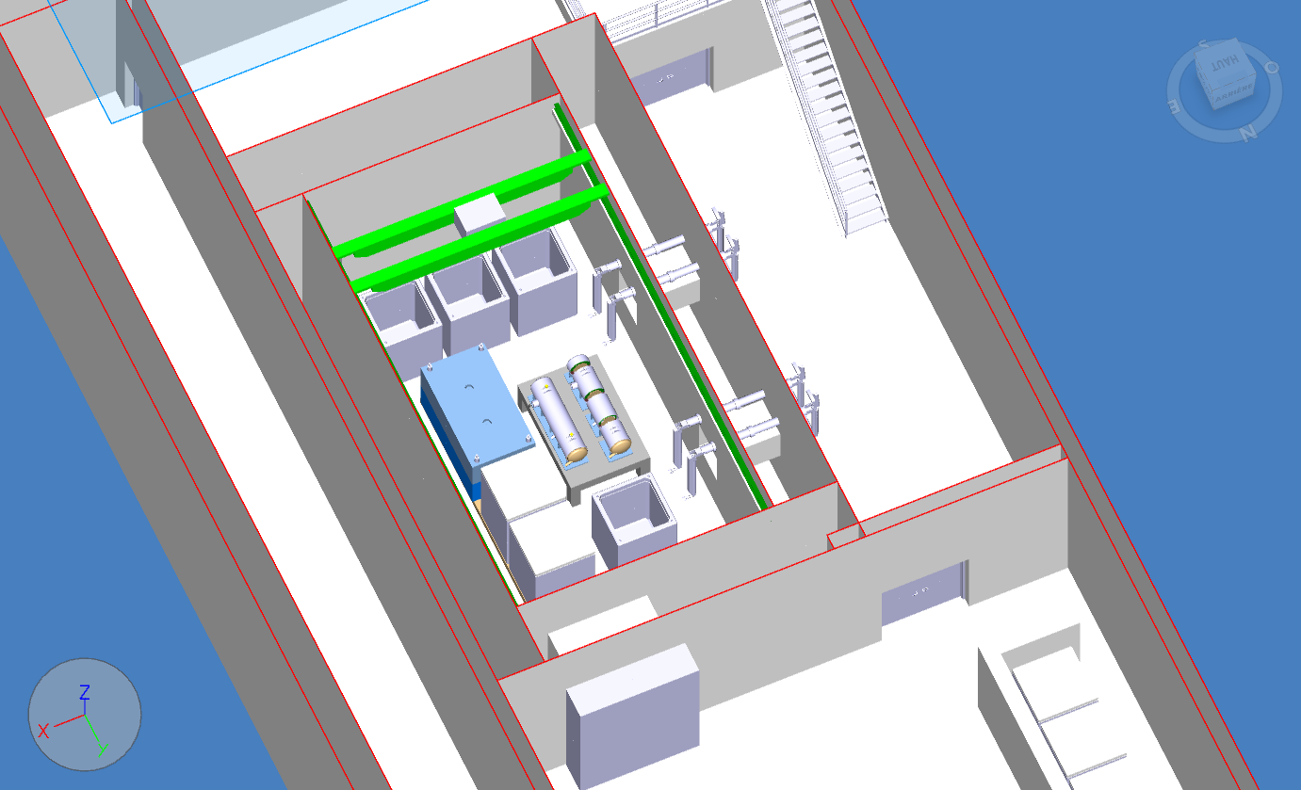
General Arrangement of the service cell
Personal SAS
6.5m
Footprint of service cell 140m²
The interface between service cell and other building system (reserved cable trays, main piping distribution lines, HVAC ducts, reserved openings or feedthroughs,…) ➔ To be completed
12m
N
Corridor ?
Equipment access
Buffer Area
Logistic Area
3D view of BDF-TARGET on Service Cell

Slide 3
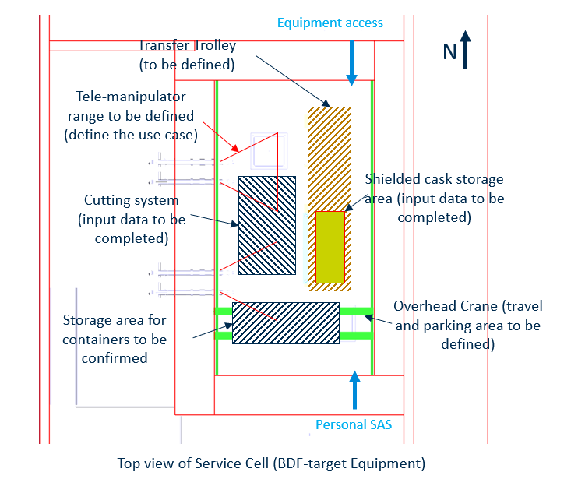
General Arrangement of the service cell

Slide 4
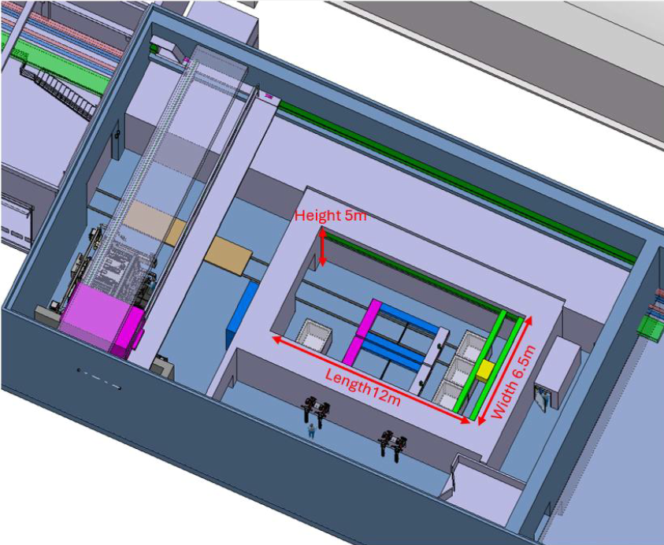
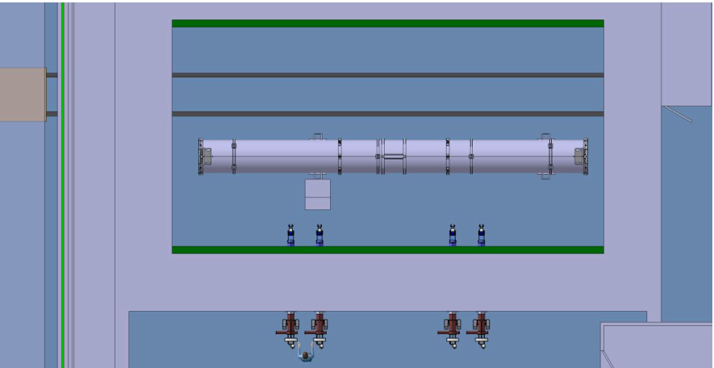
General Arrangement of the service cell
The footprint of service cell (consideration of other equipment to be processed)
The hadron stopper coil equipment has been used to define the required footprint of the service cell ➔ OK for the width of the cell, NOK for length
For the VXSS equipment (maximum length of 10.8m) ➔ following the same hypothesis used in section 7.7, the requested internal length = 16,3m
hadron stopper coil equipment
VXSS equipment
10.8m
(Extract from Technical note SPSX-PM-MEMO-0004 – Section 7.7)
12m
(Extract from Technical note SPSX-PM-MEMO-0004 – Section 10)

Slide 5
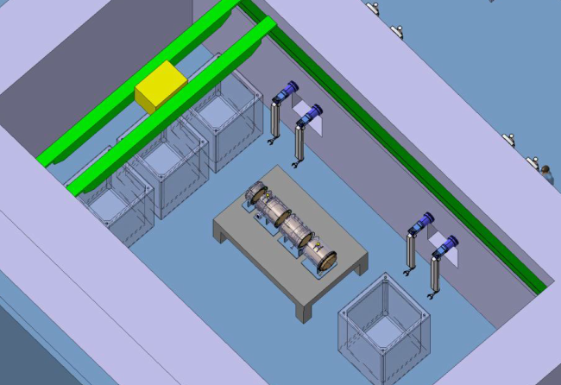
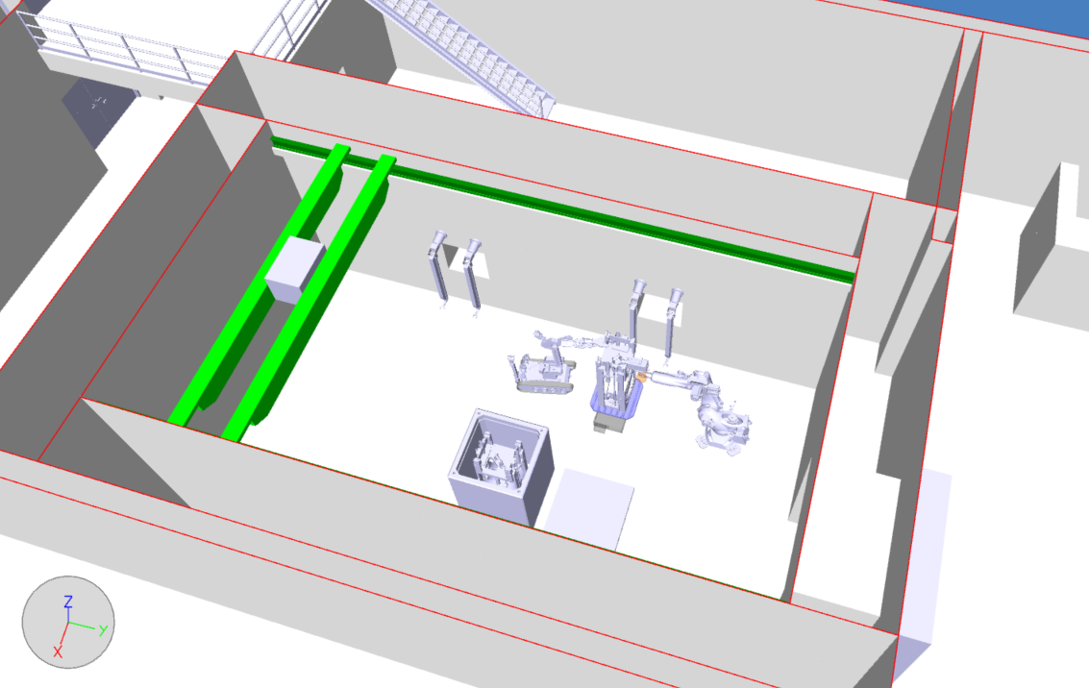
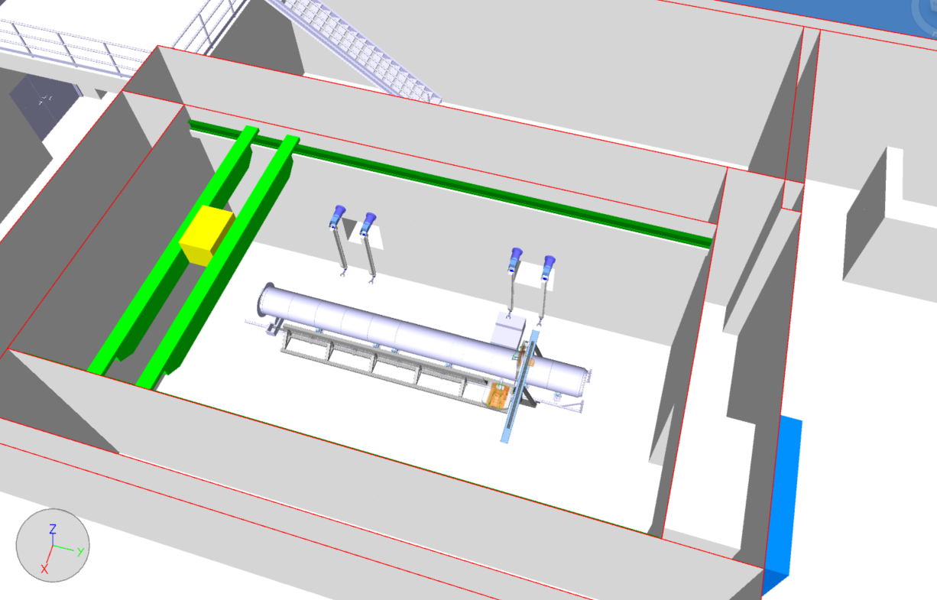
Cutting System (out of scope)
Input data – missing information :
Input data to be completed :
  The envelope size and the weight of the cutting systems,
  The expected location inside the cell during processing and maintenance phases.
  Description of cutting process for each equipment (size and weight of the sliced components)
BDF-Targetd equipment
nTOF target equipment
TDE – LHC beam dump

Slide 6
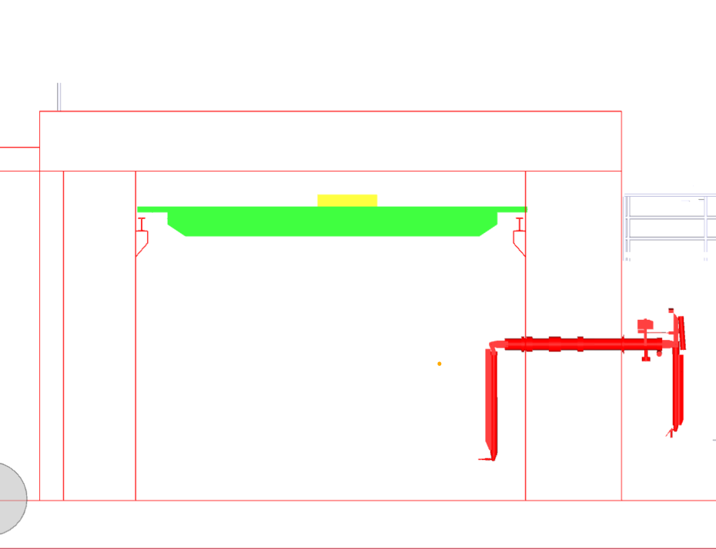
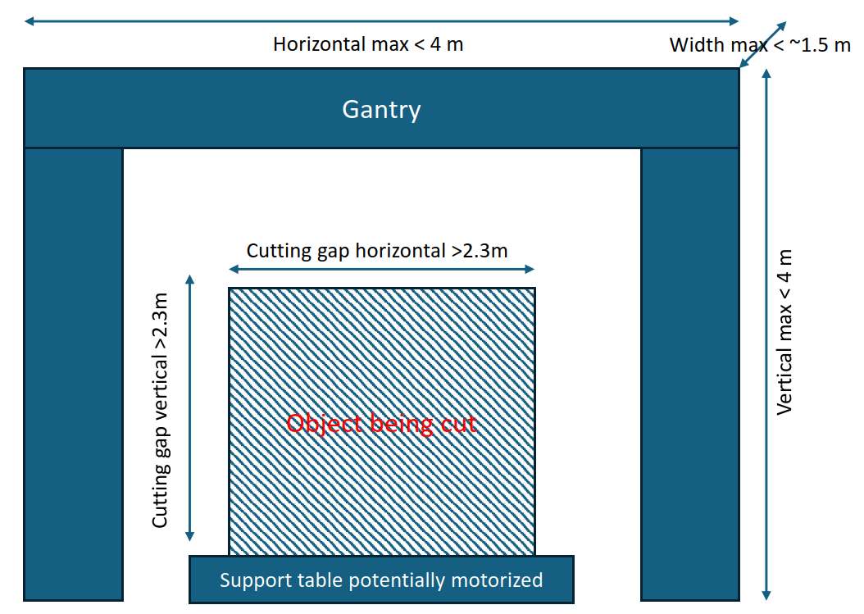
Cutting System (out of scope)
Wire Diamond saw preliminary design (DO 34680)
Font view of service cell
W
Purpose of gantry to be clarified
Cell Width 6.5m
1m could not be enough ➔ risk of clash /obstruction
Wire diamond saw + Gantry
Cell Height 5m
Vertical max 4m
Size of Support table to be defined
Horizontal max 4m
0,8m at least
(parking area for tele-manipulators)
(Extract from DO 34680)
1,7m as width for trolley area
(not sufficient as the maximum width of equipment is 2.2m)

Slide 7
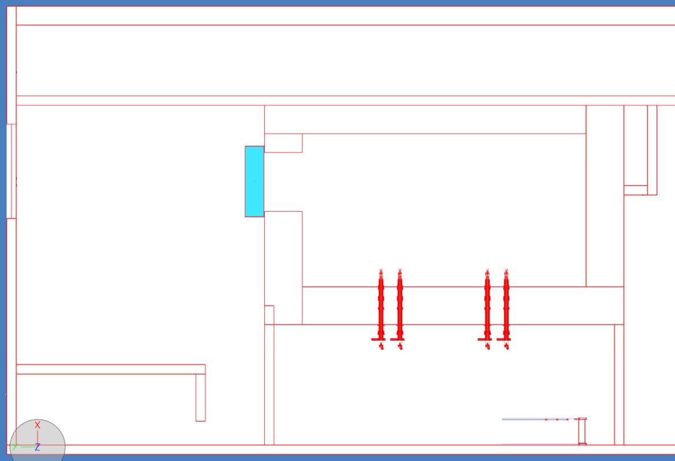
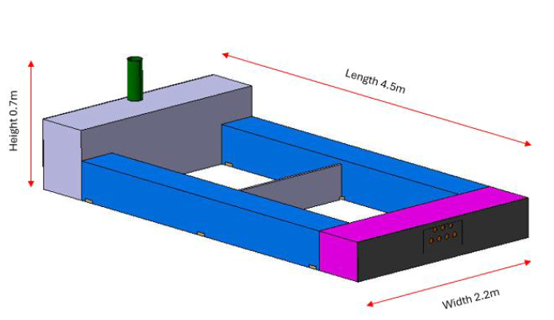
Main Equipment Analysis
Transfer Trolley - Case of introduction of hadron stopper coil equipment (maximum width)
Information required for the interface between the logistic area and building 911 (missing data in technical note).
The clearance of 15mm between the opening and the equipment could not be enough ➔ At least 30mm of clearance is recommended for each side The clearance will be impacted by the trolley design.
N
Schielded Door
15mm
2.5m
Displacement axe
Hadron stopper coil
Service Cell
11m
Logistic area
10.5m
Buffer area
Extract from Technical note SPSX-PM-MEMO-0004 - Hadron stopper coil pack design
Top view of Service Building

Slide 8
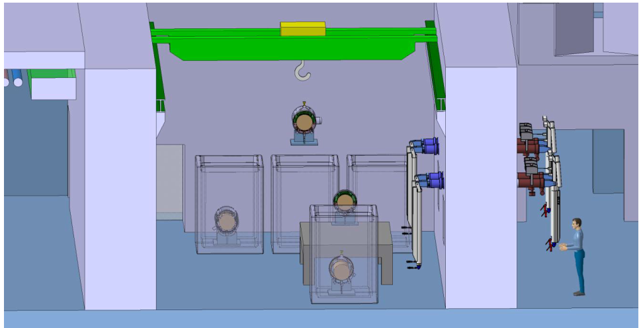
Main Equipment Analysis
Travelling overhead crane
In Technical note (SPSX-PM-MEMO-0004) section 8.1, you are expecting an overhead crane with a maximum lifting capacity of 7.5t ➔ To be confirmed (as the weight of Hadron coil stopper equipment is 30t).
The type of interface equipment for sliced components ➔ to be clarified (size, weight and handling eyebolt positions needed )
Attachment to the hook ➔ to be defined (performed using tele-manipulators or by the operators)
Extract from Technical note SPSX-PM-MEMO-0004 - Packing the sliced component in storage/disposal containers

Slide 9
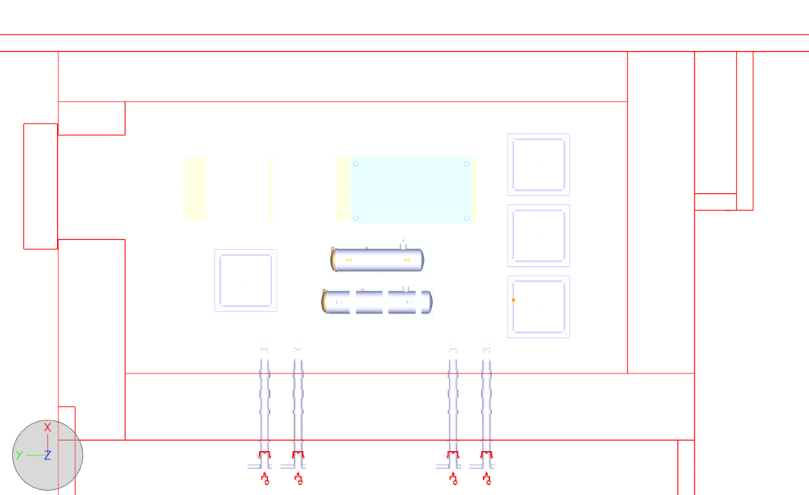
Personal access
Cleaning process to be clarified
In technical note- section 9.i, you expect that the containers cleaning is done by personnel. Could you provide description of your process, what is the expected number of operators for this operation ?
You are requesting the integration of connections for compressed air (Utilities), in the case of the air fed suit. Can you specify the type of air fed suit ?
Personal Acess
3.4m
1m
1.4m
1m
Service Cell
Top view of Service Cell (BDF-target Equipment)

