Slide 1

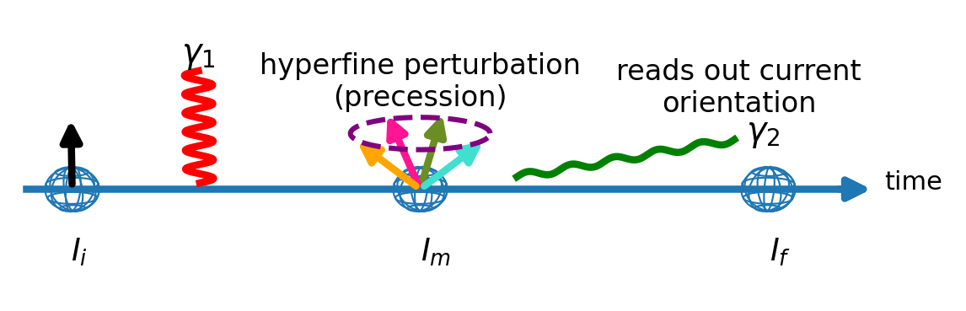
MULTIPAC and PACBIT-
Third Generation TDPAC
Supervisors
Björn Dörschel Master Student 23.09.2025 bjoern.doerschel@uni-due.de

Slide 2
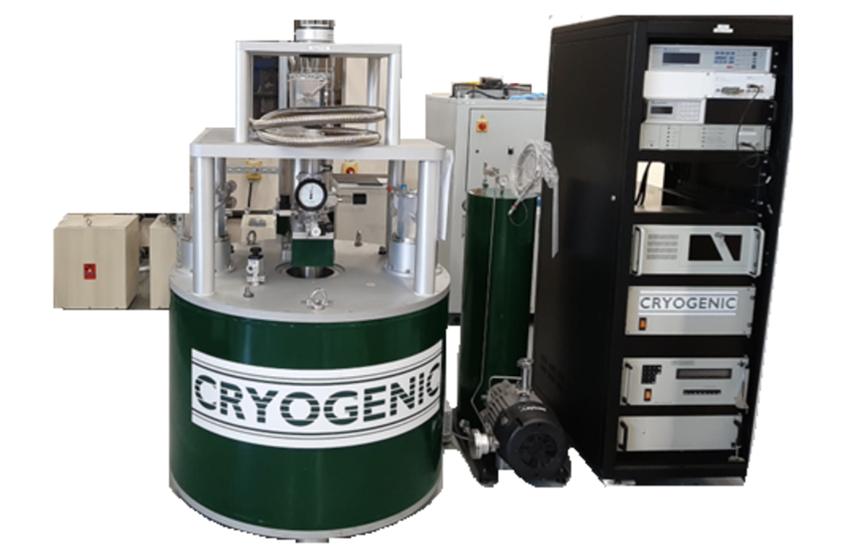
MULTIPAC and PACBit
MULTIPAC
Combines VSM and TDPAC
Up to 7.5 T
3K to 375K
Moved to SSP lab in 508 in 2026
PACBit
Main goal a real-time R(t)
Data acquisition software
Post processing
Coincidence search
R(t) fitting

Slide 3
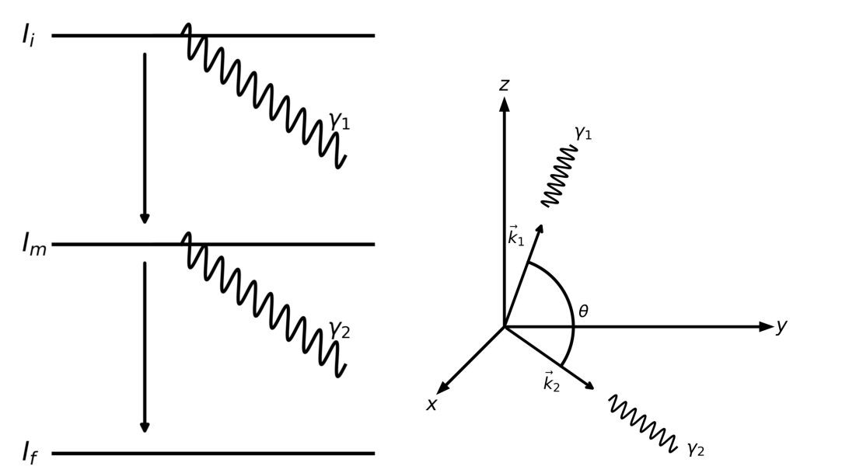
TDPAC Theory (Basics)

Slide 4
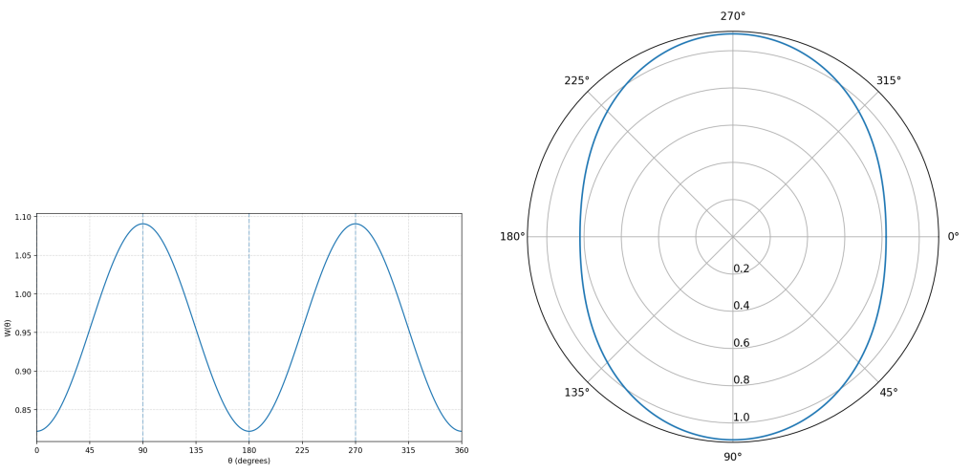

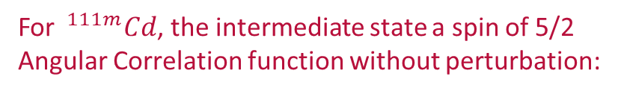
TDPAC Theory (Polycrystal only)
For $^{111m}Cd$, the intermediate state a spin of 5/2
Angular Correlation function without perturbation:

Slide 5
TDPAC Theory (Polycrystal only)

Slide 6
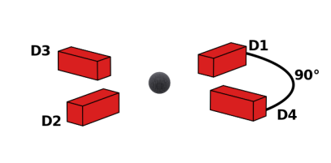

TDPAC Theory (Polycrystal only)
Relative Variation
Mean Value

Slide 7
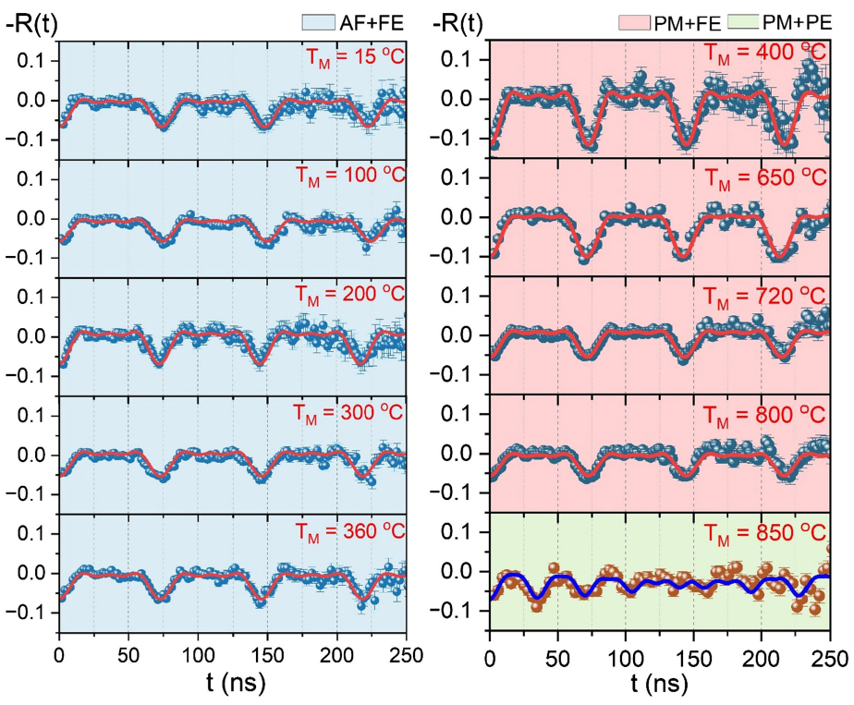
TDPAC Theory (Polycrystal only)
Relative Variation
Mean Value
DOI: 10.1103/PhysRevLett.134.216702

Slide 8
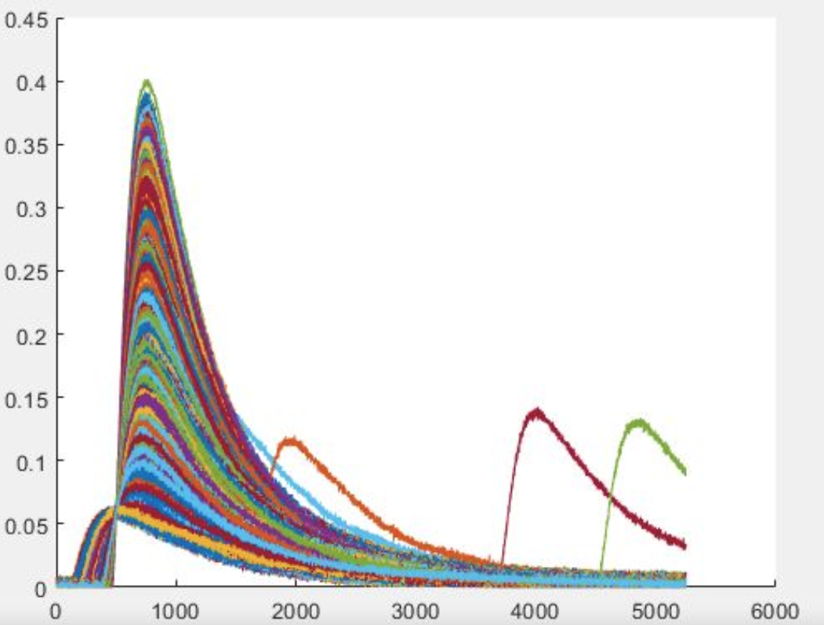
Post Processing
Steps:
Smoothing
Filtering
Integration
Rise time determination

Slide 9
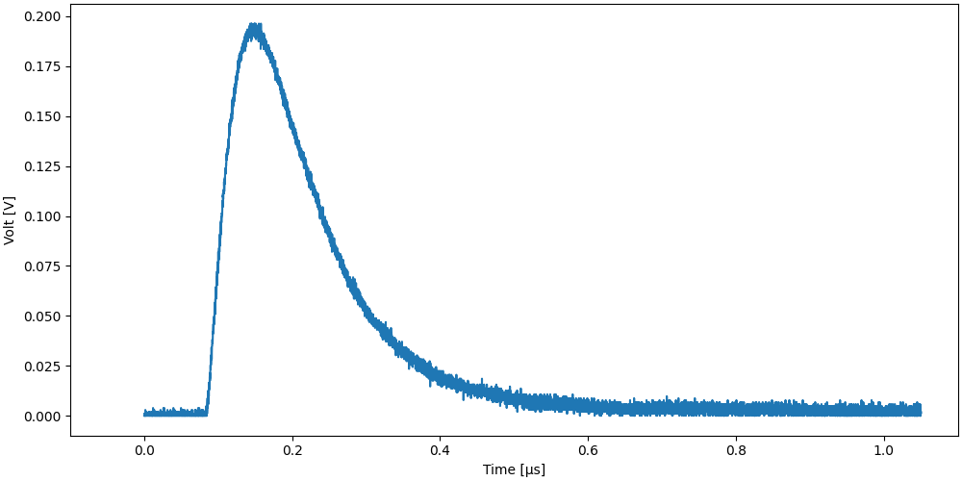
U5310A Digitizer
U5310A Digitizer
10 Bit resolution
10 GS/s sampling rate (0.1 ns)
1 Volt range
➔ 0.001 V quantisation step

Slide 10
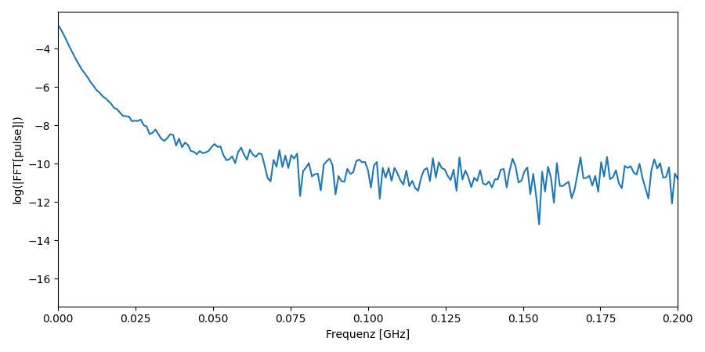
U5310A Digitizer
U5310A Digitizer
10 Bit resolution
10 GS/s sampling rate (0.1 ns)
1 Volt range
0.001 V quantisation step
Fourier transformation of pulse
Meaningfull frequencies up to 0.1GHz

Slide 11
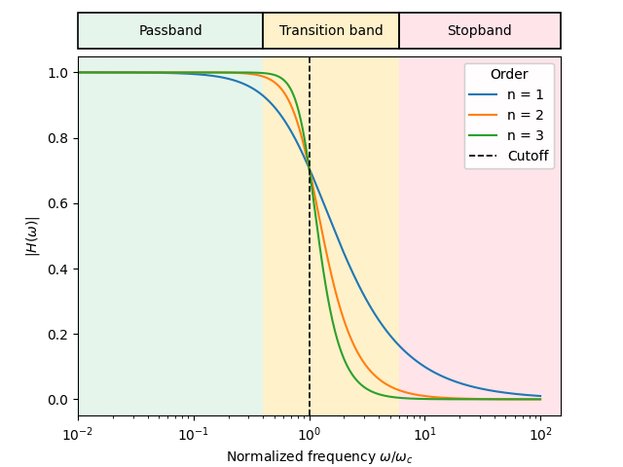
Post Processing (Smoothing)
Butterworth smoother (digital low-pass filter)
Noise reduction
Equal weighting of all frequencies
Cutoff frequency set to 0.1GHz

Slide 12
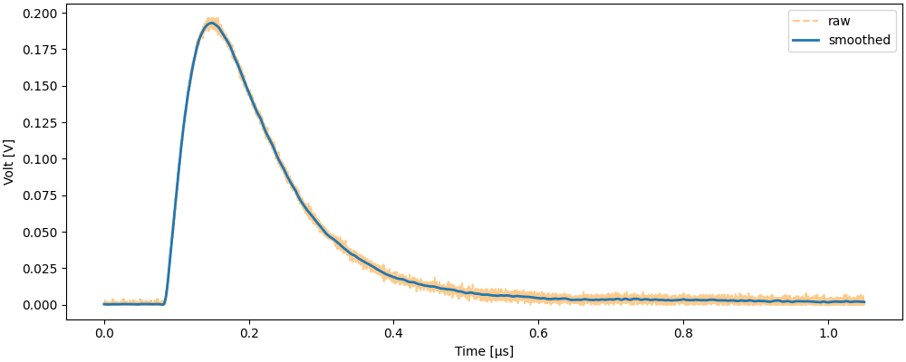
Post Processing (Smoothing)
Butterworth smoother (digital low-pass filter)
Noise reduction
Equal weighting of all frequencies
Cutoff frequency set to 0.1GHz

Slide 13
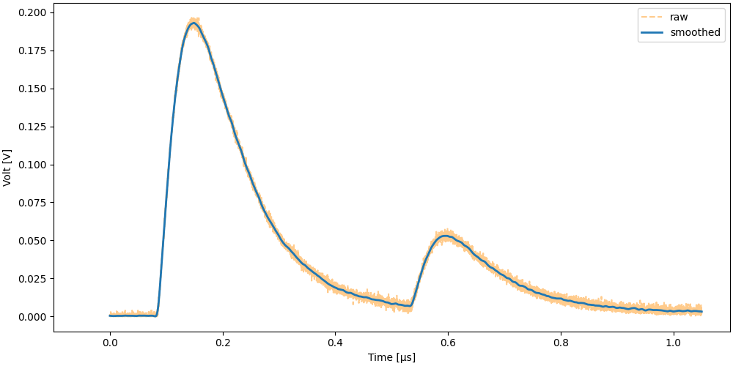
Post Processing (After Pulse Detection and Elimination)
Measure time is a fixed window (after trigger):
Two gamma rays in the same time window.
Afterpulses are a problem!

Slide 14
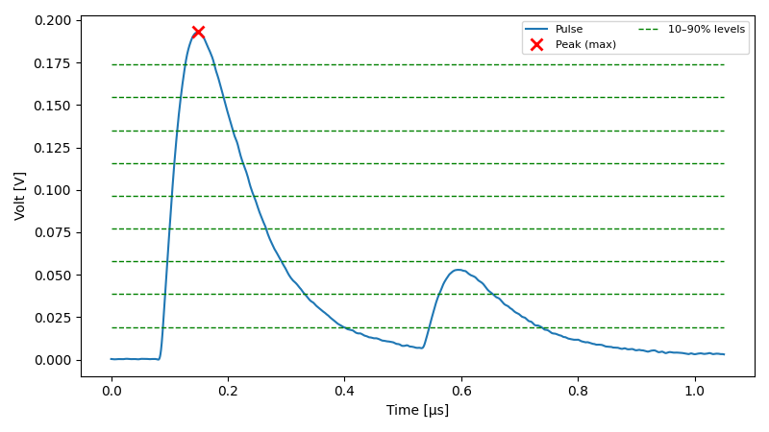
Post Processing (After Pulse Detection and Elimination)
How can secondary pulses be found? Horizontal intersection lines
(depending on the peak value).
Intersection > 2 for any line:
→ discarded

Slide 15
Post Processing (Exact Rise Time determination)
Exact rise time determination (detection time):
Must be amplitude independent
Different amplitudes = different slopes
= different rise times
Instead of CFD, use a normalized LED

Slide 16
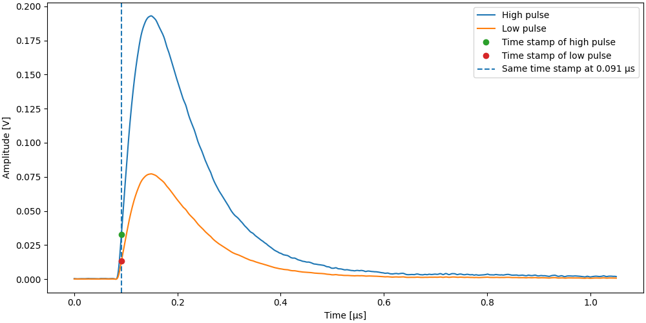
Post Processing (Exact Rise Time determination)
Exact rise time determination (detection time):
Must be amplitude independent
Different amplitudes = different slopes
= different rise times
Instead of CFD, use a normalized LED
- Divide the integration value by the constant
- Check when the pulse reaches this value.

Slide 17
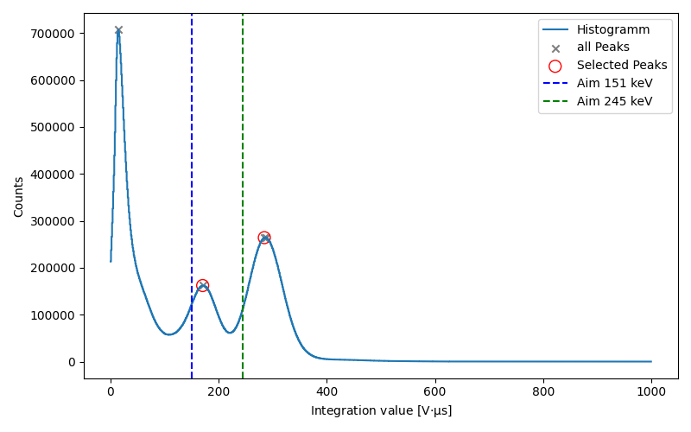
Coincidence Search

Slide 18
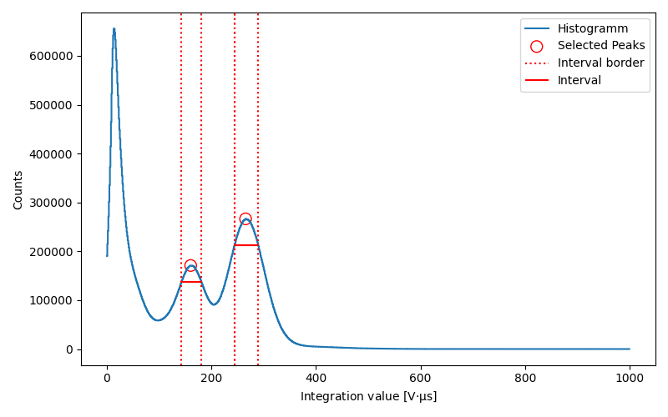
Coincidence Search

Slide 19
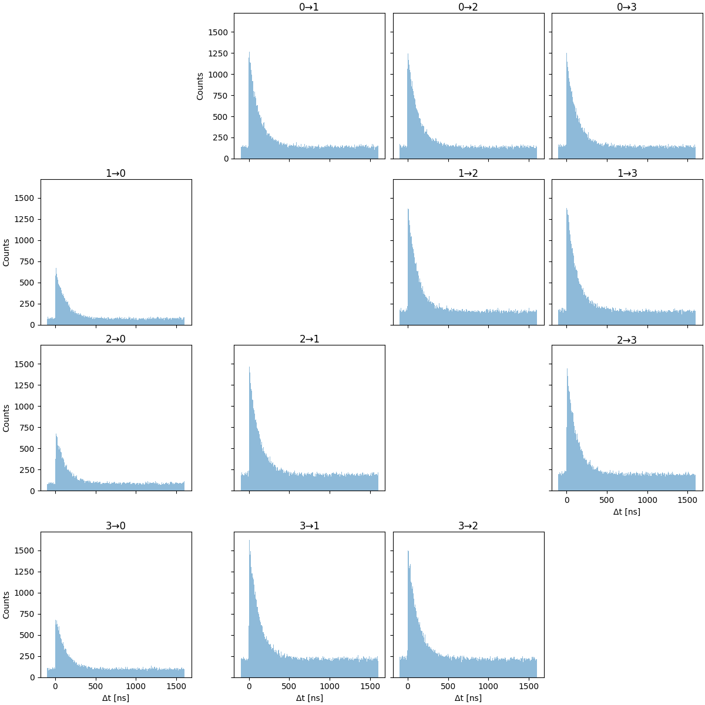
Coincidence Search

Slide 20
MULTIPAC and PACBIT-
Third Generation TDPAC
Supervisors
Björn Dörschel Master Student 23.09.2025 bjoern.doerschel@uni-due.de

