Slide 1


ISOLDE – Incidents and Lessons Learned

Slide 2
Safety Officers – Experiments
Reference Safety Rule at CERN is SR-SO: “Responsibilties and organisational structure in matters of safety at CERN”
Institute Safety Correspondent
Experimental activity at CERN (Activity Responsible)
Department Safety Officer (DSO)
“Each Collaborating Institution shall appoint, for each CERN activity or CERN experiment in which it participates, a Safety Correspondent who shall act as contact point between the Collaborating Institution and CERN in matters of Safety”.
Experimental Safety Officer (EXSO)
HSE Unit
12.3.25
Letizia Di Giulio | EP Safety Office
2

Slide 3
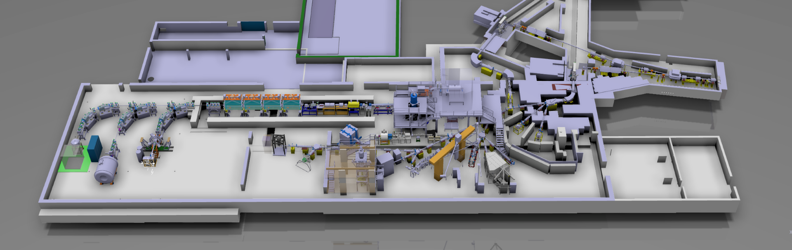

Safety Officers – ISOLDE Experiments
HSE-RP always responsible for Safety matters related to Radiation Protection!
Target + separators + RILIS:
SY (→ SY DSO)
Experimental Hall:
Infrastructure and accelerator beam lines are BE (→ BE DSO),
Experiments are EP (→ EP DSO)
EP-UIS Users and EP-SME-IS CERN employees are under the CERN EP Department
EP DSO representatives assigned (myself and James Devine)
ISOLDE EXSO nominated (Hanne Heylen)
One Deputy EXSO for each permanent set-up
12.3.25
Letizia Di Giulio | EP Safety Office
3

Slide 4
CERN Safety Incident Management
In case of incident, always submit an Incident Declaration via EDH
Reference Safety Rule at CERN is:
SR-SIM “Responsibilities in matters of safety incident management at CERN”
Safety incident is an unintended event or situation that has a non-negligible, negative consequence or potential consequence from the point of view of Safety. The term Safety Incident covers: Radiological Events, Deviations, Unsafe Situations, Near Misses, Accidents (including Commuting Accidents)
Notes:
- Radiological event: deviation from applicable RP Safety Rules

Slide 5
CERN Safety Incident Management
In case of incident, always submit an Incident Declaration via EDH
Reference Safety Rule at CERN is:
SR-SIM “Responsibilities in matters of safety incident management at CERN”
Deviation from the normal regulatory functioning of an installation/ activity whose consequences or potential consequences are non-negligible from point of view of Safety
Safety incident is an unintended event or situation that has a non-negligible, negative consequence or potential consequence from the point of view of Safety. The term Safety Incident covers: Radiological Events, Deviations, Unsafe Situations, Near Misses, Accidents (including Commuting Accidents)
Notes:
- Radiological event: deviation from applicable RP Safety Rules

Slide 6
CERN Safety Incident Management
In case of incident, always submit an Incident Declaration via EDH
Reference Safety Rule at CERN is:
SR-SIM “Responsibilities in matters of safety incident management at CERN”
Safety incident is an unintended event or situation that has a non-negligible, negative consequence or potential consequence from the point of view of Safety. The term Safety Incident covers: Radiological Events, Deviations, Unsafe Situations, Near Misses, Accidents (including Commuting Accidents)
Situation that may lead to a radiological Event, a Near Miss or an Accident

Slide 7
CERN Safety Incident Management
In case of incident, always submit an Incident Declaration via EDH
Reference Safety Rule at CERN is:
SR-SIM “Responsibilities in matters of safety incident management at CERN”
Safety incident is an unintended event or situation that has a non-negligible, negative consequence or potential consequence from the point of view of Safety. The term Safety Incident covers: Radiological Events, Deviations, Unsafe Situations, Near Misses, Accidents (including Commuting Accidents)
An unintended event that could have led to an Accident

Slide 8
CERN Safety Incident Management
In case of incident, always submit an Incident Declaration via EDH
Reference Safety Rule at CERN is:
SR-SIM “Responsibilities in matters of safety incident management at CERN”
Safety incident is an unintended event or situation that has a non-negligible, negative consequence or potential consequence from the point of view of Safety. The term Safety Incident covers: Radiological Events, Deviations, Unsafe Situations, Near Misses, Accidents (including Commuting Accidents)
An unintended event resulting in injuries to persons, material damage or negative impact on environment

Slide 9
CERN Safety Incident Management
In case of incident, always submit an Incident Declaration via EDH
Reference Safety Rule at CERN is:
SR-SIM “Responsibilities in matters of safety incident management at CERN”
Incident classification (depends on consequences and potential consequences):
Safety incident is an unintended event or situation that has a non-negligible, negative consequence or potential consequence from the point of view of Safety. The term Safety Incident covers: Radiological Events, Deviations, Unsafe Situations, Near Misses, Accidents (including Commuting Accidents)
MINOR
SERIOUS
MAJOR

Slide 10
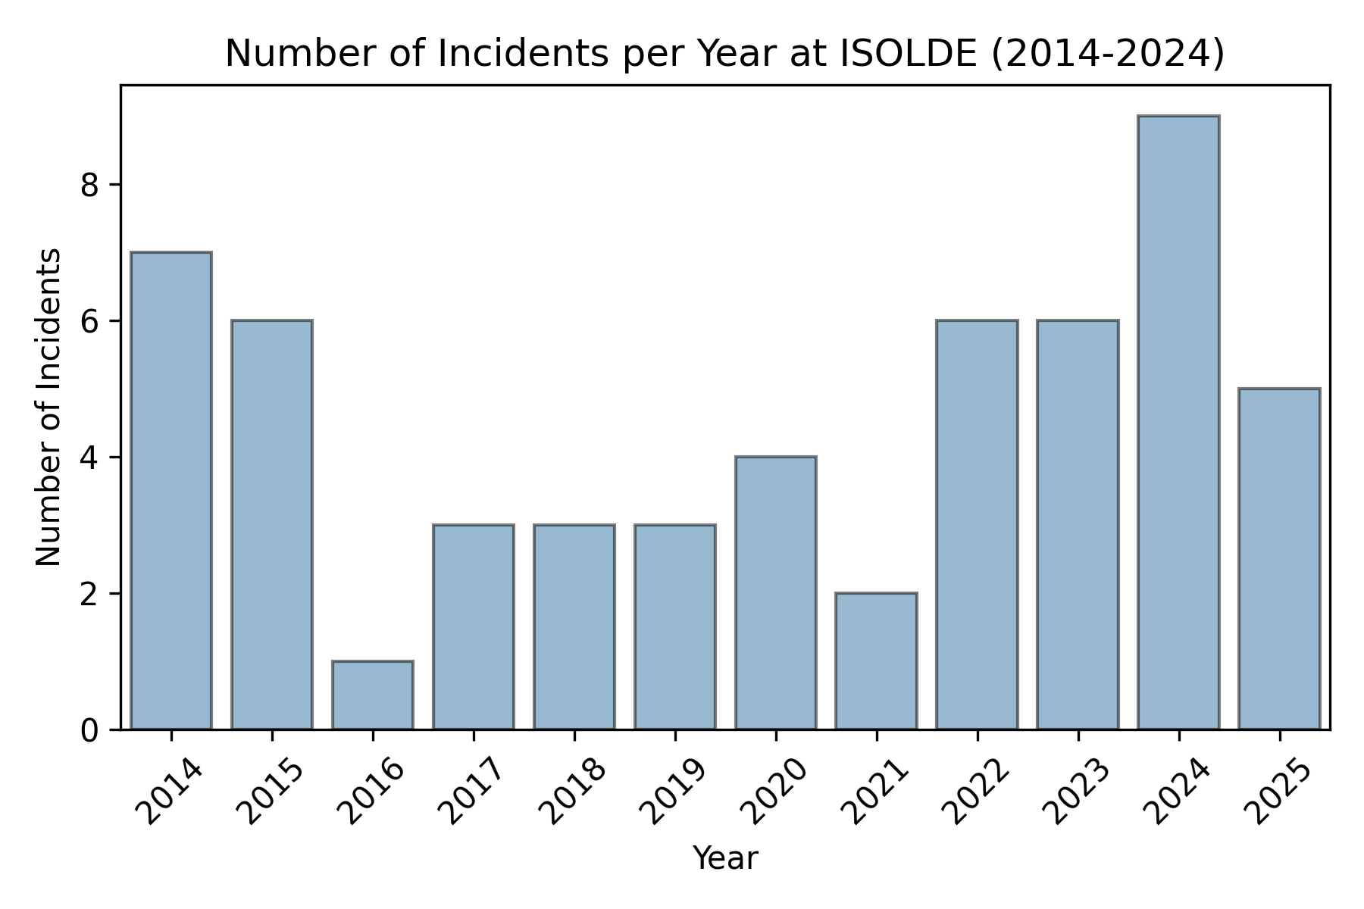

Incidents in ISOLDE
In the past 10 years, there have been about 50 incidents in ISOLDE (for the full Facility, BE, SY, EP analysis)
The yearly number of incidents is not decreasing; however, it’s important to remember that people are increasingly reporting them
The increase in reporting is an encouraging sign!
Still, our aim is to decrease these numbers
Notes:
Some numbers for comparison: 400 incidents 2025 at CERN, 33 in EP Department, 5 in ISOLDE

Slide 11
Incidents in ISOLDE - SIAG
Following Serious incident in ISOLDE, CERN HSE Unit Head mandated a Safety Incident Analysis Group to analyse the past 10 years of incident, looking for recurrent root causes
35 recommendations, divided in
Transversal: repetition of good pratices that were already implemented (as safety inspections, reporting of incidents and lesson learnt) and recently added (as workplace inductions)
Technical: needed upgrades in terms of safety (as the new source storage, new management of chemicals, new flammable gas distribution system)
Organisational: needed clarifcations in terms of mangerial roles and their safety implications (as clear mandates for ISOLDE Collaboration Spokesperson and Physics Coordinator, and nomination of DEXSOs)
EP founded ISOLDE safety projects for 150k CHF in 2025!

Slide 12

Lessons Learned
Sharing lessons learned is one of the most important part in the follow up of an incident, aiming at avoiding that the same event happens again
Most common elements:
Describe in the procedure the totality of the steps to be performed, ensure it is fully reviewed by Safety
Take your time to read and understand the safety procedures
If an unexpected event requires deviation from procedure:
Stop the activity immediately
Discuss the revised plan with Safety (EXSO or DEXSO, RP, EP Safety Office)
Only perform high-risk activities if you feel alert and physically fit!

Slide 13
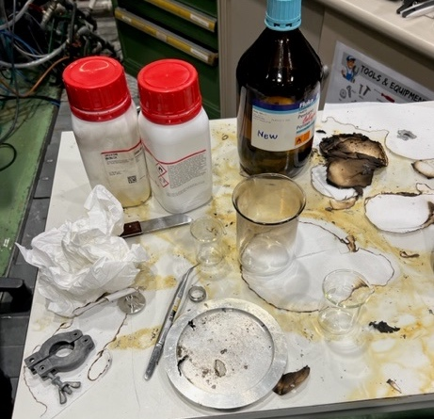
Lessons Learned – Event 1 (2023)
Alkali metals can produce fire when in contact with humidity or water. During handling, pentane is used to avoid exposure to humidity
ATEX area was created unintendingly, due to misuse of pentane
A spark produced by static electricity ignited the pentane vapours, creating the flash fire fed by flammable material present on the working table
Fire extinguished by colleagues using a jacket and a fire extinguisher

Slide 14
Lessons Learned – Event 1 (2023)
Alkali metals can produce fire when in contact with humidity or water. During handling, pentane is used to avoid exposure to humidity
ATEX area was created unintendingly, due to misuse of pentane
A spark produced by static electricity ignited the pentane vapours, creating the flash fire fed by flammable material present on the working table
Fire extinguished by colleagues using a jacket and a fire extinguisher
Do not adapt procedures without review from Safety Officers, even well-intended changes (higher quantity of pentane) can introduce new risks while trying to control known ones
Ensure everyone is briefed on the official, verified up-to-date procedure (Released on EDMS!)
Before start, always check that you have the right PPEs and that the working area is safe. Take also a moment to locate the safety equipment: fire extinguishers, AUG, …emergency exits…

Slide 15
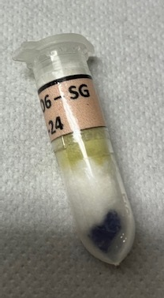
Lessons Learned – Event 2 (2024)
Sample of a toxic element found in the b. 508 kitchen after an experiment, where large number of samples implanted and studied
This sample was not irradiated but the hazards related to the element itself were not thoroughly considered
The experimental team not aware this sample was missing

Slide 16
Lessons Learned – Event 2 (2024)
Sample of a toxic element found in the b. 508 kitchen after an experiment, where large number of samples implanted and studied
This sample was not irradiated but the hazards related to the element itself were not thoroughly considered
The experimental team not aware this sample was missing
Proper sample management and formal tracking is essential, even more when working with large number of samples
Hazardous chemicals need to be stored, handled and transported appropriately. Safety Data Sheet of the entire composite element need to be readily available for users
Avoid mixing laboratory items (including PPEs like safety shoes) with personal belongings
Notes:
- Cd compounds (Cd has acute toxicity)
- All CMR and toxic chemicals must always be handled inside a fume hood, regardless of their quantity

Slide 17
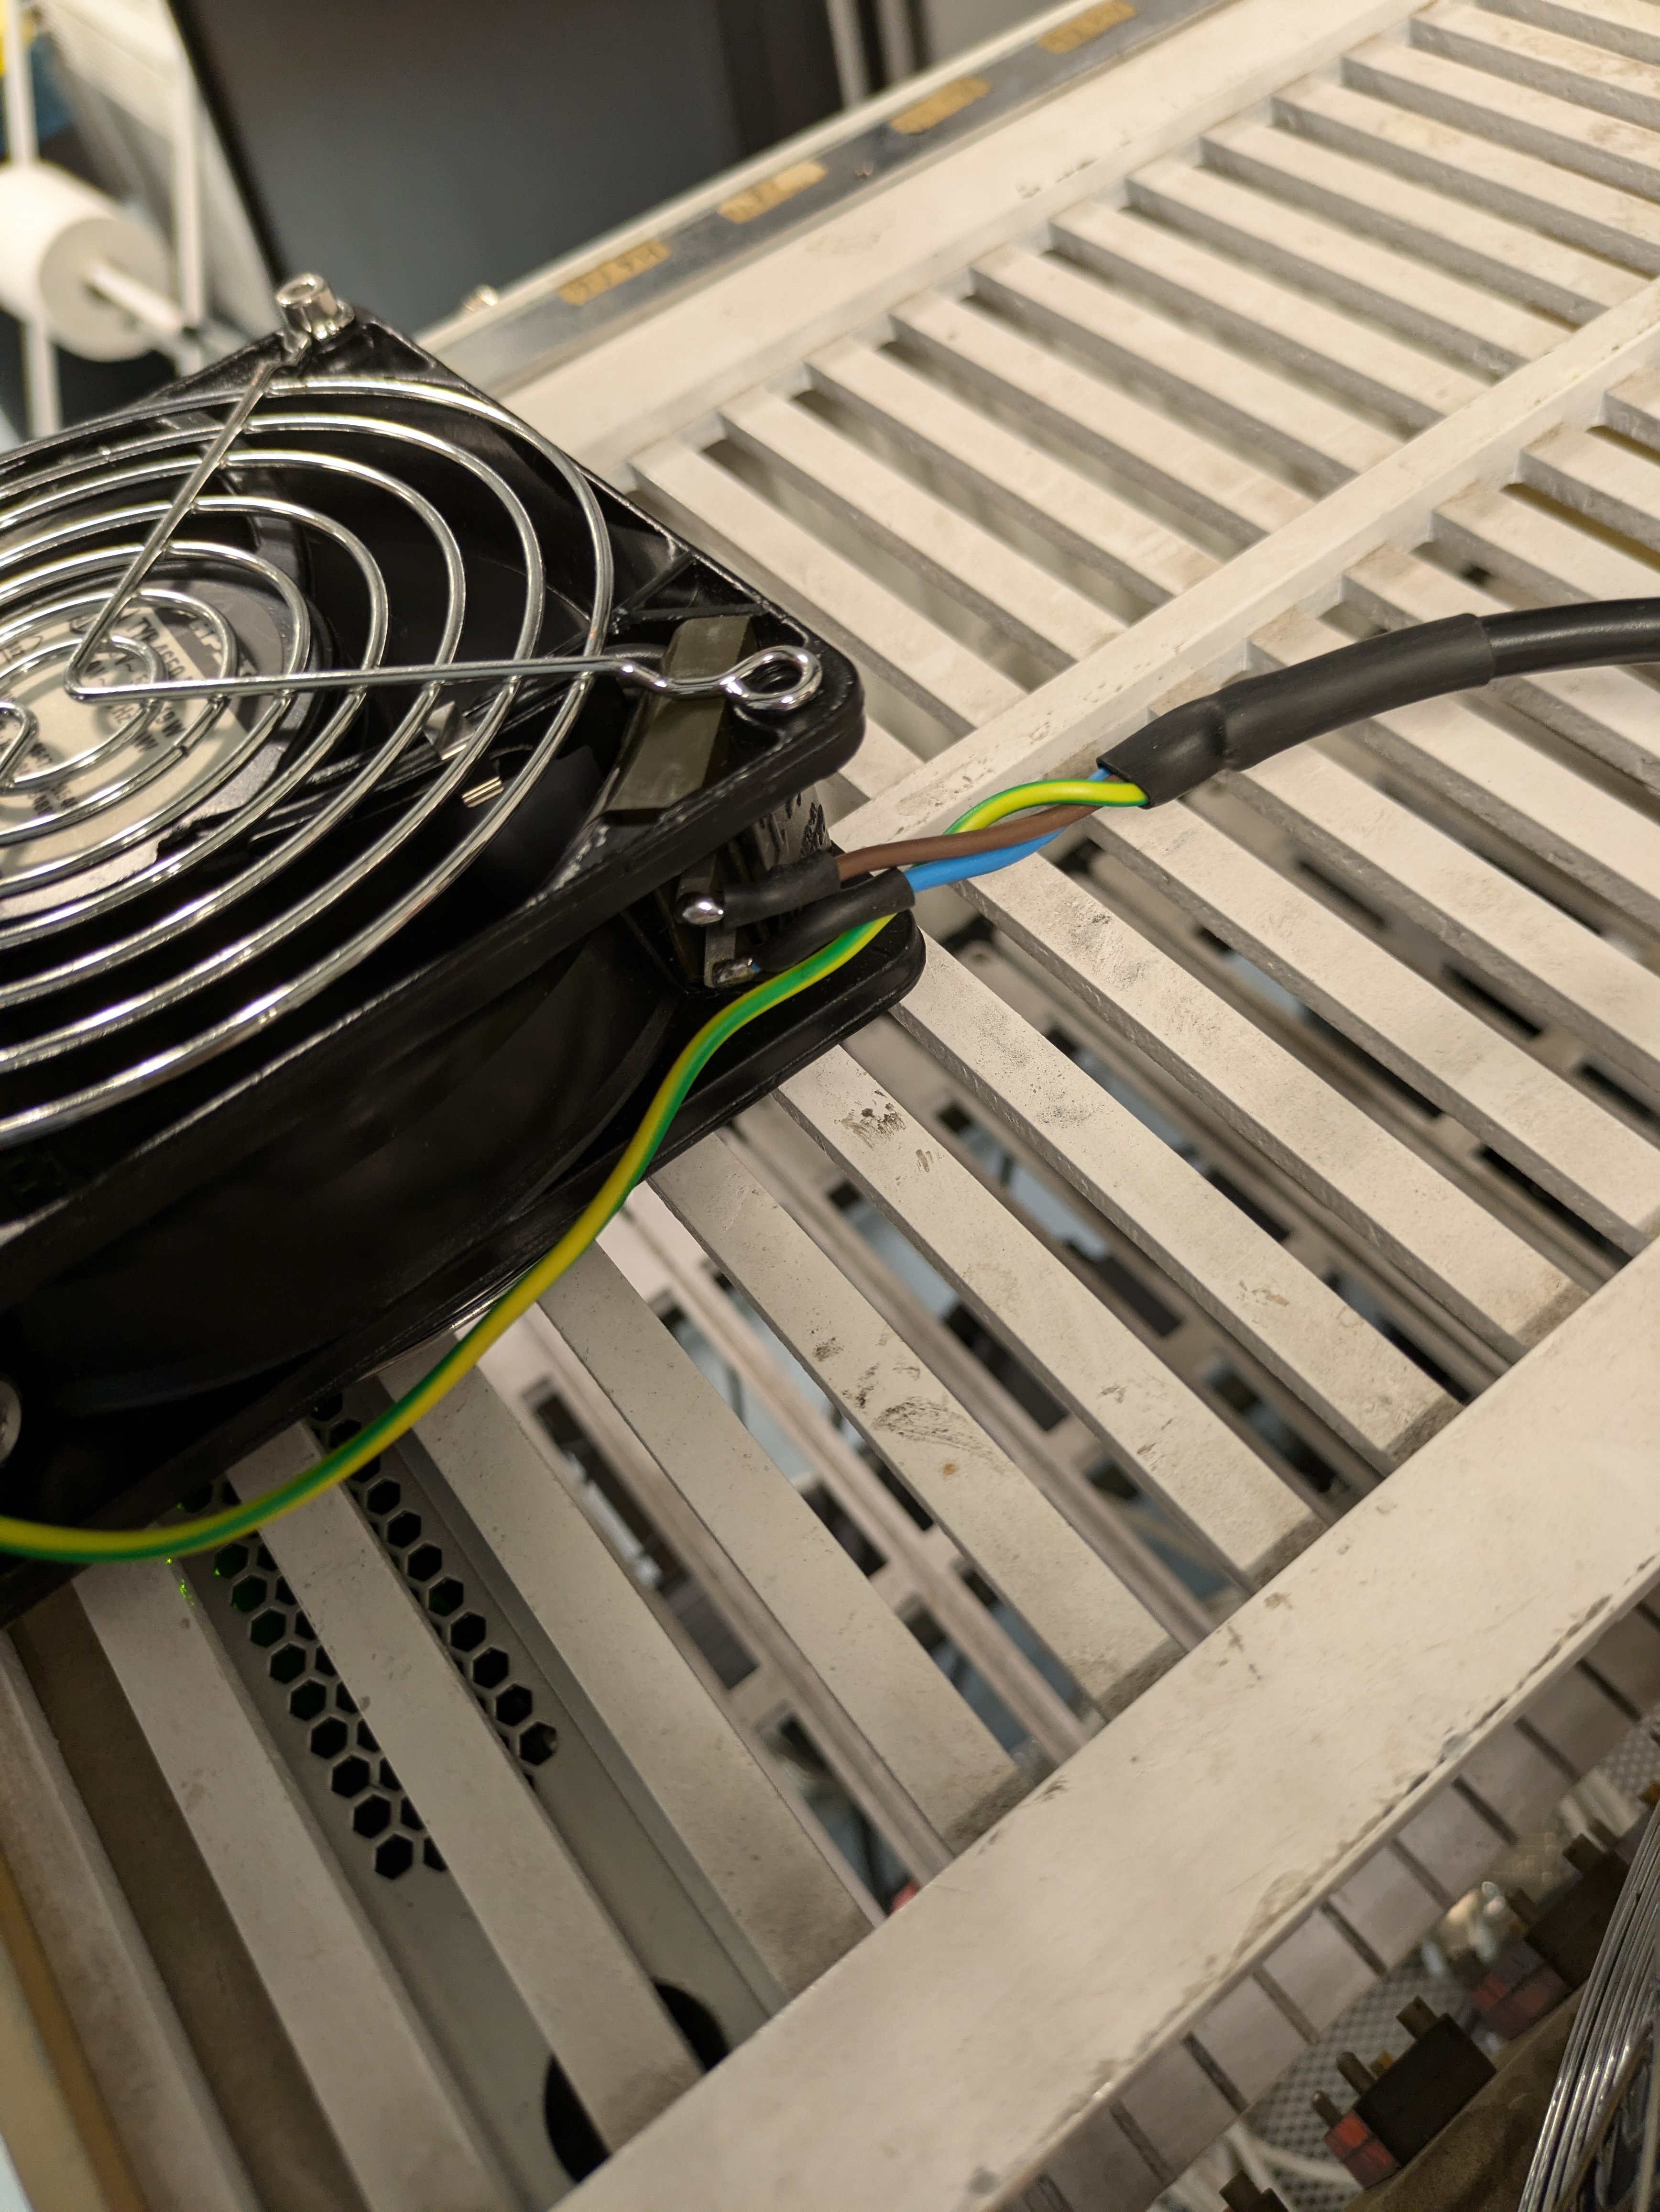
Lessons Learned – Event 3 (2024)
During an experiment, the team added extra fans to their setup. These fans were added after the electrical safety inspection
Instead of buying the correct connectors, they improvised the power connection. This left exposed metal contacts live at 230V on each of their fans
This was spotted during a follow up safety inspection. It could have caused a serious electric shock if touched
Notes:
- The installation of the fans (and connection of T13 sockets) had been rushed using improvised materials and not correctly checked by the experiment team.
- The participants in the collection were not properly knowledgeable about electrical safety principles, despite having attended the correct trainings.
- The experiment team was reminded of the requirement for IP2X protection on LV equipment.

Slide 18
Lessons Learned – Event 3 (2024)
During an experiment, the team added extra fans to their setup. These fans were added after the electrical safety inspection
Instead of buying the correct connectors, they improvised the power connection. This left exposed metal contacts live at 230V on each of their fans
This was spotted during a follow up safety inspection. It could have caused a serious electric shock if touched
Modifications to a setup after the initial inspection can introduce additional risks. In case of need, contact the Safety Officer for further inspections
The correct selection of connectors is critical for safety at 230V AC. This information is also included in the training “Electrical Safety – Working in EP experiments”; ensure everyone is trained!
Notes:
- The installation of the fans (and connection of T13 sockets) had been rushed using improvised materials and not correctly checked by the experiment team.
- The participants in the collection were not properly knowledgeable about electrical safety principles, despite having attended the correct trainings.
- The experiment team was reminded of the requirement for IP2X protection on LV equipment.

Slide 19

Conclusion
Important to have up to date procedures in one repository!
Challenges: many set-ups in a constrained place, numerous parallel activities, high turnover of personnel
We witnessed an increase of the general Safety Culture within the ISOLDE collaboration
The EDMS Safety Files are more and more populated, however, to be ensured they are always up-to-date during the life cycle of the installations!
The newly appointed (Deputy) Experimental Safety Officers for the installations are a key role to continue on this positive trend. Always ensure communication with them!
From our Safety Officers side, we keep being available in case of any doubts, questions, review or inspections

Slide 20

Thank you very much for your attention!
Questions?

Slide 21
Spare slides

Slide 22
Safety in EP Department and at ISOLDE
EP Department Head
EP DSO
ISOLDE Collaboration Spokesperson
ISOLDE EXSO
Other Safety Officers
(TSO, FGSO, CSO, RSO, LSO, ...)
ISOLDE Experiment TC/Spokesperson
ISOLDE Installation (D)EXSO
For MPA, Collaborating Institutions (TL)
Institute Safety Correspondent
Activity Leader
(MPE / MPA)
For MPE, CERN hierarchical line
DSO
HSE Unit
Personnel
(MPE / MPA / Contractor)
For contractors, Employers
Company Safety Correspondent
12.3.25
Letizia Di Giulio | EP Safety Office
22

