Slide 1
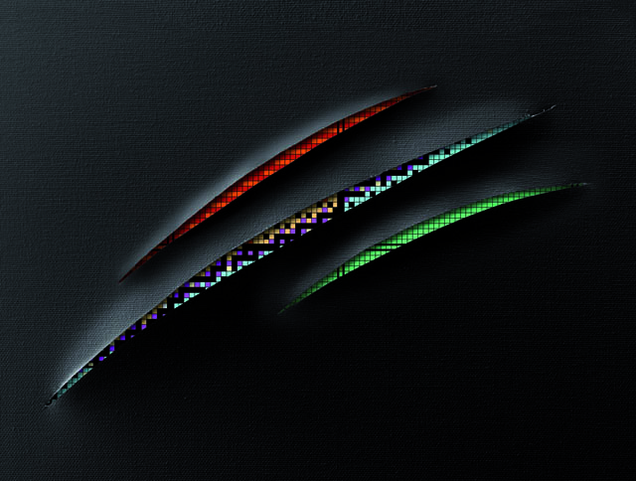

Halo orbits and
the nuclear radius
Silvia M. Lenzi
University of Padova and INFN
Workshop and Users Meeting 2025

Slide 2
Outline
The nuclear radius and
the role of low-ℓ orbits in determining structure properties
Microscopic calculations and preliminary results for isotopic shifts
Conclusions and outlook

Slide 3
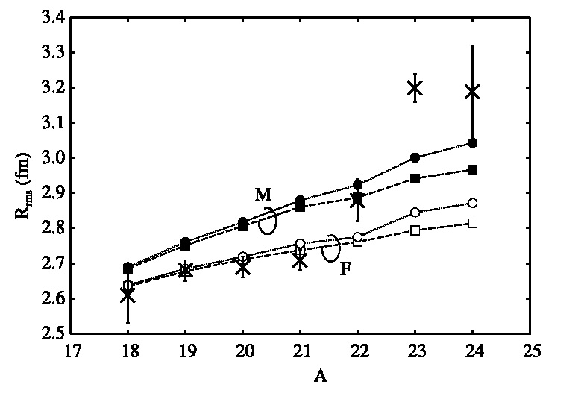
The nuclear (charge) radius
R_{p}
R_{n}
The nuclear radius is a fundamental property, quite difficult to measure and to reproduce with microscopic models and methods.
Charge radii are usually measured via electron scattering.
Laser spectroscopy allows to measure radial shifts along isotopic chains.
This applies to ground states or isomeric states.
Ca charge radii
Oxigen isotopes
R. F. Garcia Ruiz et al., NATURE PHYSICS 12 (2016) 594
H. Masui, K. Kat and K. Ikeda, NPA 895 (2012) 1

Slide 4
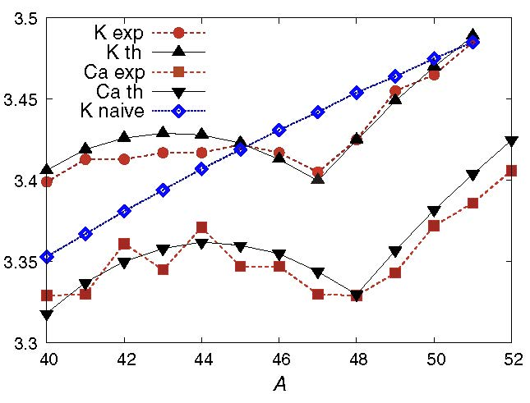
Empirical formula for charge radii
Duflo and Zuker have developed a
5-parameter empirical formula for the rms charge radii (t_{z} = N-Z):
It reproduces the sudden rise of Ca radii
K
J. Duflo and A.P. Zuker, PRC 66, 051304 (2002)
Charge radius (fm)
These 5 parameters are obtained by fitting
all measured radii up to A~60.
The last term (λ) takes into account proton-
neutron correlations.
Ca
J. Bonnard et al., PRL 116, 212501 (2016)
Using this expression, it is possible to obtain the neutron skin:

Slide 5
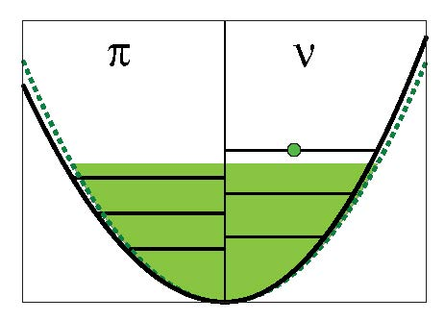
Understanding nuclear radii
Bonnard et al., studying doubly-magic nuclei ± 1 nucleon put in evidence two effects:
The radial extension of low-ℓ orbits is much larger that the others in the main shell and creates larger neutron skins.
low-ℓ
large-ℓ
Isovector monopole polarizability
Neutron skin
A | J^{π} | Δr_{νπ} (fm)
17 | 5/2⁺ | 0.056
 | 1/2⁺ | 0.147
41 | 7/2⁻ | 0.015
 | 5/2⁻ | 0.018
 | 3/2⁻ | 0.038
 | 1/2⁻ | 0.037
d_{5/2}
s_{1/2}
f_{7/2}
The addition of a nucleon induces
changes in the potential wells
of both protons and neutrons in different directions and thus
tends to equalize the radii
independent on the neutron excess
f_{5/2}
p_{3/2}
p_{1/2}
J. Bonnard, SM Lenzi and AP Zuker., PRL 116, 212501 (2016)

Slide 6
The abrupt increase of Ca radii
K
Ca
Charge radius (fm)
Ca
neutrons filling f_{7/2}
filling p orbits
Why the charge radius increases when filling p orbits?
Because p orbits are
MUCH LARGER than f orbits!
It is found that the radial difference may arrive to ~ 0.7 fm in the fp shell
J. Bonnard, SM Lenzi and AP Zuker., PRL 116, 212501 (2016)

Slide 7
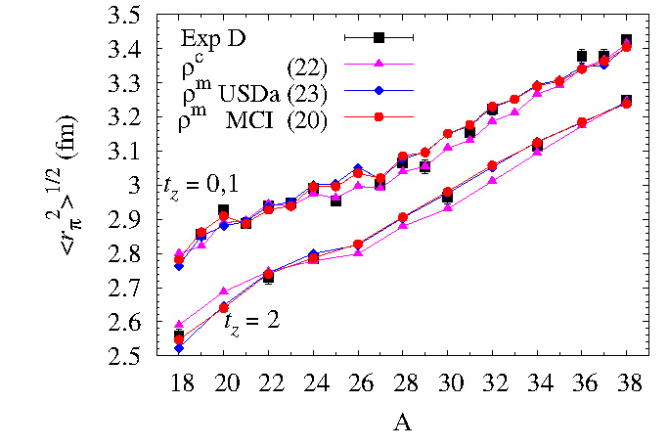
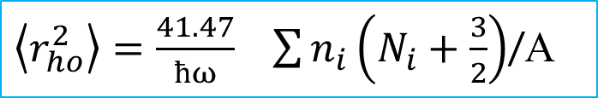


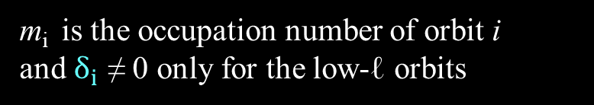
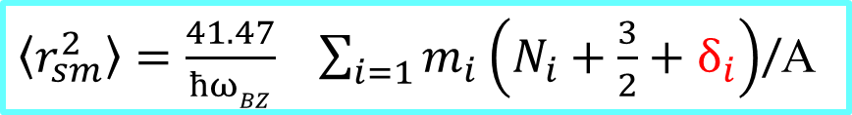
Microscopic calculation
In the harmonic oscillator basis, the radius is obtained as:
${\left\langle r_{ho}^{2}\right\rangle =\frac{41.47}{ħω}}_{}\sum{n_{i}\left(N_{i}+\frac{3}{2}\right)}$/A
N_{i} is the principal quantum number and
n_{i} is the number of particles in orbit i
Let’s try a parameterization of the radii where low-ℓ orbits are larger ($δ_{i})$ than the rest in a main shell in a full shell model calculation.
Using such a prescription, Bonnard and Zuker reproduce the charge radii along the N~Z line in the sd shell
${\left\langle r_{sm}^{2}\right\rangle =\frac{41.47}{ħωBZ}}_{}\sum_{i=1}{m_{i}\left(N_{i}+\frac{3}{2}+δ_{i}\right)}$/A
$\left\langle r_{sm}^{2}\right\rangle$^{1/2}
m_{i} is the occupation number of orbit i
and $δ_{i}$ ≠ 0 only for the low-ℓ orbits
J. Bonnard and A. P. Zuker (2018) J. Phys.: Conf. Ser. 1023 012016

Slide 8
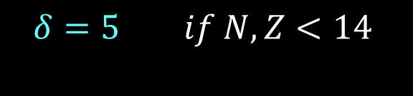
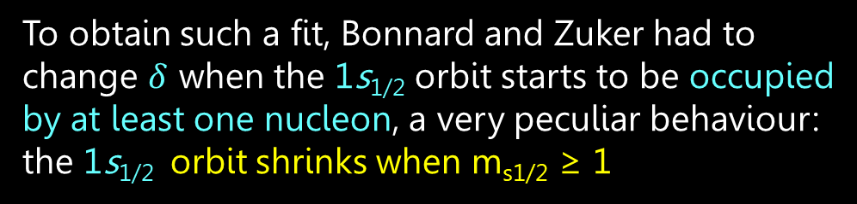
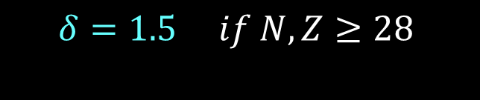
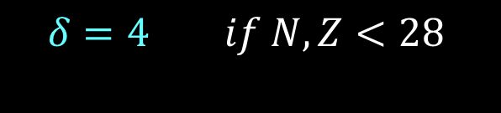
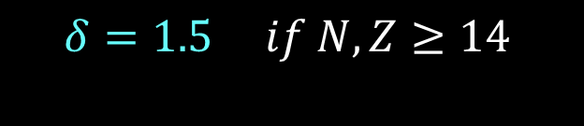
Shrink of the low-ℓ orbits’ size
To obtain such a fit, Bonnard and Zuker had to change $δ$ when the 1s_{1/2} orbit starts to be occupied by at least one nucleon, a very peculiar behaviour: the 1s_{1/2} orbit shrinks when m_{s1/2} ≥ 1
R(s) – R(d) (fm)
$$δ=5 if N,Z<14$$
2s_{1/2}
1s_{1/2}
14
$$δ=1.5 if N,Z≥14$$
1d_{5/2}
A similar behaviour is obtained for the p orbits in the fp shell
1.8
1.6
1.4
1.2
1.0
0.8
0.6
2p_{1/2}
$$δ=4 if N,Z<28$$
2p_{3/2}
2p_{3/2}
$$δ=1.5 if N,Z≥28$$
28
Ca isotopes
R(p_{3/2}) – R(f_{7/2}) (fm)
1f_{7/2}
A

Slide 9
Take away message
1) Due to the strong proton-neutron interaction, the proton and neutron radii tend to equalize.
Isovector monopole polarizability
low-ℓ
large-ℓ
2) low-ℓ orbits have larger radius than the rest of the orbits in a major shell
3) the radius of low-ℓ orbits decreases abruptly when they are occupied by at least one nucleon, but it is still
much larger than the rest of the orbits.
R(s) – R(d) (fm)

Slide 10
Further
evidences

Slide 11
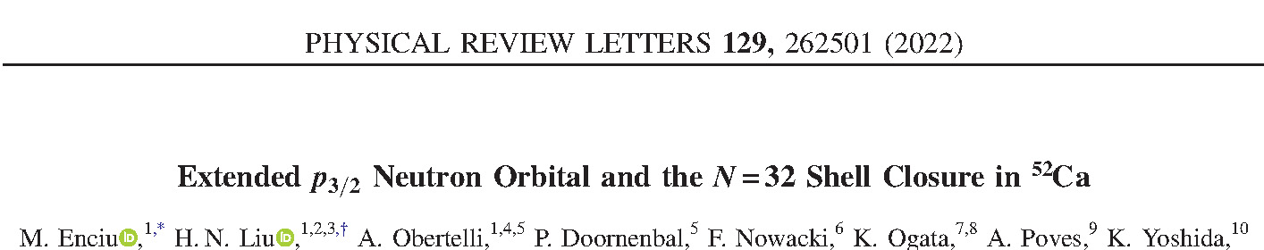
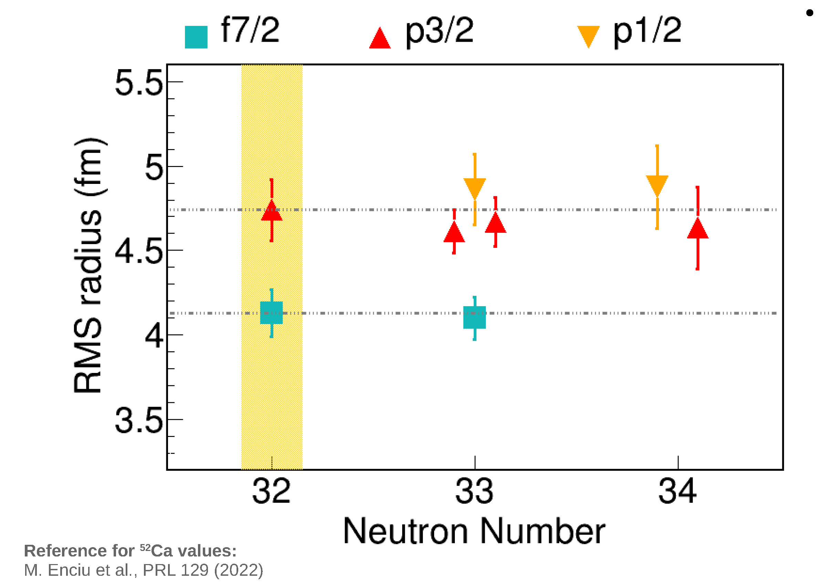
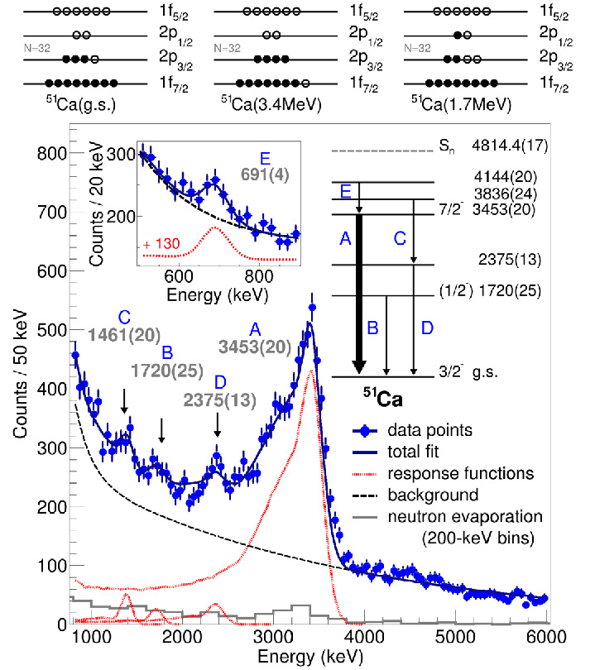

Size of p orbits in ⁵²⁻⁵⁴Ca
$$measured r_{p3/2}−r_{f7/2}=0.61 (23) \text{fm}$$
$$predicted by Bonnard et al.: r_{p}−r_{f}≈0.6−0.7 \text{fm}$$
Measure orbital radius at RIBF, RIKEN:
Neutron knock-out (p,pn) on ⁵²Ca.
Setup: MINOS TPC + DALI2+ + SAMURAI + NEBULA
preliminary results for ⁵³⁻⁵⁴Ca
the same radius for both p orbits!
Mădălina Enciu, DREB2024
The linear increase of charge radii in Ca (and K) isotopes is proposed to be due to the filling of neutrons in the «halo» p orbits

Slide 12
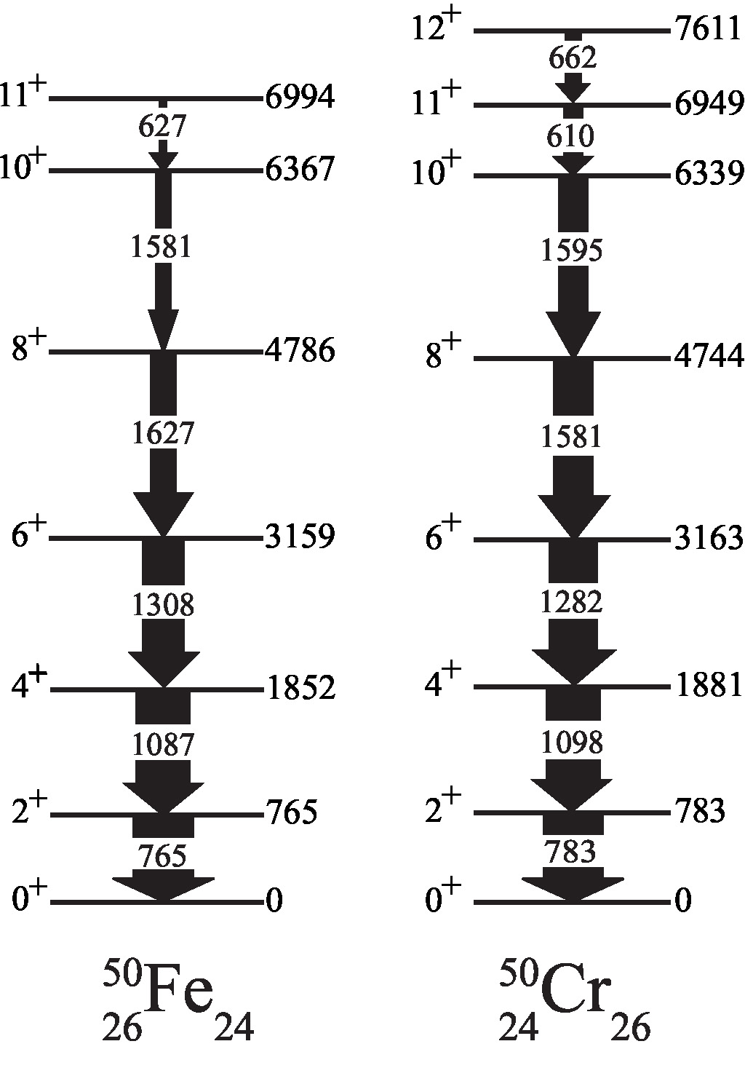
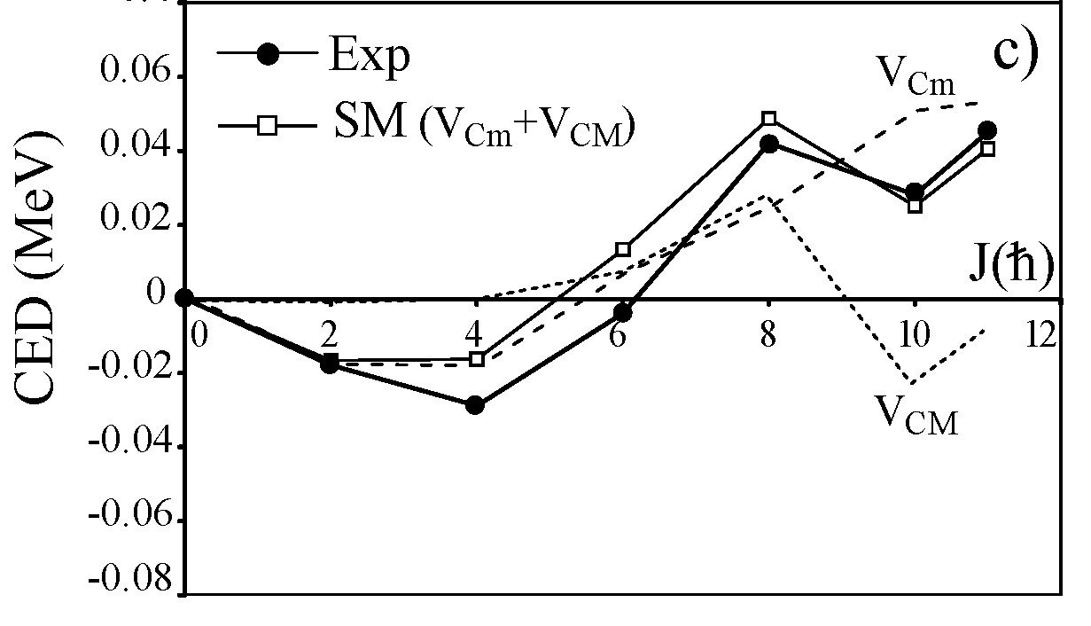
Mirror energy differences
Z
N=Z
difference in excitation energies
between analogue states in mirrors
T=1
T=1/2
N
radial term
V_{Cr}
(V_{CM} + V_{Cr})
The change in the nuclear radius with increasing angular momentum has a sizable effect on the Coulomb energy
MED (MeV)
pure Coulomb
V_{CM}
J
SML, N. Marginean, A.P. Zuker
et al., PRL 87 (2001)122501

Slide 13
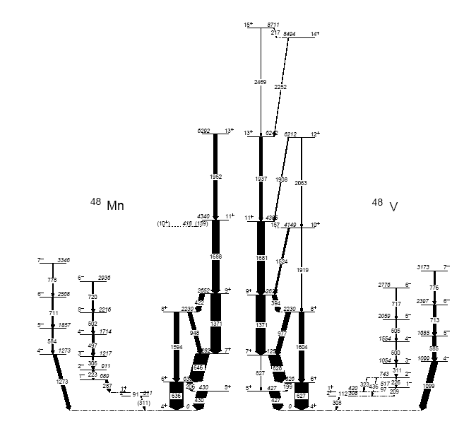
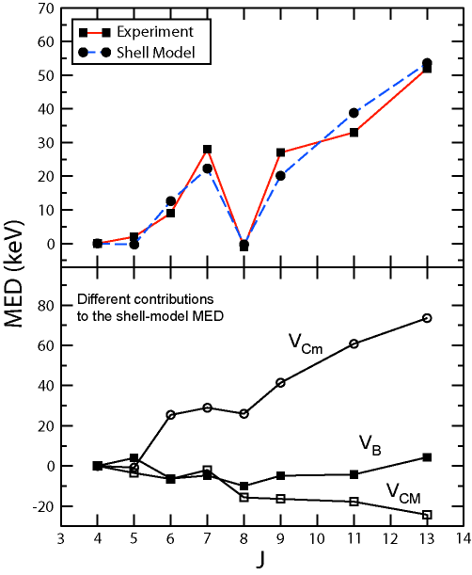
Evidence of the Coulomb radial effect
Multipole effects
are cancelled out
radial term
Most important contribution
M.A. Bentley et al.,
PRL 97, 132501 (2006)
The nucleus changes shape
towards band termination

Slide 14
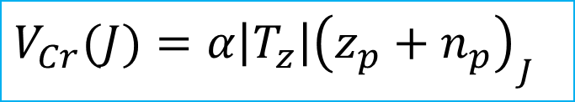
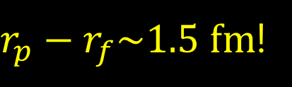
The radial effect with the shell model
The radius of a nucleus depends on the occupation of the different orbits.
In the fp shell p orbits have larger radius than the f ones.
The radial term can be expressed in terms of the occupation of the p orbits as a function of J
low-ℓ
large-ℓ
$$V_{Cr}(J)=α\left|T_{z}\right|{\left(z_{p}+n_{p}\right)}_{J}$$
z_{p} and n_{p} are the occupation numbers of protons and neutrons in the p orbits, relative to the g.s.
α is not a free parameter, it is estimated from experimental data of nuclei in the f_{7/2} shell where the p orbits are fractionally occupied (z_{p}+n_{p})<<1
α ~ 200 keV for nuclei in the f_{7/2} shell
This means that the difference of the rms
$r_{p}−r_{f}\sim 1.5 fm$!
SML, N. Marginean, A.P. Zuker et al., PRL 87 (2001)122501

Slide 15
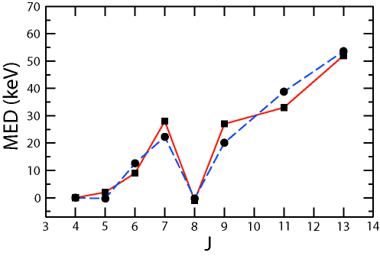
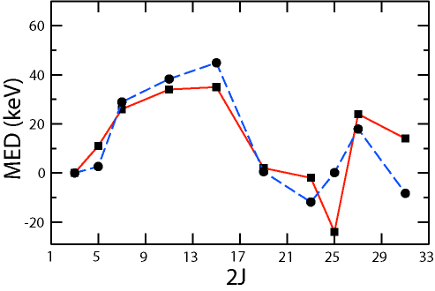

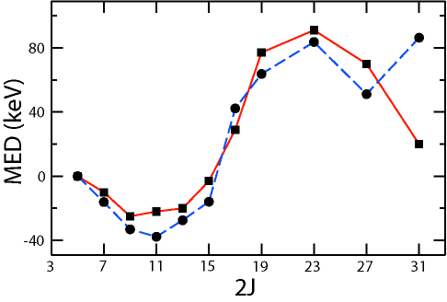
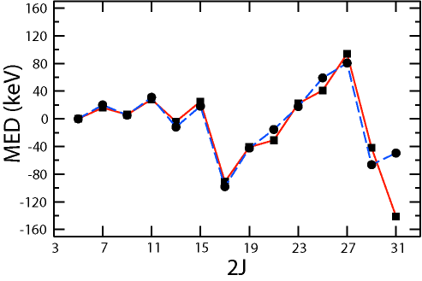
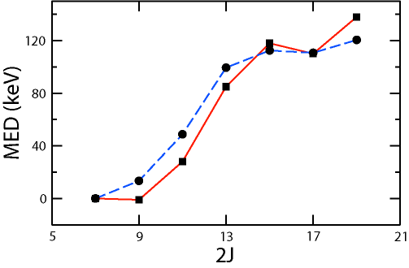


MED in the f_{7/2} shell
In these nuclei the occupation number of the p orbits is much less than one and therefore
$\left(z_{p}+n_{p}\right)<<1, α=200 keV$
A = 48
A = 47
($r_{p}−r_{f}\sim 1.5 fm)$
A = 49
A = 51
A = 53
M.A. Bentley and SML, PPNP 59, 491 (2007)

Slide 16
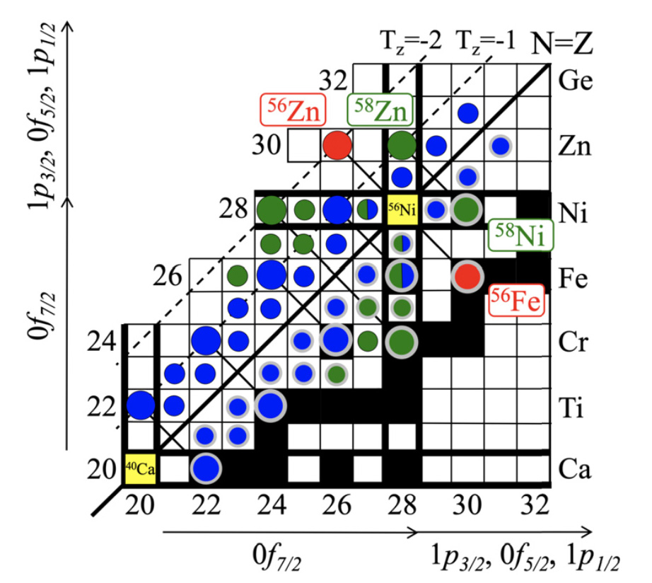


Going higher in masses
Recently, excited states in ⁵⁶Zn and ⁵⁵Cu have been observed for the first time in RIKEN with DALI2.
These nuclei have at least one nucleon occupying the 2p_{3/2} orbit
$\left(z_{p}+n_{p}\right)≥1, α\left(\text{2}\text{p}\text{3/2}\right)≪200 keV$
2p_{1/2}
2p_{3/2}
⁵⁵Cu
28
But the 2p_{1/2} orbit is still fractionally occupied
1f_{7/2}
$α\left(\text{2}\text{p}\text{1}\text{/2}\right)=200 keV$
⁵⁵Fe
$$V_{Cr}(J)=α\left|T_{z}\right|{\left(z_{p}+n_{p}\right)}_{J}$$
$V_{Cr}=\left|T_{Z}\right|(α_{p1/2}$($z_{p1/2}+n_{p1/2}$)+ $α_{p3/2}$($z_{p3/2}+n_{p3/2}$))

Slide 17
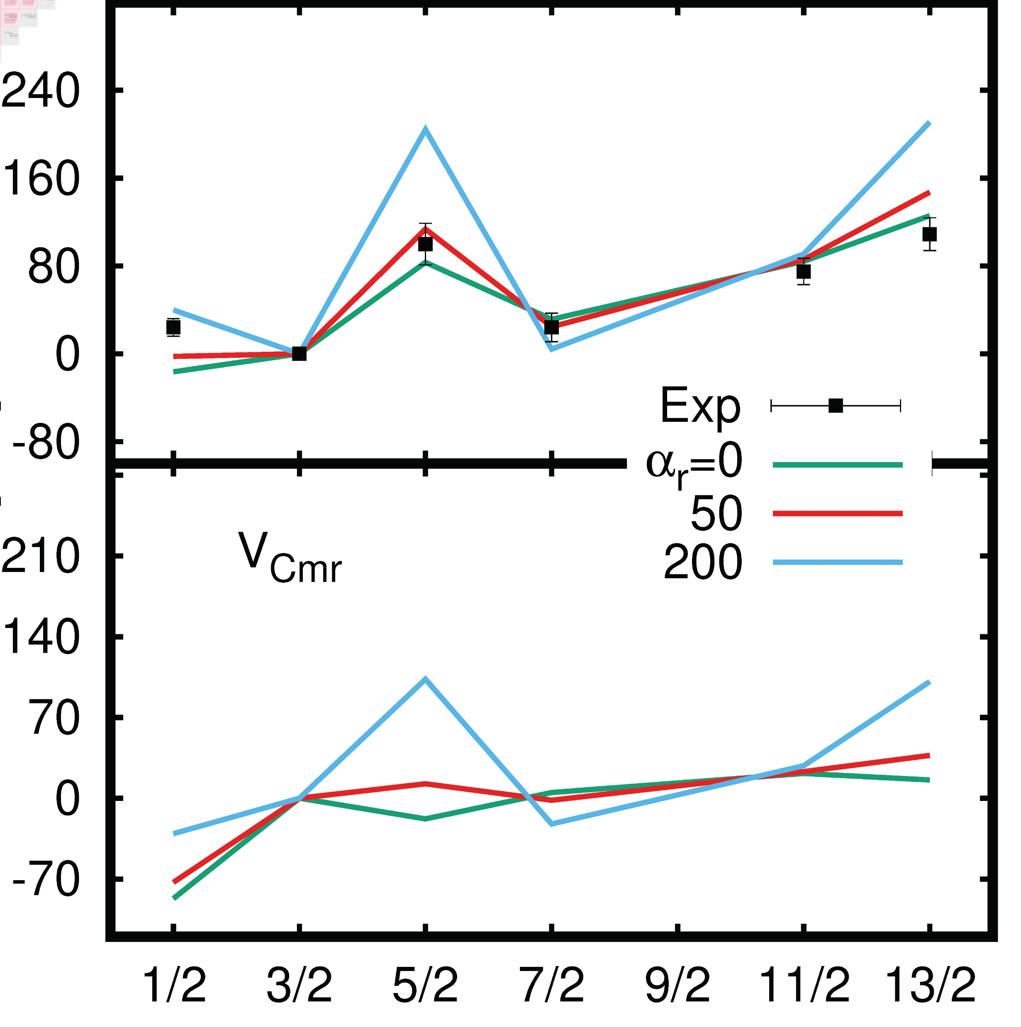
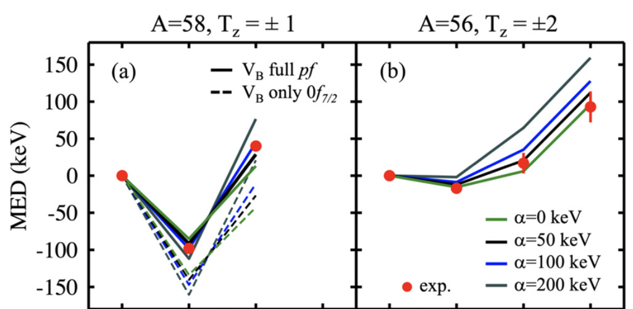
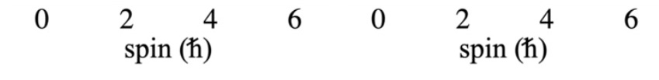
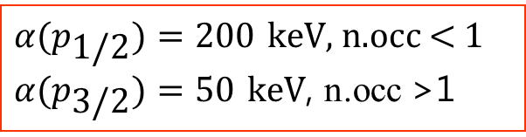
Effect of the shrink in the MED
Effect on the MED of the reduced radius of the p_{3/2} orbit that is occupied by 1 or 2 nucleons
$α{(p}_{\text{1/2}})=200 \text{keV}$, n.occ < 1
$α{(p}_{\text{3/2}})=50 \text{keV}$, n.occ >1
A=55 T_{z}= ±3/2
⁵⁵Cu-⁵⁵Fe
⁵⁸Zn-⁵⁸Ni
⁵⁶Zn-⁵⁶Fe
Vcr (keV) MED (keV)
V_{Cr}
A=55 S. Pigliapoco et al., submitted to PLB
A=56 A. Fernandez et al., PLB 823 (2021) 136784

Slide 18
Isotopic shifts:
Preliminary results

Slide 19
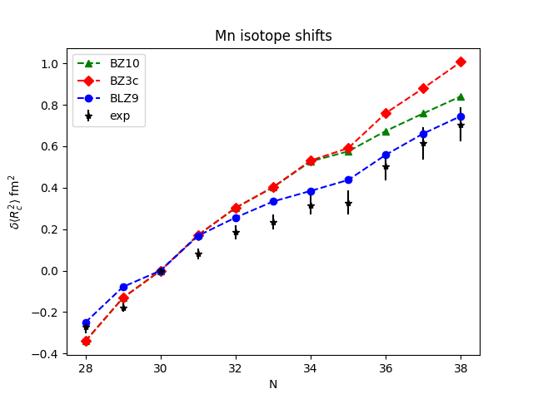
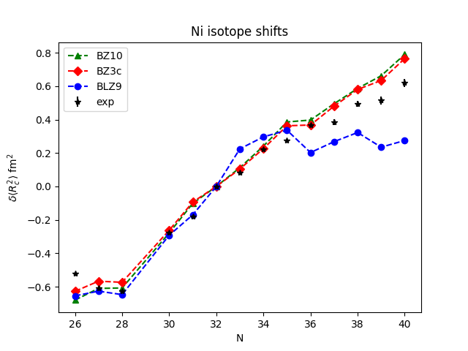
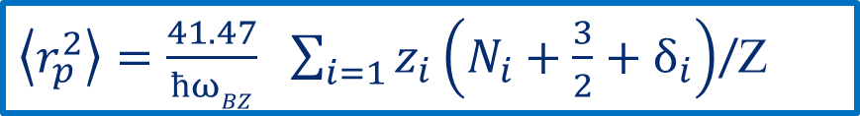
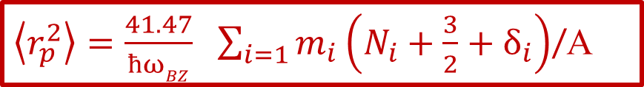
Preliminary results of charge radii calculations
Based on the previous studies by Bonnard et al., we have extended the two microscopic approaches to obtain the isotope shifts along isotopic chains:
${\left\langle r_{p}^{2}\right\rangle =\frac{41.47}{ħωBZ}}_{}\sum_{i=1}{m_{i}\left(N_{i}+\frac{3}{2}+δ_{i}\right)}$/A
${\left\langle r_{p}^{2}\right\rangle =\frac{41.47}{ħωBZ}}_{}\sum_{i=1}{z_{i}\left(N_{i}+\frac{3}{2}+δ_{i}\right)}$/Z
J Bonnard and AP Zuker (2018) J. Phys.: Conf. Ser. 1023 012016
J Bonnard, SM Lenzi and AP Zuker., PRL 116, 212501 (2016)
Giacomo Brignolo Ms Thesis (Padova)

Slide 20
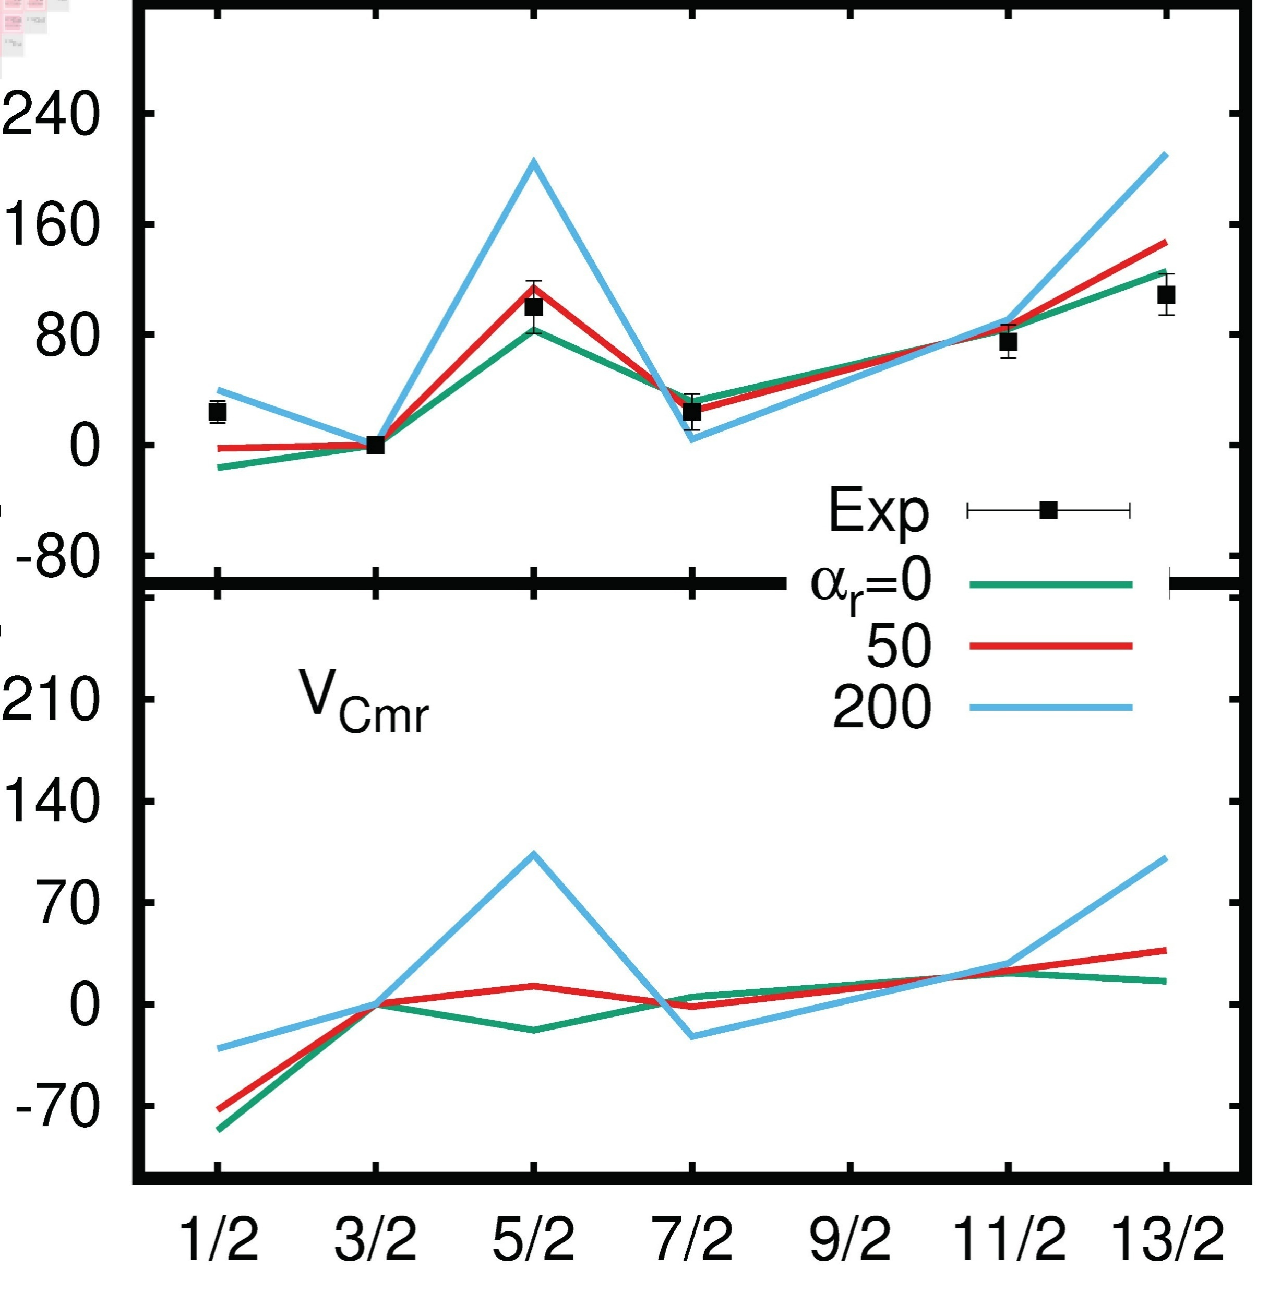
Conclusions and outlook
low-ℓ
large-ℓ
Low-ℓ orbits have larger radius than the rest of the orbits in a major shell
The radius of low-ℓ orbits decreases abruptly when they are occupied by at least one nucleon but are still much larger than the rest of the orbits.
⁵⁵Cu-⁵⁵Fe
R(s) – R(d) (fm)
MED (keV)
V_{Cr}
Preliminary results to apply the microscopic
approach along isotopic chains look promising
Thank you for your attention!

