Slide 1
Antiproton unstable matter annihilation experiment
Mark Kirschbaum, TU Darmstadt
ISOLDE Workshop and Users Meeting
Geneva, Switzerland
2025 Dec. 3.- 5.

Slide 2

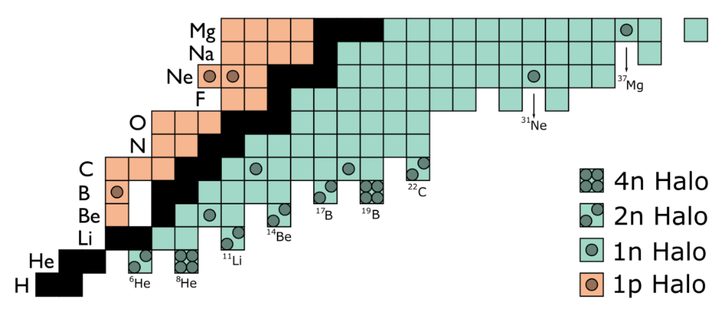

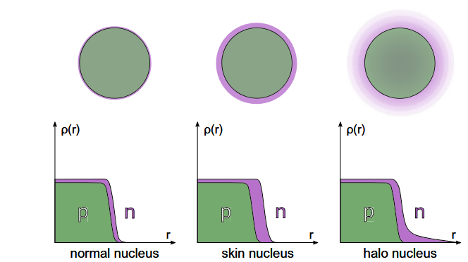

Motivation
PUMA Collaboration et al, EPJ A, 2022
Nuclei near the neutron dripline:
Nuclear halos: one (or multiple) neutrons
Neutron skins: excess of neutrons at the surface
Ideal method:
Isospin sensitive
Sensitive to the tail of nuclear density
Applicable for radioactive ion beams
Obertelli, Sagawa, Springer, 2021

Slide 3
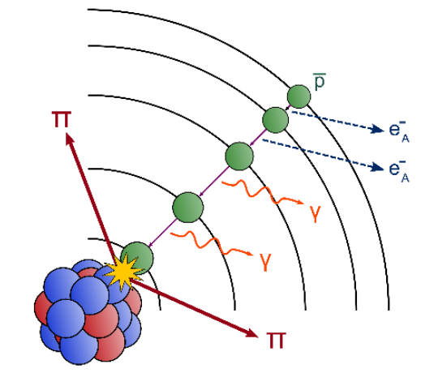
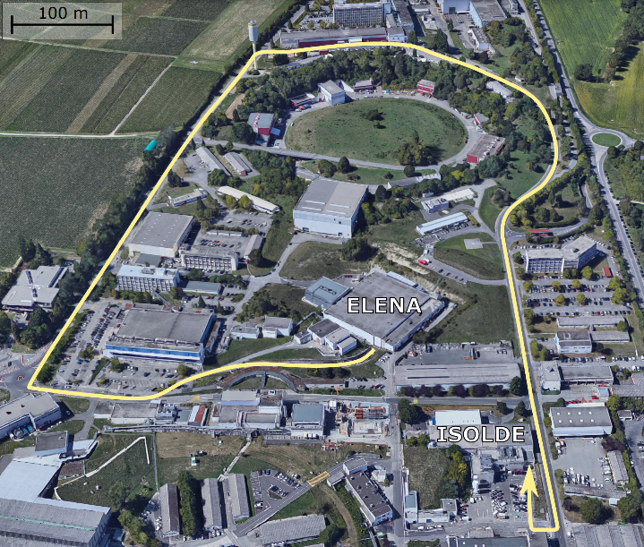
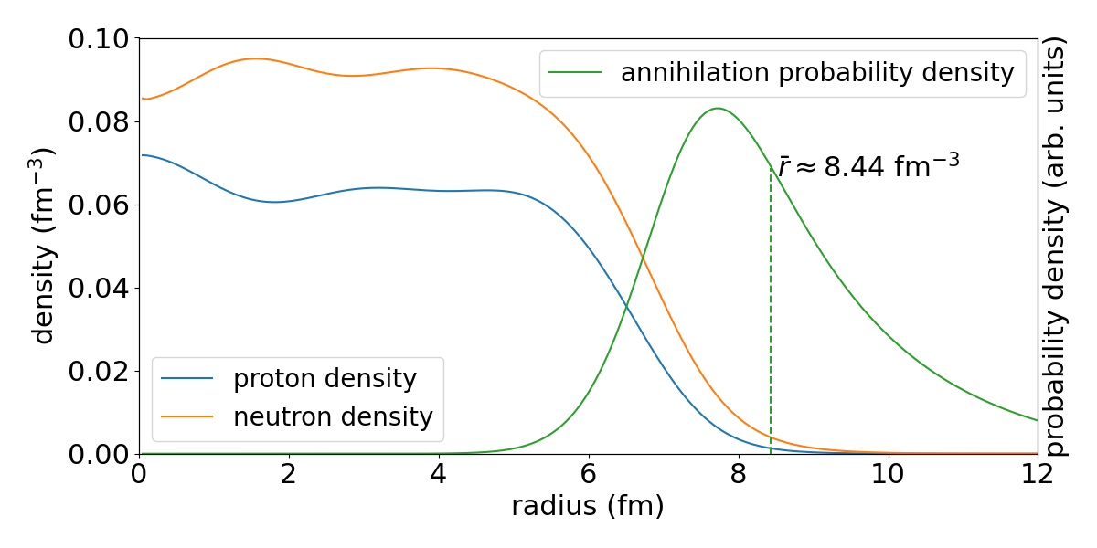
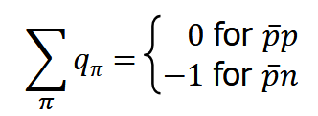
Antiprotons as a probe
Low energy antiproton – nucleon collision:
Capture of antiproton
Cascade (X-ray and Auger electron emission)
Annihilation with neutron or proton of nucleus
Pion emission and final state interactions
PUMA: Identify annihilation products (pions)
Annihilation dominates at tail of nuclear density
Electric charge conservation:
208 Pb
Bugg et al., PRL, 1973

Slide 4
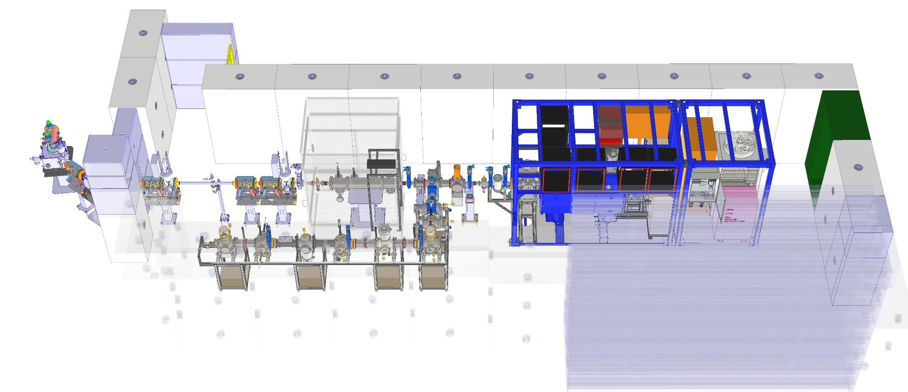
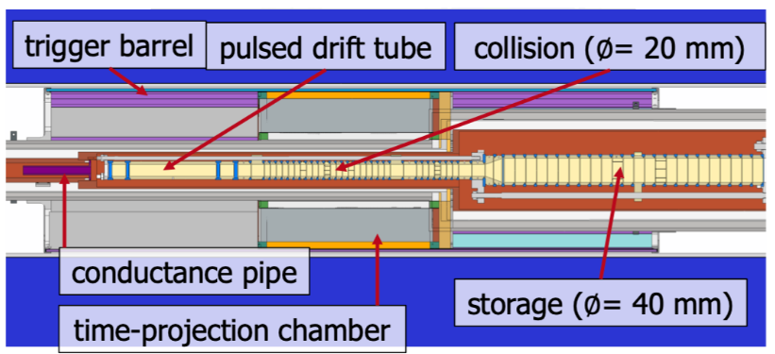
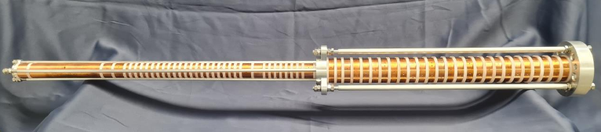
PUMA At the ad
Deceleration Beamline
Transportable Part
LNE51 beamline
installation finished,
near-operational
operational
operational
Offline Ion Source
operational at TuDa,
installation at AD in Jan’26

Slide 5
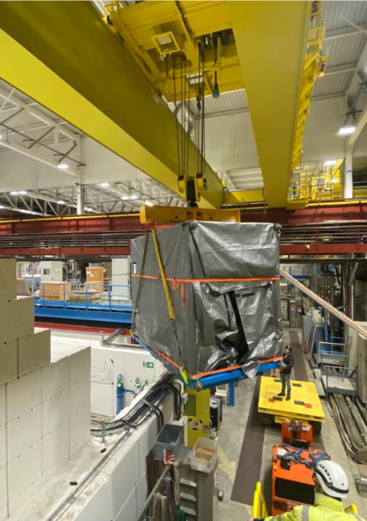
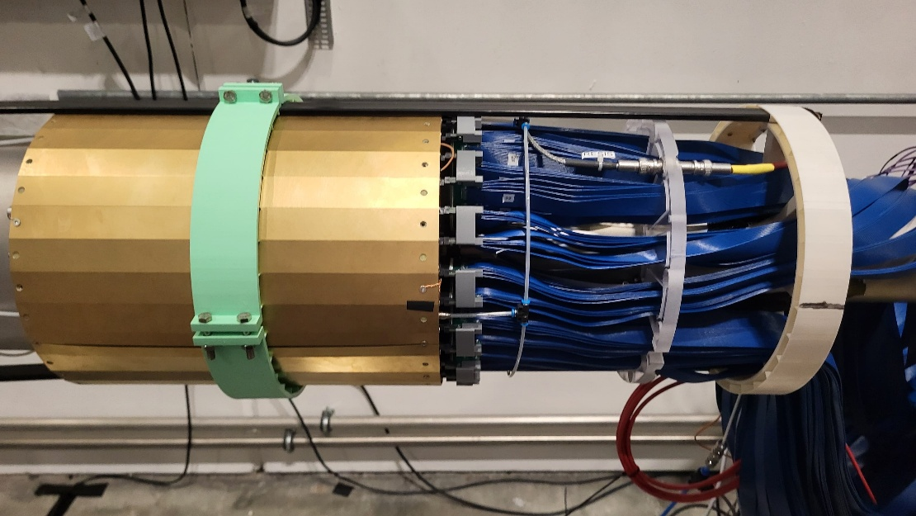
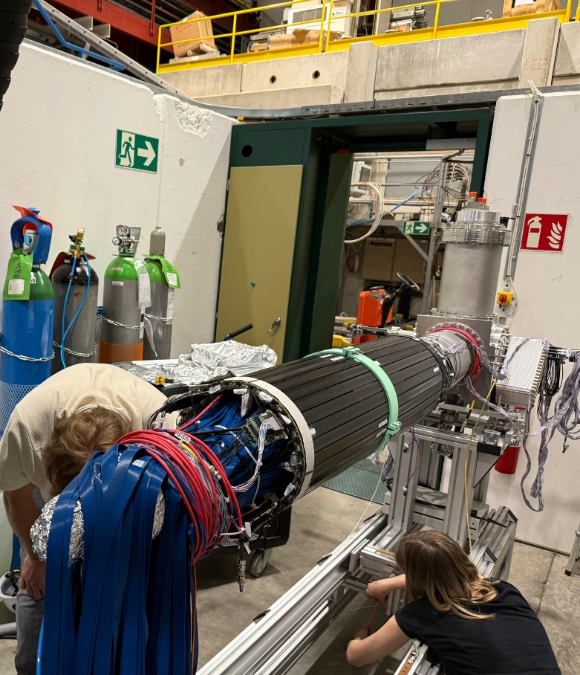
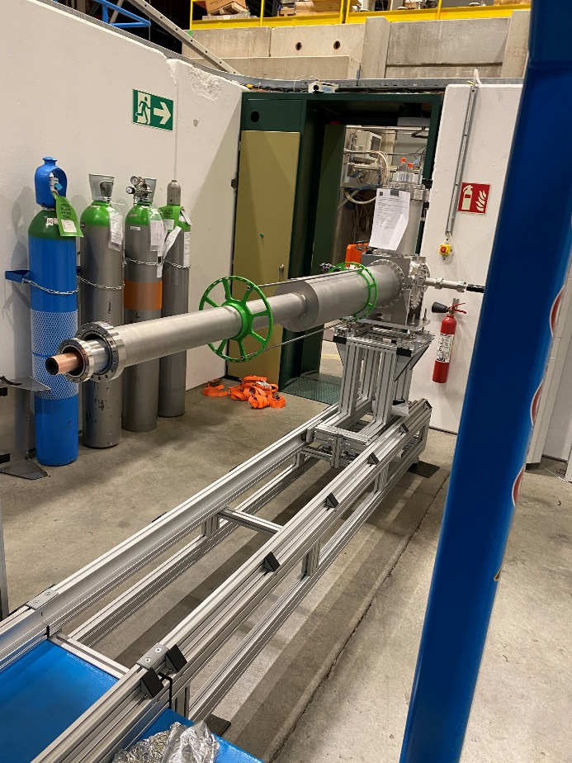
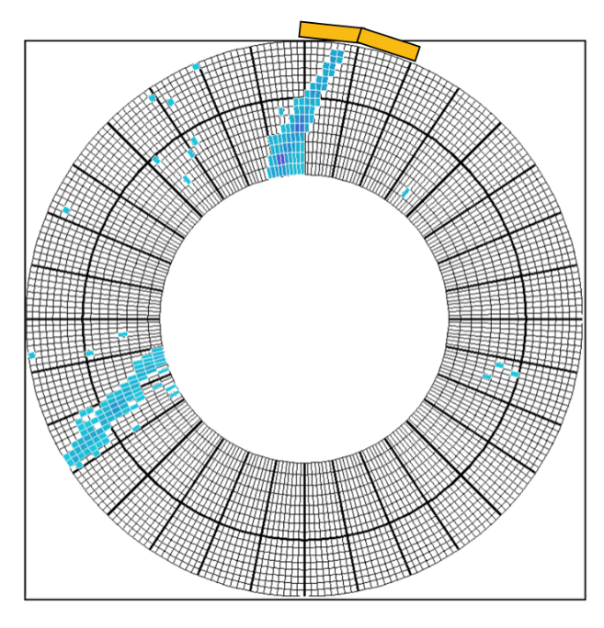
Magnet and trap installation
DEC‘24
JAN‘25
SUMMER‘25
SEP‘25

Slide 6
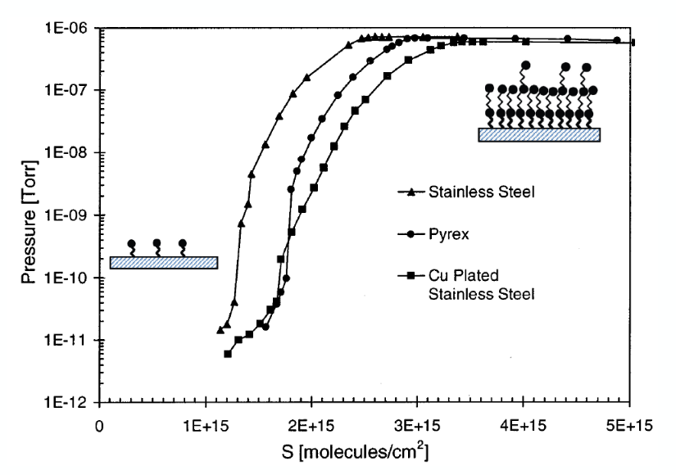
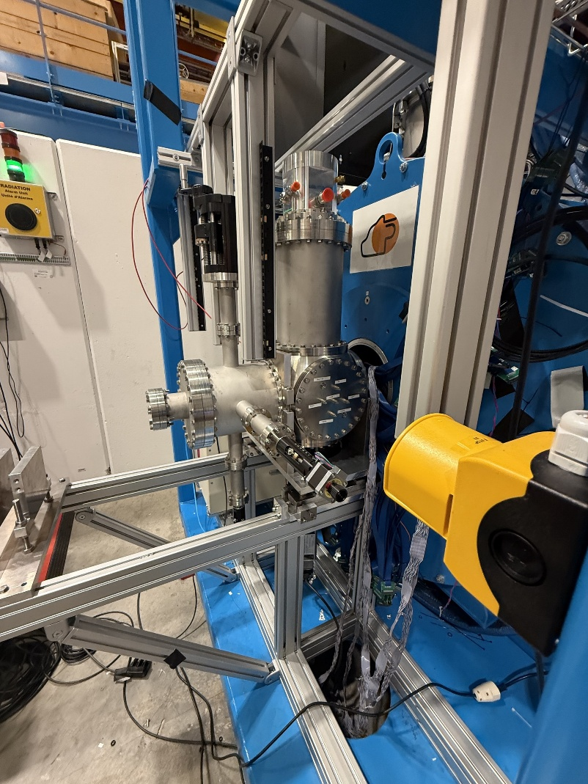
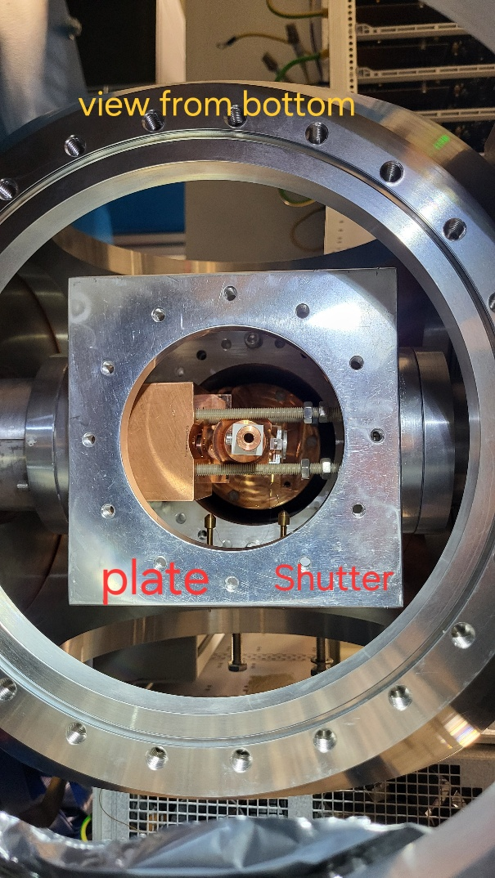
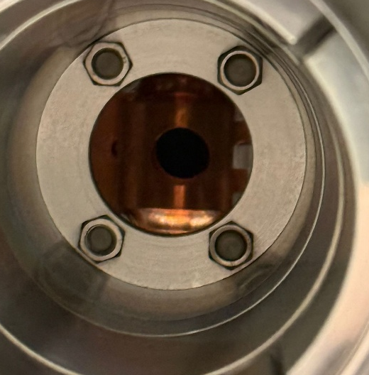
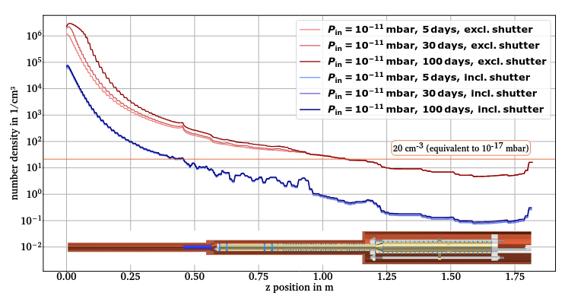
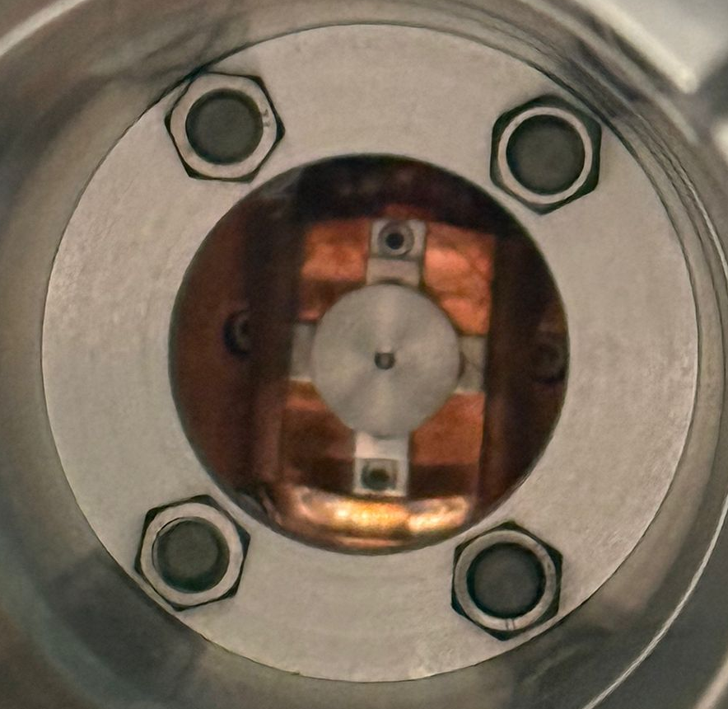
Magnet and trap installation
NOV‘25
OCT‘25

Slide 7
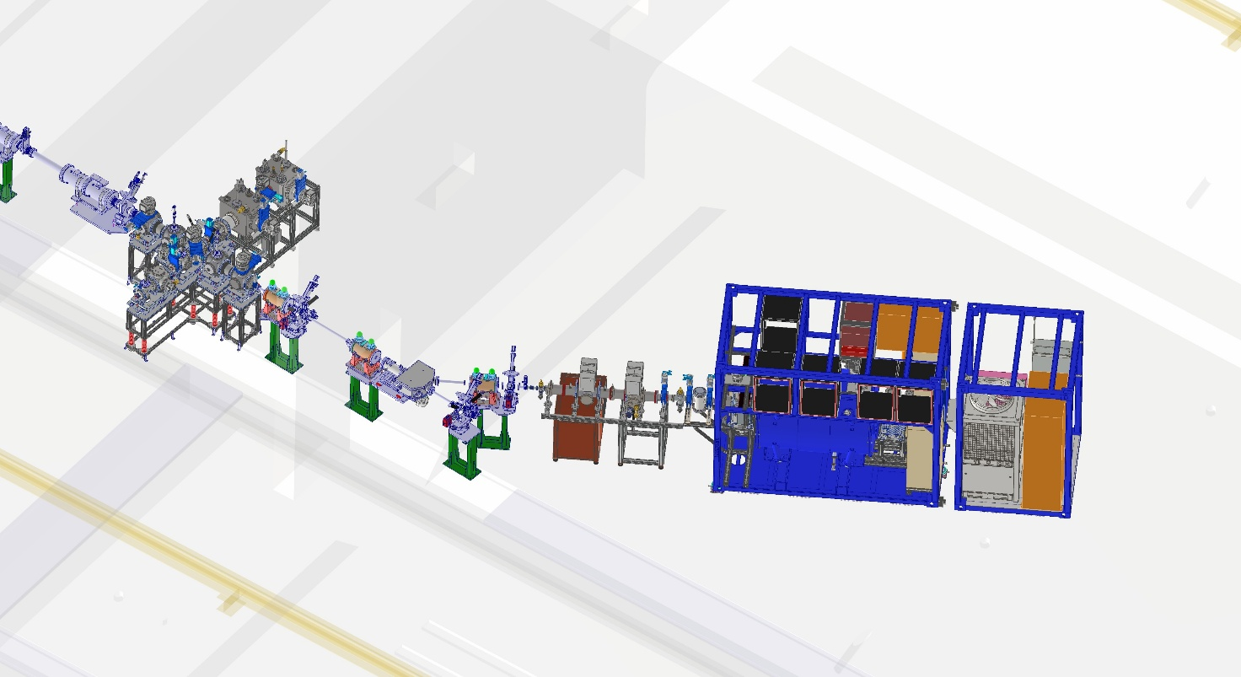
PUMA At ISOLDE
MR-ToF
RC-6:
Deceleration and accumulation of RIBs in RFQ cooler buncher Paul trap
Isobar separation for beam purification in MR-ToF MS
Reacceleration to 30 keV for beam transport
Full view
Handover point
26 kV Pulsed-Drift-Tube
Paul trap
RC-7:
Deceleration to 30 keV
Focusing into trap
RC6 beam line
(CERN responsibility)
RC7 beam line
(PUMA responsibility)

Slide 8
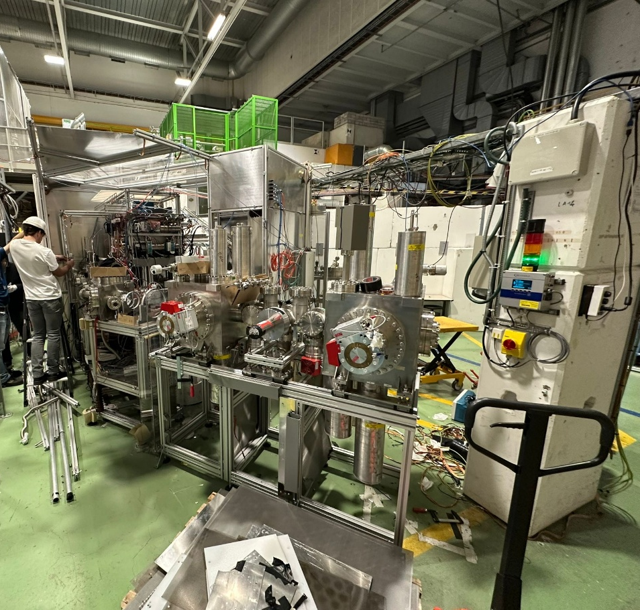
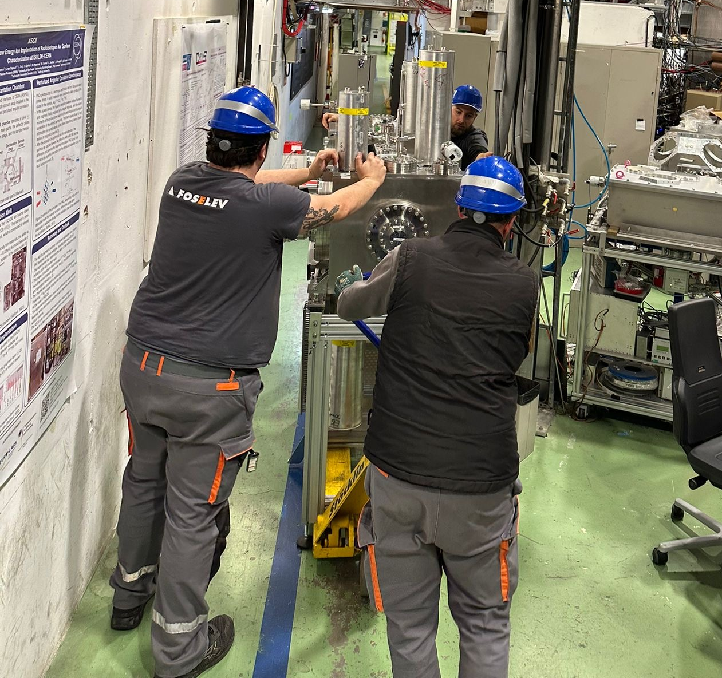
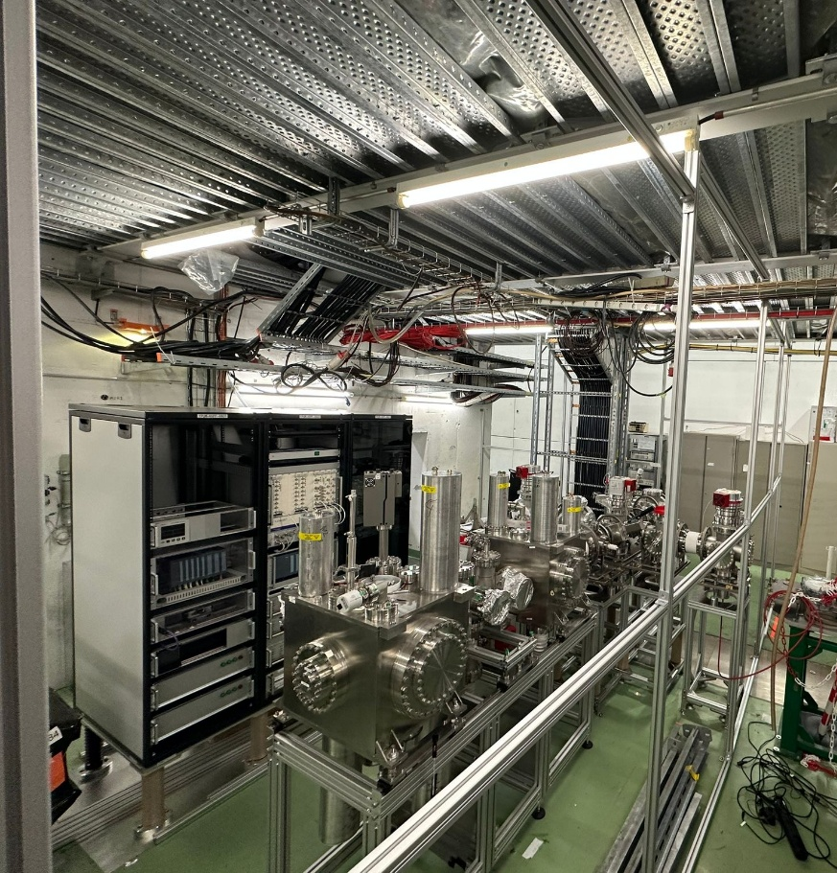
Status of RC-6
Thanks to the many people involved!
Photos courtesy Lukas Nies, CERN

Slide 9
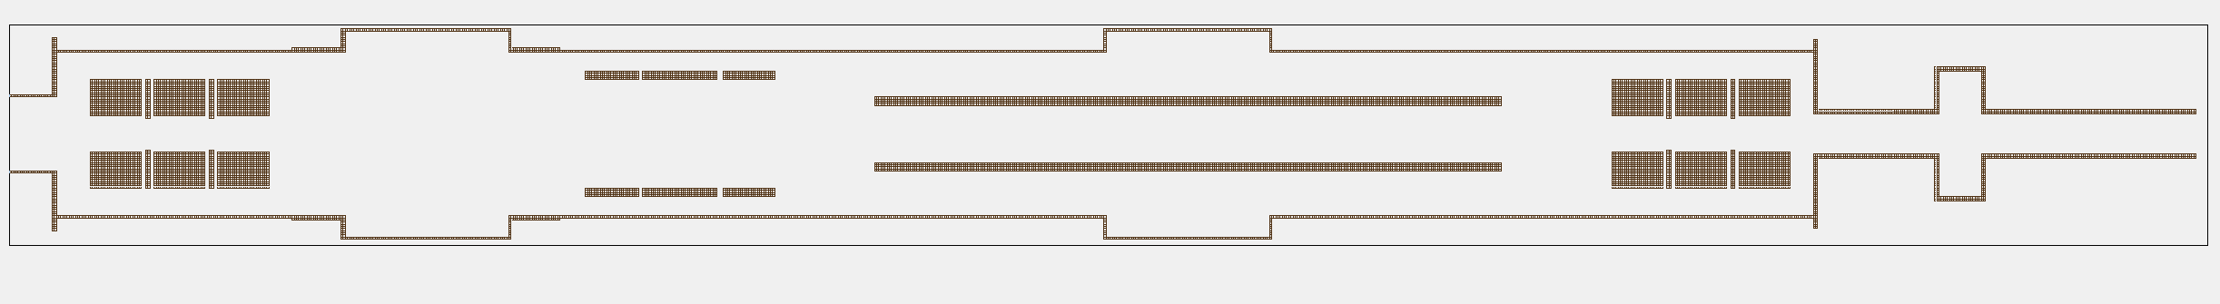
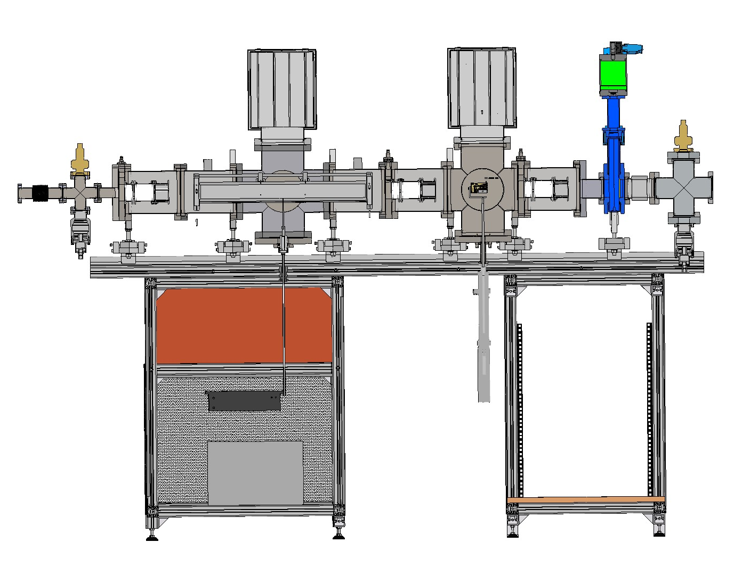
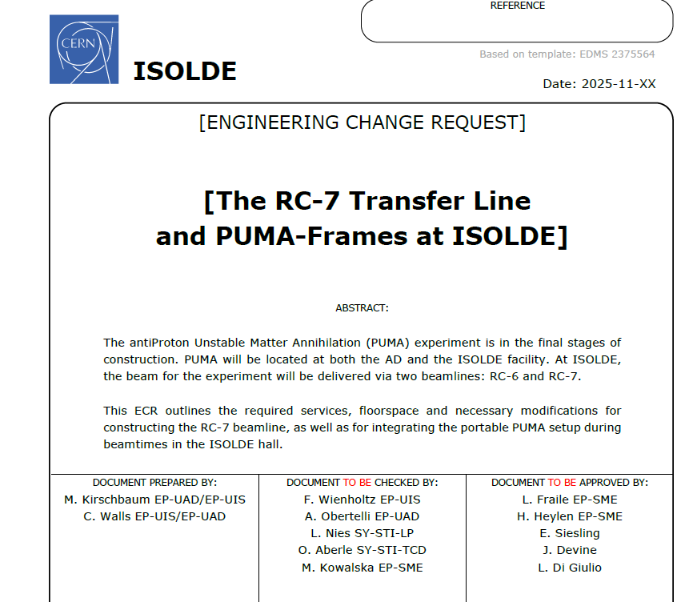
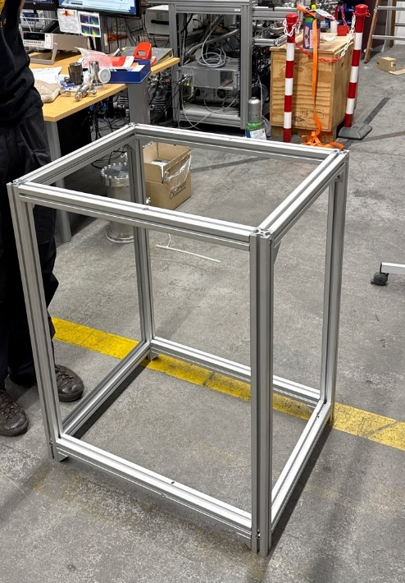
Design of RC-7
Quadrupole
Triplet
Quadrupole
Triplet
Einzel lens
26 kV
Pulsed-Drift-Tube
Diagnostic Box with Magne-TOF

Slide 10
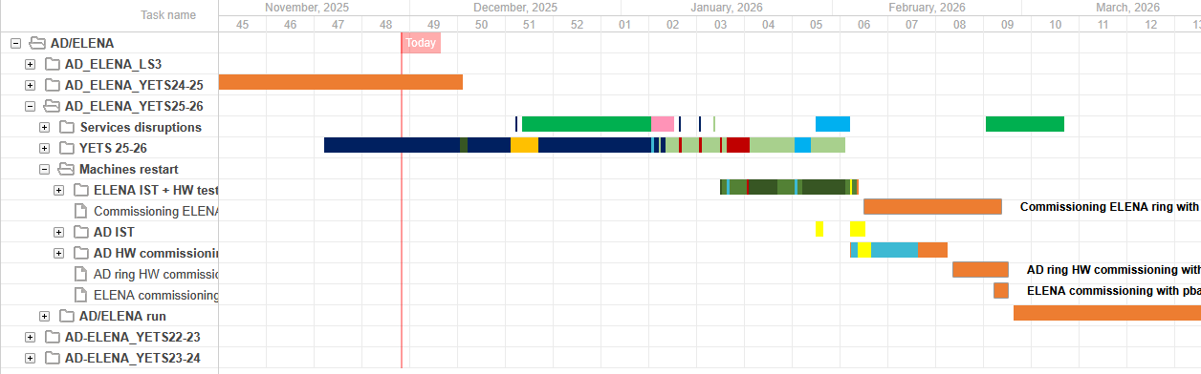
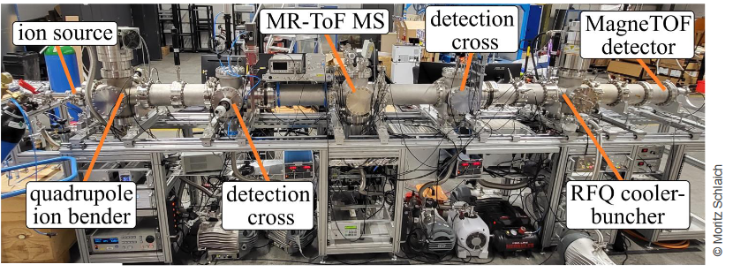
Outlook 2026
A lot on the agenda:
Installation Offline Ion Source
Trapping antiprotons
Measurements with stable isotopes at the AD
Complete RC-6
Installation RC-7 and commissioning
First transport to ISOLDE?
Very short YETS
See paper by Schlaich et al., NIM A, 2025

Slide 11
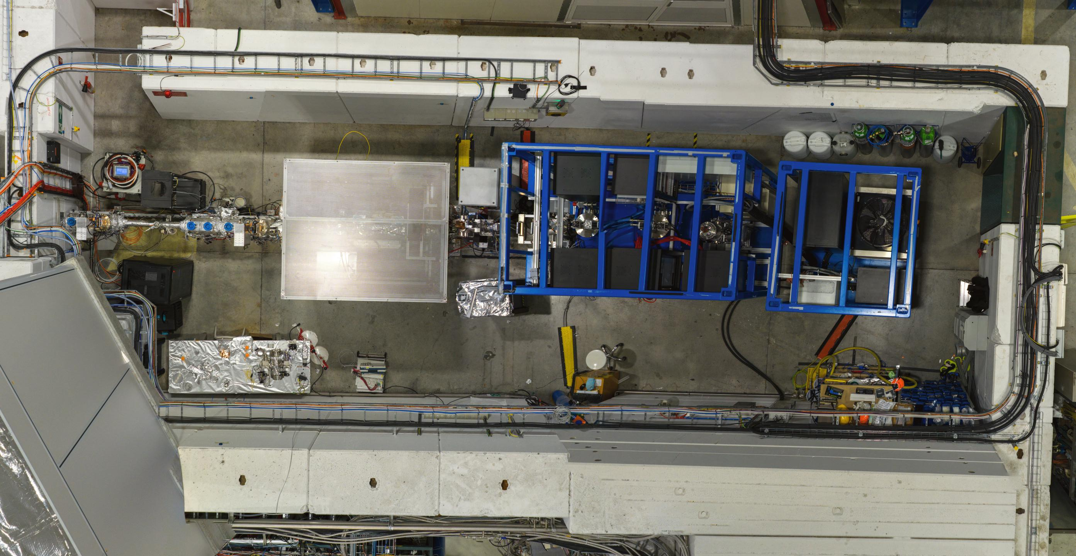
Thank you for listening!

Slide 12





The PUMA Collaboration
O. Aberle, H. Alvarez Pohl, T. Aumann, Y. Ayyad, N. Azaryan, W. Bartmann, A. Bouvard, O. Boine-Frankenheim, A. Broche, F. Butin, Cristina Cabo Landeira, P. Chiggiato, H. De Gersem, R. De Oliveira, K. Drexel, J. Ferreira Somoza, J. Fischer, M. Fraser, R. Holz, G. Hupin, M. Kirschbaum, C. Klink, M. Kowalska, P. Indelicato, R. Lazauskas, J Lopez Gonzalez, S. Malbrunot-Ettenauer, W. Müller, L. Nies, A. Obertelli, S. Pasinelli, N. Paul, L. Riik, R. Rinaldesi, D. Rossi, M. Schlaich, A. Schmidt, E. Siesling, C. Walls, F. Wienholtz

Slide 13
Backup
Mark Kirschbaum, TU Darmstadt
ISOLDE Workshop and Users Meeting 2025
Geneva, Switzerland
Dec. 3-5

Slide 14
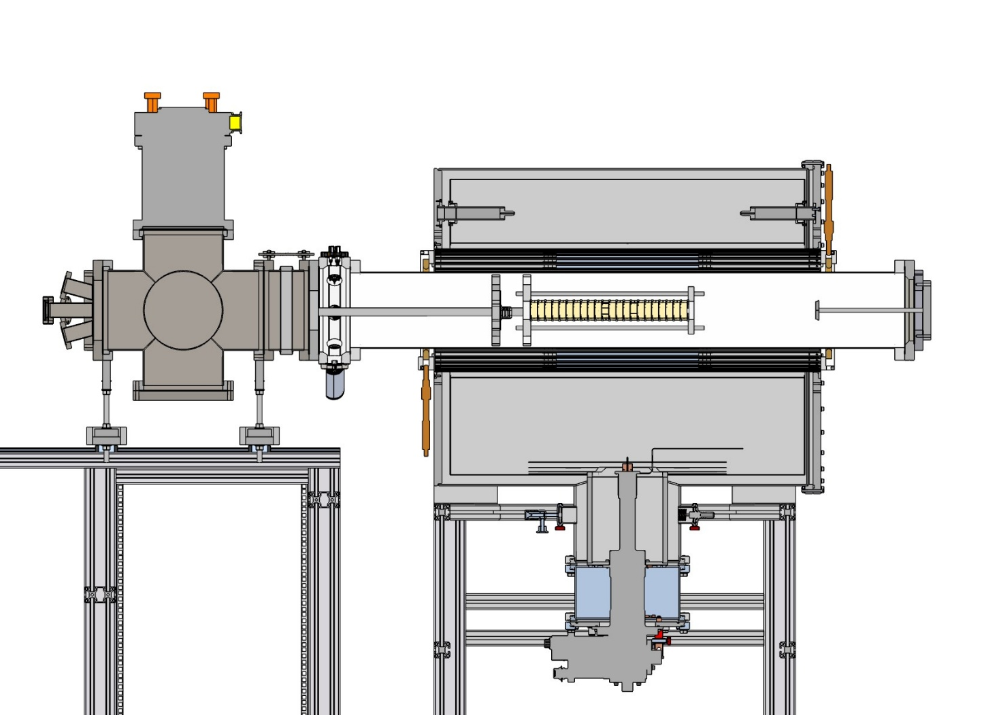
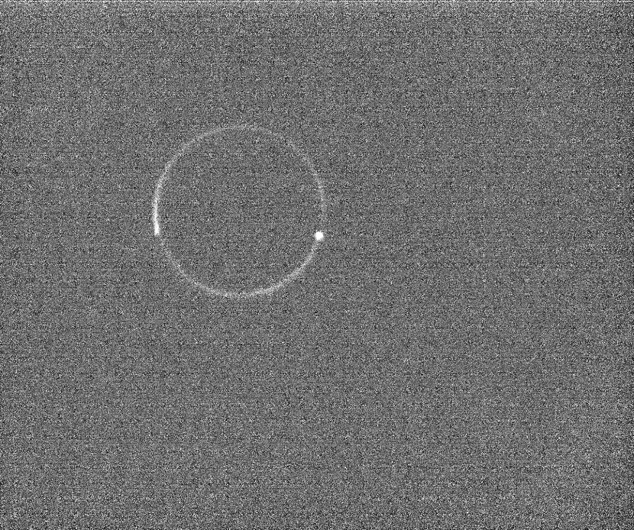
Test trap in darmstadt
Cold Electron Source
Storage Trap
First trapped electrons
MCP
3T Magnet

Slide 15
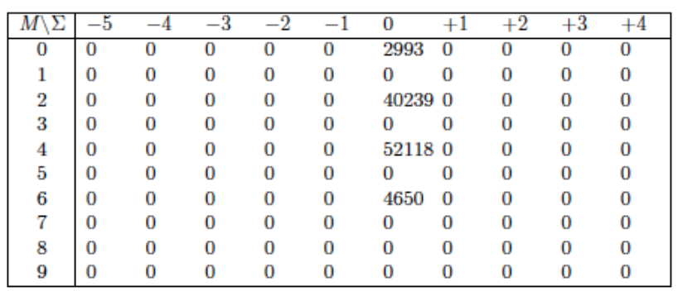
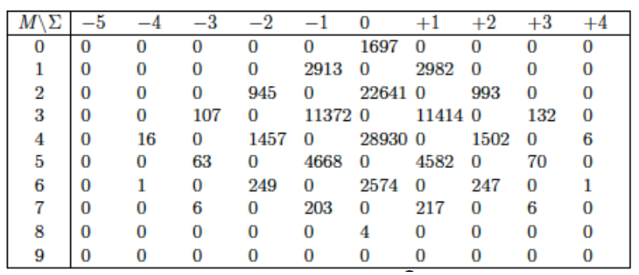
Final state interactions
[Yamazaki and Wada, AIP, 2005]
Around 80-90% of the annihilation pions reinteract with residual nucleus (changing the charge and multiplicity of the pions)
4-Parameter model [Wycech, AIP Conf. Proc., 2005]:
Event-to-event identification not possible
PUMA analysis [Y. Kubota and Y. Ono., in prep]:
Use deep learning to estimate neutron-to-proton ratio
Expected uncertainty: 10%
Antiproton-proton annihilation (no FSI)
Antiproton-proton annihilation (with FSI)

