Slide 1
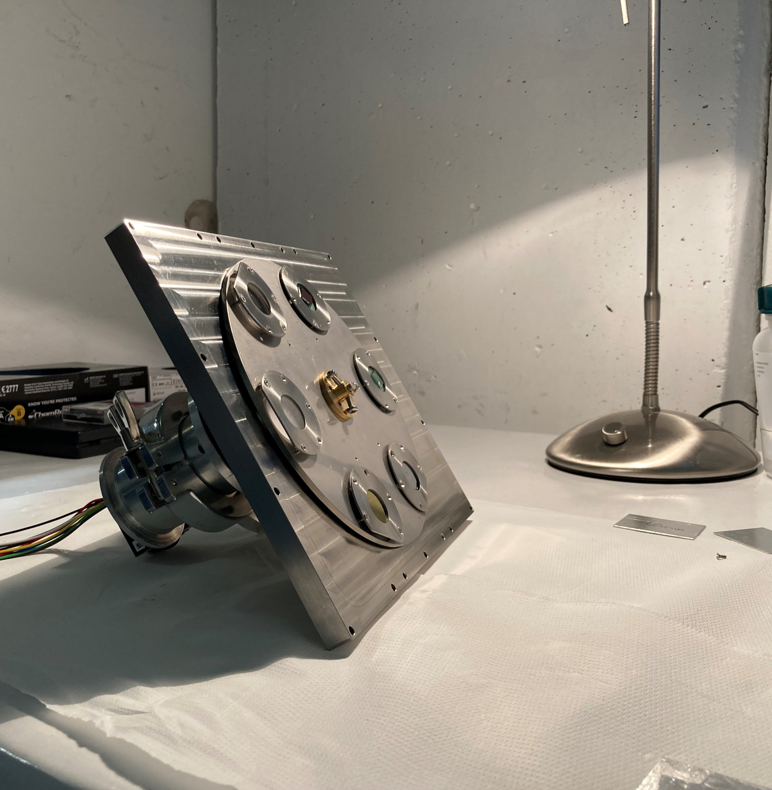
Measurements of the radiative decay of the ²²⁹Th nuclear-clock isomer in solid-state hosts
Yens Killian Elskens ISOLDE Workshop and Users Meeting 2025
Notes:
Hello everyone. I was assigned the unenviable task of giving the very last talk of this workshop. However, I have some rather interesting results to present for you, so I will ask your very last bit of attention for the next few minutes.
My name is Yens, I am a PhD student at KU Leuven, and we try to measure the radiative decay of the Th-229 nuclear clock isomer, here at ISOLDE.

Slide 2


Context
²²⁹Th has an isomer that lies low enough to probe with a laser
Ideal two-level system for a nuclear clock
Challenge: dominating IC decay
Populating the isomer through the β-decay of ²²⁹Ac within the context of a large-bandgap crystal
Results from 2021 ISOLDE beam time led to laser excitation in CaF₂ (PTB) and LiSrAlF₆ (UCLA), and even excitation with a frequency comb (JILA)
²²⁹Ac
$$β^{−}$$
^{229m}Th
$8.338$eV
²²⁹Th
[1] S. Kraemer et al. Observation of the radiative decay of the ²²⁹Th nuclear clock isomer, 2024
[2] J.Tiedau et al. Laser excitation of the ²²⁹Th nucleus, 2024
[3] R. Elwell et al. Laser excitation of the ²²⁹Th nuclear isomeric transition in a solid-state host, 2024
[4] C. Zhang et al. Frequency ratio of the ^{229m}Th nuclear isomeric transition and the ⁸⁷Sr atomic clock, 2024
Notes:
Now, first some context. Th-229 has an isomer that lies very close to the ground state, close enough to probe with a laser. The light needed to excite this lies in the vacuum ultraviolet, or VUV, regime. This makes it an ideal 2-level system for a nuclear clock. It actually took a while before they could laser-excite this nucleus, because the precise excitation energy was not known. The fact that such a low isomeric state decays very fast through internal conversion, made this more difficult to determine. The right chemical environment, however, could block out this IC channel. And in this case, the right chemical environment is a crystal with a large band gap, and, within that crystal, a position where the bandgap is preserved. So, back in 2021, our group went to ISOLDE and populated the isomer through the beta decay of Ac-229 in CaF2 and MgF2, and they measured, for the first time, the radiative decay of the isomer.
The results from this experiment were very useful, as it led last year to the first laser excitation of the isomer in CaF2 by PTB, followed closely by the excitation in LiSrAlF6 at UCLA and even the excitation with a frequency comb at JILA, bringing the relative uncertainty on the excitation energy down to 10^-12.
All the main ingredients are now present to start building a solid-state nuclear clock, and the host material will play a role in the performance of such a clock. And this is where we want t play a role in…

Slide 3





Main objectives
Performing vacuum-ultraviolet spectroscopy on ^{229m}Th to…
Study the effect of the crystal type on the radiative decay fraction
Study the time behaviour of the radiative decay in different crystalline environments
[6] S. Pineda et al. Radiative decay of the ^{229m}Th nuclear clock isomer in different host materials, PRR 2025
Notes:
I know a lot of you are very tired today, so I will immediately give you the punchline of what we do in a single sentence:
We perform Vacuum-ultraviolet spectroscopy to…
1. Determine the effect of the crystal type on the radiative decay fraction What I mean by this is: which crystals give us, relatively speaking, the largest of VUV photon countrate. This could tell us something about which chemical environment favours the radiative decay channel the best.
2. Study the time behaviour of the radiative decay in different crystalline environments.
Now, allow me to explain this a bit more

Slide 4
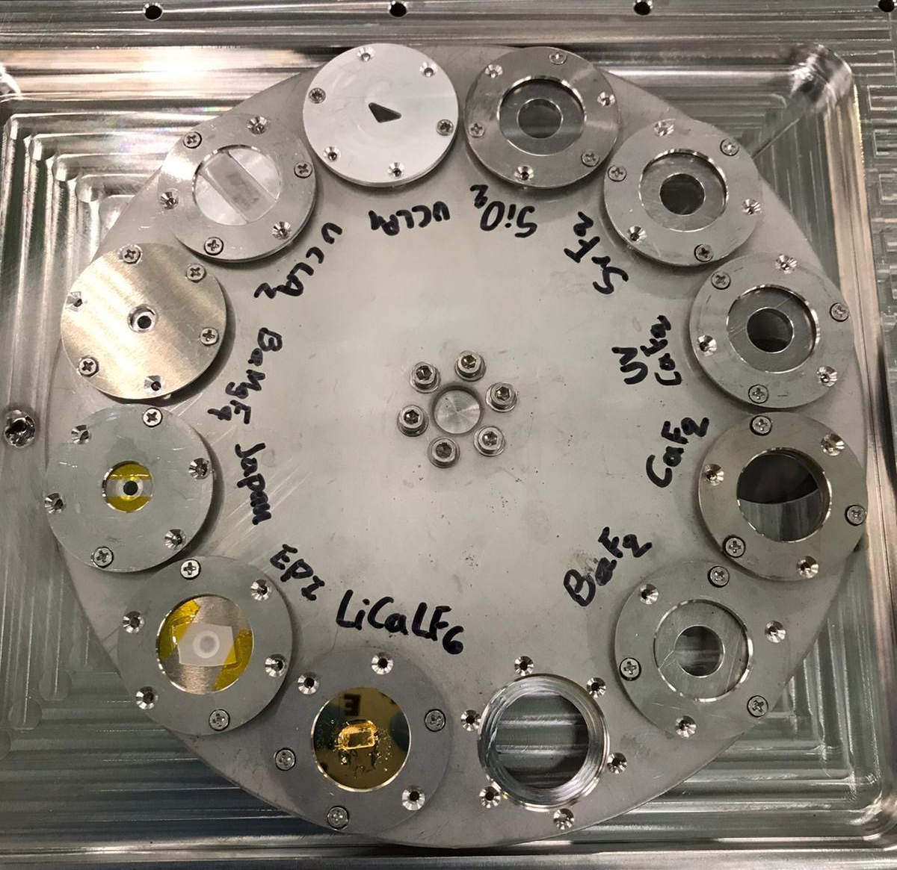
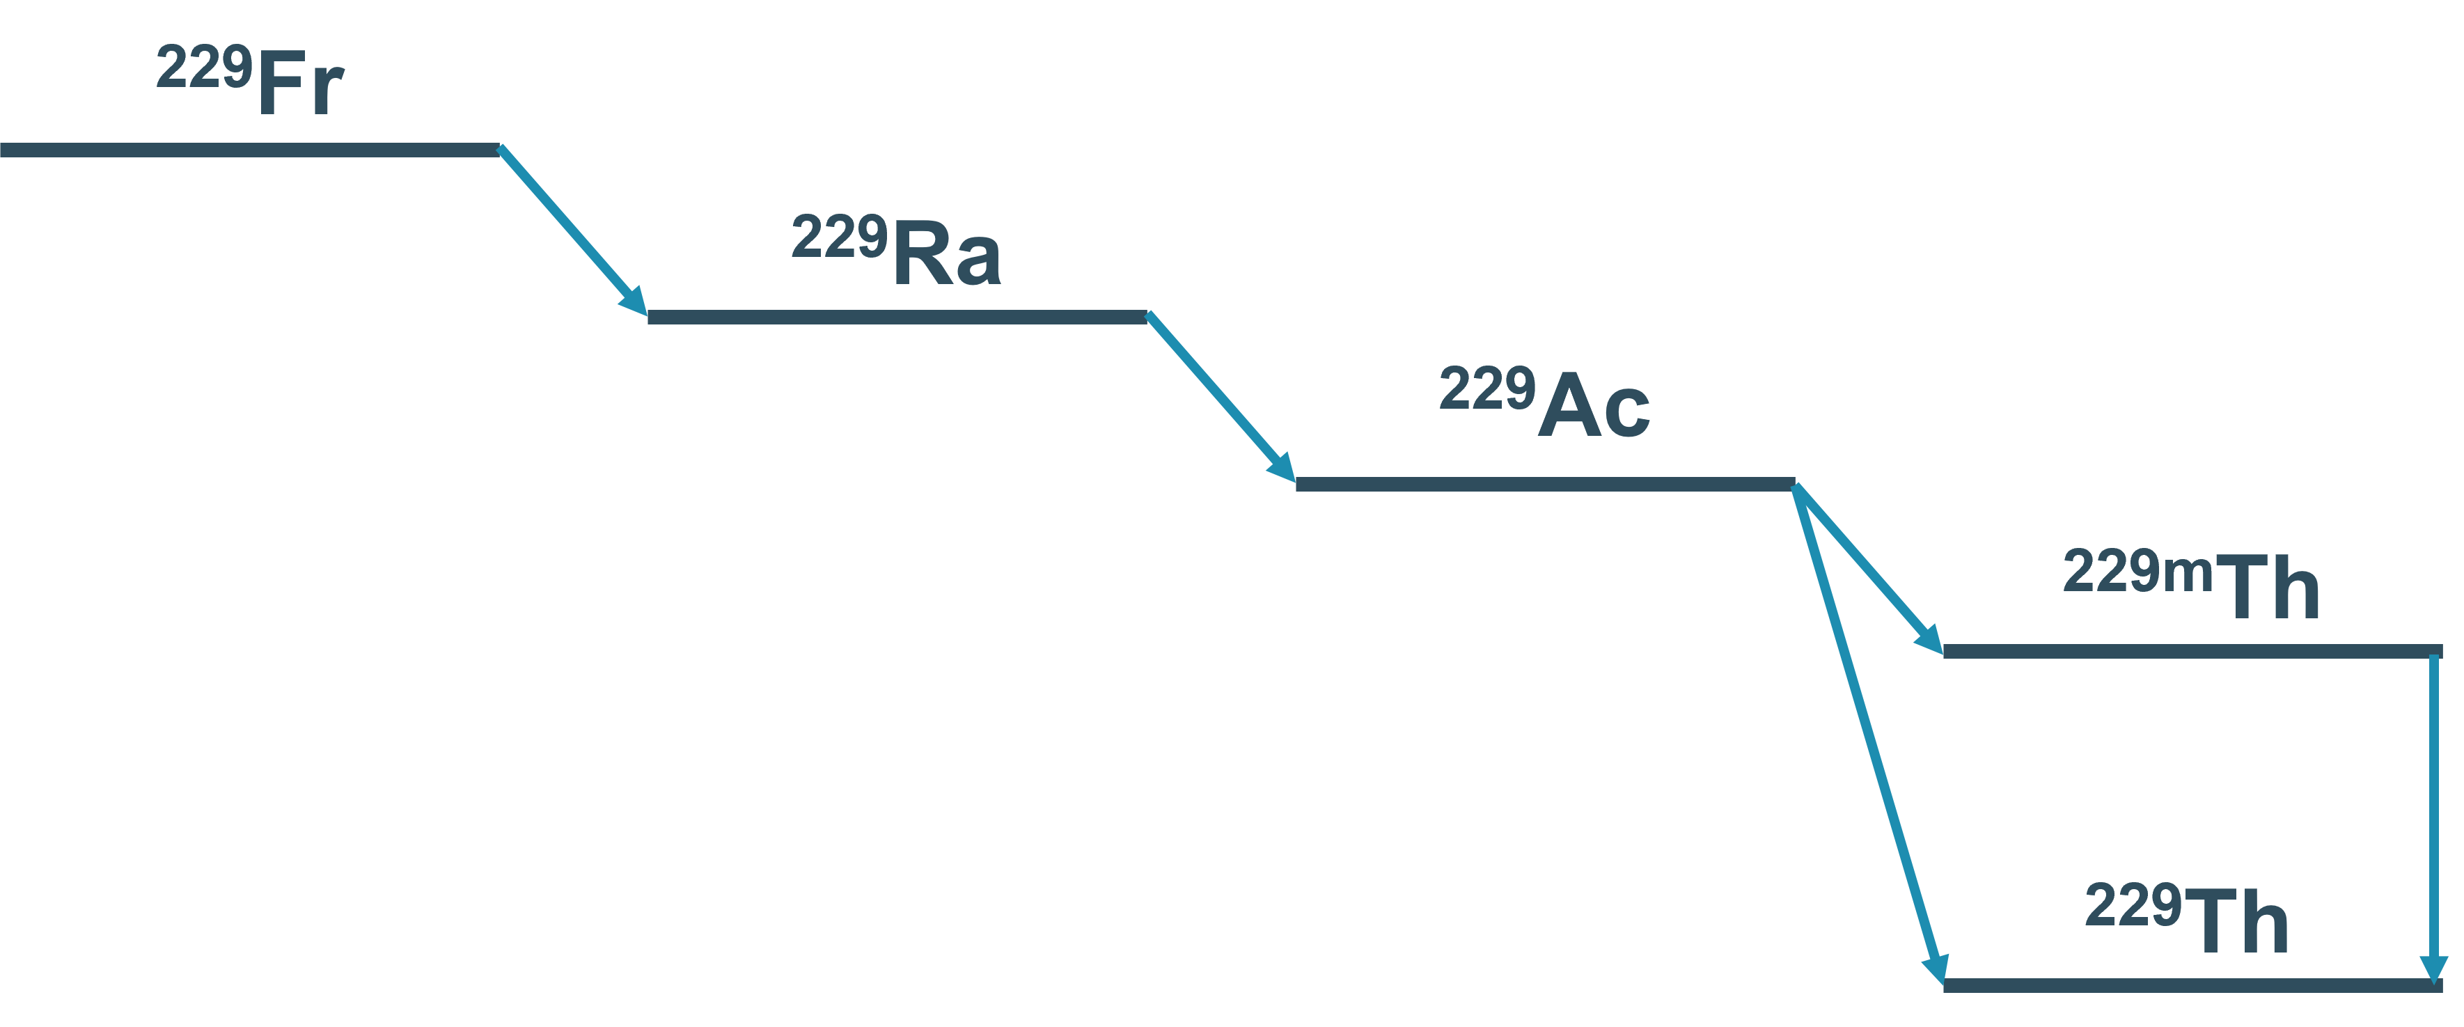
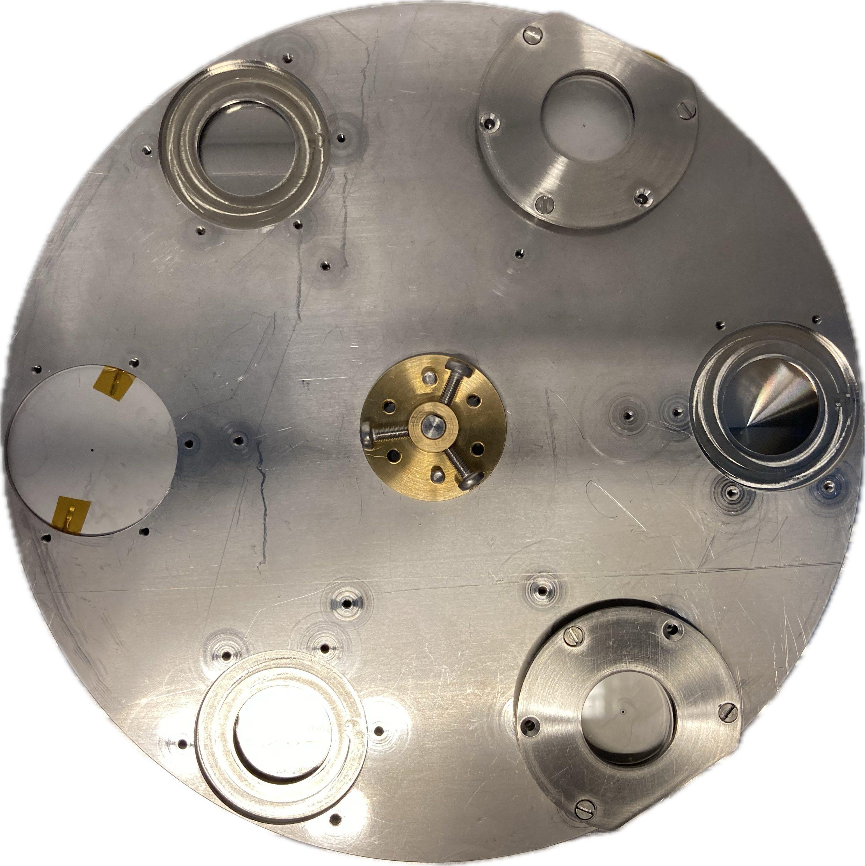



VUV spectroscopy of the isomer at LA1
Populate the isomer by implanting an A=229 beam in our crystals
$$β^{−}$$
50.2 s
$$β^{−}$$
4 m
$$β^{−}$$
62.7 m
$$β^{−}$$
Notes:
So let’s break this up. How do we perform VUV spectroscopy? First of all, we don’t perform laser spectroscopy. We don’t try to excite the isomer from the ground state, we populate the isomer through the beta decay of Ac-229. We do this at LA1, where we implant an A=229 beam, consisting of Fr, Ra and Ac-229 into a large-bandgap crystal mounted on a wheel. This will, in part, populate the isomer, in part the ground state. We then try to measure the VUV photons coming from this decay.

Slide 5
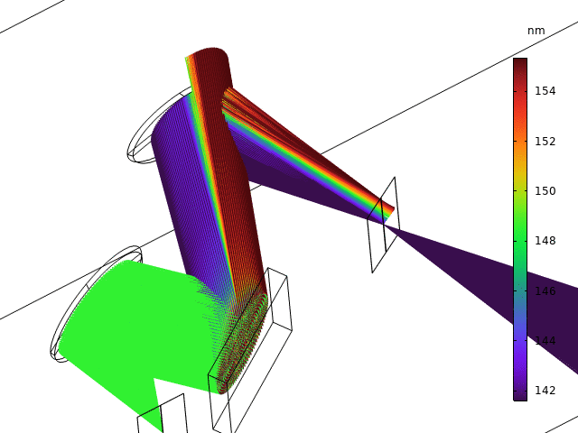
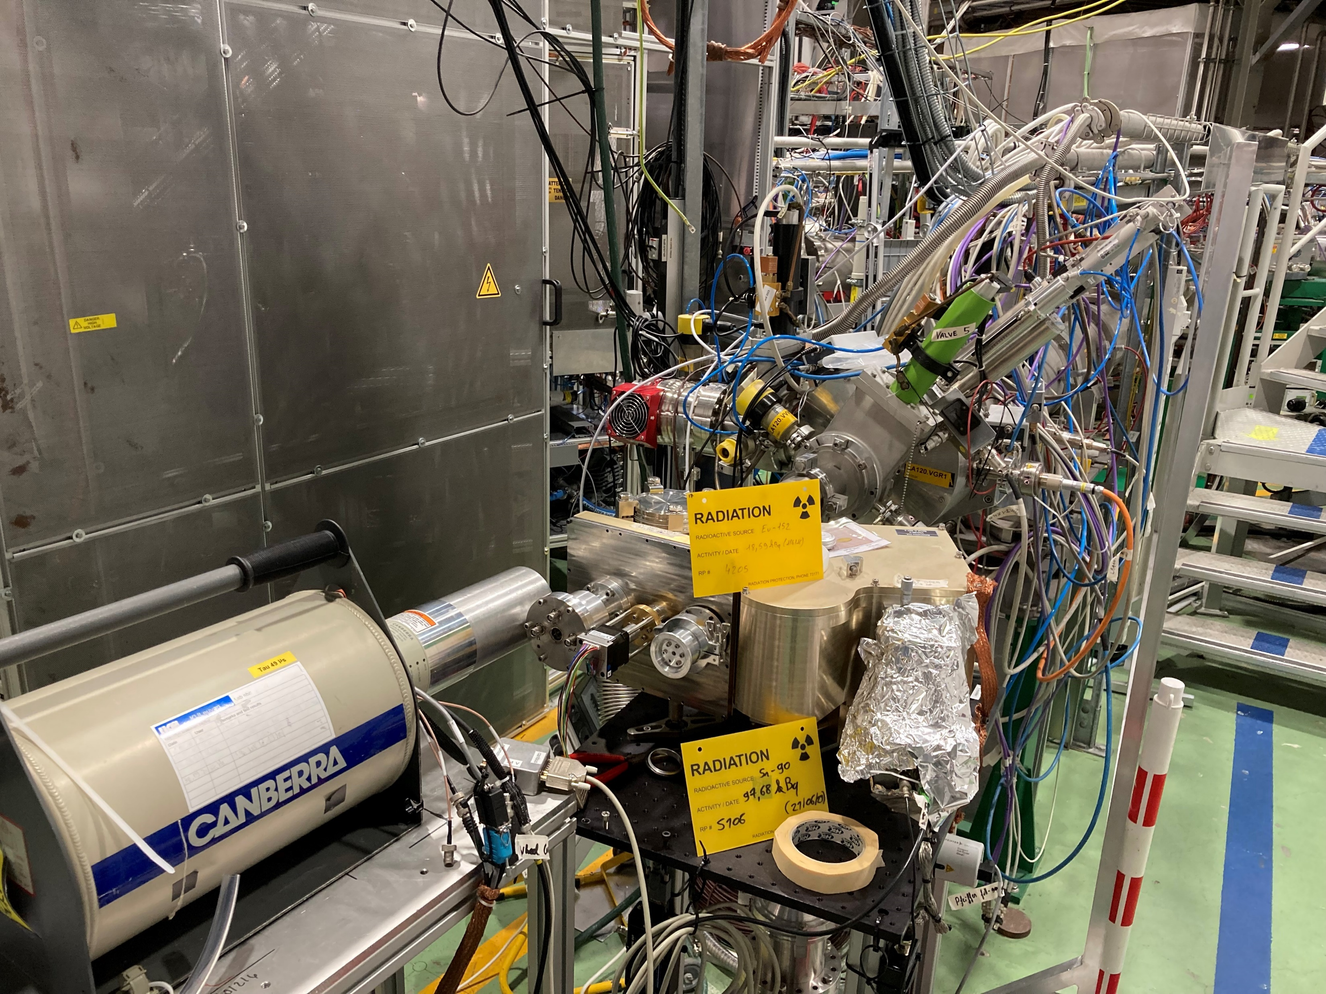
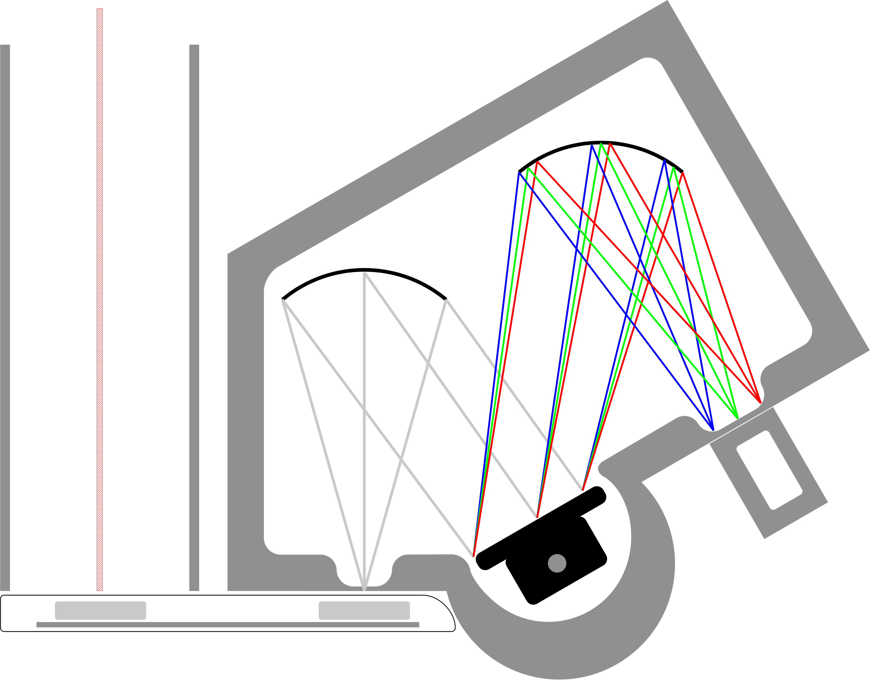
VUV spectroscopy of the isomer at LA1
A=229
mirrors
PMT
large-bandgap crystals
Notes:
How do we measure this? We have a VUV spectrometer which is a Czerny-turner monochromator. After implantation, we move our crystals in front of the entrance slit of the spectrometer, which collects all the light, parallellises it onto a diffraction grating and focusses the diffracted light onto a PMT. By turning the grating we can scan the ROI, as you can see in this GIF.
What results did we get so far to reach our goals?

Slide 6

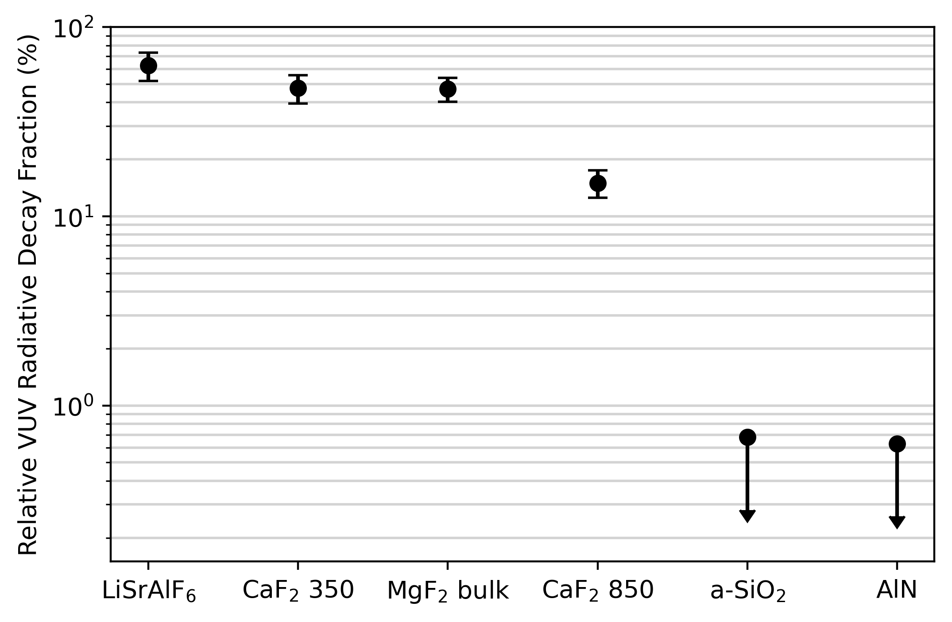
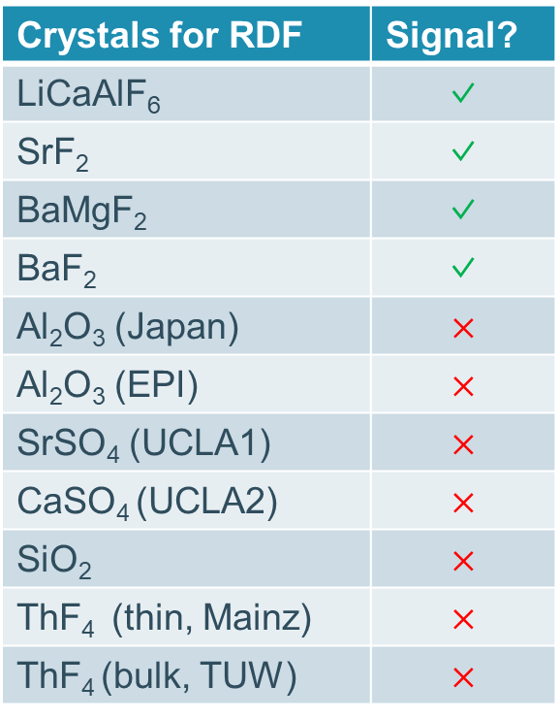
Effect of crystal type on the radiative-decay fraction
Results 2025 (preliminary)
Results 2023
Compare the radiative decay fraction of different crystals relative to CaF₂ bulk (highest absolute efficiency)
Crystals for RDF | Signal?
LiCaAlF₆ | ✓
SrF₂ | ✓
BaMgF₂ | ✓
BaF₂ | ✓
Al₂O₃ (Japan) | $$×$$
Al₂O₃ (EPI) | $$×$$
SrSO₄ (UCLA1) | $$×$$
CaSO₄ (UCLA2) | $$×$$
SiO₂ | $$×$$
ThF₄ (thin, Mainz) | $$×$$
ThF₄ (bulk, TUW) | $$×$$
[5] S. Pineda et al. Radiative decay of the ^{229m}Th nuclear clock isomer in different host materials, PRR 2025
Notes:
Let’s have a look at the radiative decay fractions. Here on the left, you see the main results on this topic from the 2023 beam time. They have been published in PRR earlier this year by Skyy Pineda. We compared two types of CaF2 thin film, MgF2, and LiSrAlF6 to a CaF2 bulk crystal (which had the highest RDF). And we didn’t see a signal in SiO2 and AlN. The results from our beam time this year have not been analysed yet, but we tested a bunch of new crystals, and I can briefly show here in which ones we saw a signal. So, LiCaAlF, SrF2, BaMgF2 and BaF2.
NOTES FOR Q/A:
About difference between both CaF2 types: (1) bulk crystal is from Thorlabs, thin films from IMEC. Thin films were grown on Si substrate with Molecular-beam epitaxy method (EBM), apparently, this can induce a large amount of interstitial point defects -> in-gap states. (2) difference between the two thin films because the 350 was grown with A-type stacking -> fully strained on Si substrate, 850 was B-type stacking -> fully relaxed-> more defects
About the fact that we didn't see a signal in SiO2: bandgap is only part of the story. When people say that a crystal has the 'proper bandgap', they mean that the thorium inside that crystal doesn't occupy states within the bandgap. Maybe this is not the case in SiO2. Peik has a paper where he did this calculation for CaF2 (DFT calculations). Due to the amorphous nature of our SiO2 crystal, these kind of calculations are very tricky.

Slide 7
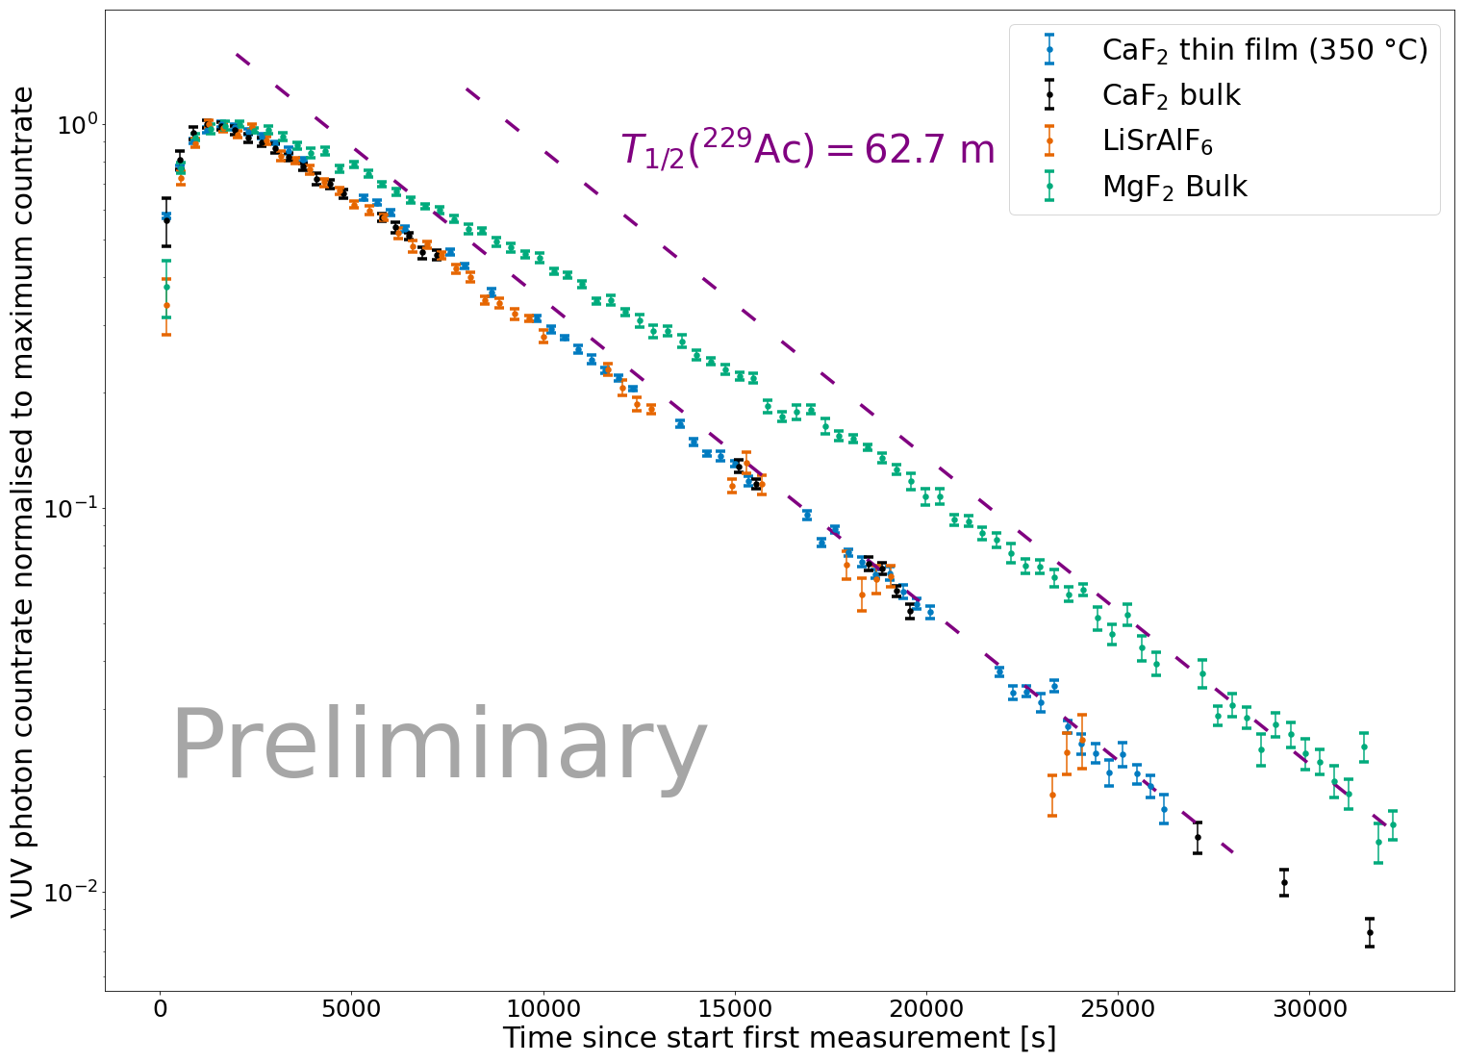

Studying the time behaviour of the VUV signal
The isomer’s radiative decay does not reach transient equilibrium with ²²⁹Ac when expected
When it reaches equilibrium depends on the crystal
It looks like the activity of the precursors ‘quenches’ the VUV signal
Such quenching has been observed to be caused by X-rays (Spring-8) and by laser light (PTB)
[6] T. Hiraki et al. Controlling ²²⁹Th isomeric state population in a VUV transparent crystal, Nature, 2024
[7] F. Shaden et al. Laser-induced quenching of the Th-229 nuclear clock isomer in calcium fluoride, PRL, 2024
[8] T. Hiraki et al. laser Mössbauer spectroscopy of ²²⁹Th, 2025
Notes:
Now what I’m actually more excited about are the time-behaviour measurements. How do we measure the time behaviour? Well, we simply repeatedly scan the region of interest, and plot the peak height as a function of time. Remember, the isomer is fed from an A=229 decay chain, where 229Ac is the longest-living in the chain. What you expect (from Bateman equations) is that the isomer decay grows in for a bit (depending on the halflife) and then reaches transient equilibrium with Ac-229.
What we actually see is this. This is data from 2023. The green points are observations in MgF2 bulk, orange is the LiSrAlF, blue is CaF2 thin film and black is the bulky version. In purple we see the expected decay of Ac-229 (it’s a log scale, so this is a line) and we see that in none of the crystals the transient equilibrium is reached when we expect this to reach. What’s more, when this point is reached seems to depend on the crystal type. The half-life has of course an effect on these time-behaviour curves, but the effect of this would be expected to be seen in the shoulder. Here it looks more like our efficiency is increasing in time, and that this depends on the chemical environment of the isomer. So what’s going on?
It seems that the VUV signal is quenched when we have a lot of activity of the precursors in the crystal.
Well, we’re luckily not the only ones seeing this. It has been observed both to be caused by X-rays at the spring-8 facility in Japan and by laser light at PTB.

Slide 8
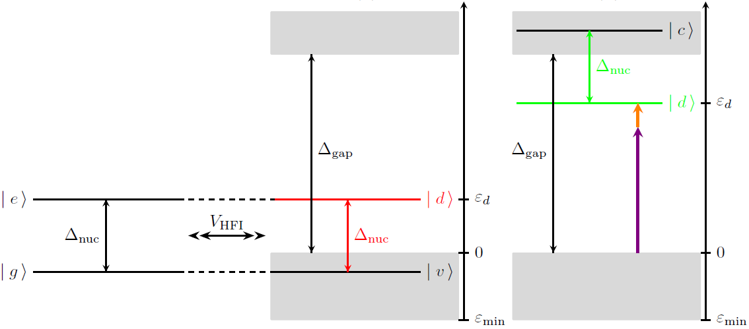
Quenching mechanism: opening up the IC channel?
Internal conversion allowed
Internal conversion forbidden allowed!
[9] J. E. S. Terhune et al. Photo-induced quenching of the ²²⁹Th isomer in a solid-state host, 2024
Notes:
So the overall radiative-decay fraction is determined by whether the isomer sits in a position where the band gap is preserved. So if the defect state that it introduces sits too close to the valence band, the IC channel is not blocked out, and there are electrons available to take on the energy of the nuclear decay. If it is high enough above valence band, IC is normally forbidden.
Now, the hypotheses is that the external radiation induced by the X-rays or the laser, allows to excite the defect states in situations where the band gap was preserved, and as a result opens up the IC. That would mean that our radiative decay fraction changes over time, which is exactly what we see happening!

Slide 9
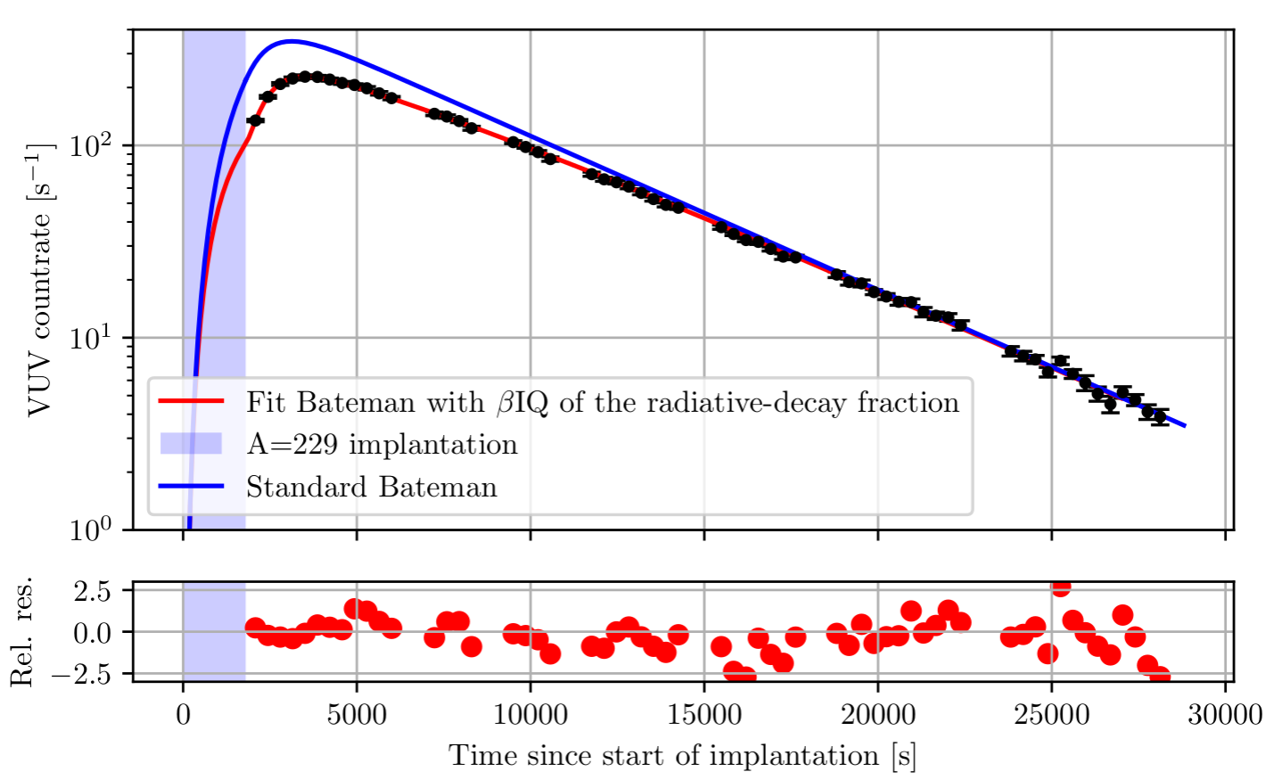
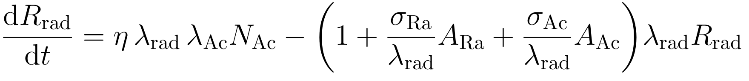
Describing the quenching mechanism in CaF₂
Assume linear relationship between quenched fraction and activity of the precursors present in the crystal.
CaF₂
Notes:
Now, we are not sensitive to aht these processes actually are, but that doesn’t mean we can’t describe our data.
If we now change our Bateman equation, where we have quenched fraction that decays radiatively, we actually manage to describe our results in CaF2. Hammering down the values of these parameters allows us to quantify the strength of this quenching in CaF2.
Now, we were of course intrigued by this, when we saw this in 2023. We saw this quenching from a beta-decay chain, we wondered if we would also see this if we implanted an alpha-decay chain on top of it.

Slide 10
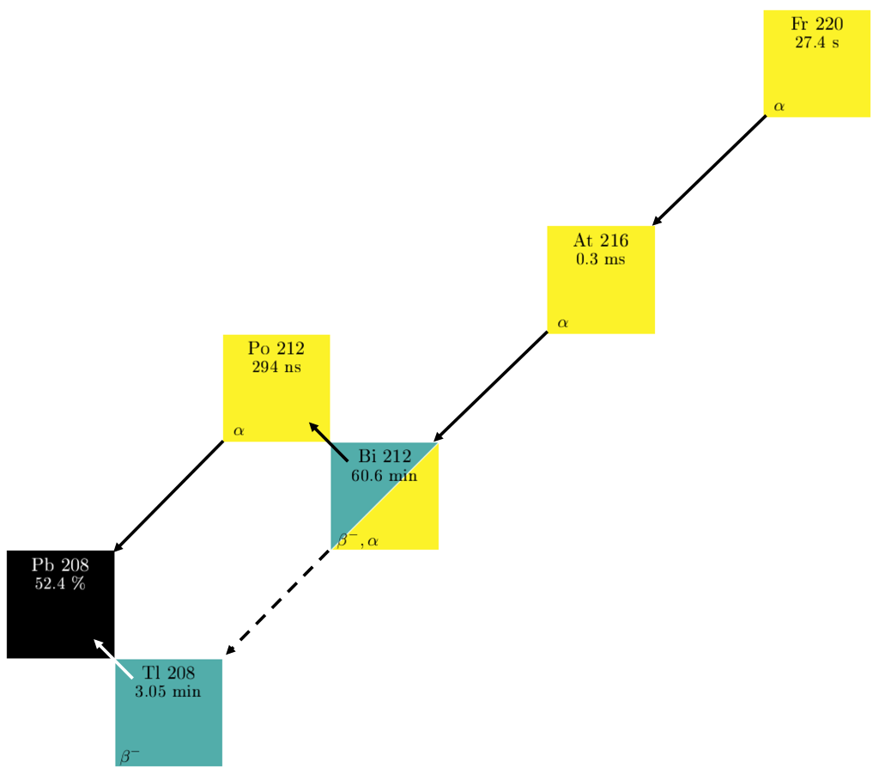
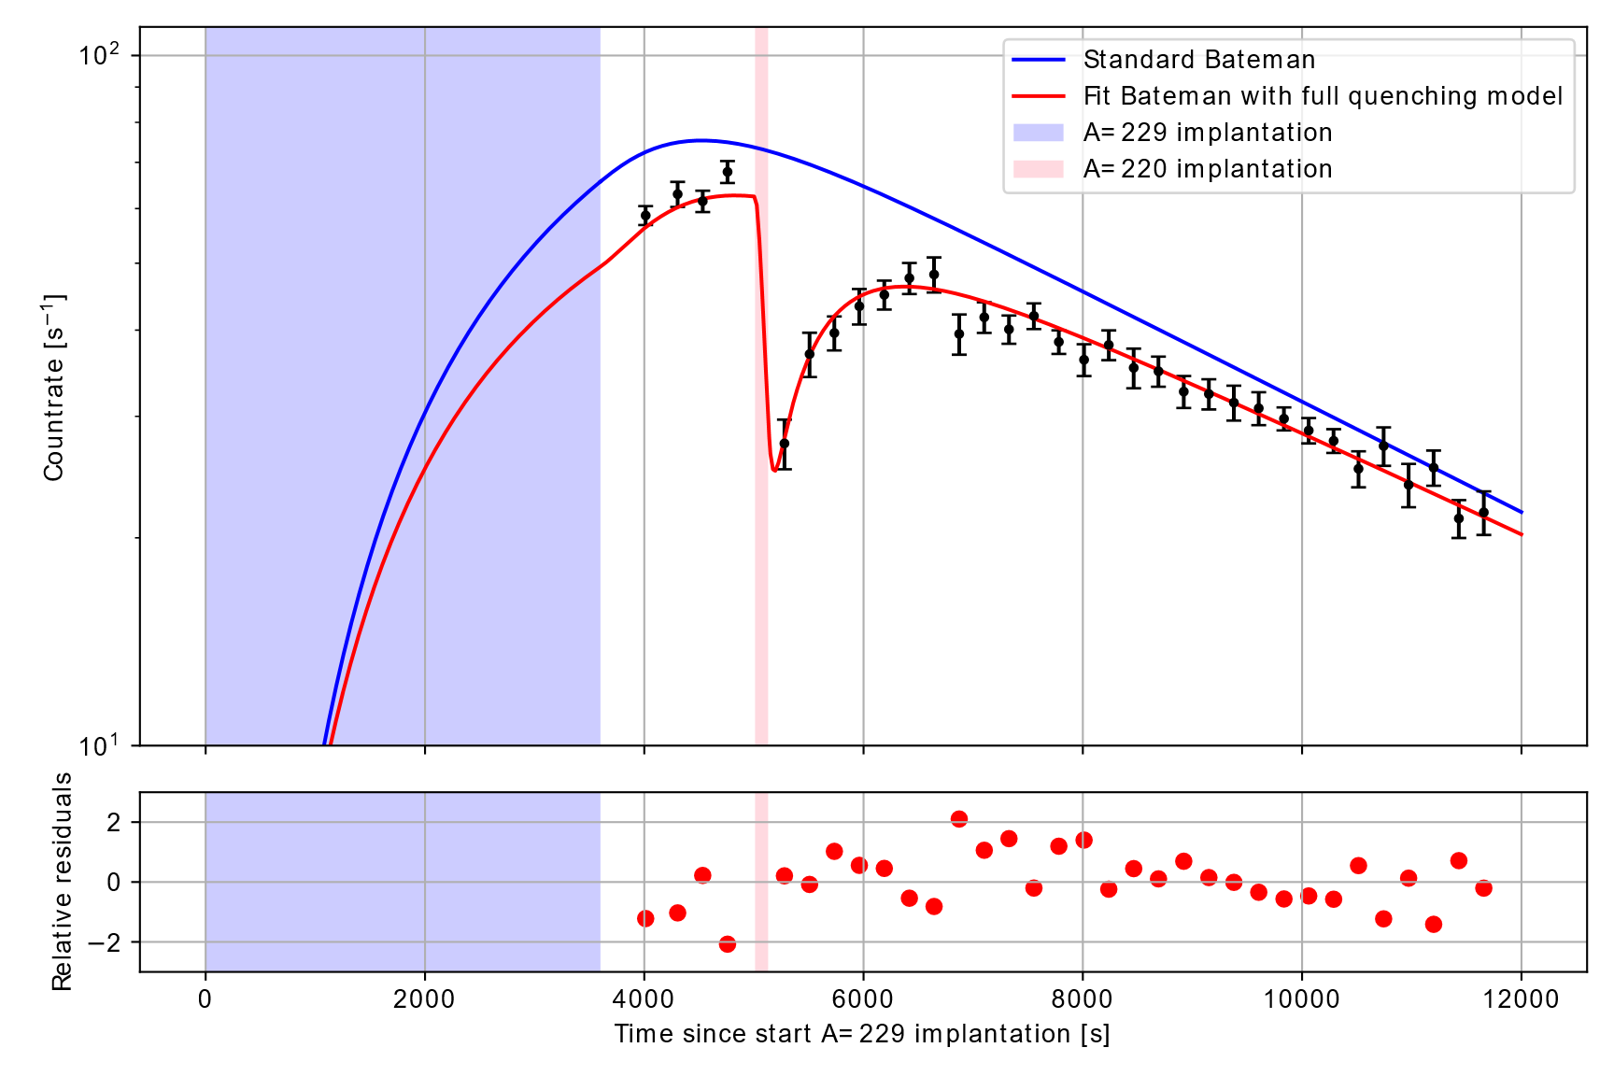
2025: α emitters also quench the signal
A=229 (1h)
A=220 (2 min)
Preliminary
Notes:
So that’s one of the things we did this year. We implanted an A=220 chain, consisting of 220Fr (27 s). It decays to 216At before reaching a bottle neck at 212Bi (~60 min) and then partly decays to 208Tl and 212Po. So, we first implanted A=229, and then for just 2 minutes an A=220, and we see that it’s severely quenched, and we can describe this using a similar model.

Slide 11
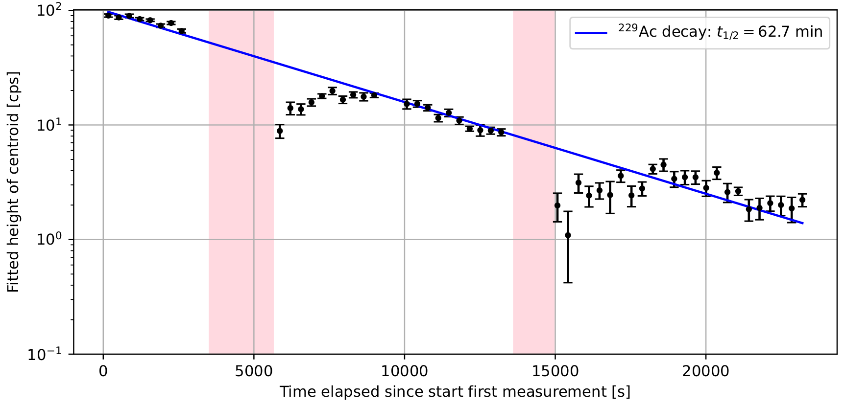


2025: effect annealing on quenching
Preliminary
SrF₂
$$≲300 °C$$
36 min
$$≲300 °C$$
23 min
Notes:
Now of course, when we talk to our solid-state physics colleagues about this, they find this very interesting. And when thinking in terms of opening up the internal-conversion channel with defect states, they asked us: ‘why don’t you anneal your sample?’. So, we anneal our sample. This is very preliminary data from this year in SrF2 (but we also did this in MgF2 and CaF2). So, we annealed roughly until 300 C. And we see that annealing enhances our quenching.
Unfortunately, with the data we have at the moment, and with the stage of the analysis we are in at the moment, I cannot give you a definite reason on why this is happening. But it poses a very interesting question, because if we are moving towards building a solid-state nuclear clock, and we see that our performance can be influenced by the chemical environment in such a way, it’s important that we understand it. Especially If temperature starts playing a role.

Slide 12
Conclusion
We performed vacuum-ultraviolet spectroscopy on ^{229m}Th to…
measure the effect of the chemical environment on the radiative-decay fraction
investigate a quenching mechanism of the radiative decay, which can be …
α-decay induced
β-decay induced
Temperature enhanced
Notes:
Well, the conclusion you already know. I’ll summarise it again in roughly one sentence:
We perform vacuum-ultraviolet spectroscopy of 229mTh to measure the effect of the environment on the RDF and investigate the quenching mechanisms wich can be induced by alpha and beta decay, and enhanced by increased temperature.

Slide 13

Acknowledgements
The IS715 collaboration
M. Athanasakis, S. Arasada, M. Au, S. Bara, M. Bartokos, K. Beeks, S. Casci, P. Chhetri, K. Chrysalidis, A. Claessens, J. G. Correia, Ch. Dullmann, Y. Elskens, R. Ferrer, R. Heinke, G. Holthoff, E. Hudson, F. Ivandikov, U. Köster, S. Kraemer, M. Laatiaoui, R. Lica, G. Magchiels, J. Moens, H. Morgan, D. Moritz, I. Morawetz, L. Pereira, S. V. Pineda, S. Raeder, S. Rother, A. de Roubin, S. Sabrieva, M. Satrazani, F. Schaden, K. Scharl, T. Schumm, S. Stegeman, J. Stricker, T. Teschler, P. Thirolf, P. Van Duppen, A. Vantomme, R. Villarreal, U. Wahl, Y. Wang, M. Wiesinger, F. Zacherl
Notes:
With this, I end my talk. I thank you for your attention, also the collaborators and EUROLABS, and I will take any questions you may have.

Slide 14
Back up

Slide 15
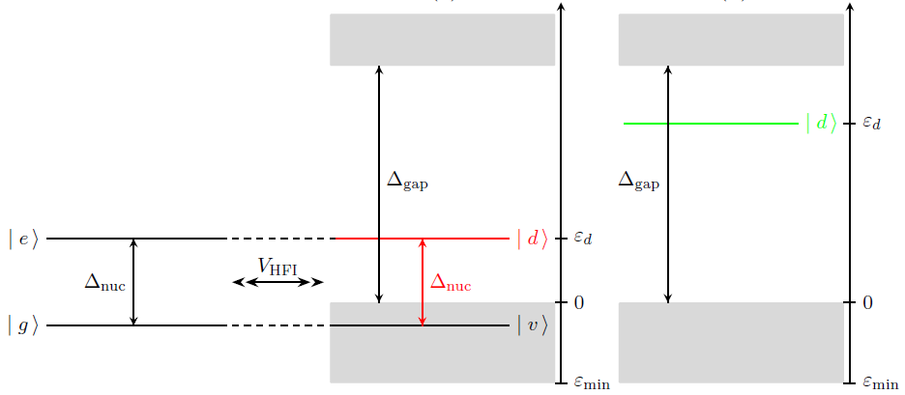
Forcing the radiative decay with large-bandgap crystals
Internal conversion allowed
Internal conversion forbidden
[10] H. W. T. Morgan et al. Theory of internal conversion of the ²²⁹Th nuclear clock isomer in solid-state hosts
Notes:
And this is where the CaF2 crystal comes in. We can force the radiative decay to happen if we make sure no electrons are available to absorb the energy of the isomer. We can do that if we introduce the isomer inside a crystal with a large band gap (for example CaF2). Now if we introduce Th-229 inside a crystal, we will also introduce a defect state. If our isomer lies in the ‘wrong position’, the defect state will be too close to the top of the band gap, and you will have electrons available which can absorb the energy from the nucleus, so internal conversion is still allowed. We say that the bandgap is not preserved. In CaF2 this happens if you place Th interstitially in the crystal. However…

Slide 16
Forcing the radiative decay with large-bandgap crystals
Internal conversion allowed
Internal conversion forbidden
[10] H. W. T. Morgan et al. Theory of internal conversion of the ²²⁹Th nuclear clock isomer in solid-state hosts
Notes:
However, if the isomer ends up in a ‘right’ position, the defect state lies far enough above the edge of the valence band such that no electrons are available for internal conversion. The internal conversion channel is, in such a state, forbidden. We say the bandgap is preserved, and we force the isomer to decay radiatively, that is: emitting a VUV photon. For Th4+, such a ‘good’ position is a substitutional lattice position (so it substitutes for Ca), where it binds with two interstitial impurities.
It is important to give this context, because it shows how the type of solid-state host can determine how well the IC channel is blocked out. This is what we want to focus on in our research.

Slide 17
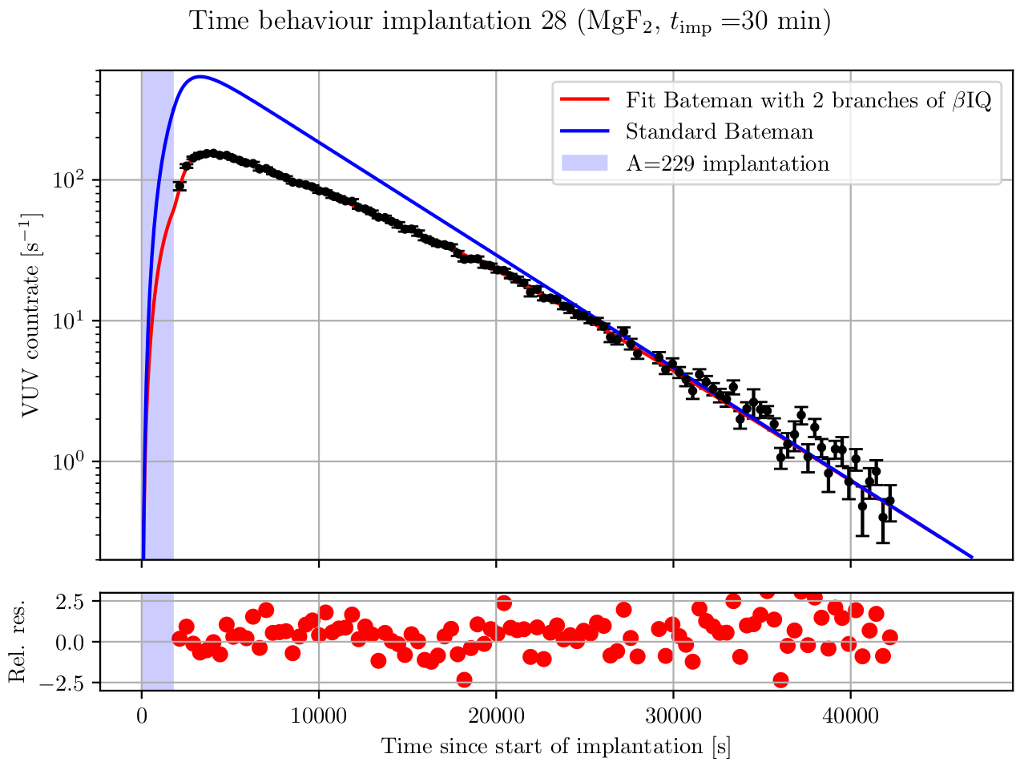
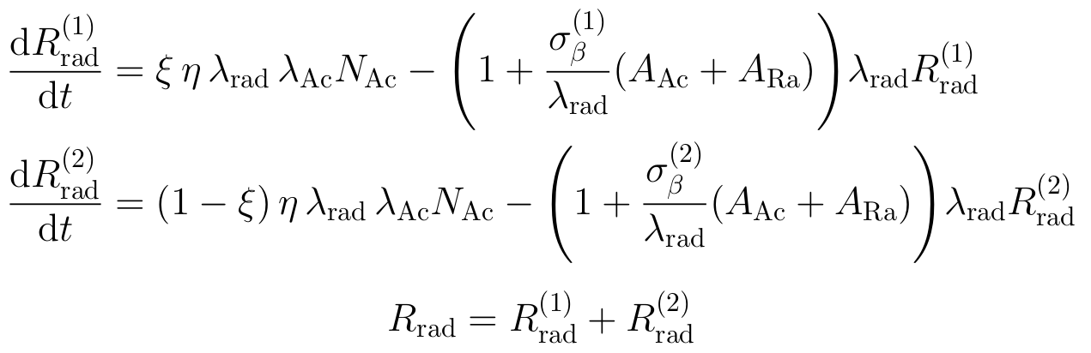
Describing the quenching mechanism in MgF₂
Assume 2 lattice sites which preserve the bandgap, each with a different quenching cross section.
MgF₂
Notes:
So, if we now change our last Bateman equation, where we have fraction that decays radiatively vs a fraction that decays through IC, where that fraction depends on the radiation present, we actually manage to describe our results in CaF2, reaching a halflife equivalent to earlier measurements by PTB, Spring-8 and JILA.
Unfortunately, we can’t describe it yet in MgF2. So our model might be too simple. I’m right now still trying to figure out how we can describe this.

Slide 18
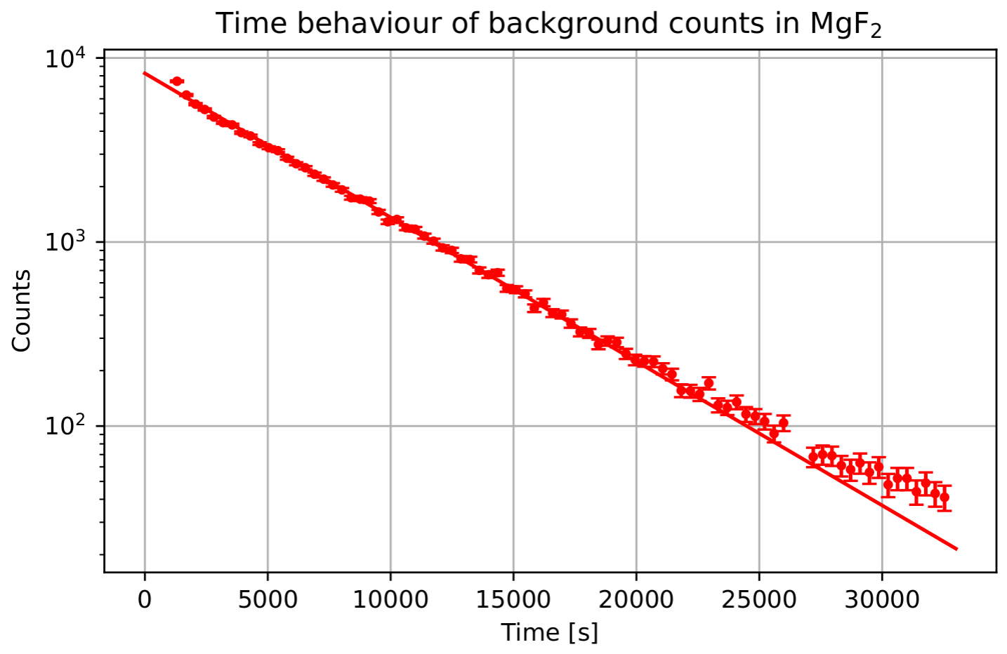
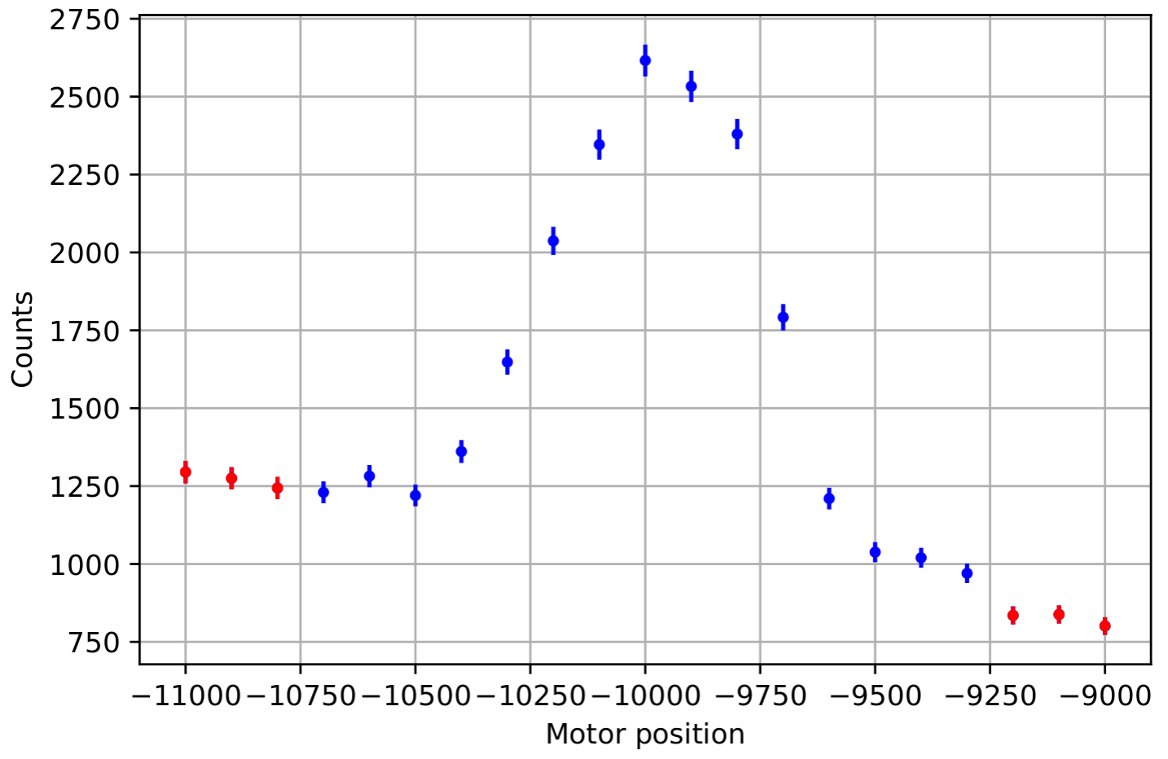

Q: Is the ‘quenching’ actually a dead-time issue?
²²⁹Ra
A: No
$t_{1/2}^{fit}=64.1±0.5$ min

Slide 19
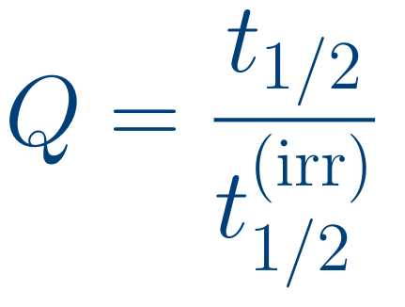
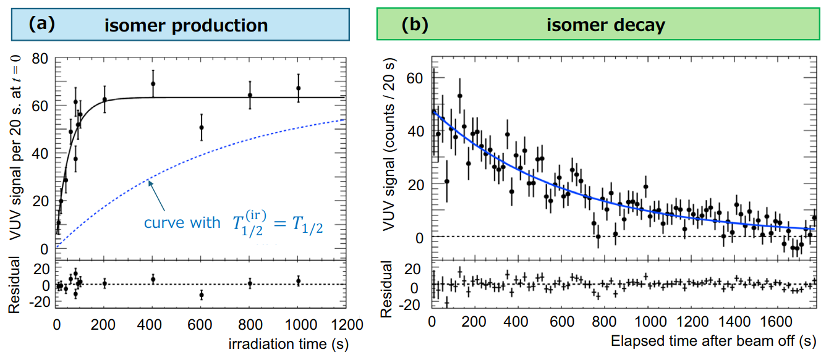
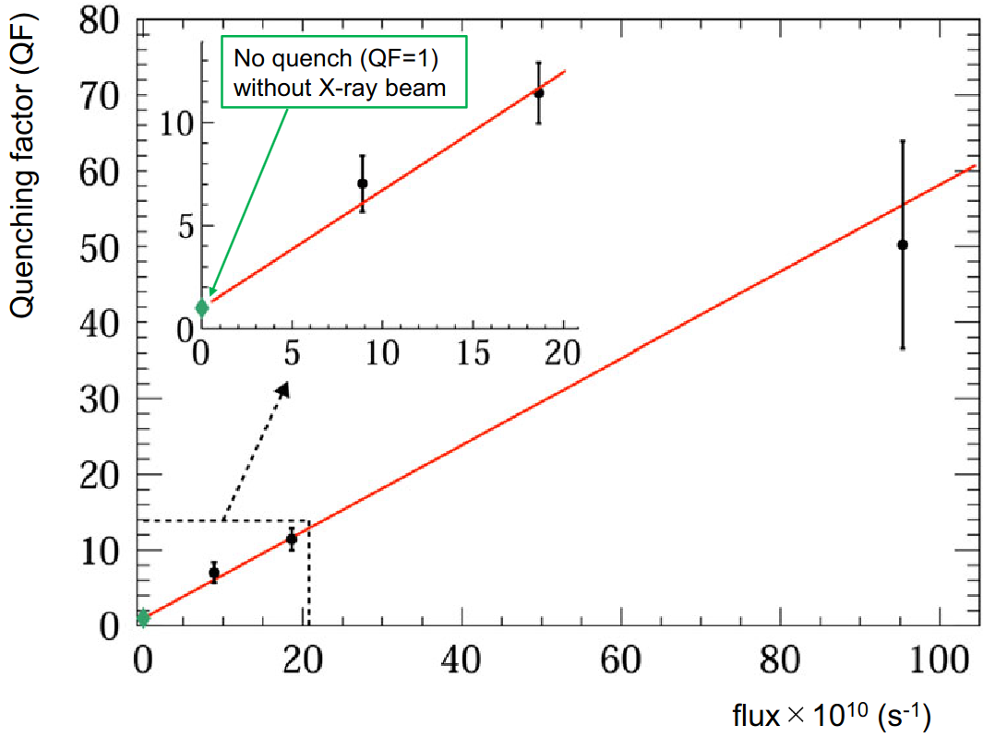
‘Quenching’ of the halflife
VUV spectroscopy at Spring-8 by X-ray pumping the isomer
Flux-dependent ‘quenching’ of the observed halflife
[11] T. Hiraki et al. Controlling ²²⁹Th isomeric state population in a VUV transparent crystal, 2024
Notes:
The thing is, earlier this year, a paper came out from the Spring-8 facility. They also perform VUV spectroscopy in CaF₂ (in a totally different way) by X-ray pumping the isomeric state. When the X-ray beam is on (so during the population), they observe a different halflife compared to the decay period. They call it ‘quenching’ of the halflife, and though the physical processes that are responsible for this are speculative, they, phenomenologically, describe a linear relation between what they call the ‘quenching factor’ Q (the ratio of the two halflives) and the X-ray flux.

