Slide 1
The ATS MD part III
(Achromatic Telescopic Squeezing scheme)
Participants: Any (active) volunteers
Goal:
MD1 (S. Fartoukh & R. Assmann →10h): “Pre-squeeze’’ IR1 and IR5 to β* = 40 cm in view of a direct application for the LHC with tight collimator settings
MD2 (S. Fartoukh→ 6h): Squeeze IR1 and IR5 to β* = 10-15 cm to validate the ATS scheme with two low-β IRs pushed to the HL-LHC β* or below
Type of beams:
MD1: γε <1.5-2 μm with a fat pilot (1E10) for the first ramp & squeeze, and 1 nominal bunch per beam for the second ramp & squeeze (details in next slides)
MD2: γε ~1-1.5 μm with a fat pilot (1E10).
Machine conditions: see details in next slides

Slide 2
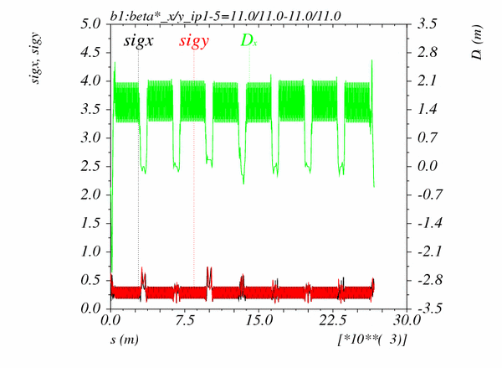
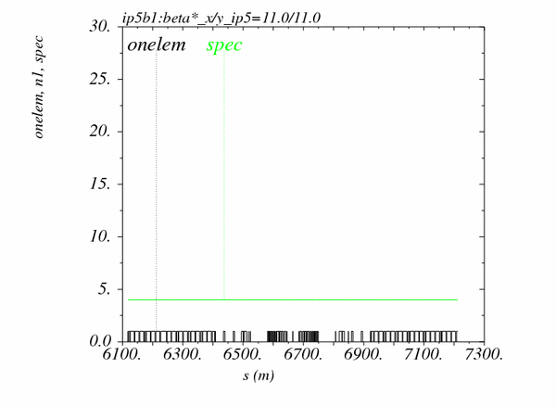
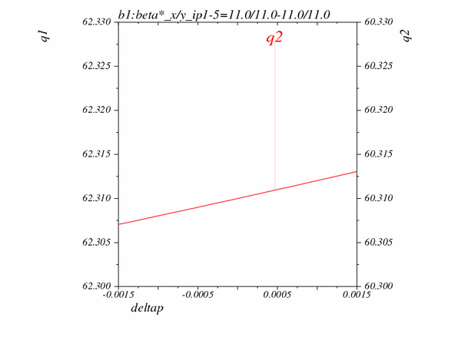
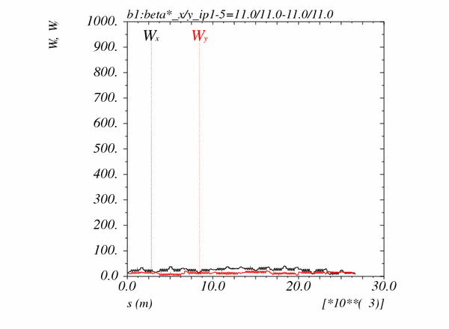
Squeezing IR1 and IR5 to β*=10 cm … on paper
Beam size [mm] and dispersion
at 3.5 TeV (for γε=3.5 μm)
Triplet aperture compared to TCP
tight settings (4 sigmas)
Tunes vs δ_{p}
Montague functions

Slide 3
Procedures
Dry run : 3h (floating MD)
Injection and ramp does not change w.r.t. previous ATS MDs
New squeeze sequence ready and checked, available under
/afs/cern.ch/eng/lhc/optics/ATS_V6.503/OPTICS_round_IR1_40-10_IR5_40-10
New ATS squeeze hypercycle in preparation
Activity (and comments) | Time estimate [h]
Recycling the machine from 3.5 TeV to new injection settings | 0.5
Load the ramp, ramp, and arm the squeezed functions | 0.5
Pre-squeezed down to β*= 40 cm with a few stops (e.g. 6m, 2m and 1m) to validate the new smoothing procedure for the sextupole currents | 0.5
Test the standard and specific ATS knobs at β*=40 cm | 0.5
Squeeze IR1 and IR5 down to β*=10 cm | 0.5
Test the standard and specific ATS knobs at β*=40 cm | 0.5

Slide 4
MD1 (10h): Pre-squeeze to 40 cm & tight collimator settings
Activity (and comments) | Time estimate [h]
Recycling the machine from 3.5 TeV to new injection settings before MD start | (2.0)
First fill with a fat pilot & Ramp down (5h) 1) ADT on only for damping injection oscillations 2) TCP, TCS, TCT remains to injection setting during the ramp, 3) Octupole off 4) Beam1/2 injected in bucket 1/2001 5) flat machine but parallel separation on in IR1/5
Injection, correction of orbit, tune, coupling and Q’ |  | 0.5
Ramp, rough optics measurement/correction at 3.5 TeV (closed orbit, tune, coupling, Q’) & manual adjustment of the TCPH/V to 6.5σ in IR7 and TCTH/V to 8.5σ in IR1 and IR5 |  | 1.0 → 0.5
Pre-squeeze IR1 and IR5 down to β*=1m (with a few stops e.g. 4m and 2m) and Measurement/correction of closed orbit, tune, coupling, Q’ + incorporation Measurement of the β-beating, dispersion and Montague function at 1m only |  | 1.0
Pre-squeeze IR1 and IR5 down to β*=40 cm (with a few stops e.g. 80 cm and 60 cm) and Measurement/correction of closed orbit, tune, coupling, Q’ + incorporation Measurement of the β-beating, dispersion and Montague function at 40 cm only Calculate a correction, send it and remeasure |  | 2.0
If time permits and still some beam, manual adjustment of the TCPH/V to 4σ in IR7 and TCTH/V to 4.5σ in IR1 and IR5, then squeeze to 10 cm (… if still some beam) |  | 0 → 0.5
Dump & Ramp down |  | 0.5

Slide 5
MD1 continued
Activity (and comments) | Time estimate [h]
Second fill with 1 nominal bunch /beam (5 h) 1) ADT on (with new settings) 2) TCP, TCS, TCT follow the tight settings during the ramp (taking care of the absence of crossing angle for the TCT) 3) Octupole ON, 4) Beam1/2 injected in bucket 1/1, 5) flat machine but parallel separation on in IR1/5
Injection, correction of orbit, tune, coupling and Q’ | 0.5 → 0.25
Ramp & rough optics measurement/correction at 3.5 TeV (closed orbit, tune, coupling, Q’) | 0.5
Pre-squeeze IR1 and IR5 down to β*=1m and then 40 cm with Measurement/correction of closed orbit, tune, coupling, Q’ + incorporation | 1.0 → 0.5
Collimation related studies: finding the collision, establishing safe settings & alignment, loss maps. | 3.0 → 3.75

Slide 6
MD2 (6h): Squeeze to 10 cm
Activity (and comments) | Time estimate [h]
Recycling the machine from 3.5 TeV to new injection settings before MD start | (2.0)
Fat pilots only (6h) 1) ADT on only for damping injection oscillations 2) TCP, TCS, TCT remains to injection setting during the ramp, 3) Octupole off 4) Beam1/2 injected in bucket 1/2001 5) Machine stricly flat (no X-angle, no parallel sep in any IR)
Injection, correction of orbit, tune, coupling and Q’ |  | 0.5
Ramp, rough optics measurement/correction at 3.5 TeV (closed orbit, tune, coupling, Q’) & manual adjustment of the TCPH/V to 6.5σ in IR7 and TCTH/V to 8.5σ in IR1 and IR5 |  | 0.5
Pre-squeeze IR1 and IR5 down to β*=1m and then 40 cm with Measurement/correction of closed orbit, tune, coupling, Q’ + incorporation Specific β-beat measurement and fine correction (if needed) at 40 cm |  | 1.0
Squeeze down to β*=10 cm with stops and optics measurement at 30 cm, 20 cm and 15 cm & step by step manual adjustment of the TCPH/V down to 4σ in IR7 and TCTH/V down to 4.5σ in IR1 and IR5 Measurement/correction of closed orbit, tune, coupling, Q’ + incorporation Measurement of the β-beating, dispersion and Montague function Eventually β-beating correction if this owrks with the ATS optics |  | 4.0

