Slide 1
TDI vacuum and
UFO MD
LHC Study Working Group
  Tobias Baer for TDI and UFO MD team.
  October, 18th 2011

Slide 2
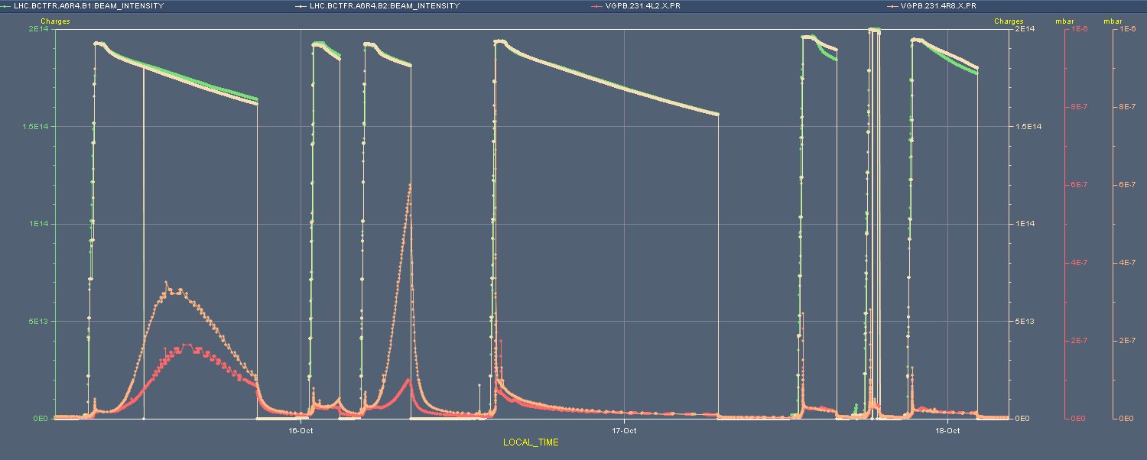
TDI vacuum
Observations on 15/16.10.2011:
Important reduction of the vacuum activity during coasts after opening the TDI gap after injection to +/- 55 mm instead of +/- 20 mm (bunches were slightly longer for this fill)
+/-20 mm
+/-55 mm

Slide 3
TDI Studies
Aim: Understand the correlation between the TDI vacuum pressure, heat load and temperature with the TDI gap.
Parasitic impedance studies parallel to physics (vacuum activity, heat load, temperature for different TDI positions.
Upgrade of impedance model to full 3D model.
MD: Study tune shift depending on TDI position for single bunch and 1380 buches at injection.
Important input to impedance model.
Identify deviations from model (e.g. defects in coating)

Slide 4
UFO Studies
Aim: Investigation of production mechanism of UFOs at MKIs by pulsing the MKIs on the partly filled machine.
Preceding parallel MKI UFO MD (MD#2) showed that UFO production can be stimulated by MKI pulsing.
In parallel to TDI studies: UFO studies (postponed from MD#3.)
Three main aspects:
Study UFO asymmetry between kickers (UFO location)
Study delay of UFO occurence w.r.t. MKI kick (UFO dynamics)
Study UFOs at MKQ (Metalized vacuum chamber as possible mitigation)

Slide 5
Tentative Program
Beam 1 (UFO studies) | Beam 2 (TDI studies)
Machine protection validation of procedure with pilot bunches for both beams. (45min)
Inject 1236 nominal bunches. | Inject single nominal bunch.
Move TEDs in, disable SPS MKE timing on LHC cycle, switch to BLM study buffer.
Test 1: Pulse all four MKI kickers, every minute for 1.5h. | Test 1: Measure tune for different TDI positions.
No pulsing of MKIs. | Inject 1380 nominal bunches. During injection: TI8 TED out, use IQC buffer, SPS LSS4 MKE timing on LHC cycle enabled.
Test 2: Pulse only MKI D, every minute for 1h. | Test 2: Measure tune for different TDI positions.
Test 3: Pulse only MKI A, every minute for 1h.
Test 4: Pulse the MKQ magnets at full strength, H & V simultaneously, every minute for 1h.
Dump beams, recovery and revalidation. (30min)
Condensed version

Slide 6
Thank you for
your attention!
Tobias Baer
CERN BE/OP
Tobias.Baer@cern.ch
Office: +41 22 76 75379
Further information:
C. Bracco et al., “UFOs at MKIs”, 9th LSWG meeting, August 2011.
T. Baer et al., “MKI UFOs at Injection”, CERN-ATS-Note-2011-065 MD, August 2011.

Slide 7
Backup slides

Slide 8
Initial schedule
Investigation on the sources of the UFOs seen at the injection kickers MKI. The UFO rates will be measured for specified beam condition, by pulsing the MKI on a gap in the partly filled machine.
Difference with previous MD
  This time test MKIs both IP2 and IP8, last time only IP8.
    The big UFO storms happened at IP2
  First MD was a proof of principle showing that:
    We can pulse the individual kicker magnets
    That we get interesting data by pulsing without injecting beam
  As a dedicated MD, get more them and better statistics
  This time we have extended BLM buffers, which allow us to measure the time difference between pulsing and the UFO
  Also pulse the MKQ in a beam free gap to check the behaviour of continuously coated ceramic chamber
    MKQ @ 450 GeV: kick 1.3 σ for 2800 V (max),
    with a total pulse length of 7 μs

Slide 9
Initial MD Plan
Check procedure of pulsing a single kicker with 12 pilots in the machine for B1 & B2 (1.0 hours)
Check kicking the MKQ, 4 kickers together with 12 pilots in the machine for B1 & B2 (0.5 hour)
Fill the machine (0.5 hour)
Fill the machine with 1236 bunches and pulse the injection kickers for both IP2 and IP8
  All 4 MKIs (1.5 hour, pulse about every 2 min)
  MKI-A only, B1 & B2 (1.5 hours, pulse about every 2 min)
  MKI-D only, B1 & B2 (1.5 hours, pulse about every 2 min)
Pulse the MKQ in the beam free gap (1.5 hours, pulse every 2 min)

