Slide 1
25 ns MD
Status and request
G. Arduini, V. Baglin, H. Bartosik, P. Baudrenghien, N. Biancacci, C. Bracco, S. Claudet, O. Dominguez Sanchez De La Blanca, J. Esteban Muller, B. Goddard, W. Hofle, G. Iadarola, JM Jimenez, E. Metral, M. Pojer, G. Rumolo, B. Salvant, E. Shaposhnikova, R. Steinhagen, L. Tavian; D. Valuch; W. Venturini Delsolaro, F. Zimmermann

Slide 2
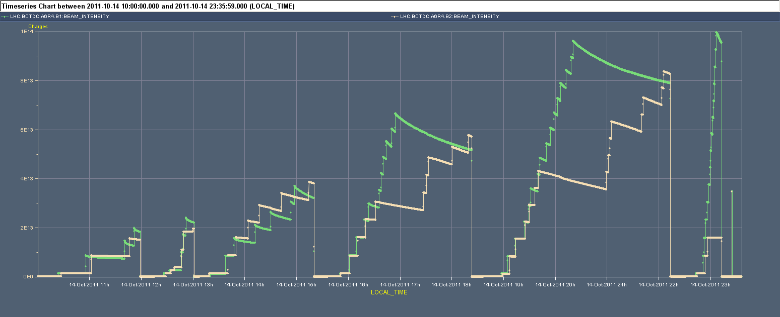
25 ns MD
0.925 μs
1020 + 156 b
3.625 μs
1092 + 1020 b
Reference meas. variable spacing
6.325 μs
732 + 660 b
Setting-up
Limited by pressure rise on MKI8. Now limited to 2.5x10⁻⁹ mbar. No injection interlock level during the scrubbing run and pressures of up 10⁻⁸ mbar reached.

Slide 3
Heat load
3.625 μs
1092 + 1020 b
Reference meas. variable spacing
6.325 μs
732 + 660 b
L. Tavian

Slide 4
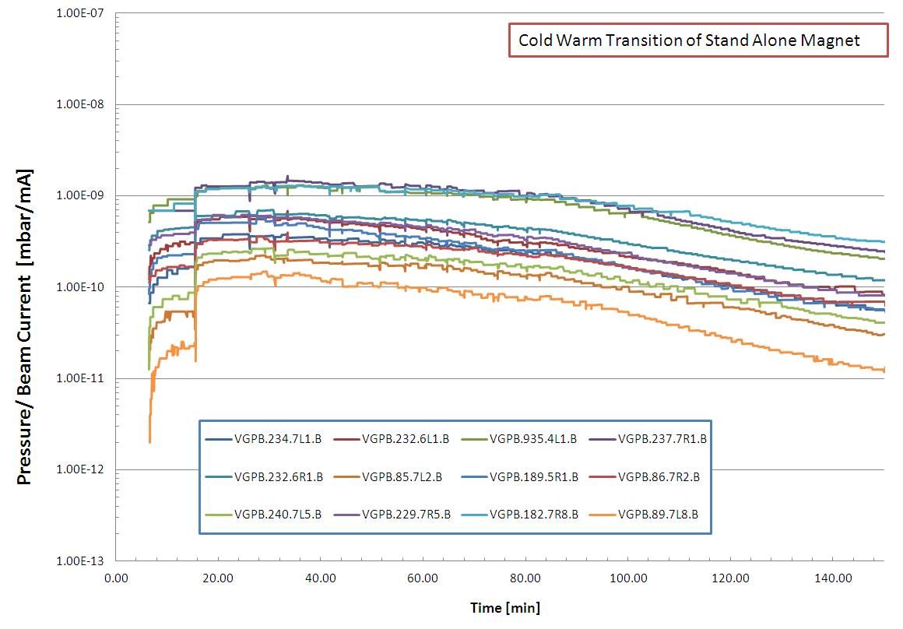
Vacuum
Reduction of approx. Factor 4 in all the Cold Warm Transition of Stand Alone Magnets after 2 hours
G. Bregliozzi
After that period possible to inject >1.4x10¹¹ p/b with no important vacuum instability so far ➔ would be good to have another period of ~24 h this week to test potential effects on high intensity 50 ns operation

Slide 5
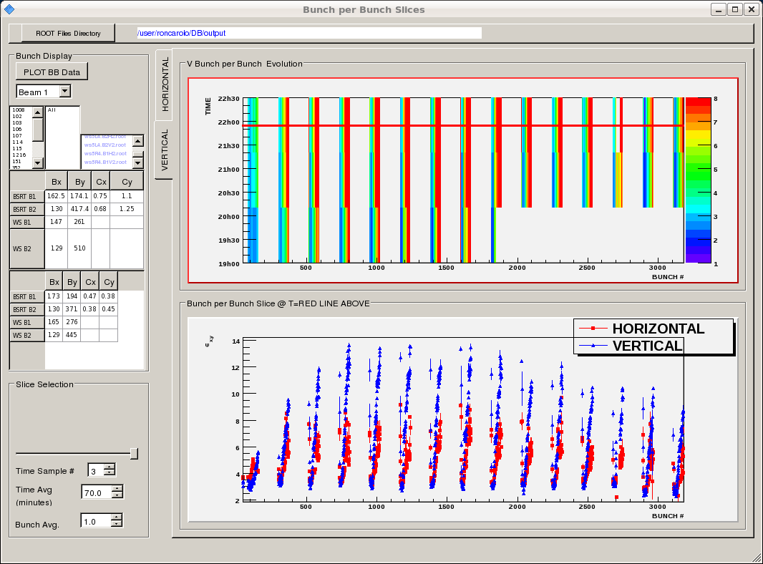
Emittances along trains

Slide 6
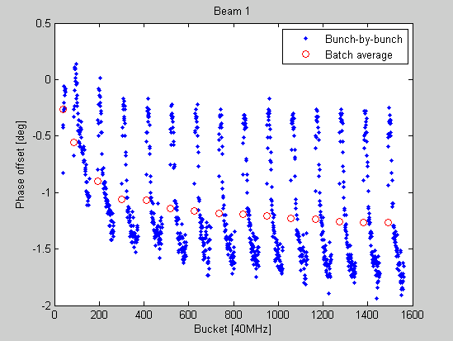
RF stable phase shift along batches
E. Shaposhnikova, JF Esteban Muller

Slide 7
Aim
Explore the operation with ~2000 bunches with 25 ns and give input for the understanding of the vacuum dynamic behaviour in the machine
This test should take place well before the end of the proton run to have the possibility to test the (hopefully) positive impact on 50 ns operation at high intensity and it would provide vital input for the operation in 2012.
2100 bunches (trains of 72 bunches - 25 ns spacing ) x 1.1x10¹¹ = 1400 bunches (50 ns spacing) x 1.5x10¹¹

Slide 8
Proposal
Possibly end of this week (Friday):
  Setting-up of injection with 25 ns beams (72 bunches) and checks – 2-3 hours
  Accumulation of up to ~2100 bunches in trains of 72 bunches spaced by 925 ns and measurement of heat load and vacuum evolution, possibly inject a few trains of 288 bunches (16 hours)
  Reference measurements for SEY, reflectivity (3 hours)
  Recovery (1 hour)
Test the impact on 50 ns operation pushing intensity to ~1.5x10¹¹ p/bunch during week-end and following week.

