Slide 1
Injection efficiency study
28/08/2025 211th FCC-ee Accelerator Design Meeting
Giulia Nigrelli
G. Nigrelli^{1,2,3}, M. Boscolo^{1,2}, R. Bruce¹, Y. Dutheil¹, T. Mori⁴,
S. Redaelli¹, K. Skoufaris¹, S. Yue¹
¹ CERN, Geneva, Switzerland,
² INFN-LNF, Frascati, Italy,
³ Sapienza Università di Roma, Roma, Italy
⁴ KEK, Tsukuba, Japan

Slide 2
Table of content
28/08/2025 211th FCC-ee Accelerator Design Meeting
Giulia Nigrelli
Introduction
Top-up injection for FCC-ee
Injection efficiency
Collimation performances during injection
Effect of non-linearities
Losses dirstribution - lossmaps

Slide 3
Introduction
28/08/2025 211th FCC-ee Accelerator Design Meeting
Giulia Nigrelli
We focus on ring losses during the injection process, since they might cause backgrounds to the experiment. The cases of interest include:
Perfect injection:
Injected beam, baseline scheme with and without collimators. (this talk)
Losses due to the bump: the beam circulating in the collider must be brought close to the injected one. In this procedure part of the beam is scraped at the septum/absorber placed at the injection point. (More information here)
Injection failures scenarios (to be identified by ABT) impact on collimation/experiments:
Issues with the bump, like partial closure.
Mismatched injected beam, like higher energy offset.

Slide 4
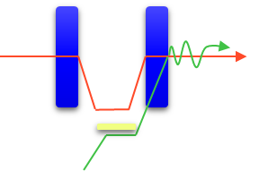
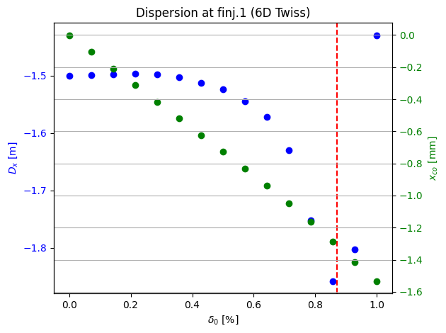

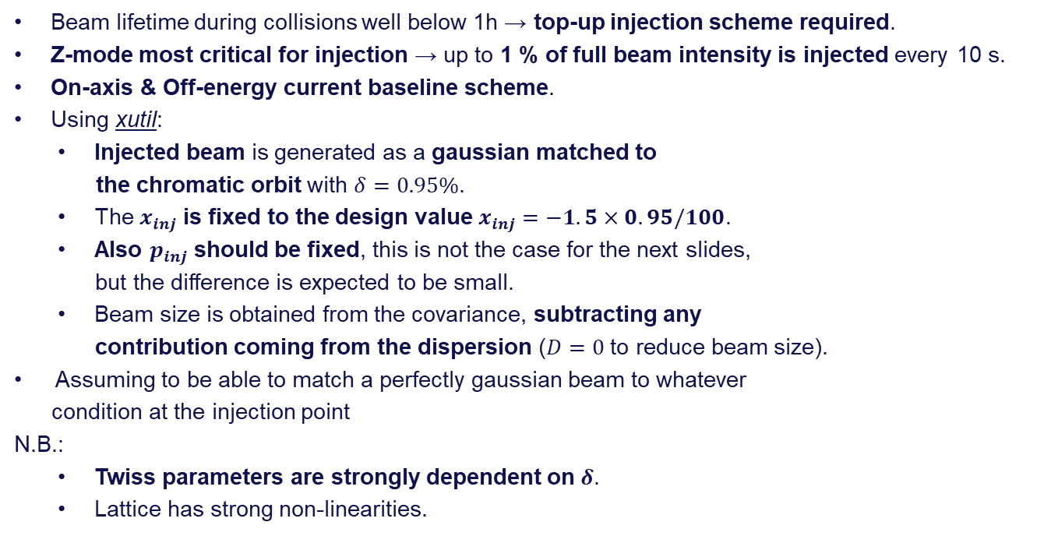
Top-up Injection for FCC-ee
28/08/2025 211th FCC-ee Accelerator Design Meeting
Giulia Nigrelli
Beam lifetime during collisions well below 1h → top-up injection scheme required.
Z-mode most critical for injection → up to 1 % of full beam intensity is injected every 10 s.
On-axis & Off-energy current baseline scheme.
Using xutil:
Injected beam is generated as a gaussian matched to
the chromatic orbit with $δ=0.95\%$.
The $x_{inj}$ is fixed to the design value $x_{inj}=−1.5×0.95/100$.
Also $p_{inj}$ should be fixed, this is not the case for the next slides,
but the difference is expected to be small.
Beam size is obtained from the covariance, subtracting any
contribution coming from the dispersion ($D=0$ to reduce beam size).
Assuming to be able to match a perfectly gaussian beam to whatever
condition at the injection point
N.B.:
Twiss parameters are strongly dependent on $δ$.
Lattice has strong non-linearities.
$π−$bump
Circulating
beam
Septum blade
Injected beam

Slide 5
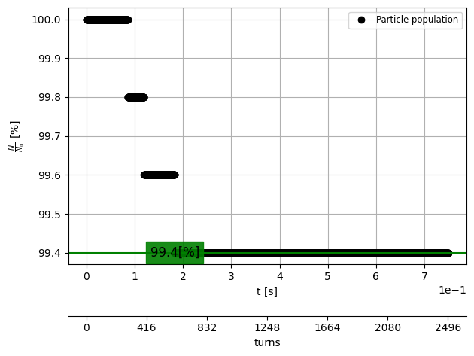
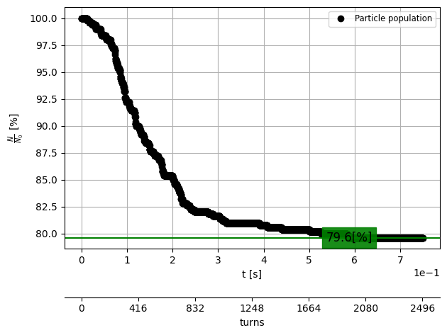
Injection efficiency for V25.3_GHC
28/08/2025 211th FCC-ee Accelerator Design Meeting
Giulia Nigrelli
Bare lattice with aperture model and no collimators used a baseline to compare to:
Only SR - quantum model
Beam-beam + SR quantum

Slide 6
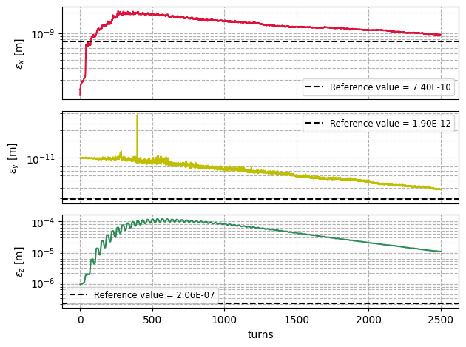
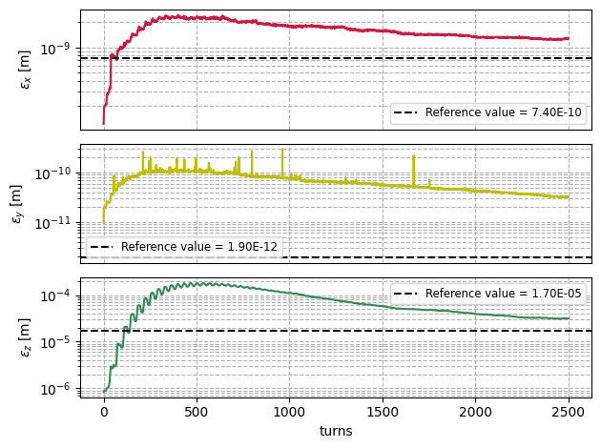
Emittance evolutions for V25.3_GHC
28/08/2025 211th FCC-ee Accelerator Design Meeting
Giulia Nigrelli
Emittance evolution follow the expected behavior.
Only SR - quantum model
Beam-beam + SR quantum

Slide 7
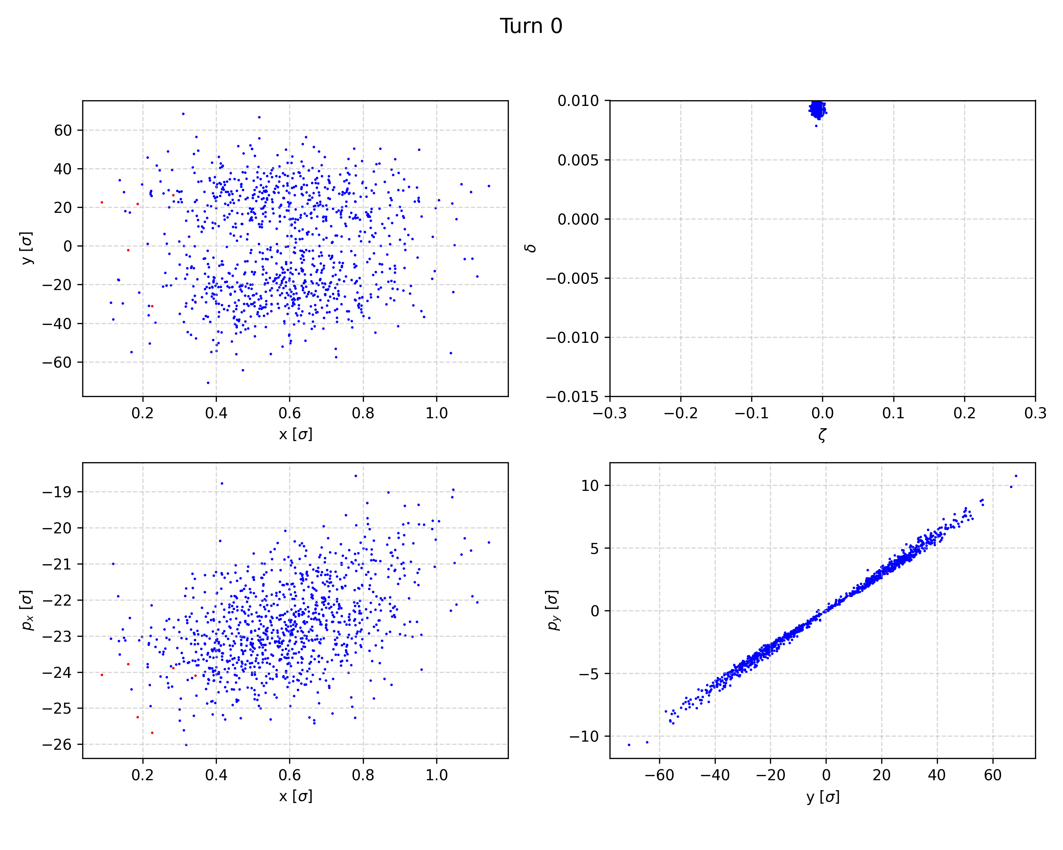
Efficiency with collimators
28/08/2025 211th FCC-ee Accelerator Design Meeting
Giulia Nigrelli
Injection efficiency with the collimation system is still under investigation.
The efficiency will likely decrease once the collimators are inserted.
The drop is not trivial to estimate due to non linearities → at the collimators the amplitude are larger causing more losses.
Turn 0 – secondary vertical collimator

Slide 8
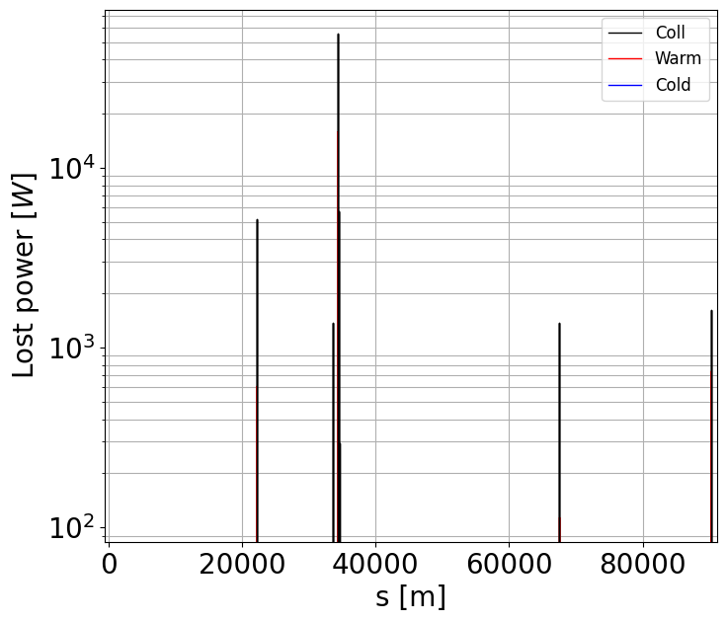
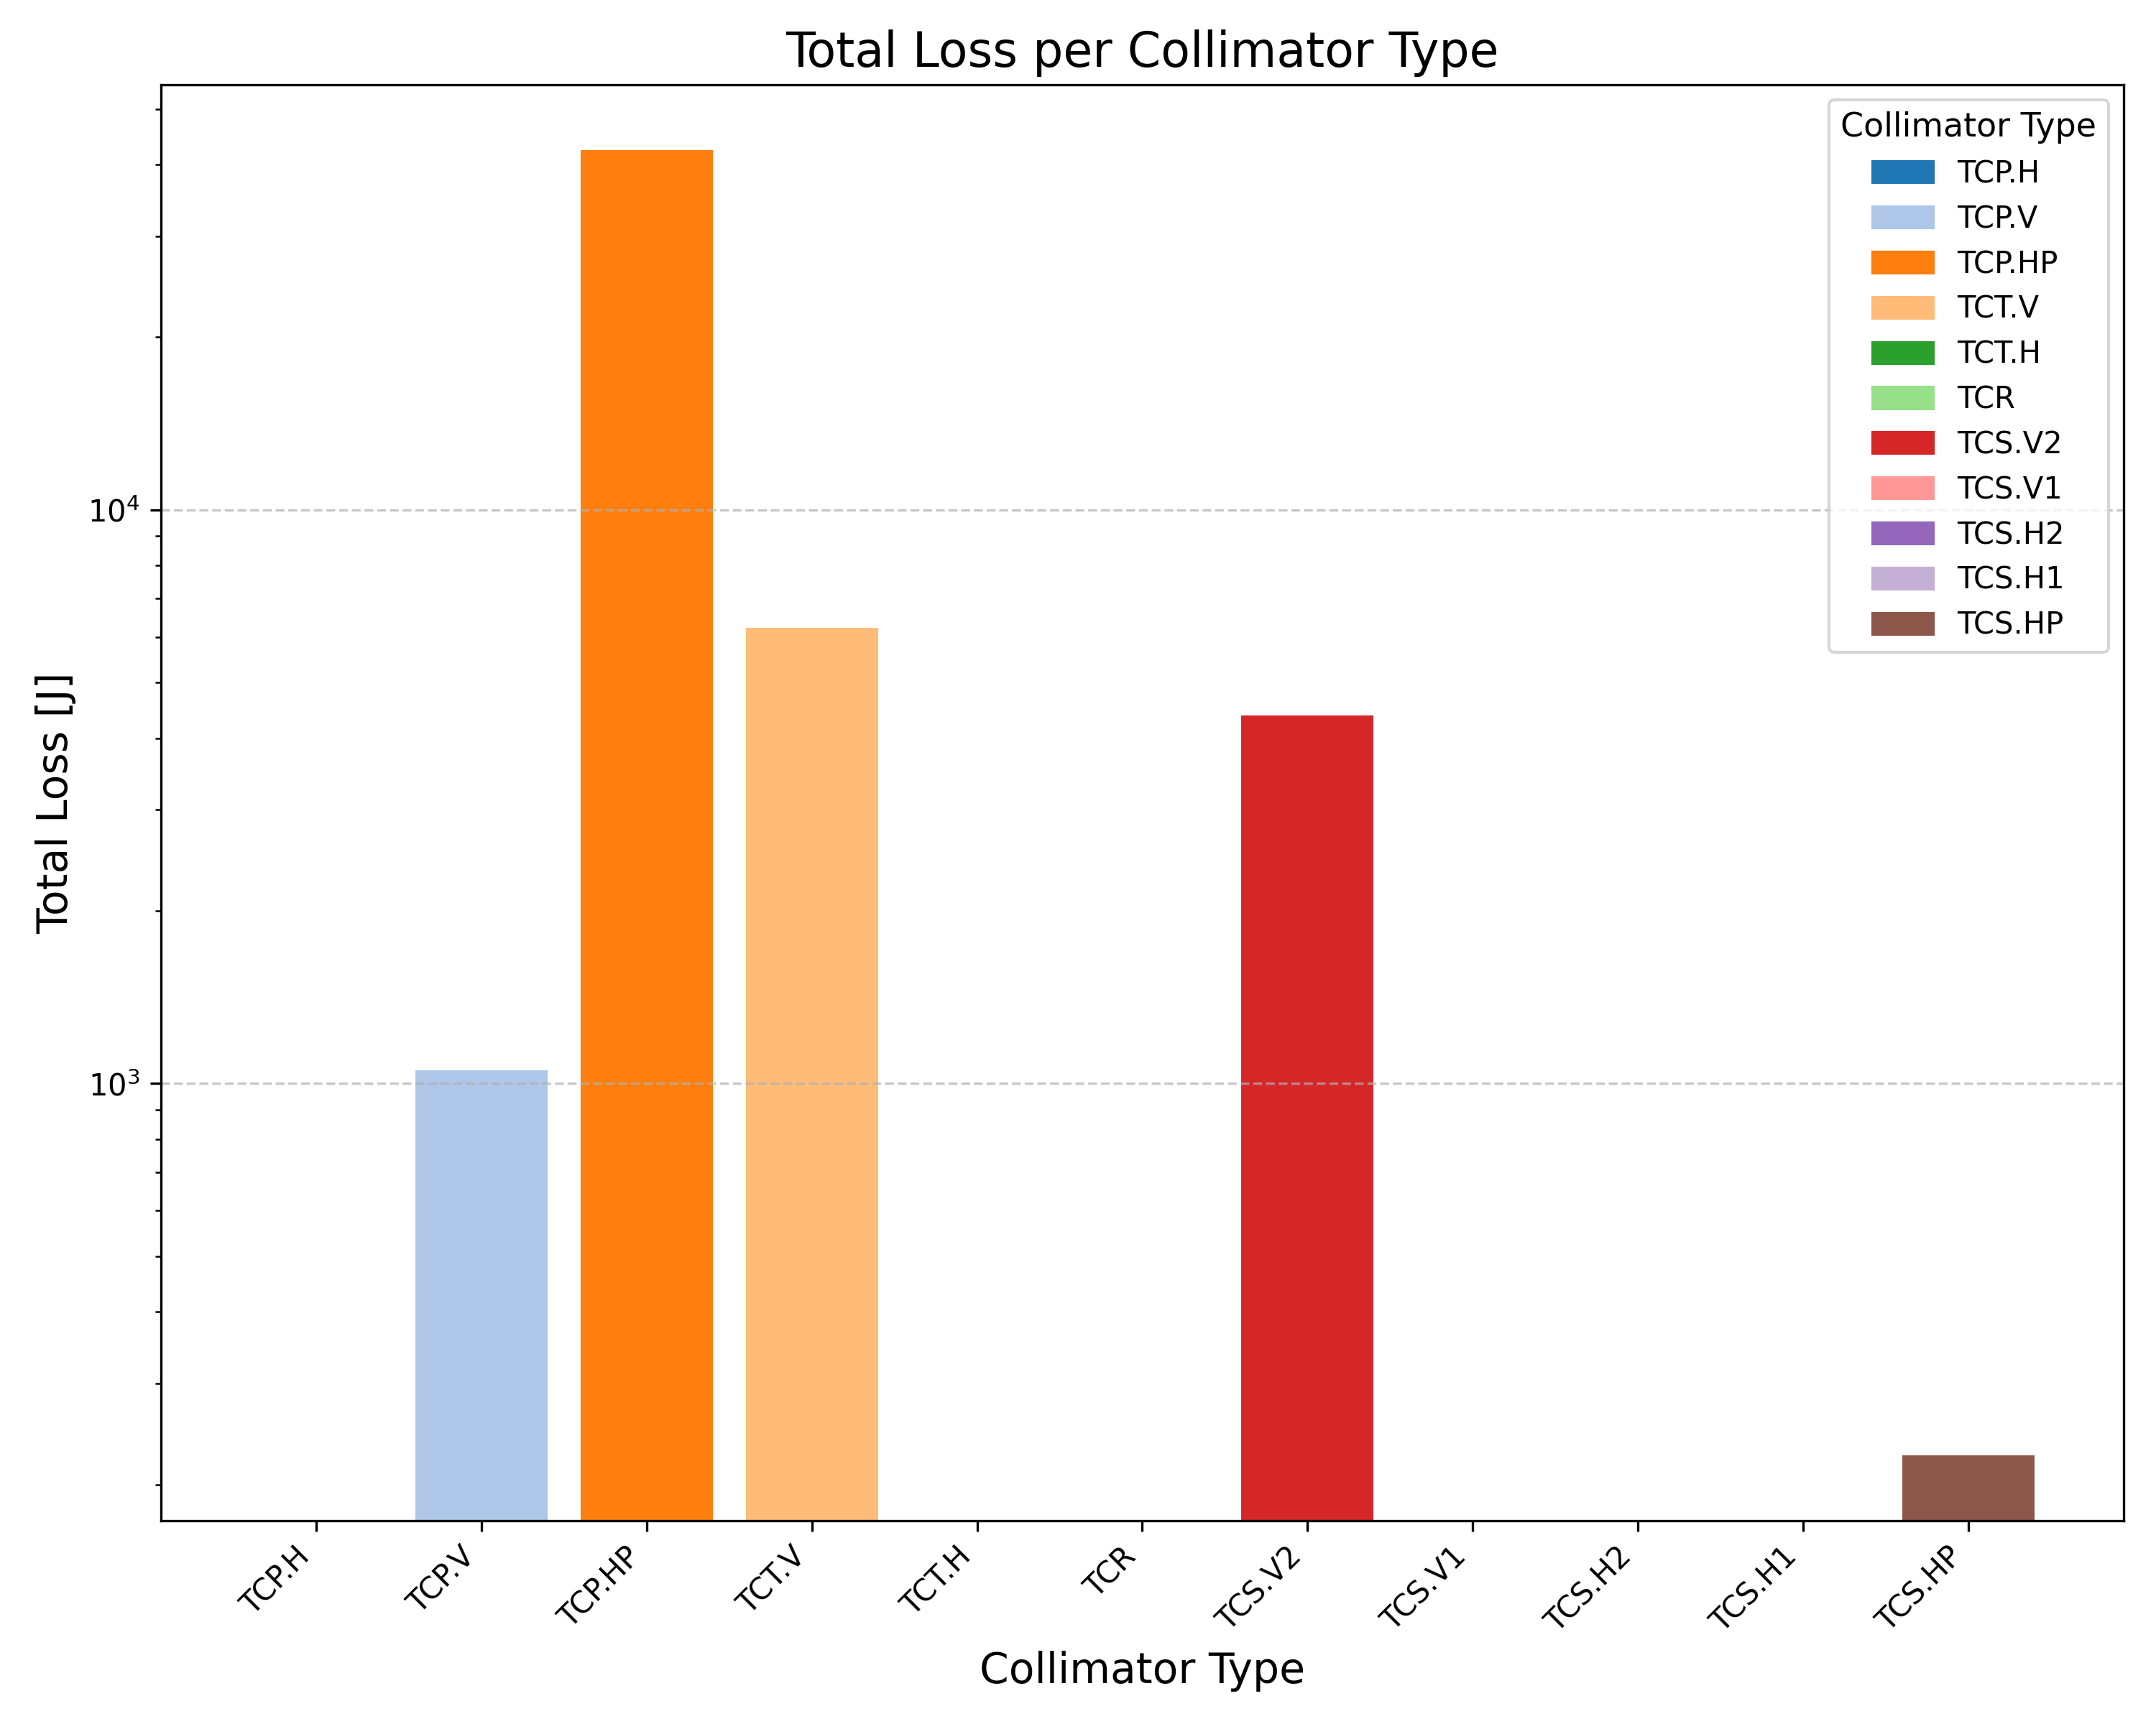
Losses from injected beam
28/08/2025 211th FCC-ee Accelerator Design Meeting
Giulia Nigrelli
*PRELIMIANRY RESULTS - VERY LOW STATISTICS
Indeed, losses are rather high in that secondary collimator.
Losses are distributed all over the ring, mostly on vertical and momentum collimators.
Background to the experiment must be assessed.

Slide 9
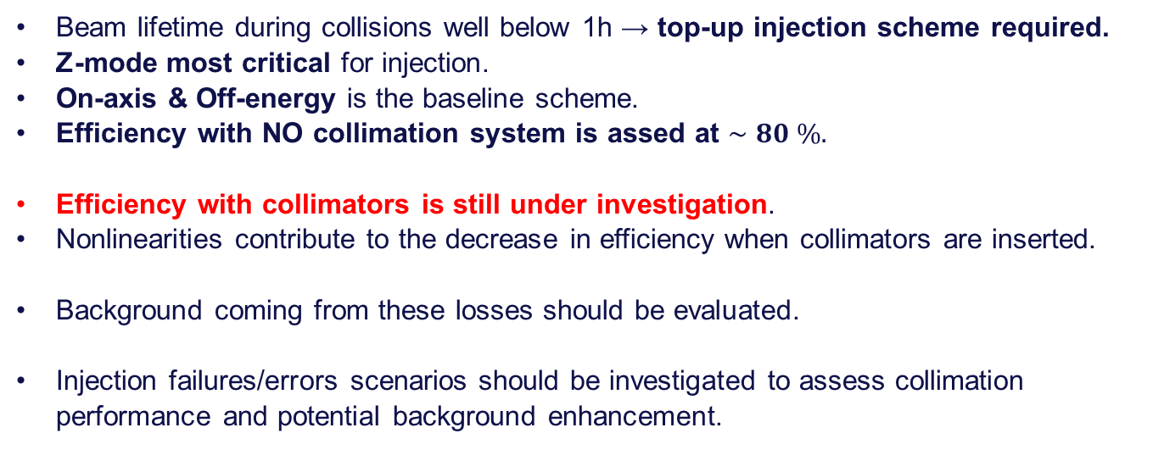
Conclusions
28/08/2025 211th FCC-ee Accelerator Design Meeting
Giulia Nigrelli
Beam lifetime during collisions well below 1h → top-up injection scheme required.
Z-mode most critical for injection.
On-axis & Off-energy is the baseline scheme.
Efficiency with NO collimation system is assed at $∼80 \%.$
Efficiency with collimators is still under investigation.
Nonlinearities contribute to the decrease in efficiency when collimators are inserted.
Background coming from these losses should be evaluated.
Injection failures/errors scenarios should be investigated to assess collimation performance and potential background enhancement.

Slide 10
Backup
28/08/2025 211th FCC-ee Accelerator Design Meeting
Giulia Nigrelli

Slide 11
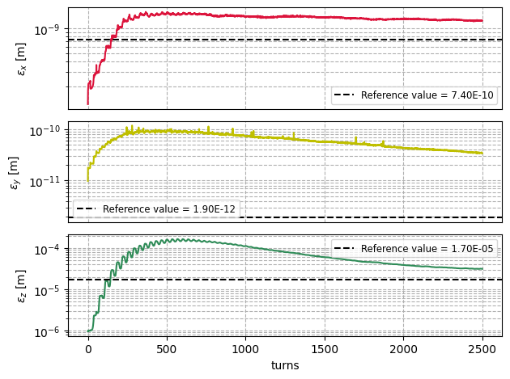
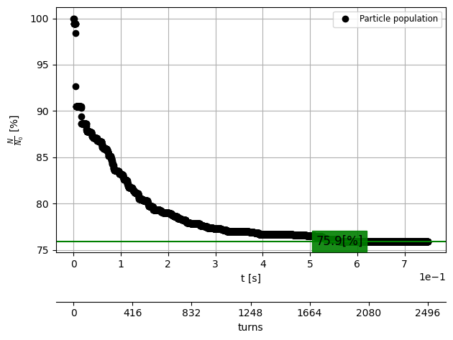
Injection efficiency with collimators
28/08/2025 211th FCC-ee Accelerator Design Meeting
Giulia Nigrelli
Lattice with aperture model, collimators, BB ans SR → efficiency assessment $∼ \%$.

Slide 12
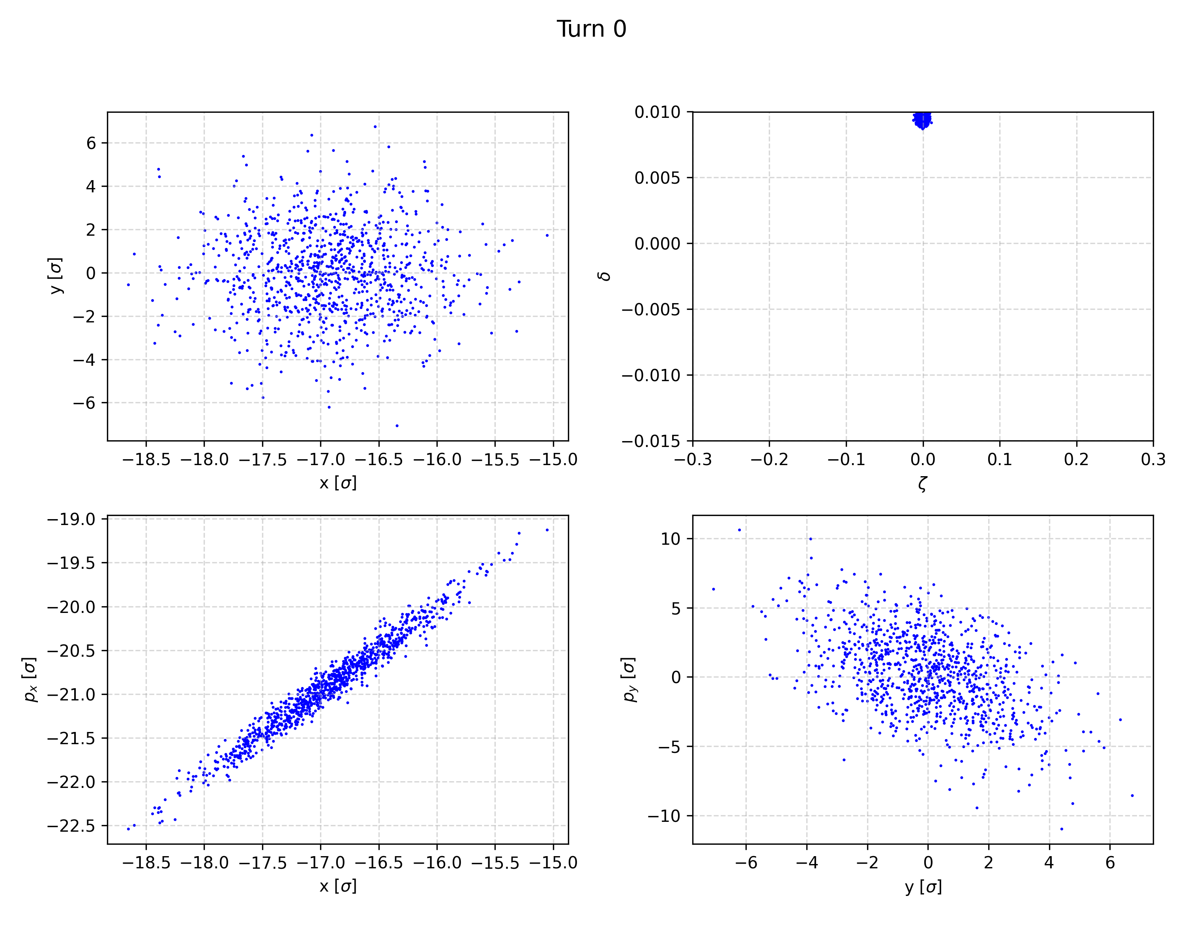
Effect of lattice non-linearities
28/08/2025 211th FCC-ee Accelerator Design Meeting
Giulia Nigrelli
10% drop is probably due to non linearities → at the collimators the amplitude are larger causing more losses .
Turn 0 – injection point
Turn 0 – secondary vertical collimator

Slide 13
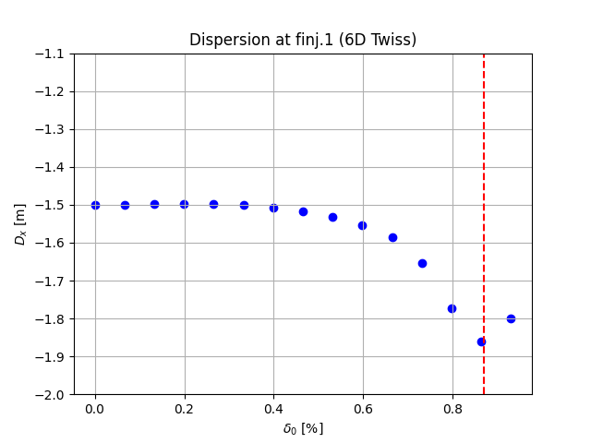
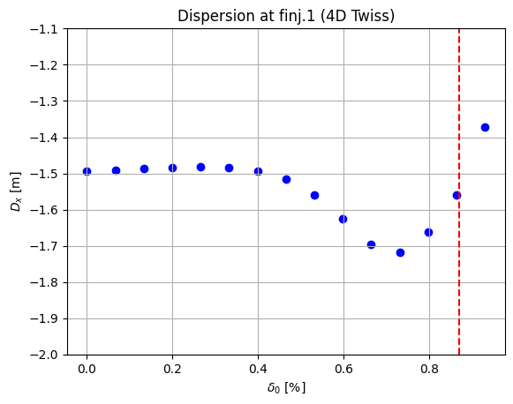
Dispersion X evolution at FINJ.1-V25.3_GHC
28/08/2025 211th FCC-ee Accelerator Design Meeting
Giulia Nigrelli
Twiss parameters are strongly influenced by the delta offset.
Twiss4d(5d) is calculated with radiation off(alla-hadron machine avoiding tapering complication).
*
*
*After 0.87% twiss calculated with closed orbit.

Slide 14
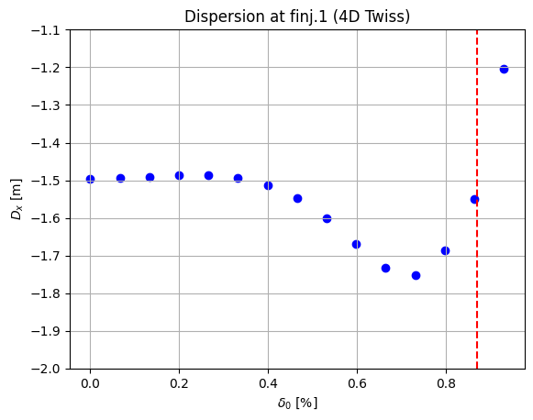
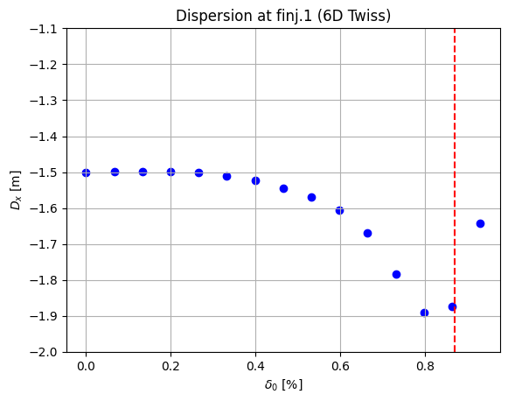
Dispersion X evolution at FINJ.1-V25.2_GHC
28/08/2025 211th FCC-ee Accelerator Design Meeting
Giulia Nigrelli
Twiss parameters are strongly influenced by the delta offset.
Twiss4d(5d) is calculated with radiation off(alla-hadron machine avoiding tapering complication).
*
*
*After 0.87% twiss calculated with closed orbit.

Slide 15
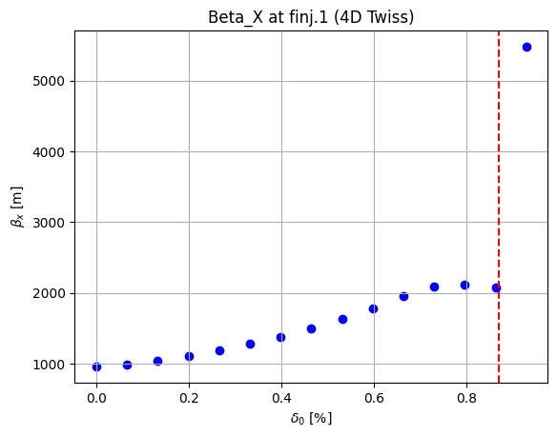
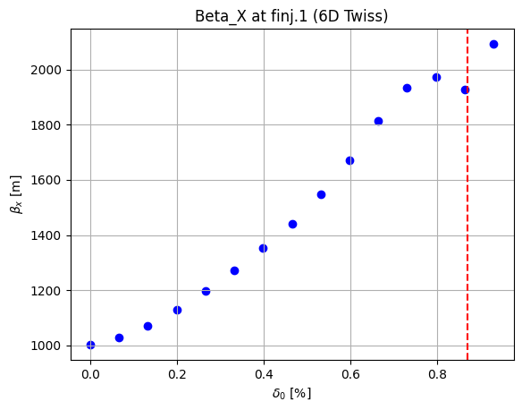
Beta X evolution at FINJ.1-V25.2_GHC
28/08/2025 211th FCC-ee Accelerator Design Meeting
Giulia Nigrelli
Twiss parameters are strongly influenced by the delta offset.
Twiss4d(5d) is calculated with radiation off(alla-hadron machine avoiding tapering complication).
*
*
*After 0.87% twiss calculated with closed orbit.

Slide 16
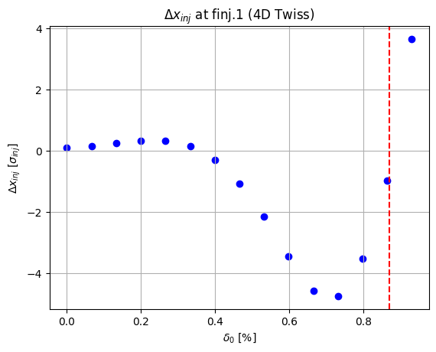
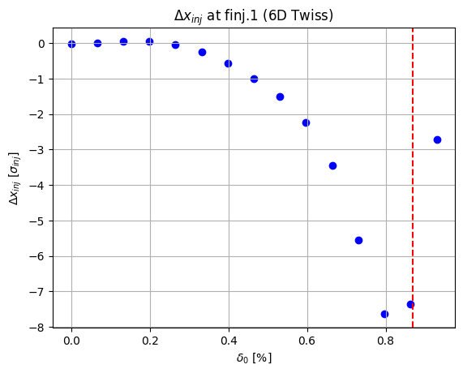

Deviation from $x_{inj}=−1.5 ∗\frac{0.95}{100}$ -V25.2_GHC
28/08/2025 211th FCC-ee Accelerator Design Meeting
Giulia Nigrelli
Since the dispersion changes significantly the beam matched into the chromatic orbit won’t be at the design injection location.
*After 0.87% twiss calculated with closed orbit.

Slide 17
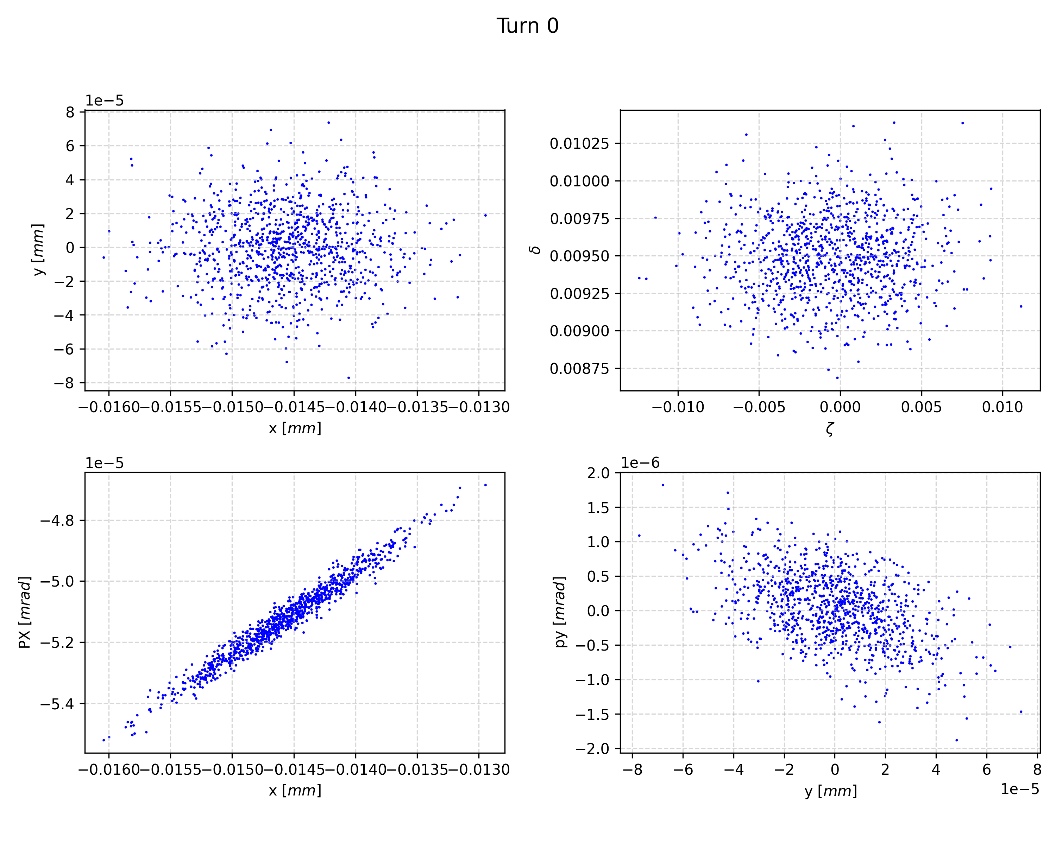
28/08/2025 211th FCC-ee Accelerator Design Meeting
Giulia Nigrelli
Initial distribution at finj.1:

Slide 18
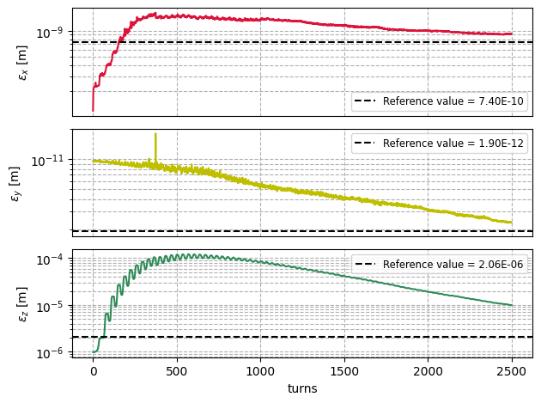
Emittances for V25.3_GHC
28/08/2025 211th FCC-ee Accelerator Design Meeting
Giulia Nigrelli
Bare lattice with aperture model and no collimators used a baseline to compare to:
Only SR - quantum model
Beam-beam + SR quantum

Slide 19
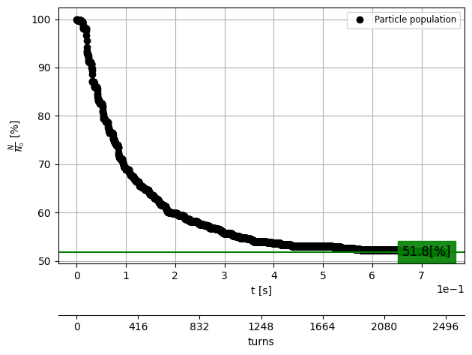
Injection efficiency for V25.3_GHC
28/08/2025 211th FCC-ee Accelerator Design Meeting
Giulia Nigrelli
Comparison between generation with tw4d and tw6d
SR+BB-TW4D
SR+BB-TW6D

Slide 20
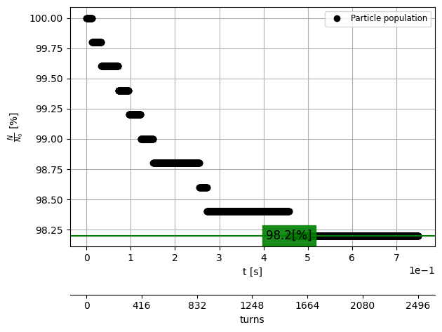
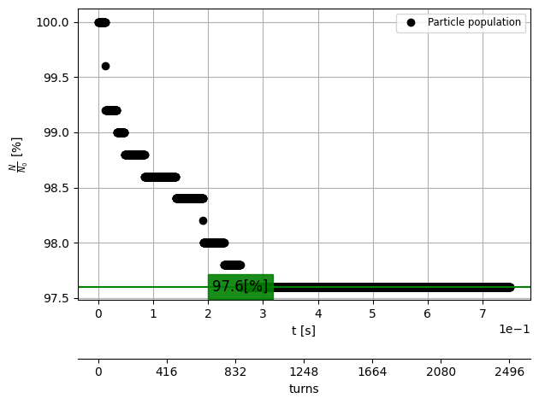
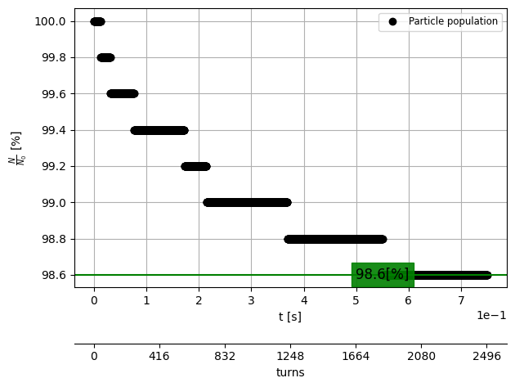
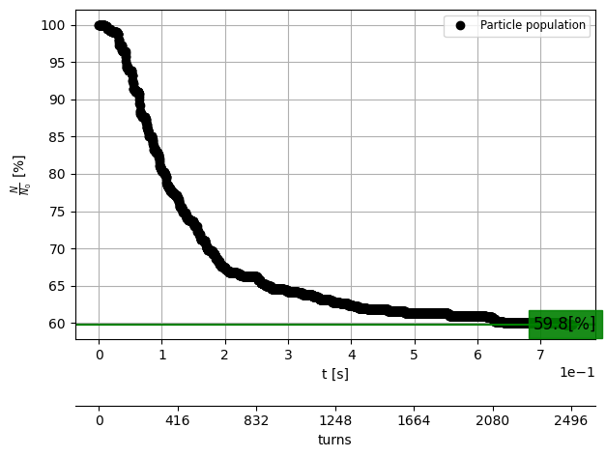
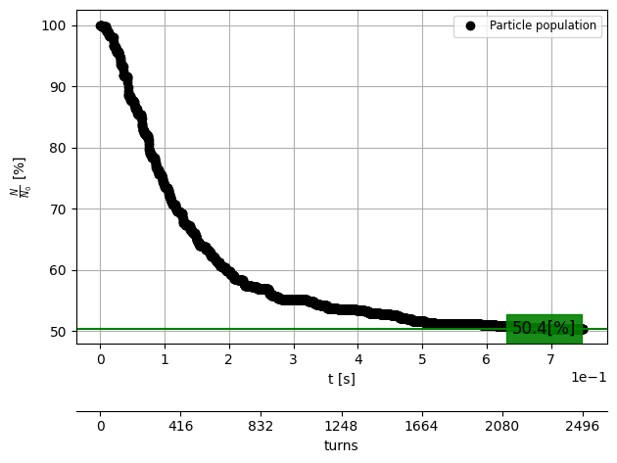

21/08/2025 FCC-ee top-up injection
Giulia Nigrelli
Injection efficiency for V25.2_GHC
SR - tw4d
SR - tw4d - xinj
SR - tw6d - xinj
BB - tw4d
BB - xinj - tw4d
BB - tw6d - xinj

Slide 21
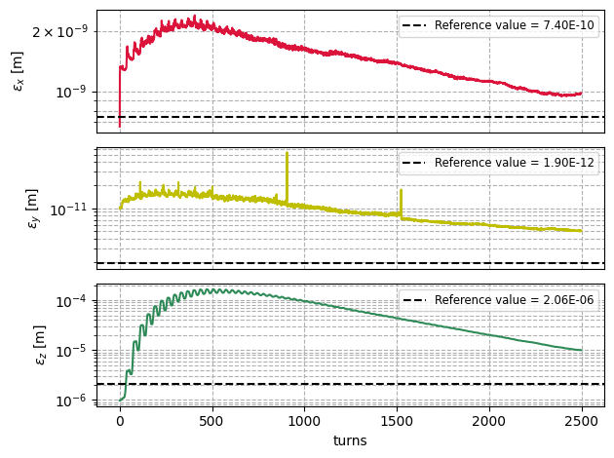
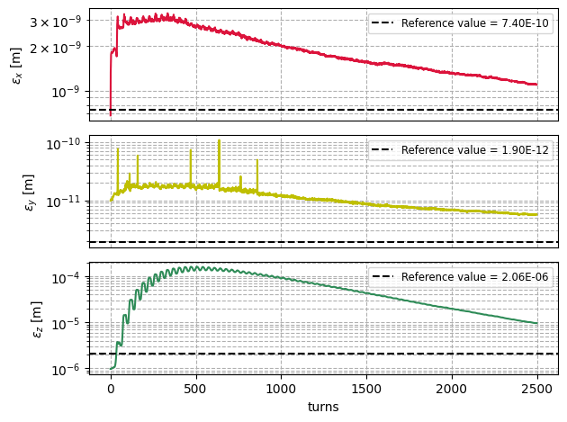
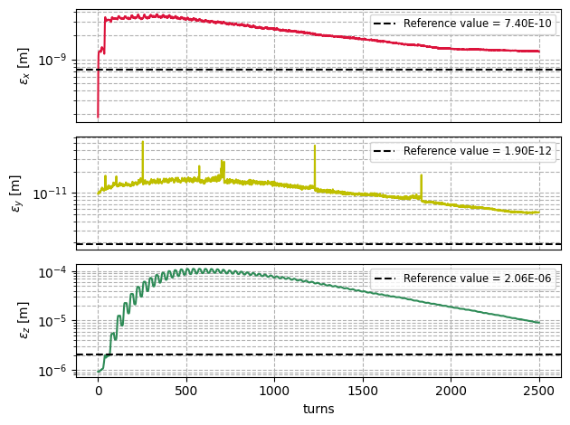
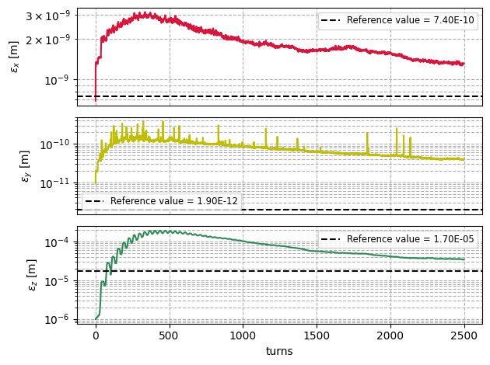
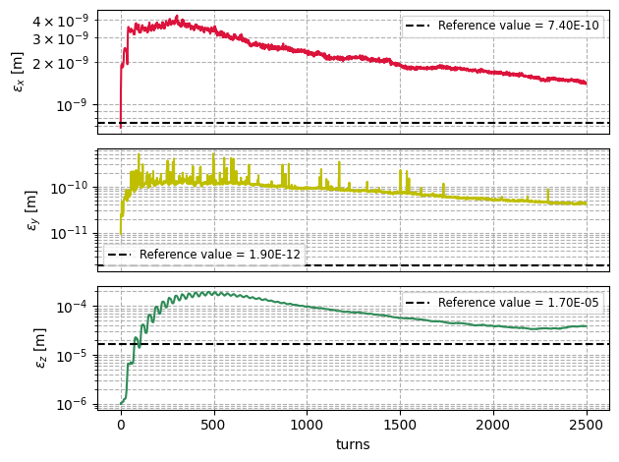
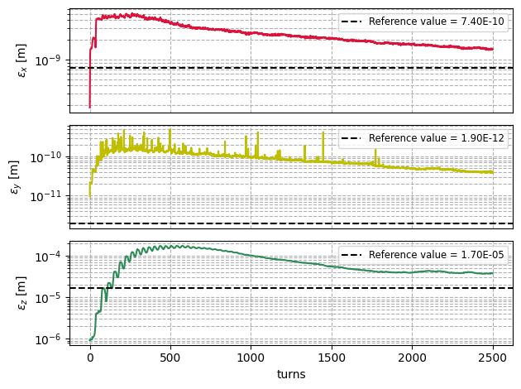
21/08/2025 FCC-ee top-up injection
Giulia Nigrelli
SR - tw4d
SR - tw4d - xinj
SR - tw6d - xinj
BB - tw4d
BB - xinj - tw4d
BB - tw6d - xinj

Slide 22
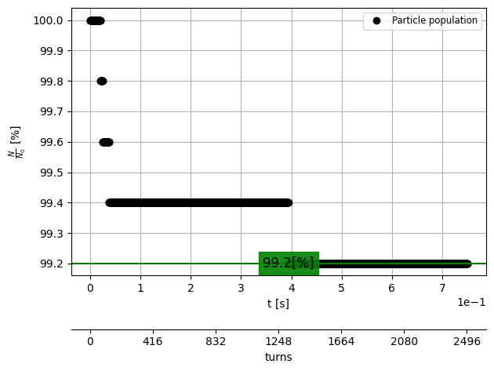
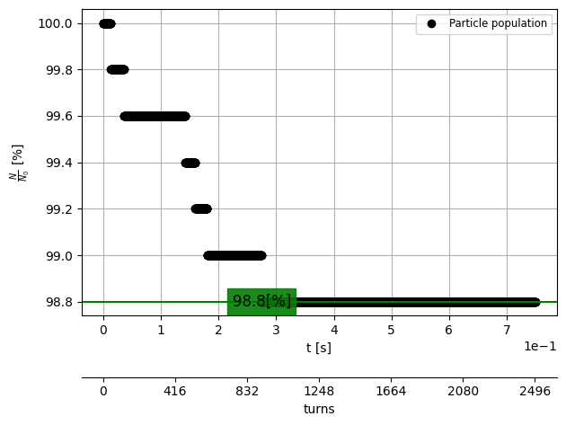
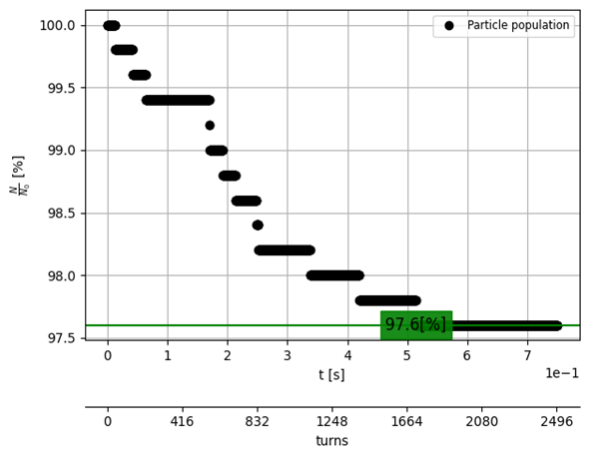
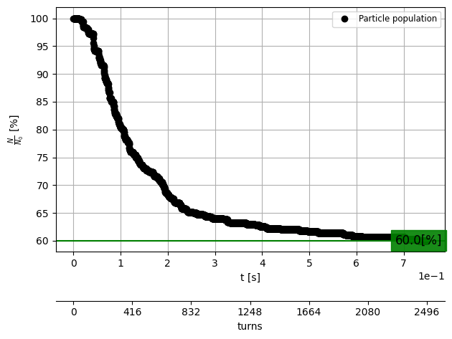
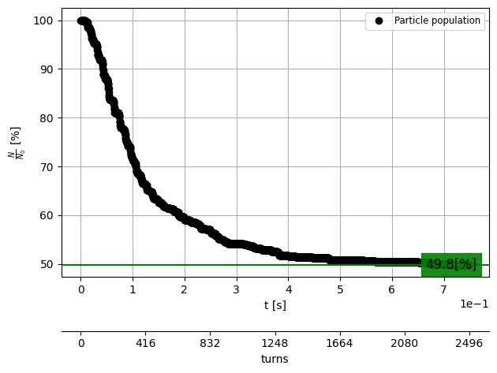
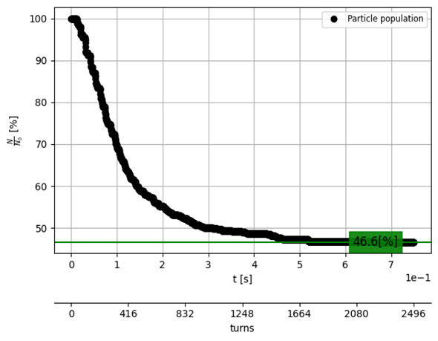
21/08/2025 FCC-ee top-up injection
Giulia Nigrelli
Injection efficiency for V25.2_GHC – NO D0
SR - tw4d
SR - tw4d - xinj
SR - tw6d - xinj
BB - tw4d
BB - xinj - tw4d
BB - tw6d - xinj

Slide 23
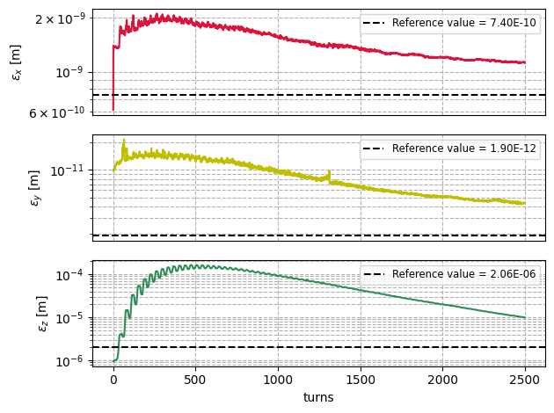
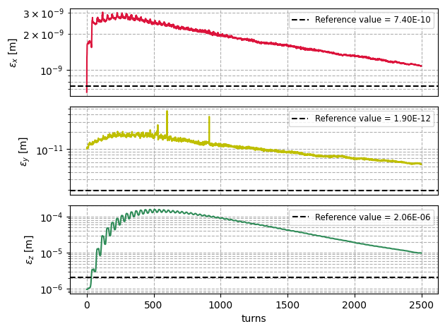
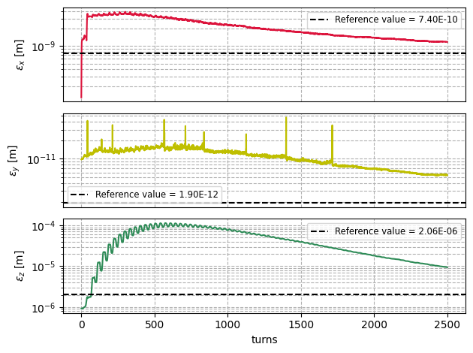
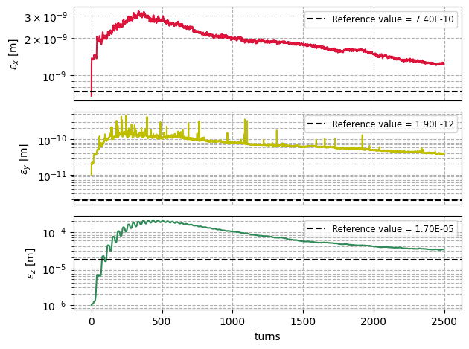
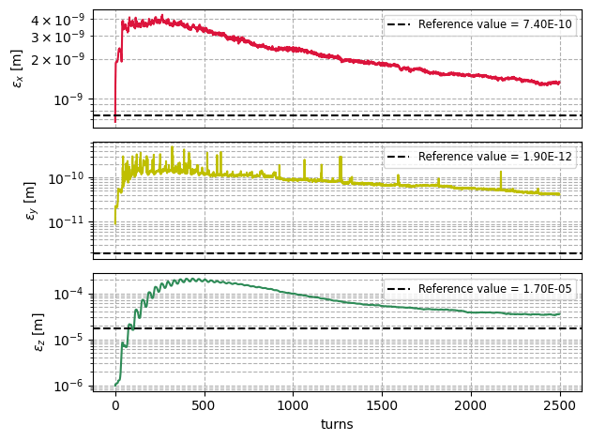
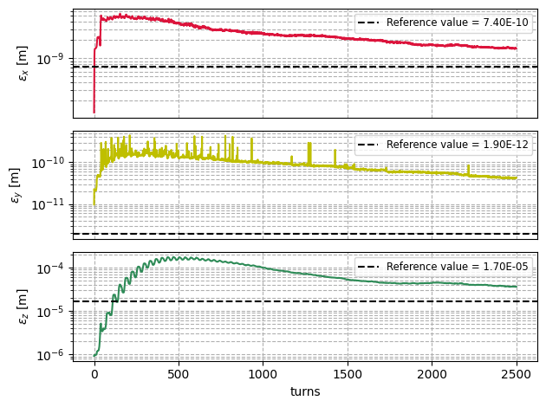
21/08/2025 FCC-ee top-up injection
Giulia Nigrelli
SR - tw4d-noD0
SR - tw4d - xinj-noD0
SR - tw6d - xinj-noD0
BB - tw4d-noD0
BB - xinj - tw4d-noD0
BB - tw6d - xinj-noD0

Slide 24
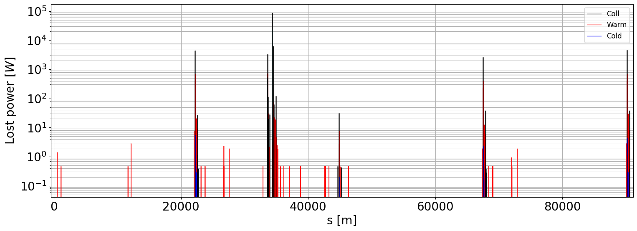
Lossmaps for V25.2_GHC

Slide 25
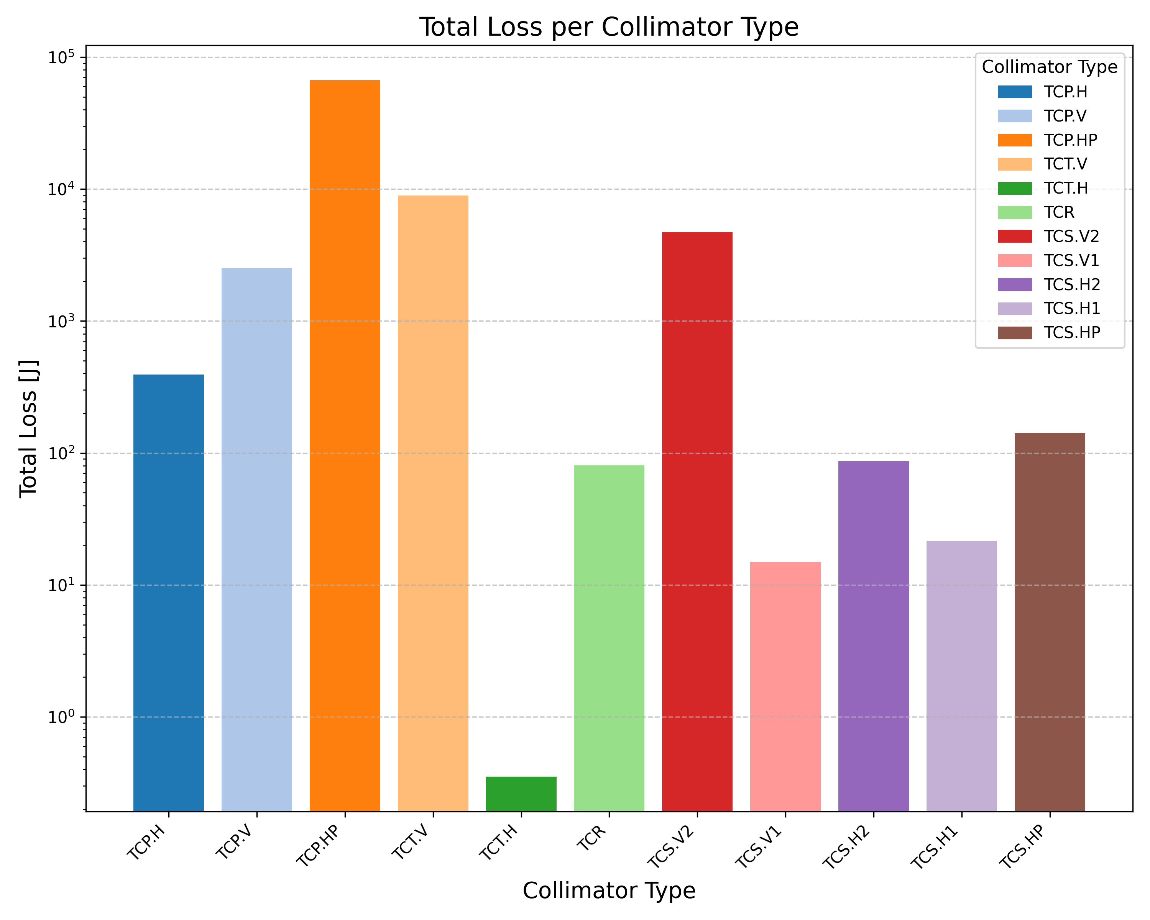
Collimator losses for V25.2_GHC
Non linearities

Slide 26


Collimator losses for V25.2_GHC
At finj.1
At tcs.v2

Slide 27


At finj.1 - TW6D
At finj.1 - TW4D

Slide 28




$$X_{INJ}=−1.5∗\frac{0.95}{100}$$
At finj.1 - TW6D
At finj.1 - TW4D
$$X_{inj}=<x>$$

Slide 29



21/08/2025 FCC-ee top-up injection
Giulia Nigrelli
“Nonlinear” injection
The nonlinear dispersion gives horizontal offset to compensate a smaller delta offset.
Based on the hybrid injection scheme, for a $δ_{offset}$ of 0.8 $→x_{offset}=3.6 σ$.
The performances improve significantly!

Slide 30

Injection efficiency for V25.2_GHC
21/08/2025 FCC-ee top-up injection
Giulia Nigrelli
This is likely due to non linearities.
baseline
hybrid

Slide 31

xutil - features summary
21/08/2025 FCC-ee top-up injection
Giulia Nigrelli
Recursive twiss for high delta offset;
Matched beam distribution into chromatic orbit;
Can impose specific closed orbit (for instance injection point $x_{inj}=−1.5∗0.95/100$);
Can remove dispersion contribution to match transport line zero dispersion.

Slide 32


Chromatic orbit
21/08/2025 FCC-ee top-up injection
Giulia Nigrelli
Issue:
V25.2_GHC does not allow to get a twiss with $δ>0.93\%$,
Twiss6d at extreme delta, with radiation and tapering is not easy to control.
For instance, the closed orbit for high delta is not closed (the impact is not very significant).
Solution:
Generating transverse distribution with twiss4d with the max delta offset,
Generating longitudinal distribution fixing the closed orbit to $z,δ=\left[0, 0.95\%\right]$ and covariance $cov=[\left[0, σ_{z}\right],[0, σ_{δ}]]$

Slide 33


SR
SR-D0
V25.2_GHC
NEW BUCH LENGTH (2.43E-3)
CORRECT INJ POINT (FINJ.1)
Fixed x_inj
BB
BB-D0

Slide 34
SR
SR-D0
V25.2_GHC
NEW BUCH LENGTH (2.43E-3)
CORRECT INJ POINT (FINJ.1)
Fixed x_inj
BB
BB-D0

Slide 35



SR-FINJ.1
SR-FINJ.4
V25.2_GHC
NEW BUCH LENGTH (2.43E-3)
No D=0
No fixed x_inj
BB-FINJ.1
BB-FINJ.4

Slide 36




SR-FINJ.1
SR-FINJ.4
V25.2_GHC
NEW BUCH LENGTH (2.43E-3)
No D=0
No fixed x_inj
BB-FINJ.1
BB-FINJ.4

Slide 37


BB-NEW σz
BB-OLD σz
V25.2_GHC
NEW BUCH LENGTH (2.43E-3)
No D=0
No fixed x_inj
Correct injection point finj.1

Slide 38



SR
SR-D0
V25.2_GHC
OLD BUCHE LENGTH (4.43E-3)
WRONG INJ POINT (FINJ.4)
BB
BB-D0

Slide 39




SR
SR-D0
V25.2_GHC
OLD BUCHE LENGTH (4.43E-3)
WRONG INJ POINT (FINJ.4)
BB
BB-D0

Slide 40
Colors
Backgrounds
Background Blue
Background Purple
Background Yellow
Background Grey
Use for Layout
Radiant Blue
Flash
Energy
Green
Red
Deep Blue

Slide 41

Graphical Elements
Badges
This information is a badge because it is important!
This information is a badge because it is important!
Separation lines 1.5 pt
Arrows
Use blue badges on light backgrounds
Infographics
This information is a badge because it is important!
This information is a badge because it is important!
Use light badges on dark backgrounds

