Slide 1

Proposal of BLM thresholds for MD#15209
IR3 operational losses limit
Belen Salvachua, Sara Morales Vigo, Anton Lechner, Daniele Mirarchi, Volodymir Rodin, Kate Louise Taylor
262nd Machine Protection Panel
29/08/2025

Slide 2
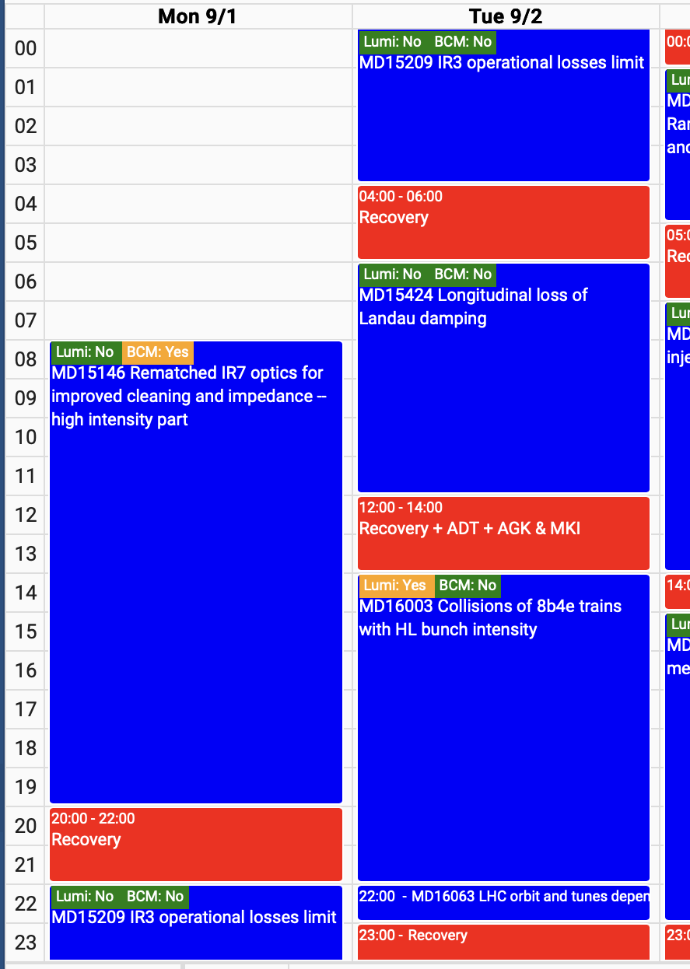
Introduction
MD15209: IR3 operational losses limit scheduled for Monday night.
The goal is to assess if 200 kW (500kW) losses at the start of ramp could be sustained where main limitations are:
  Q6
  Warm magnets
  TCLA
107th BLMTWG scheduled on Monday morning: https://indico.cern.ch/event/1582150/
2025/08/29 262nd MPP – B.Salvachua

Slide 3
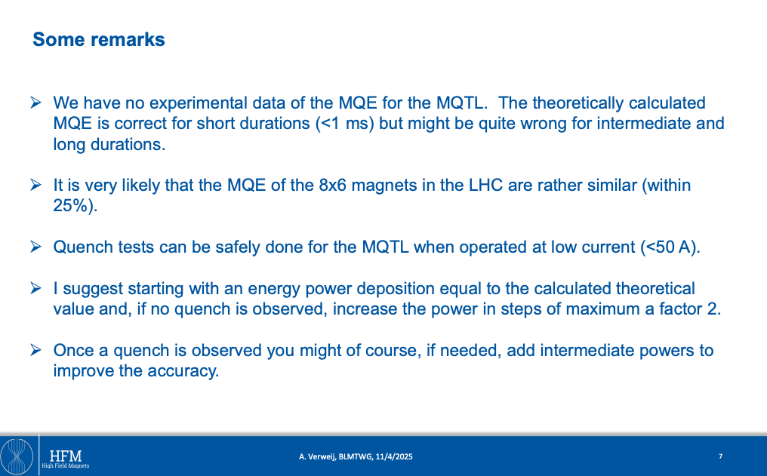
IR3 studies and limitations
Discussed at Joint BLMTWG meeting with ColUSM:
https://indico.cern.ch/event/1533801/
  IR3 losses potential limitation for HL-LHC
  BLM Threshold model for IR7 was updaed in LS1 but more studies were needed to do similarly in IR3.
  Q6 (MQTL 4.5K) quench levels are much lower than MQY/MQM e.g. 1.3s@450GeV MQTL=34mW/cm³ MQY/MQM = 240mW/cm³
A. Verweij
2025/08/29 262nd MPP – B.Salvachua

Slide 4
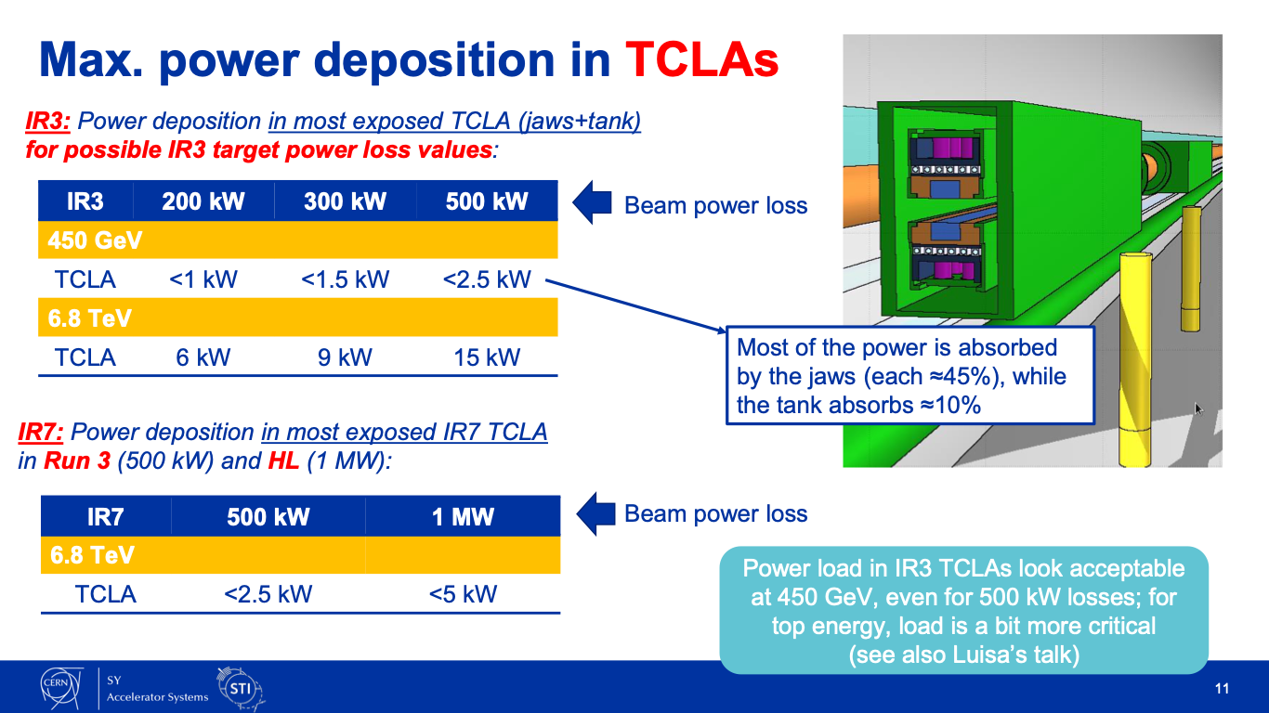
IR3 studies and limitations
A.Lechner
Discussed at Joint BLMTWG meeting with ColUSM:
https://indico.cern.ch/event/1533801/
  IR3 losses potential limitation for HL-LHC
  BLM Threshold model for IR7 was updaed in LS1 but more studies were needed to do similarly in IR3.
  Q6 (MQTL 4.5K) quench levels are much lower than MQY/MQM e.g. 1.3s@450GeV MQTL=34mW/cm³ MQY/MQM = 240mW/cm³
  IR3 TCLA at 450 GeV expected power deposition below IR7 TCLA at 6.8TeV
L. Puddu: thermo-mechanical analysis OK
2025/08/29 262nd MPP – B.Salvachua

Slide 5
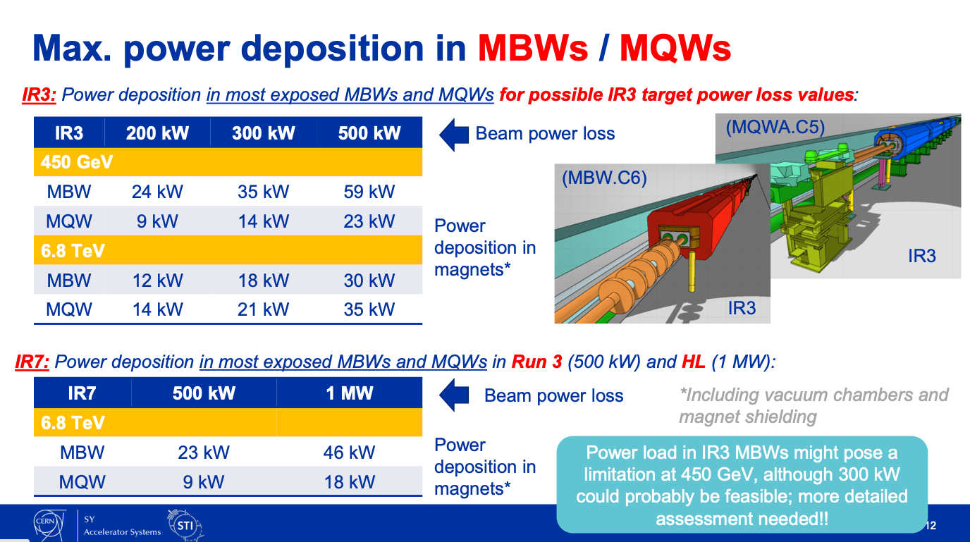
IR3 studies and limitations
A.Lechner
Discussed at Joint BLMTWG meeting with ColUSM:
https://indico.cern.ch/event/1533801/
  IR3 losses potential limitation for HL-LHC
  BLM Threshold model for IR7 was updaed in LS1 but more studies were needed to do similarly in IR3.
  Q6 (MQTL 4.5K) quench levels are much lower than MQY/MQM e.g. 1.3s@450GeV MQTL=34mW/cm³ MQY/MQM = 240mW/cm³
  IR3 TCLA at 450 GeV expected power deposition below IR7 TCLA at 6.8TeV
  IR3 MBW at 450 GeV might pose a limitation:
    200 kW in IR3 at 450 GeV similar to 500 kW in IR7 at 6.8 TeV
P. A. Thonet: significant margin at 500kW found on the studies of power dissipation
500 kW target power loss for start of ramp losses
2025/08/29 262nd MPP – B.Salvachua

Slide 6
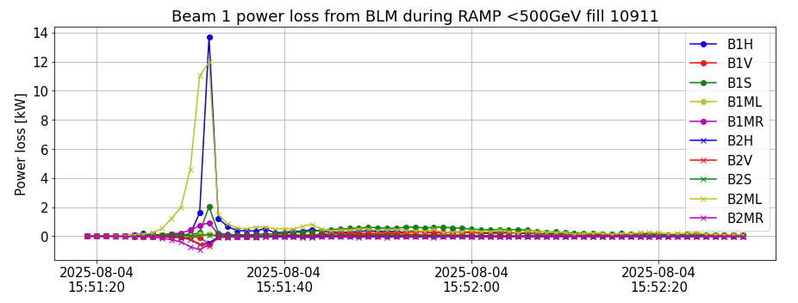
Preparation of BLM Thresholds
Scaling from start-of-ramp losses during regular fills
After TS1 phase knob changed to solve issue of IR7 hierarchy breakage, this has moved most of off-momentum losses to IR7 for Beam 1:
  The test can only be done in Beam 2
Around 1kW peak loss in IR3 B1 and 12 kW B2 -> Using RS09 calibration
Would need a factor 200 higher power loss in IR3 B1 to reach 200kW (would need to reach 16*200=3200kW in IR7 B1!)
2025/08/29 262nd MPP – B.Salvachua

Slide 7
Factors in BLM needed to reach 500+20% =600 kW in RS09 with time structure in start-of-ramp
preliminary
Max factor from many fills scaled and analyzed – final factors will be presented on the BLMTWG on Monday
Family | BLM | MF | 01 | 02 | 03 | 04 | 05 | 06 | 07 | 08 | 09 | 10 | 11 | 12 | MT RS09 before scaling
THRI_TCTVA | BLMTI.04R2.B2E10_TCTPV.4R2.B2 | 0.2 | - | - | - | - | - | - | - | 4.2 | 3.8 | 2.8 | - | - | 2.23e-2 ion 4.4e-2
THRI_3_TCP | BLMTI.06R3.B2E10_TCP.6R3.B2 | 0.4 | 3.8 | 3.8 | 3.8 | 3.8 | 3.8 | 3.4 | 2.8 | 3.8 | 2.6 | - | - | - | 6.72
THRI_3_TCSG | BLMTI.05L3.B2E10_TCSG.B5L3.B2 | 0.4 | - | - | - | - | - | - | 3.0 | 2.6 | - | - | - | - | 2.01
 | BLMTI.04L3.B2E10_TCSG.4L3.B2 |  | - | - | - | - | - | - | 2.2 | - | - | - | - | -
 | BLMTI.05R3.B2E10_TCSG.5R3.B2 |  | - | - | - | - | - | - | 3.8 | 3.4 | 2.4 | - | - | -
THRI_TCLA | BLMTI.05L3.B2E10_TCLA.B5L3.B2 | 0.4 | - | - | - | - | - | - | 2.8 | 4.4 | 3.2 | - | - | - | 2.88e-1
 | BLMTI.05L3.B2E10_TCLA.A5L3.B2 |  | - | - | - | - | - | - | 4.0 | 6.4 | 4.4 | 2.8 | - | -
THRI.IP3_MQW | BLMQI.04R3.B2E10_MQWA.E4R3 | 0.4 | - | - | - | - | - | - | - | 2.4 | 3.2 | 2.2 | - | - | 8.5e-2 IR7: 2.67e-1
 | BLMQI.05R3.B2E10_MQWA.D5R3 |  | - | - | - | - | - | - | - | - | 2.8 | - | - | -
 | BLMQI.05R3.B1I30_MQWA.E5R3 |  | - | - | - | - | - | - | - | - | 2.8 | - | - | -
 | BLMQI.05R3.B1I20_MQWA.C5R3 |  | - | - | - | - | - | - | - | - | 2.2 | - | - | -
THRI.IP3.P1_MQTL | BLMQI.06L3.B2E10_MQTL | 0.4 | - | - | - | - | - | - | 2.6 | 8.0 | 10. | 6.0 | 4.8 | - | 3.83e-3
THRI.IP3.P2_MQTL | BLMQI.06L3.B1I20_MQTL | 0.333 | - | - | - | - | - | - | - | - | 2.6 | 4.6 | - | - | 3.83e-3 Was not updated to RS10=RS09
 | BLMQI.06L3.B2E20_MQTL |  | - | - | - | - | - | - | - | - | 2.4 | 4.0 | - | -
2025/08/29 262nd MPP – B.Salvachua

Slide 8
Summary table for 500kW+20%
Final factors will be presented on the BLMTWG on Monday
preliminary
Family | BLM | New Family | Chagne
THRI_TCTVA | BLMTI.04R2.B2E10_TCTPV.4R2.B2 | THRI_TCTVA_QT25 | AD_HOC_FACTOR_CORRECTION EL1-EL3 RS08-10= 4 factor
THRI_3_TCP | BLMTI.06R3.B2E10_TCP.6R3.B2 | THRI_3_TCP_QT25 | SCALE_CORRECTION = 4
THRI_3_TCSG | BLMTI.05L3.B2E10_TCSG.B5L3.B2 | THRI_3_TCSG_QT25 | AD_HOC_FACTOR_CORRECTION EL1-EL3 RS07-09 = 4 factor
 | BLMTI.04L3.B2E10_TCSG.4L3.B2
 | BLMTI.05R3.B2E10_TCSG.5R3.B2
THRI_TCLA | BLMTI.05L3.B2E10_TCLA.B5L3.B2 | THRI_TCLA_QT25 | AD_HOC_FACTOR_CORRECTION EL1-EL3 RS07-10= 6.4 factor
 | BLMTI.05L3.B2E10_TCLA.A5L3.B2
THRI.IP3_MQW | BLMQI.04R3.B2E10_MQWA.E4R3 | THRI.IP3_MQW_QT25 | AD_HOC_FACTOR_CORRECTION EL1-EL3 RS09 = 2.8
 | BLMQI.05R3.B2E10_MQWA.D5R3
 | BLMQI.05R3.B1I30_MQWA.E5R3
 | BLMQI.05R3.B1I20_MQWA.C5R3
THRI.IP3.P1_MQTL | BLMQI.06L3.B2E10_MQTL | THRI.IP3.P1_MQTL_QT25 | AD_HOC_FACTOR_CORRECTION EL1-EL3 RS07 = 2.6 RS08 = 8.0 RS09 = 10.0 RS10 = 6.6 RS11 = 4.8
THRI.IP3.P2_MQTL | BLMQI.06L3.B1I20_MQTL | THRI.IP3.P2_MQTL_QT25 | AD_HOC_FACTOR_CORRECTION EL1-EL3. RS09-10 = 4 factor
 | BLMQI.06L3.B2E20_MQTL
2025/08/29 262nd MPP – B.Salvachua

Slide 9
Updates on the MD procedure:
Two main updates w.r.t. what presented before MD1:
Only partial scraping will be performed to avoid triggering BPM interlock on bunch intensity
Main implication: more bunches than the initially planned need to be injected
Initial estimation: full scraping of 20 INDIVs of 1.6e11 p sufficient to get 200 kW power loss
Updated estimation:
  Scraping down to 1 σ of 54 INDIVs of 1.6e11 p, or with 28 INDIVs if scraping down to 0.5 σ,
  to ultimate target of 200 kW power loss
  Scraping down to 1 σ of 136 INDIVs of 1.6e11 p, or with 70 INDIVs if scraping down to 0.5 σ,
  to ultimate target of 500 kW power loss
Main change w.r.t. initial request: possibility to inject Nx36b trains (no specific filling scheme needed)

Slide 10
Summary
BLM Thresholds will be calculated from scaling of start-of-ramp losses.
Beam 2 IR3 (only) will be scale up to allow up to 500kW + 20% on the Applied Thresholds using mainly RS09 (1.3 s)
Time structure will be checked with the test done yesterday with a pilot beam. Factors for other RS could be affected by this result.
Final factors will be discussed on Monday morning at the BLMTWG.
Recovery by moving monitors to the original families.
2025/08/29 262nd MPP – B.Salvachua

