Slide 1
Public Event Advisory Board – 02 October 2025 Meeting Q3

Slide 2
Agenda
Evaluation of the season Quantum! and STELLAR
Season 25/26 Generation Higgs launch
Presentation of Antigel 2026
Presentation of Arts at CERN summit by Giulia Bini
2026-2027 season ideas (incl. proposal by Chiara Mariotti)
AOB and find the next date

Slide 3
Members
Antonella Del Rosso
Barbara Solich
Chiara Mariotti
Enrique Rico Ortega
François Briard or Loraine Massarotti
Frederick Bordry
Nina Förster (welcome!)
Malika Meddahi
Manuela Cirilli
Mélissa Gaillard
Paola Catapano
Guest for today: Giulia Bini
Dante Larini (Chair)
Zoe Nikolaidou (Deputy Chair)

Slide 4
Refresh: Public Events Strategy Missions
1 Deliver a yearly season of event programming by following a key theme for CERN
2 Seek cohesion and diversity in the choice and format, including through the arts and pop culture, with the aim of offering a programme accessible to all.
3 Strengthen our audience from the region, further integrating with the local cultural, artistic, business, civil society and educational scene through partnerships to seek synergies and collaborations.
4 Apply principles of multidisciplinarity, diversity and inclusiveness in the event curation, designed to cater to a wide & varied audience.
5 Ensure a high quality, cost efficient and well organised event architecture, living up to high standards and seeking frequent feedback.
6 Position public events as a valuable platform for CERN experts to not only promote their research, but also connect the dots with existing or potential partners.
7 Bring cohesion throughout CERN regarding public events by engaging and collaborating with internal partners

Slide 5
Agenda
Evaluation of the season Quantum! and STELLAR
Season 25/26 Generation Higgs launch
Presentation of Antigel 2026
Presentation of Arts at CERN summit by Giulia Bini
2026-2027 season ideas (incl. proposal by Chiara Mariotti)
AOB and find the next date

Slide 6

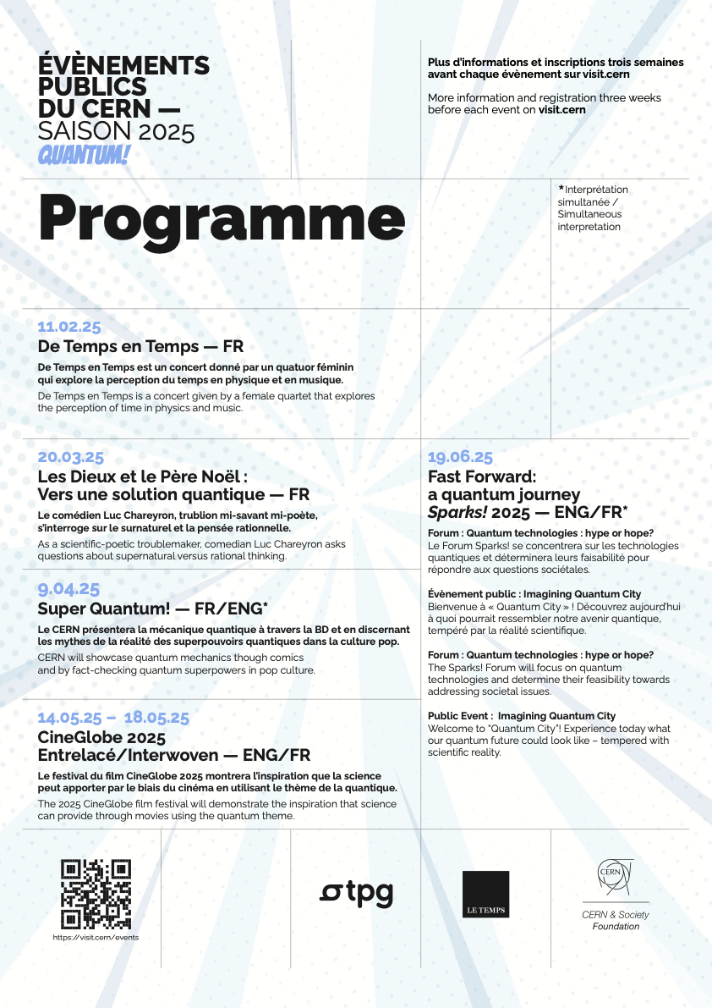
Season 2025 assessment
Date | Event | Venue | Attendance | No-show rate
11.Feb.25 | De temps en temps | SG A | 300 | 17%
20.Mar.25 | Les dieux et le Père Noel | SG ABC | 470 | 11%
09.Apr.25 | Ateliers Super Quantum | Lab A | 37 | 8%
09.Apr.25 | Super Quantum | SG A | 210 | 42%
14.May.25 | CineGlobe - Total | SG A+BC+Globe+Piazza | 1100 | \
14.May.25 | CineGlobe - Opening night | SG A | 220 | 34%
16.May.25 | CineGlobe - Award | SG A | 92 | 37%
19.Jun.25 | Sparks! | SG ABC | 420 | 41%
Total |  |  | Attendance | No-show
 |  |  | 2537 | 27%

Slide 7
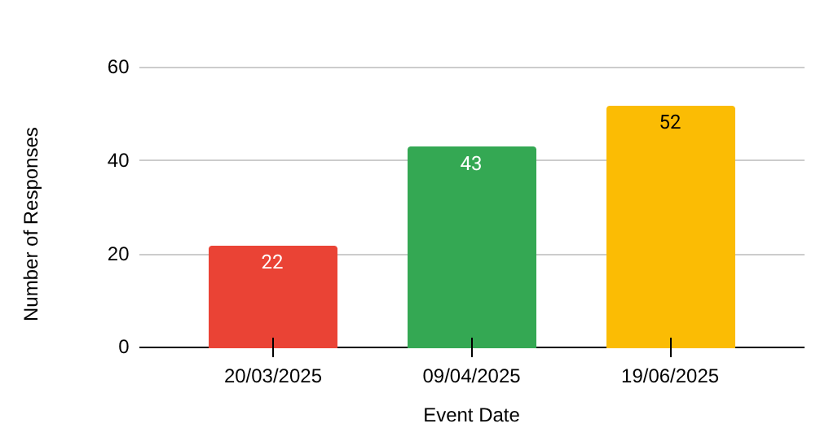
Events covered & data collected
Data was extracted from the Indico pages linked to each event.
Note: the sample size is modest, but offers a valuable starting point for qualitative insights.
A total of 117 responses distributed as follows :
Event Names
[...] Les Dieux et le Père
Noël
[...] Super Quantum
[...] Sparks

Slide 8
Main results (executive summary) | Call to action
70.9% of the audience were not affiliated to CERN, our community representing roughly 28.9% of the audience | This result is very satisfactory, our work in the diversification of our audiences is efficient and should be mantained
TPG trailers and the Newsletter are our strongest means of communication. Newspaper campaigns (Le Temps) were not efficient. | Reinforce Newslettre capabilities Strenghen partnership with TPG by organising follow-up meeting and seeking creative ways of collaborating Seek and test other means of communication (for example: season 25-26 will make use of radio adverts, results are to be seen)
Our audience were highly satisfied with our events, with 81.2% of our sample scoring events between 8 and 10 out of 10 (10 being the highest and 1 the lowest score) | This result is excellent and could serve as a benchmark for the analysis of our next seasons
When asked what type of event our audience would prefer in future at CERN, most of them answered scientific conferences, followed by film screenings. | Take this into account when planning our future events, including more talks, at different levels of complexity
The survey revealed that the public mostly appreciated the quality of the speakers, the humour, the accessibility of the scientific content and the overall organisation. | Good points to keep in mind and prioritise.
As points to improve, it was shown that the main areas were: the level of complexity (too high), a need to focus less theory and more on practical examples, the simultaneous translation and that the length of the events. | For the level of complexity: we should differentiate between our events: high level of complexity (CERN 70) VS accessible (Super Quantum) For practical examples, more collaborations could be sought with KT and other areas of application within CERN For translation, a follow up with our colleagues from SG
No-shows were on average 27% (ranging from 11% for Les Dieux et le Pere Noel… and 42% for Super Quantum). | Issue to follow up with SG, a brain-storming session could be organised to try and find new solutions.

Slide 9
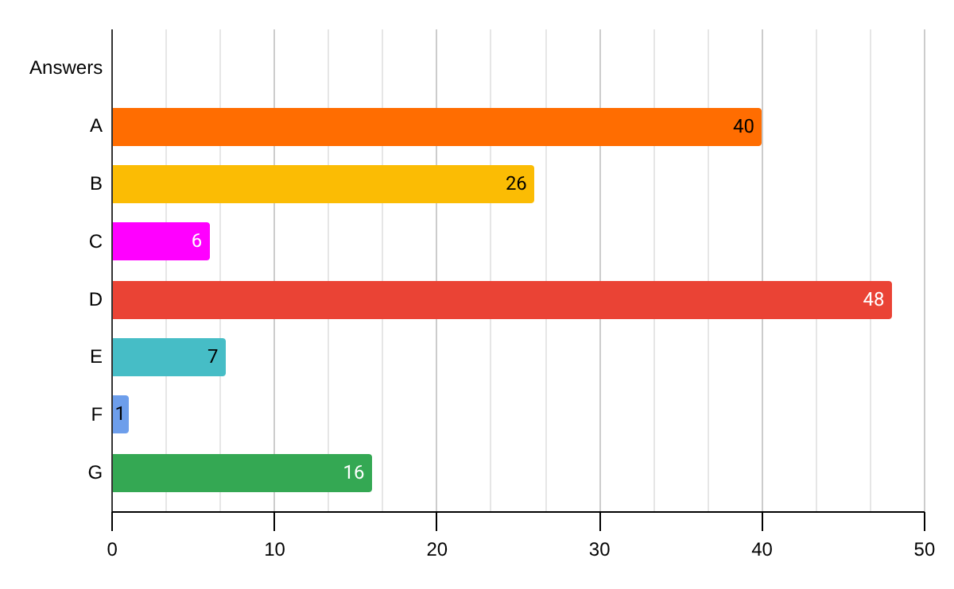
Example: Question 2 Analysis
How did you hear about this event (several answers possible) ?
[...] A : Newsletter CERN Public events
[...] B : CERN website
[...] C : Social media
[...] D : Advertising on public transport
[...] E : Cultural calendar
[...] F : Cultural newsletter of 'Le Temps'
[...] G : By the word of mouth
# of time chosen

Slide 10
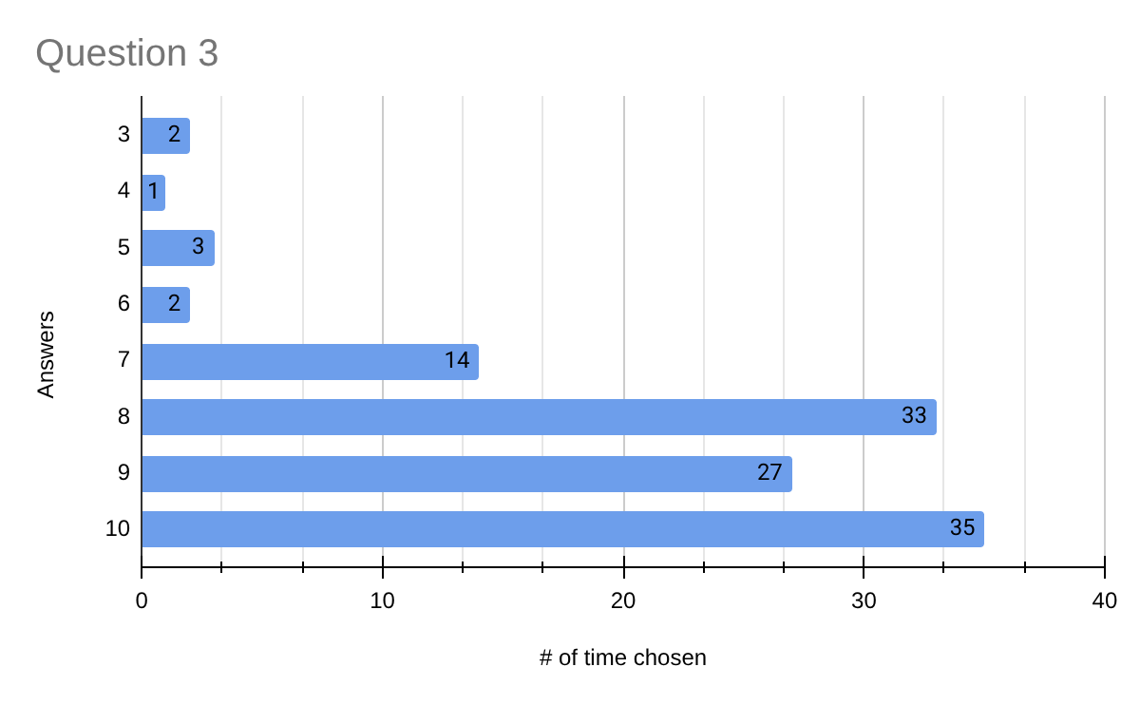
Example: Question 3 Analysis
On a scale of 1 (poor) to 10 (excellent), how would you rate your experience at this event?
The public is highly satisfied with the experience. This validates the format, content, and tone of the events.
A consistently high rating means people are likely to recommend the events, even without being asked. Word of mouth becomes a credible communication lever.

Slide 11
Agenda
Evaluation of the season Quantum! and STELLAR
Season 25/26 Generation Higgs launch
Presentation of Antigel 2026
Presentation of Arts at CERN summit by Giulia Bini
2026-2027 season ideas (incl. proposal by Chiara Mariotti)
AOB and find the next date

Slide 12
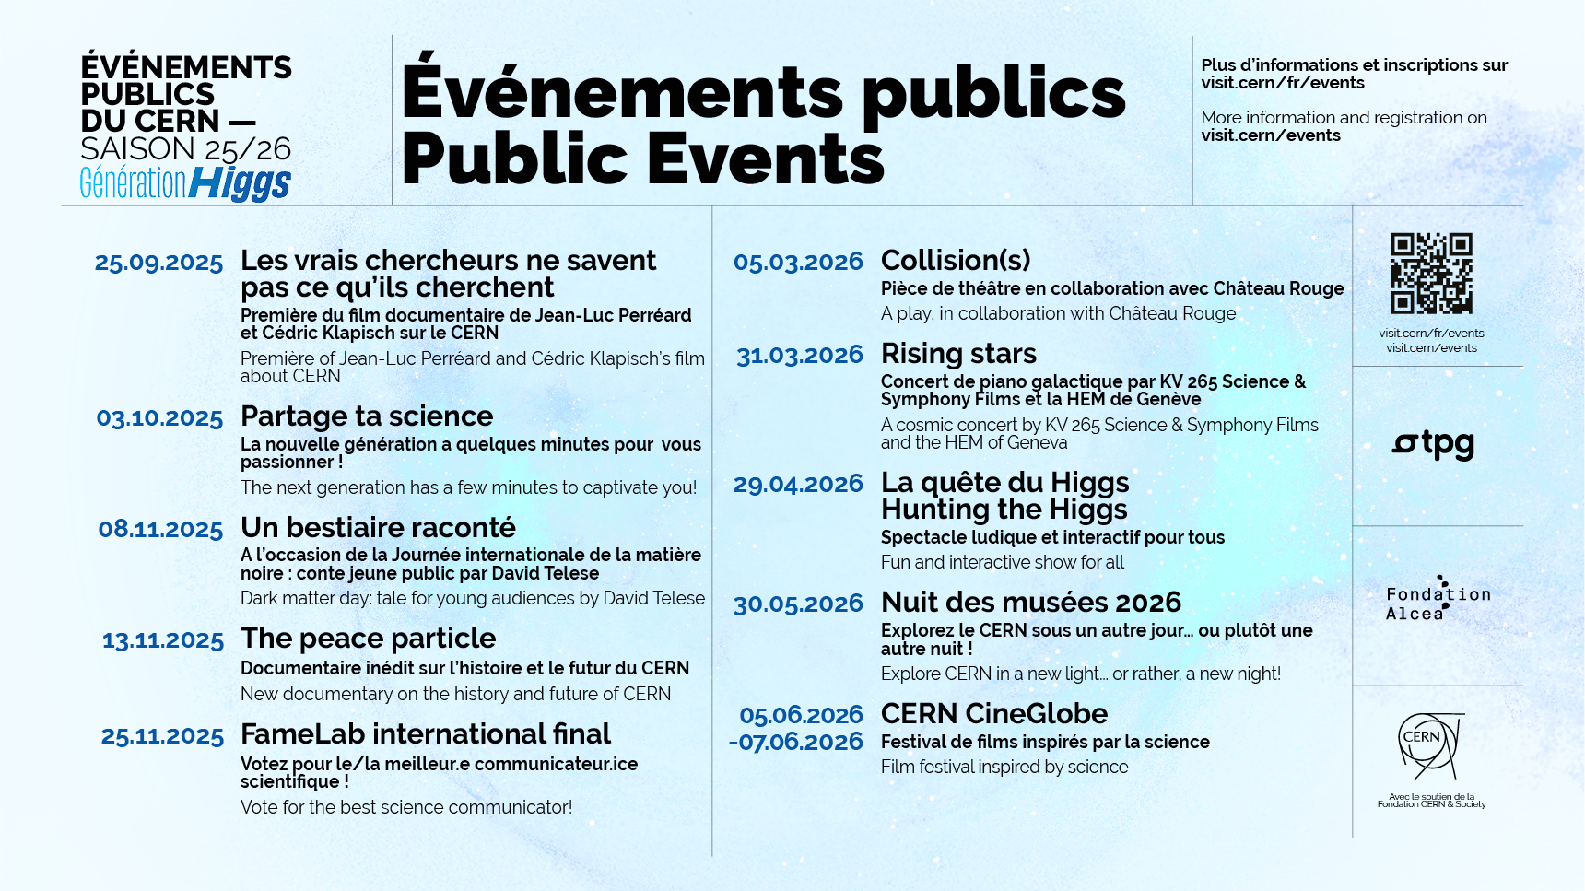

Slide 13


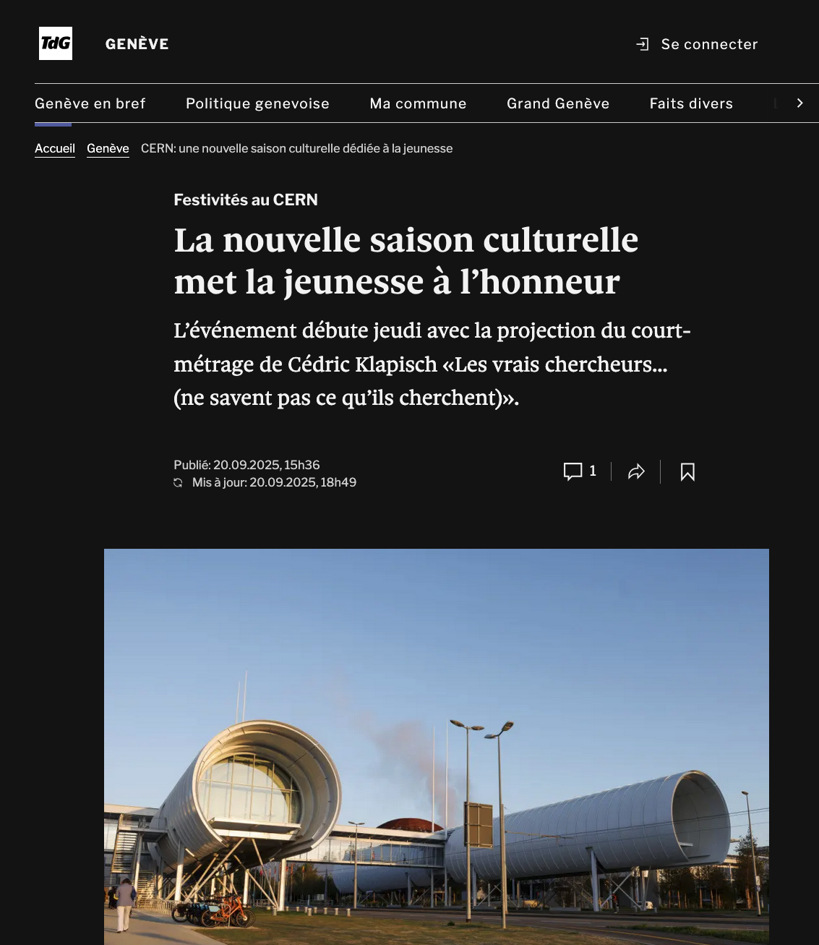
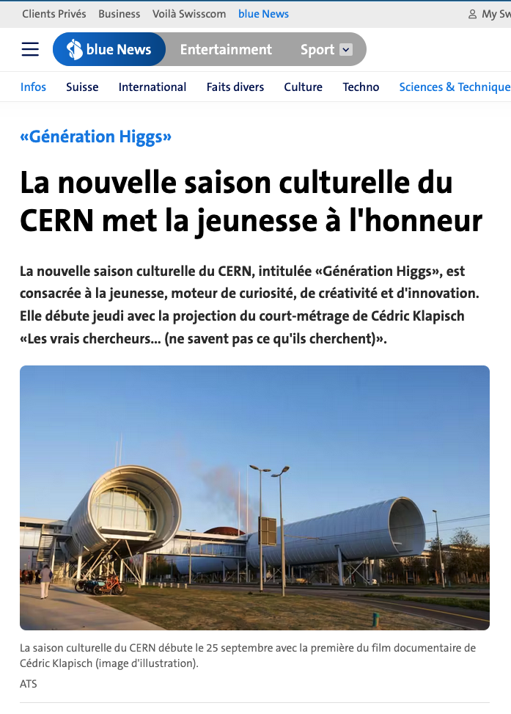
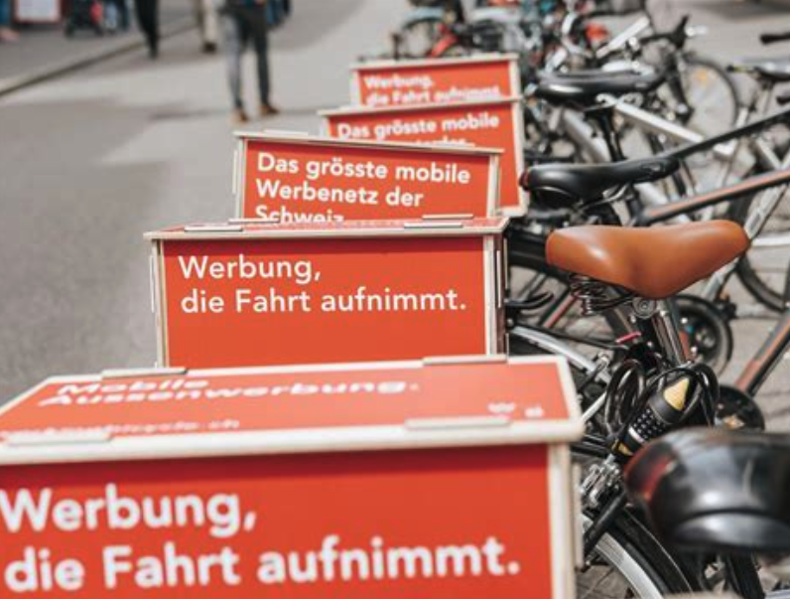
Communication and collaborations around the season
Partnerships across the Greater Geneva region
Radio campaign with Media One (Radio Lac)
Radio interview of Mélissa on Radio Lac
Adverts on bicycles (FameLab)

Slide 14
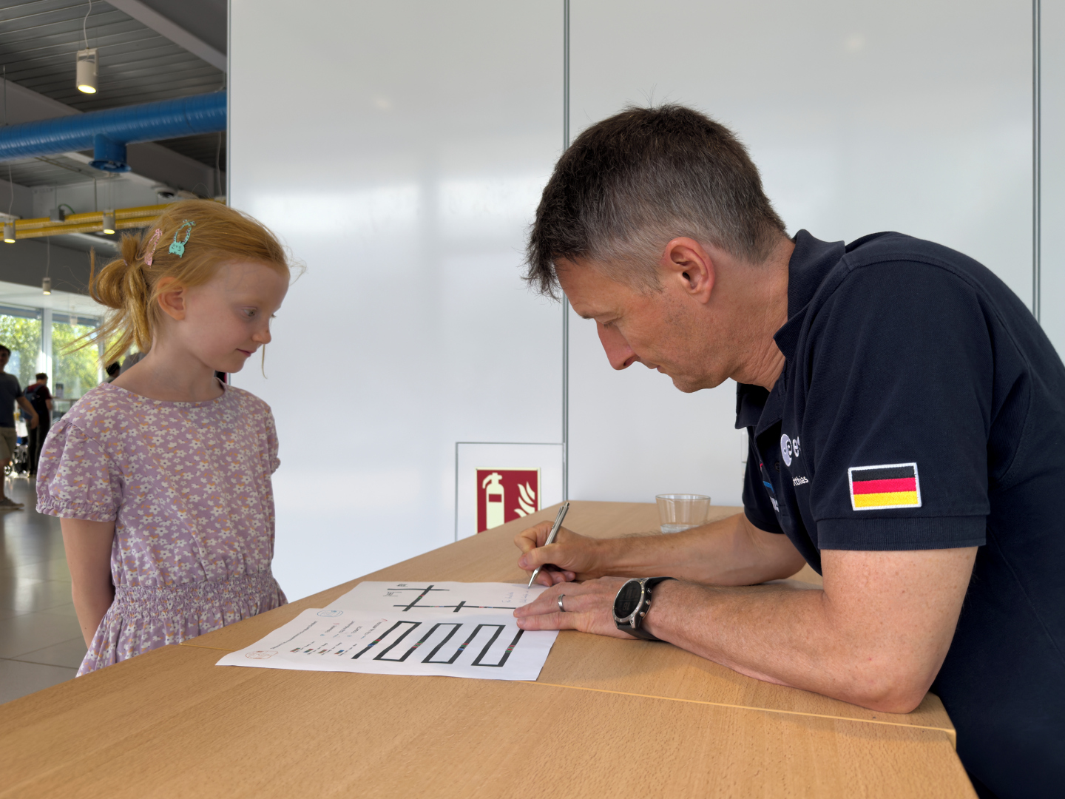
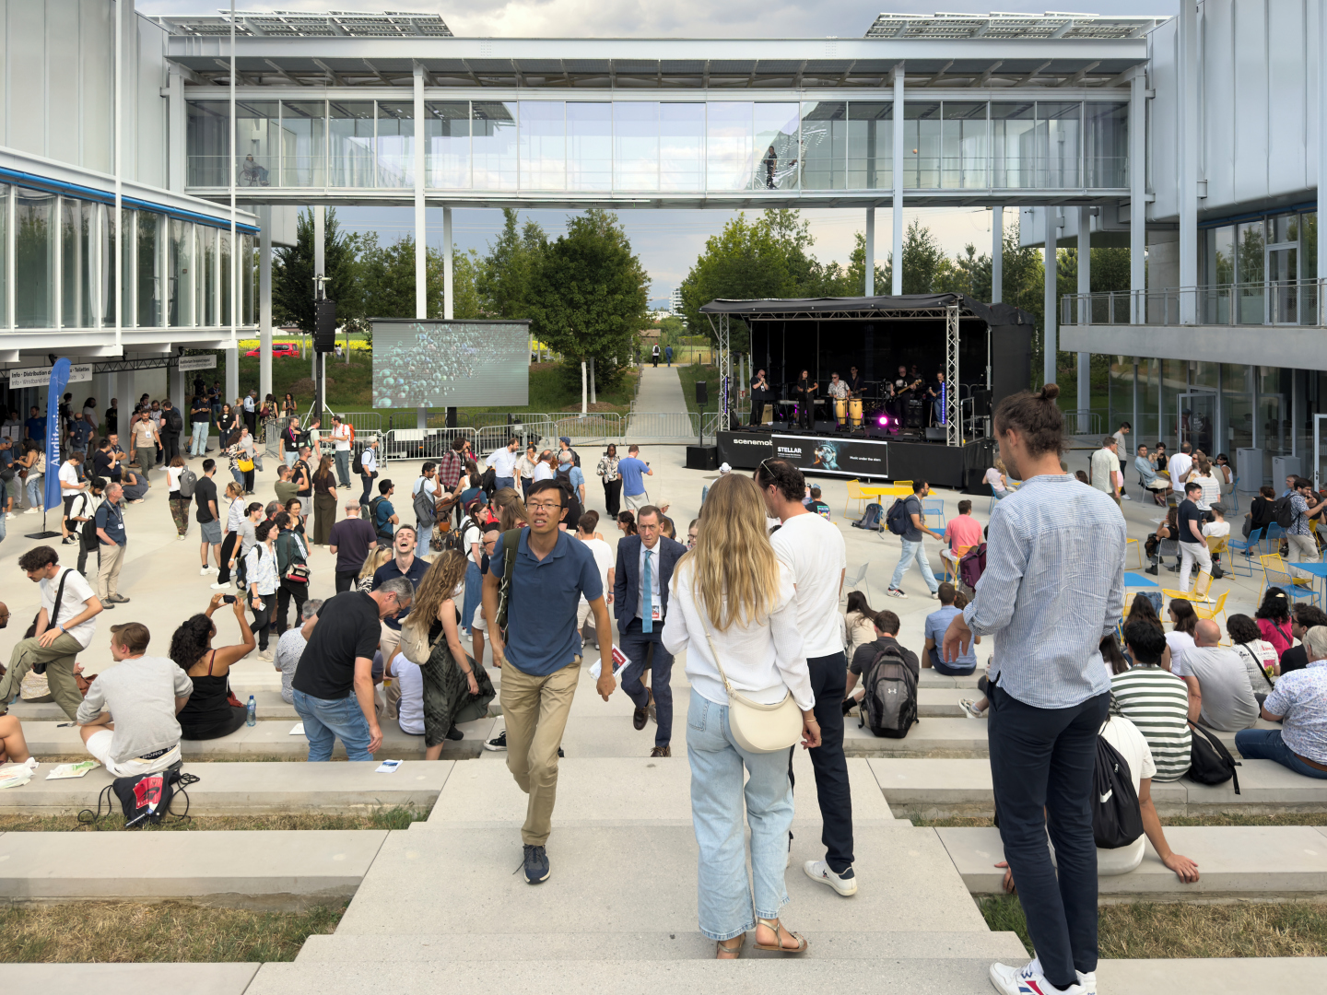
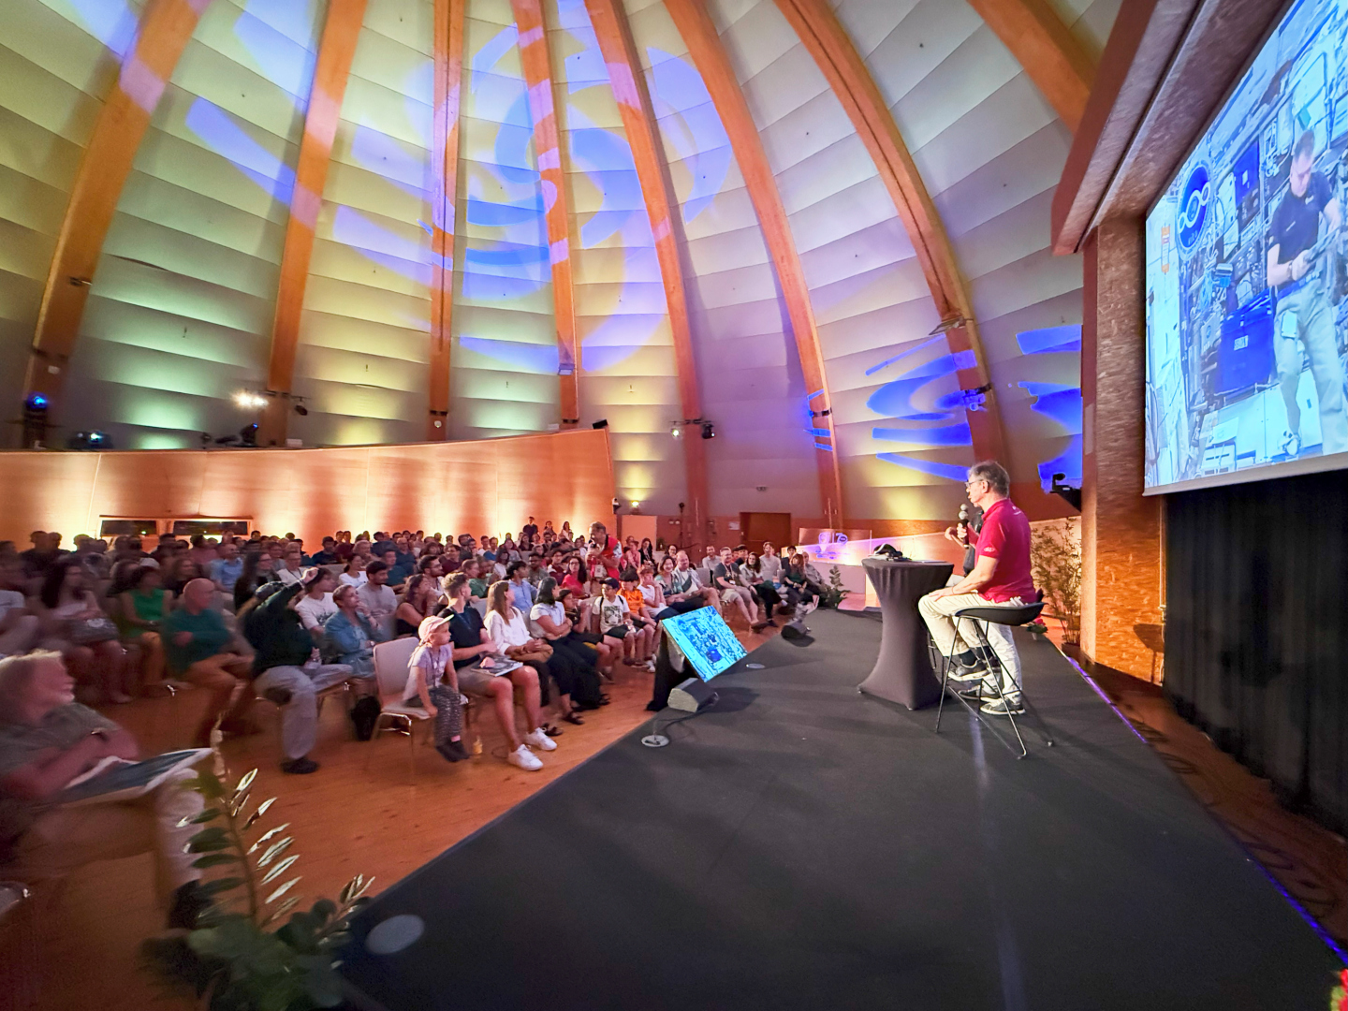
STELLAR (19 July)
Estimated 1500 participants overall
3 talks (600 pax / 250 pax / 250 pax)
4 meet the astronauts ( 2 x 200 pax)
3 book signings (30 pax by author)
3 music bands (150 pax average)
10 hands-on activities (850 pax in total)
Strong reason to consider a new summer science festival next year

Slide 15
Agenda
Evaluation of the season Quantum! and STELLAR
Season 25/26 Generation Higgs launch
Presentation of Antigel 2026
Presentation of Arts at CERN summit by Giulia Bini
2026-2027 season ideas (incl. proposal by Chiara Mariotti)
AOB and find the next date

Slide 16
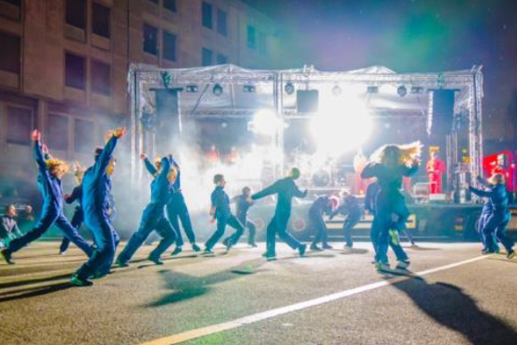
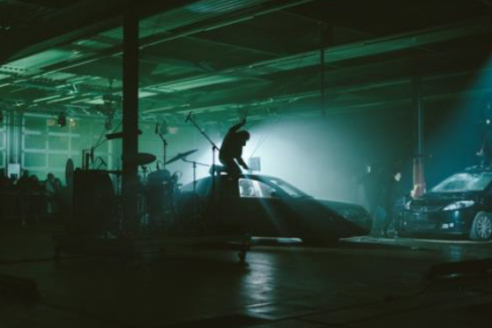






«Spaced Out» (working title) : custom-made event by Antigel
ANTIGEL 2024
One of the most prominent festivals of performing arts in Geneva
80% of their shows were sold out
46’000 participants in 54 different places
The Antigel Festival presents a one-of-a-kind immersive experience, where a scientific talk, original music, and visual performance come together in real time. This interdisciplinary encounter invites audiences on a sensory and intellectual journey through the universe, where science resonates with the power of sound and image.
19 February 2026
Interdisciplinary
90 min
French
Not known
Internal costs 15 000 CHF

Slide 17
Agenda
Evaluation of the season Quantum! and STELLAR
Season 25/26 Generation Higgs launch
Presentation of Antigel 2026
Presentation of Arts at CERN summit by Giulia Bini
2026-2027 season ideas (incl. proposal by Chiara Mariotti)
AOB and find the next date

Slide 18
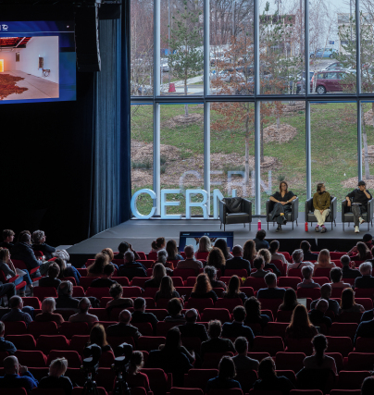
Arts at CERN – Art & Science Summit – March 2025
The theme of this third edition of the Art & Science Summit: The Hybrid Nexus (working title), aims to explore quantum and artificial intelligence infrastructures, as well as the impact of their convergence on artistic practice and culture. It will pick up where Uncertainty left off: the exploration of the “jungle of ideas” opened up by a hundred years of quantum mechanics.
After introducing the fundamental concepts at the heart of research conducted at CERN, the Summit will focus on examining the current phase of transition in quantum technologies and artificial intelligence, considered as vectors of transformation that affect not only our society but also the fundamental stakes of artistic creation and the new frontiers of scientific and technological development.
Quantum: A Jungle of Ideas
The Hybrid Fabric
Hybrid Infrastructures
Hybrid Infrastructures anchored in fundamental research and the mysteries of particles, through the work of emerging artists: Martyna Marciniak, Amanda Metzger, and Alice Bucknell. Their explorations of concepts drawn from fundamental physics — such as muons, dark matter, or the double-slit experiment — feed reflections that reveal the interconnection between physical infrastructures and cosmological phenomena.
200 participants + 120 professional day

Slide 19
Agenda
Evaluation of the season Quantum! and STELLAR
Season 25/26 Generation Higgs launch
Presentation of Antigel 2026
Presentation of Arts at CERN summit by Giulia Bini
2026-2027 season ideas (incl. proposal by Chiara Mariotti)
AOB and find the next date

Slide 20
Season 26-27 timeline
January 2026
Approval of concept
May 2026
Finalise all events, materials and publications (posters, partnerships, dates, trailer, indico etc.), ready for promotion
September 2026
Launch and first event

Slide 21
Season 26-27 ideas
Key theme: Future
Working title: Futurs vivants / Living futures
Interpretation:
Link between the future and human beings, bringing emotions to new technologies in order to make them “come alive”
Link with CERN: showing that future investments and efforts in fundamental research (FCC and others) are crucial for our future and our quest for knowledge, but also bring enormous benefits to our lives (jobs, technological opportunities, training).
The concept shows that CERN's role in the future will contribute not only to particle physics, but also to various fields that will benefit from this driving force.
Future of science: link with other sciences would be very important, where there would be a link with physics.

Slide 22
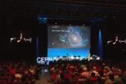

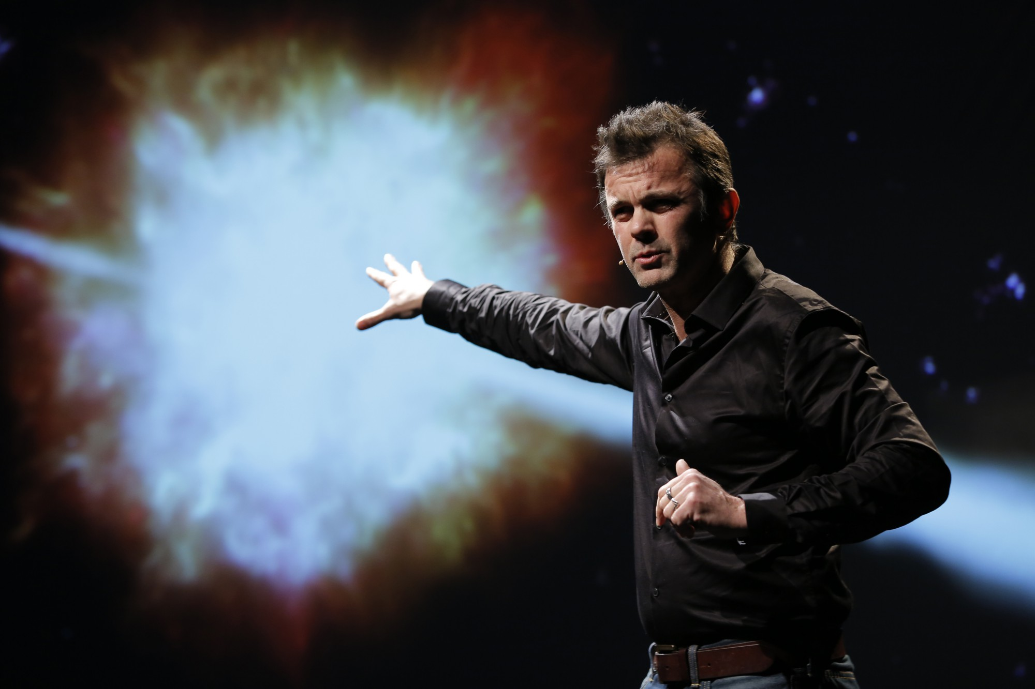
Season 26-27 ideas
Septembre 2026 : High-level (but still general public) conference on new physics
Inviting CERN management to take part, in addition to world-renown physicists.
October 2026: Dark Matter Day on Halloween
Concerts and activities around the theme, in collaboration with a local radio (radio Vostok: Vostok Sessions)
November 2026 Show by Frédéric Ferrer : WOW ! cartographie 5 : Conférence sur les possibilités de vivre ailleurs
Humorous show/lecture, based on scientific facts (show developed via a commission from the Centre National d’Etudes Spatiales, CNES) on the possibility of humans living on another planet (in collaboration with Chateau Rouge)

Slide 23
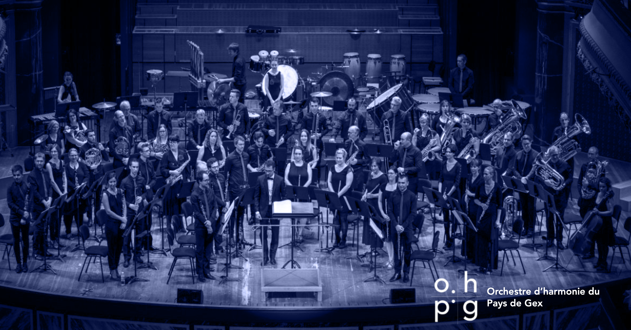
Proposal for a Concert at the Science Gateway spring 2027
OHPG: ~50% PRO from CH&Fr
~80 concerts since 2011 in CH&FR

Slide 24
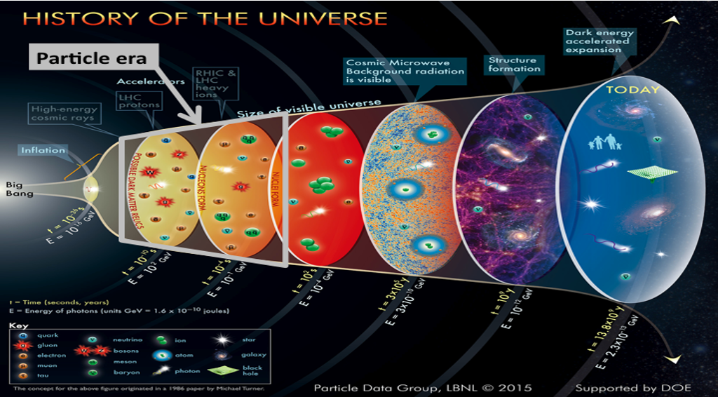
The History of the Universe
DRAFT
title, narrative,
details to be decided
From the infinitely small to the infinitely vast: a journey through space and time
a spectacle of music, images, and creation.
Le premier jour - J. Balissat (CH)
connection - D. Vicinanza – Sonification
Alchemy in Silent Space - NAXOS
Music from Earth seen from Space –
D. Vicinanza - Sonification
Stratoscope - G. Dupurtuis (CH)
Voyager - D. Vicinanza - Sonification
This musical voyage begins with the very first instant of the universe, the Big Bang, and follows the unfolding of cosmic history all the way to the present day, to our Earth as it is now, and to the view of our planet from the skies. The passage of time and the continuity of the story will be carried by the pulse and rhythm of the music, where sounds and movements will seamlessly transform into images. It is through the rhythm that we are able to look back in time, retracing the origins of the cosmos with the help of the Large Hadron Collider, and to gaze outward, exploring the farthest reaches of the universe with our spacecraft.

Slide 25
Agenda
Evaluation of the season Quantum! and STELLAR
Season 25/26 Generation Higgs launch
Presentation of Antigel 2026
Presentation of Arts at CERN summit by Giulia Bini
2026-2027 season ideas (incl. proposal by Chiara Mariotti)
AOB and find the next date

Slide 26
AOB and future date
Meeting | Proposed date
PEAB Q4 (2025) | Tuesday 2 December 3pm
PEAB Q1 (2026) | Tuesday 3 March 3pm
PEAB Q2 (2026) | Tuesday 9 June 3pm

Slide 27
Thank you!

