Slide 1
STFC – ISIS Visit
BDF Vacuum Vessel & Service cell
Gemma Humphreys, Marco Calviani, Rui Franqueira Ximenes, Jean-Louis Grenard - CERN
06/08/2025
STFC - Rutherford Appleton Laboratory

Slide 2
Introduction
Environment
Vacuum Vessel
Feedthrough Requirements
Feedthrough Parameters
Current Design Solution
Gasket
Pipe Management
Thermocouples
Service Cell

Slide 3
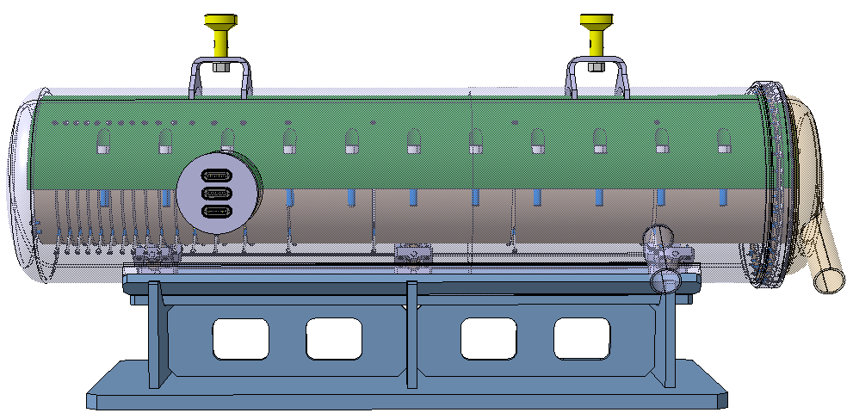
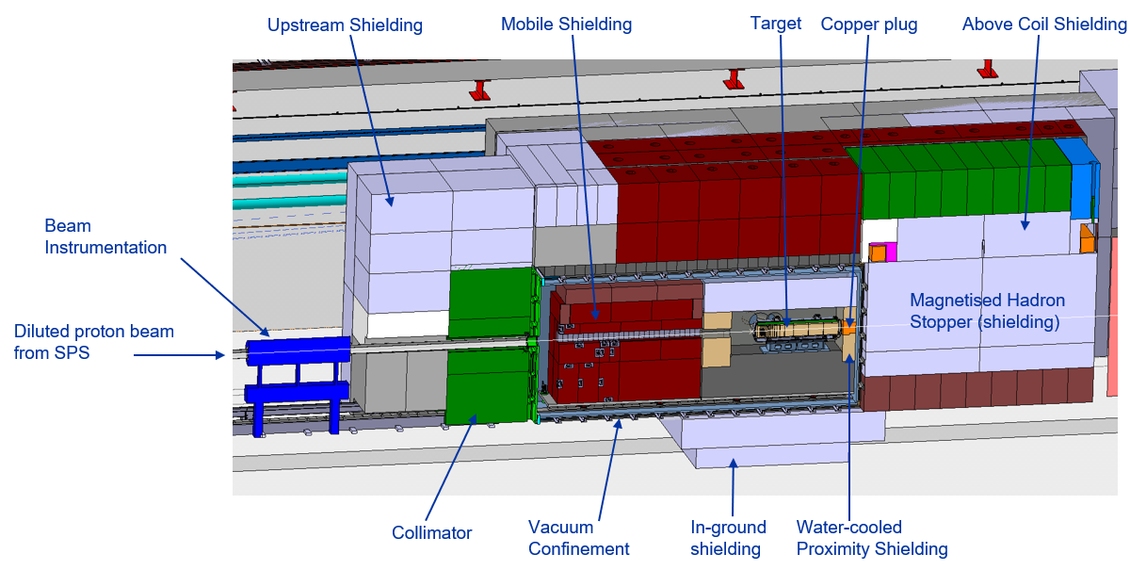
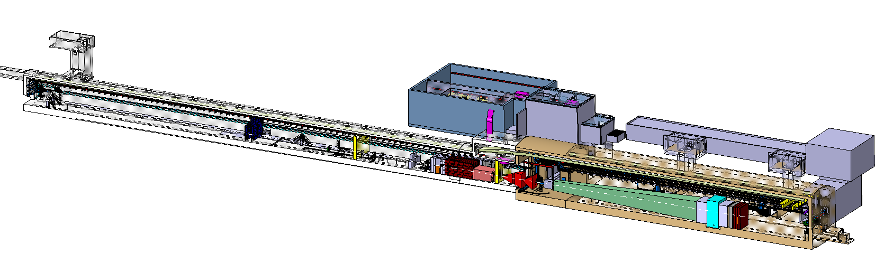

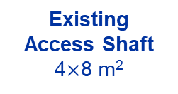
BDF/SHiP Target Complex
BDF target
1.5m Tungsten Target
New
Service Building
~ 1000 m²
Existing
Access Shaft
4$×$8 m²
B911
B918
Beam Dilution System
TCC8
170m
*TCC8: Tunnel Target Cave N.8
**ECN3: Experiment Cave North N.3
New Target Complex
containing the Beam Dump Target
ECN3
BDF/SHiP experiment
(Richard Jacobsson)

Slide 4
Vacuum Vessel
Primary Functions:
Minimise activation of the surrounding air
Maintain vacuum level of 10⁻³ mbars
House the target, related proximity shielding and relevant cooling components
Maintain target alignment with the beamline
Keep beam line vacuum continuity
Auxiliary Functions:
Contain a system to ease the removal of the target and shielding
Provide structural integrity
Integrate with the safety systems
Allow for integration of coolant pipes and life monitoring systems into the vessel
Vacuum vessel door
Vacuum vessel flanges connections
External Dimensions (without guide rails):
  6410 x 2050 x 2965mm
Internal Dimensions:
  6210 x 1750 x 2665mm
Volumes:
  Internal = 28.96m³
  External = 38.96m³
Empty Weight:
  ~25000kg
Foreseen Internal Load:
  ~175000kg
Guide Rails
Detail design study with industry to start in September

Slide 5
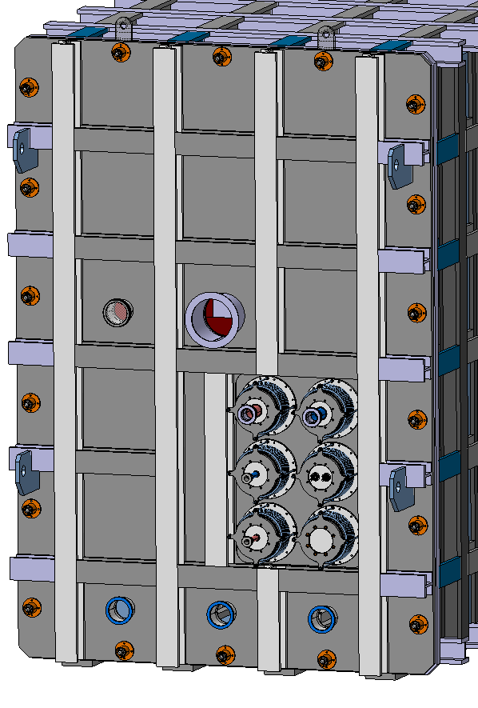
Vacuum Vessel Feedthroughs
Beam pipe
Feedthrough Requirements:
Frequency of opening vessel and exchanging the target
  Once per year vessel opening
  Once per 5 years target exchange
Must have a method to correct for misalignment (e.g. bellows/flexible pipes)
  Manufacturing tolerances
  Thermal expansion
  Misalignment from pipe weight
Prevent leaks when in operation or when disconnecting the pipes for vessel opening
Maintain vacuum
Allow for simple and fast connection/disconnection
Ideally remotely compatible
Target and proximity shielding feedthroughs must be integrated separately
2 x DN50 Helium Cooling Pipes
(Target)
Thermocouples
Spare
2 x DN25 Water Cooling Pipes
(Proximity Shielding)
Pumping ports

Slide 6
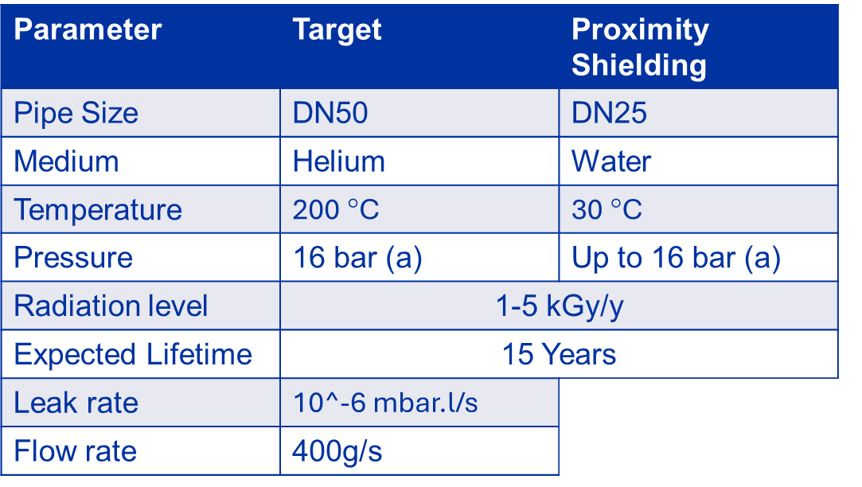
Foreseen Parameters
At connection flanges
It is foreseen to open the connectors and the door once per year and the gasket to be replaced each time

Slide 7
Human vs Robotic Intervention
Dose rate in this area:
  Integrated: 1 – 5 kGy/year
  Residual: 500-800 µSv/h
Human intervention – relatively quick and simple process for connection and disconnection
  Vacuum vessel length optimised for radiation levels to be low enough for human intervention at the door
Robotic Intervention – takes more time and requires area to be easily accessible by robots

Slide 8
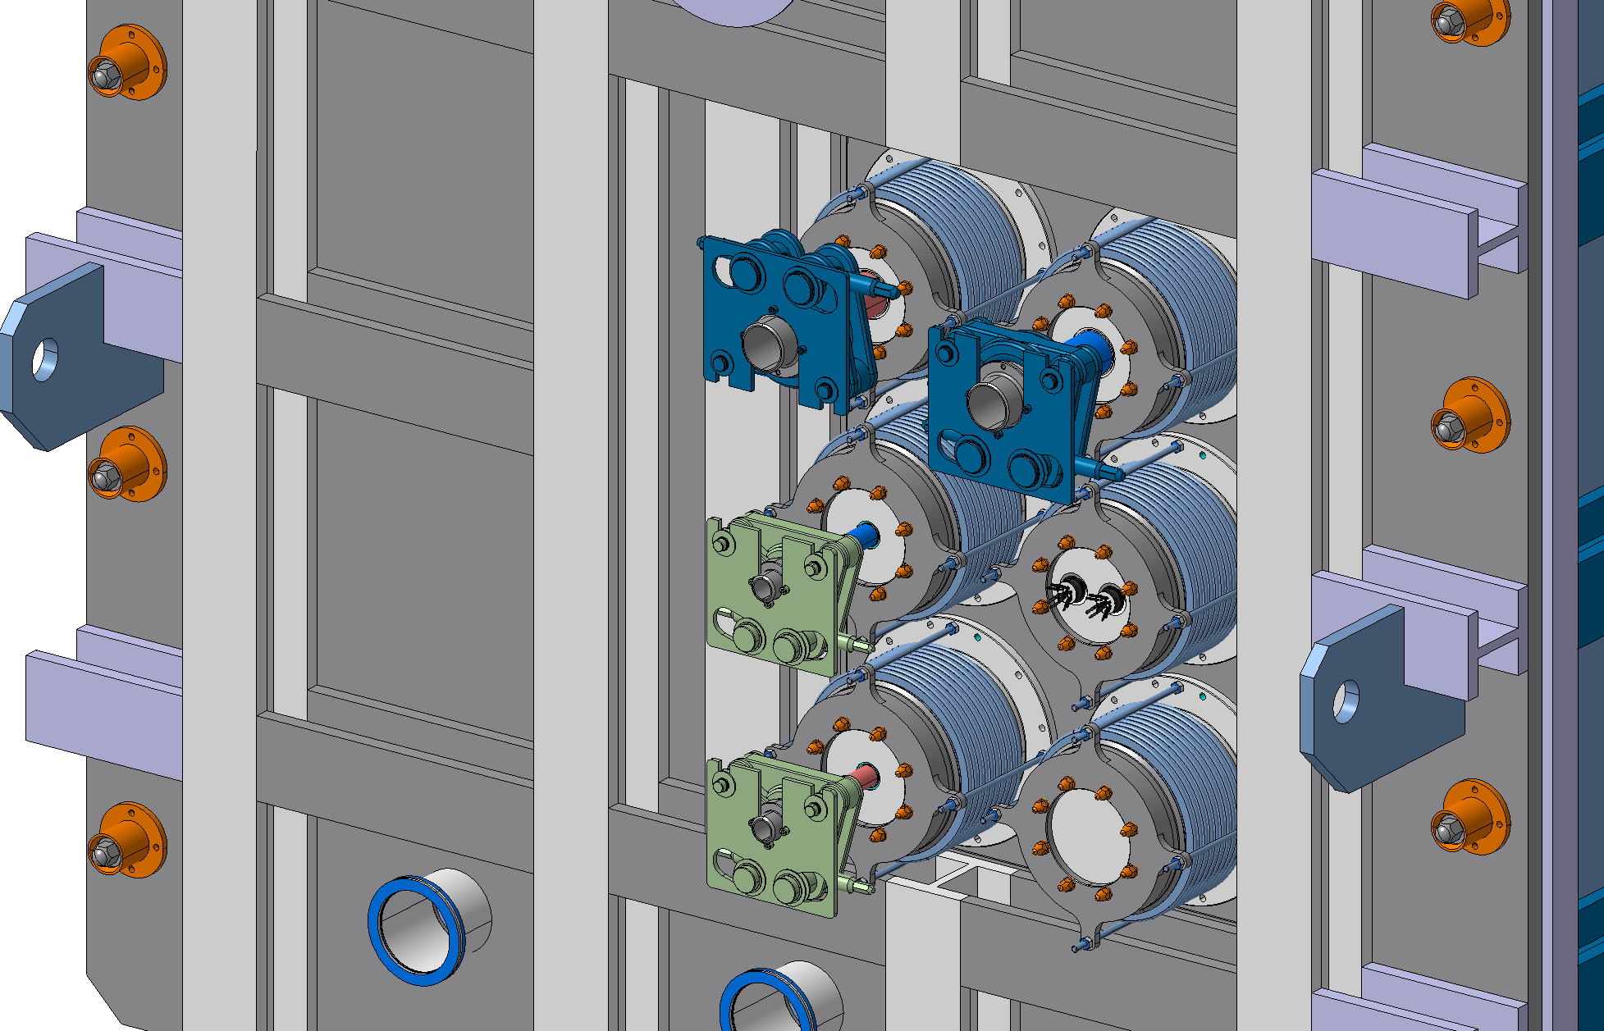
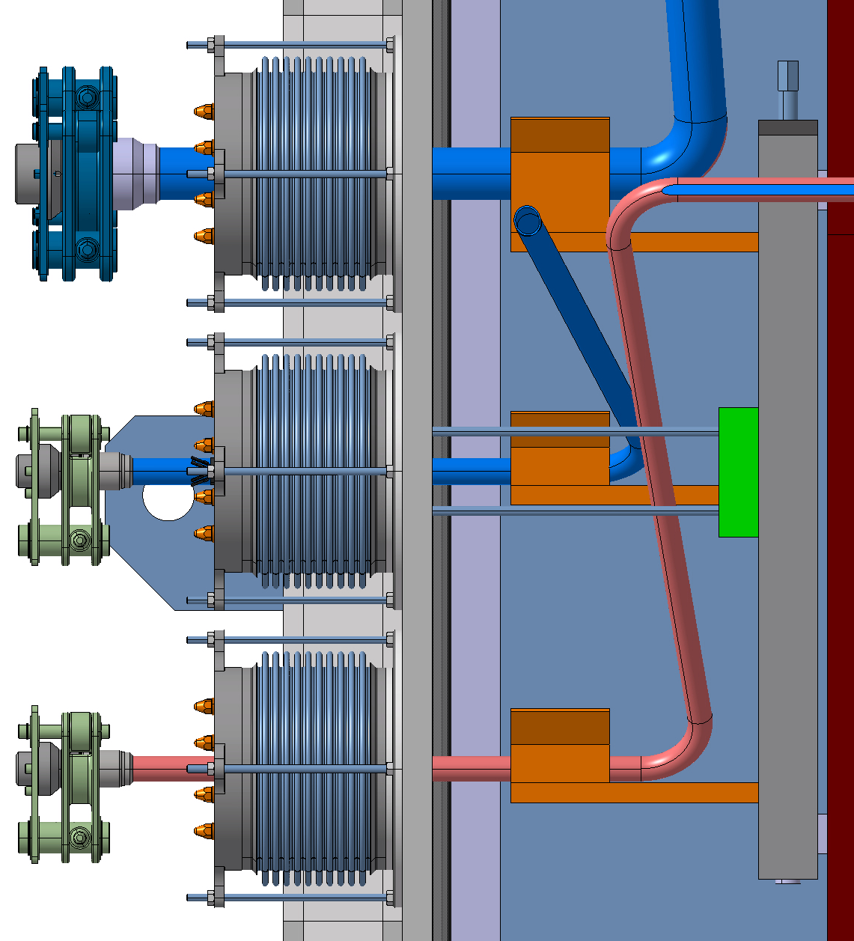
Original Configuration
Remotely Operated Flange Connections
Main problem:
Connector weight ~10 kg, cannot rest upon the bellow
DN200 Bellows
Rigid pipes from within vacuum vessel, likely connected to flexible ones onwards from vessel

Slide 9
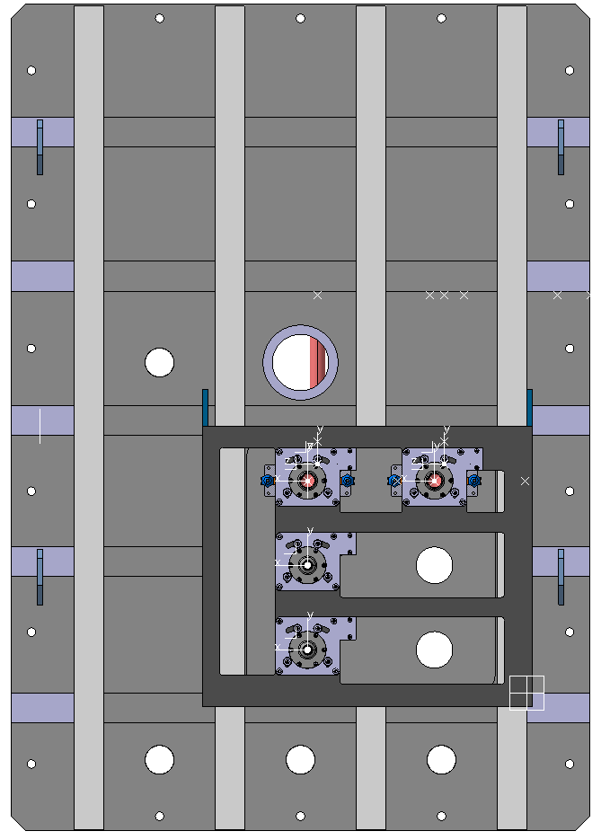
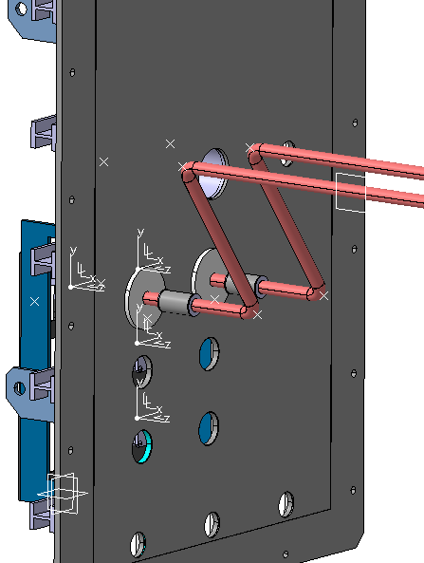
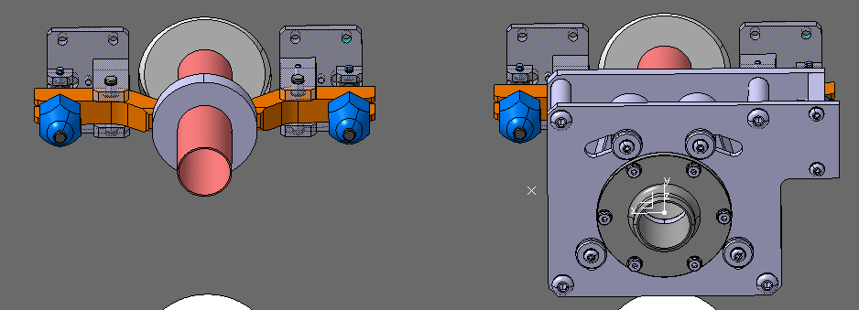
Current Connection Idea
Remotely operated connector for onward pipes
Rigid pipes with a flexible section
Flange attached to pipes
Clamping mechanism to feed pipe through door
Support structure attached to the vessel door
Design study ongoing with Destec ltd
http://www.destec.co.uk/

Slide 10

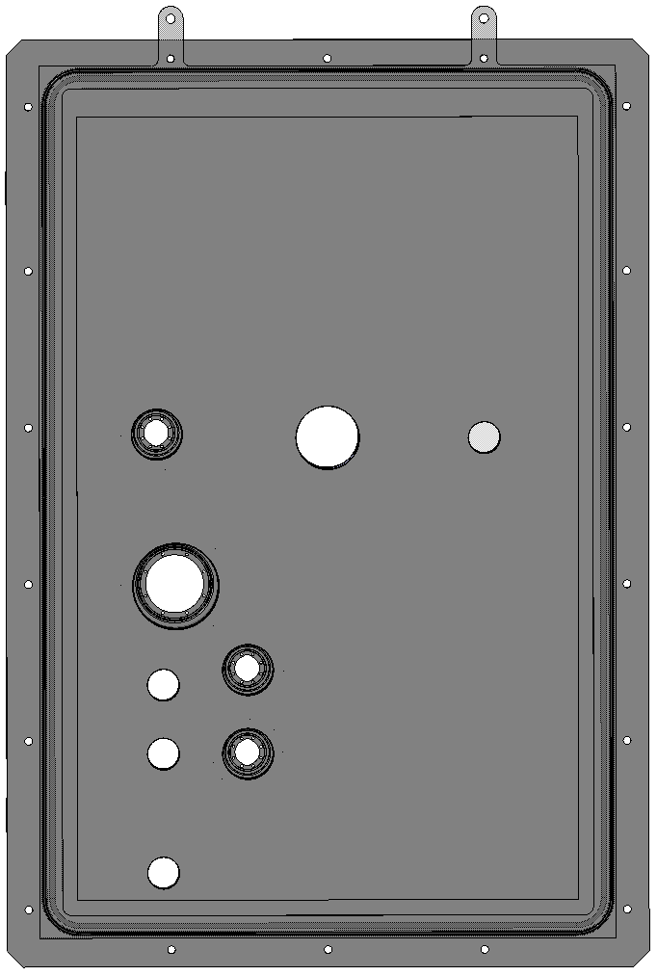
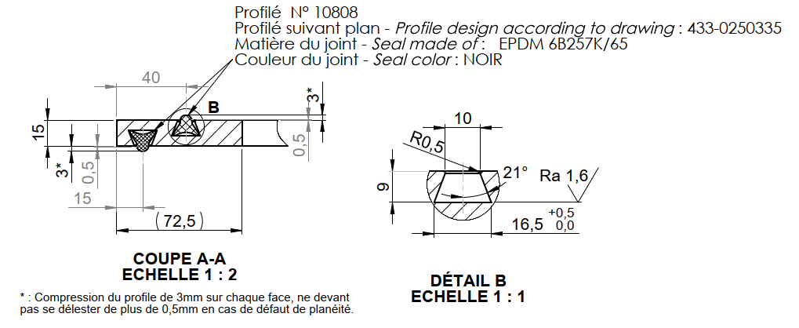

Vessel gaskets
Irradiation ageing and testing 3 silicon rubber and 1 EPDM sample
  O-ring leak testing
  Compression testing
Door seal and gaskets will be replaced every time the door is opened (once per year)
2 EPDM profiles mounted on a metal frame and installed onto vessel door (same principle as ISIS target station)

Slide 11
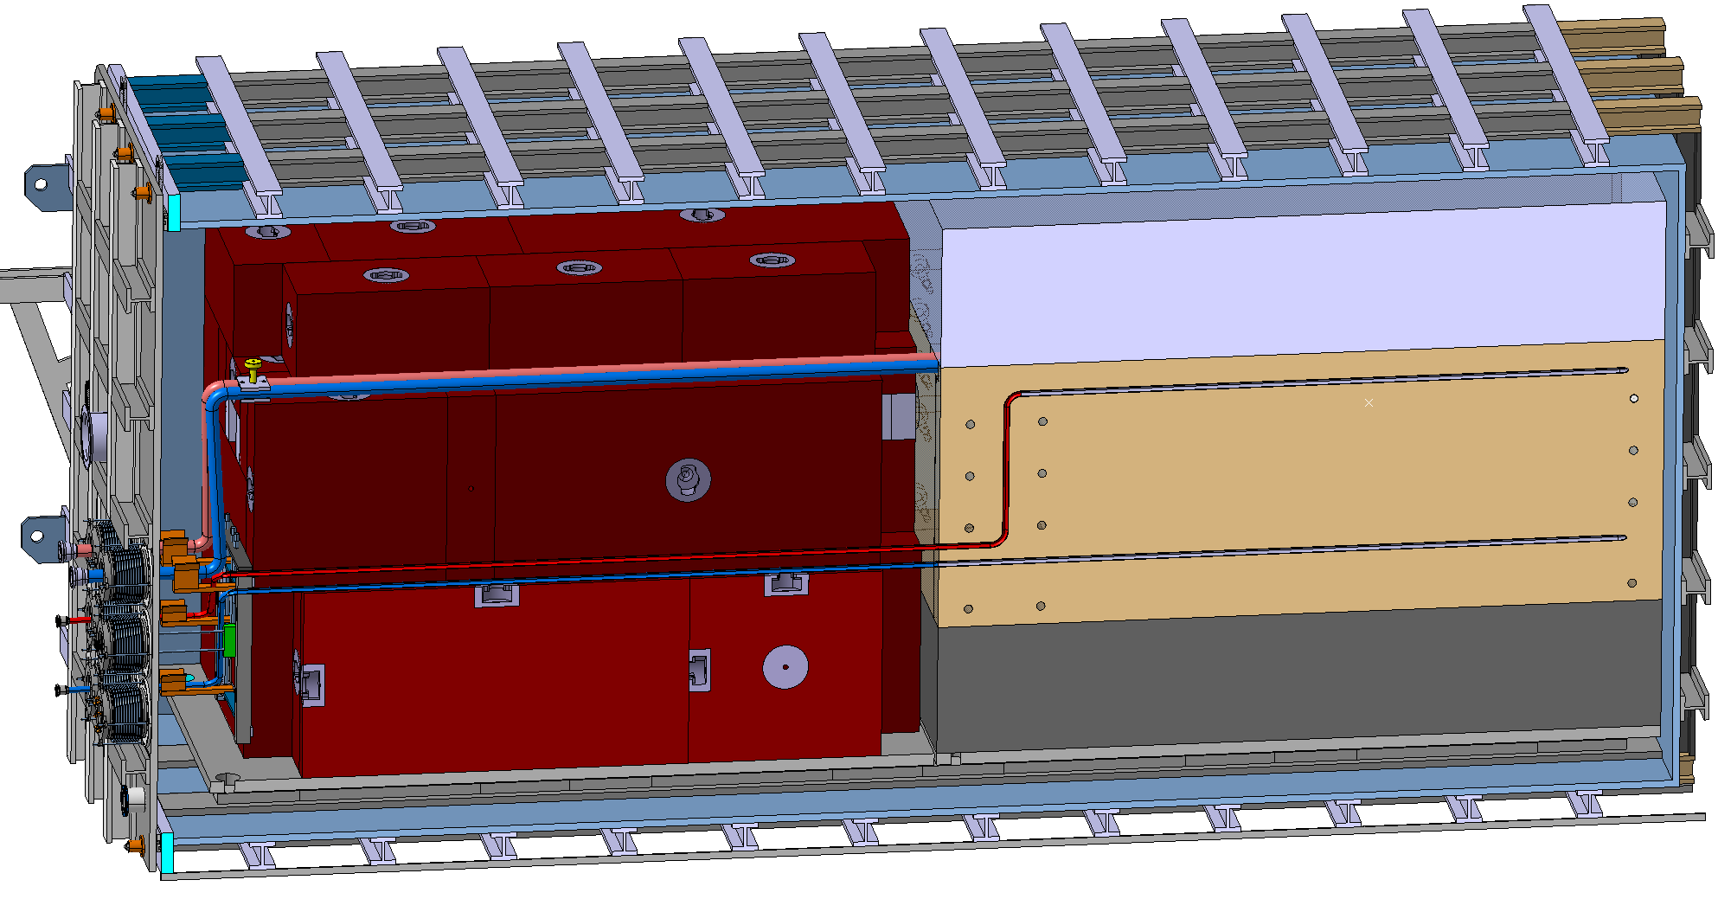
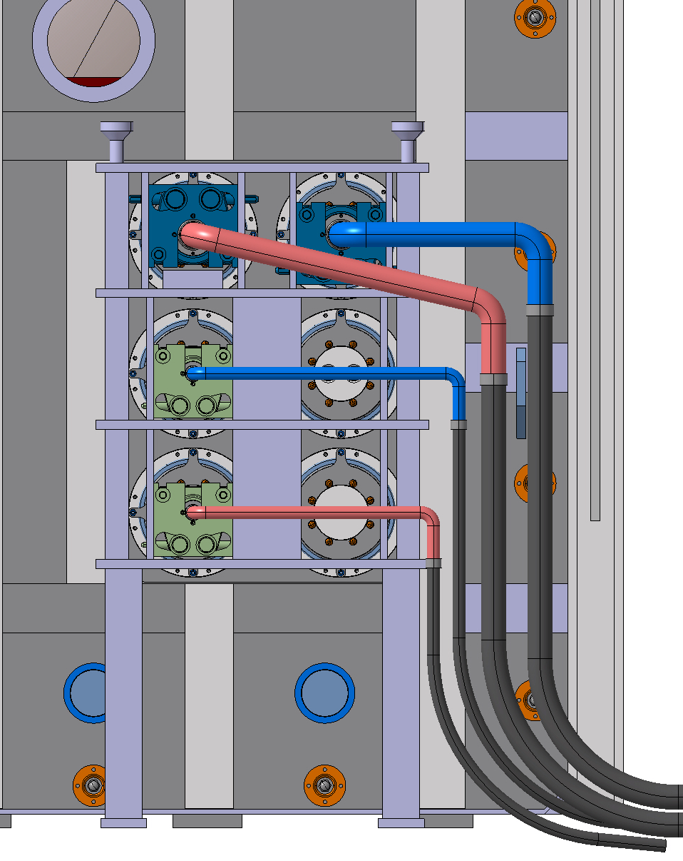
Pipe Management
Within the vacuum vessel:
  4 rigid pipes all with a flexible section before the door
Outside of vacuum vessel:
4 flexible pipes with rigid sections after the door
Support Frame
Lifting point

Slide 12
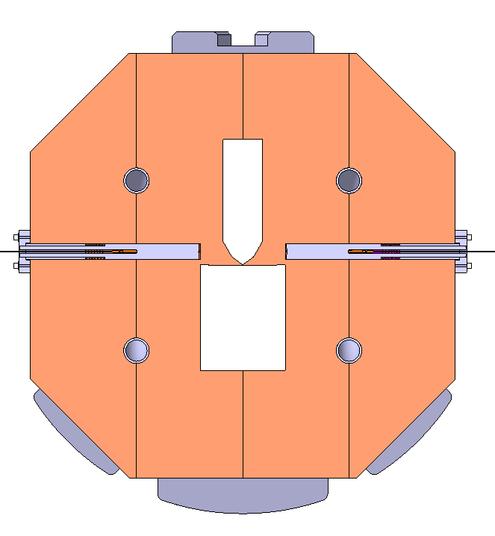

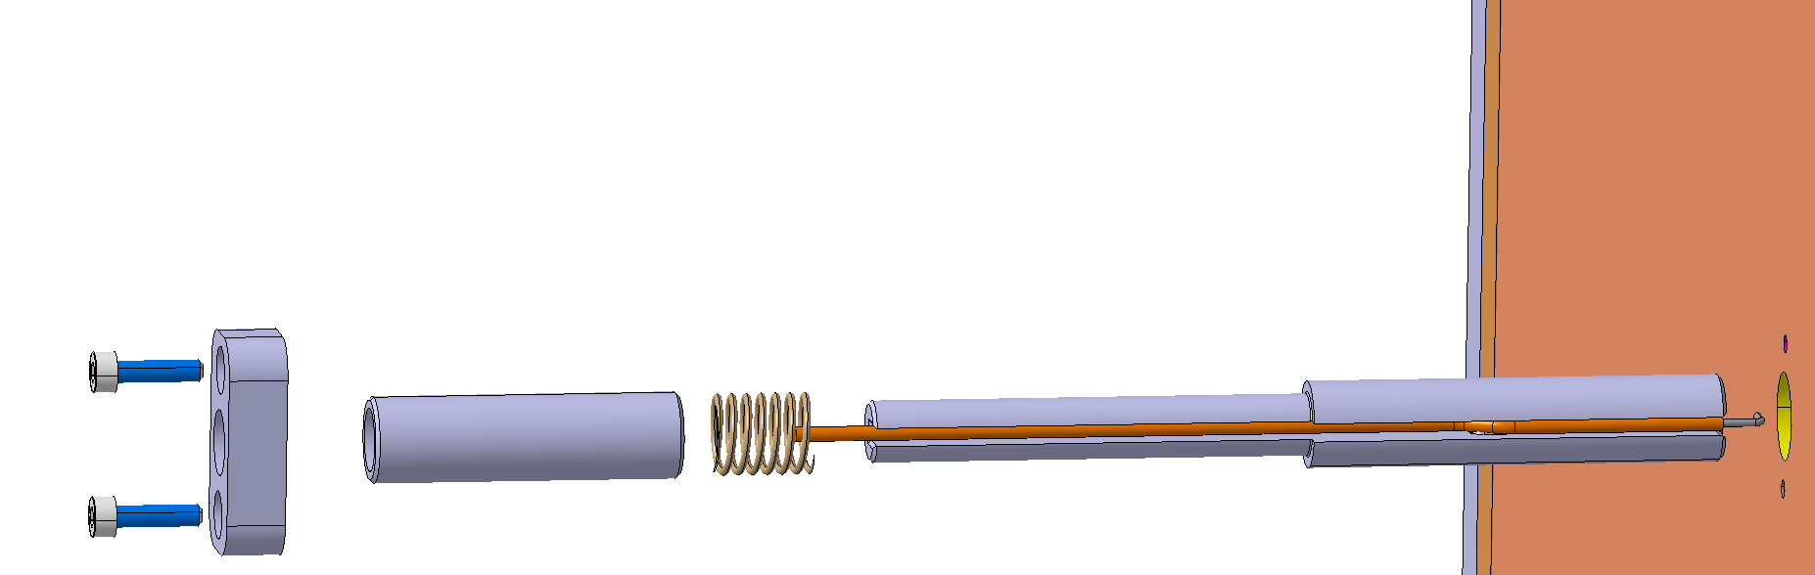
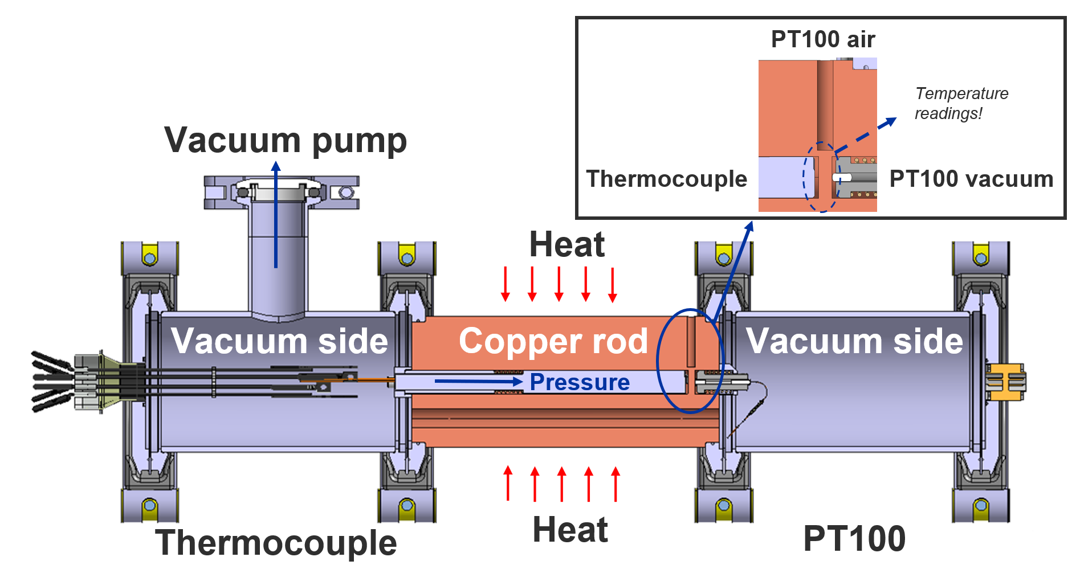
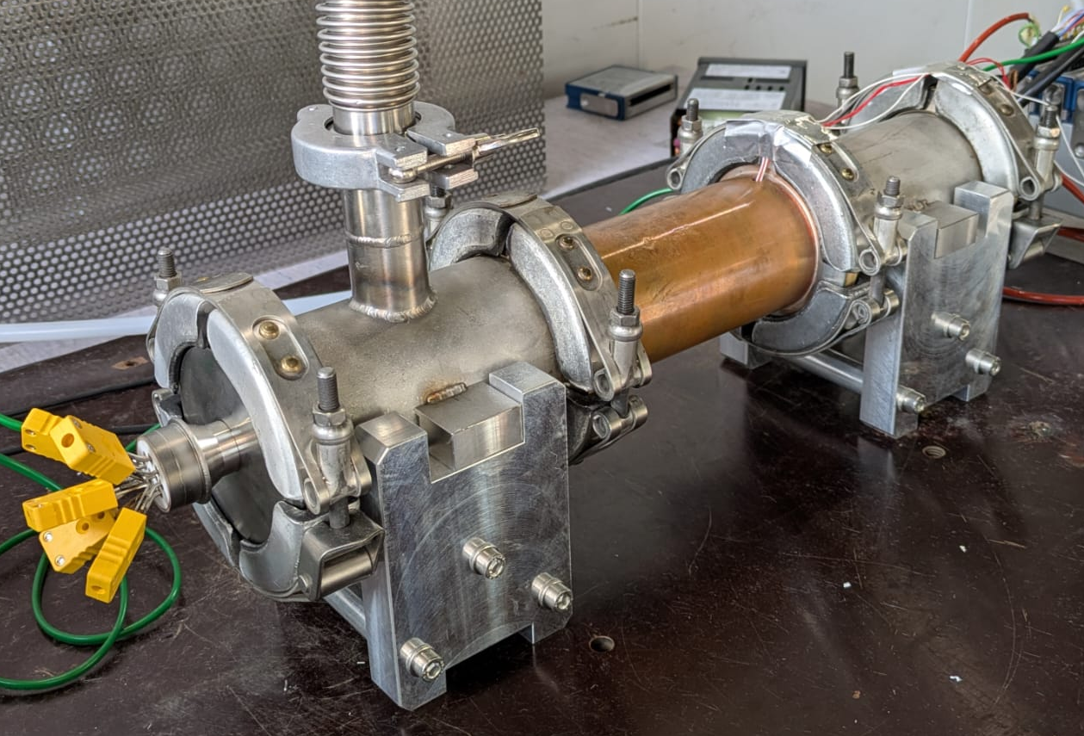
Testing of thermocouples in vacuum
Four thermocouples integrated in a Collimator to detect beam misalignment
  Vacuum test bench recreates thermocouple contact system of collimator
  - PT100s in vacuum and in air verify thermocouple measurements

Slide 13
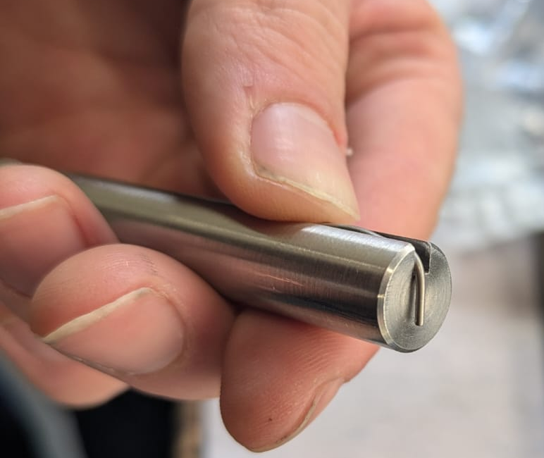
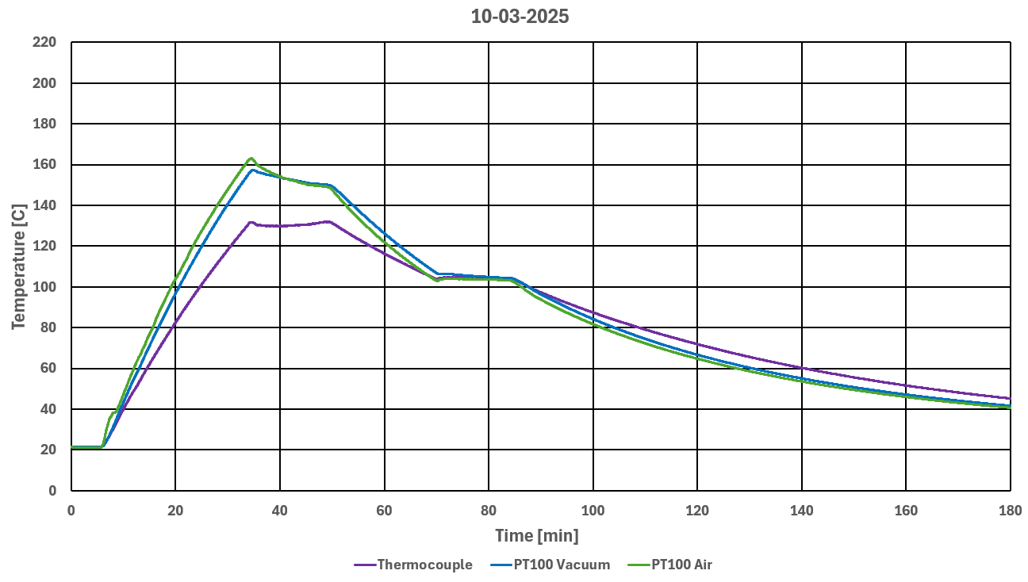
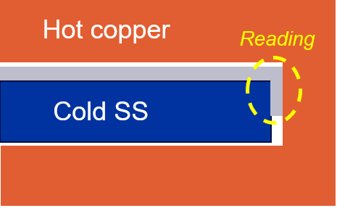
Mechanically pushed thermocouple
Thermocouple installed to test repeatability
- Principle of cold steel bar shown the non efficiency of the system (SS didn’t become hot because being under vacuum
- Bad reliability on this contact → Solution needed
PT100 Air [°C] | TC [°C] | ΔT [°C]
162.9 | 131.8 | 31.1
Test | Contact System | TC Type | TC Diameter [mm]
#5 | Standard design | Sheath type k RS | ⌀1

Slide 14
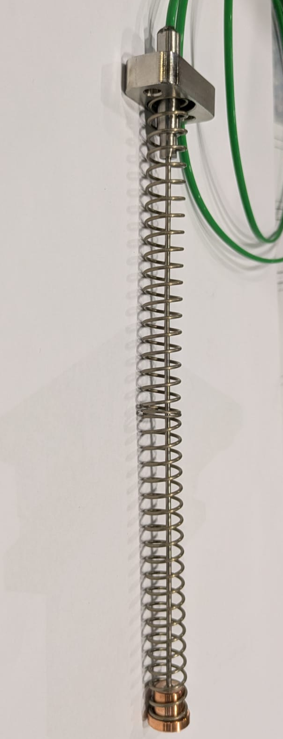
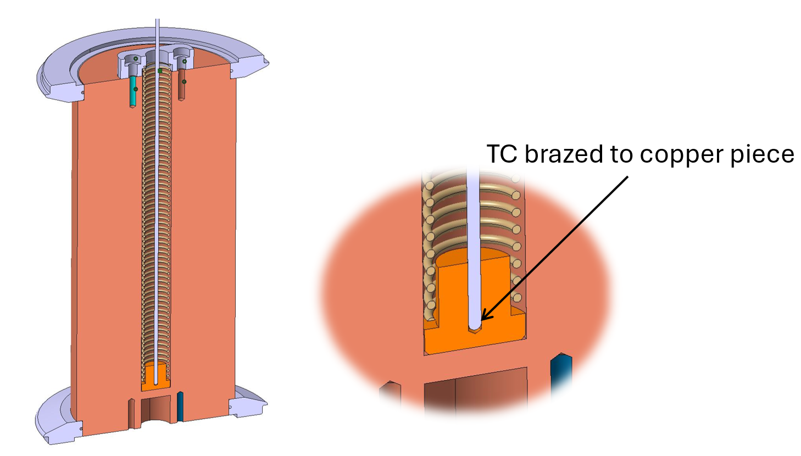
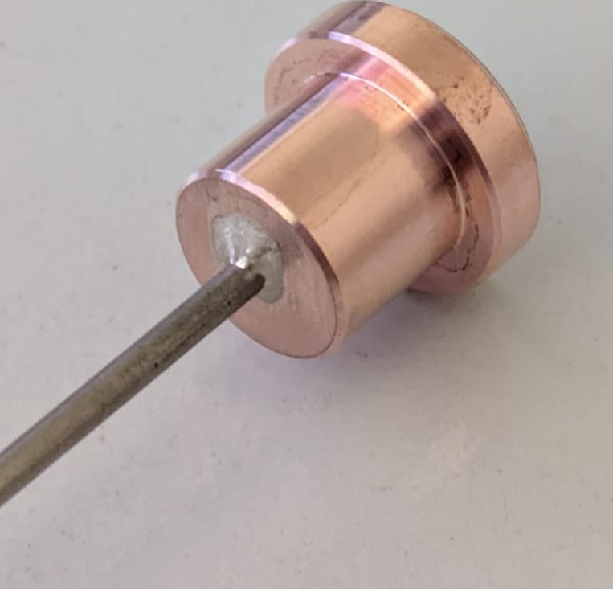
Brazed TC solution
Reducing response delay of a TC contact system without bending the TC
Creating a copper insert and brazing the Inconel sheathed thermocouple
Using an induction brazing machine
Dismountable solution (could be easily implemented by not having major issue of brazing on large scale component)

Slide 15
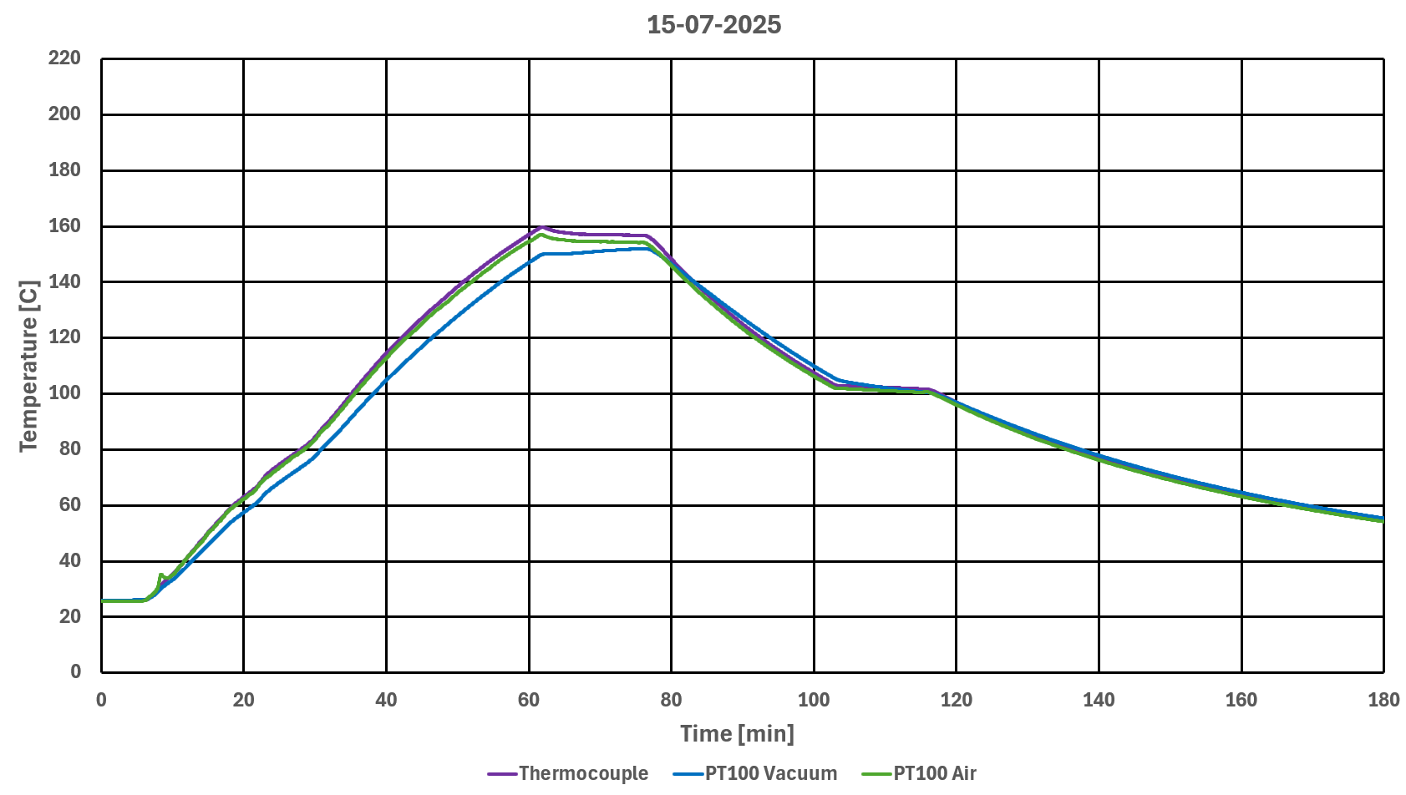
Brazed Inconel sheathed thermocouple to Cu insert
PT100 Air [°C] | TC [°C] | ΔT [°C]
156.9 | 159.7 | 2.8
Hoping to ensure good contact between TC and Cu insert
- Very good result in accuracy
- Direct response
Test | Contact System | TC Type | TC Diameter [mm]
#12 | Brazed design | Sheath type k RS | ⌀1.5

Slide 16
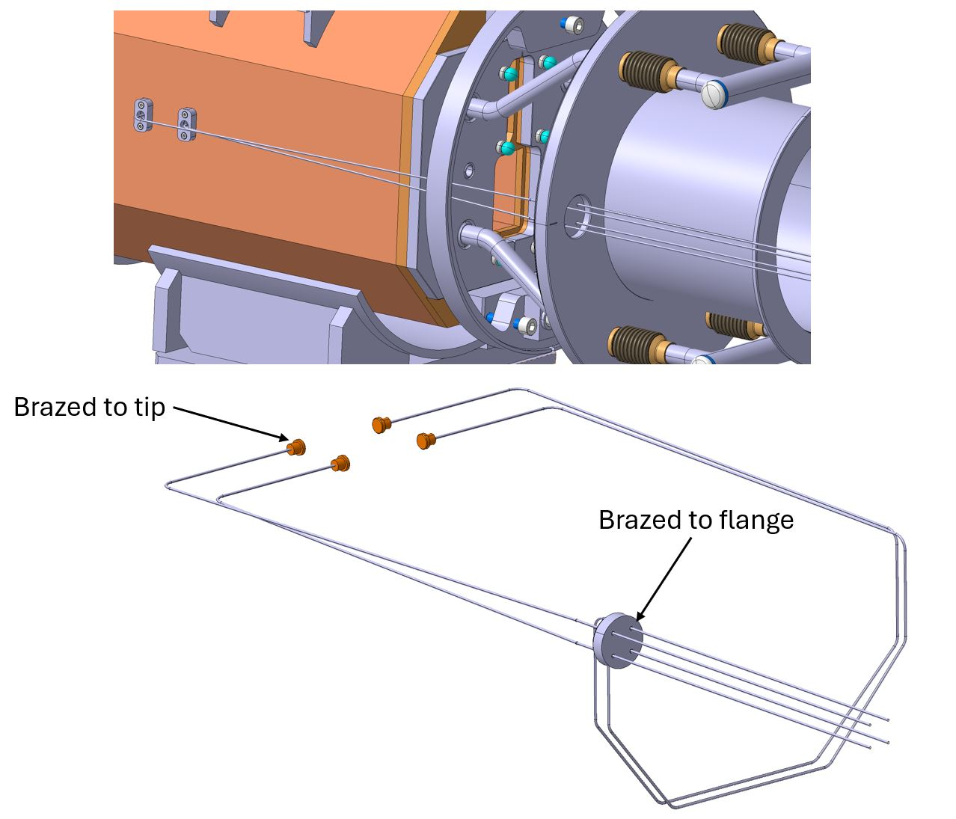
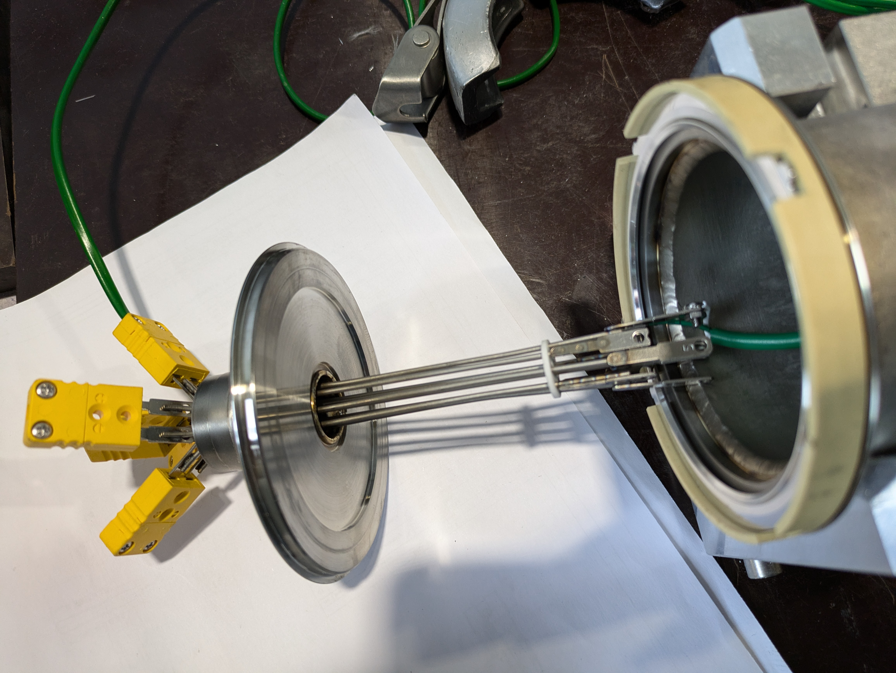
Thermocouples Feedthroughs
Required for target and proximity shielding life monitoring
Vacuum thermocouples feedthrough we are expecting (up to now!)
→ Junction of thermocouple wires and feedthrough weak point
Some ongoing ideas to improve robustness

Slide 17
Questions for future discussions!
How were the feedthroughs and onward connections incorporated into the vessel at ISIS?
What additional feedthroughs did you have to add that weren’t originally foreseen?
Decision on fix points, flexible hoses how to make it?
Qualification of thermocouples assemblies before installation?
How to ensure thermocouples are well calibrated and measuring temperature as expected?
How to have reliable and robust thermocouples feedthrough?

Slide 18
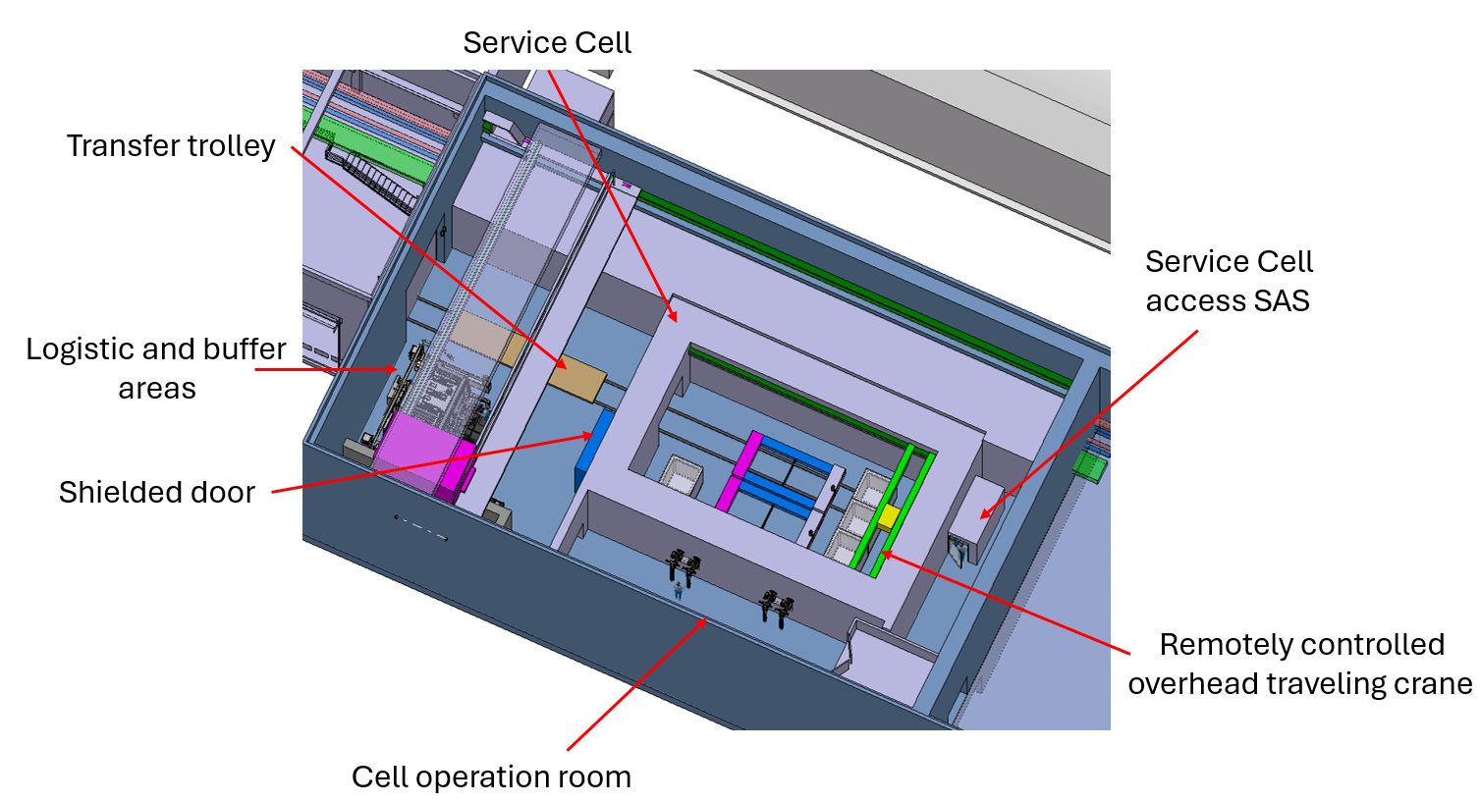
Service Cell update
Q1- Q2 2025
  Definition of the requirements in the context of BDF
  Integration of CERN legacy waste in the scope of the service cell
  Integration within the new target complex service building
Contract signed for the preliminary design of the service cell with a contractor having the experience in large scale hot-cell
  Initial review of CERN concept
  Integration design of the service cell
  Service cell processes and sequences for foreseen operations in the service cell to prepare the BDF component for final disposal
  Verification of compatibility of cell with other CERN legacy objects.
  Initial designs of equipment and tooling needed for the foreseen handling / remote handling operations in the service cell
  Definition of the interfaces of the service cell and of the different utilities required for the operation of the service cell

Slide 19
Questions for future discussions!
Failures scenarios and mitigation measures best practices?
  Ad-hoc internal bunker for specific tasks
  Cell separation(s)
Cell configuration approaches what is best strategy
  Management of large gradient of dose rate and contamination risk how to handle this
Logistics to bring equipment in and out a cell
  Transfer cask
  Large objects manipulation
Cell design return of experience

