Slide 1
CST wake for beam going through matter, some examples
Alexej Grudiev
25/08/2025

Slide 2
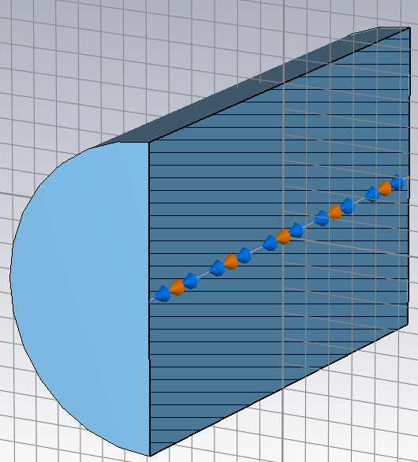
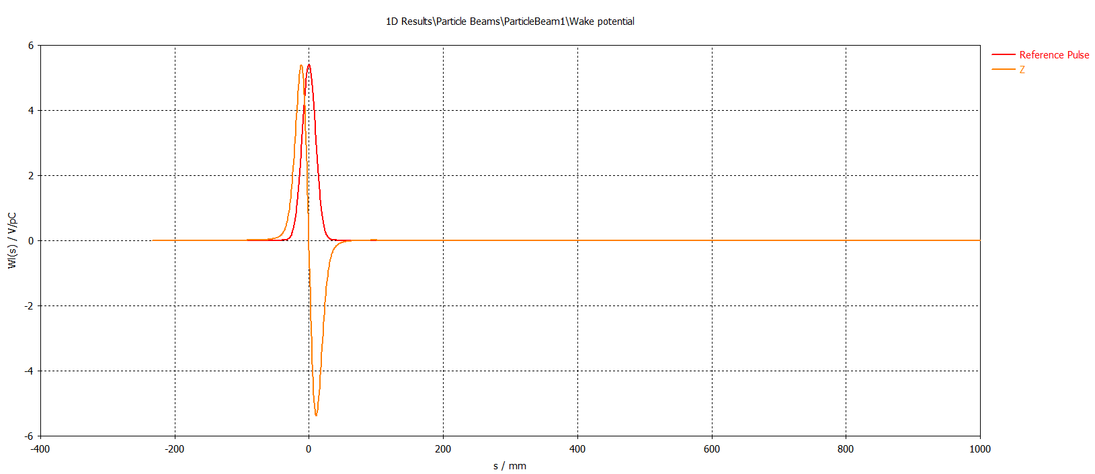
Reference: PEC beam pipe: beta = 0.9

Slide 3
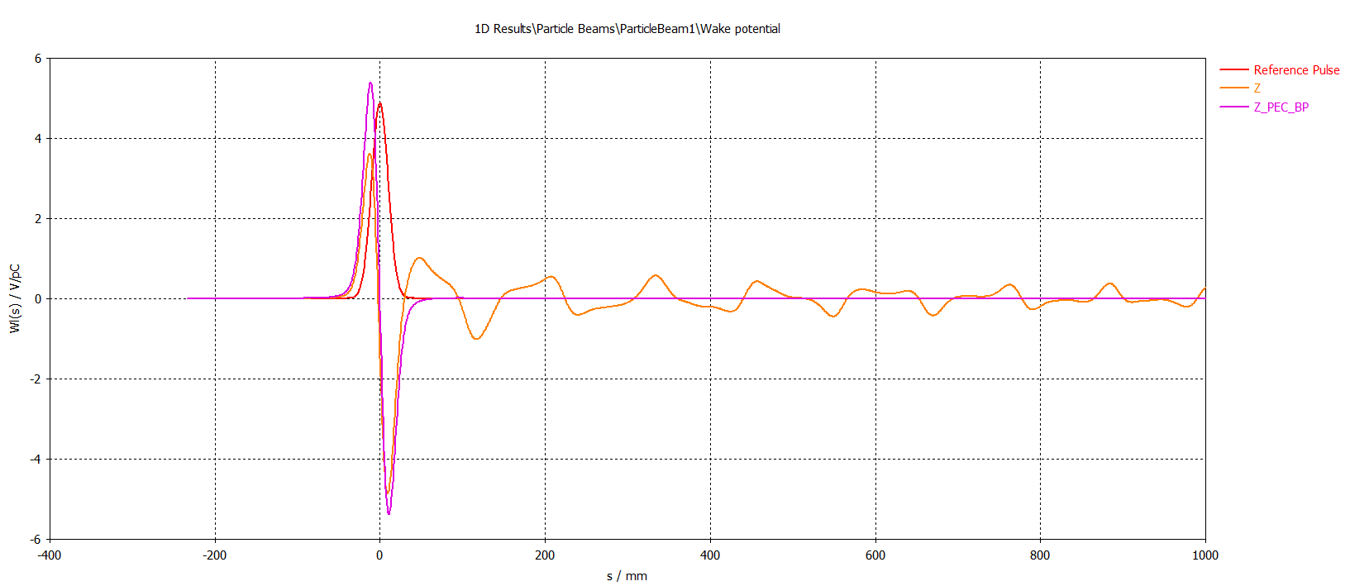
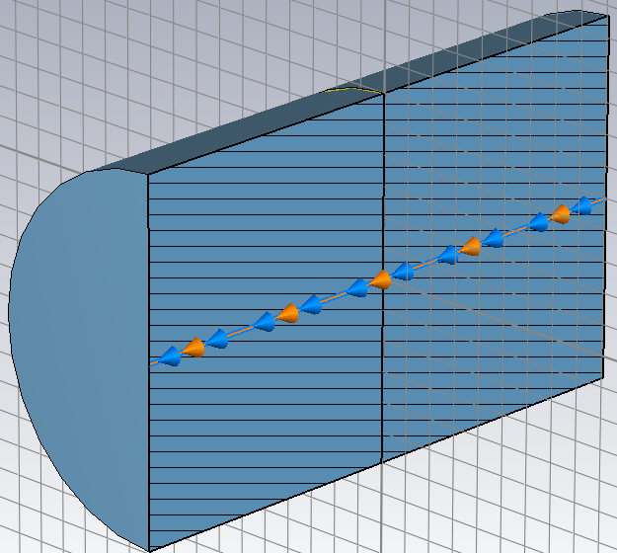
Example 1: Beam goes though 100um Al foil

Slide 4
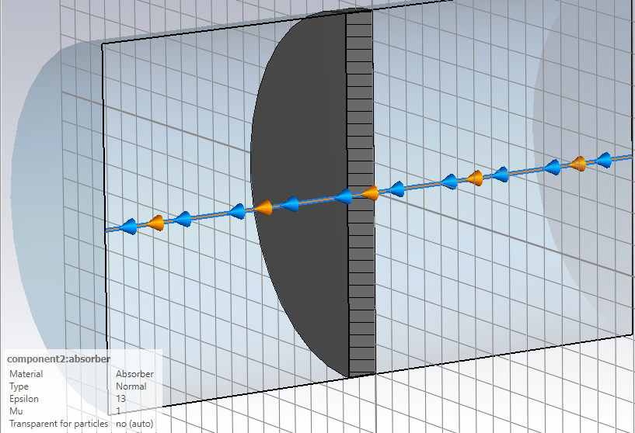
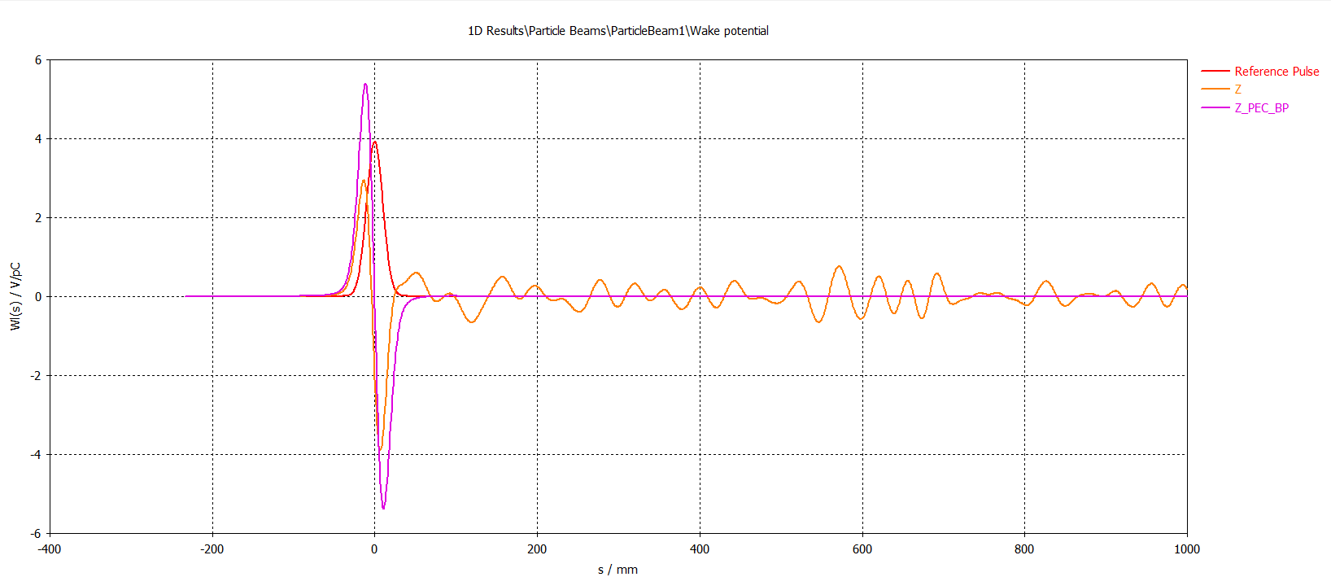
Example 2: Beam goes though 10mm dielectric: eps=13

Slide 5
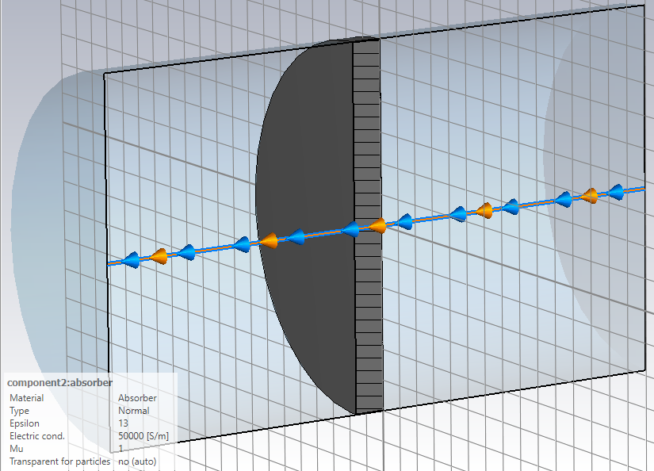
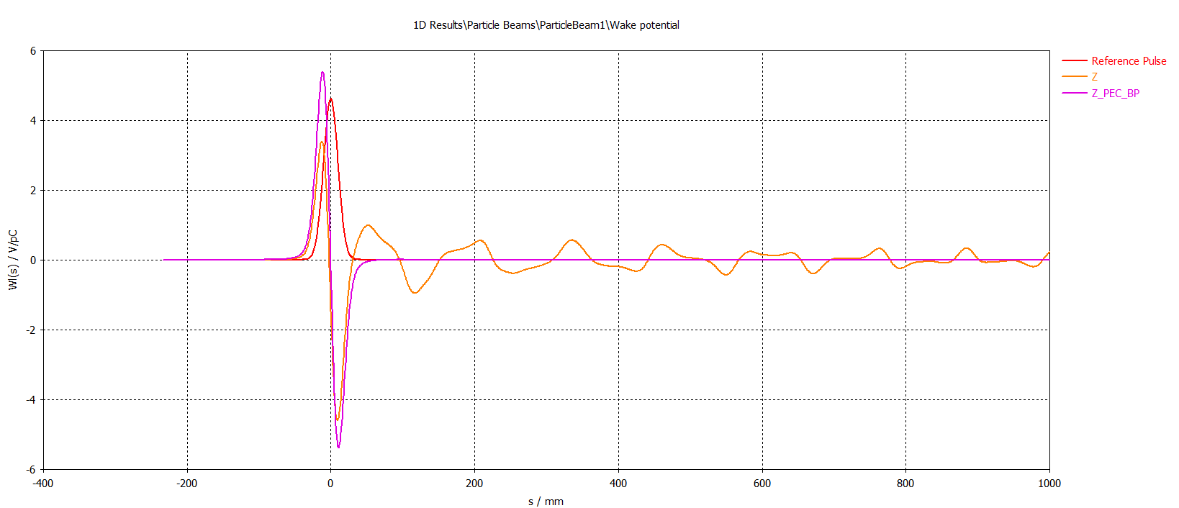
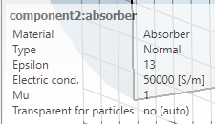
Example 3: Beam goes though 10mm LiH disk (eps=13, conductivity=50000S/m)

