Slide 1
MoEDAL/MAPP status 09/2025
Richard Soluk – MoEDAL Collaboration (Technical Coordinator) University of Alberta

Slide 2

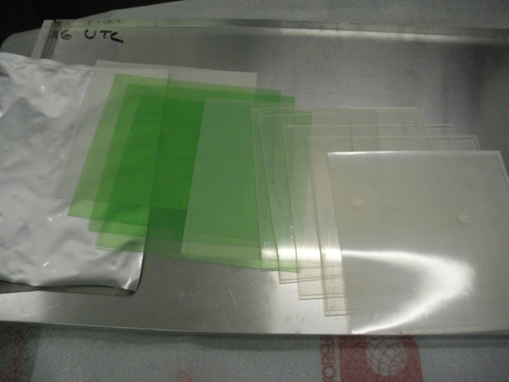
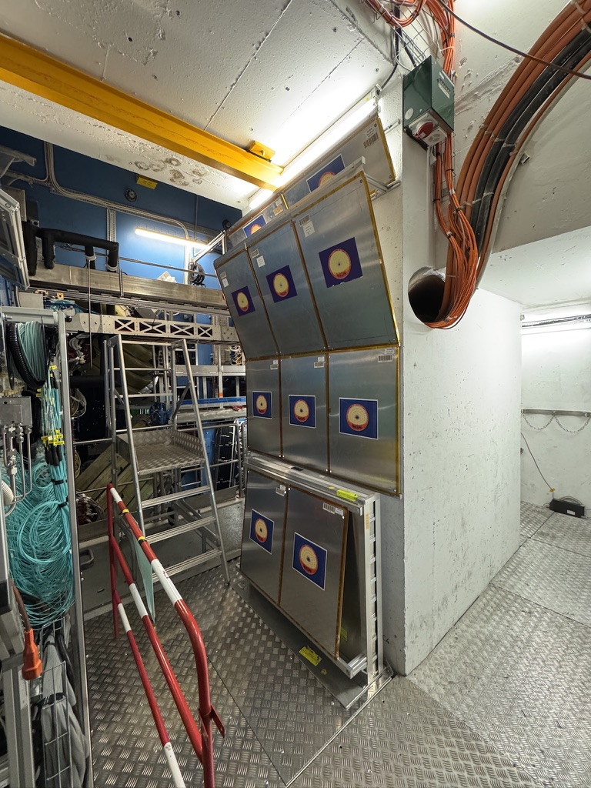
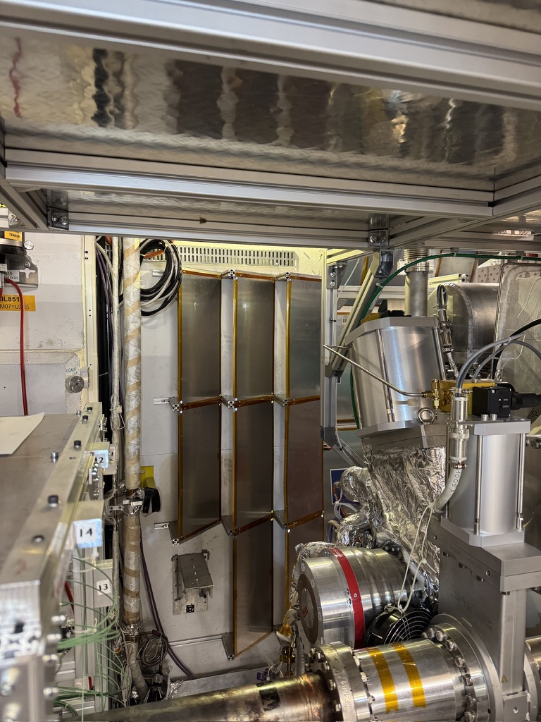
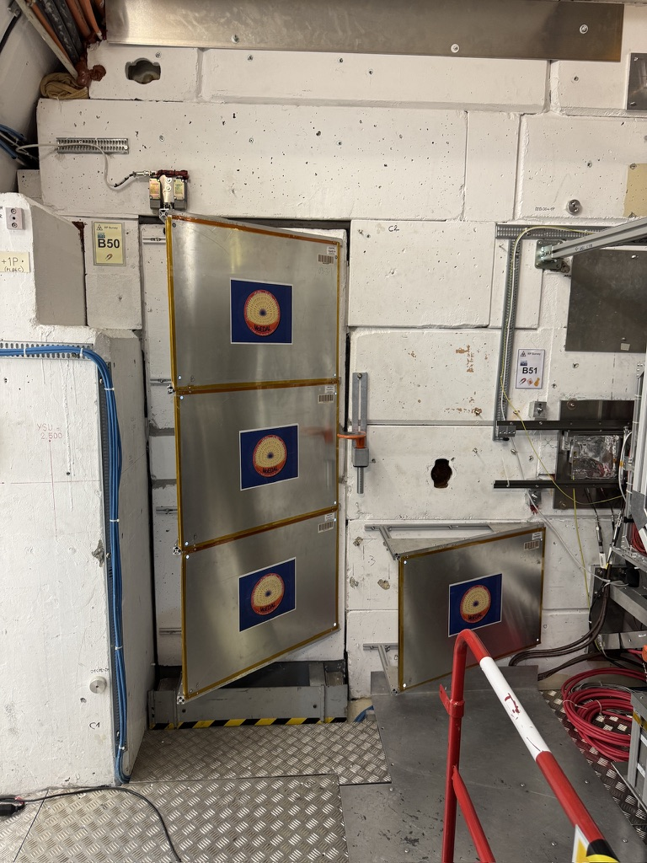
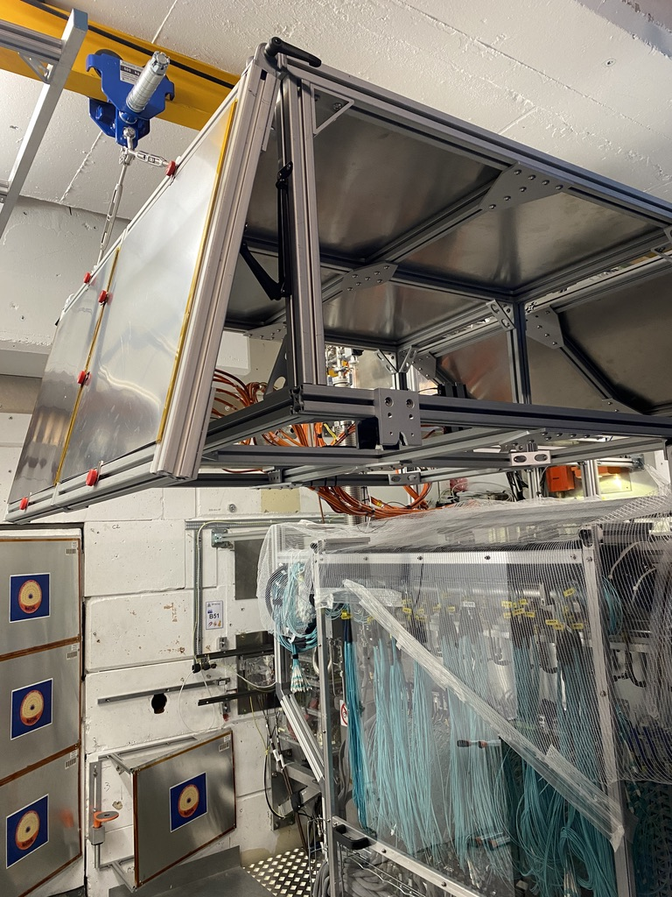
MoEDAL 2025 NTD
MoEDAL
Two full sets (171 stacks each) exposed in 2024
One set for pp (highest integrated luminosity yet)
One set for PbPb
Both sets successfully etched at INFN Bologna
Scanning underway for run 2 CR39 sheets at Helsinki
Run 3 CR39 sheets will follow
Previously scanned makrofol has higher threshold
New set of stacks deployed for 2025 (full run)

Slide 3
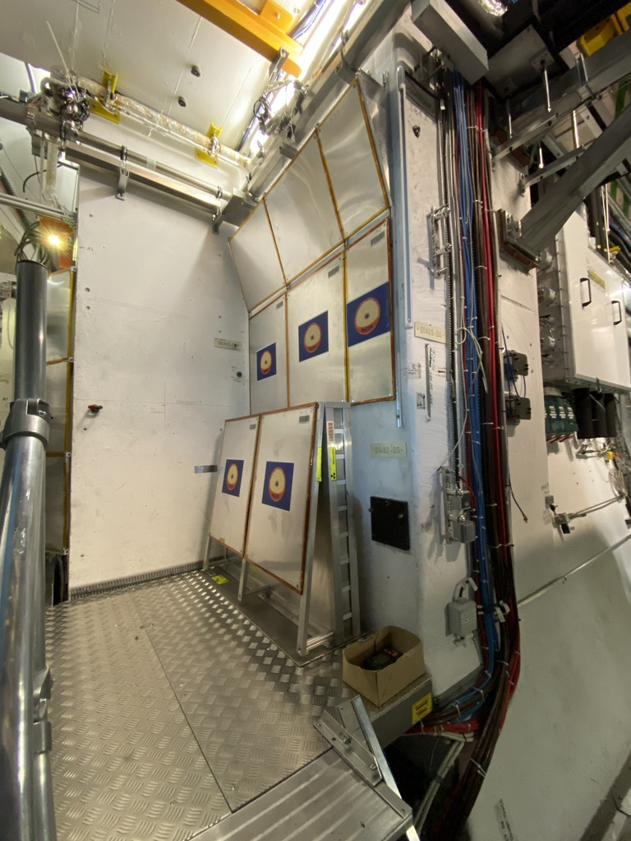
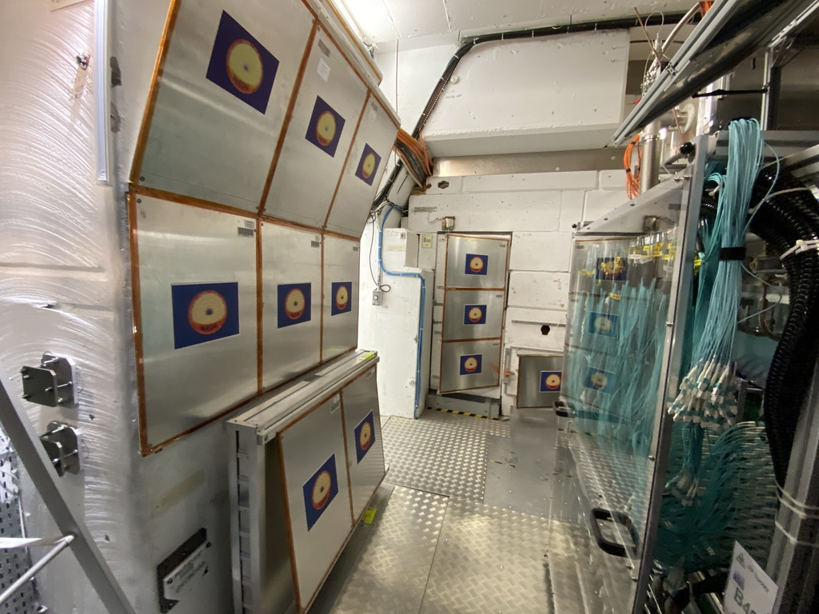
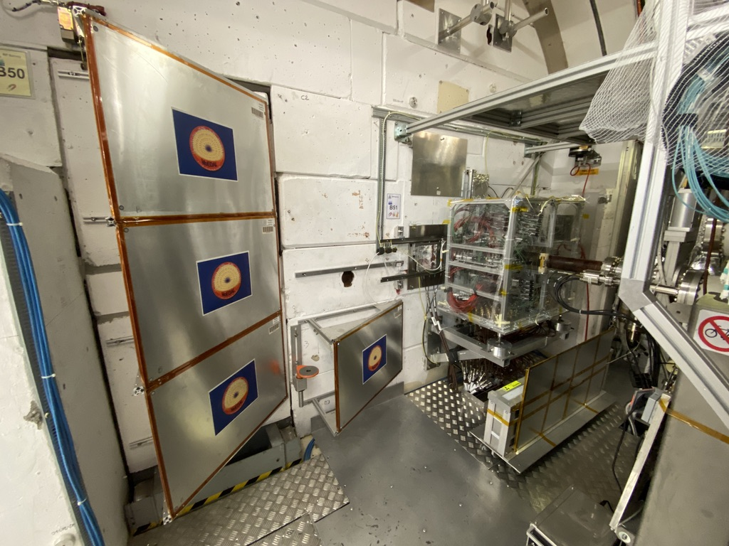
MoEDAL 2025 MMT
MoEDAL
Aluminum bars 25.4x25.4x190 mm
42 boxes of 48 bars around IP8 (672kg)
Integrating luminosity for almost all of run 3
~12 fb⁻¹ (6.8TeV p beams end of 2024)
Almost all from 2024
~0.76 nb⁻¹ (2.68TeV/n Pb beams end of 2024)
Scanning to take place after RP cooldown
Late 2026 or early 2027

Slide 4
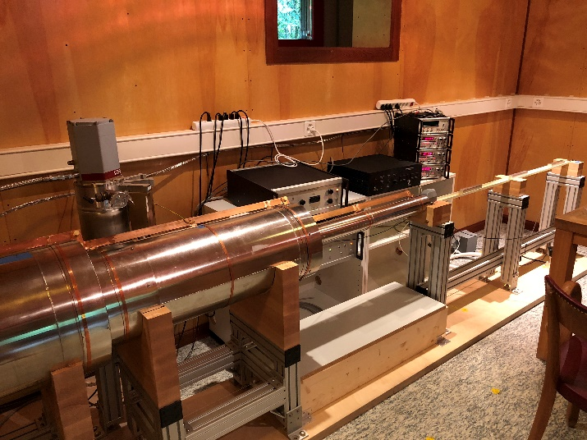
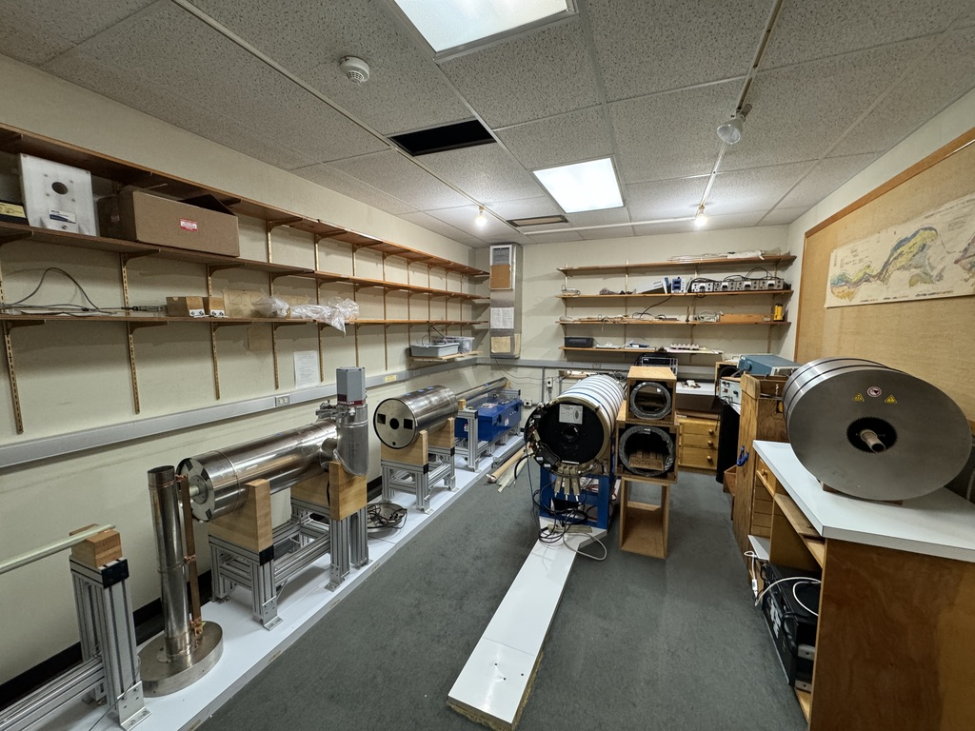
MoEDAL MMT Magnetometer
MoEDAL
ETH Zurich did work to improve reliability
Additional grounding
Grounding sweepers on tray
Filter on supply air
Columbia university has this magnetometer operational and kept modifications
They report good operation and sensitivity
Similar model available in Barcelona through the IFIC Valencia group
Helsinki Institute of Physics working on installation of compatible new magnetometer
Will evaluate Columbia and Valencia devices in October and Helsinki when available

Slide 5
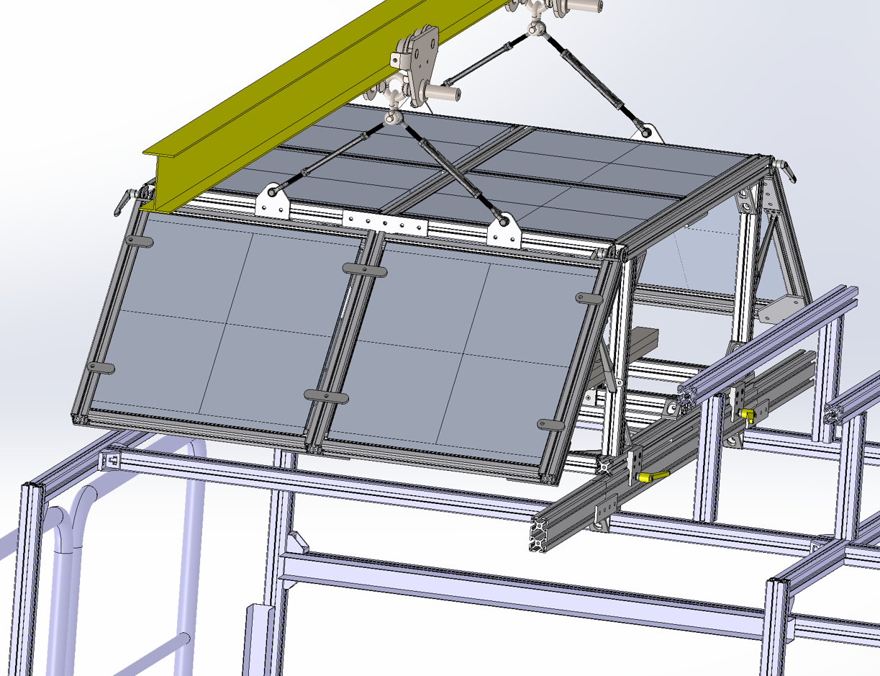
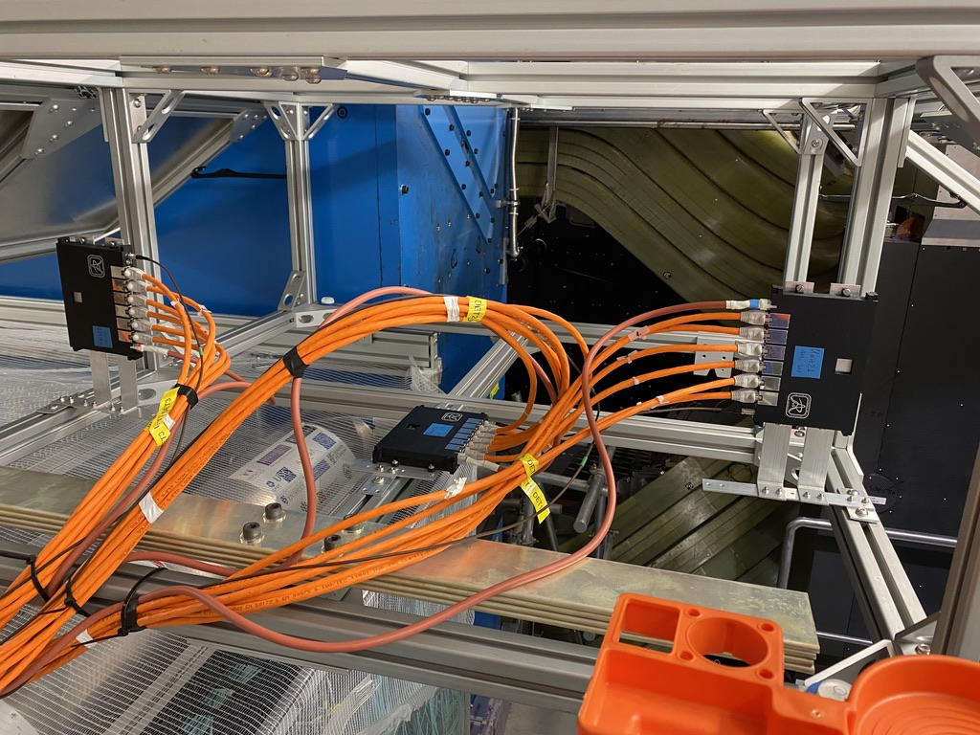
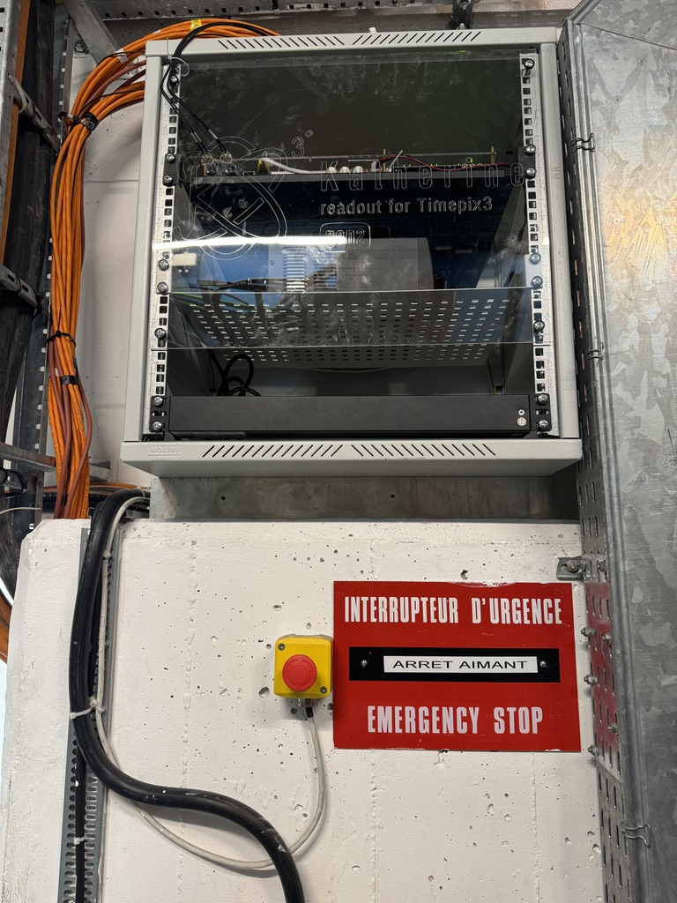
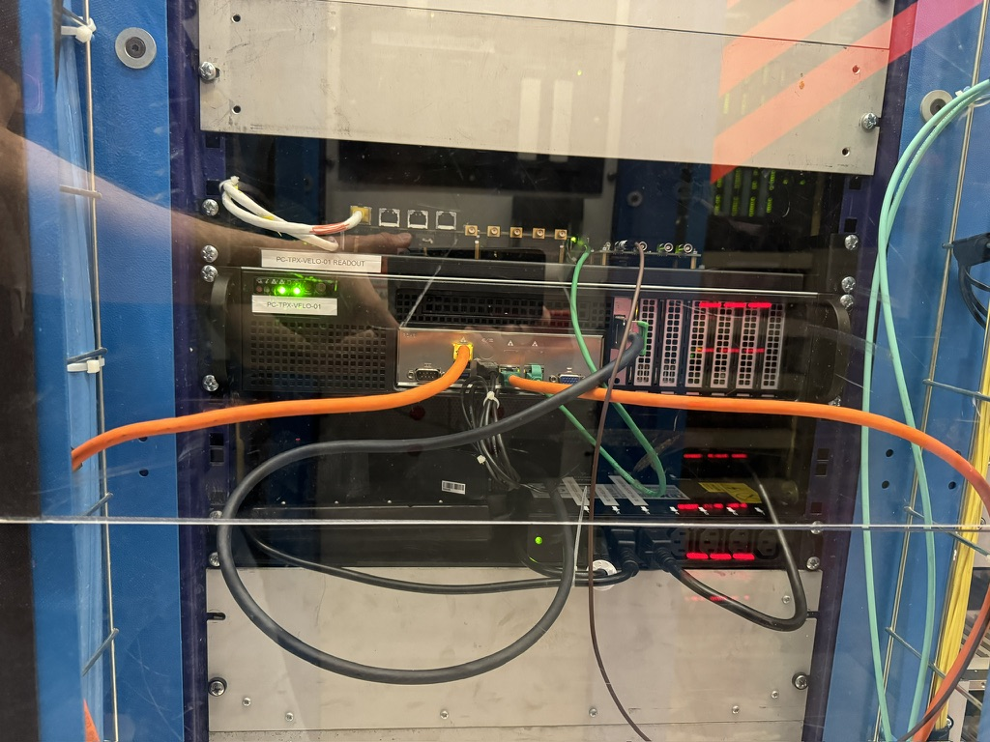
MoEDAL 2025 TPX
MoEDAL
6 TPX3 sensors deployed inside the VELO TOP
256x256 55μm pixels
Various neutron moderators
Operational for most of run 3 with some radiation issues
2023 Front End electronics had to be relocated
Low voltage power supply struggles near VELO
Replaced in TS1 2025

Slide 6
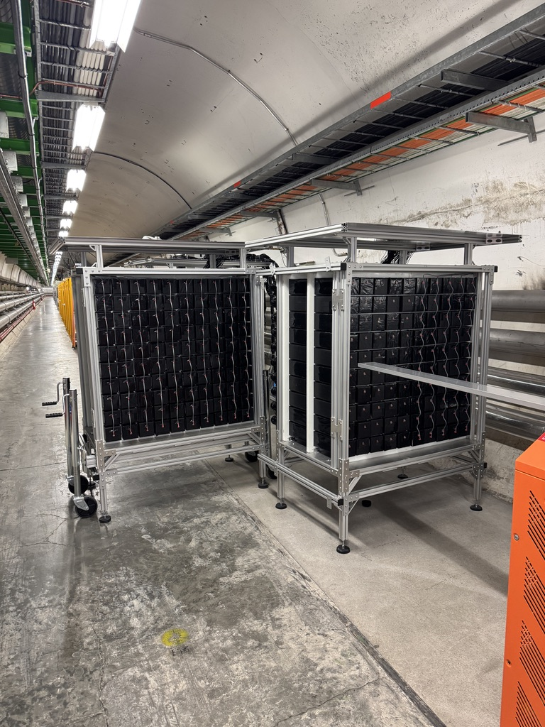
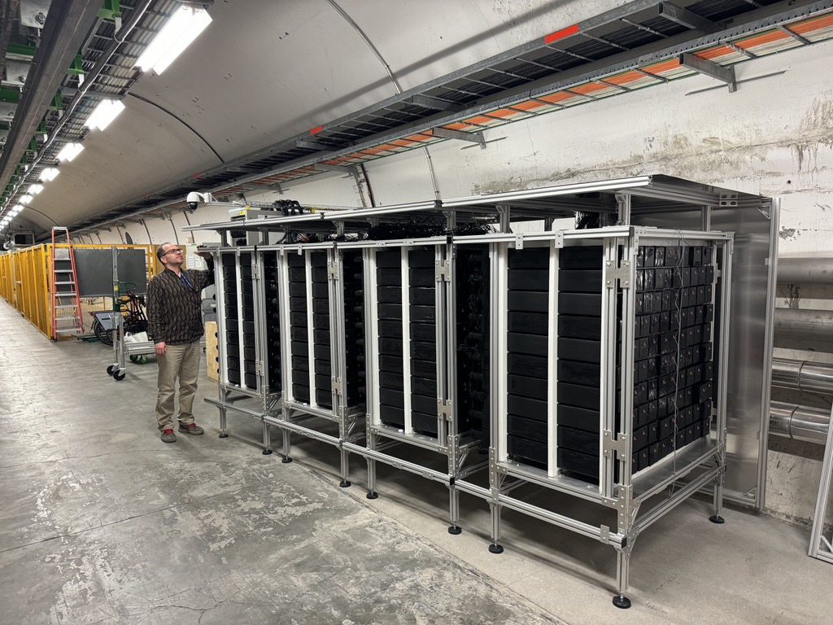
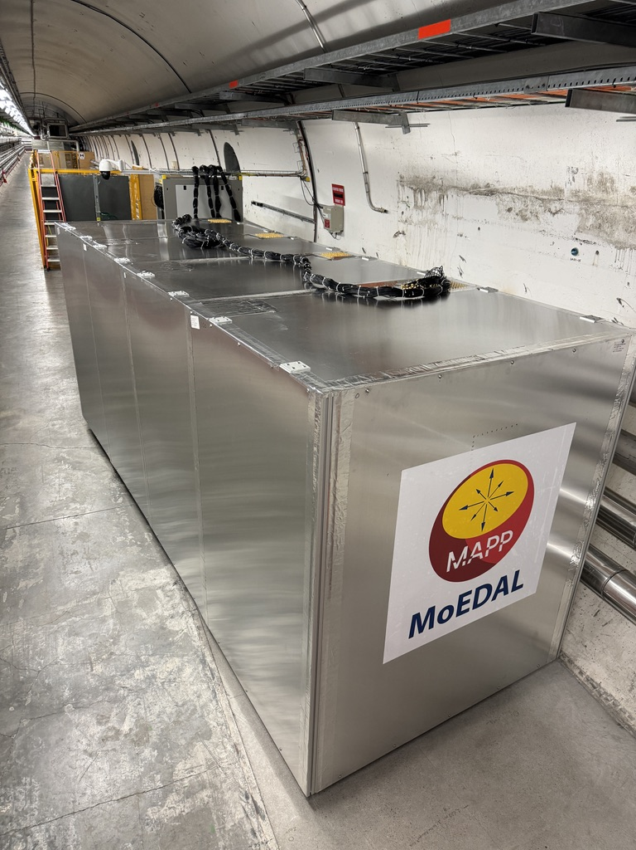
MAPP TS1 2025
MoEDAL
MAPP detector composed of 10 x 10 x 75 cm PS scintillator bars
Read out by either 75mm or 90mm diameter PMTs
398 of 400 bars installed and cabled
Last 2 planned for TS1 but access was very limited
Flame shield not opened

Slide 7
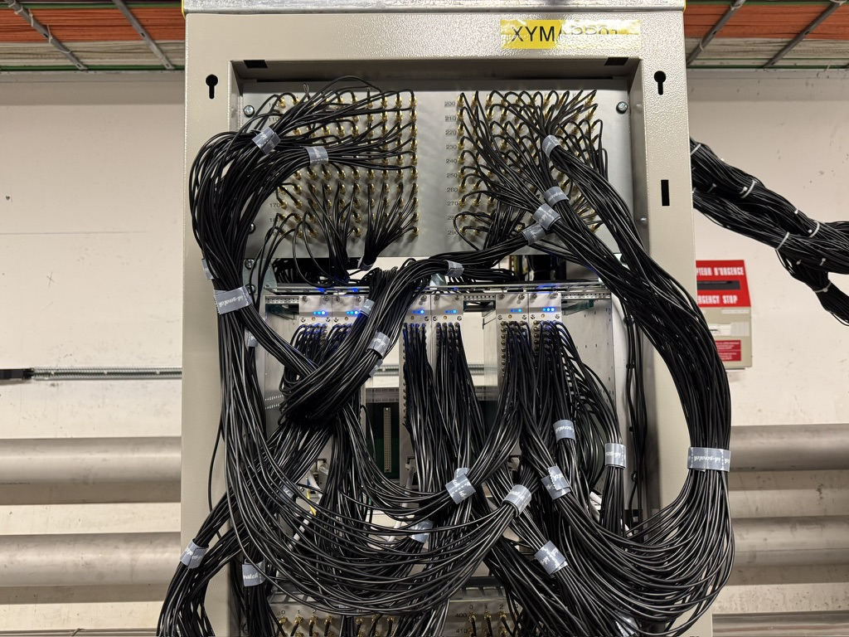
MAPP Electronics TS1 2025
MoEDAL
Minor adjustments to electronics setup
Cabled 6 of the 7 ADC boards
7th board only reads a small number of channels
Each boards reads a horizontal slice through the 4 detector stations (64 channels/board)
Each row of inputs being 4 colinear detectors
View from IP
Channel assignment of each of the MAPP ADC boards

Slide 8
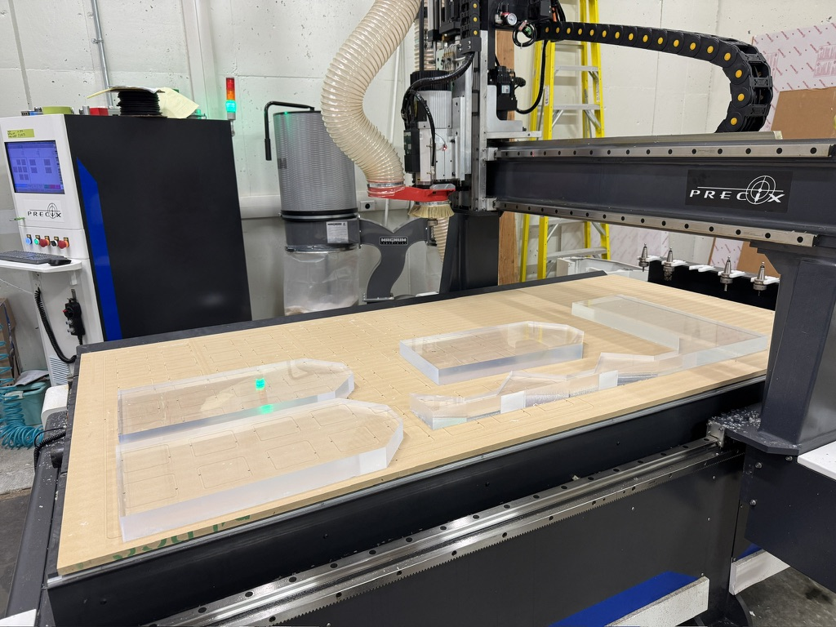
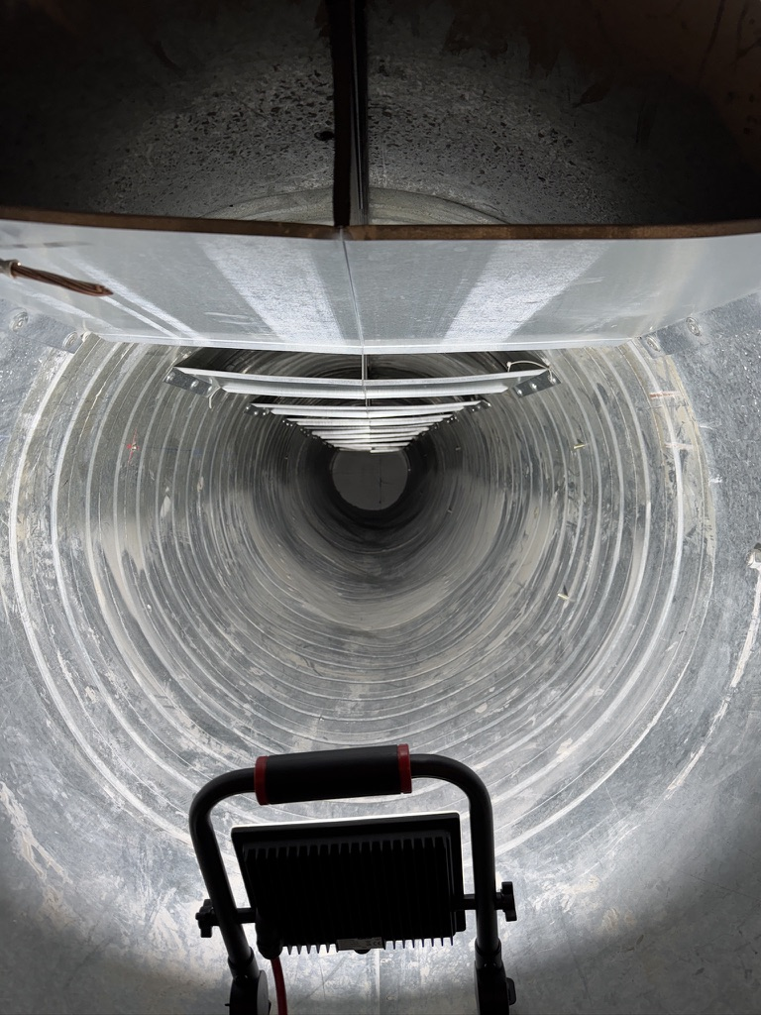
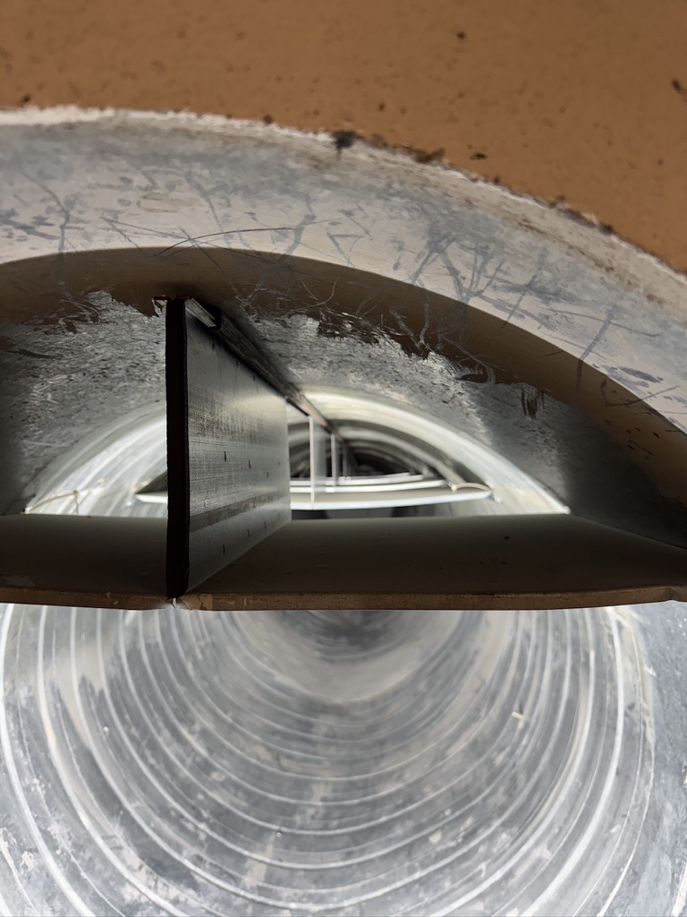
MAPP Outrigger
MoEDAL
CNC router to Alberta now installed and running
Test cuts done to produce layer 4 scintillator panels using repurposed scintillator lent by the Alabama group
3 of 20 pieces cut
New tooling on order to try and improve surface quality
During TS1 measurements made of duct 4 to verify dimensions
Outrigger work independent of MAPP commissioning

Slide 9
YETS 2025-2026
MoEDAL
No MoEDAL/MAPP work planned for TS2
YETS 2025-2026
MAPP
Install 7th ADC board
Finish cabling calibration LEDs
Install calibration boards
Install front veto panels (10mm plastic scintillator)
MoEDAL
Remove 2025 NTDs
Remove some NTD infrastructure and forward MMT
Required for normal VELO alcove work
Hopefully don’t need to remove VELO TOP
Install new NTDs at end of YETS
Move TPX low voltage power supply to electronics barrack
Requires pulling a new cable (if possible)

