Slide 1
B-train White Rabbit 6.0 upgrade
TE-MSC-MMM B-train team
27/08/2025

Slide 2
1. Introduction

Slide 3

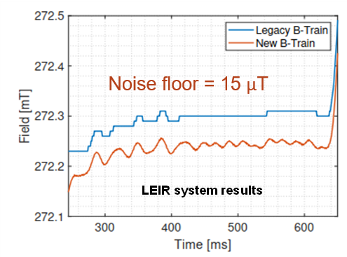
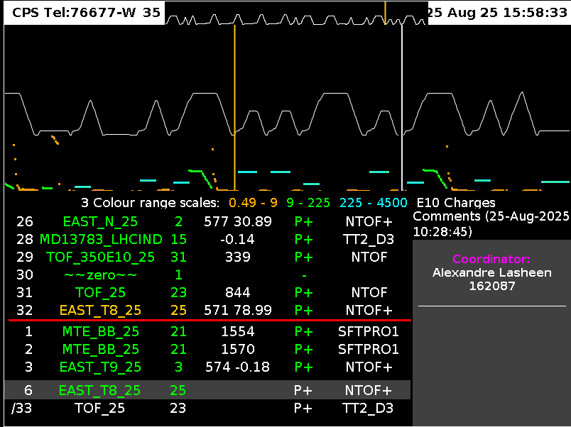


White Rabbit B-train frame
Active = copy of whichever version is chosen by OP Switch via FESA parameter, requires resynchronization (mechanism to be improved)
Measurement (as precise as we can get!)
Simulated = image of LSA cycles
https://gitlab.cern.ch/BTrain-TEAM/Btrain-over-WhiteRabbit/-/wikis/wr-btrain-frame-format
Old B-train hardware removed Empty frame slot could be re-used
Synthetic = mathematical model B=f(I)
Notes:
Future Strategy (Vincenzo)
Measurement:
Refurbished coil and markers for the SPS integral fluxmeter.
Integral measurement coil for the PS Reference magnet.
Harden markers and marker signal detection learning from the lesson of Run3.
Continue to maintain the current hardware and software, answering, where possible, any upcoming request from the operations.
Simulated:
Continue the cooperation with SY-RF-BR(PSB), BE-ABP-LNO(PS), and BE-CSS-DSB(SPS) to develop measurement driven simulation strategies (digital twins).
The objective is to build a simulated field calculated in real time in the hardware from the current sent to the magnet.
The difference with respect to the current simulated B-train is the possibility to predict also the magnets non linearities such as eddy-currents and hysteresis.

Slide 4
User options (AFAIK)
 | EPC | RF | BI, ABT
NO BTRAIN | Open-loop I(t) Fine-tuned by trial-and-error | Frequency Program Fine-tuned by trial-and-error (best for unchanging cycles) Promising Machine Learning approach (EPA) Errors must remain within radial loop correction range | Frequency Program Precision sufficient (LEIR, AD, ELENA)
MEASURED B-TRAIN (w/ or w/o field marker) | B(t) feedback Ensure desired magnetic cycle plays | B(t) feedback More margin left for the radial loop Field marker → capture of hysteresis effects Perturbations from field ripple, measurement noise | B(t) feedback High precision, not really needed
SIMULATED B-TRAIN | n.a. | Nominal cycle Ad-hoc trims needed | Nominal cycle No advantage vs Frequency program

Slide 5
B-train users (2025)
 | White Rabbit users
Machine​ | SY-EPC | SY-RF Tomoscope RF train | SY-BI (β norm in BCT, Orbit) | SY-ABT (SPS beam dump)
LEIR​ | ─ (closed-loop possible) | ─ Internal LLRF B function/Measured​ | ─ (BCT uses the Frequency Program from LLRF) ​ | ─
PSB​ | Measured​ | Simulated (modified with ad-hoc functions) ​ | Measured​ (TBC) | ─
PS​ | Measured​ (POPS; PFW under consideration) | Measured | Measured​ (TBC)​​ | ─
SPS​ | ─ (closed-loop possible) | ─ Internal LLRF B function/Measured​ | ─ (TBC)​​ | ─ (dump triggered by TSU) ​
AD​ | ─ | Simulated (Measured not available)​ | Measured (BCCCA; BCT uses the Frequency Program from LLRF) ​ | ─
ELENA​ | ─ (closed-loop ready) | ─ Internal LLRF B function/Measured​ (switch to Simulated under consideration)​ | ─ (BCT uses the Frequency Program from LLRF) ​​ | ─
Other users:
Machine operations (beam diagnostics)
Real-world training data for Machine Learning models
Magnet characterization, B-train internal diagnostics
Notes:
PSB RF: Diego Barrientos
PS RF: Ben Woolley
SPS RF: Arthur Spierere
PS BI: Tom Lewens
PS BI (NCCA) Gunn Khatri

Slide 6
2. Roundtable and discussion

Slide 7
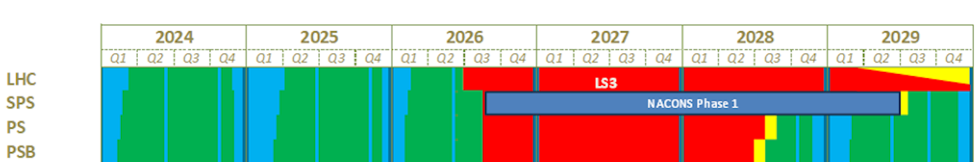
TE-MSC B-train planning
HW drivers update for Debian
Other internal updates, offline tests (drift correction, diagnostics, magnetic sensors)
update to WR6.0, internal tests
WR6.0 offline TX/RX tests
Injection chain commissioning
AD/ELENA schedule not included here yet

Slide 8
Questions for B-train WR users (+ OP teams …)
Do you want to keep using B-train (Measured and/or Simulated) at all
Do you want to upgrade to V6 ? Or take the risk of using unsupported version
Any interest in new HW board types (e.g. standardize with CUTE)
Any interest in doubling up the fibers/switches for redundancy ?
Can you estimate the upgrade workload
Upgrade with internal resources possible ?
Alternatives if not: - Shared Post(s) (e.g. Grad): repartition of costs ? Supervision ? - CONS request (deadline soon!) - other ideas ?
Can you schedule a time frame for testing off-line (before commissioning )
Notes:
Time series forecasting ?

