Slide 1
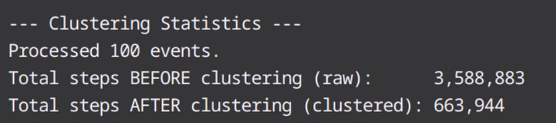
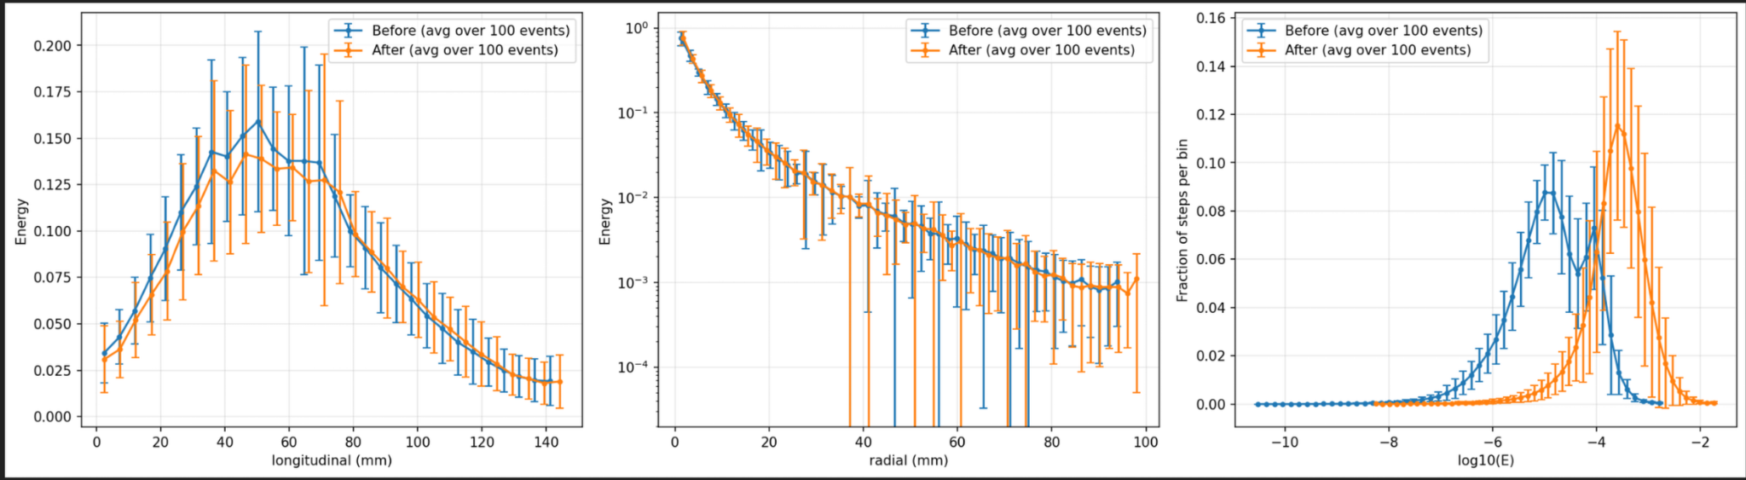
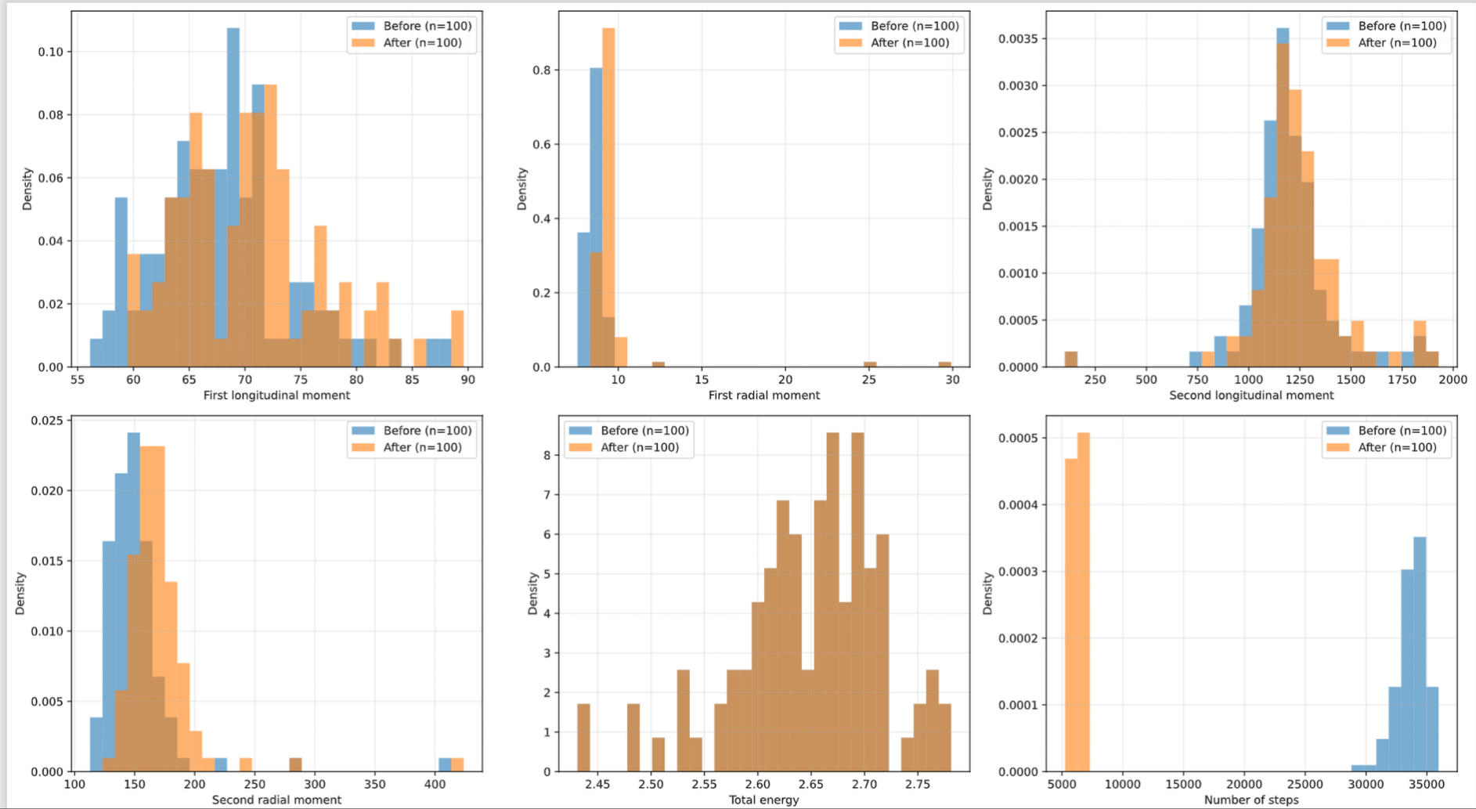
Baseline Results
This shift towards the right in the log10 energy profile plots has been a repeating pattern and i think it's due to the fact the energy sums are larger than the typical individual step energy on average so the distribution of energy moves to higher values.Therefore resulting in the rightwards shift.

Slide 2
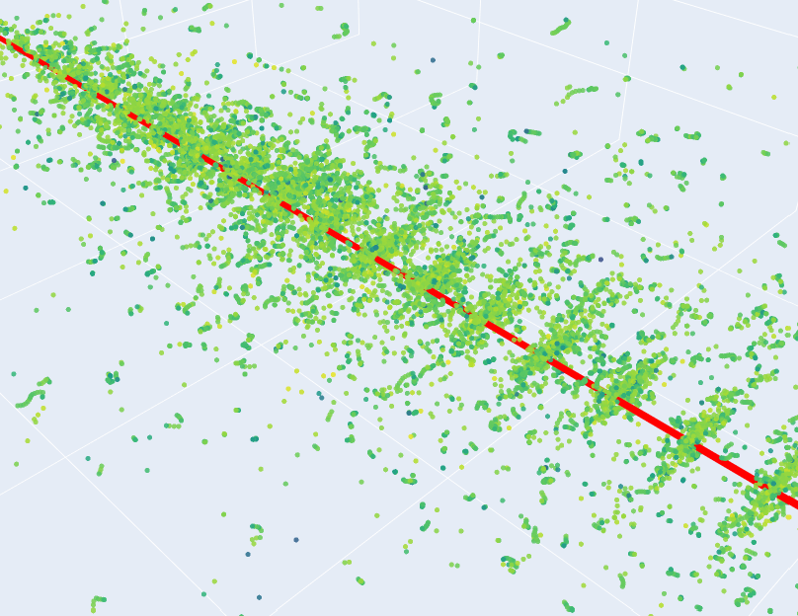
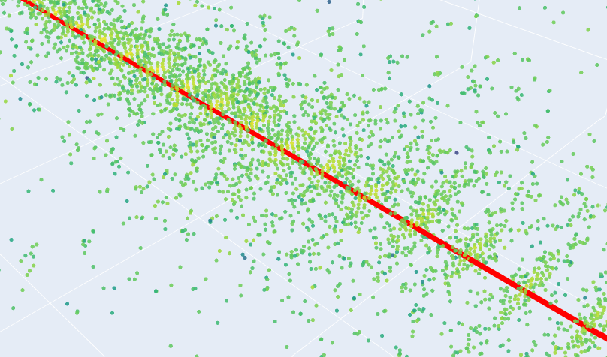
Before Clustering
After Clustering

Slide 3
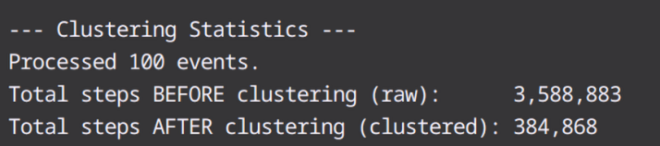
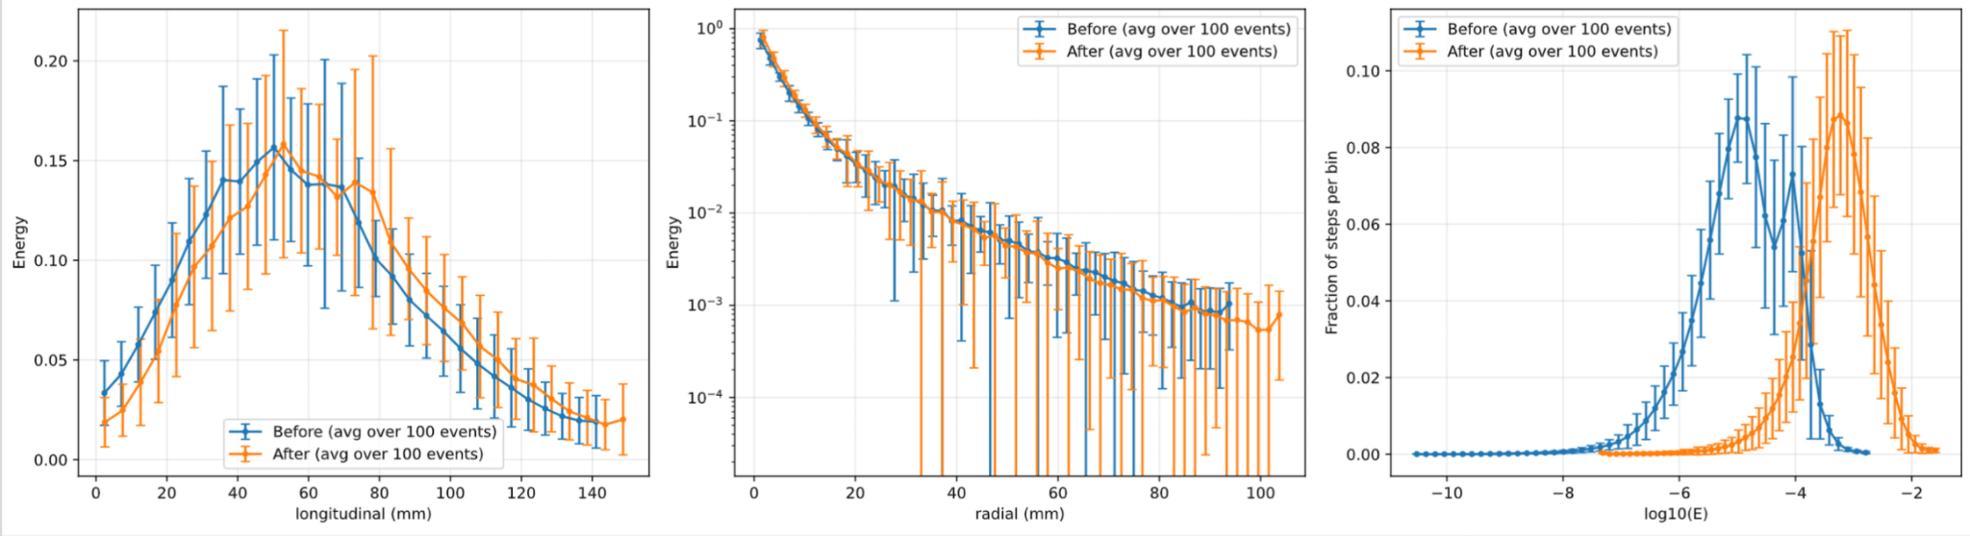
Detector Independence
We first calculate the shower axis using an energy weighted PCA
Create a new temporary coordinate system for that shower.
W→distance along shower axis
(u,z) →transverse plane, perpendicular to the shower axis
Create our own pseudo layers
Apply the same grid based clustering

Slide 4
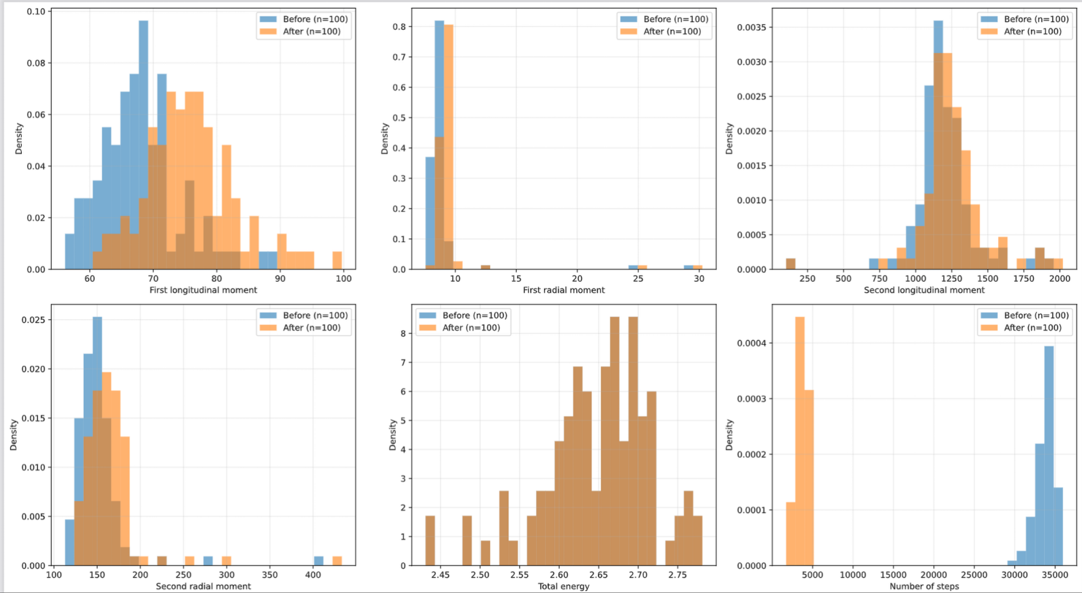
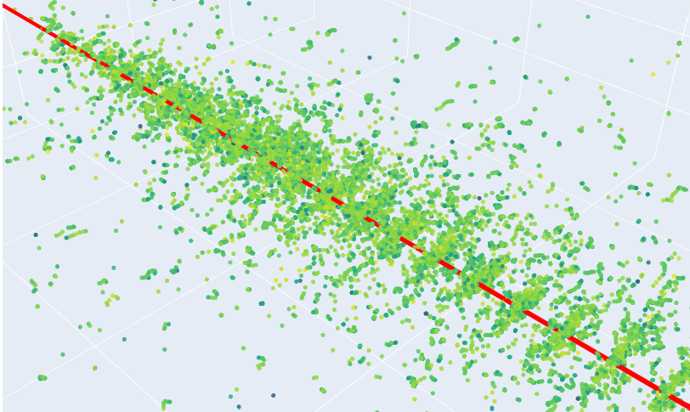
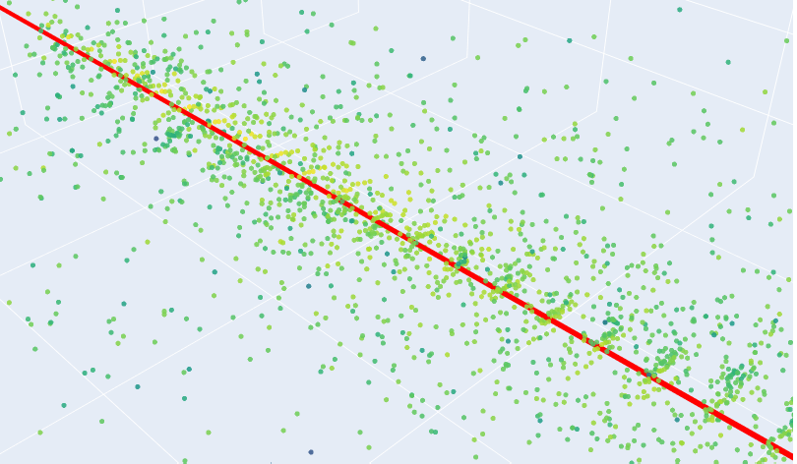

Slide 5
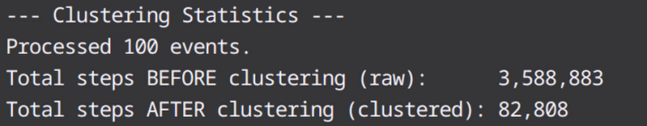
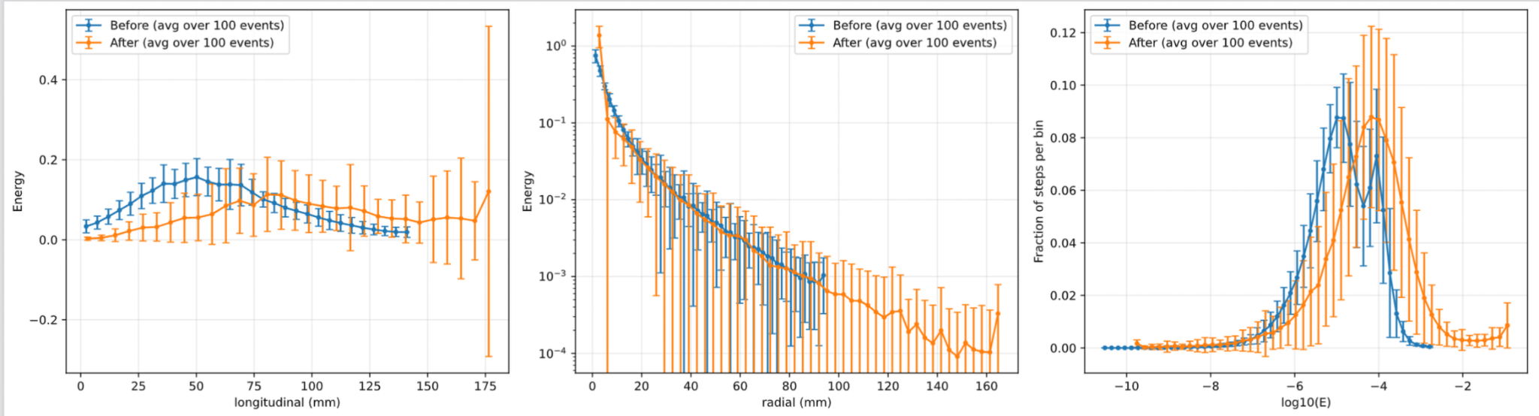
Different Clustering Strategies
Connected Components: With our original approach, we treat each occupied bin as one cluster
Conceptually this asks which occupied bins are neighbours on the grid and belong to the same contiguous cluster. It then merges all the adjacent occupied bins into a component and makes one cluster per component

Slide 6
Detector Readout Issue
The detector readout if i'm not mistaken is a list of hits per cell so the actual detector will never see the raw geant4 steps or the clusters
What i have been doing is creating a map of:
Unique cellID’s that contributed to the cluster
Sum of step energies per cellID within the cluster
Take the earliest step time per cellID within the cluster
Position?
Then projecting to the readout by looping through each cellID, event and adding up the clusters energy and keeping the minimum time.
Then to have proper validation, it makes sense to do the same thing directly to all the raw steps then if the readout_from_clusters = readout_from_raw_steps then we know the detector cant tell a difference.
Thinking about where my validation is going wrong:
Compute a global shower axis from before clustering (PCA)
I have realised that we are filtering incorrectly.The 1/99 percentiles are computed separately on the before and after distribution and since this cut only uses counts of steps
The profiles are then based on these filtered data
We are obviously not considering the detector readout, but how would we do this?

