Slide 1
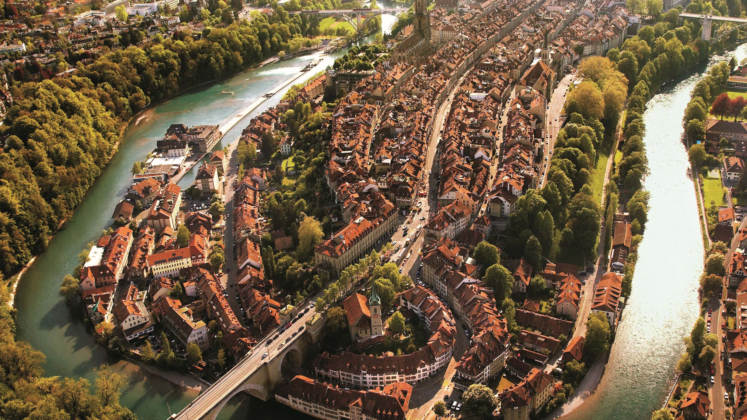


Setup of a probe station for FCC
and first measurement
Yau King Ying (Harrison)

Slide 2
Table of Content
Today’s Discussion
Motivation for my project
What is FCC?
Why do we need a probe station for FCC?
Setting up analysis code
Objectives and goals
Software development
Setting up fully functioning probe station
Validation measurements
Research methodology
Results
Conclusions and future prospects

Slide 3
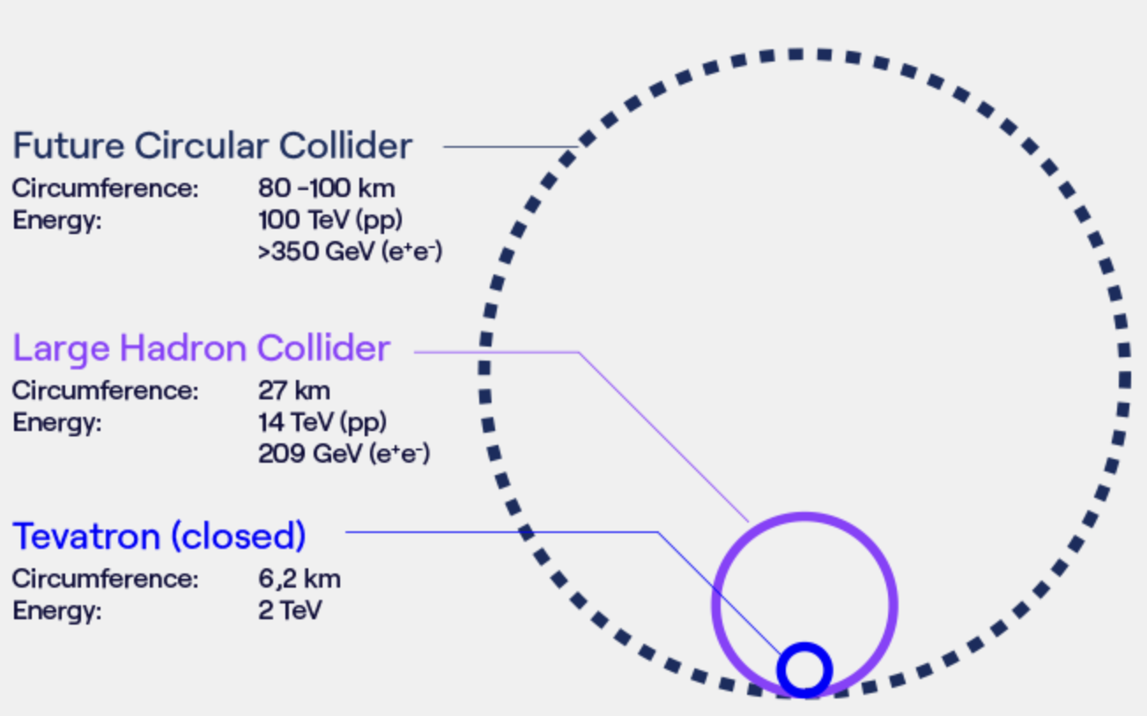
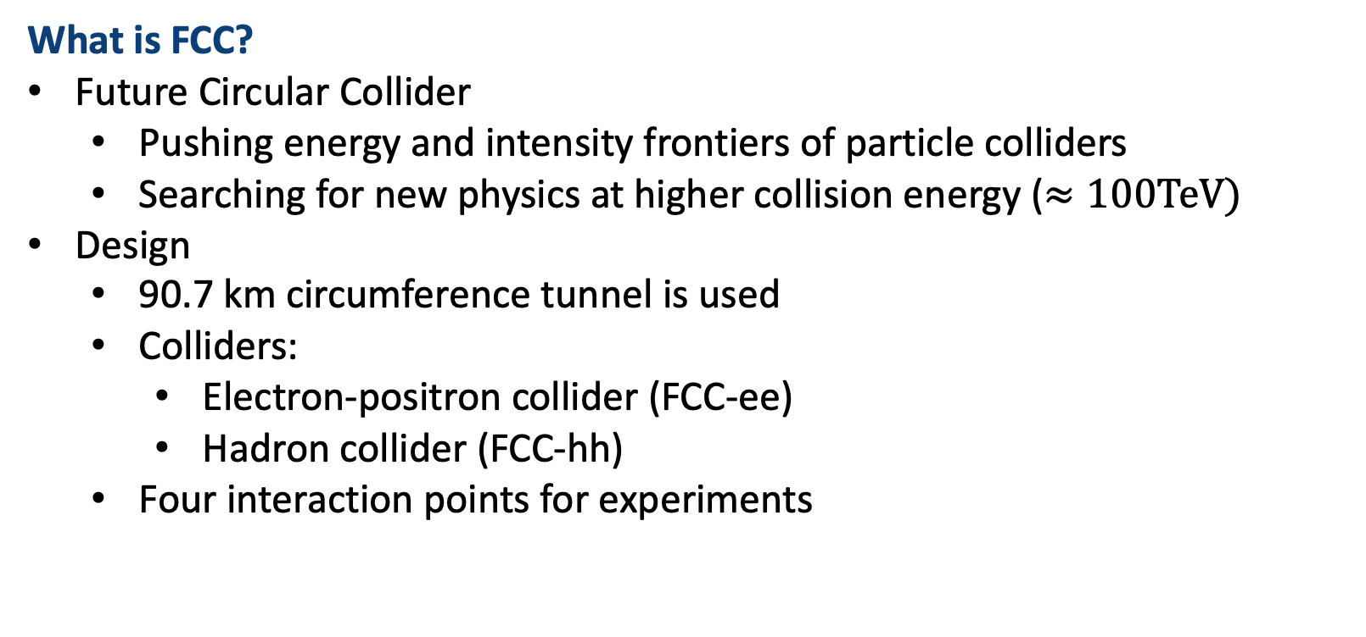
Motivation for my project
What is FCC?
Future Circular Collider
Pushing energy and intensity frontiers of particle colliders
Searching for new physics at higher collision energy ($≈100TeV)$
Design
90.7 km circumference tunnel is used
Colliders:
Electron-positron collider (FCC-ee)
Hadron collider (FCC-hh)
Four interaction points for experiments

Slide 4
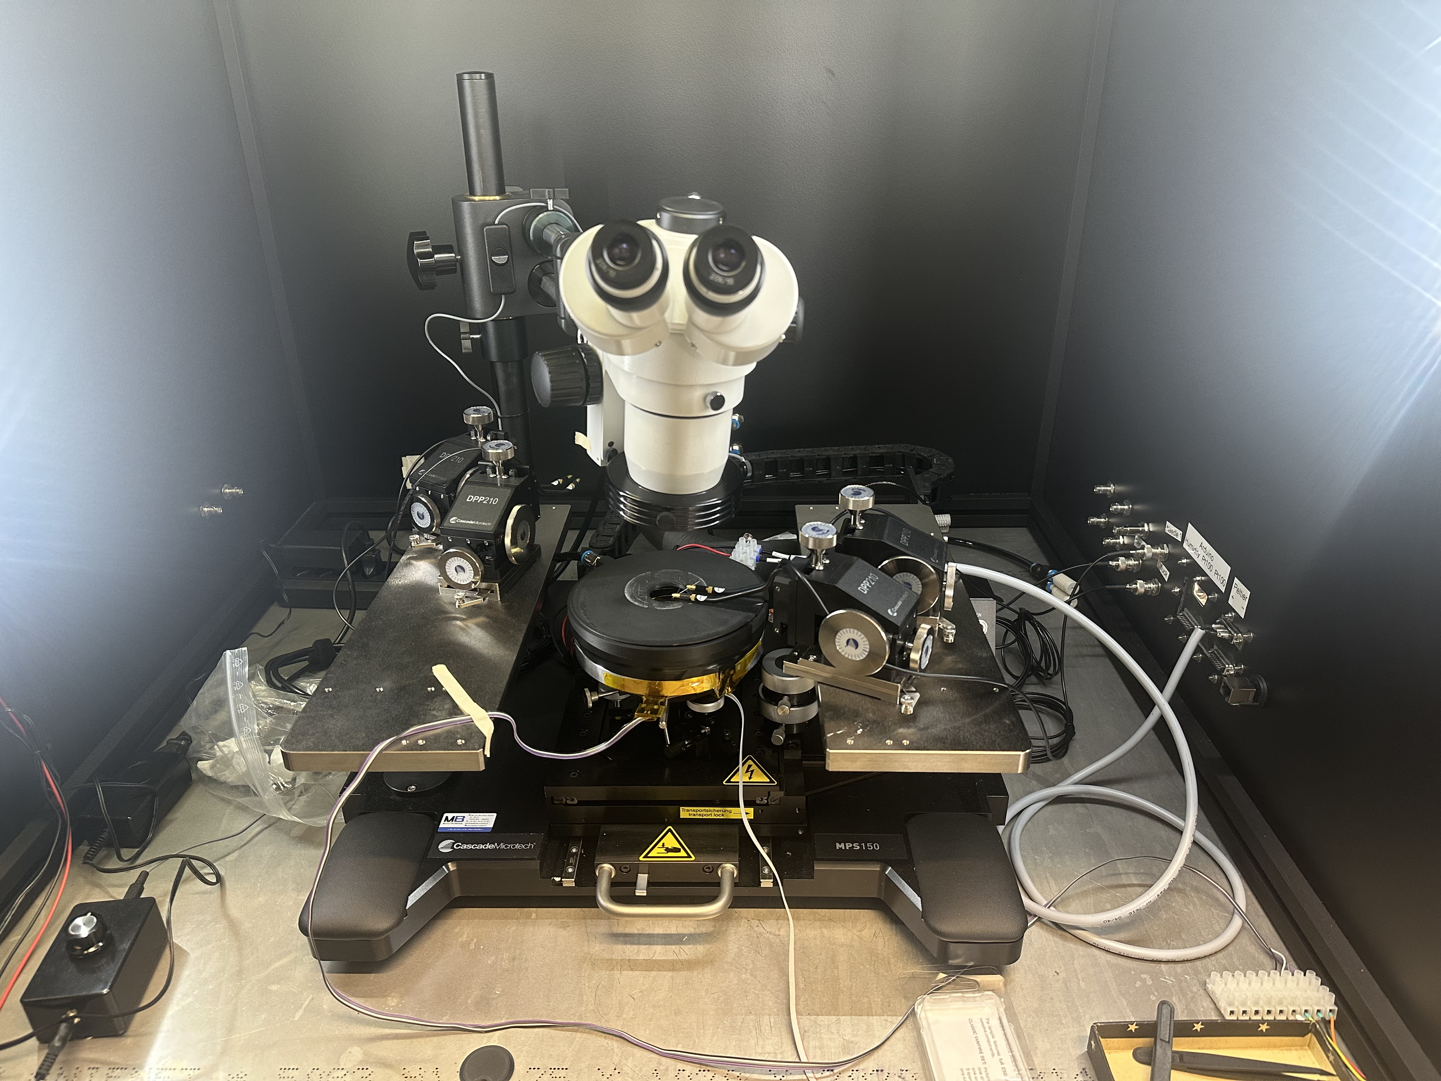
Motivation for my project
Why do we need a probe station for FCC?
Performance optimization
Component validation
R&D for new sensor
Explore new technologies for FCC
LGADs (timing sensors)
AC-LGADs
For example: Timing at the FCC-ee
Improve event reconstruction
Provide a time-of-flight measurement for particle ID
Improve momentum resolution in tracking system

Slide 5
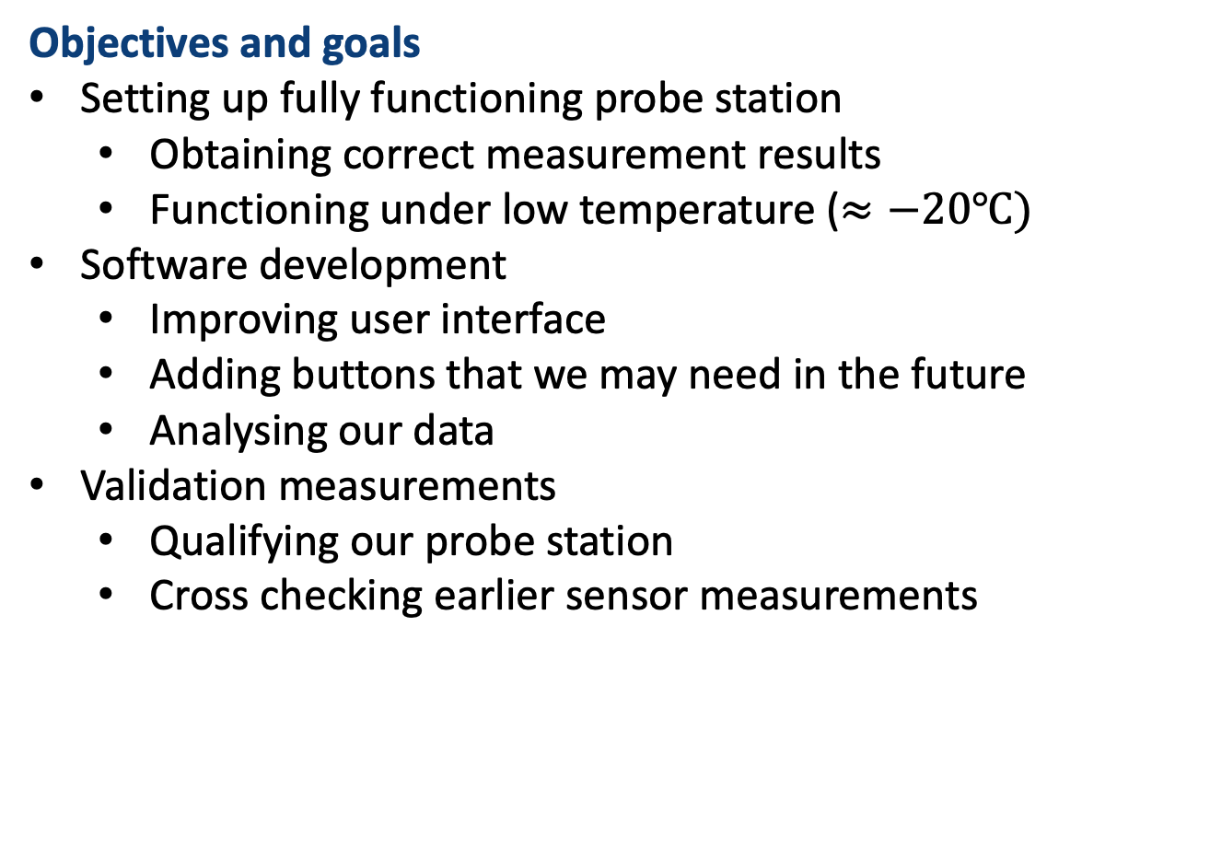
Objectives and goals
Objectives and goals
Setting up fully functioning probe station
Obtaining correct measurement results
Functioning under low temperature ($≈−20℃)$
Software development
Improving user interface
Adding buttons that we may need in the future
Analysing our data
Validation measurements
Qualifying our probe station
Cross checking earlier sensor measurements

Slide 6
Research methodology
How do we accomplish our goals?
Setting up fully functioning probe station
Fixing hardware issues
Implementing a proper temperature control unit
Software development
Adapting existing code from other institute (very old) to our setup
Adding buttons that we may need in the future
Adopting the old analysis script
Validation measurement
Comparing our results with past measurements
Measuring at different temperature

Slide 7
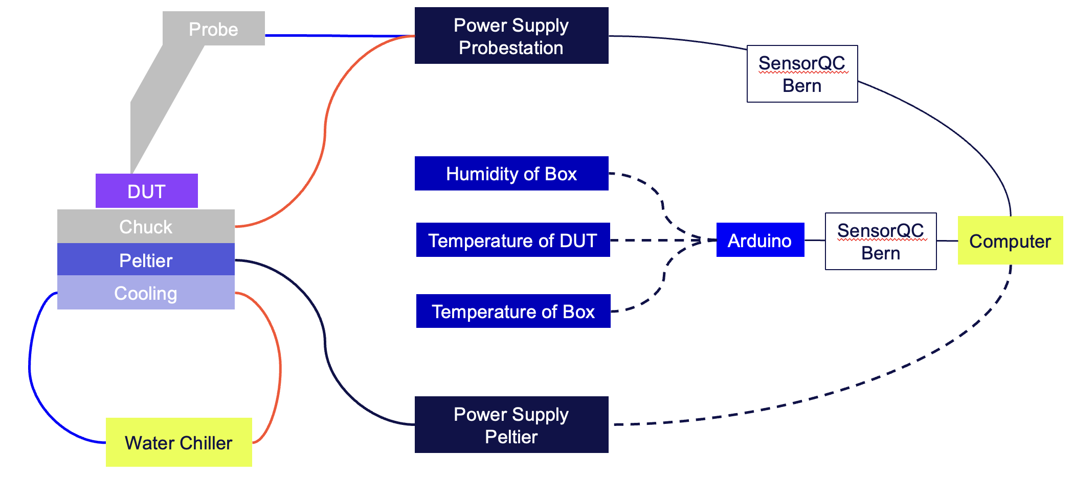
Research methodology
Setting up the probe station
Full setup
Systematic Diagram of the probestation in LHEP Uni Bern

Slide 8
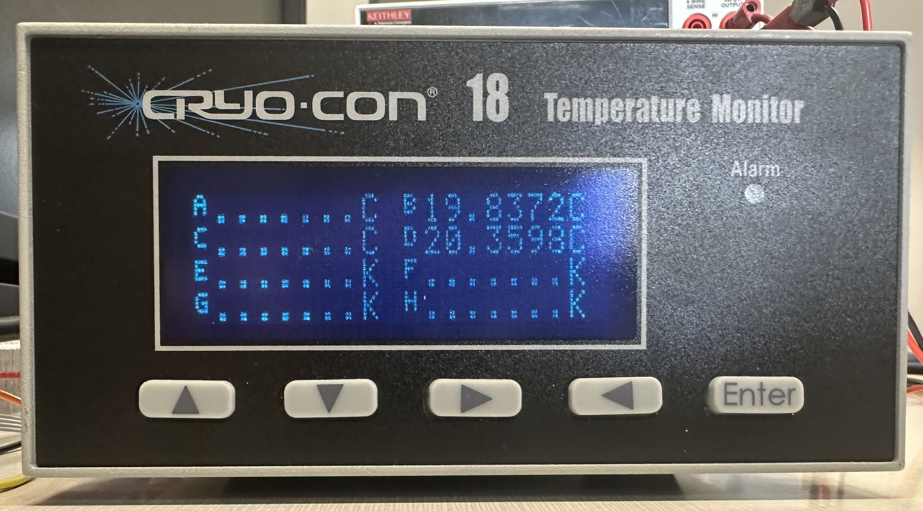
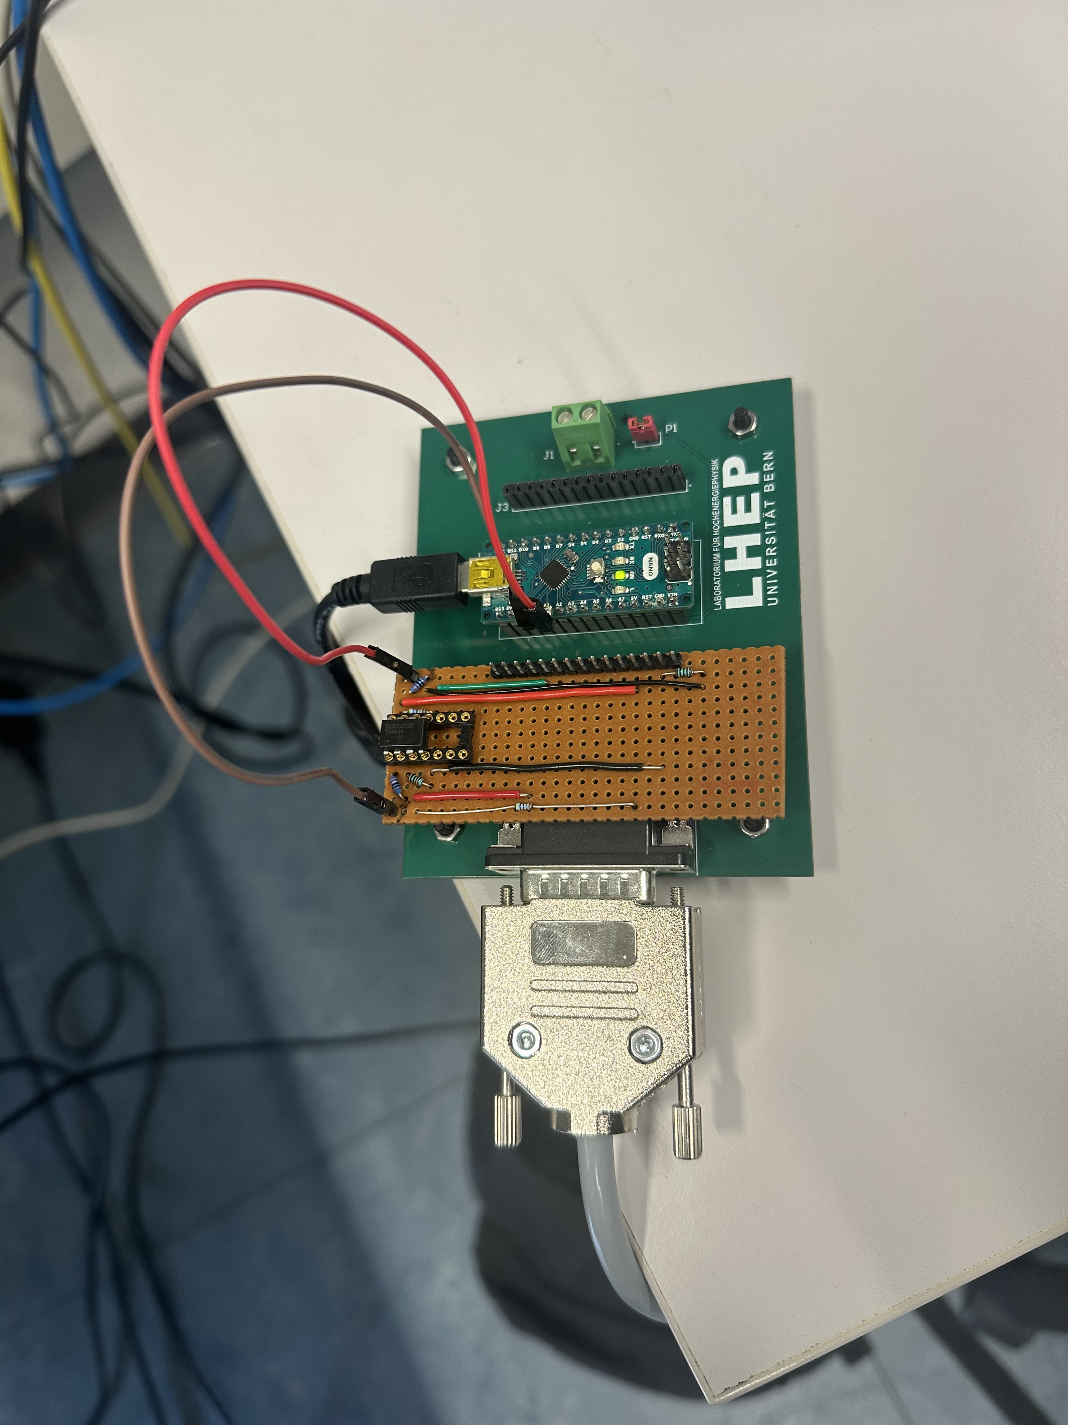
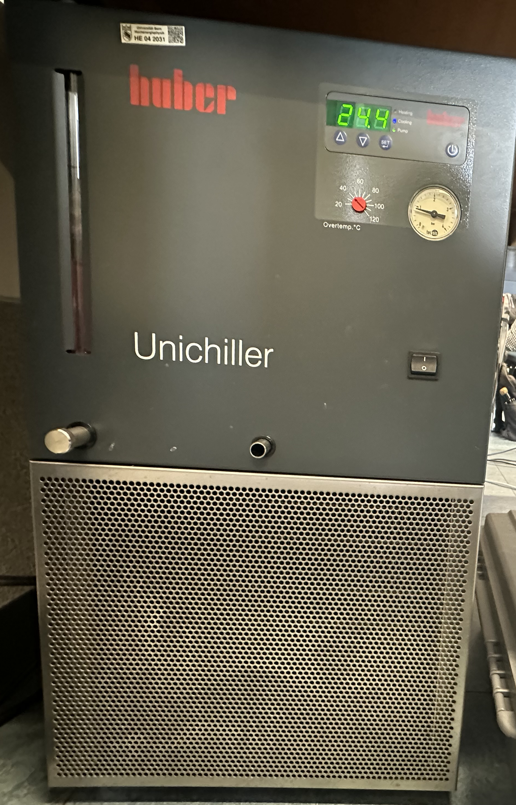
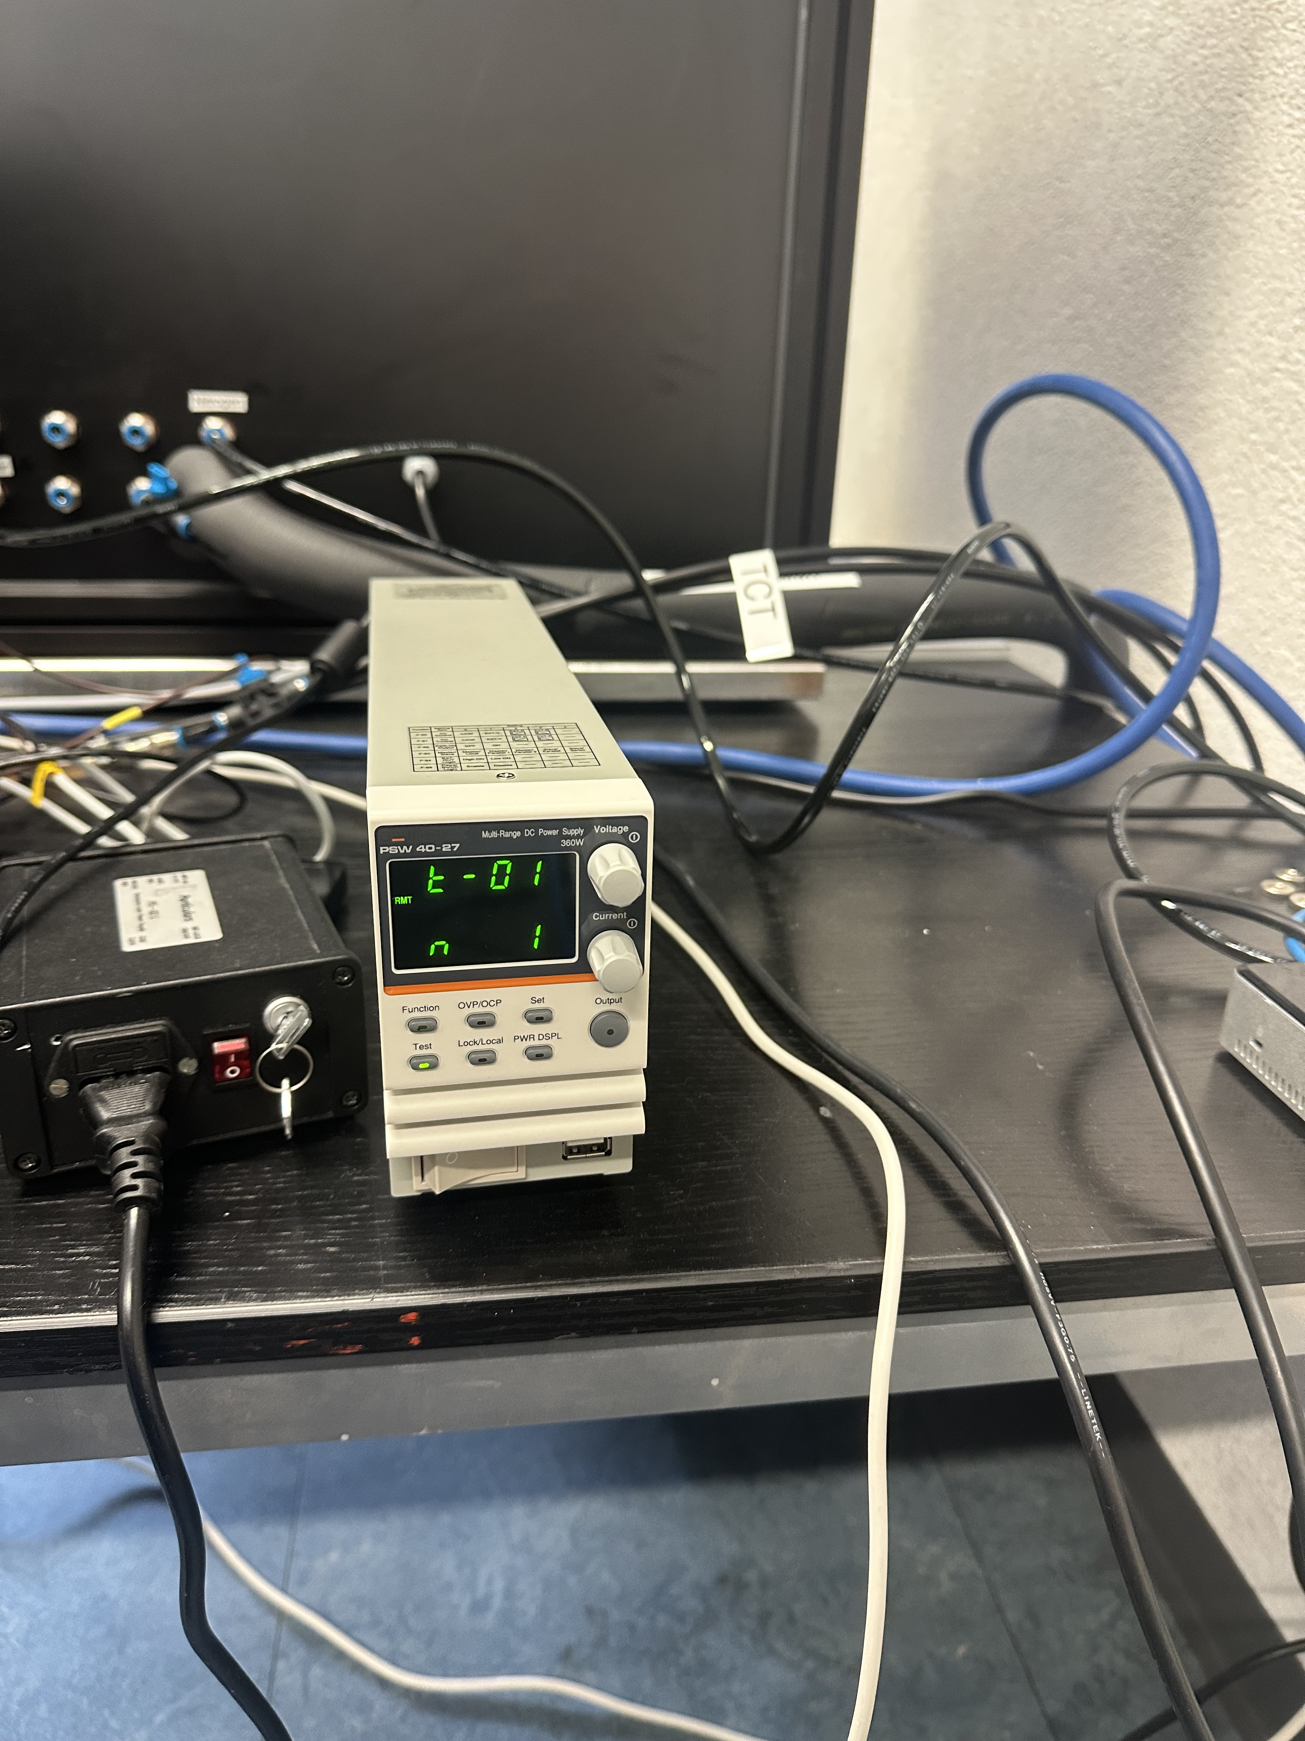
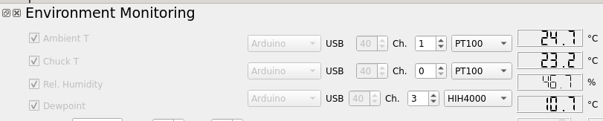
Research methodology
Setting up probestation
Temperature control
Setting up the probe station
Temperature control
Instead of using this…
Temperature monitor(old)
Arduino setup
Power supply for peltier
Chiller

Slide 9
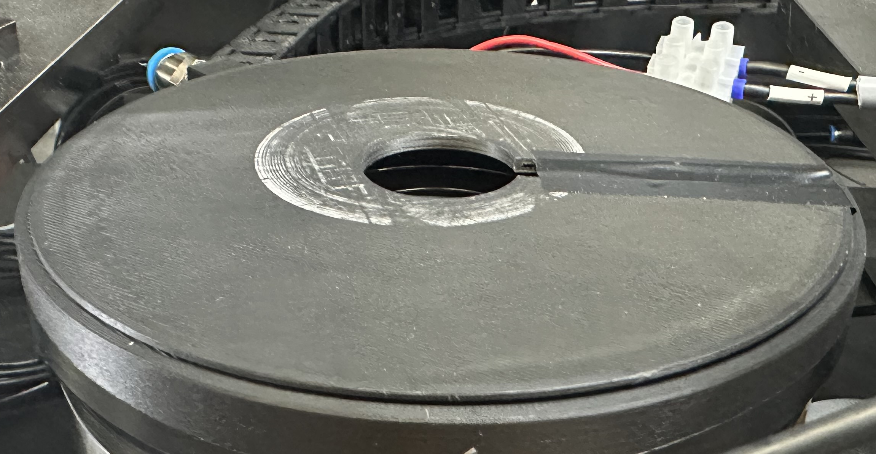
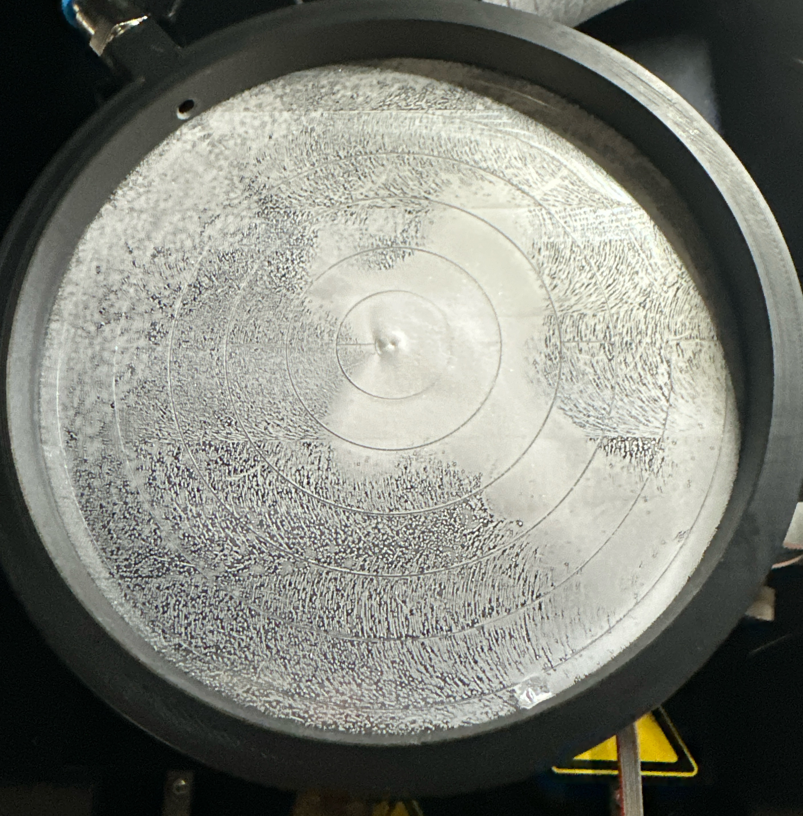
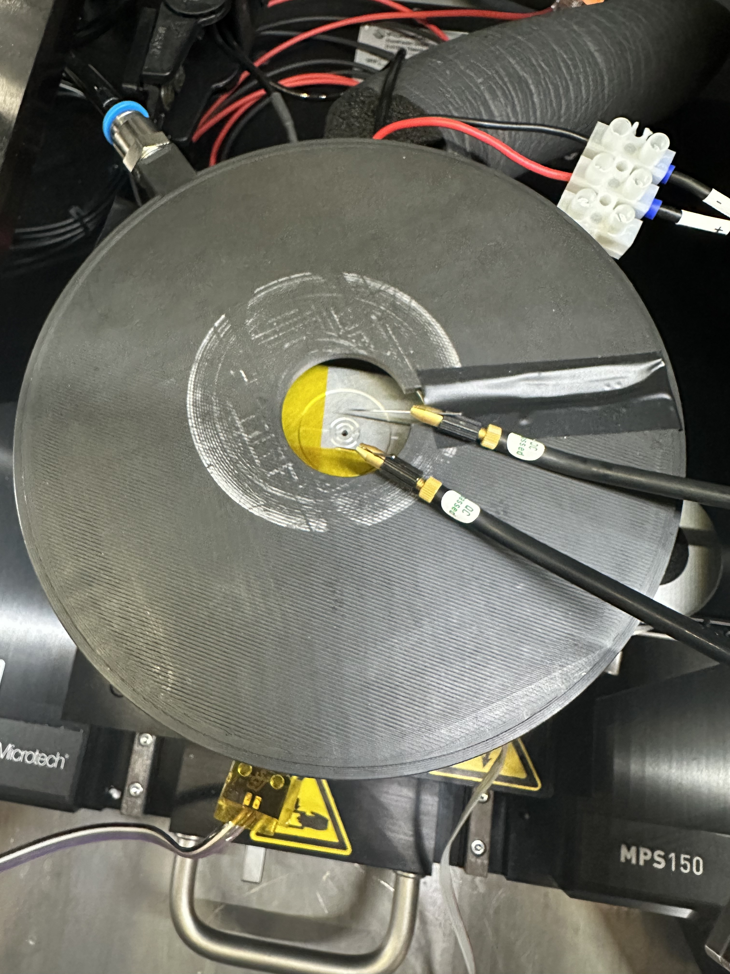
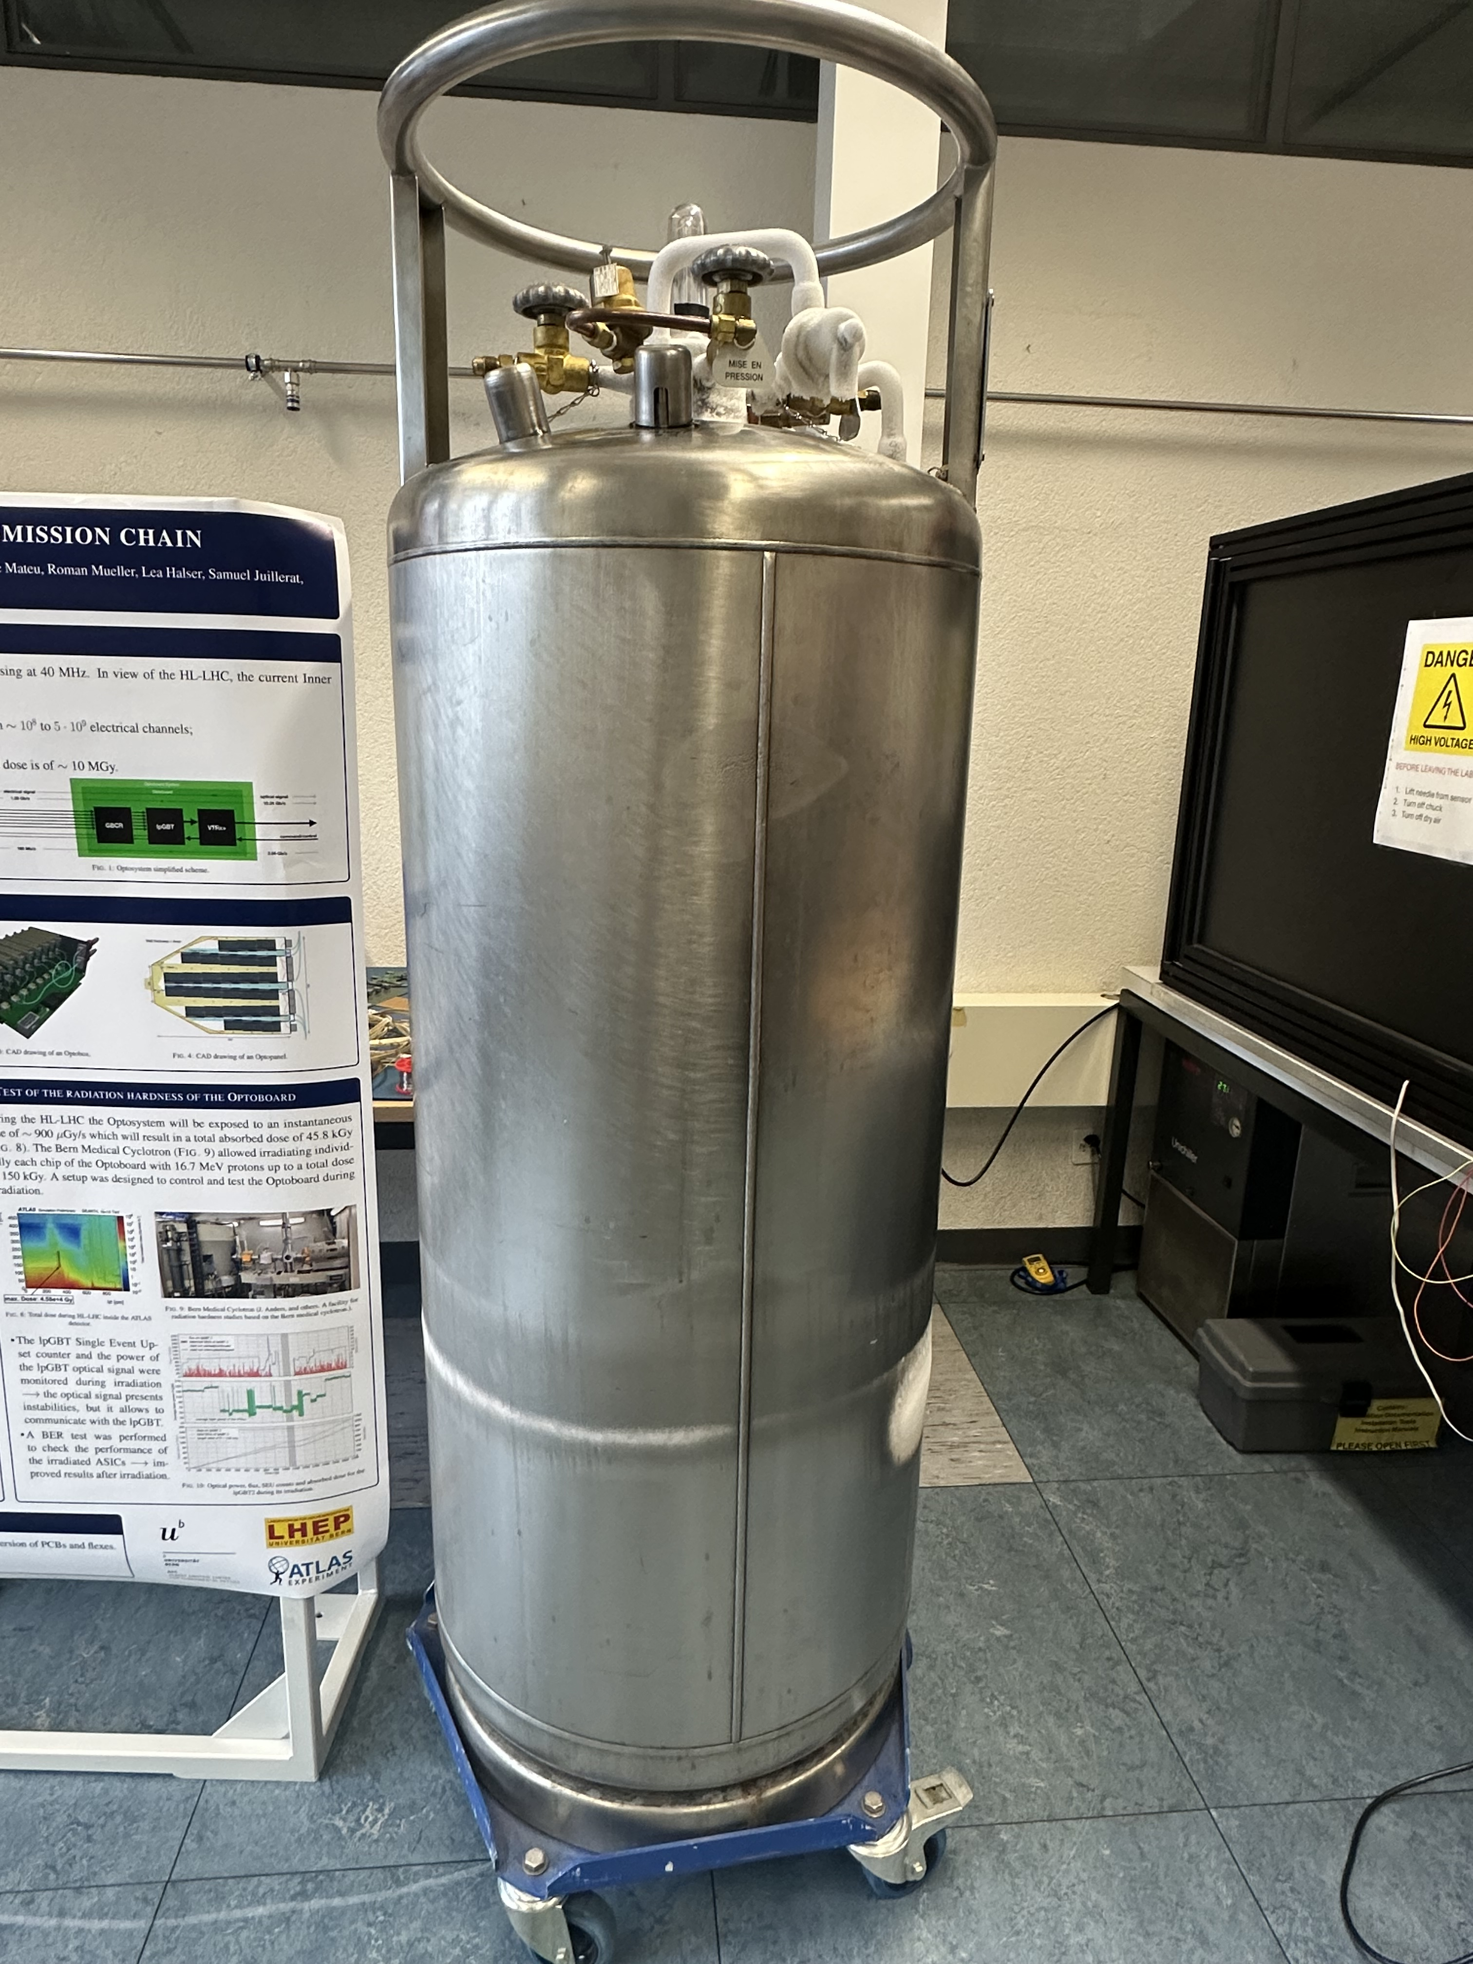
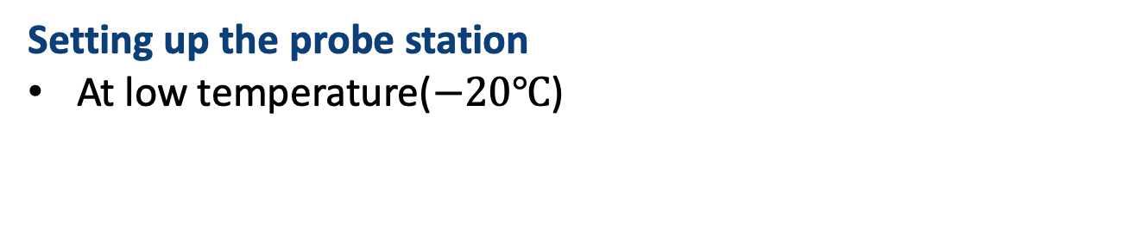

Research methodology
Setting up the probe station
At low temperature($−20℃$)
A Lid for the chuck
Before
$N_{2}$ tank
After

Slide 10

Research methodology
Software Development
GUI

Slide 11
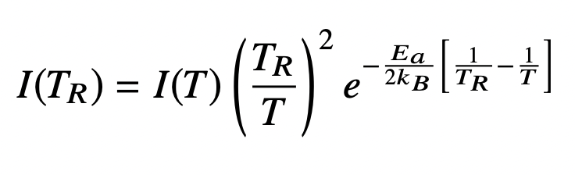
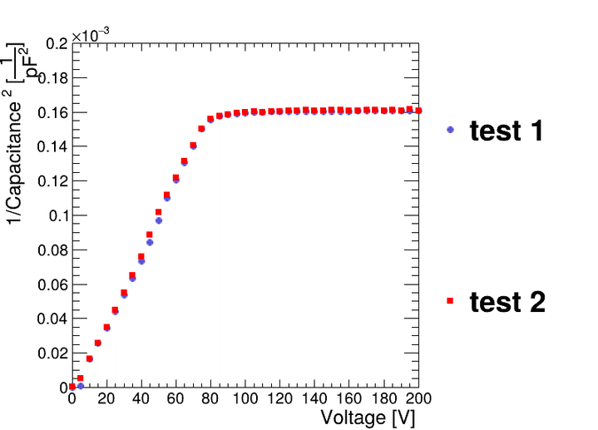
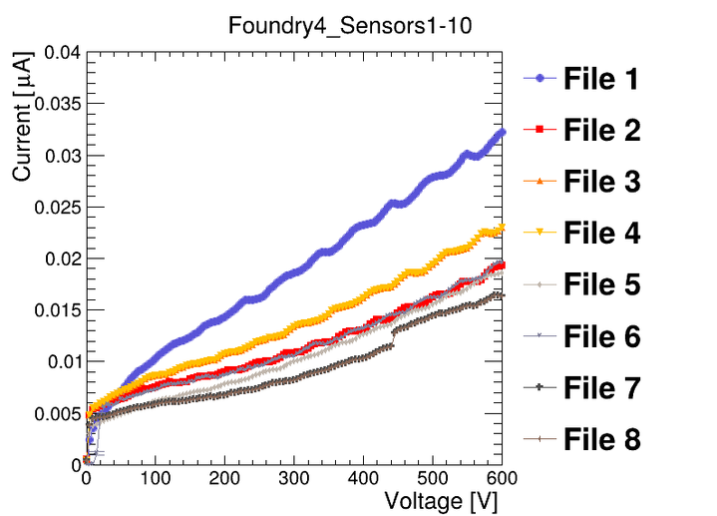
Research methodology
Software Development
Make the old analysis script functioning
Adding temperature conversion equation
Adding options for plotting with different scales

Slide 12
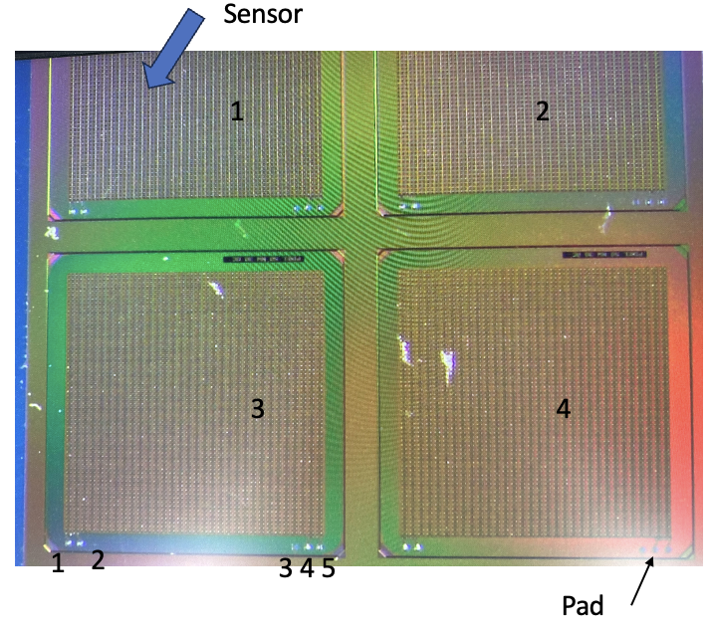
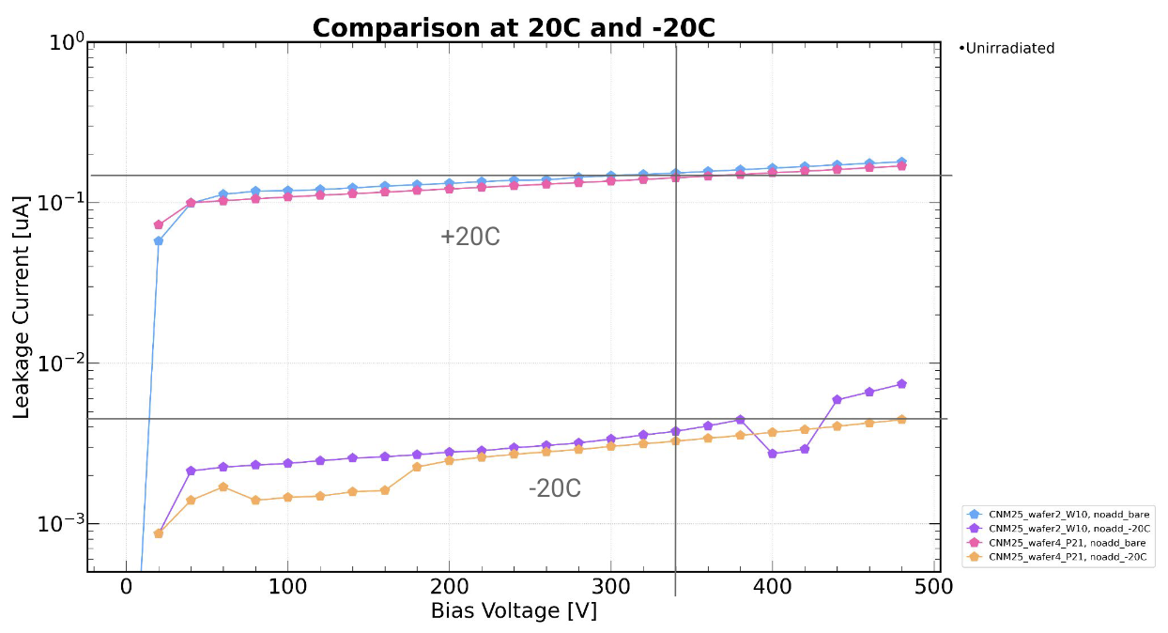
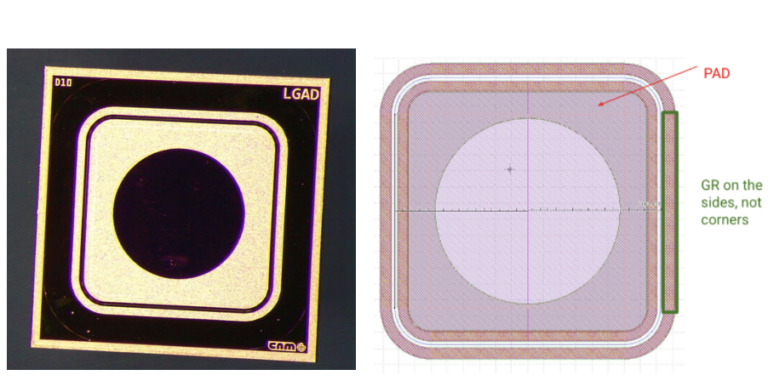
Research methodology
Validation measurements
Probing several pixel sensors using our setup
Comparing our results with past measurements
PIN

Slide 13
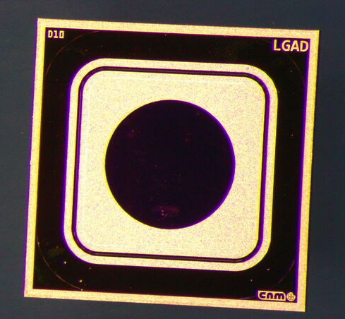
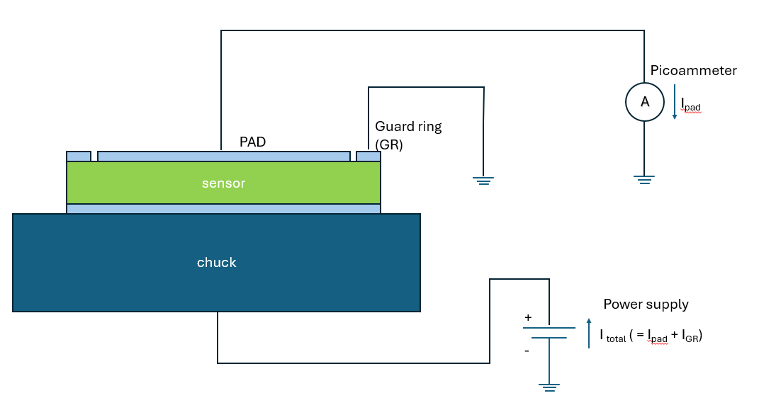

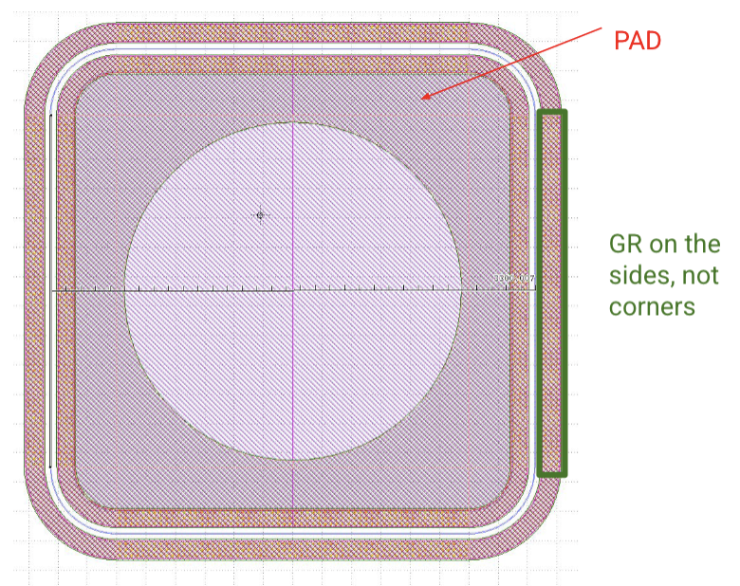
Research methodology
Sensors at LHEP Uni Bern
PIN

Slide 14
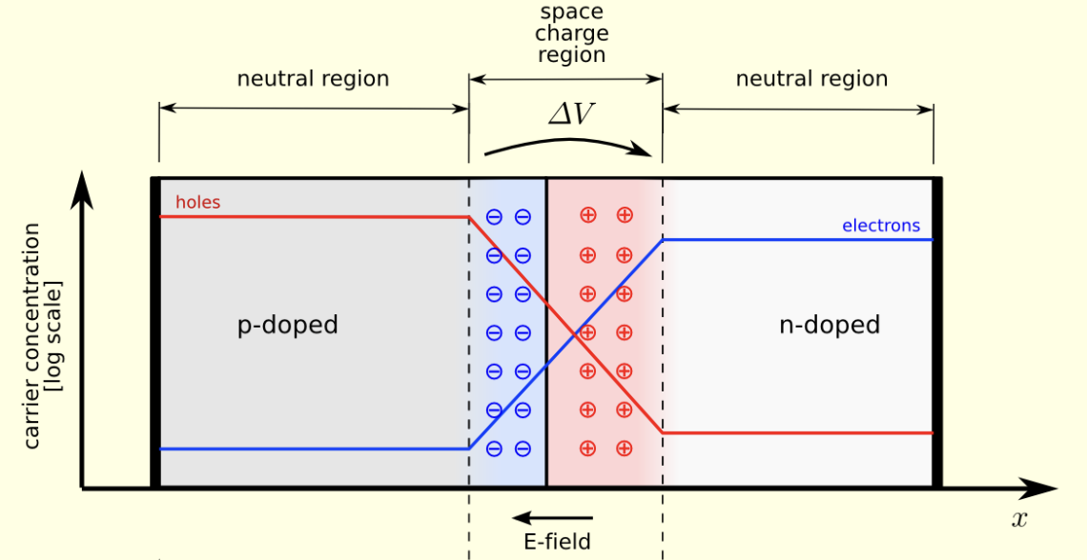
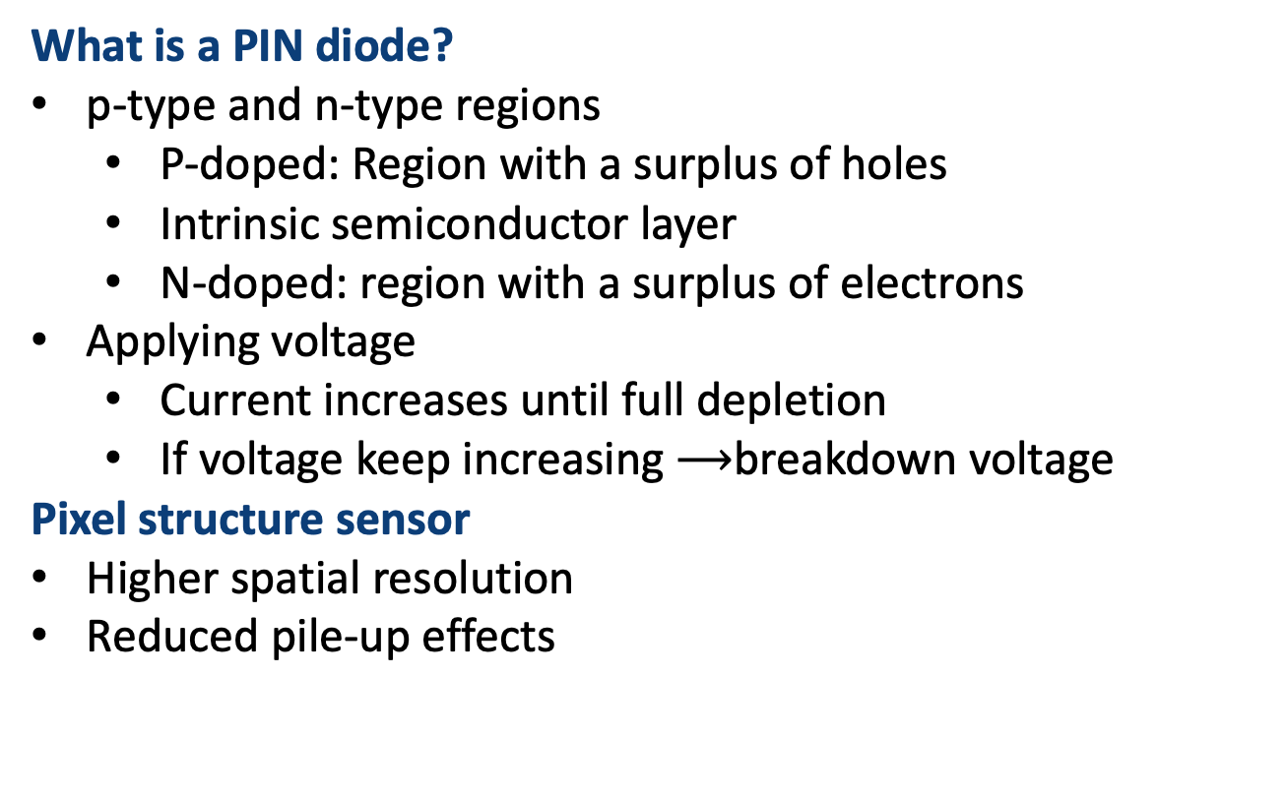
Research methodology
What is a PIN diode?
p-type and n-type regions
P-doped: Region with a surplus of holes
Intrinsic semiconductor layer
N-doped: region with a surplus of electrons
Applying voltage
Current increases until full depletion
If voltage keep increasing $⟶$breakdown voltage
Pixel structure sensor
Higher spatial resolution
Reduced pile-up effects
PIN

Slide 15
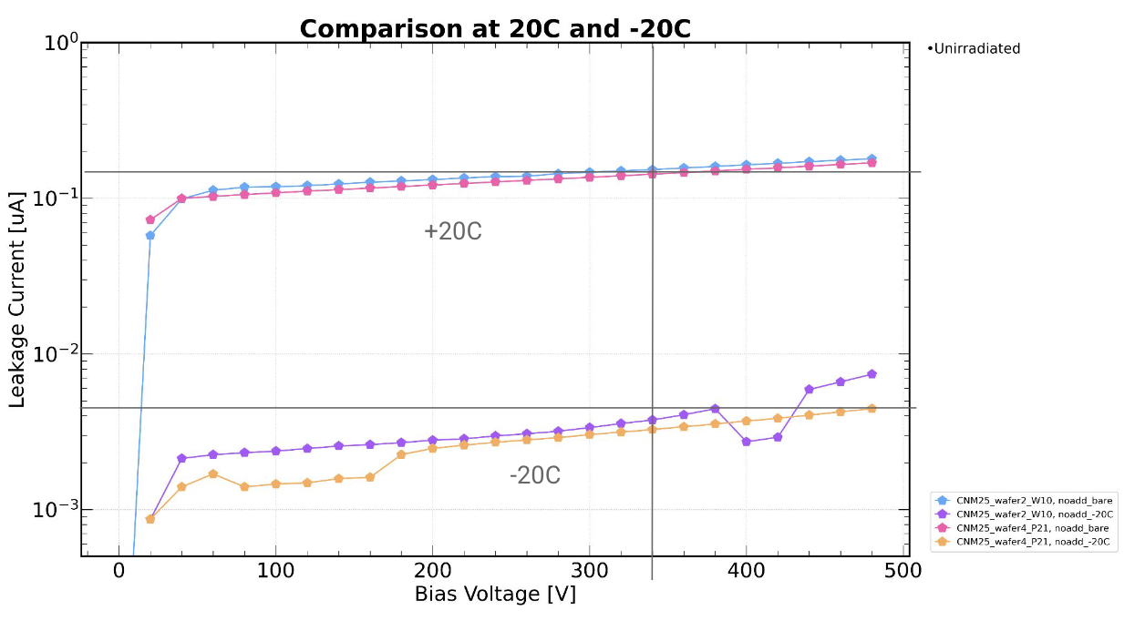




Research methodology
Validation measurement
Measuring our sensors at different temperatures
i.e.$−20℃,20℃$
Temperature conversion equation
, $E_{a}=1.21eV$
Minimising effects due to the temperature dependence of the leakage current
Comparing results at different temperature
Old result at $−20℃$
Old result at $20℃$
Our result at $20℃$

Slide 16
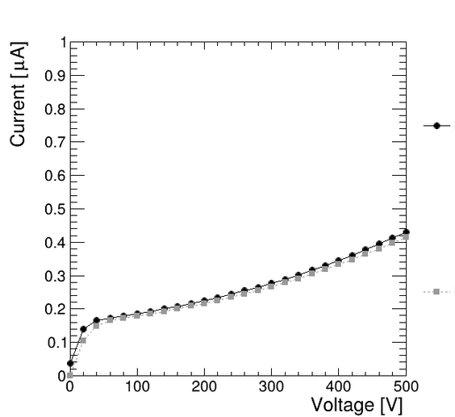
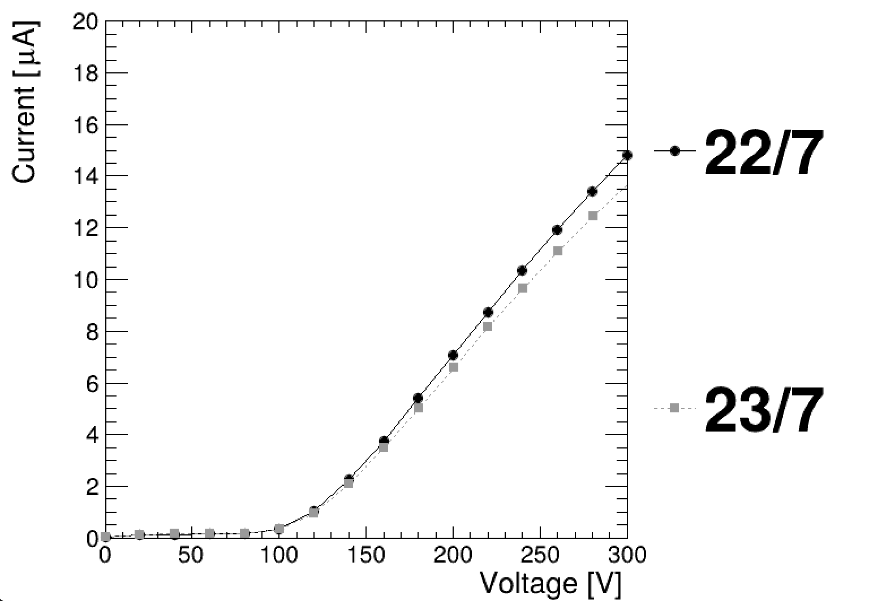
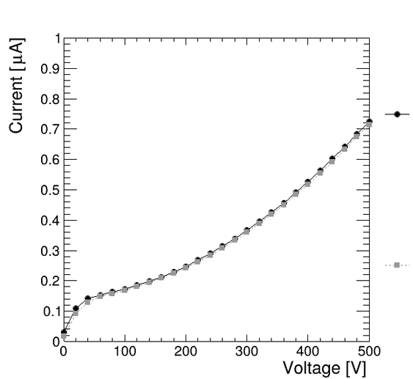
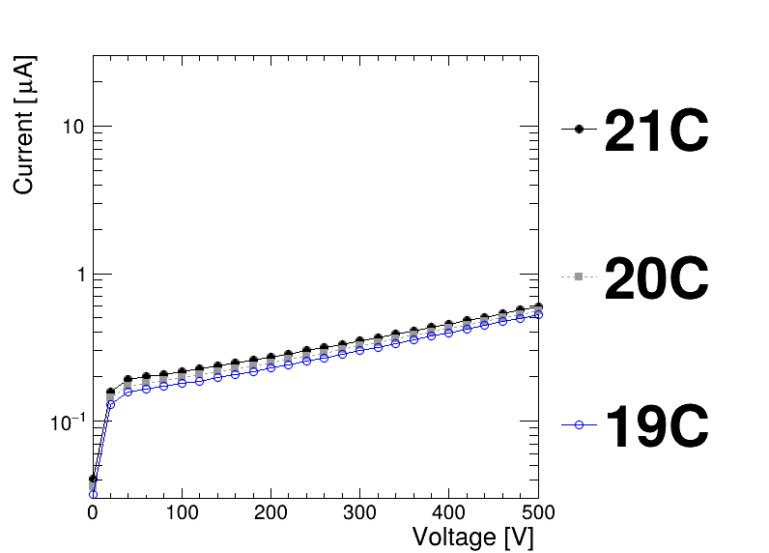
Results(PIN diodes)
Dependency of IV curves with different parameters
Consistency check
No. of needles
Overdrive
Temperature
I04
2 needles
I04
1 needles
More Overdrive
Less Overdrive

Slide 17
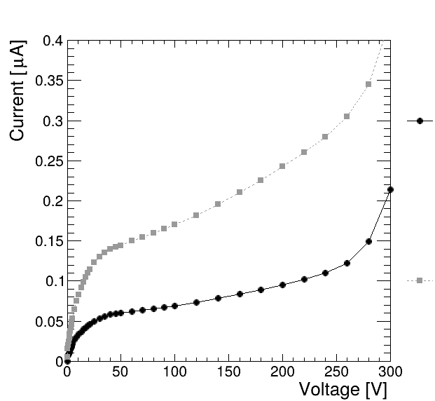
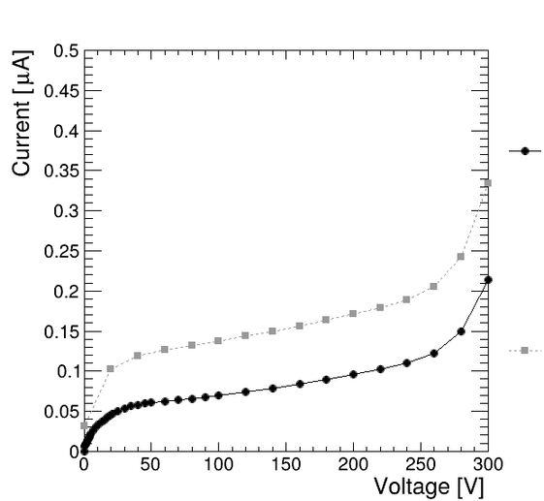
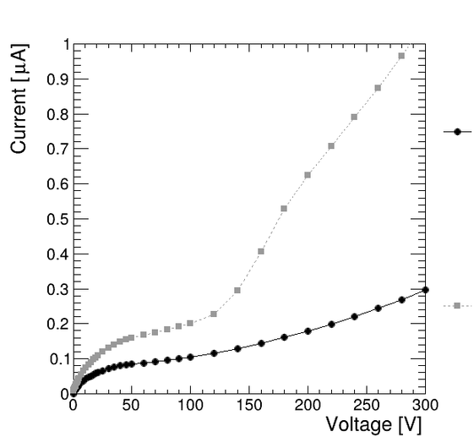
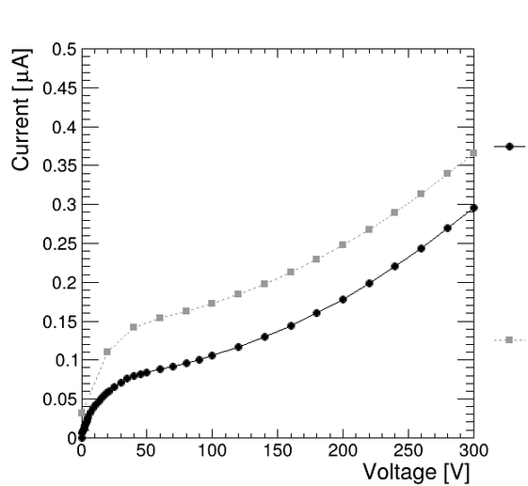
Results(PIN diodes)
Measurement at 20℃
K04 Pad current
K04 Pad current(old)
K04 Total current
K04 Pad current(new)
Pad Current
VS
Total Current
New Data
VS
Old Data
F10 Pad current
F10 Pad current(old)
F10 Total current
F10 Pad current(new)

Slide 18
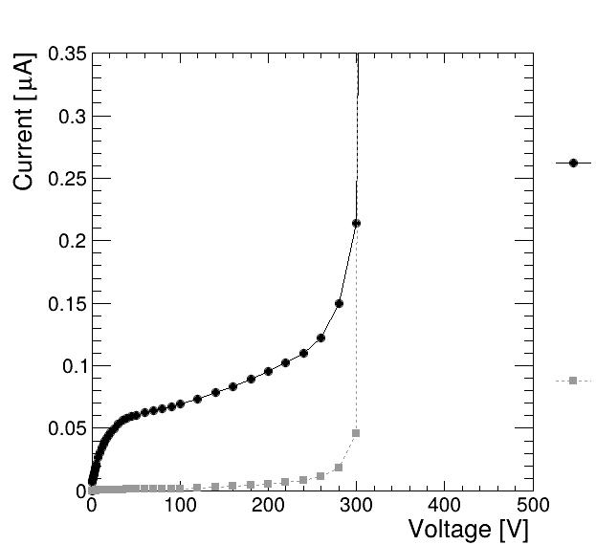
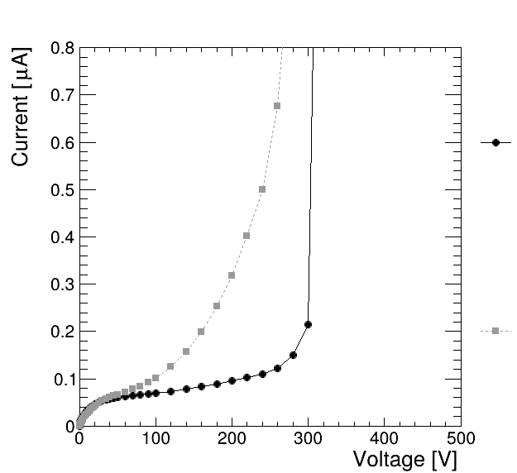
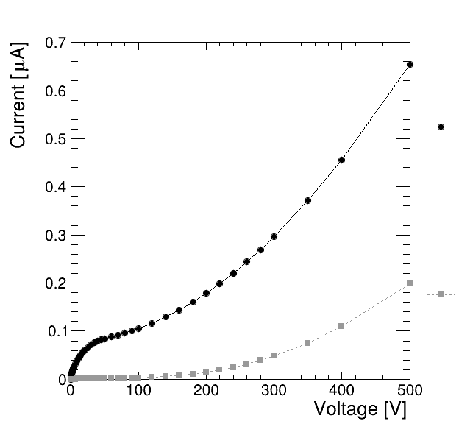
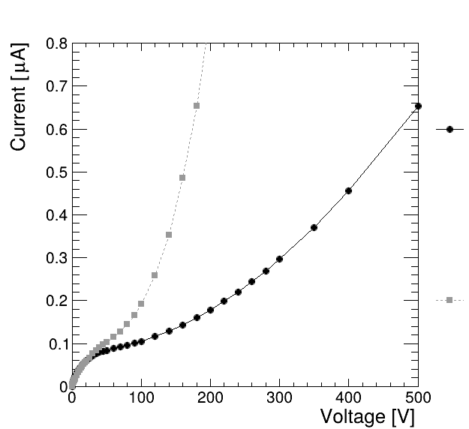

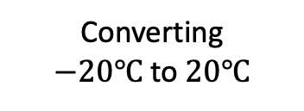







Results(PIN diodes)
Studying IV curves of old data with different temperatures
K04 Pad current(20$℃$)
K04 Pad current(20$℃$)
K04 Pad current(−20$℃$)
K04 Pad current(−20$℃$)
Direct
Measurement
Converting
$−20℃$ to $20℃$
F10 Pad current(20$℃$)
F10 Pad current(20$℃$)
F10 Pad current(−20$℃$)
F10 Pad current(−20$℃$)

Slide 19
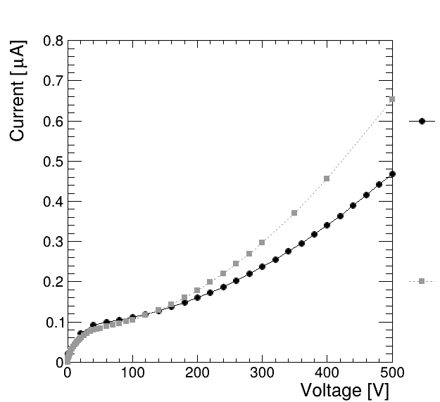
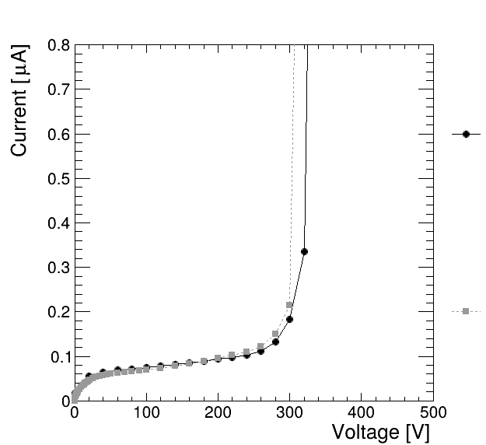
Results(PIN diodes)
Rescaling the new measurements to match the old measurements
25℃-> 20℃
27℃-> 20℃
F10 Pad current(new)
K04 Pad current(new)
F10 Pad current(old)
K04 Pad current(old)

Slide 20
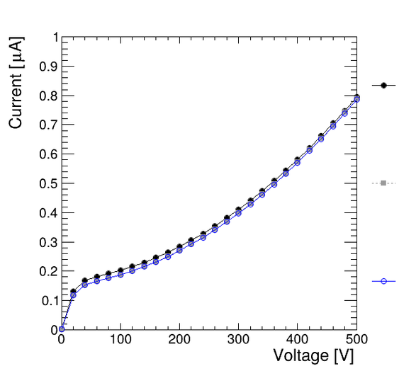
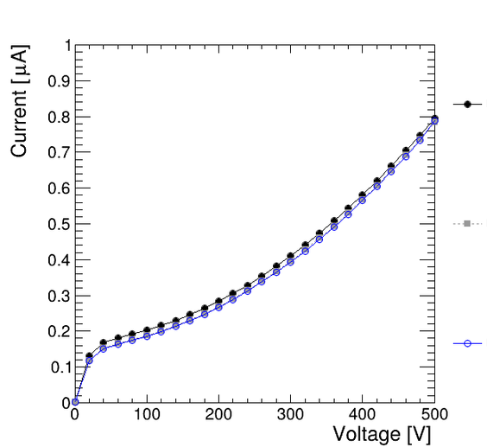
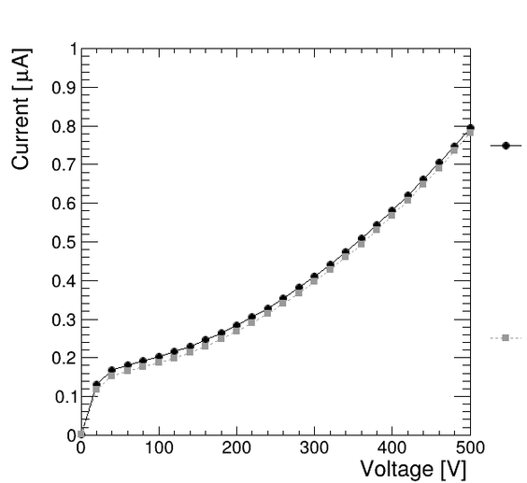
Results(PIN diodes)
Studying the effect on IV curves with different parameters
Ramp volt
= 5V
Ramp speed
= 100ms
Wait time
= 500ms
Ramp volt
= 10V
Ramp speed
= 200ms
Wait time
= 50000ms
Ramp volt
= 20V
Ramp speed
= 400ms

Slide 21


Results(pixel sensors)
Comparing old and new measurement at 20℃
S1P1 and S1P2
S2P1 and S2P2

Slide 22
Conclusions and future prospects
What have I accomplished?
Contributed to setting up a functional probe station for FCC sensor measurements
Revived a set of functioning analysis scripts
Produced results for analysis and comparison
Developed a better user interface
What needs to be done?
Get cooling automated for the chuck
Understand the disagreement between our results and old results
Clean up the code
Test new sensors

Slide 23
THE END
Thank you for listening.
Any questions?

