Slide 1
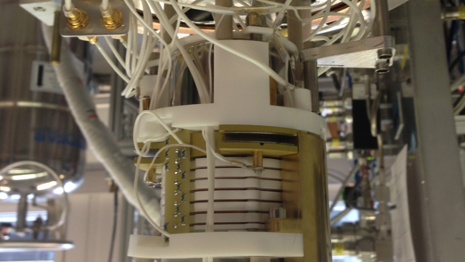


Electric-Field Simulations for the Xurich III Dual-Phase Xenon TPC (Low-Field Regime)
Validating uniform drift and safe extraction at 20–600 V/cm for upcoming neutron runs
Elena Muñoz Rivas
Luisa Hötzsh
Laura Baudis
Summer Student Program - Bern, Sep 8
Notes:
Xurich es el banco de pruebas local de UZH para microfísica en Xe; tras varias iteraciones, afrontamos nuevas medidas con neutrones y nuevos fotomultiplicadores: toca rediseñar y simular el campo a bajo drift field.
We optimise the upgraded Xurich TPC for neutron runs by achieving highly uniform drift fields at low E and safe extraction, using 3D simulations to identify and fix design hotspots.

Slide 2
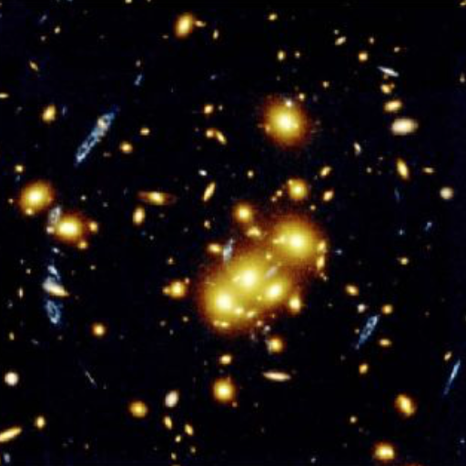
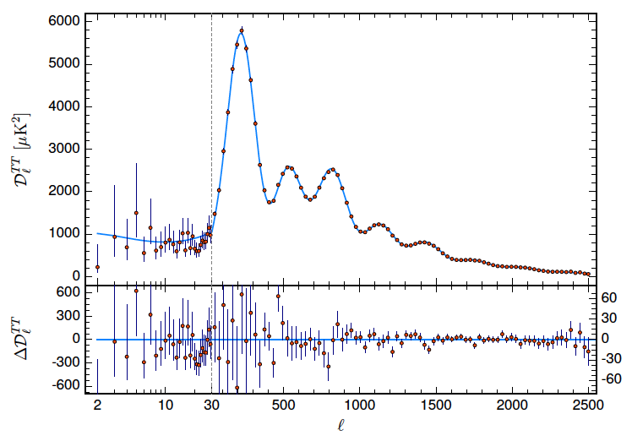
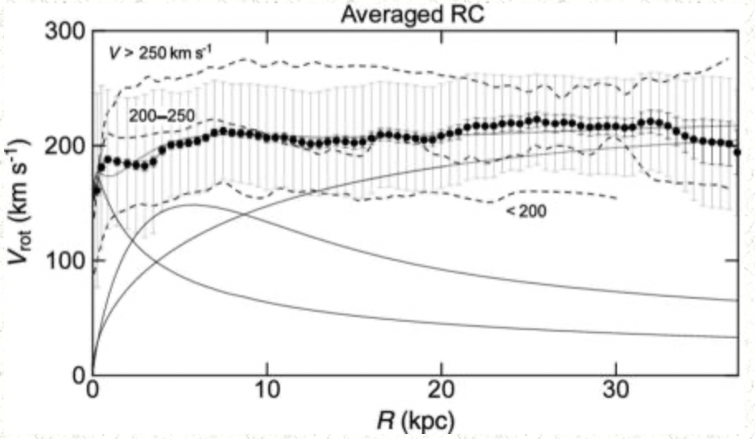
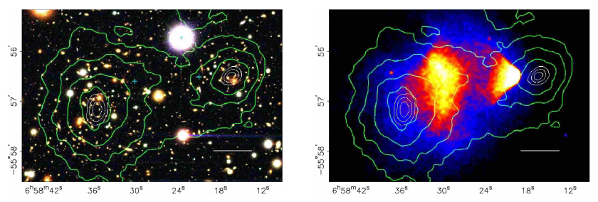
Astrophysical evidence for DM
Cluster lensing³
Planck TT spectrum²
Dark Matter is required by multiple, independent probes
Rotation curves¹
Bullet Cluster (optical+X-ray)⁴
1 McGaugh + 2016 2 Planck Collab. 2020 3 NASA, Gravitational Lenses 4 de Dominicis 2022
Sep 8 2025 Elena Muñoz Rivas 2

Slide 3
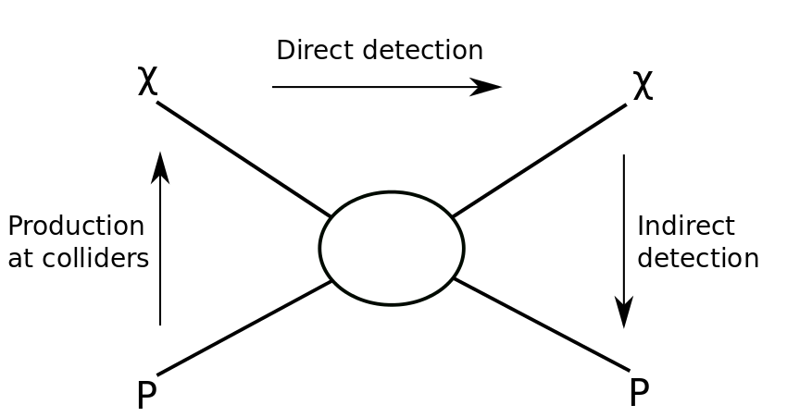
Direct Detection
  Rare Underground Scatters as a Complement to Colliders/Indirect
  Three approaches to look for DM particles:
  Goal: detect a new particle species consistent with Galactic DM
Direct Detection
Colliders: production
Indirect: annihilation/decay
Direct: elastic scatters in targets
Sep 8 2025 Elena Muñoz Rivas 3
Notes:
Sabemos que la materia oscura existe, por evidencias astrofísicas como las curvas de rotación de galaxias, el fondo cósmico de microondas y los mapas de lentes gravitacionales.
Durante mucho tiempo, la comunidad se ha centrado en las WIMPs clásicas, que tendrían masas en el rango de unos pocos GeV hasta varios TeV, y se detectarían mediante retrocesos nucleares. Sin embargo, como se ve en los últimos resultados experimentales, esa región está fuertemente restringida — ya hemos buscado mucho ahí, sin éxito.
Por eso, cada vez hay más interés en modelos que predicen una materia oscura más ligera, en el rango de MeV a GeV. Estos modelos están bien motivados teóricamente: por ejemplo, a través de mecanismos como el freeze-in, donde la materia oscura nunca estuvo en equilibrio térmico, o modelos de materia oscura asimétrica, similares al origen de la materia normal.
También hay modelos con mediadores ligeros, como dark photons o campos escalares, que permiten que estas partículas ligeras interactúen con el sector visible.
En el eje de masas vemos todo el espectro de posibilidades: desde materia oscura ultraligera como axiones o campos bosónicos, pasando por la región de interés de este trabajo —que está destacada en azul—, hasta objetos mucho más masivos como materia oscura compuesta o agujeros negros primordiales.
We have three complementary strategies: try to make dark matter in colliders, look for traces of its annihilation in the cosmos, or—what we do—wait for it to bump into our detector underground. Direct detection is like sitting in a quiet room, waiting for the tiniest knock

Slide 4
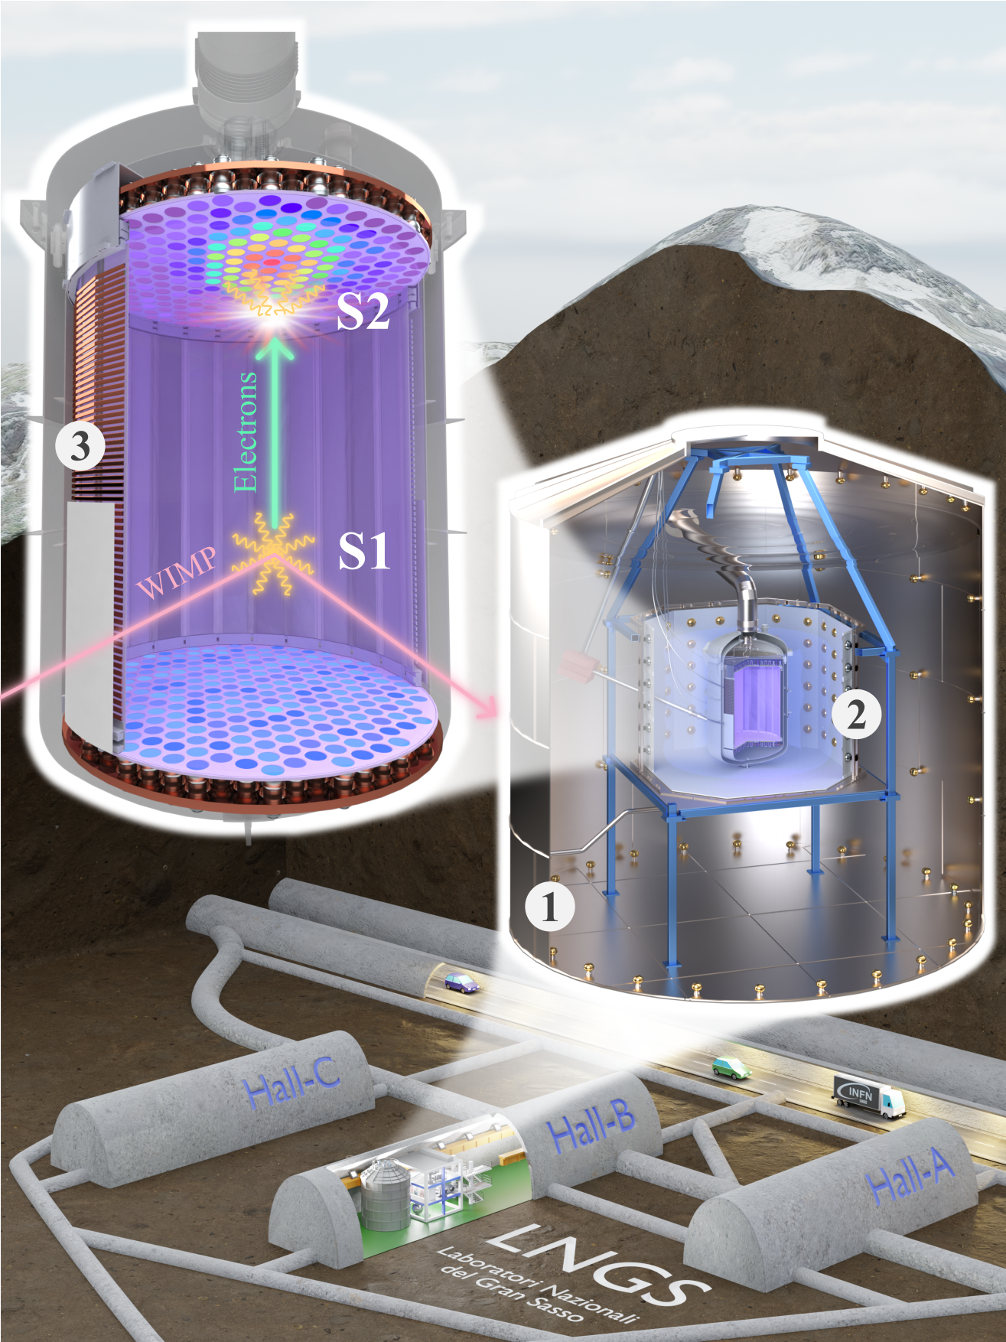
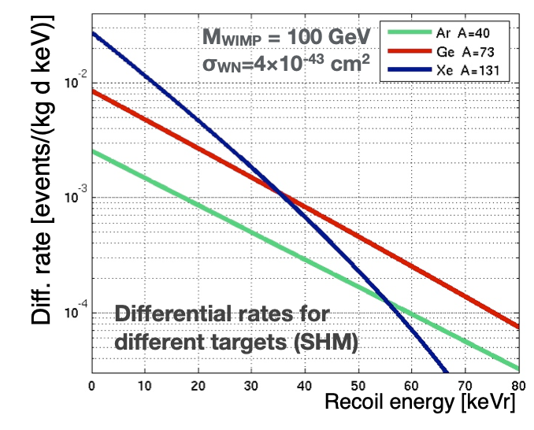
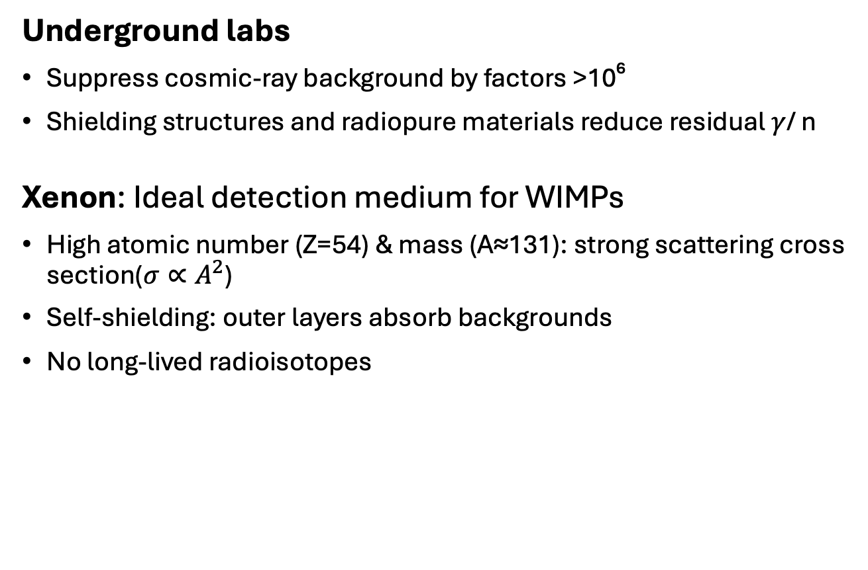
Why underground /Xenon?
Underground labs
Suppress cosmic-ray background by factors >10⁶
Shielding structures and radiopure materials reduce residual $γ$/ n
Xenon: Ideal detection medium for WIMPs
  High atomic number (Z=54) & mass (A≈131): strong scattering cross section($σ∝A^{2}$)
  Self-shielding: outer layers absorb backgrounds
  No long-lived radioisotopes
  Strategy: elastic nuclear recoils for WIMPs
Laboratori Nazionali del Gran Sasso
Radon removal Xenon nT 10.1103/zc1w-88p6
Sep 8 2025 Elena Muñoz Rivas 4
Notes:
In a dual-phase xenon time-projection chamber, a particle interaction in liquid xenon creates two signatures: prompt scintillation light, S1, and free electrons. A uniform drift field carries those electrons upward to the liquid–gas interface. There, a strong extraction field pulls them into the gas, where they produce proportional scintillation, S2. From the S1–S2 time we get the depth, and from the S2 light pattern on the top sensors we infer the horizontal position. The relative sizes of S1 and S2 depend on the electric field because the field controls recombination and drift, so field quality directly sets our energy response, position linearity, and ER/NR separation.
For our neutron program we will run at lower drift fields than previous Xurich campaigns. At low E, recombination changes more rapidly with the field, which means even small inhomogeneities translate into spatial biases in S1/S2 and therefore in reconstructed energy and position. Our goal is to achieve ΔE/E at the percent level across the fiducial volume while still maintaining a high extraction field in the gas gap. That’s why we simulate the full 3D geometry — rings, grids, gaps, dielectrics — scanning designs to identify hotspots and the simplest changes that flatten the field. This follows lessons learned in Xurich II and in larger TPCs like LUX and XENONnT, where field distortions and PTFE charge-up were observed and modeled.
My contribution was to build and mesh the full 3D electrostatic model of the upgraded Xurich TPC, implement a parametric resistor chain for the field rings, and run low-field scans from ~20 to 300 V/cm. I quantified uniformity via ΔE/E in the fiducial, mapped surface hotspots (E_max) on rings and grids, and proposed a minimal geometry change plus HV setpoints that deliver percent-level uniformity with safe extraction margins. I also prepared the validation plan with 83mKr/37Ar and drift-velocity checks.
To hear a whisper you need silence. That’s why we take our detectors deep underground, beneath a mountain, where cosmic rays cannot reach. And our material of choice is xenon: heavy and dense, so it’s a big target; extremely pure, so there’s little internal noise; and unique, because it gives us both light and charge signals, two complementary messengers from every interaction.

Slide 5
Dual-phase xenon TPC
A Dual-Phase TPC Provides Two Signals and 3D Positioning
Sep 8 2025 Elena Muñoz Rivas 5
Notes:
In a dual-phase xenon time-projection chamber, a particle interaction in liquid xenon creates two signatures: prompt scintillation light, S1, and free electrons. A uniform drift field carries those electrons upward to the liquid–gas interface. There, a strong extraction field pulls them into the gas, where they produce proportional scintillation, S2. From the S1–S2 time we get the depth, and from the S2 light pattern on the top sensors we infer the horizontal position. The relative sizes of S1 and S2 depend on the electric field because the field controls recombination and drift, so field quality directly sets our energy response, position linearity, and ER/NR separation.
For our neutron program we will run at lower drift fields than previous Xurich campaigns. At low E, recombination changes more rapidly with the field, which means even small inhomogeneities translate into spatial biases in S1/S2 and therefore in reconstructed energy and position. Our goal is to achieve ΔE/E at the percent level across the fiducial volume while still maintaining a high extraction field in the gas gap. That’s why we simulate the full 3D geometry — rings, grids, gaps, dielectrics — scanning designs to identify hotspots and the simplest changes that flatten the field. This follows lessons learned in Xurich II and in larger TPCs like LUX and XENONnT, where field distortions and PTFE charge-up were observed and modeled.
My contribution was to build and mesh the full 3D electrostatic model of the upgraded Xurich TPC, implement a parametric resistor chain for the field rings, and run low-field scans from ~20 to 300 V/cm. I quantified uniformity via ΔE/E in the fiducial, mapped surface hotspots (E_max) on rings and grids, and proposed a minimal geometry change plus HV setpoints that deliver percent-level uniformity with safe extraction margins. I also prepared the validation plan with 83mKr/37Ar and drift-velocity checks.

Slide 6
Dual-phase xenon TPC
A Dual-Phase TPC Provides Two Signals and 3D Positioning
Interaction → prompt scintillation S1 + ionisation electrons
Sep 8 2025 Elena Muñoz Rivas 5
Notes:
In a dual-phase xenon time-projection chamber, a particle interaction in liquid xenon creates two signatures: prompt scintillation light, S1, and free electrons. A uniform drift field carries those electrons upward to the liquid–gas interface. There, a strong extraction field pulls them into the gas, where they produce proportional scintillation, S2. From the S1–S2 time we get the depth, and from the S2 light pattern on the top sensors we infer the horizontal position. The relative sizes of S1 and S2 depend on the electric field because the field controls recombination and drift, so field quality directly sets our energy response, position linearity, and ER/NR separation.
For our neutron program we will run at lower drift fields than previous Xurich campaigns. At low E, recombination changes more rapidly with the field, which means even small inhomogeneities translate into spatial biases in S1/S2 and therefore in reconstructed energy and position. Our goal is to achieve ΔE/E at the percent level across the fiducial volume while still maintaining a high extraction field in the gas gap. That’s why we simulate the full 3D geometry — rings, grids, gaps, dielectrics — scanning designs to identify hotspots and the simplest changes that flatten the field. This follows lessons learned in Xurich II and in larger TPCs like LUX and XENONnT, where field distortions and PTFE charge-up were observed and modeled.
My contribution was to build and mesh the full 3D electrostatic model of the upgraded Xurich TPC, implement a parametric resistor chain for the field rings, and run low-field scans from ~20 to 300 V/cm. I quantified uniformity via ΔE/E in the fiducial, mapped surface hotspots (E_max) on rings and grids, and proposed a minimal geometry change plus HV setpoints that deliver percent-level uniformity with safe extraction margins. I also prepared the validation plan with 83mKr/37Ar and drift-velocity checks.

Slide 7
Dual-phase xenon TPC
A Dual-Phase TPC Provides Two Signals and 3D Positioning
Interaction → prompt scintillation S1 + ionisation electrons
Drift field moves e⁻ to the surface
Sep 8 2025 Elena Muñoz Rivas 5
Notes:
In a dual-phase xenon time-projection chamber, a particle interaction in liquid xenon creates two signatures: prompt scintillation light, S1, and free electrons. A uniform drift field carries those electrons upward to the liquid–gas interface. There, a strong extraction field pulls them into the gas, where they produce proportional scintillation, S2. From the S1–S2 time we get the depth, and from the S2 light pattern on the top sensors we infer the horizontal position. The relative sizes of S1 and S2 depend on the electric field because the field controls recombination and drift, so field quality directly sets our energy response, position linearity, and ER/NR separation.
For our neutron program we will run at lower drift fields than previous Xurich campaigns. At low E, recombination changes more rapidly with the field, which means even small inhomogeneities translate into spatial biases in S1/S2 and therefore in reconstructed energy and position. Our goal is to achieve ΔE/E at the percent level across the fiducial volume while still maintaining a high extraction field in the gas gap. That’s why we simulate the full 3D geometry — rings, grids, gaps, dielectrics — scanning designs to identify hotspots and the simplest changes that flatten the field. This follows lessons learned in Xurich II and in larger TPCs like LUX and XENONnT, where field distortions and PTFE charge-up were observed and modeled.
My contribution was to build and mesh the full 3D electrostatic model of the upgraded Xurich TPC, implement a parametric resistor chain for the field rings, and run low-field scans from ~20 to 300 V/cm. I quantified uniformity via ΔE/E in the fiducial, mapped surface hotspots (E_max) on rings and grids, and proposed a minimal geometry change plus HV setpoints that deliver percent-level uniformity with safe extraction margins. I also prepared the validation plan with 83mKr/37Ar and drift-velocity checks.

Slide 8
Dual-phase xenon TPC
A Dual-Phase TPC Provides Two Signals and 3D Positioning
Interaction → prompt scintillation S1 + ionisation electrons
Drift field moves e⁻ to the Surface
Extraction field in GXe produces S2
Sep 8 2025 Elena Muñoz Rivas 5
Notes:
In a dual-phase xenon time-projection chamber, a particle interaction in liquid xenon creates two signatures: prompt scintillation light, S1, and free electrons. A uniform drift field carries those electrons upward to the liquid–gas interface. There, a strong extraction field pulls them into the gas, where they produce proportional scintillation, S2. From the S1–S2 time we get the depth, and from the S2 light pattern on the top sensors we infer the horizontal position. The relative sizes of S1 and S2 depend on the electric field because the field controls recombination and drift, so field quality directly sets our energy response, position linearity, and ER/NR separation.
For our neutron program we will run at lower drift fields than previous Xurich campaigns. At low E, recombination changes more rapidly with the field, which means even small inhomogeneities translate into spatial biases in S1/S2 and therefore in reconstructed energy and position. Our goal is to achieve ΔE/E at the percent level across the fiducial volume while still maintaining a high extraction field in the gas gap. That’s why we simulate the full 3D geometry — rings, grids, gaps, dielectrics — scanning designs to identify hotspots and the simplest changes that flatten the field. This follows lessons learned in Xurich II and in larger TPCs like LUX and XENONnT, where field distortions and PTFE charge-up were observed and modeled.
My contribution was to build and mesh the full 3D electrostatic model of the upgraded Xurich TPC, implement a parametric resistor chain for the field rings, and run low-field scans from ~20 to 300 V/cm. I quantified uniformity via ΔE/E in the fiducial, mapped surface hotspots (E_max) on rings and grids, and proposed a minimal geometry change plus HV setpoints that deliver percent-level uniformity with safe extraction margins. I also prepared the validation plan with 83mKr/37Ar and drift-velocity checks.

Slide 9
Dual-phase xenon TPC
A Dual-Phase TPC Provides Two Signals and 3D Positioning
Interaction → prompt scintillation S1 + ionisation electrons
Drift field moves e⁻ to the Surface
Extraction field in GXe produces S2
(x,y) from S2 light pattern; z from S1–S2 time
Sep 8 2025 Elena Muñoz Rivas 5
Notes:
In a dual-phase xenon time-projection chamber, a particle interaction in liquid xenon creates two signatures: prompt scintillation light, S1, and free electrons. A uniform drift field carries those electrons upward to the liquid–gas interface. There, a strong extraction field pulls them into the gas, where they produce proportional scintillation, S2. From the S1–S2 time we get the depth, and from the S2 light pattern on the top sensors we infer the horizontal position. The relative sizes of S1 and S2 depend on the electric field because the field controls recombination and drift, so field quality directly sets our energy response, position linearity, and ER/NR separation.
For our neutron program we will run at lower drift fields than previous Xurich campaigns. At low E, recombination changes more rapidly with the field, which means even small inhomogeneities translate into spatial biases in S1/S2 and therefore in reconstructed energy and position. Our goal is to achieve ΔE/E at the percent level across the fiducial volume while still maintaining a high extraction field in the gas gap. That’s why we simulate the full 3D geometry — rings, grids, gaps, dielectrics — scanning designs to identify hotspots and the simplest changes that flatten the field. This follows lessons learned in Xurich II and in larger TPCs like LUX and XENONnT, where field distortions and PTFE charge-up were observed and modeled.
My contribution was to build and mesh the full 3D electrostatic model of the upgraded Xurich TPC, implement a parametric resistor chain for the field rings, and run low-field scans from ~20 to 300 V/cm. I quantified uniformity via ΔE/E in the fiducial, mapped surface hotspots (E_max) on rings and grids, and proposed a minimal geometry change plus HV setpoints that deliver percent-level uniformity with safe extraction margins. I also prepared the validation plan with 83mKr/37Ar and drift-velocity checks.

Slide 10
Dual-phase xenon TPC
A Dual-Phase TPC Provides Two Signals and 3D Positioning
Interaction → prompt scintillation S1 + ionisation electrons
Drift field moves e⁻ to the Surface
Extraction field in GXe produces S2
(x,y) from S2 light pattern; z from S1–S2 time
S2/S1 ratio → distinguishes nuclear vs electronic recoils
Sep 8 2025 Elena Muñoz Rivas 5
Notes:
In a dual-phase xenon time-projection chamber, a particle interaction in liquid xenon creates two signatures: prompt scintillation light, S1, and free electrons. A uniform drift field carries those electrons upward to the liquid–gas interface. There, a strong extraction field pulls them into the gas, where they produce proportional scintillation, S2. From the S1–S2 time we get the depth, and from the S2 light pattern on the top sensors we infer the horizontal position. The relative sizes of S1 and S2 depend on the electric field because the field controls recombination and drift, so field quality directly sets our energy response, position linearity, and ER/NR separation.
For our neutron program we will run at lower drift fields than previous Xurich campaigns. At low E, recombination changes more rapidly with the field, which means even small inhomogeneities translate into spatial biases in S1/S2 and therefore in reconstructed energy and position. Our goal is to achieve ΔE/E at the percent level across the fiducial volume while still maintaining a high extraction field in the gas gap. That’s why we simulate the full 3D geometry — rings, grids, gaps, dielectrics — scanning designs to identify hotspots and the simplest changes that flatten the field. This follows lessons learned in Xurich II and in larger TPCs like LUX and XENONnT, where field distortions and PTFE charge-up were observed and modeled.
My contribution was to build and mesh the full 3D electrostatic model of the upgraded Xurich TPC, implement a parametric resistor chain for the field rings, and run low-field scans from ~20 to 300 V/cm. I quantified uniformity via ΔE/E in the fiducial, mapped surface hotspots (E_max) on rings and grids, and proposed a minimal geometry change plus HV setpoints that deliver percent-level uniformity with safe extraction margins. I also prepared the validation plan with 83mKr/37Ar and drift-velocity checks.

Slide 11
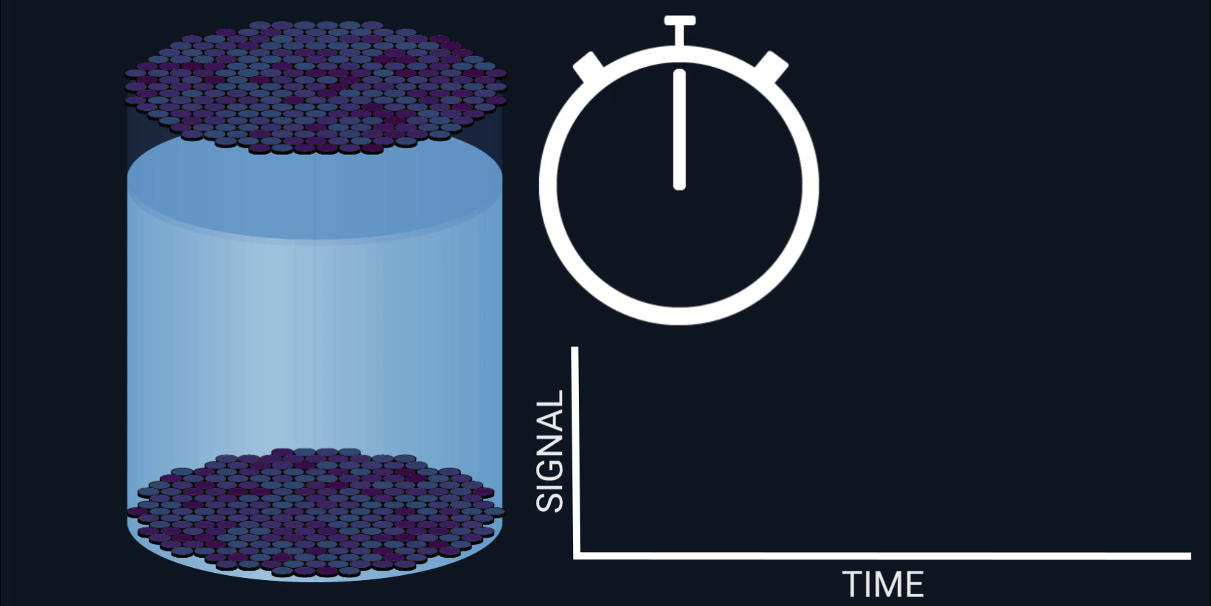
Dual-phase xenon TPC
Notes:
In a dual-phase xenon time-projection chamber, a particle interaction in liquid xenon creates two signatures: prompt scintillation light, S1, and free electrons. A uniform drift field carries those electrons upward to the liquid–gas interface. There, a strong extraction field pulls them into the gas, where they produce proportional scintillation, S2. From the S1–S2 time we get the depth, and from the S2 light pattern on the top sensors we infer the horizontal position. The relative sizes of S1 and S2 depend on the electric field because the field controls recombination and drift, so field quality directly sets our energy response, position linearity, and ER/NR separation.
For our neutron program we will run at lower drift fields than previous Xurich campaigns. At low E, recombination changes more rapidly with the field, which means even small inhomogeneities translate into spatial biases in S1/S2 and therefore in reconstructed energy and position. Our goal is to achieve ΔE/E at the percent level across the fiducial volume while still maintaining a high extraction field in the gas gap. That’s why we simulate the full 3D geometry — rings, grids, gaps, dielectrics — scanning designs to identify hotspots and the simplest changes that flatten the field. This follows lessons learned in Xurich II and in larger TPCs like LUX and XENONnT, where field distortions and PTFE charge-up were observed and modeled.
My contribution was to build and mesh the full 3D electrostatic model of the upgraded Xurich TPC, implement a parametric resistor chain for the field rings, and run low-field scans from ~20 to 300 V/cm. I quantified uniformity via ΔE/E in the fiducial, mapped surface hotspots (E_max) on rings and grids, and proposed a minimal geometry change plus HV setpoints that deliver percent-level uniformity with safe extraction margins. I also prepared the validation plan with 83mKr/37Ar and drift-velocity checks.
For a given mass and cross section of WIMPs, the interaction rate with target atoms is higher at low energies. This eﬀect is even more significant for more massive nuclei like xenon.

Slide 12
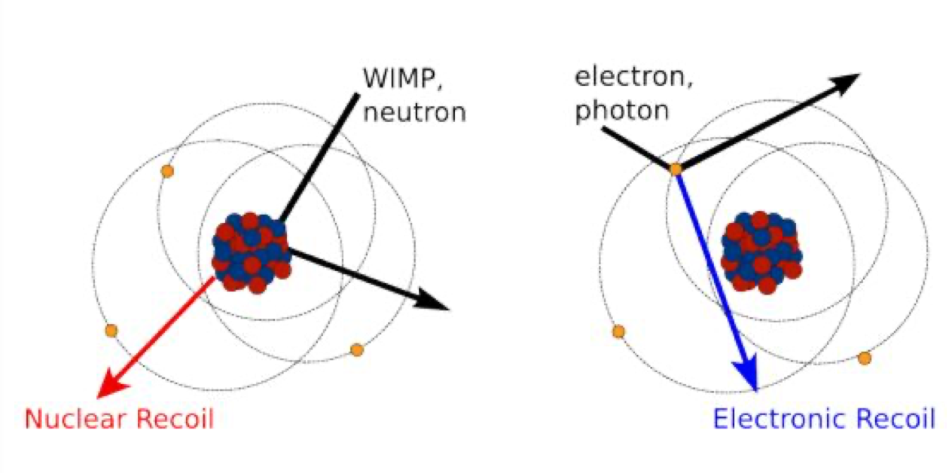
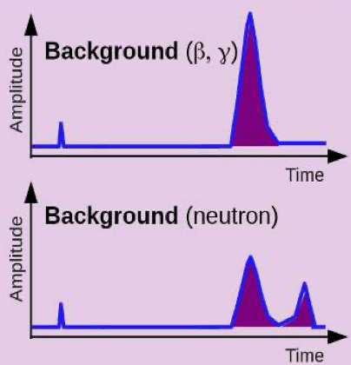
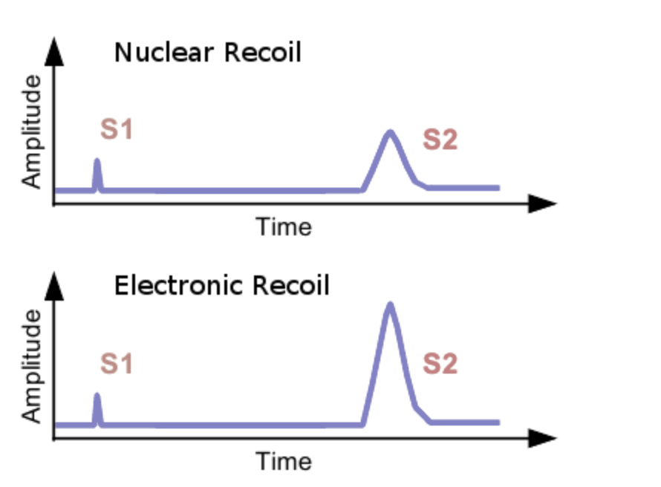
ER vs NR discrimination (S2/S1 scatter)
Recoil type identification
S2/S1 different for Electronic Recoils (ER) and Nuclear Recoils (NR)
Electronic recoils (ER) yield higher S2/S1
Nuclear recoils (NR) yield lower S2/S1
Typical ER rejection > 99% while retaining most NR signal
less ionisation, more scintillation
more ionisation, less scintillation
Sep 8 2025 Elena Muñoz Rivas 7
Notes:
In a dual-phase xenon time-projection chamber, a particle interaction in liquid xenon creates two signatures: prompt scintillation light, S1, and free electrons. A uniform drift field carries those electrons upward to the liquid–gas interface. There, a strong extraction field pulls them into the gas, where they produce proportional scintillation, S2. From the S1–S2 time we get the depth, and from the S2 light pattern on the top sensors we infer the horizontal position. The relative sizes of S1 and S2 depend on the electric field because the field controls recombination and drift, so field quality directly sets our energy response, position linearity, and ER/NR separation.
For our neutron program we will run at lower drift fields than previous Xurich campaigns. At low E, recombination changes more rapidly with the field, which means even small inhomogeneities translate into spatial biases in S1/S2 and therefore in reconstructed energy and position. Our goal is to achieve ΔE/E at the percent level across the fiducial volume while still maintaining a high extraction field in the gas gap. That’s why we simulate the full 3D geometry — rings, grids, gaps, dielectrics — scanning designs to identify hotspots and the simplest changes that flatten the field. This follows lessons learned in Xurich II and in larger TPCs like LUX and XENONnT, where field distortions and PTFE charge-up were observed and modeled.
My contribution was to build and mesh the full 3D electrostatic model of the upgraded Xurich TPC, implement a parametric resistor chain for the field rings, and run low-field scans from ~20 to 300 V/cm. I quantified uniformity via ΔE/E in the fiducial, mapped surface hotspots (E_max) on rings and grids, and proposed a minimal geometry change plus HV setpoints that deliver percent-level uniformity with safe extraction margins. I also prepared the validation plan with 83mKr/37Ar and drift-velocity checks.

Slide 13
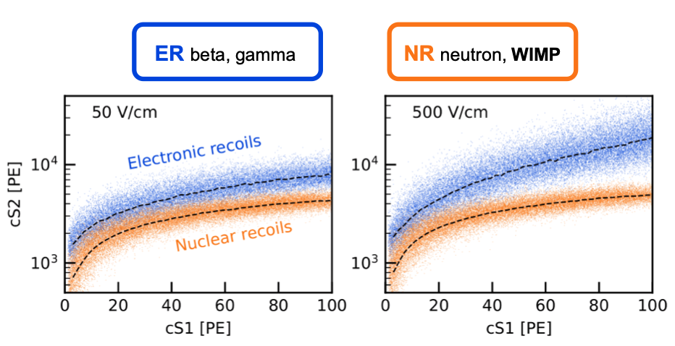
Implications of electric field
Uniform drift & extraction fields = accurate reconstruction
Ensures linear mapping of electron drift time → depth (z)
Avoids position biases in S2 light distribution (x,y)
Signal ratio depends on drift field
Lower drift field increases e⁻–ion recombination
Higher recombination → more prompt scintillation S1↑ and fewer electrons survive to the gas → S2 ↓ discrimination becomes harder
Sep 8 2025 Elena Muñoz Rivas 8
Notes:
In a dual-phase xenon time-projection chamber, a particle interaction in liquid xenon creates two signatures: prompt scintillation light, S1, and free electrons. A uniform drift field carries those electrons upward to the liquid–gas interface. There, a strong extraction field pulls them into the gas, where they produce proportional scintillation, S2. From the S1–S2 time we get the depth, and from the S2 light pattern on the top sensors we infer the horizontal position. The relative sizes of S1 and S2 depend on the electric field because the field controls recombination and drift, so field quality directly sets our energy response, position linearity, and ER/NR separation.
For our neutron program we will run at lower drift fields than previous Xurich campaigns. At low E, recombination changes more rapidly with the field, which means even small inhomogeneities translate into spatial biases in S1/S2 and therefore in reconstructed energy and position. Our goal is to achieve ΔE/E at the percent level across the fiducial volume while still maintaining a high extraction field in the gas gap. That’s why we simulate the full 3D geometry — rings, grids, gaps, dielectrics — scanning designs to identify hotspots and the simplest changes that flatten the field. This follows lessons learned in Xurich II and in larger TPCs like LUX and XENONnT, where field distortions and PTFE charge-up were observed and modeled.
My contribution was to build and mesh the full 3D electrostatic model of the upgraded Xurich TPC, implement a parametric resistor chain for the field rings, and run low-field scans from ~20 to 300 V/cm. I quantified uniformity via ΔE/E in the fiducial, mapped surface hotspots (E_max) on rings and grids, and proposed a minimal geometry change plus HV setpoints that deliver percent-level uniformity with safe extraction margins. I also prepared the validation plan with 83mKr/37Ar and drift-velocity checks.

Slide 14
Implications of electric field
Low drift field → higher recombination → lower S2/S1 (bands closer)
Why low fields now?
Upcoming neutron measurements planned at 20–300 V/cm (lower than in previous runs)
This detector has never been systematically characterized in this low-field regime
Small field non-uniformities matter more at low field → we must validate uniform drift and safe extraction
GOAL OF THIS STUDY
Verify that the new design delivers uniformity in LXe and stable extraction
Sep 8 2025 Elena Muñoz Rivas 8
Notes:
In a dual-phase xenon time-projection chamber, a particle interaction in liquid xenon creates two signatures: prompt scintillation light, S1, and free electrons. A uniform drift field carries those electrons upward to the liquid–gas interface. There, a strong extraction field pulls them into the gas, where they produce proportional scintillation, S2. From the S1–S2 time we get the depth, and from the S2 light pattern on the top sensors we infer the horizontal position. The relative sizes of S1 and S2 depend on the electric field because the field controls recombination and drift, so field quality directly sets our energy response, position linearity, and ER/NR separation.
For our neutron program we will run at lower drift fields than previous Xurich campaigns. At low E, recombination changes more rapidly with the field, which means even small inhomogeneities translate into spatial biases in S1/S2 and therefore in reconstructed energy and position. Our goal is to achieve ΔE/E at the percent level across the fiducial volume while still maintaining a high extraction field in the gas gap. That’s why we simulate the full 3D geometry — rings, grids, gaps, dielectrics — scanning designs to identify hotspots and the simplest changes that flatten the field. This follows lessons learned in Xurich II and in larger TPCs like LUX and XENONnT, where field distortions and PTFE charge-up were observed and modeled.
My contribution was to build and mesh the full 3D electrostatic model of the upgraded Xurich TPC, implement a parametric resistor chain for the field rings, and run low-field scans from ~20 to 300 V/cm. I quantified uniformity via ΔE/E in the fiducial, mapped surface hotspots (E_max) on rings and grids, and proposed a minimal geometry change plus HV setpoints that deliver percent-level uniformity with safe extraction margins. I also prepared the validation plan with 83mKr/37Ar and drift-velocity checks.

Slide 15
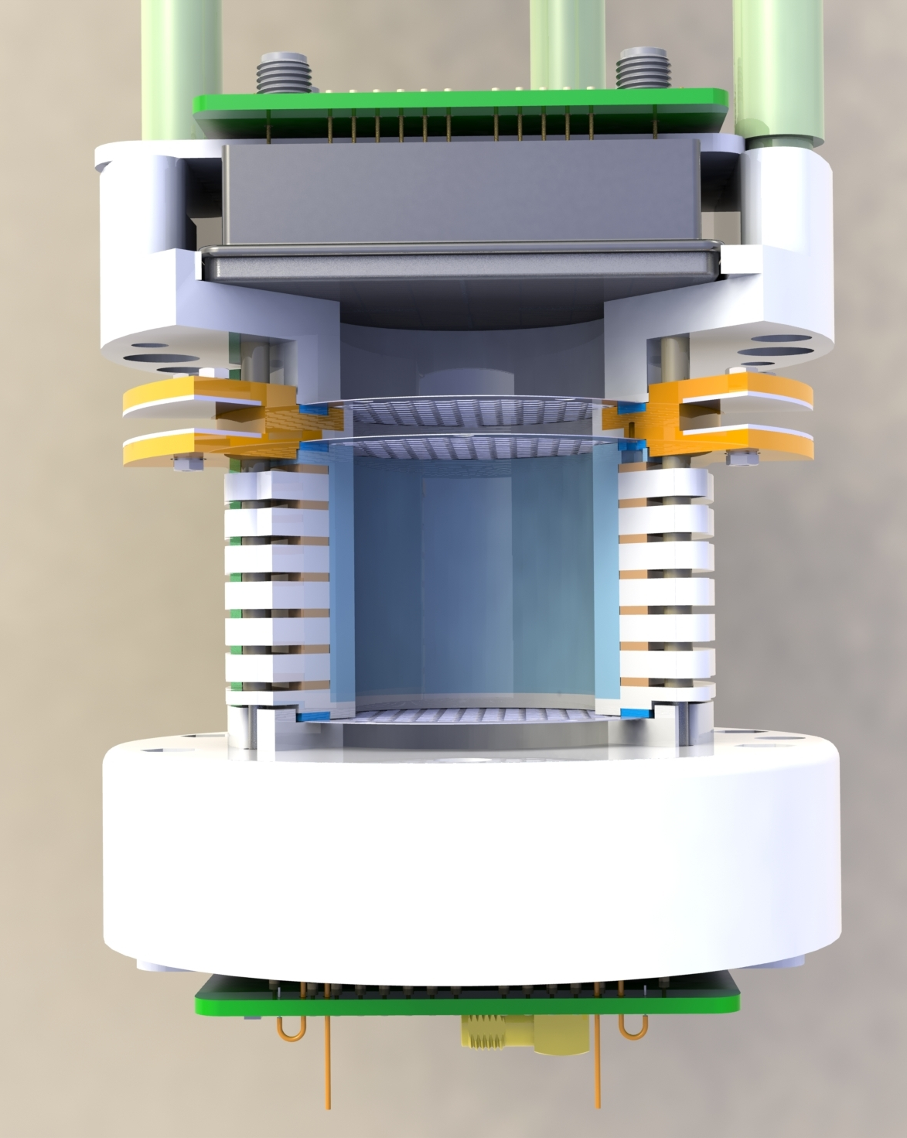
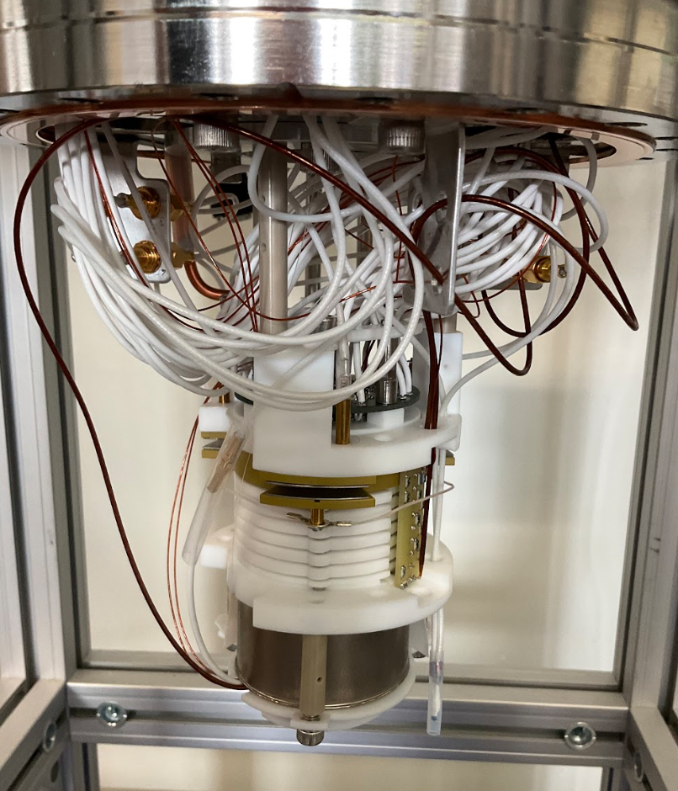
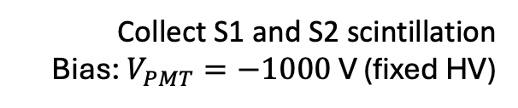
The Xurich Project – Local Dual-Phase Xenon TPC at UZH
Xurich III
Xurich II
1
2
4
3
1- PMTs
5
7
6
Collect S1 and S2 scintillation
Bias: $V_{PMT}=−1000$ V (fixed HV)
8
1
Baudis et al., Eur. Phys. J. C 78 (2018) 351; arXiv:1712.08607. Thieme et al., Eur. Phys. J. C 80 (2020) 477
Sep 8 2025 Elena Muñoz Rivas 9

Slide 16
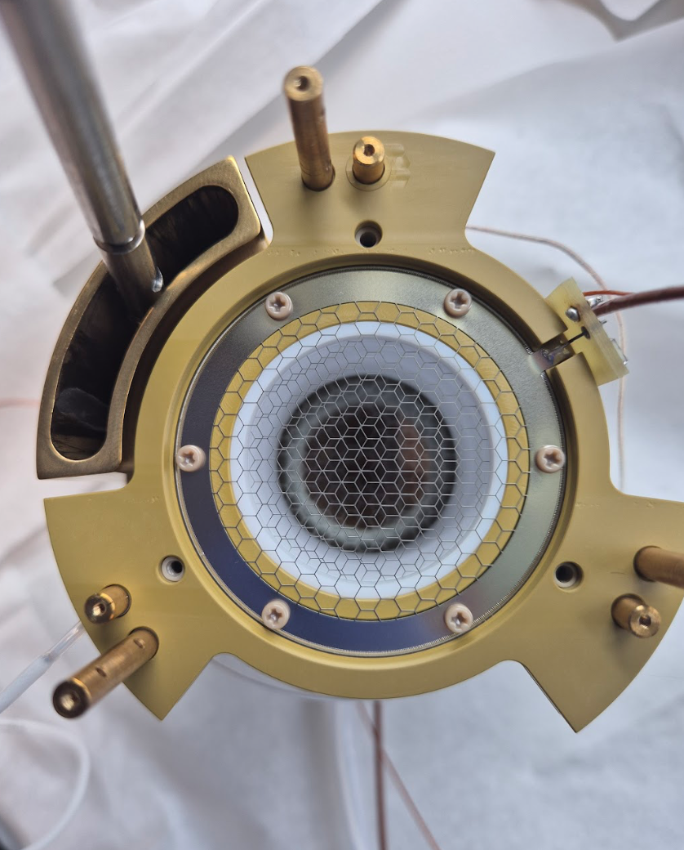





The Xurich Project – Local Dual-Phase Xenon TPC at UZH
Xurich III
1
$2.7$ mm
2
4
3
5
7
6
2- Anode
3- Gate
8
$V_{an}−V_{gate}=+4000$V
4- GXe
$4$ mm active Gxe gap
1
High extraction efficiency ($≈10$kV/cm)
Sep 8 2025 Elena Muñoz Rivas 10

Slide 17
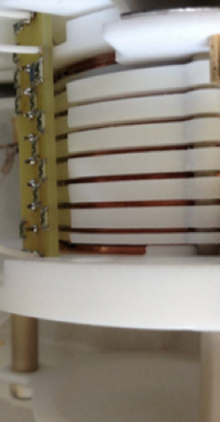
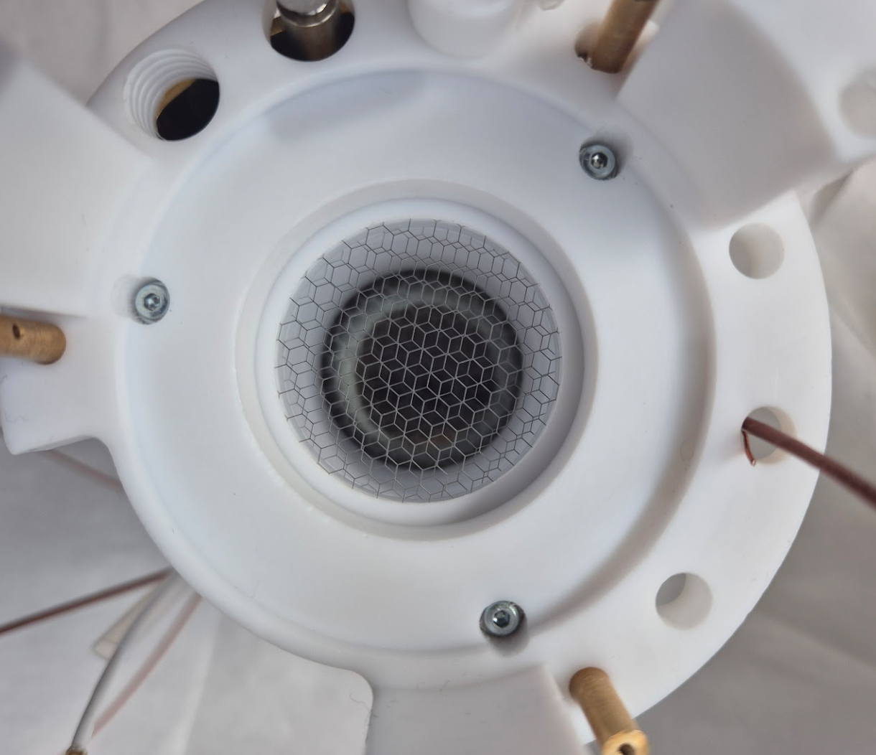
The Xurich Project – Local Dual-Phase Xenon TPC at UZH
Xurich III
1
$2.7$ mm
2
4
3
6- Field- shaping rings (Cu)
5
7
6
Graded potentials to linearize drift field
5- Active LXe volume
8
7- PTFE walls
High VUV reflectivity (↑ light yield) and electrical insulation
1
8- Cathode
Defines start of drift region
Sep 8 2025 Elena Muñoz Rivas 11

Slide 18
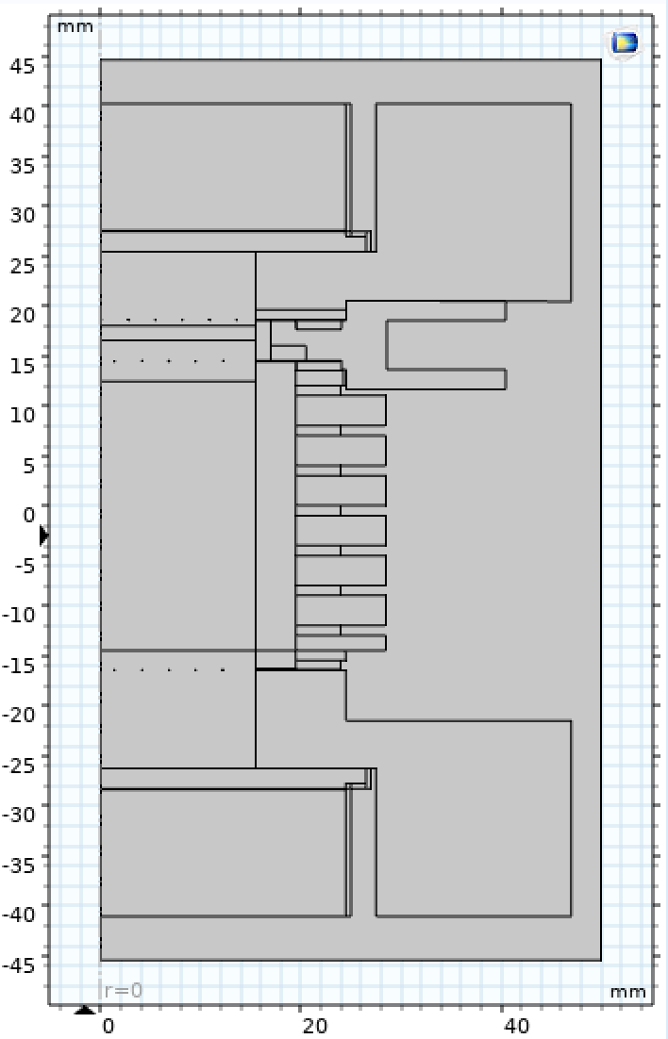
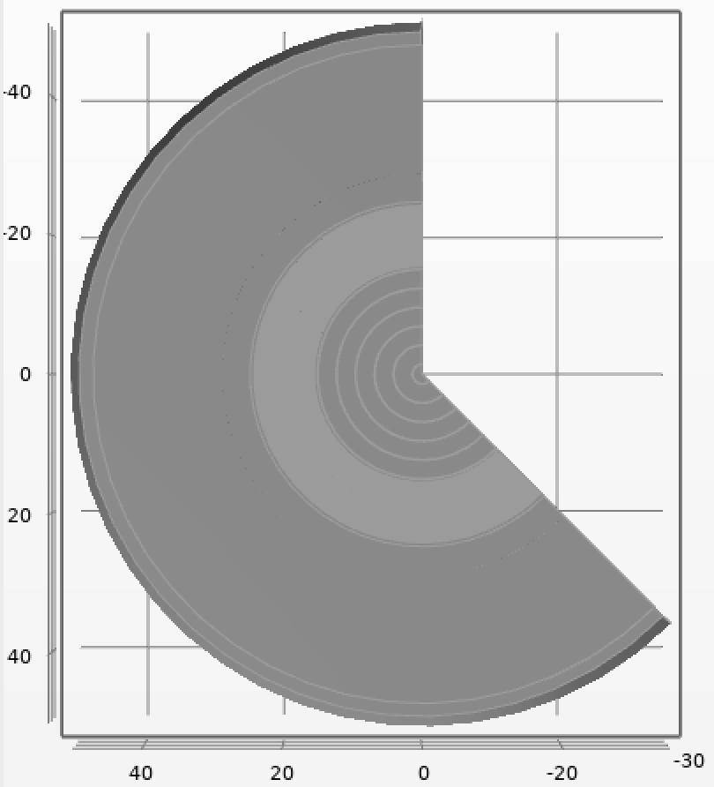
COMSOL (2D)
COMSOL is a multiphysics simulation software that models how physical fields—such as electric, magnetic, thermal, or mechanical—behave in complex geometries
anode
2D Axisymmetric model
Fast scans of voltages and geometry
gate
cathode
By revolving the geometry, electrodes become circular, which does not fully match the real detector
Sep 8 2025 Elena Muñoz Rivas 12
Notes:
A 450 V/cm ya se midió la atenuación de S1 por recombinación (q≈0.74, ~–25%) y la caída de LY a baja energía; al bajar E, la uniformidad pesa más para reconstrucción y umbrales.
Goal: determine which design elements (field rings, grids, spacings, liquid level, dielectrics) we must refine to hit uniformity and HV safety targets.

Slide 19
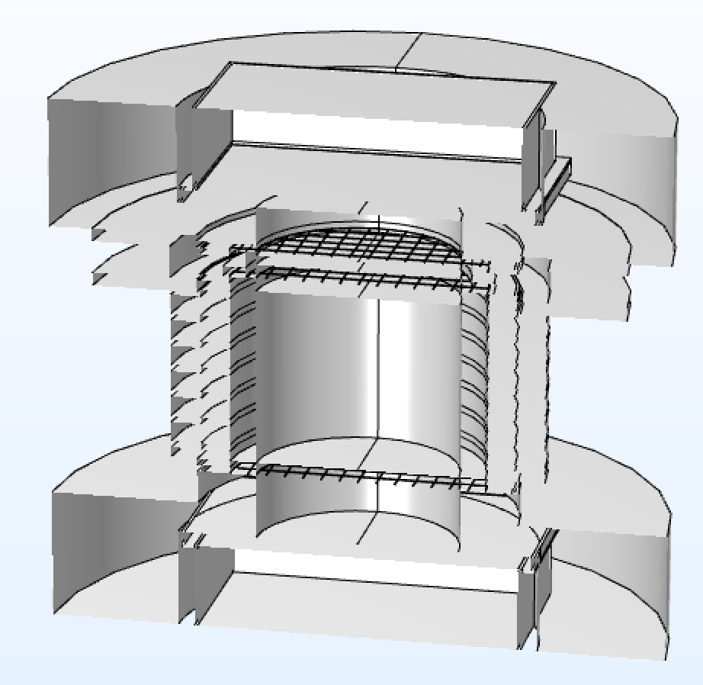
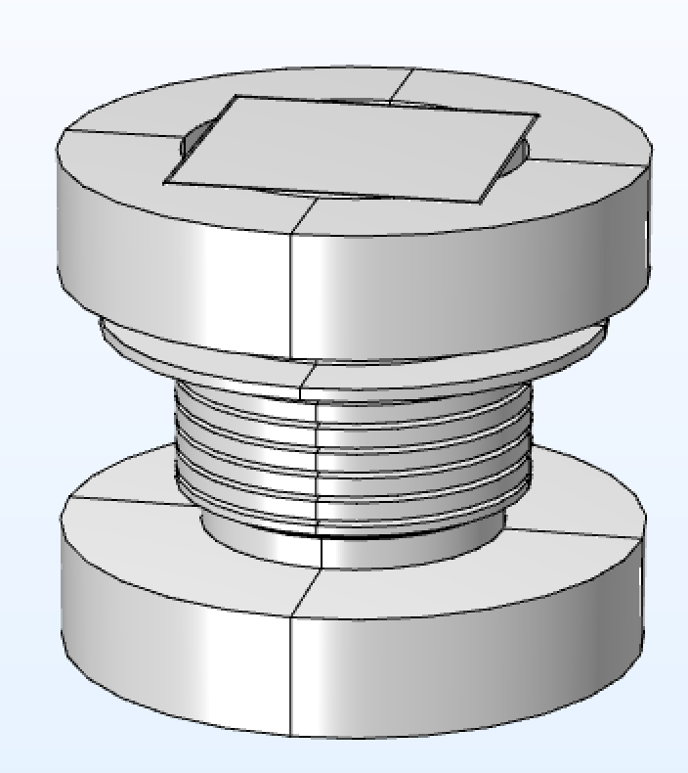
COMSOL (3D)
anode
gate
3D model
Realistic Geometry to Validate Symmetry Assumptions
Captures edge effects, local hotspots, and deviations near grids
cathode
Sep 8 2025 Elena Muñoz Rivas 13
Notes:
A 450 V/cm ya se midió la atenuación de S1 por recombinación (q≈0.74, ~–25%) y la caída de LY a baja energía; al bajar E, la uniformidad pesa más para reconstrucción y umbrales.
Goal: determine which design elements (field rings, grids, spacings, liquid level, dielectrics) we must refine to hit uniformity and HV safety targets.

Slide 20
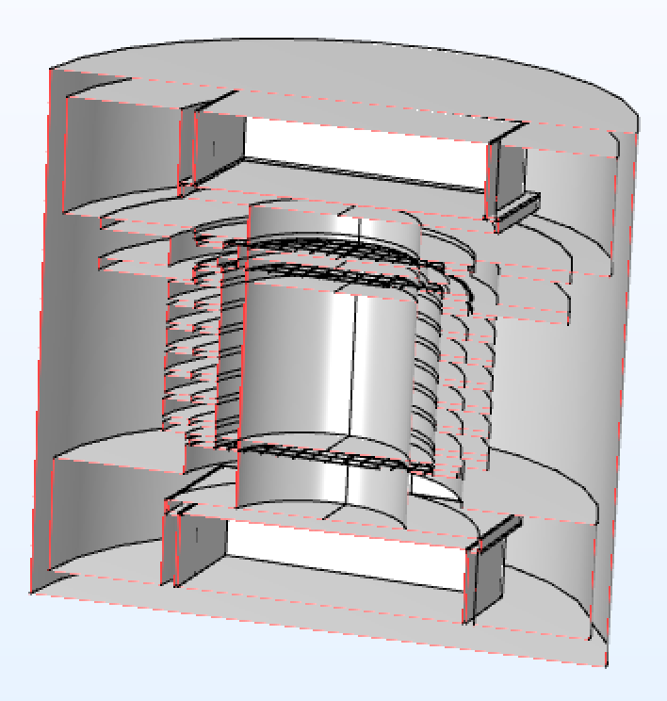
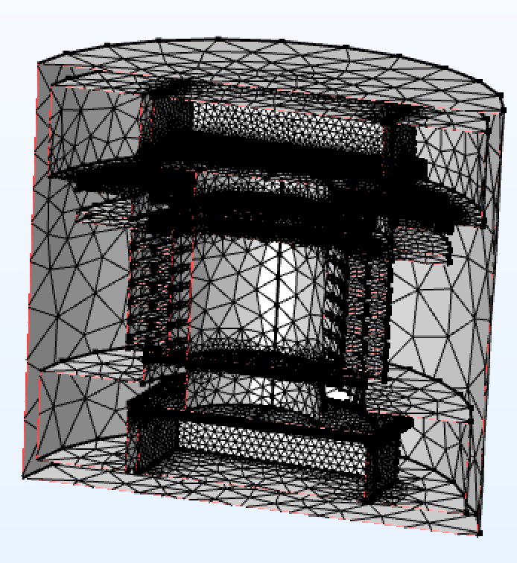

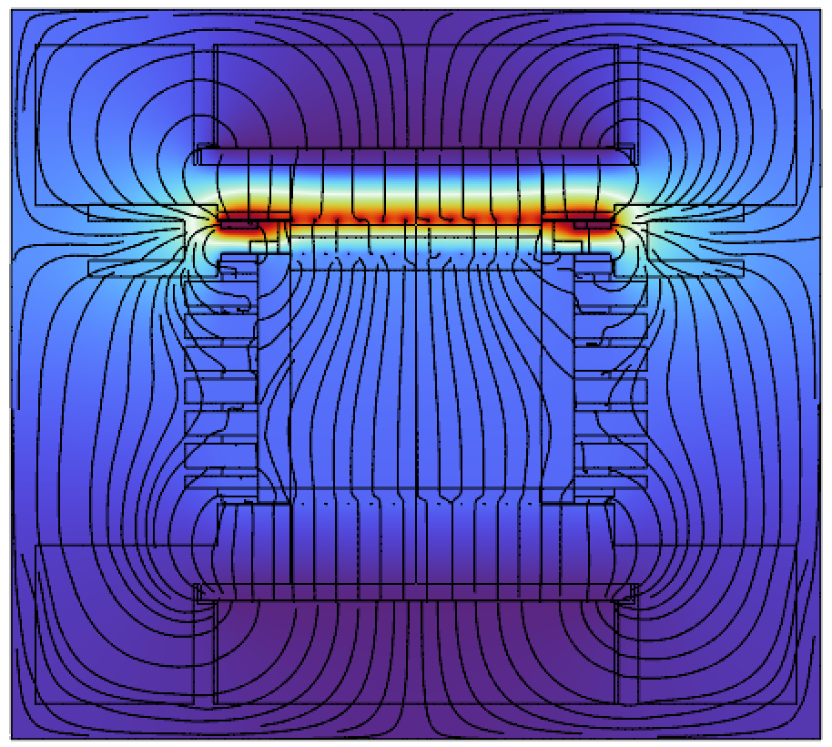
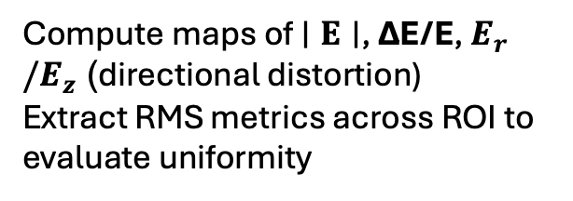
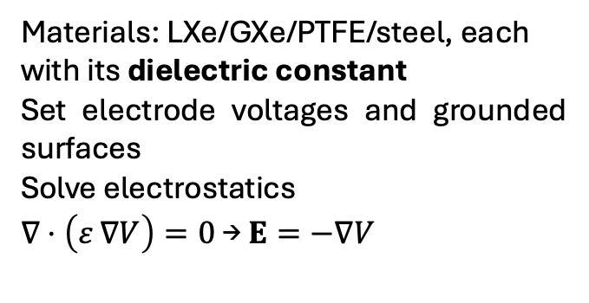
Steps in building models with COMSOL
Geometry
Meshing
Solution
Materials: LXe/GXe/PTFE/steel, each with its dielectric constant
Set electrode voltages and grounded surfaces
Solve electrostatics
$∇⋅\left(ε ∇V\right)=0$ → $E=−∇V$
Fine mesh near thin electrodes to resolve field gradients
Compute maps of $∣E∣$, ΔE/E, $E_{r}/E_{z}$ (directional distortion)
Extract RMS metrics across ROI to evaluate uniformity
Sep 8 2025 Elena Muñoz Rivas 14

Slide 21
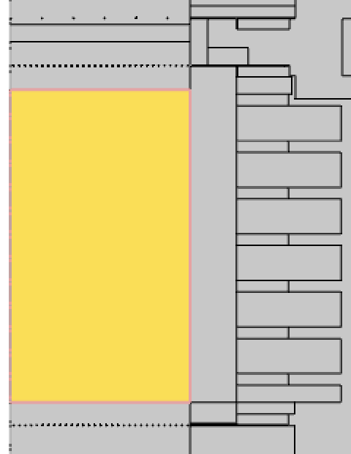

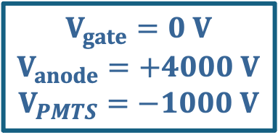
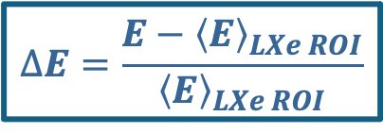
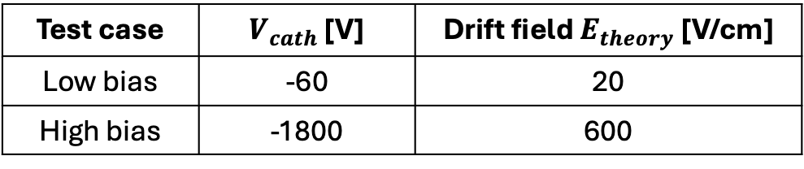

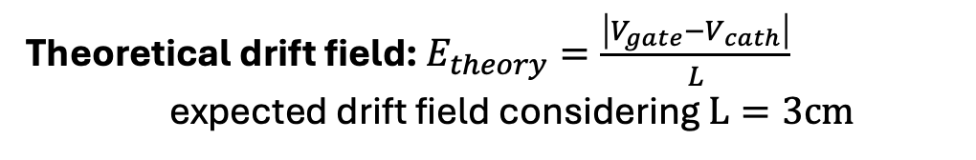
Results: Test Voltages, ROI and Theoretical Fields
Values computed in the LXe ROI, averaging the drift region between cathode and gate
$$∆E=\frac{E−{\left\langle E\right\rangle }_{LXe ROI}}{{\left\langle E\right\rangle }_{LXe ROI}}$$
$$E_{r}/E_{z}$$
Relative deviation of the local field with respect to the average in the LXe ROI
Ratio of radial to longitudinal field components, used to quantify directional distortion
Theoretical drift field: $E_{theory}=\frac{\left|V_{gate}−V_{cath}\right|}{L}$
expected drift field considering $L=3cm$
First test configurations – cathode bias scan
$$V_{gate}=0 V$$
$$V_{anode}=+4000 V$$
$$V_{PMTS}=−1000 V$$
Test case | $V_{cath}$ [V] | Drift field $E_{theory}$[V/cm]
Low bias | -60 | 20
High bias | -1800 | 600
$$L=3cm$$
Sep 8 2025 Elena Muñoz Rivas 15

Slide 22
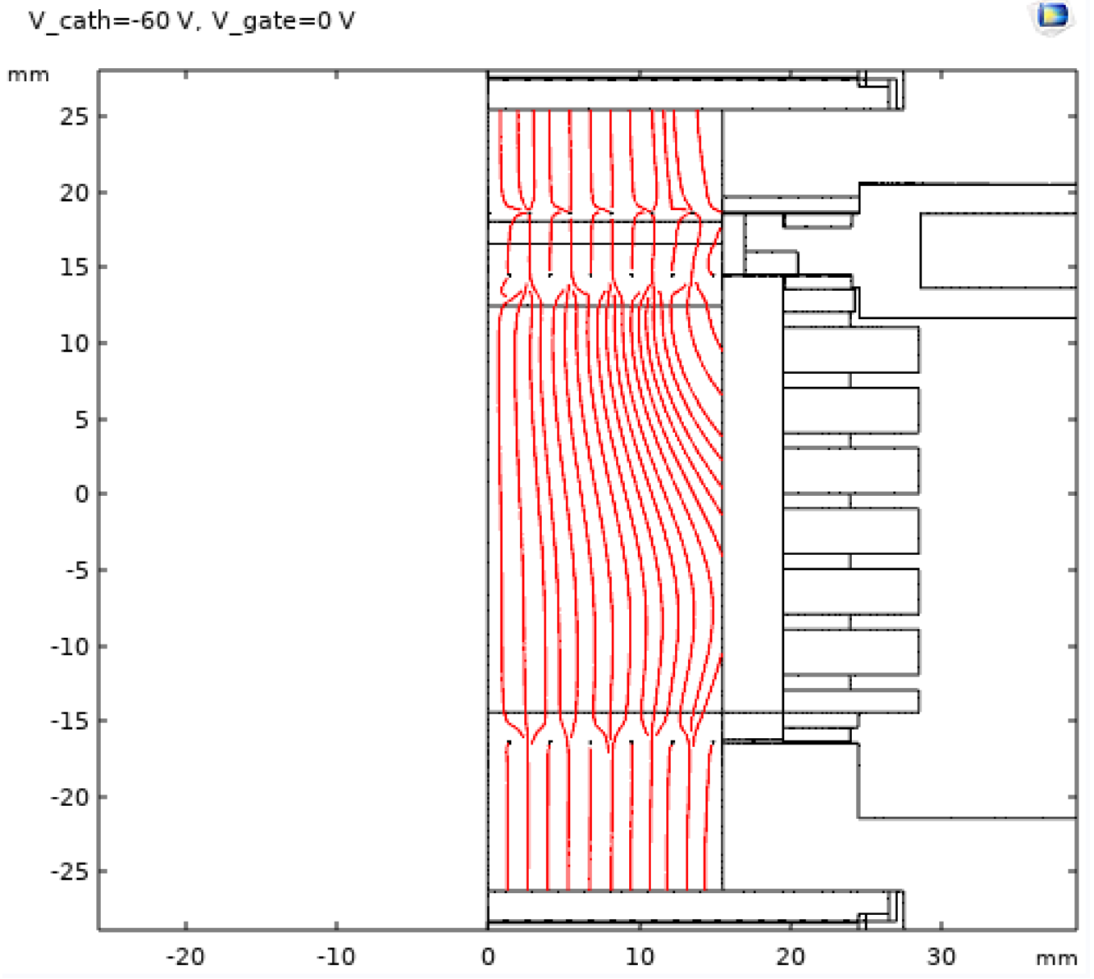
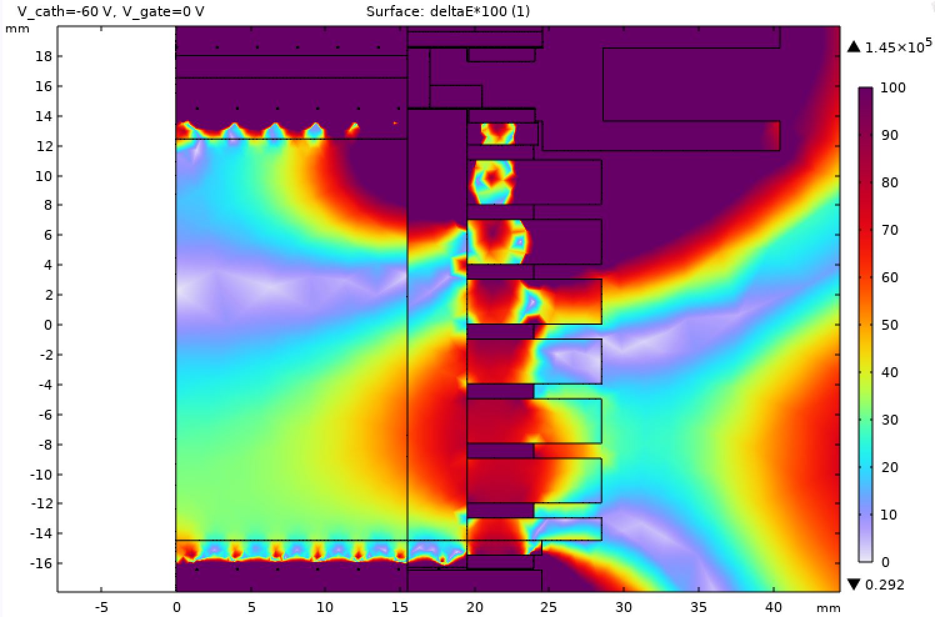
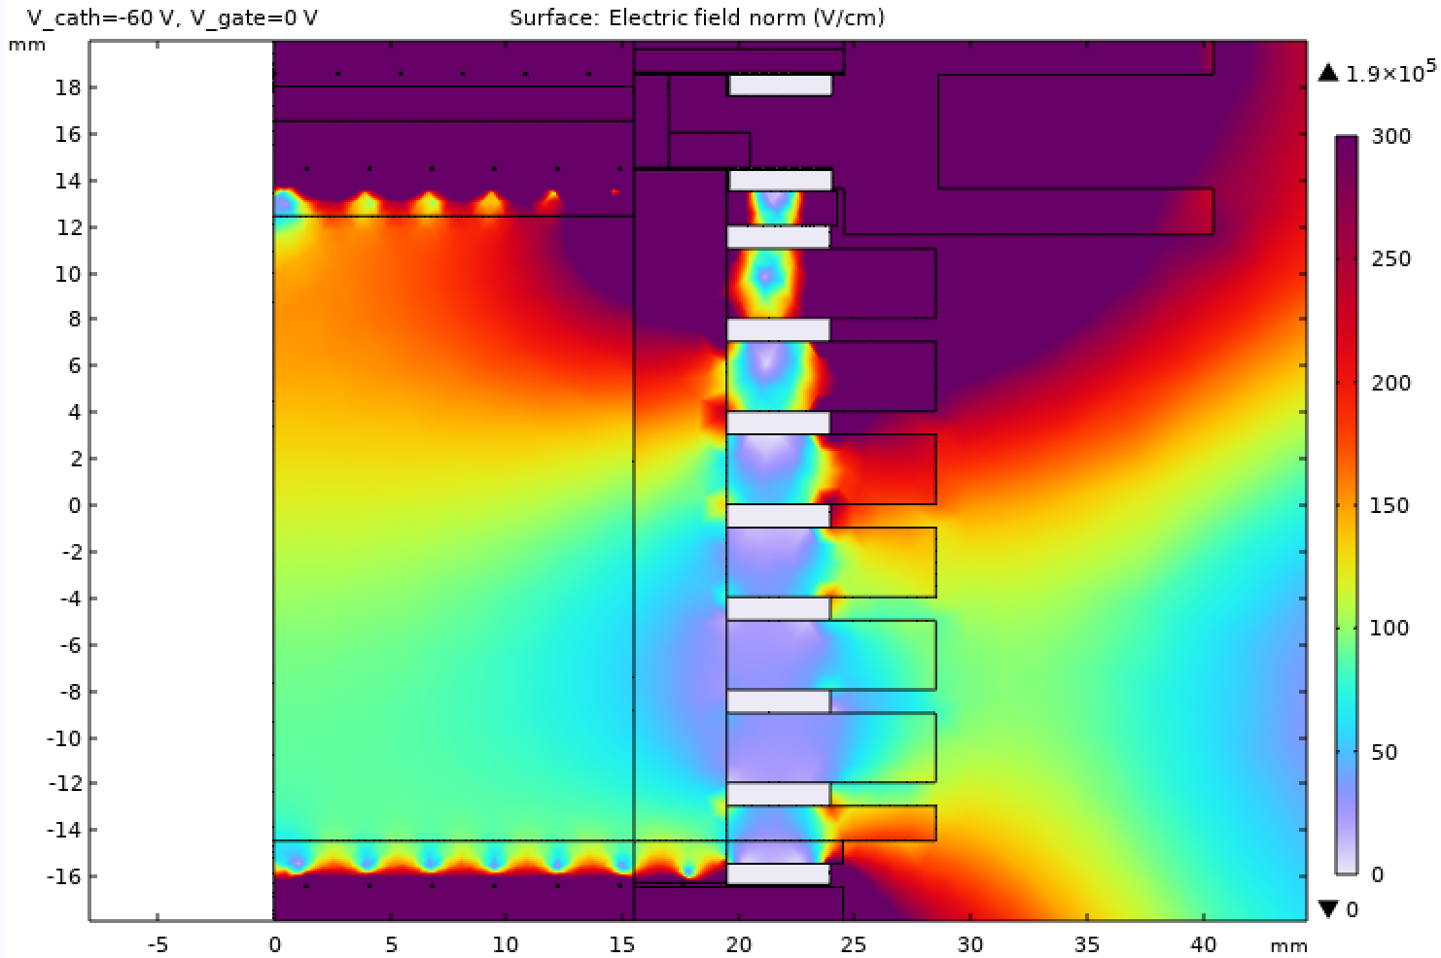
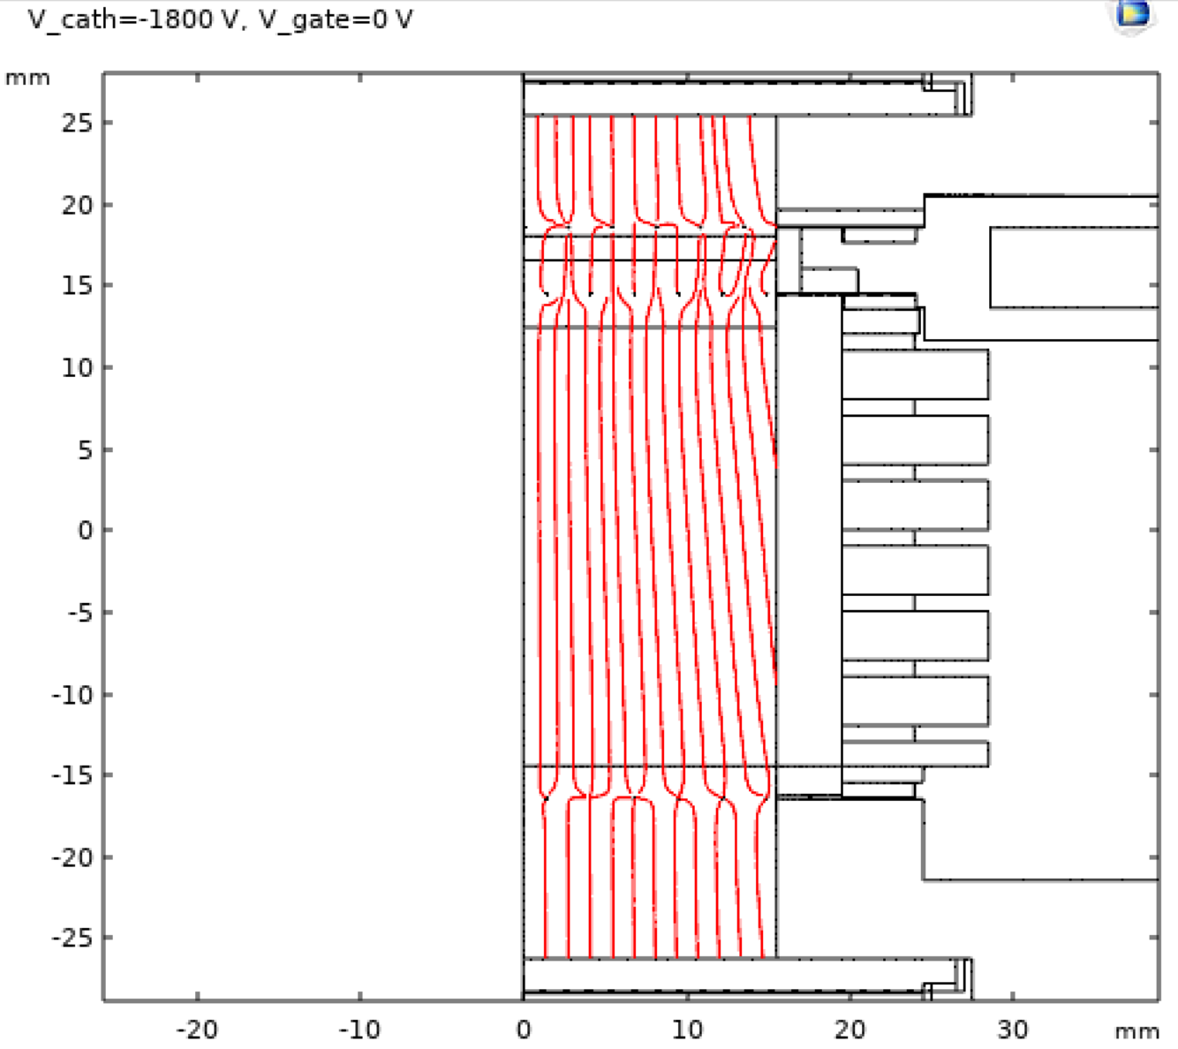
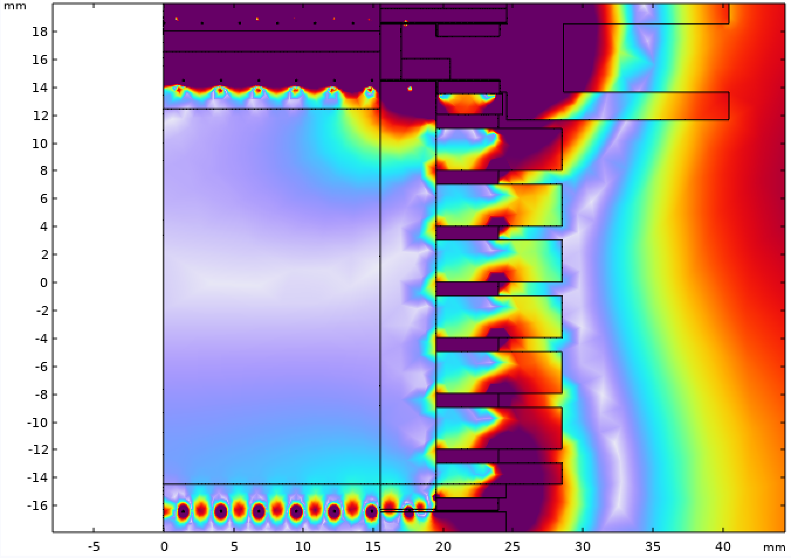
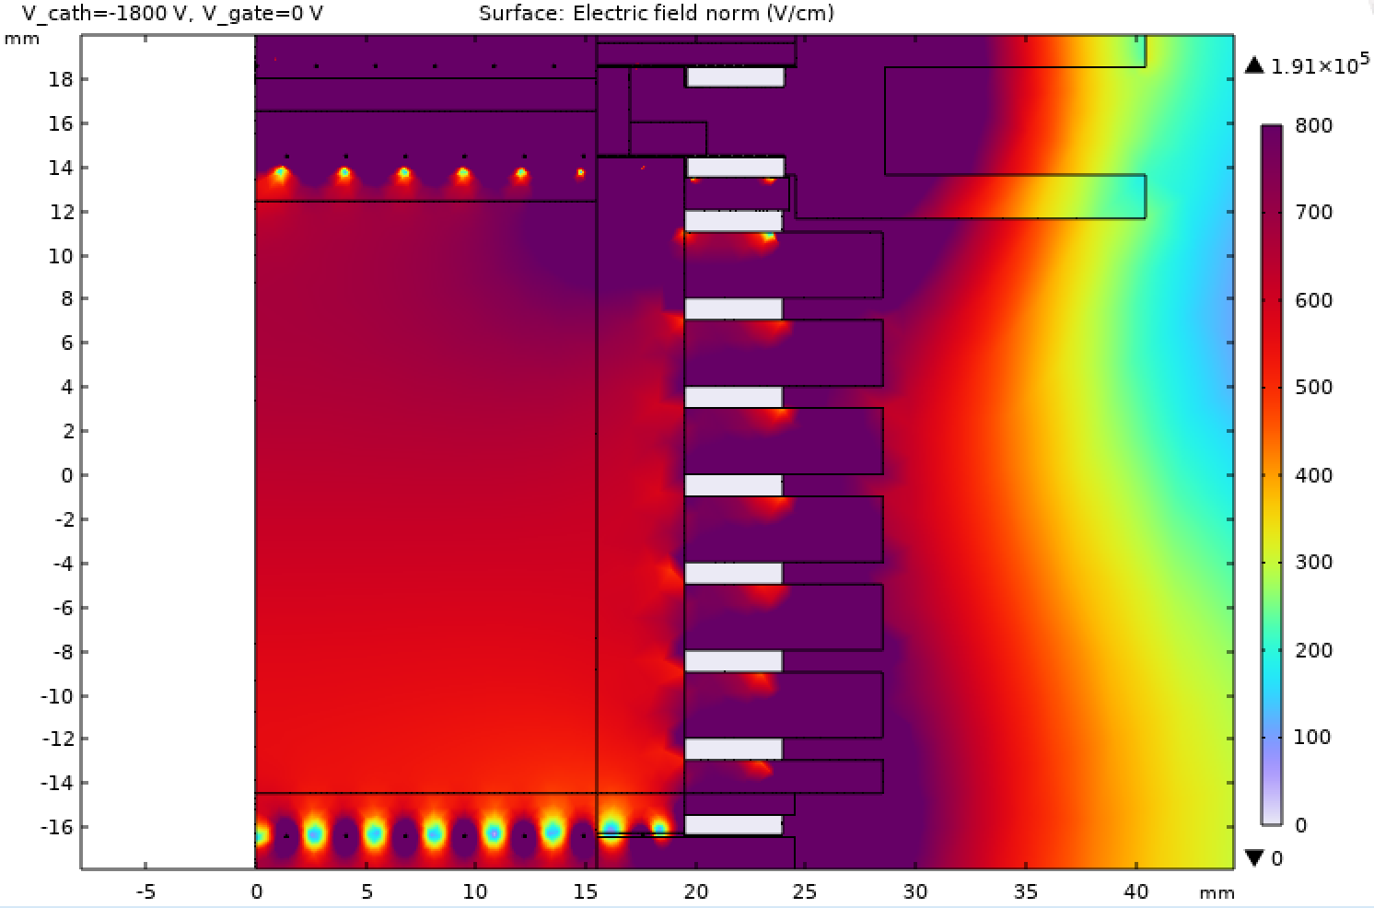




2D Study: Field behavior at low vs high drift bias
$∆E$ [%]
100
90
80
70
60
50
40
30
20
10
0
$E_{drift}$ [V/cm]
300
250
200
150
100
50
0
$E_{theory}=20 V/cm$
100
90
80
70
60
50
40
30
20
10
0
800
700
600
500
400
300
200
100
0
$E_{theory}=600 V/cm$
Sep 8 2025 Elena Muñoz Rivas 16

Slide 23




2D Study: Field behavior at low vs high drift bias
$∆E$ [%]
$$∆E≈43\%$$
100
90
80
70
60
50
40
30
20
10
0
$E_{drift}$ [V/cm]
300
250
200
150
100
50
0
$E_{theory}=20 V/cm$
Larger non-uniformities
Strong edge distortion
|E| $≈120$ V/cm deviates from $E_{theory}$
100
90
80
70
60
50
40
30
20
10
0
800
700
600
500
400
300
200
100
0
$$∆E≈9\%$$
$E_{theory}=600 V/cm$
$\text{|}\text{E}\text{|}≈620$ V/cm $≈E_{theory}$
Better uniformity
Sep 8 2025 Elena Muñoz Rivas 16

Slide 24
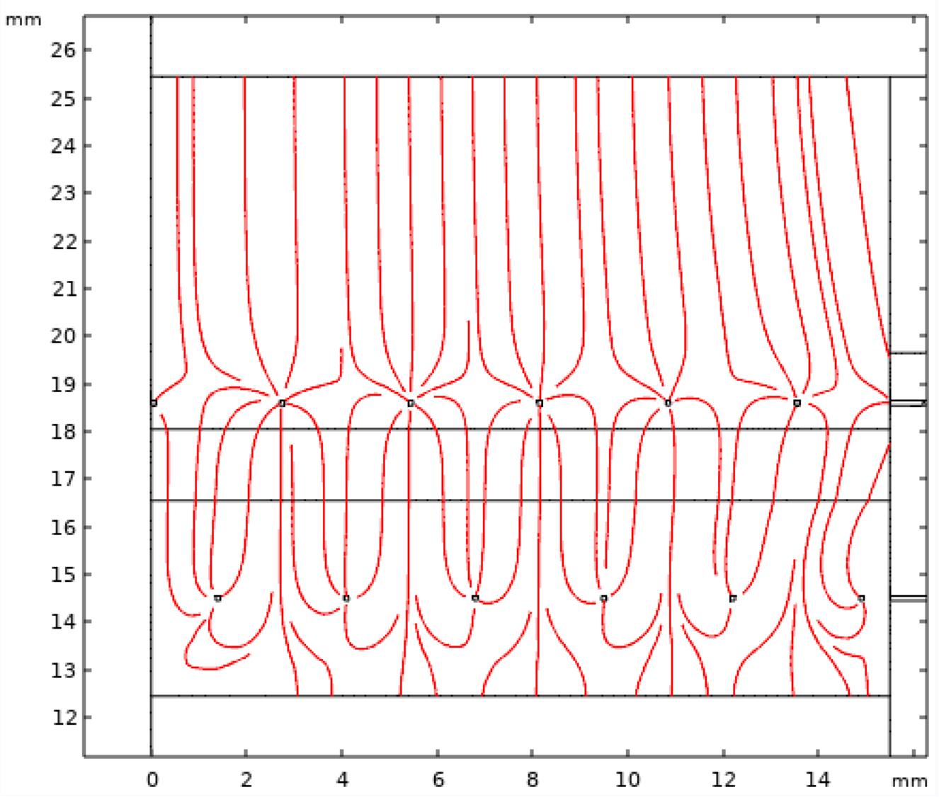
2D Study: Extraction field
Extraction field remains uniform across tested drift fields
Sep 8 2025 Elena Muñoz Rivas 17

Slide 25
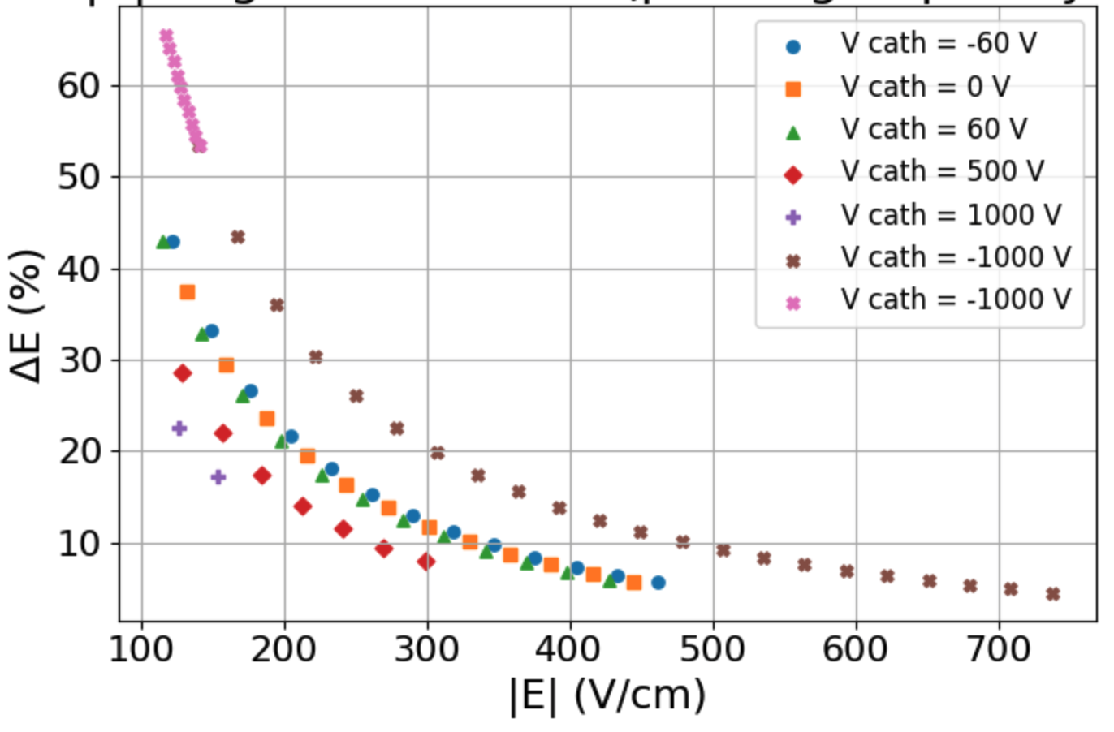
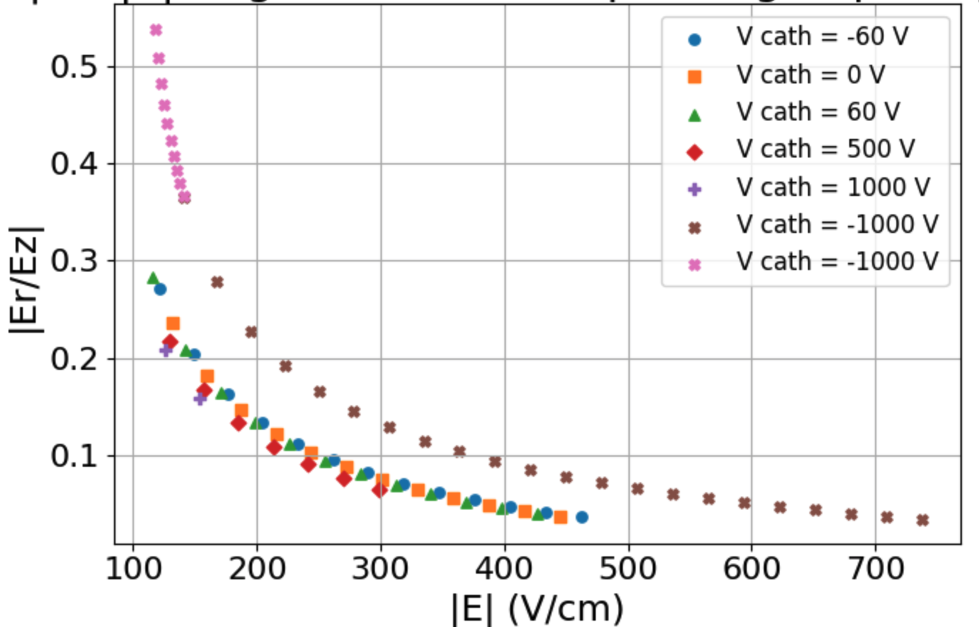

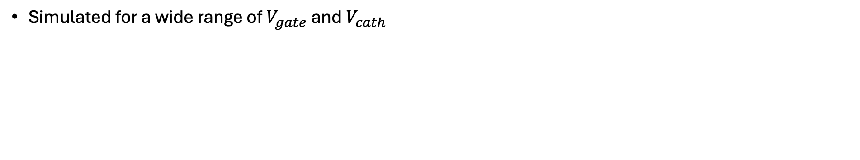
2D Study: Cathode and gate scan
Simulated for a wide range of $V_{gate}$ and $V_{cath}$
Non-uniformities (ΔE) decrease with higher drift field: from >40% at ~100 V/cm to <10% at >500 V/cm
Radial distortions (|Er/Ez|) also shrink at high fields, indicating better alignment with the drift direction
Sep 8 2025 Elena Muñoz Rivas 18

Slide 26
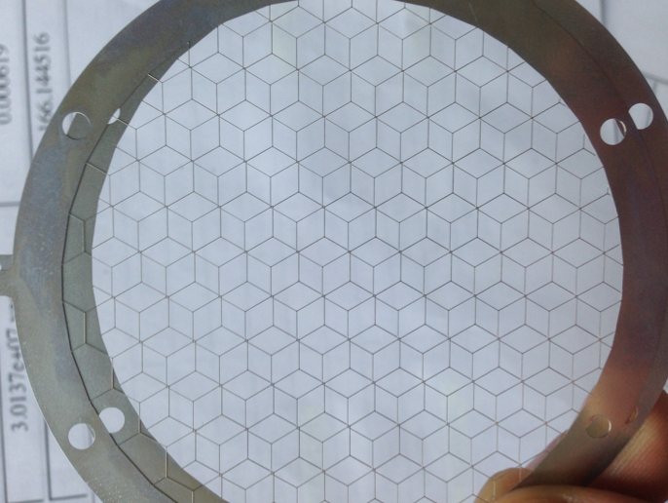
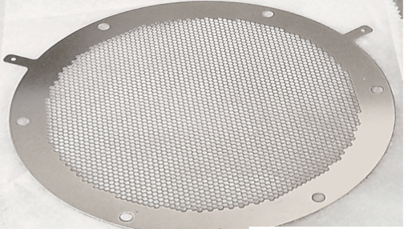
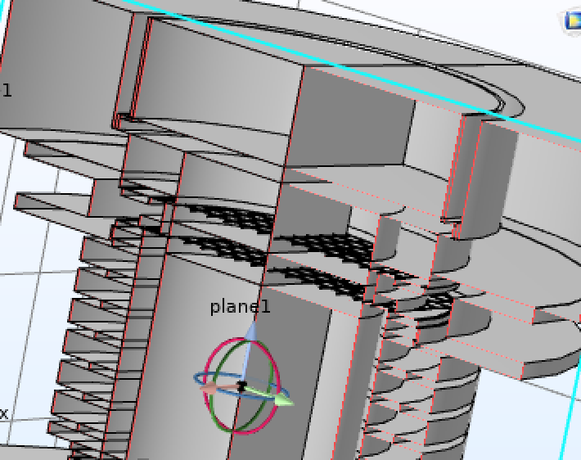
2D Study: Mesh pitch
Geometry variations: The mesh pitch (0.5–2.7 mm) is varied to study their effect
Goal: Evaluate how these design choices impact field uniformity (ΔE) and radial distortions (|Er/Ez|) inside the liquid xenon region
p = 2.7 mm
p = 1 mm
Sep 8 2025 Elena Muñoz Rivas 19

Slide 27
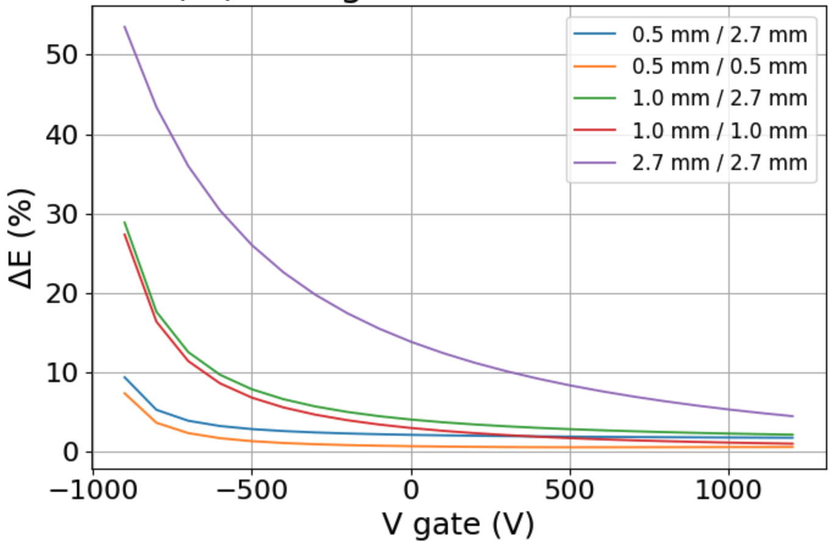
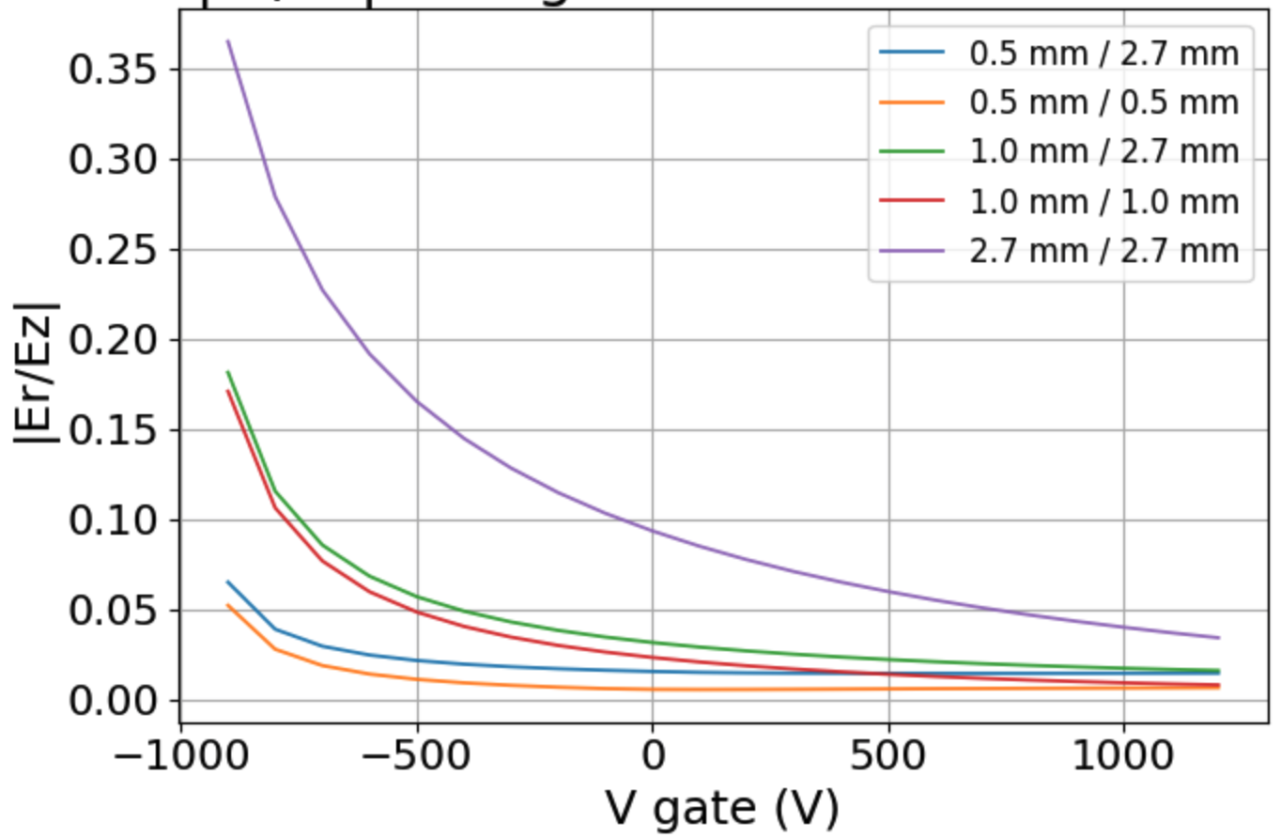
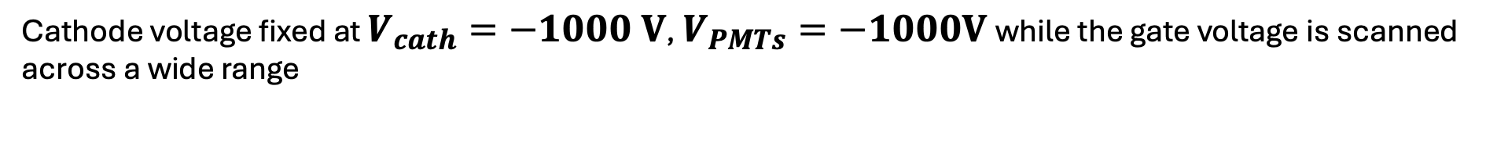
2D Study: mesh pitch
Cathode voltage fixed at $V_{cath}=−1000 V$, $V_{PMTs}=−1000V$ while the gate voltage is scanned across a wide range
0.5 mm pitch yields the lowest ΔE(%) across; 2.7 mm suffers higher non-uniformity
Trade-off: field quality vs optical transparency and light collection efficiency
Sep 8 2025 Elena Muñoz Rivas 20

Slide 28







2D Study: mesh pitch
$E_{drift}$ [kV/cm]
14
10
6
2
$E_{drift}$ [kV/cm]
14
10
6
2
$∆E$ [%]
100
90
80
70
60
50
40
30
20
10
0
$∆E$ [%]
100
90
80
70
60
50
40
30
20
10
0
p = 0.5 mm
p = 2.7 mm
Sep 8 2025 Elena Muñoz Rivas 21

Slide 29




3D Superposition method
Pre-solve basis fields $E_{k}$ for each electrode at 1 V; any operating point is a linear combination $\sum{V_{k}E_{k}}$
Validated with a direct 3D solve; only differences localized at edges/wires
Enables fast scans of low-field setpoints and ring-ladder shapes.
Sep 8 2025 Elena Muñoz Rivas 22

Slide 30


3D Superposition method
Superposition results: Deviation (%) across LXe ROI as function of drift field
Best configuration: minimum deviation achieved with fixed voltages (reference case)
PMT bias scan: tested PMTs between –950 and –1100 V → only small variation in deviation
No impact on uniformity
Sep 8 2025 Elena Muñoz Rivas 23

Slide 31


3D Superposition method: Ring scaling
Parameterize last ring voltages $V_{ring}(i)∝{\left(\frac{d_{i}−d_{c}}{d_{g}−d_{c}}\right)}^{s}$:
  Shallower near gate: s≈0.7 → best uniformity
  Steeper near gate: s>1 → worse (concentrates drop at the top).
Ring that is being changed
1R
1R
1R
1R
1R
1R
Sep 8 2025 Elena Muñoz Rivas 24

Slide 32


3D Superposition method: Pitch
Smaller pitch (1 mm) achieves better uniformity than 2.7 mm
Finer spacing between rings reduces large local field distortions
However, smaller pitch comes at the cost of more mechanical complexity
pitch = 2.7 mm
pitch = 1 mm
Sep 8 2025 Elena Muñoz Rivas 25

Slide 33

Summary and Conclusions
Low-Field Operation Is Viable with a Shallow Ladder and Fine Pitches
Uniformity: ΔE/E in the LXe ROI drops from >40% at ~100 V/cm to <10% at >500 V/cm
Design choices: s≈0.7 near the gate and 0.5 mm pitches (gate & cathode) minimize ΔE and |$E_{r}$|/$E_{z}$
Next: Perform optical simulations to evaluate whether fine-pitch grids still allow sufficient VUV light transmission. The goal is to determine how small we can go in pitch without sacrificing S1/S2 light collection or losing information
Sep 8 2025 Elena Muñoz Rivas 26

Slide 34
The End
Elena Muñoz Rivas
Luisa Hötzsh
Laura Baudis
Bern, Sep 8
Notes:
Xurich es el banco de pruebas local de UZH para microfísica en Xe; tras varias iteraciones, afrontamos nuevas medidas con neutrones y nuevos fotomultiplicadores: toca rediseñar y simular el campo a bajo drift field.
We optimise the upgraded Xurich TPC for neutron runs by achieving highly uniform drift fields at low E and safe extraction, using 3D simulations to identify and fix design hotspots.

Slide 35
Backup
Elena Muñoz Rivas
Luisa Hötzsh
Laura Baudis
Bern, Sep 8
Notes:
Xurich es el banco de pruebas local de UZH para microfísica en Xe; tras varias iteraciones, afrontamos nuevas medidas con neutrones y nuevos fotomultiplicadores: toca rediseñar y simular el campo a bajo drift field.
We optimise the upgraded Xurich TPC for neutron runs by achieving highly uniform drift fields at low E and safe extraction, using 3D simulations to identify and fix design hotspots.

Slide 36

Astrophysical evidence for DM
  Dark matter exists — rotation curves, CMB, lensing maps
  Candidates:
NEUTRAL
DOESN’T INTERACT WITH LIGHT
NEEDS TO BE COLD
HAS MASS
STABLE OVER LIFETIME OF THE UNIVERSE
NON-RELATIVISTIC
Notes:
Sabemos que la materia oscura existe, por evidencias astrofísicas como las curvas de rotación de galaxias, el fondo cósmico de microondas y los mapas de lentes gravitacionales.
Durante mucho tiempo, la comunidad se ha centrado en las WIMPs clásicas, que tendrían masas en el rango de unos pocos GeV hasta varios TeV, y se detectarían mediante retrocesos nucleares. Sin embargo, como se ve en los últimos resultados experimentales, esa región está fuertemente restringida — ya hemos buscado mucho ahí, sin éxito.
Por eso, cada vez hay más interés en modelos que predicen una materia oscura más ligera, en el rango de MeV a GeV. Estos modelos están bien motivados teóricamente: por ejemplo, a través de mecanismos como el freeze-in, donde la materia oscura nunca estuvo en equilibrio térmico, o modelos de materia oscura asimétrica, similares al origen de la materia normal.
También hay modelos con mediadores ligeros, como dark photons o campos escalares, que permiten que estas partículas ligeras interactúen con el sector visible.
En el eje de masas vemos todo el espectro de posibilidades: desde materia oscura ultraligera como axiones o campos bosónicos, pasando por la región de interés de este trabajo —que está destacada en azul—, hasta objetos mucho más masivos como materia oscura compuesta o agujeros negros primordiales.
Algunos de los modelos más interesantes hoy en día predicen materia oscura ligera de forma natural.
Por ejemplo, en el mecanismo de freeze-in, la materia oscura nunca estuvo en equilibrio térmico, sino que se fue generando lentamente mediante interacciones ultra-débilmente acopladas.
Esto permite masas muy pequeñas, del orden de MeV, sin conflictos con las observaciones.
También existen modelos de materia oscura asimétrica, en los que, igual que ocurre con la materia normal, hay un exceso de partículas sobre antipartículas.
En estos casos, la cantidad de materia oscura queda relacionada con la de bariones, lo que sugiere masas más ligeras, incluso por debajo de 5 GeV.
Por eso, la materia oscura ligera no solo está abierta experimentalmente, sino que está bien motivada desde el punto de vista teórico.
Este trabajo se centra en explorar la región intermedia, donde la materia oscura sería térmica, ligera y posiblemente detectable mediante retrocesos electrónicos en detectores como DAMIC-M.

Slide 37

Scintillation in Xe
Xe* = exciton
Xe2* = excimer
Notes:
Backup A — Basics of recombination and yields (for non-experts)
Lower drift fields → higher recombination → more S1, less S2.
Energy estimator benefits from combined scale (α·S1 + β·S2) to reduce fluctuations.
At very low E, non-uniformities bias position/energy; hence our ΔE/E target.
Backup B — Extraction region and grids
S2 forms in gas; require high field between gate–anode; grid geometry controls transparency and peak fields.
Design checks: wire diameter, pitch, tension; avoid micro-sparking; maintain optical transparency.
Backup C — HV safety checklist
Round all edges; avoid sharp corners; verify E_max on metals and at interfaces.
Choose conservative margins vs known breakdown behaviours; document polishing/coating steps.
Backup D — Validation with calibration sources
83mKr (9.4 & 32.1 keV) uniform; 37Ar (2.8 keV) for low-energy response.
Use position maps and S2/S1 patterns to spot field-bending and extraction issues.
Slide design cues (for a Swiss panel)
Clean white background; one idea per slide; figures ≥70% del área.
Captions with a takeaway (e.g., “ΔE/E < 1% @100 V/cm with +2 rings”).
Sans-serif consistent; axis labels ≥24 pt; always show units.

Slide 38


Production mechanisms
Aggarwal et al. (DAMIC-M Coll.), Probing benchmark models…, 2025
Freeze-in: e⁺ e⁻ → χ χ never reaches equilibrium, yield grows until T ≲ $m_{e}$→ relic ∝ coupling² (ultra-weak)
Freeze-out: χ χ ↔ e⁺ e⁻ in equilibrium, decouples at T ≈ mχ /20 → relic set by annihilation cross-section
Benchmarks give σₑ(mχ) targets → probed here by DAMIC-M exclusion curves
July 2025 Elena Muñoz Rivas
Notes:
Pipeline completo y validado
Alta eficiencia (≥ 95 % 1 e⁻)
Bases para futuras búsquedas MeV‑DM
Notas (2 min): Conectar con objetivos iniciales.
Trabajo futuro
Mejorar Hot‑column & OD → ML
Reducir fondo < 1 dru con Cu‑electroformado
Análisis modulación diaria 1 e⁻ - Conecta con objetivos iniciales (“pipeline validado → listo para 1 kg·año”).
- Roadmap: daily modulation, mejora ML para máscaras, nuevo blindaje.
- Una diapositiva final “Thank you & Questions”.

Slide 39


Nuclear-recoil limits (WIMPs)
Current status of SI WIMP searches
The GeV–TeV window is now probed down to $σ_{\text{χ}\text{−}\text{N}}$ ≃ 2.2 × 10⁻⁴⁸ cm² (LZ)
Sensitivity drops steeply below ≈ 1 GeV/c²: recoil energies fall under detector thresholds → motivates e⁻-recoil searches like DAMIC-M
Approaching the “neutrino floor” (dashed line): coherent ν-nucleus scattering becomes an irreducible background
Figure from F. Petricca, Direct Detection of Dark-Matter Report (Community Feedback Mtg., Feb-2021)
July 2025 Elena Muñoz Rivas
Notes:
Los grandes experimentos que buscan WIMPs a través de retrocesos nucleares han alcanzado sensibilidades espectaculares, pero su eficacia cae bruscamente por debajo de 1 GeV/c², donde las energías son demasiado pequeñas para ser detectadas.
Esto deja una ventana abierta para experimentos como DAMIC-M, que exploran el rango de baja masa utilizando interacciones con electrones.
Además, los experimentos nucleares se acercan al "neutrino floor", una barrera fundamental donde la señal de materia oscura ya no puede distinguirse del fondo natural producido por neutrinos.
En la detección por retroceso nuclear, una partícula de materia oscura colisiona con un núcleo del detector, dándole un pequeño empujón. Esa energía de retroceso se puede detectar como luz, carga o calor.
Esta técnica ha permitido alcanzar límites muy precisos para WIMPs de masas altas, pero pierde eficacia por debajo de 1 GeV, donde los retrocesos son demasiado pequeños para ser medidos.
Además, se aproxima el límite impuesto por los neutrinos, que producen señales indistinguibles de la materia oscura.

Slide 40










Field behavior at low vs high drift bias
$E_{teo}=20 V/cm$
$E_{teo}=600 V/cm$
(r = 0): field magnitude as a function of z from cathode to gate
(z = L–GXe interface):
field magnitude from the center (r = 0) out to the PTFE wall
Sep 8 2025 Elena Muñoz Rivas 13/20

Slide 41
Field behavior at low vs high drift bias
Field lines at low drift bias show strong bending near the gate–cathode region → loss of uniform drift
At high drift bias, field lines straighten
Gas gap: field lines remain vertical and uniform, ensuring stable electron extraction
Sep 8 2025 Elena Muñoz Rivas 13/20

Slide 42

Variation in cathode and gate – 2.7 mm pitch
Sep 8 2025 Elena Muñoz Rivas 14/20

Slide 43


2D geometry study: mesh pitch
Sep 8 2025 Elena Muñoz Rivas

Slide 44

Why a field cage? (rings vs no rings)
Without rings: edge fields bow inward → radial components, worse near the gate; ΔE/E rises at the wall.
With rings (linear ladder): potential drops smoothly → straighter field lines, flatter plateau in LXe.
Add one more ring near the gate: further shields the extraction fringe → ΔE/E ↓ in the upper liquid.
Sep 8 2025 Elena Muñoz Rivas

Slide 45


Varying number of rings (n = 7 vs. 8)
Adding one more ring (n = 8) slightly reduces axial inhomogeneity compared to 7 rings
The improvement is modest but systematic across the drift field range
More rings distribute the potential drop more smoothly, helping uniformity
nring = 7
nring = 8
Sep 8 2025 Elena Muñoz Rivas

Slide 46


3D Superposition method: All Rings scaling
Parameterize ring voltages $V_{ring}(i)∝{\left(\frac{d_{i}−d_{c}}{d_{g}−d_{c}}\right)}^{s}$:
  Shallower near gate: s≈0.7 → best uniformity
  Steeper near gate: s>1 → worse (concentrates drop at the top).
1R
1R
1R
1R
1R
1R
Sep 8 2025 Elena Muñoz Rivas

