Slide 1
POLAR-2 Weekly Meeting
18-Aug-2025
(week 34)

Slide 2
WP0 - Management
Pol LOE: Polish budget/CN officially approved?
Discussions in progress with Tübingen and IHEP for PLAN-B
Documentation:
  SoW: no update. New update depends on changes/conclusions of thermals analysis
  ICD:
    ICD_v6 document drafted after CSU meeting.​

Slide 3
WP0 - Management
ICD:
  Mechanical Design of POLAR-2 well documented
  Thermal Analysis being reviewed with CSU
    Updated RAA sent to Franck (it is now thermally isolated)
    Franck is updating simulations (issues with solver fixed!!)
    FEA is done, document has been sent to CSU last week with already some feedbacks (discussions on Wednesday)
    Main modification: SUN is at 65° respect to Zenith axis (less SUN power consequently)
  Communication interface of ICD sent to CSU (no response about it)
  ICD will converge when thermal analysis is complete and validated by all contributors
  Communication interface information is accepted
  Add 'Annex' with qualification requirements

Slide 4
WP0 - Management
Beidou:
  CSU is ok if POLAR-2 includes hardware for Beidou
    License to be requested in parallel
  No news about Beidou 3 licences
    Jianchao will contact Shaolin to inquire about possibilities
    Possible synergies with HERD, BSD, POLAR-2 ?
    Development board available for ground-to-ground testing (https://e.tb.cn/h.TugrgUteW76QzSu?tk=lNcXekX3A7X)

Slide 5
WP1 – Detector Module
10 Carbon Fiber sockets are delivered from Composite Design company (CD)
Target insertion looks OK so far... (inner size checked)
  GO/NoGO gauge : received at DPNC for outer dimension check, will be sent to CD for final production
  Quote by CD received...quite cheap for re machining (170 CHF / 10 units, and 1080 for 120 units).
  8 remaining sockets have been re-machined and sent to DPNC (looks good except some tiny issues on the round corners … will be adjusted for the mass production.
  Total cost estimate for 120 sockets fully operational= 24300 CHF (VAT excluded)
~260 bars have been wrapped by Coralie (TBC on a bi weekly basis)
147 bars have been wrapped by Johannes in 202
3 targets assembled (in 202)
Sorbothane pads have been cut and received at DPNC (480 pads)
CITIROC will stop production by early 2026 (currently 1000 units in stock)

Slide 6
WP1 – Detector Module Production

Slide 7
WP2 - FEE
Check again the voltage generation circuit and HK circuit. To understand the correctly how is behaving the FEE with the temperature correction → Will use FEE009.
FEE gain pulse calibration tests.
FEE V1 #4 presents HV high current consumption. Probe station tests show that at least 2 SiPM channels are not working.
  Now we see problems with HV distribution, still under investigation.
Production of 25 (30?) FEE PCB will be ordered today.
We have to think about conformal coating
FW: version 3.3 released by Yannick.
  Need to prepare a test/validation plan.

Slide 8
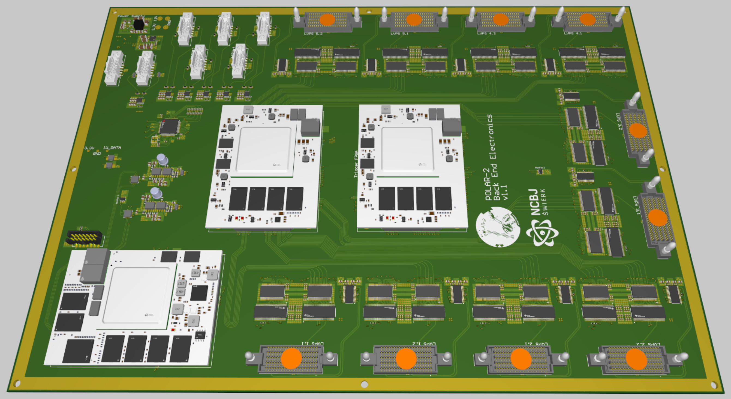
WP3– BEE (PL)
              BEE Review Report – to be finished
              Corrections after BEE review – implemented
              NP: I have not yet seen the report on my question of unconnected pins
              Manufacturing and assembly documentation - ready

Slide 9
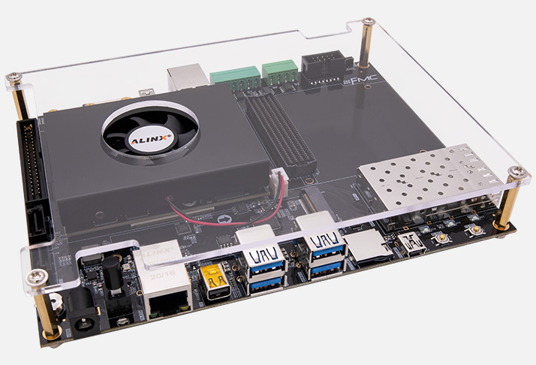
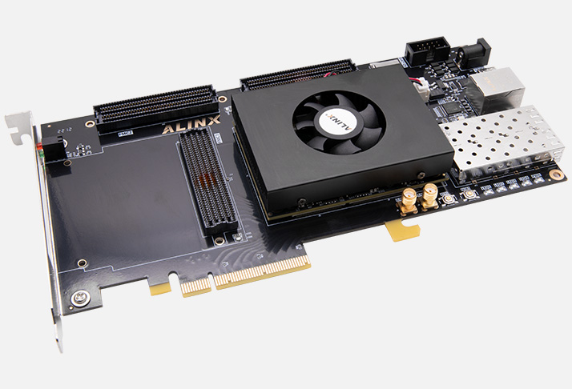
WP3– BEE (Tübingen)
              Alinx modules & Dev-Boards ordered:
                1x AXU9EGB (Zynq UltraScale+)
                2x AXKU042 (Kintex UltraScale)
                Delivery should be ~2 weeks
              Zynq UltraScale+ board (Trenz) is available
                will be used to start development of the inter-FPGA communication interface
                Is there anything (document / details / ideas) available on the requirements of this interface from where we can start?

Slide 10
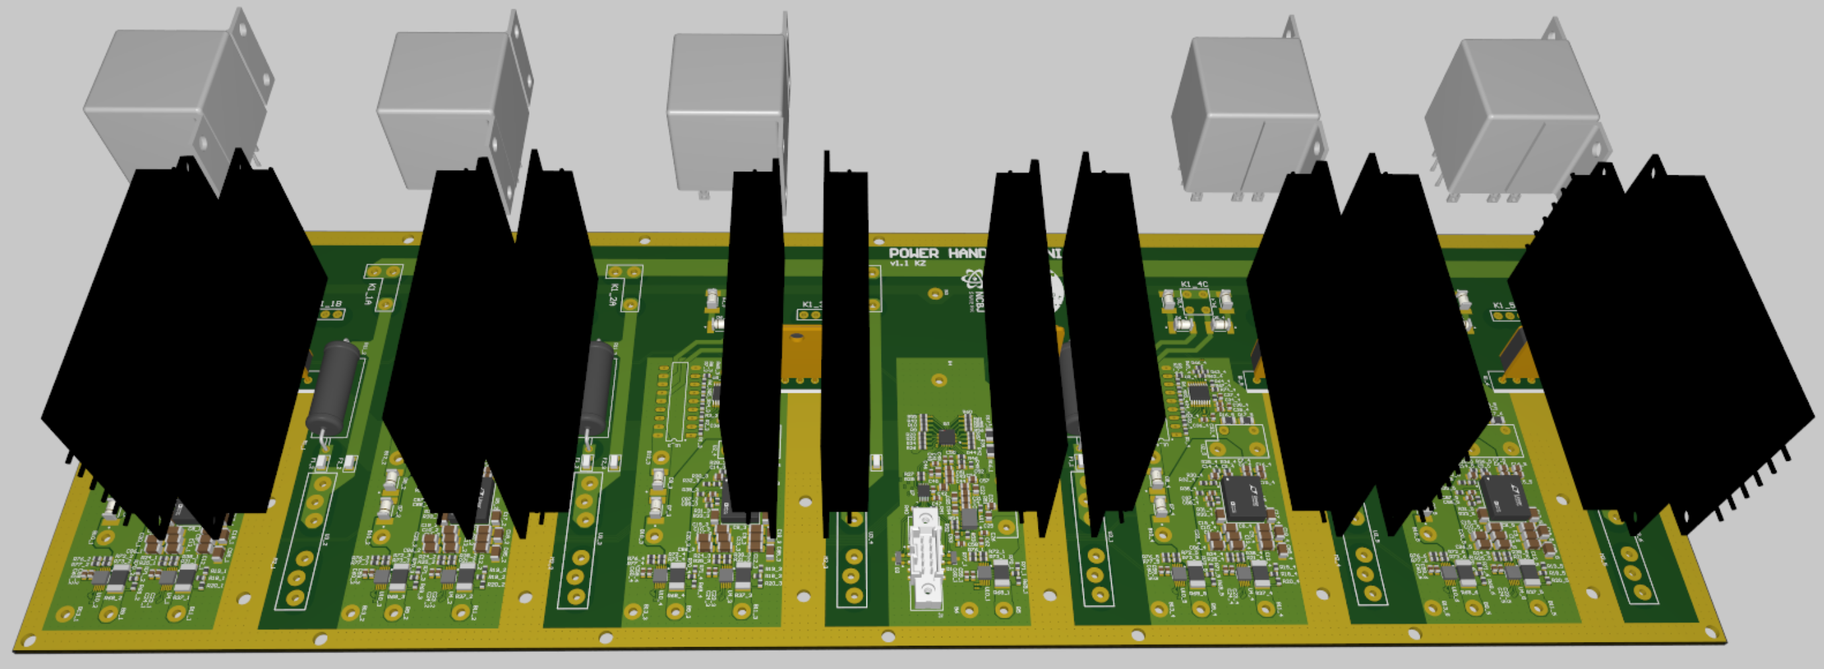
WP4 – PHU – LVPS First Stage
              LVPS First Stage Review Report – to be finished
              Corrections after LVPS First Stage review – implemented
              Manufacturing and assembly documentation - ready

Slide 11
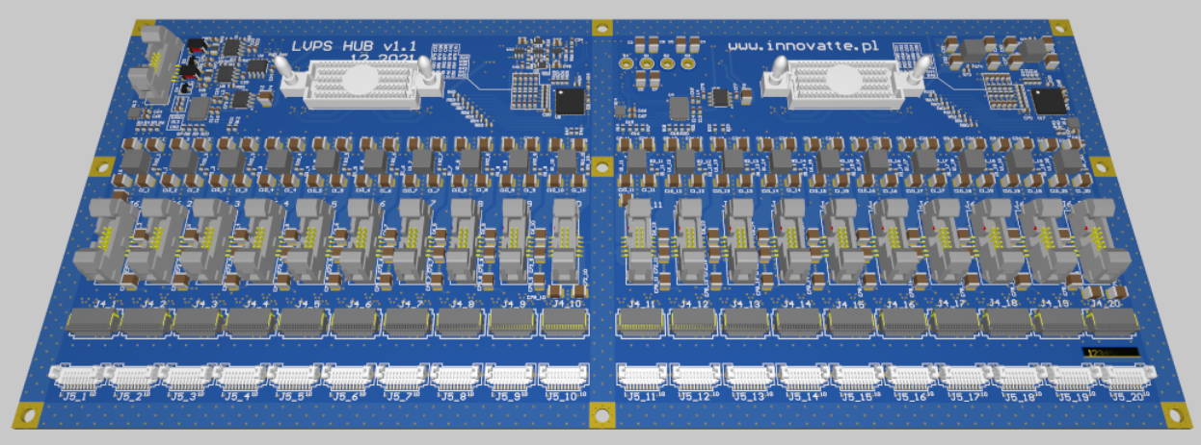
WP4 – PHU - LVPS Hub
              Designed and manufactured by external company
              Modifications to be done:
                FEE connector change
                Startup delay circuit to be modified
                New requirement is > 3.9V (was 3.8V), require a change of resistor setting

Slide 12
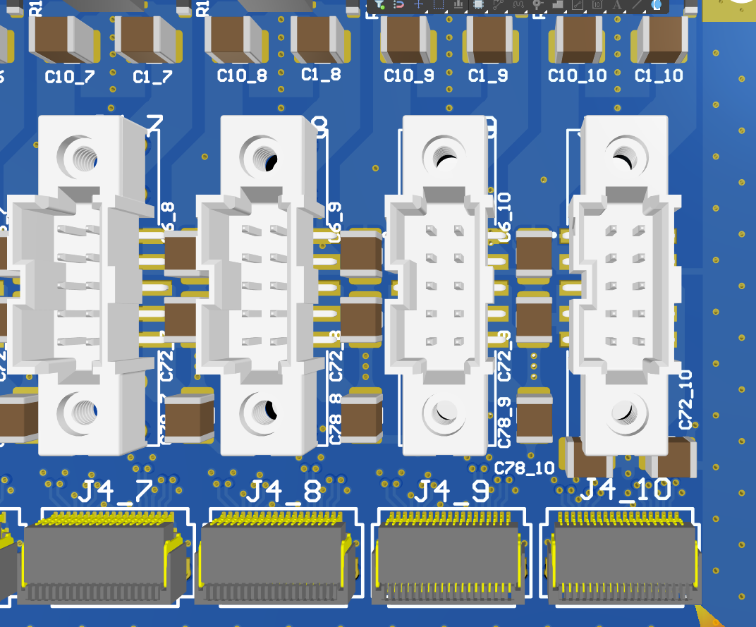
WP4 – PHU + LVPS (Tübingen)
              Started with replacing the FEE power connectors:
                As they are larger, the space is tight
                Got confirmation from Franck on the distance requirements towards other connectors (Firefly) for (un-) mating which should be fine
                Distance to capacitors is also tight and some need to be moved
                Signal re-outing in progress
                Who can provide details on the selected capacitors (and their requirements) in order to understand if we can use a smaller package?
                In general, more details are needed
                → Who is updating the requirements document(s)?

Slide 13
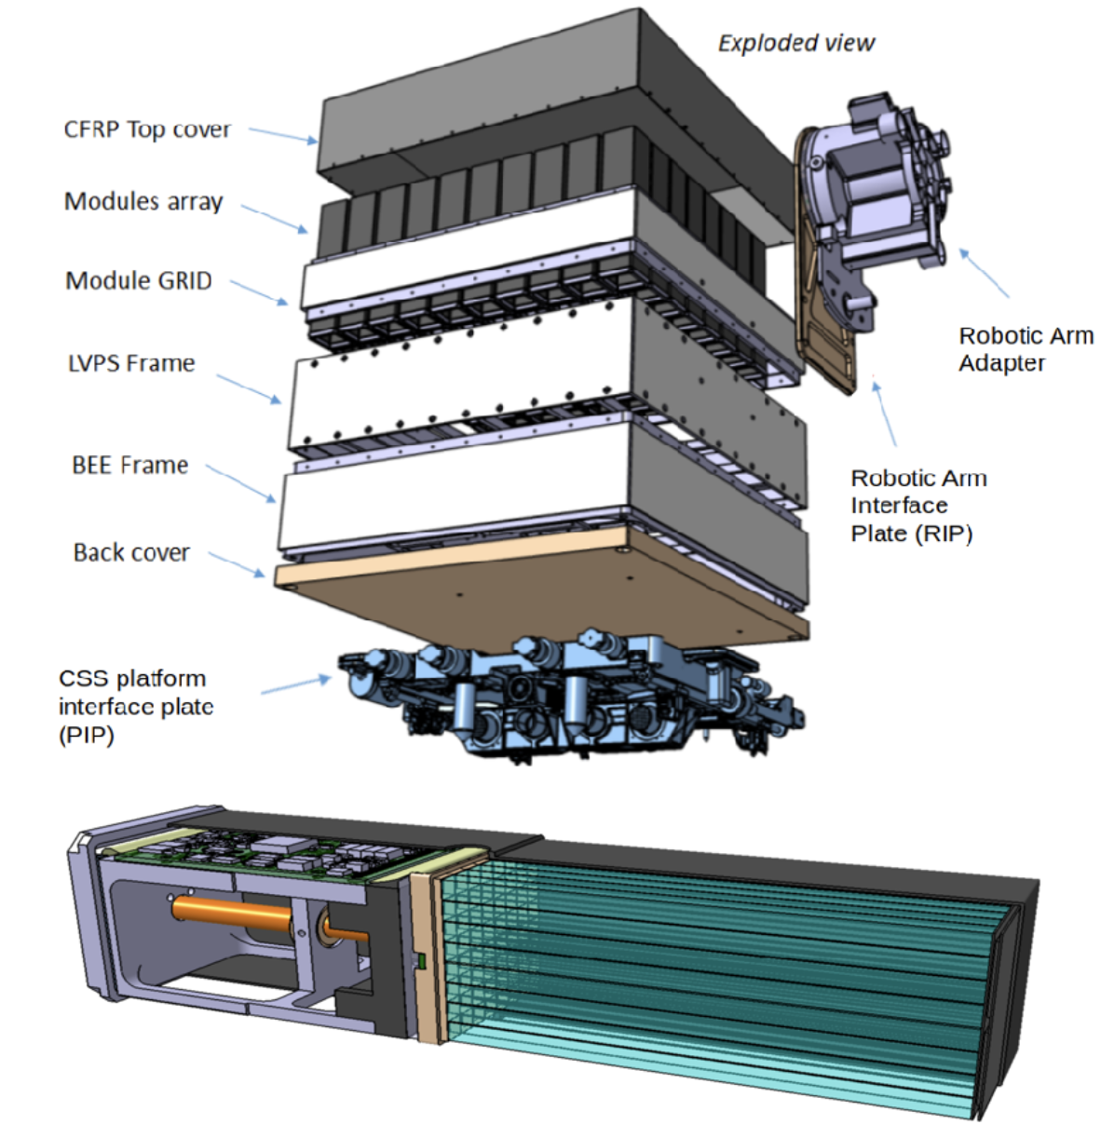
WP5 – Payload Thermo-Mechanical Structure (PTMS)
Instrument stacked in pieces:
Polarimeter will be assembled and delivered to China. RAA and PIP will be assembled on CSS
Full instrument will weigh <160kg (including RAA and adapter plate)... Weight to be updated (modules are being optimized after thermal studies)
New design under FEA simulations (see next slide)
Cable routing to RAA being discussed (unacceptable to route over CFRP Top Cover)

Slide 14
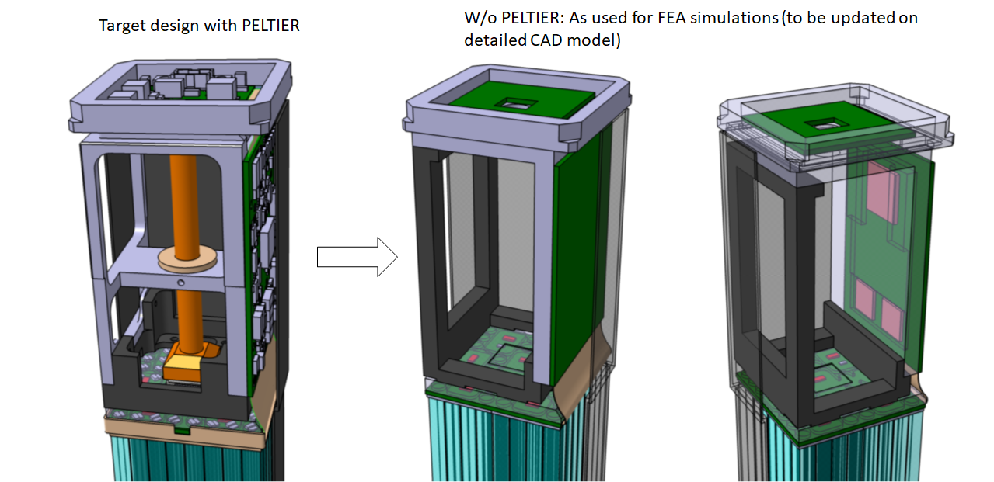
WP5 – Payload Thermo-Mechanical Structure (PTMS)
Minimum gain:
- 60gr per module

Slide 15
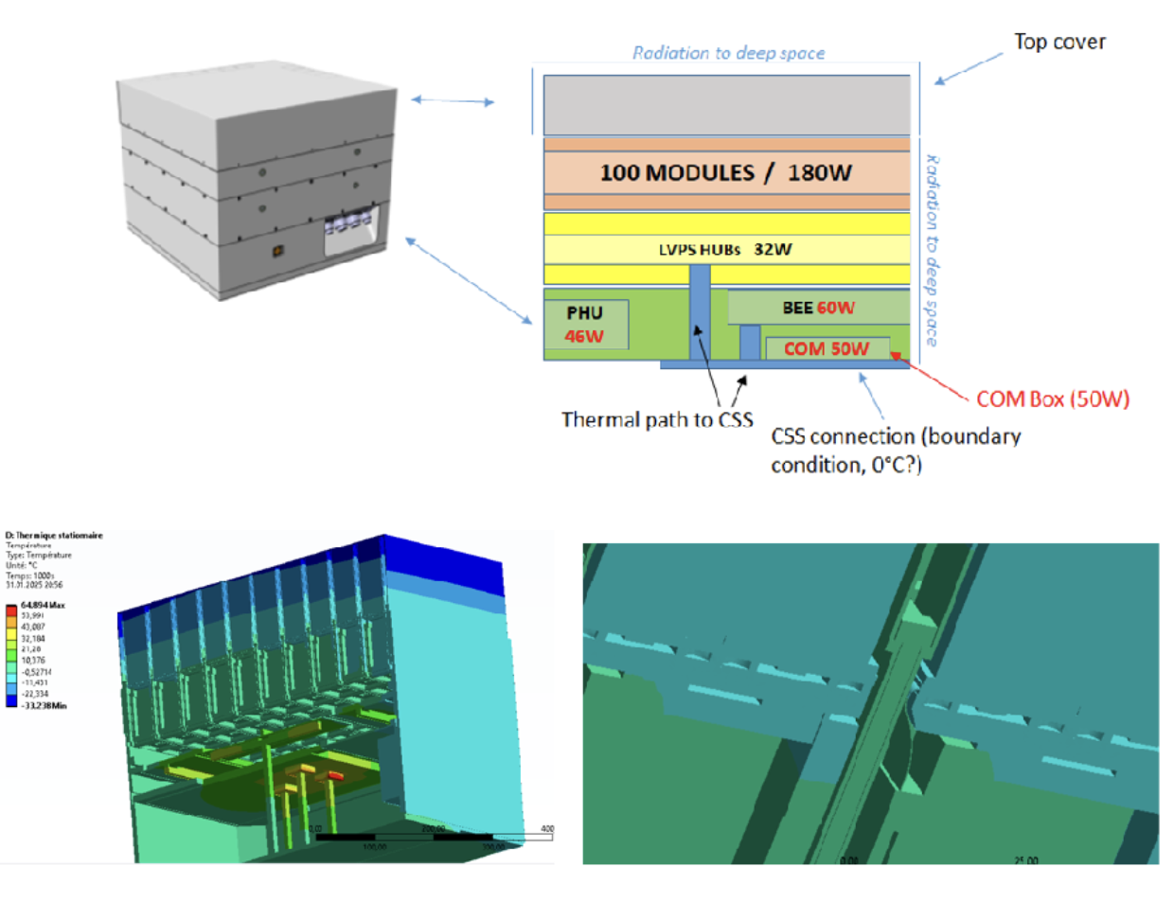
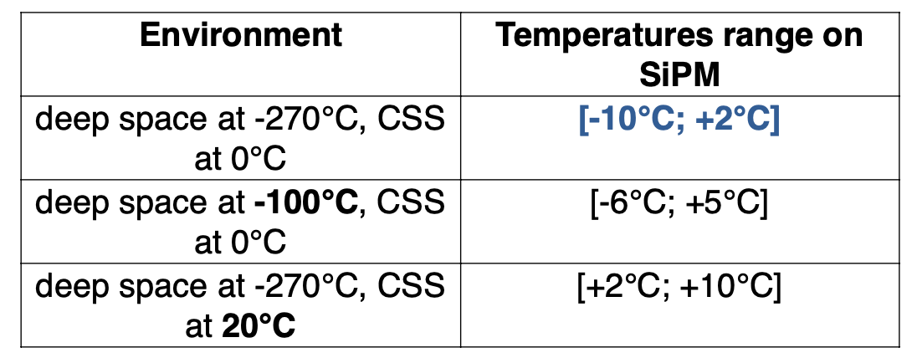
WP5 – Payload Thermal-Mechanical Structure (Steady state)
Leading to transient analyses (COLD & HOT conditions, Beta angles..)

Slide 16
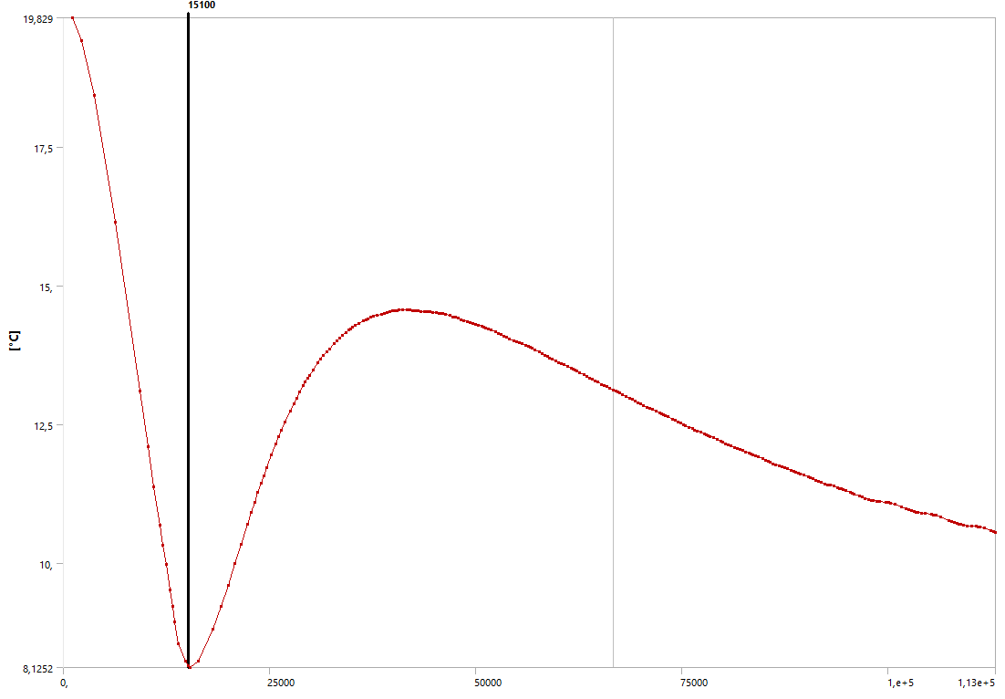
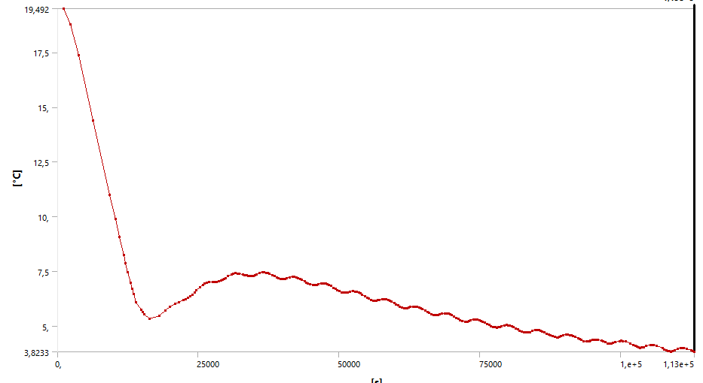
WP5 – Payload Thermal-Mechanical Structure (transient... up to 31 hours)
SiPM temperature close to the center...
SiPM temperature at a POLAR2 corner..
Need some updates according to CSU, βangle up to 65° to be accounted .. FEA ongoing by DPNC (see next slides)
Latest simulations up to 31 hours...showed 3.8°C at corner and 10.5 °C at center

Slide 17
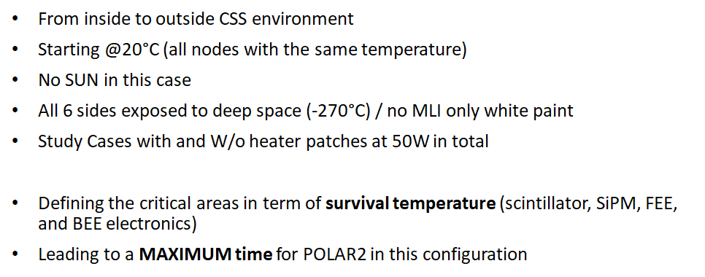
WP5 – Payload Thermal-Mechanical Structure (transient... at cold conditions, from CSS "extraction" )

Slide 18
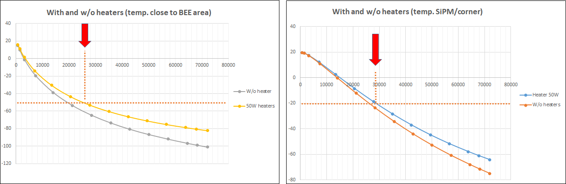
WP5 – Payload Thermal-Mechanical Structure (transient... at cold conditions, from CSS "extraction" )

Slide 19
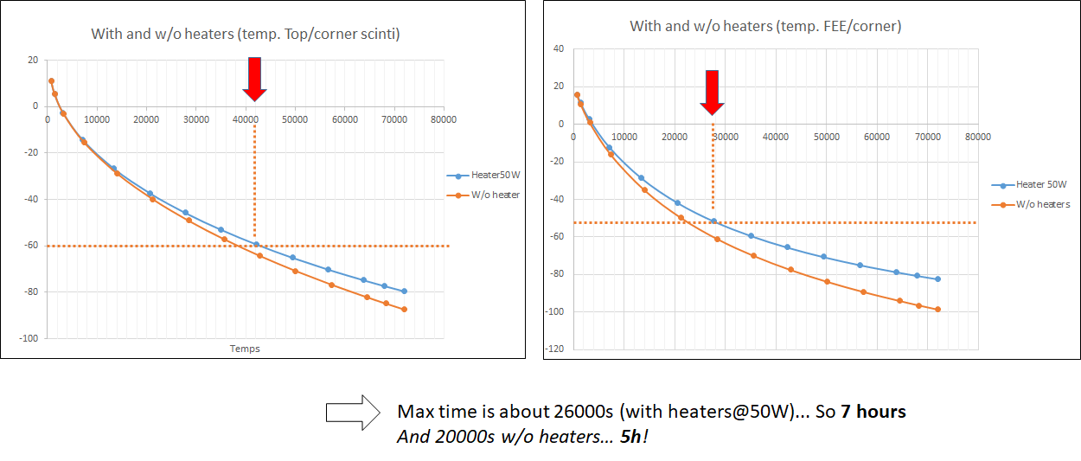
WP5 – Payload Thermal-Mechanical Structure (transient... at cold conditions, from CSS "extraction" )

Slide 20
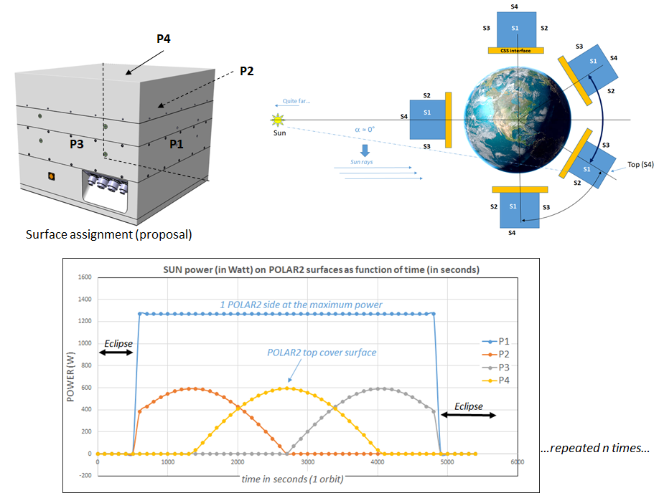
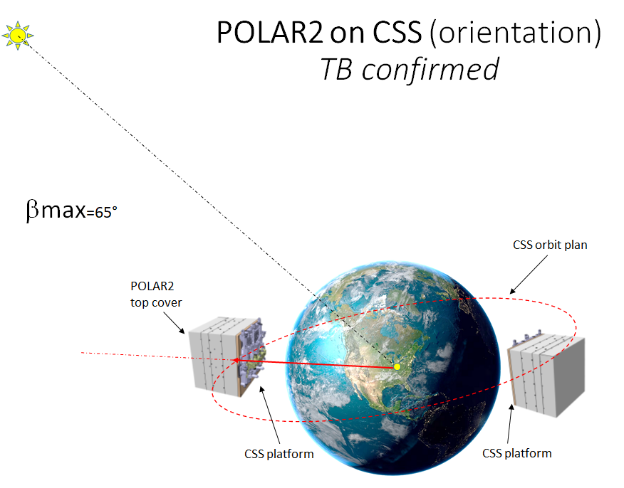
WP5 – Payload Thermal-Mechanical Structure
βangle issue: simulations at 65°

Slide 21
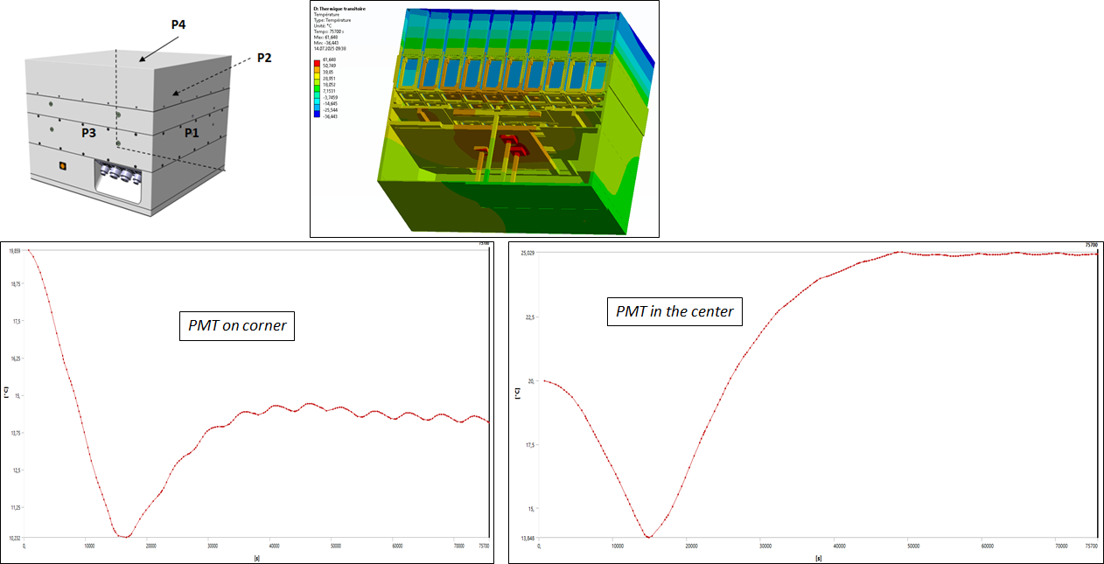
WP5 – Payload Thermal-Mechanical Structure
βangle issue: simulations at 65°

Slide 22
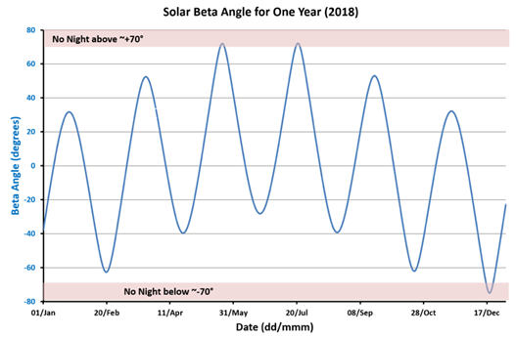
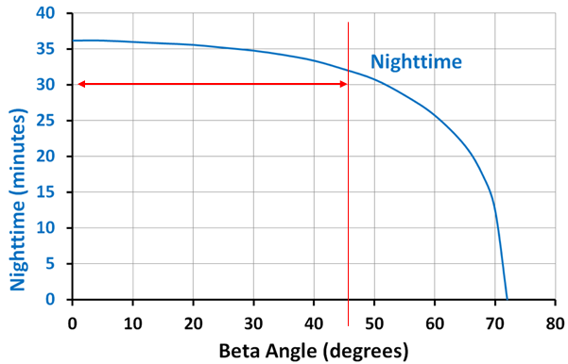
WP5 – Payload Thermal-Mechanical Structure
βangle issue: simulations at 65°
Next steps:
Apply MLI on critical surface? Like P1?... and the opposite surface when negative beta...
Check with other β angles ...see that of ISS (AMS02 example below)
Up to 45°, eclipse is around 32 minutes
ISS beta angle

Slide 23
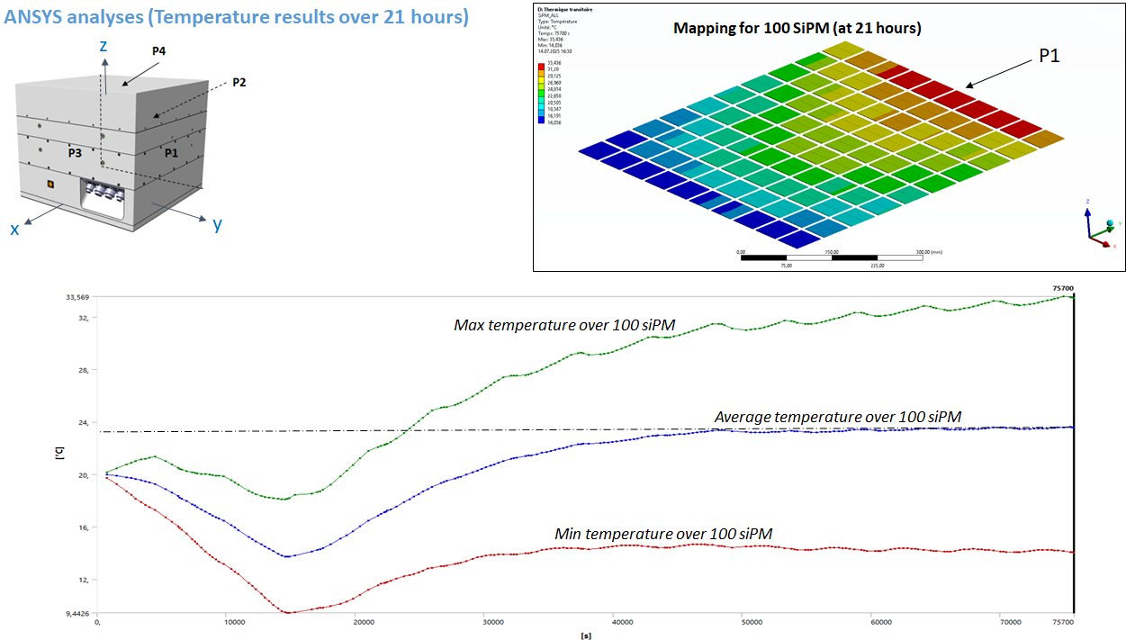
WP5 – Payload Thermal-Mechanical Structure

Slide 24
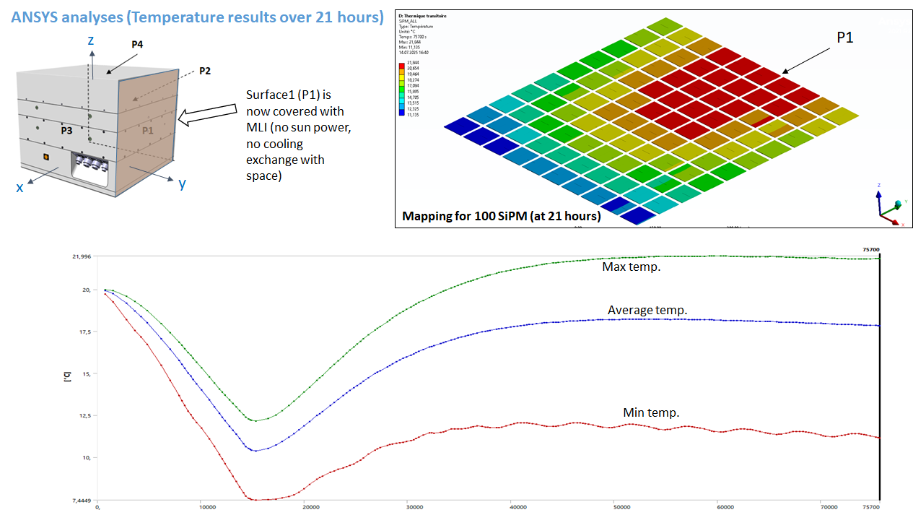
WP5 – Payload Thermal-Mechanical Structure

Slide 25
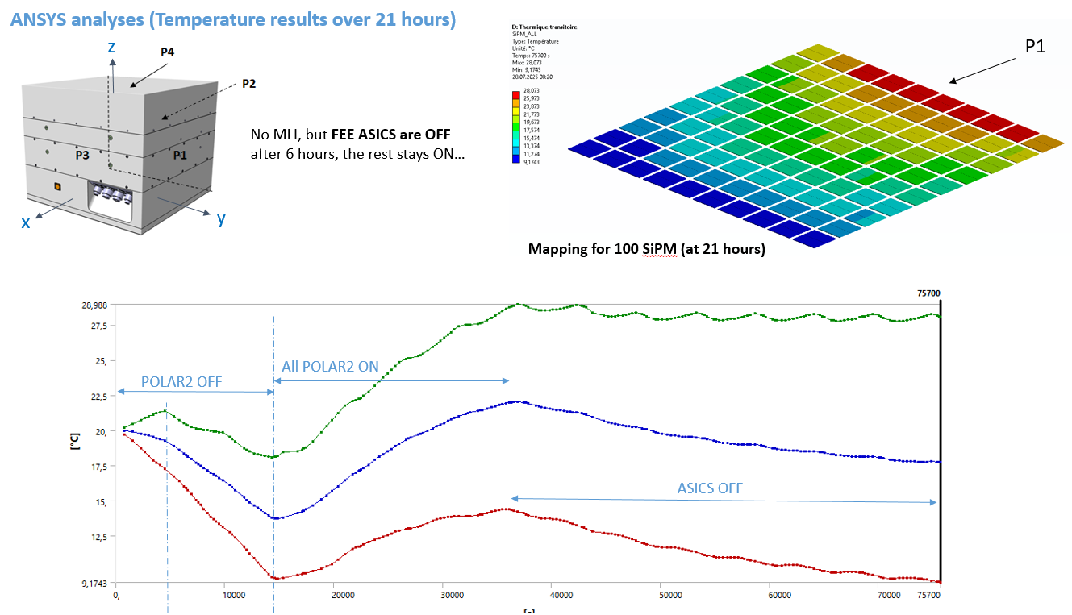
WP5 – Payload Thermal-Mechanical Structure

Slide 26
WP5 – Payload Thermal-Mechanical Structure
Thermal analysis report to CSU
  Last iterations with various beta angles and report will be released to CSU for review (by mid August)
  To estimate the impact (sensitivity) of β angle on temperatures
  For instance:
  30° angle, giving 35 minutes nighttime
  0° angle, giving 36 minutes nighttime.

Slide 27
WP6 – Qualification and Verification
Radiation requirements for BEE and LVPS
  Conditions by UniGe: 1kRad (10 Gray)
  Conditions by CSU: None. But test must be performed. Performance metrics decided by UniGe
2nd Roughness measurements at HEPIA (5 bars) were consistent with previous batches. Johannes will contact Scionix to understand what happened in the production.
Probe station tests will resume when the cold water circuit upgrade will be completed (beg. August).

Slide 28
WP7 – Flight Model Acceptance
Need to contact UniBe for space qualification.
  For TV, we should prepare the list of components with their mass and outgassing properties.
  For vibration, we have to get from CSU the vibration levels during launch (considering POLAR-2 will be in a transportation box).
  Preliminary design document of the payload packaging transmitted by Jianchao.

Slide 29
WP8 – POLAR-2 Onboard Software System
Still framing problem with ZYNQ., perhaps Tuebingen can help.
Vishal has installed vivado2025 on his computer
We received ALINX board. It boots. I tested PYNQ can run some jupiternotebooks. Will have to decide which operating system we want. I can share an ethernet connection with Tuebingen if needed.
Price for testing the firmware is 30K$ (initial cost) + 10K$ per FPGA. If we find 45k Nicolas can do it in China before end of the year. We have to find this money now!
Yannick say that reading several FEE with GPIO is possible but need some work but we will not pursue that, Best is to go to alinx board as test system in a near future.

Slide 30
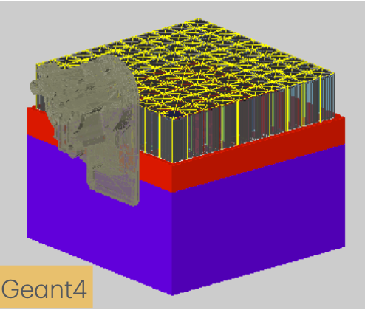
Simulations
Working on Analysis software to unify all scripts we have
  This week: finger fit routines included
  Goal: Full module characterization with a single command
Current implementation includes
  Change of positioning on CSS
  Robotic arm adapter
  Tungsten plate
Open tasks
  Impact of shadow cast by RAA
  Updated implementation of response in framework
  More cleanup

Slide 31
ESRF
Request accepted
  15 shifts
  Beamline ID19
  Week 6 in 2026 proposed (MD day used to setup)
Tasks to complete before ESRF
  Procurement of components for 10 modules (9+1 reserve)
    Yannick will place order for 25 FEEs on Monday (18/Aug). CITIROCs + SiPM to be delivered 1 month in advance.
    Mechanical structures (end cap, alu support structure, etc.)
    cables
  Wrapping 640 bars (~400 done)
  Readout (Nicolas, Dominik, Uni. Tuebingen)

Slide 32
EQM

Slide 33
EQM – Gantt Remarks
The DAQ system should still be added to the chart.
The FEE transportation boxes should still be added to the chart.
2 weeks of Christmas Holidays are taken into account (then if heroes are around, this will just make a nicer chart for January 26).
As soon as we have more infos on the CN7 validation, we should start ordering the PCBs (with or without conclusions on the HV problem of FEE v1, as agreed some weeks ago already).

Slide 34
Conferences/Paper/Misc.
ICRC proceeding deadline 19/Sep (final version)
NDA writing proceeding for SPIE (about POLAR-2 in general)
More??

