Slide 1
MD16003 Collisions of 8b4e trains with HL bunch intensity
C. Antuono, H. Bartosik, X. Buffat, E. De La Fuente Garcia, Y. Dutheil, I. Efthymiopoulos, M. Hostettler,
B. Karslen-Baeck, S. Kostoglou, K. Li, I. Mases Sole, N. Mounet, G. Rumolo, B. Salvant, G. Sterbini,
R. Tomas, H. Timko, J. Uythoven, D. Valuch, J. Wenninger, C. Wiesner, D. Wollmann C. Young, C. Zannini
Present proposal for intensity, required validation and 8b4e considerations
Strategy to monitor vacuum activity in 6L2 at injection
Coordinate AGK and MKI settings change with MD12843 and MD13743
rMPP, 22/08/2025

Slide 2
Introduction
Why 8b4e:
  Colliding trains with HL bunch intensity for the 1st time: targetting 4x56b@2.3e11 ppb.
  Only scheme without limitations at top energy (RF, dump, e-cloud).
  Serves as preparatory step towards 2026 tests & towards HL-LHC. Several things to be checked and prepared in advance: preparation from injectors, injection losses, start of ramp losses, cleaning of debunched beam via ADT intra-batch cleaning, evolution of beam quality along the cycle such as losses, emittance growth, tail population, beam-beam…
Why large number of bunches:
  Beam-beam studies only require a few trains (head-on, long-range & statistics).
  Other studies require a fuller machine for more realistic representation of HL conditions: rate of debunched beam & efficiency of intra-batch cleaning, losses along the cycle, bunch-by-bunch spread in emittance growth, luminosity, tails..

Slide 3
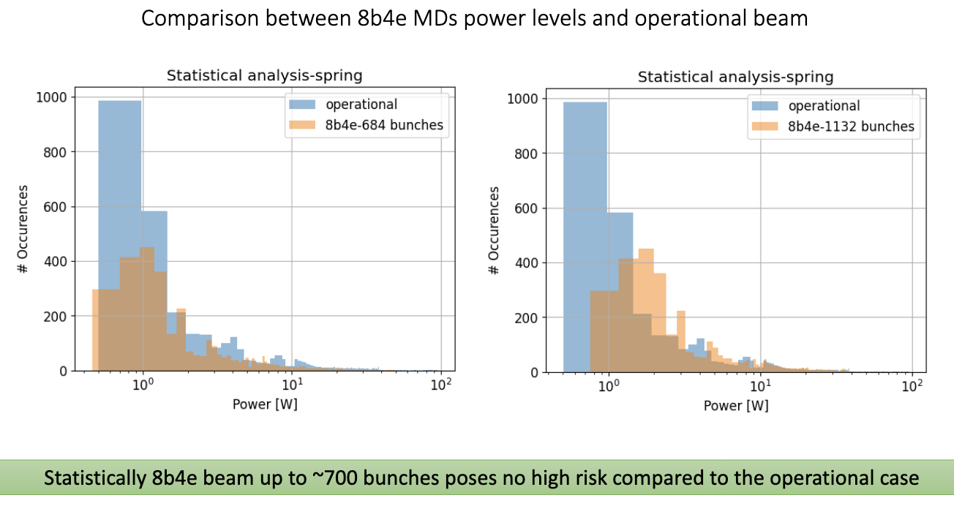
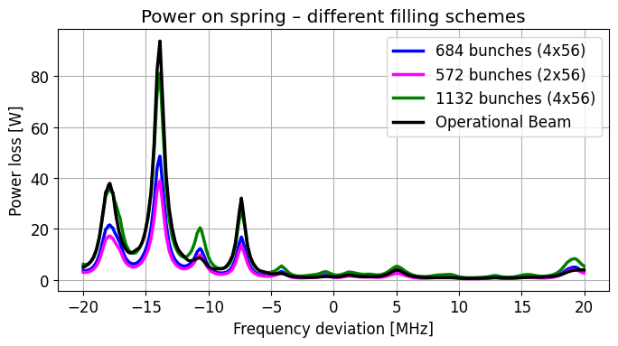
Introduction
What is presently achieved by injectors (I. Mases, C. Zannini, K. Li, H. Bartosik, G. Rumolo et. al):
  2x56b@2.3e11 ppb after SPS scraping & 1.75/1.64 um emittance.
  3x56b@2.3e11 ppb challenging due to cavity pressure spikes.
Main limitations (LBOC C. Zannini, C. Antuono, B. Salvant, E. De La Fuente et. al):
  8b4e@2.3e11 previously tested at injection with 1100b (Fill 10267, B2), however current limitation is the 6L2 non-conformity.
  → Beam induced power during MD must stay below operational levels. Impedance team simulations: safe limit ~700 bunches.

Slide 4
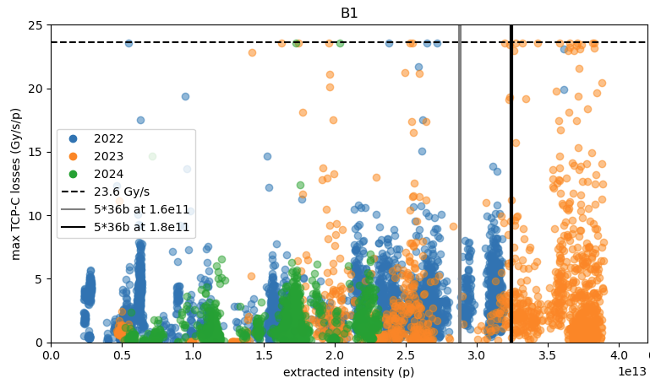
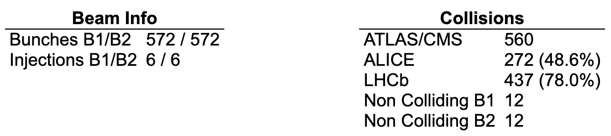
Main points
Filling scheme: 560b with 2x56@2.3e11 ppb + 12b non-colliding operational. Filling scheme by C. Young, approved by impedance team: trains distributed around the ring + maximizing collisions in IP2/8, 6 injections.
Y. Dutheil Injection losses
2x56@2.3e11, not really probing injection losses but we will extract info from:
4x72b@2.3e11=6.6e13p

Slide 5
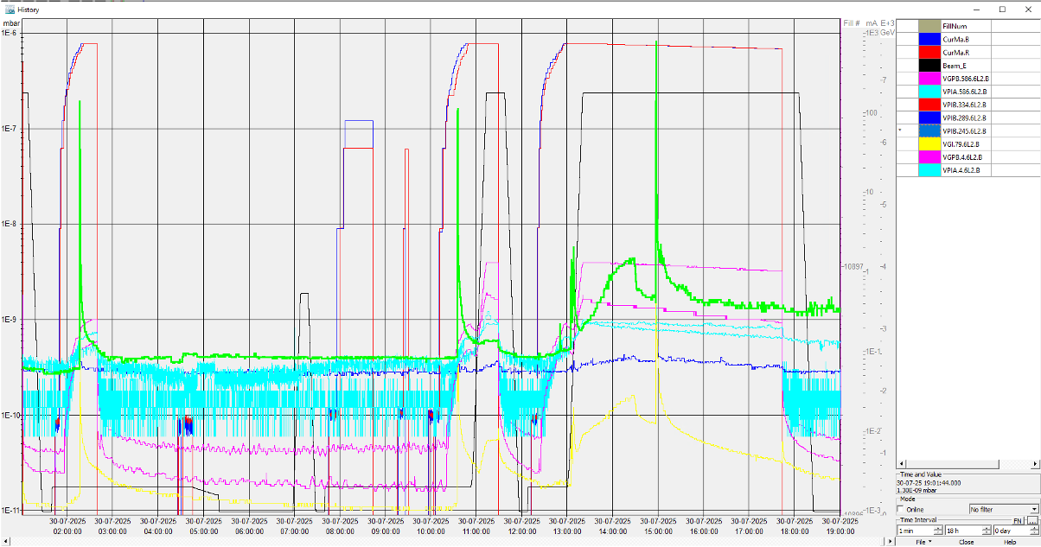
Main points
Filling scheme: 560b with 2x56@2.3e11 ppb + 12b non-colliding operational. Filling scheme by C. Young, approved by impedance team: trains distributed around the ring + maximizing collisions in IP2/8, 6 injections.
Y. Dutheil Injection losses
2x56@2.3e11, not really probing injection losses but we will extract info from:
4x72b@2.3e11=6.6e13p
Monitor vacuum activity in 6L2: VGI.79.6L2.B.PR
Bunch length:
  New SIS interlock (J. Wenninger).
  Monitor that bunch length stays above 1.2 ns during full cycle, especially during ramp.

Slide 6
MD procedure
Change of AGK & MKI (Y. Dutheil): MKI pulse length of 7.8us for 2x56b, compatible with 4x72b MD. Will be reverted in later MDs.
Octupoles & chroma at operational settings, RF settings & ADT settings for high intensity, no specific RF tuning for 8b4e.
Inject, ramp, collide in “Stable Beams”:
  Pileup target at 132.
  End of beta* leveling: manually reduce crossing angle down to 120, will monitor impact of BBLR on lifetime & luminosity imbalance.
  Maintain configuration for at least 4-5 hours.
  Roman pots & LHCb VELO inserted.

