Slide 1
Fusillo
A Curved-Canted-Cosine-Theta (CCCT)
Dipole Demonstrator at CERN
Ariel Haziot
SMT section meeting – 02.09.2025
Cold tests data from V. Di Capua, M. Pentella and SM18 team

Slide 2
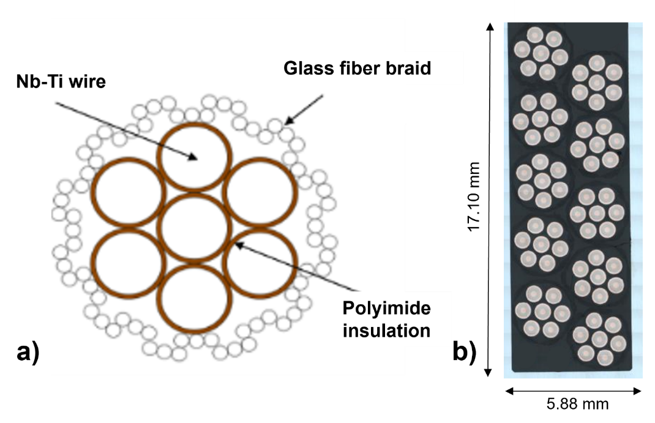
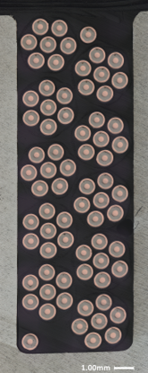
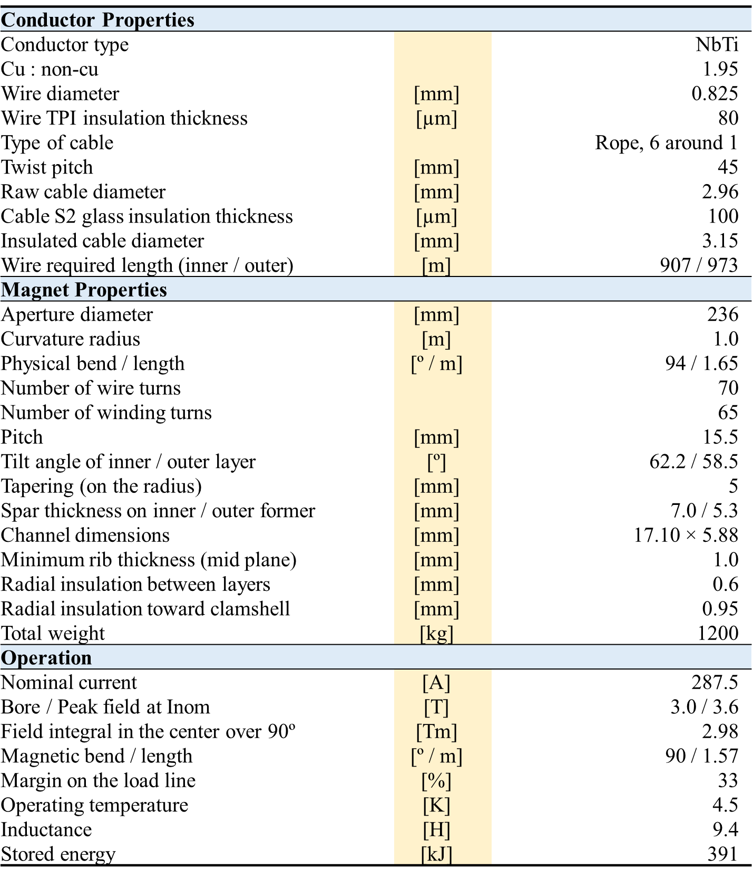
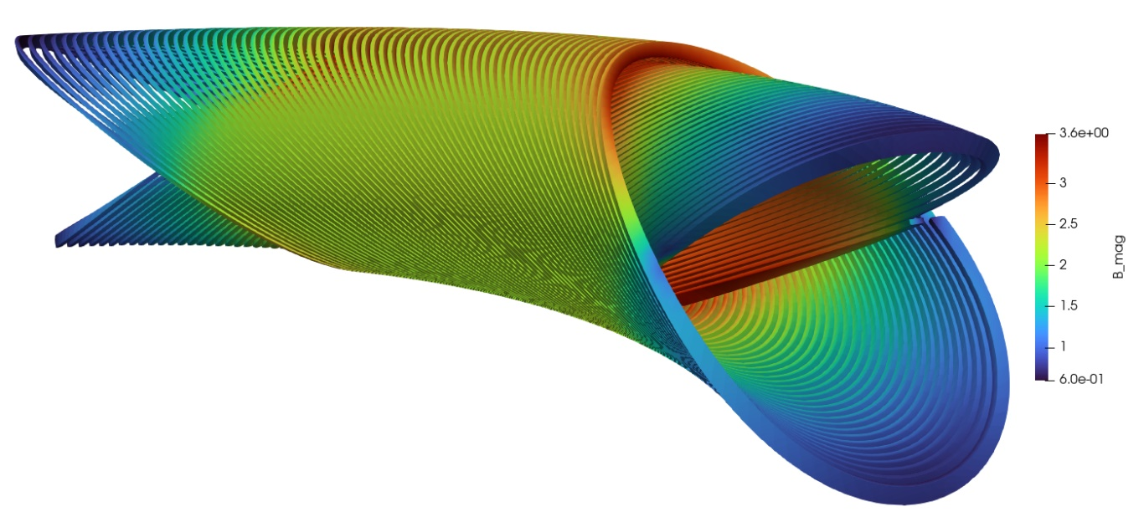
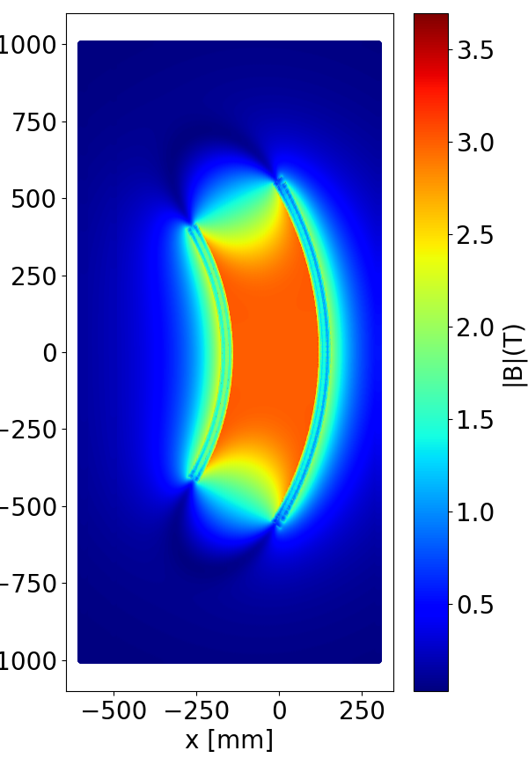
Design Summary

Slide 3
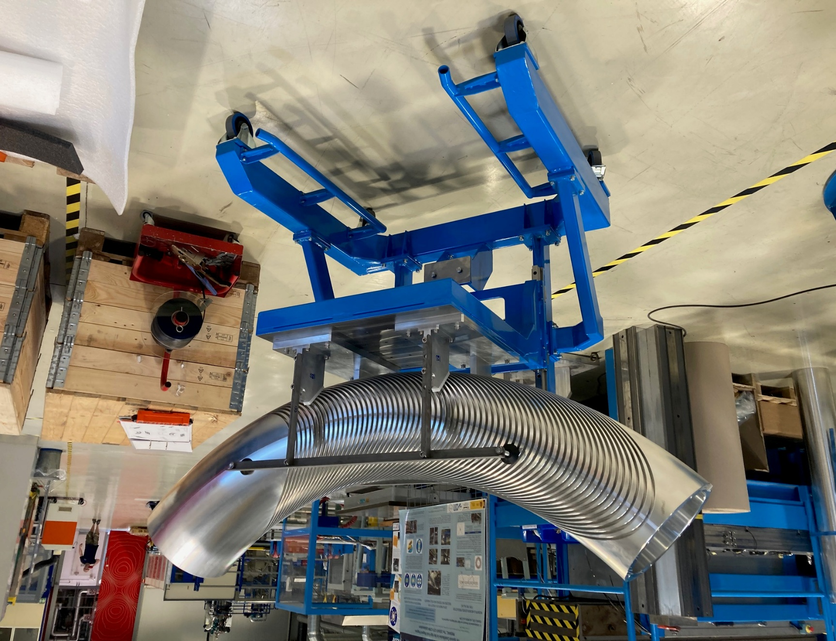
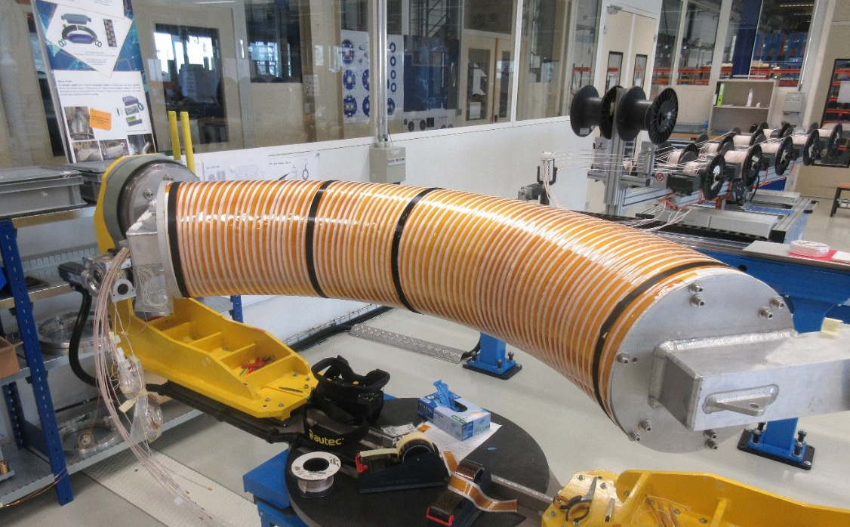
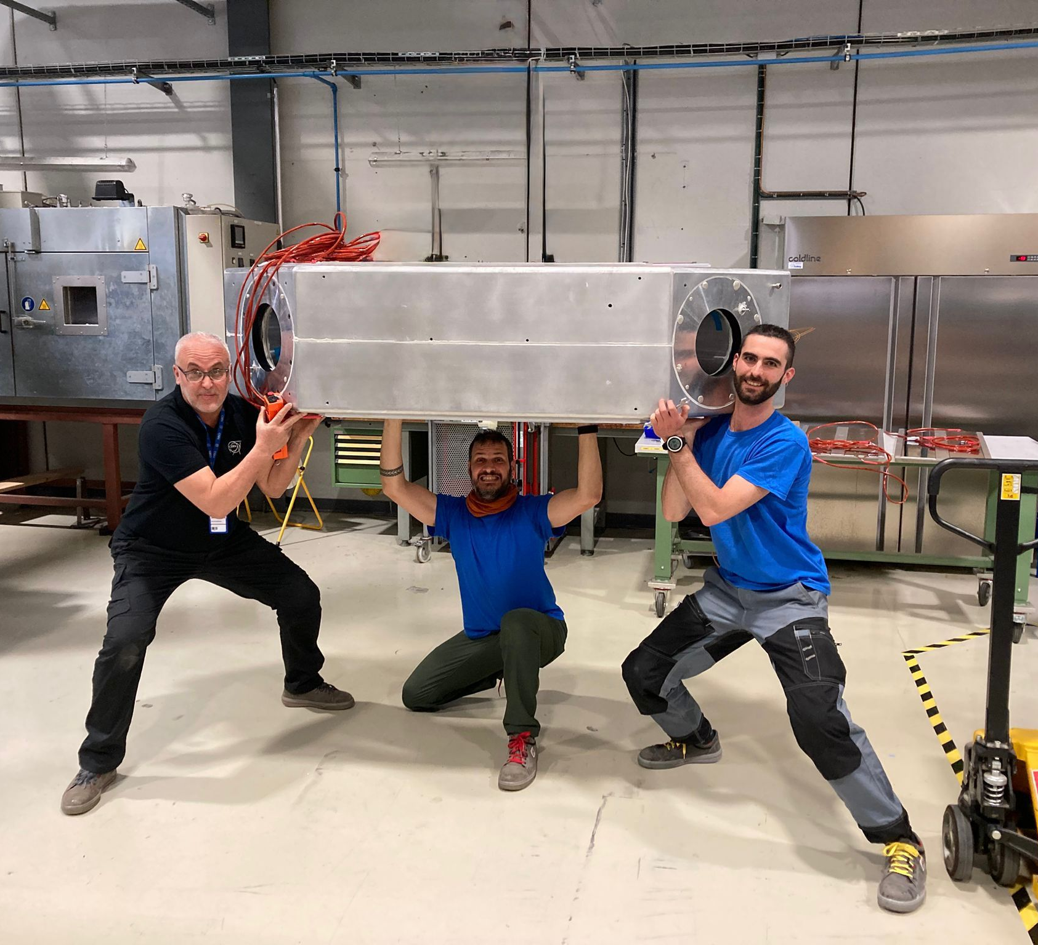
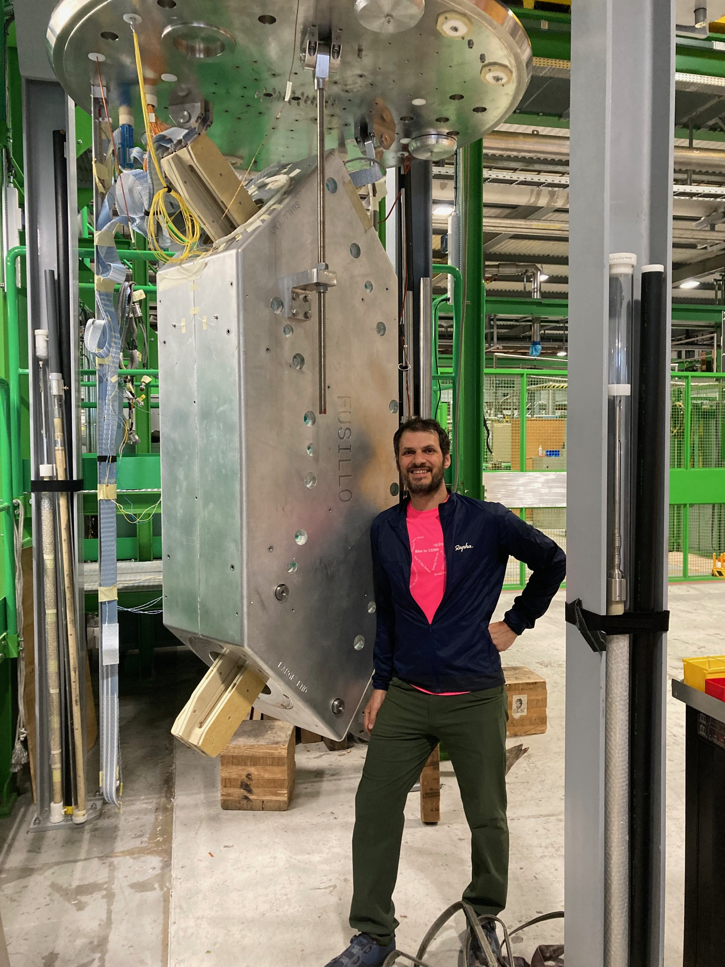
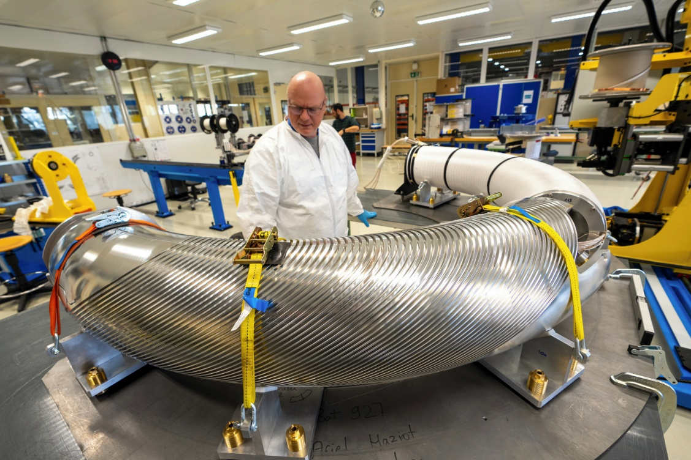
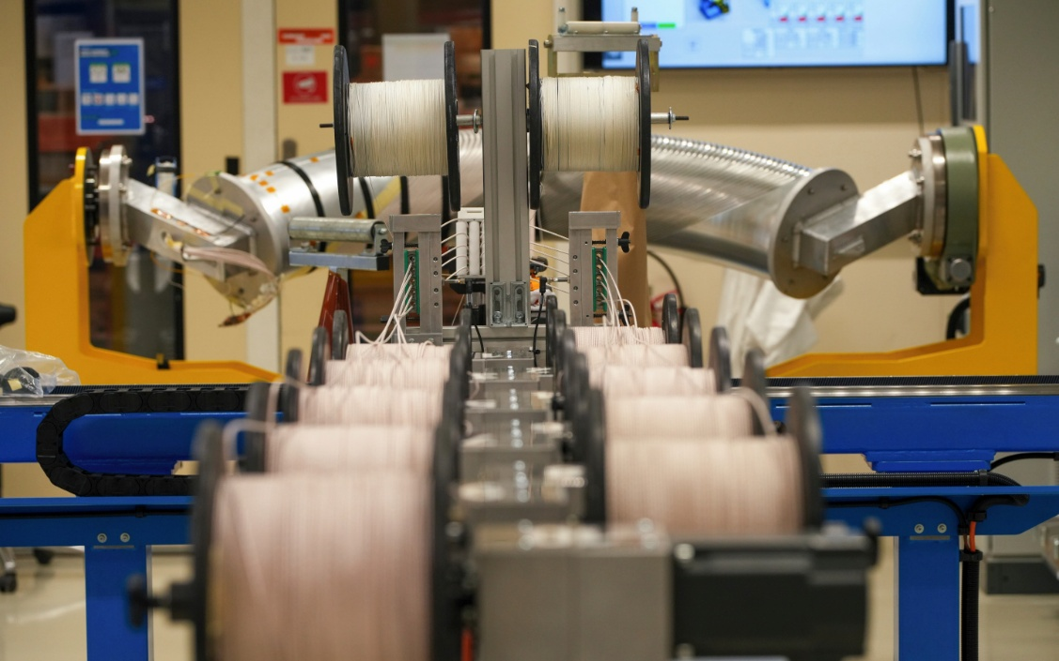
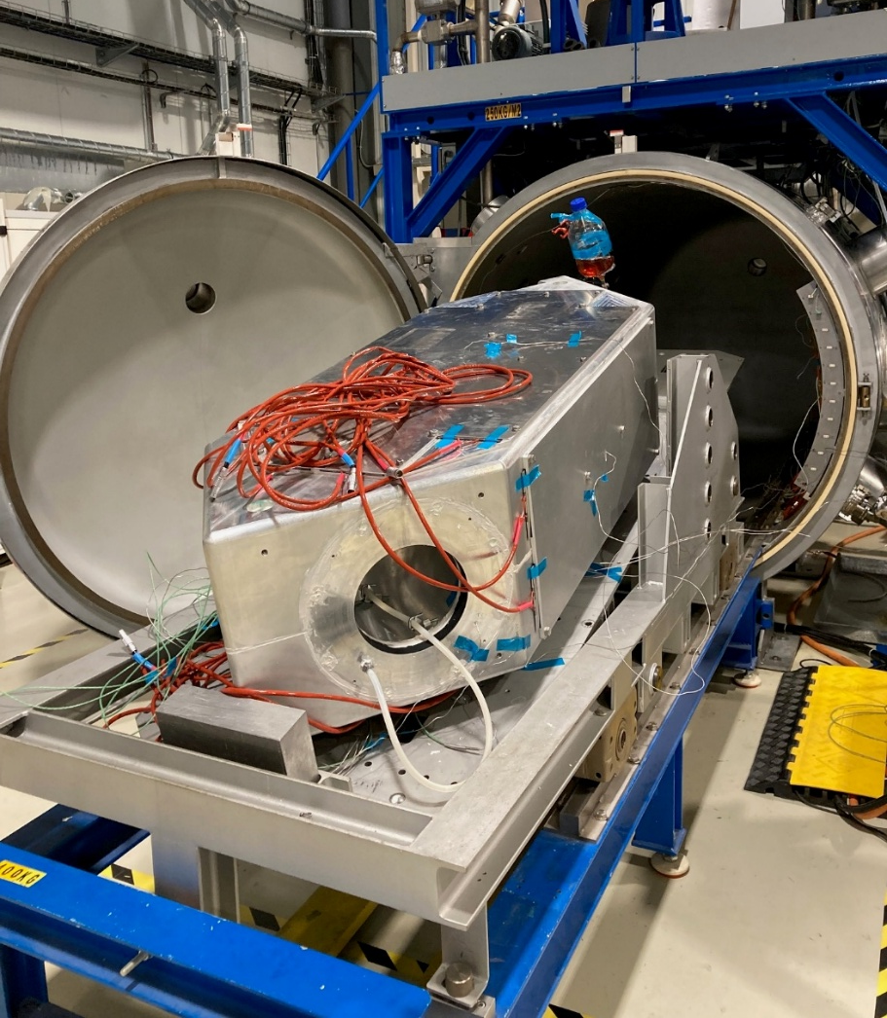
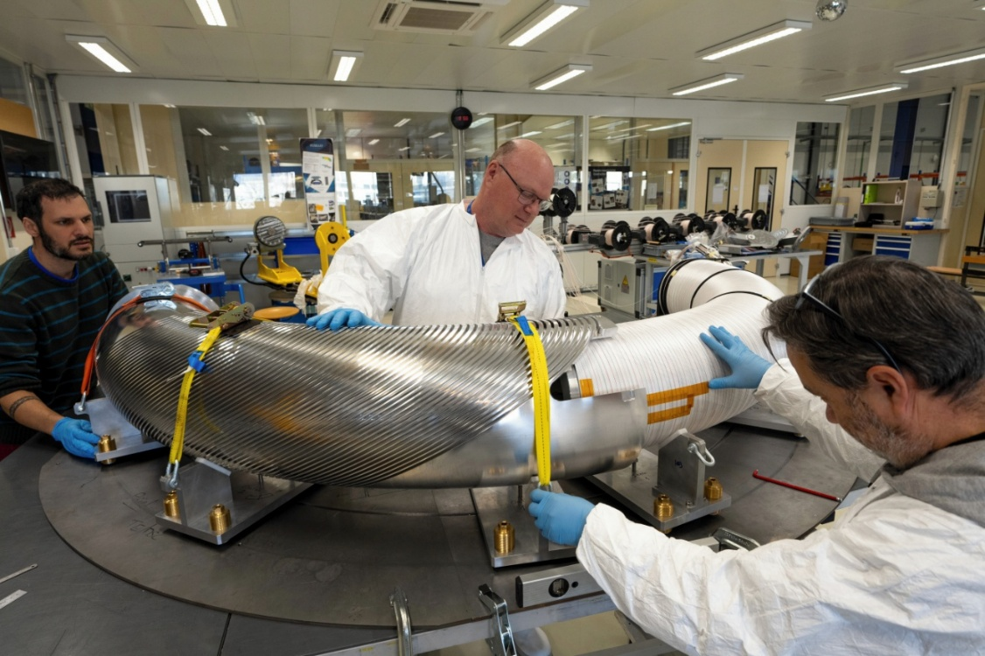
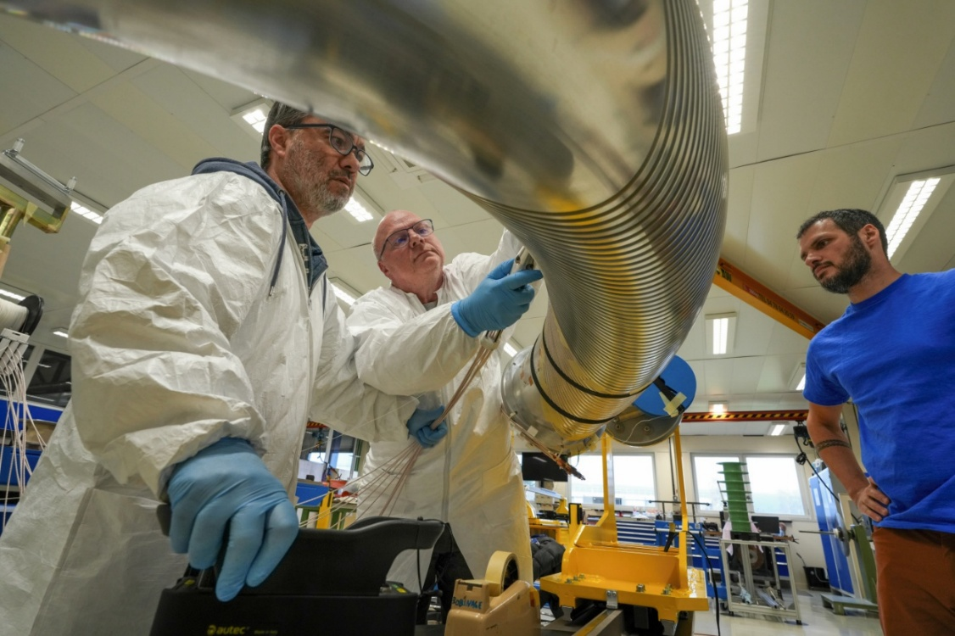
Magnet fabrication
On insert 28.05.2025
Winding Nov. 2024 – Jan. 2025
Impregnation Apr. 2025

Slide 4
Power converter issues
Power convert used for the test : 600 A / 10 V / 200 mH
Tension limit
In a magnet with 9.4 H, a ramp of 1 A/s already builds up 9.4 V.
Regulation issues
Not possible to adapt the PC regulation to the high inductance of the magnet
As a result, the nominal ramp rate was reduced 0.25 A/s impacting the testing time (~20 min per ramp)
Not expected good news: the varistors used for protection seem to heat up a lot after each quench. If quench event would have been closer, this could have led to a deterioration of the protection system…

Slide 5
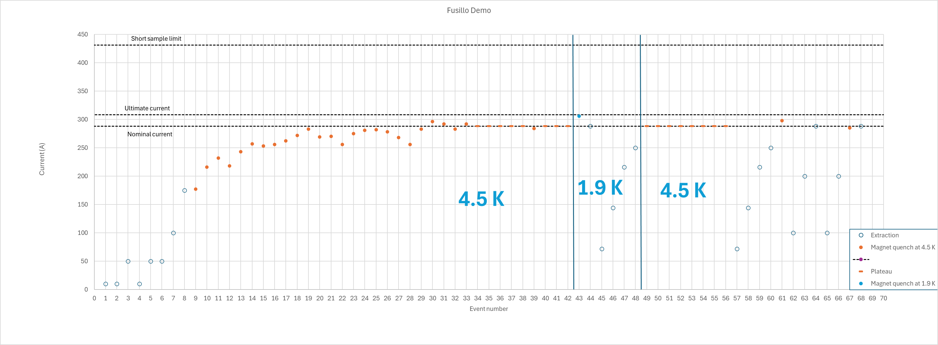
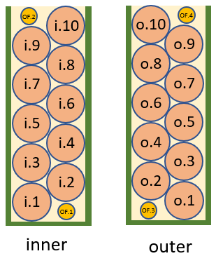
Training
Training
Magnetic
measurements
FQPC
tests
Magnetic
measurements
FQPC
tests
rope 5/7
rope 7
rope 10
rope 7
rope 9
rope 2
rope 3/5/7
rope 7
rope 5/7/9
rope 7
rope 7
rope 7
rope 5/7
rope 10
rope 7
rope 7/9
rope 7
rope 9
rope 5/7
rope 5
rope 5/7
rope 10
rope 10
rope 9/10
rope 5/7/9
rope 9
11 quenches events at 4.5 K to reach nominal current (287.5 A)
Difficulties to go higher
Trial to train at 1.9 K shows too high quench integral

Slide 6
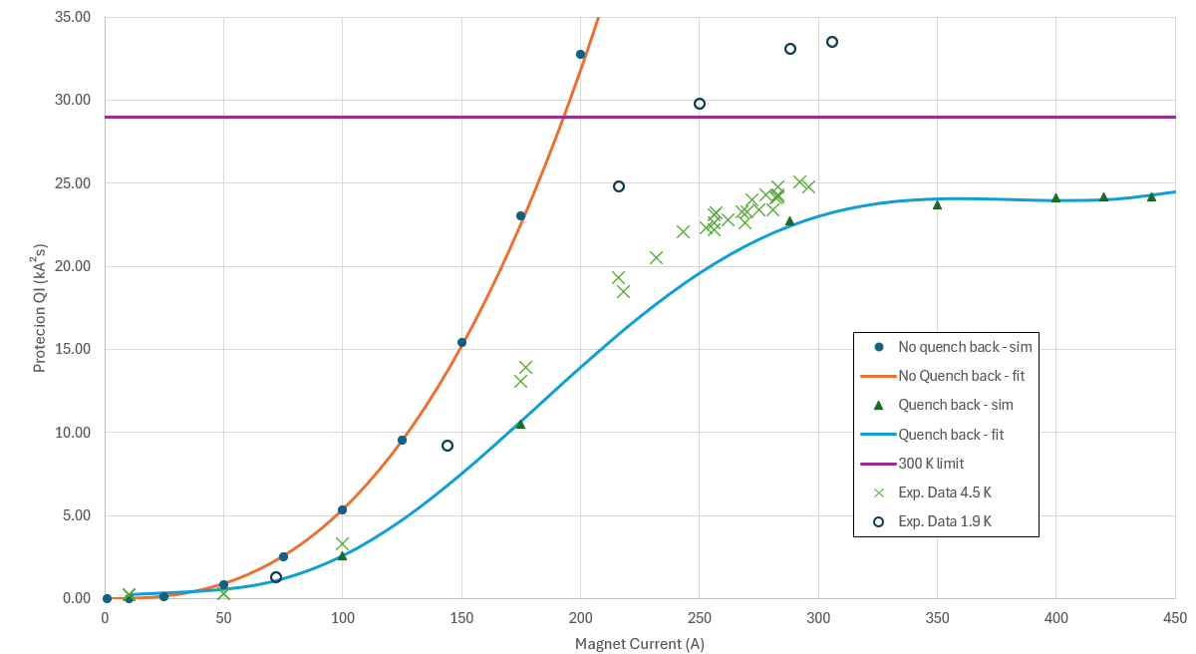
Quench Integral
Quench integral at 1.9 K significantly higher than at 4.5 K
The quench back effect on which the protection relies on is reduced at 1.9 K
Explanations involve the enhanced cooling of the formers and the lower thermal contact between the former and the cable (cracks, superfluid)

Slide 7
Thermal cycle and magnet memory
Training
Magnetic
measurements
FQPC
tests
Magnetic
measurements
FQPC
tests
Thermal cycle
rope 5/7
rope 7
rope 10
rope 7
rope 9
rope 2
rope 3/5/7
rope 7
rope 5/7/9
rope 7
rope 7
rope 7
rope 5/7
rope 10
rope 7
rope 7/9
rope 7
rope 9
rope 5/7
rope 5
rope 5/7
rope 10
rope 10
rope 9/10
rope 5/7/9
rope 9
Good memory!
After thermal cycle magnet reached 301 A with only 1 quench at 271 A.

Slide 8
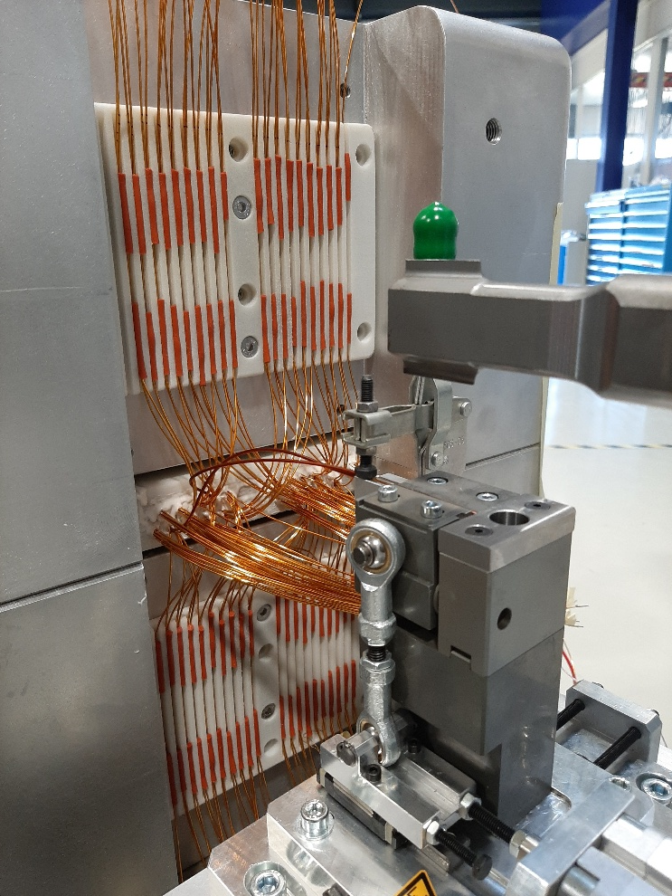
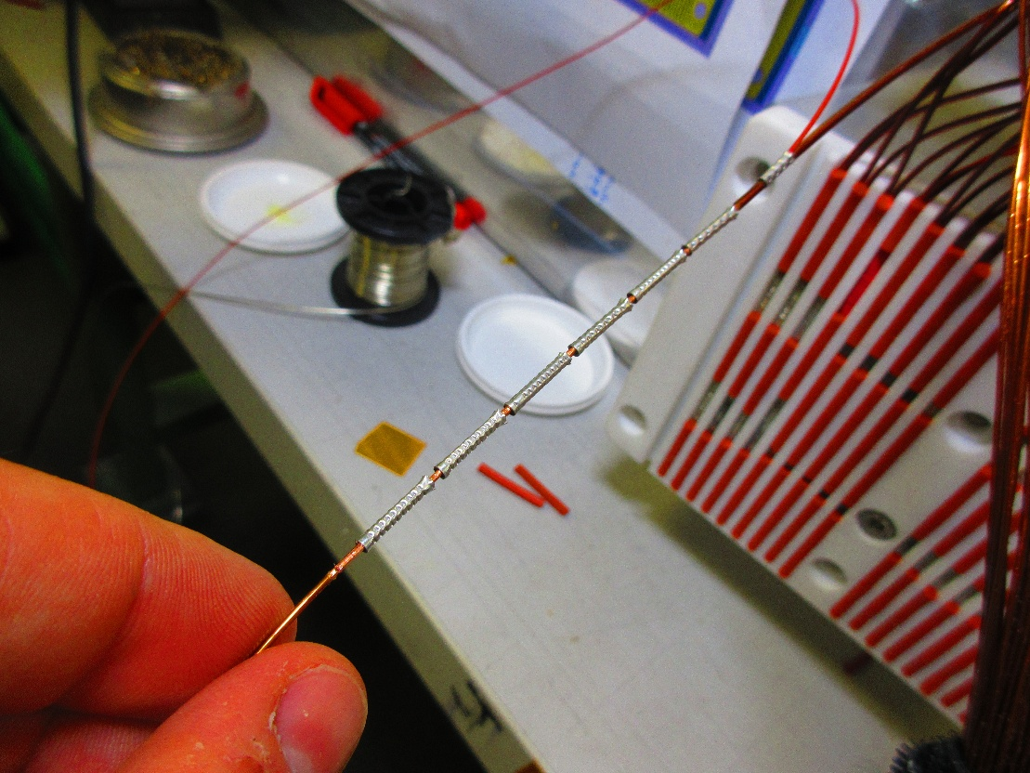
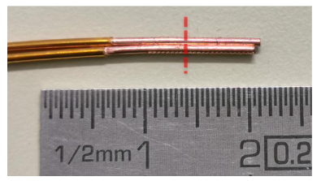
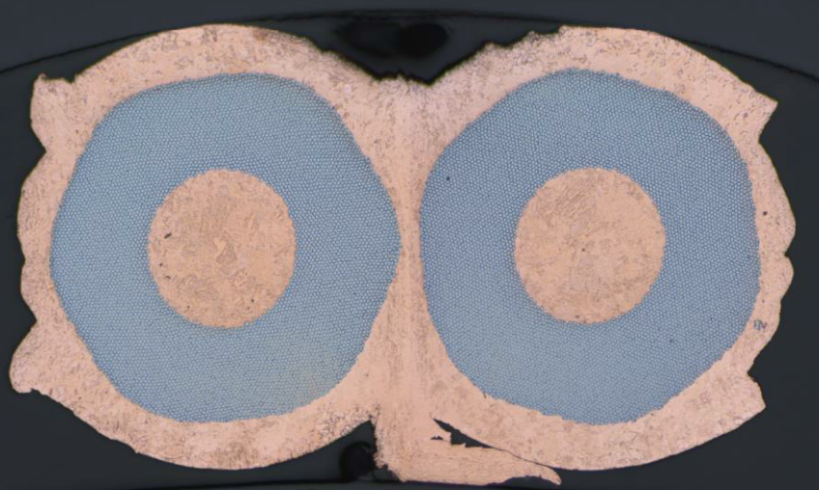
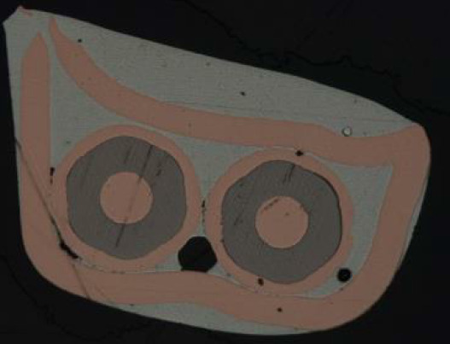
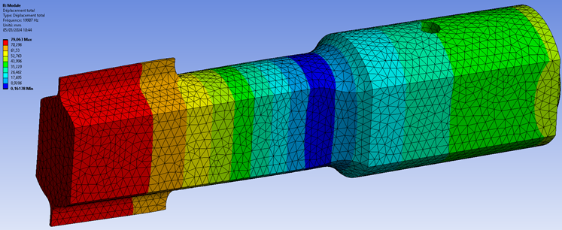
Splice measurements
Traditional way for splice was crimping copper sleeve and soldering
A splice using ultrasonic welding was introduced, improving the splice resistance but also the repeatability of the process and reducing the size.
A dedicated 30 mm long sonotrode and a specific clamping tool were developed.
Final welding machine and sonotrode
Splice as used on the MCBRD corrector magnets
Splice using ultrasonic welding

Slide 9
Splice measurements
Fusillo Subscale 1
Traditional splice (80 mm)
Fusillo Subscale 2
Ultrasonic splice (10 mm)
Fusillo Demonstrator
Ultrasonic splice (30 mm)
 | Resistance [nΩ] | Resistance error [nΩ]
Average | 4.6 | 0.25
 | Resistance [nΩ] | Resistance error [nΩ]
Average | 5.2 | 0.11
 | Resistance [nΩ] | Resistance error [nΩ]
Average | 1.07 | 0.08
Linear splice resistance: 37 nΩ.cm
Linear splice resistance: 5.2 nΩ.cm
Linear splice resistance: 3.2 nΩ.cm

Slide 10
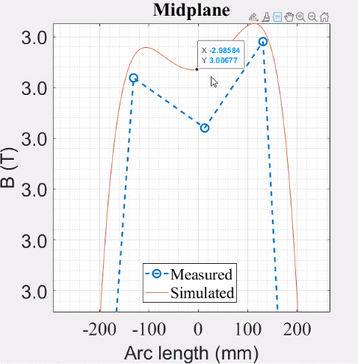
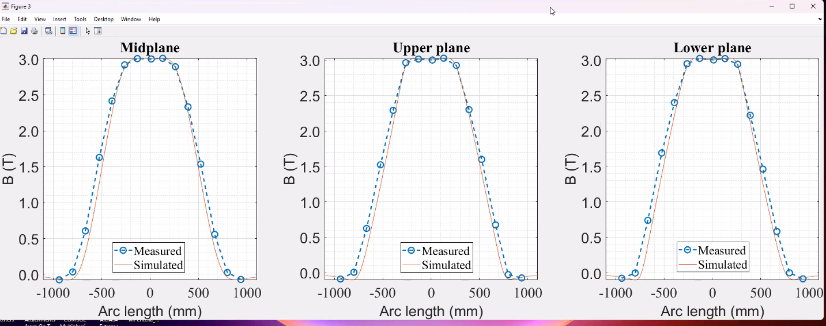
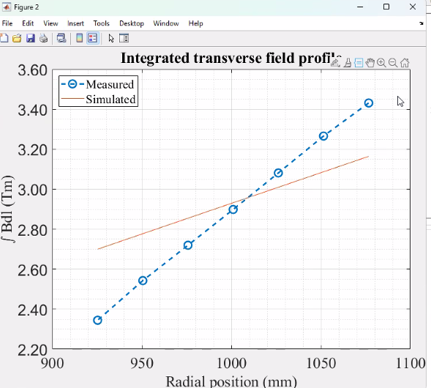
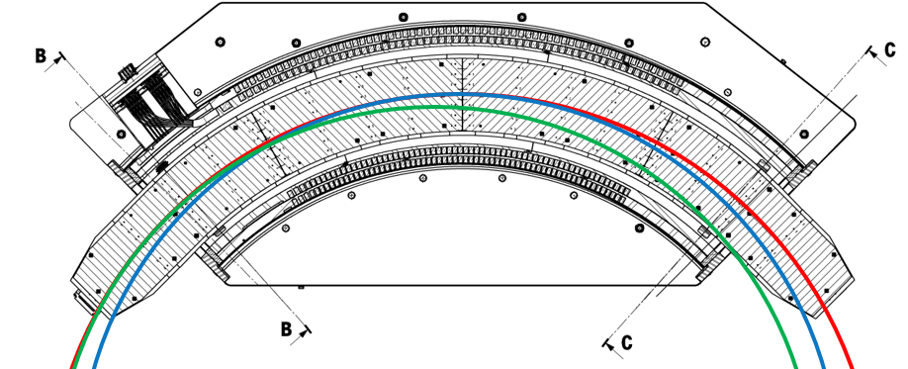
Magnetic measurements
Good overall agreement with simulation
Deviations could be the result of misalignment
It seems the magnetometer is not shrinking as expected. To be understood

Slide 11
FUSILLO
Thank you

Slide 12
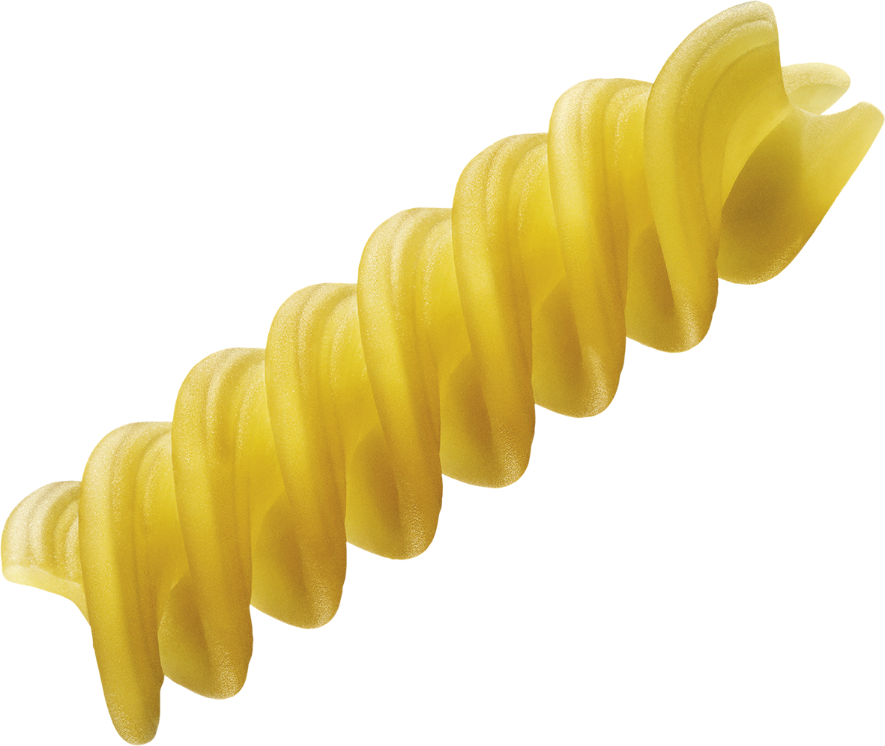
Fusillo references
I. Martel et al., “An innovative Superconducting Recoil Separator for HIE-ISOLDE”, Nucl. Instrum. Methods Phys. Res. B, 541, 176 (2023)
A. Haziot et al., “Curved-Canted-Cosine-Theta (CCCT) Dipole Prototype Development at CERN”, IEEE Trans. Appl. Supercond., 34, 4002608 (2024)
M. Wozniak et al., “Quench Protection of Fusillo Subscale Curved CCT Magnet”, IEEE Trans. Appl. Supercond., 34, 4702805 (2024)
M. Liebsch and S. Russenschuck., “Coil design for strongly curved magnets based on the differential geometry of the frenet frame”, IEEE Trans. Appl. Supercond., 34, 4900205 (2024)
M. Wozniak et al., Transient behavior of the Fusillo Subscale Curved CCT Magnet, IEEE Trans. Appl. Supercond., ASC2024-2LOr2A-03 (2025)
M. Wozniak et al., Quench Protection of the Fusillo Demonstrator Curved CCT Magnet, IEEE Trans. Appl. Supercond., ASC2024-5LOr2B-05 (2025)

Slide 13

































Magnet assembly Design – Wiring
EE11
i.10
The wires coming out of the 2 layers are connected in series with 70 splices.
The ropes are connected according to their location in the channel in a way to reduce the potential difference seen by their neighbours in case of quench.
Inside the rope, the wires are also connected following the same strategy.
EE10
EE9
i.9
EE8
i.8
EE7
i.7
EE6
i.6
EE5
i.5
EE4
i.4
EE3
i.3
EE2
i.2
Lead in
i.1
EE1
Rope layout
Channel layout
Splice box
Layer jump
OF.2
i.10
o.10
OF.4
o.1
i.9
o.9
o.2
i.x.1
i.x.2
i.8
o.8
o.3
i.x.3
i.7
o.7
i.x.4
i.6
o.6
o.4
i.x.5
i.5
o.5
o.5
i.x.6
i.x.7
i.4
o.4
i.3
o.3
o.6
i.2
o.2
o.7
i.x
i.1
o.1
OF.1
OF.3
o.8
inner
outer
o.9
Lead out
EE12
o.10

Slide 14
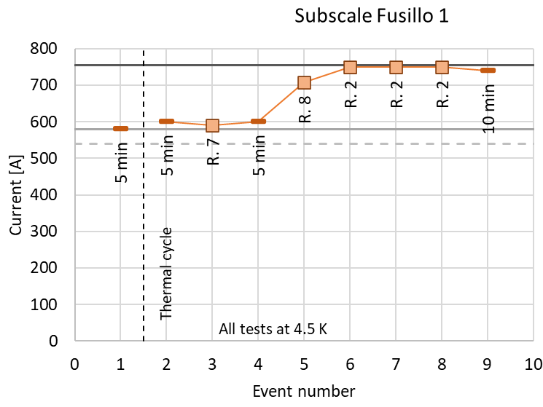
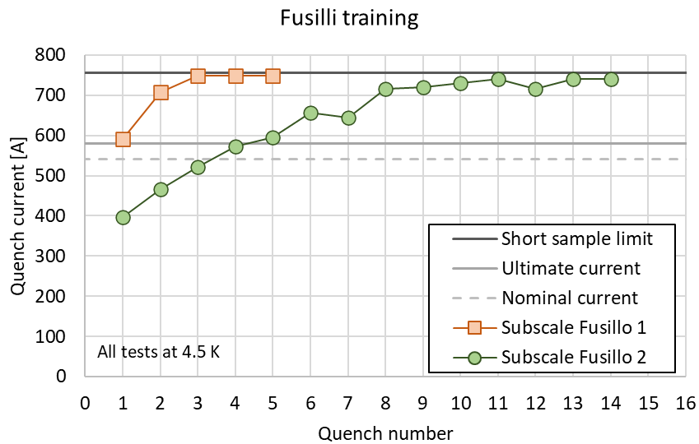
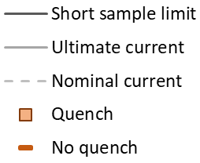
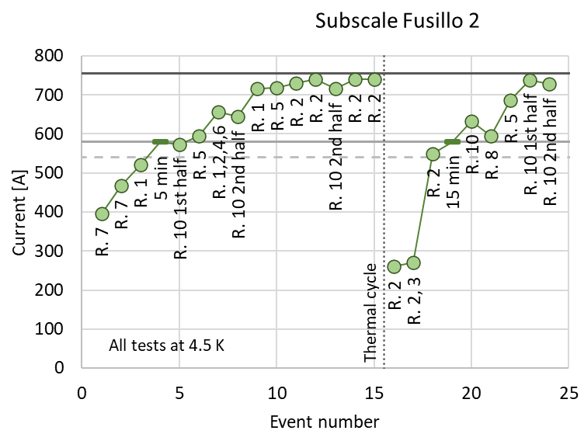
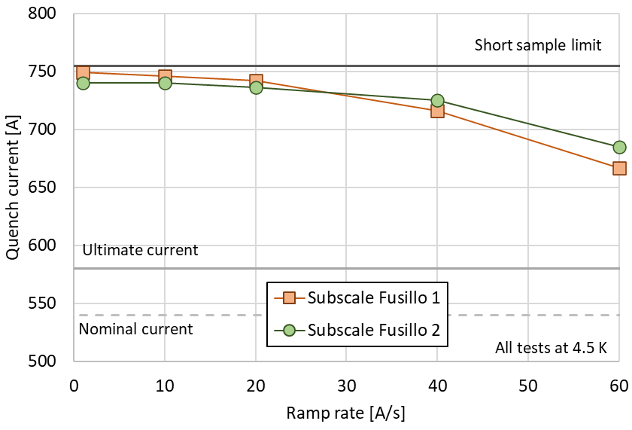
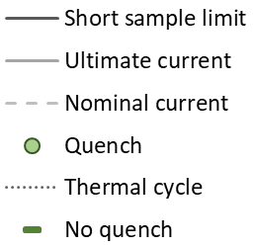
Subscale program - Results
Powering results
Fusillo SS 2 trains much slower than 1.
Very clear loss of training memory in Fusillo SS 2.
i.10
o.10
i.9
o.9
i.8
o.8
i.7
o.7
i.6
o.6
i.5
o.5
i.4
o.4
i.3
o.3
All quenches in Rope 2
i.2
o.2
i.1
o.1
inner
outer
F. Mangiarotti, Subscale Fusillo 1 test result, EDMS 2939700
F. Mangiarotti, Subscale Fusillo 2 test result, EDMS 3203732

Slide 15
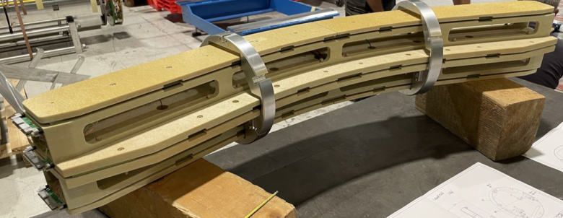
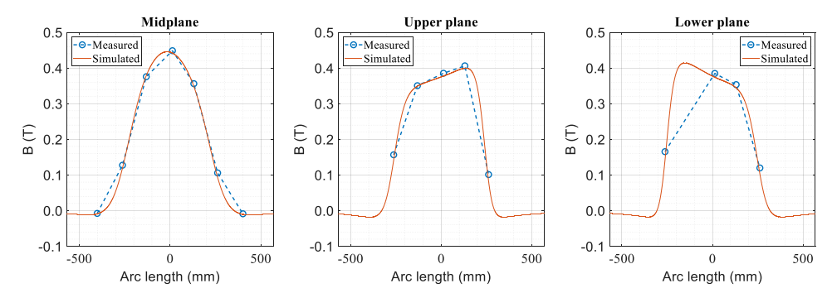
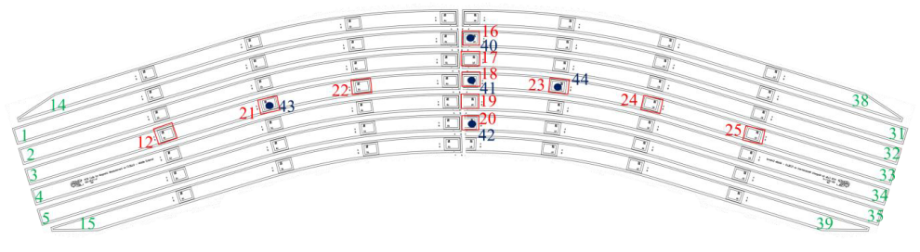
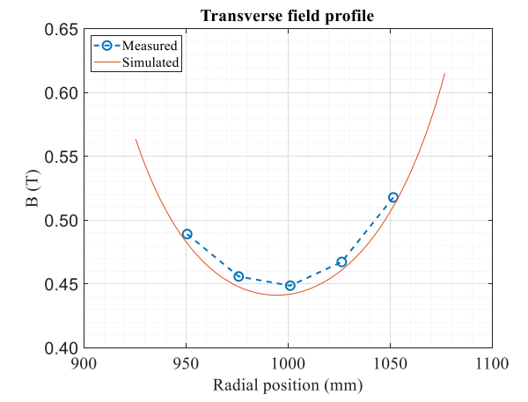
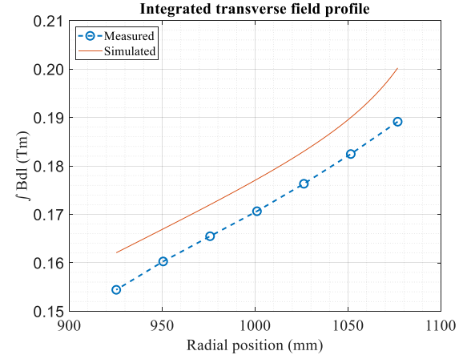
Subscale program - Results
Magnetic results
The measured values agree in a range of 0.1 % with the simulated vales.
Consistency with Fusillo SS1 is below 0.8 % (midplane, center), ~ 7 units.
The integrated field is consistent within 20-30 units.
The shift might be related to the positioning uncertainty
The “banana”, curved magnetometer
Fusillo Subscale 1
Fusillo Subscale 2
M. Pentella, Magnetic measurement of the first FUSILLO sub-scale model, EDMS 3011208
M. Pentella, Magnetic measurement of the second FUSILLO sub-scale model, EDMS 3070320

Slide 16
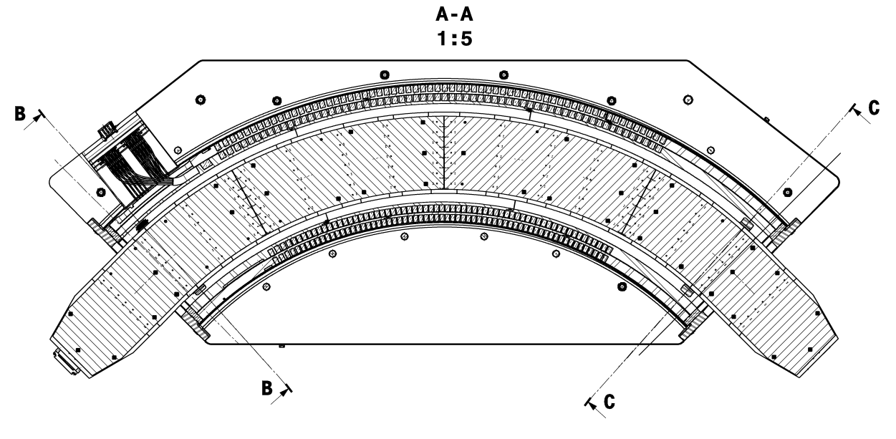
Magnetometer

Slide 17
