Slide 1
Newcomer presentation
Daphné Beaujoint
September 2025

Slide 2
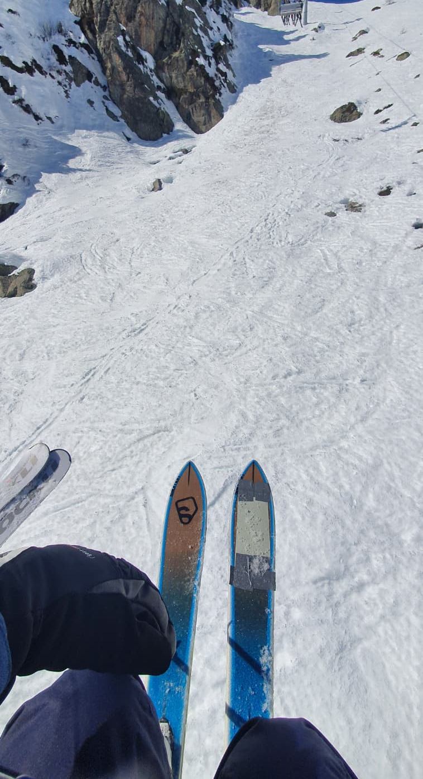
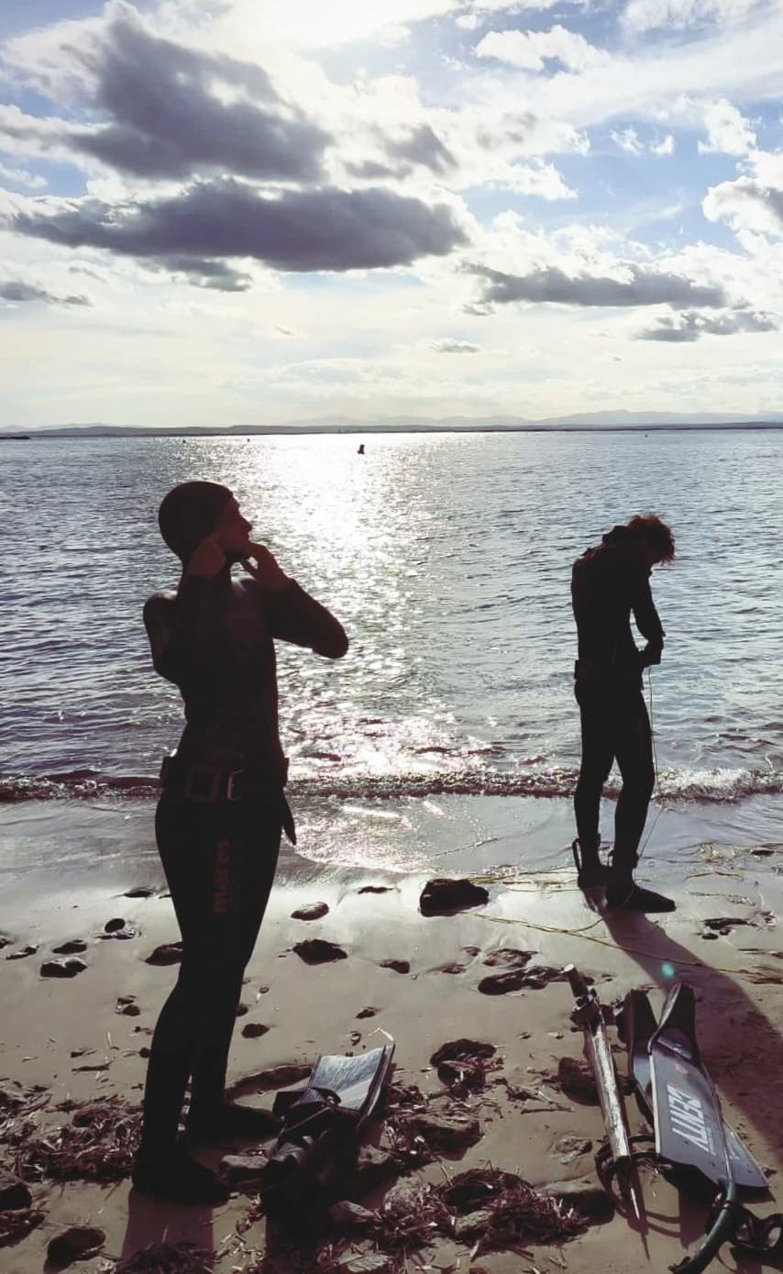
About me
  Originally from Annecy
  Joined POLAB in July 2025
  Background in Materials Science and Engineering, specializing in polymers and composites
  Experience in fiber surface treatments, composite recycling, and mechanical testing
  Speak French, English, Italian, Spanish, Bulgarian, and German
  Outside work hours you can usually find me in water🌊
Actively working on all of these pictures ☺

Slide 3
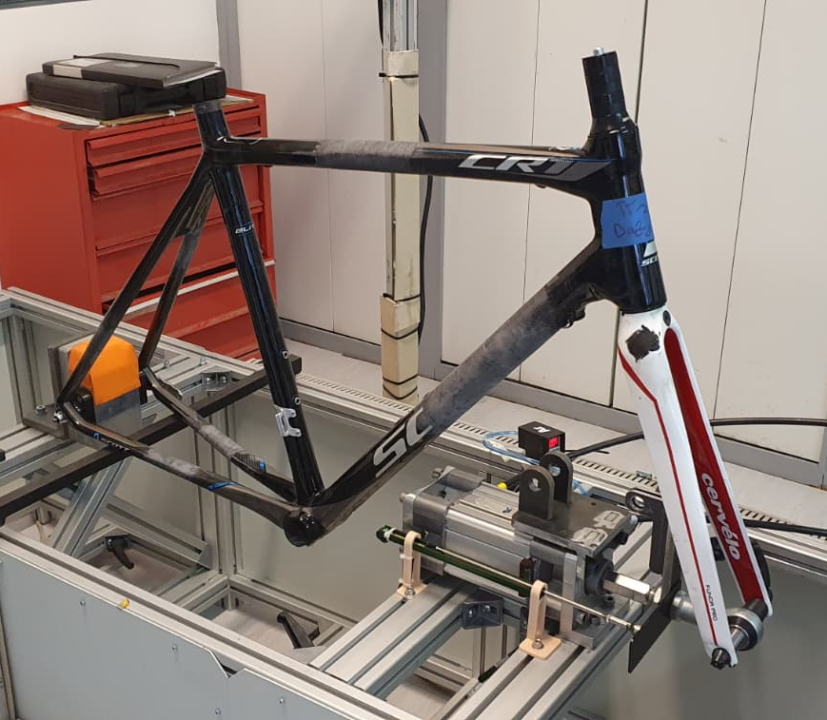
Education
  Preparatory School in Dijon - Focused on mathematics, physics, and engineering fundamentals
  Bachelor’s Degree in the South of France - Specialized in the repair and maintenance of composite materials, applied to aerospace (planes), renewable energy (wind turbine blades), and sports equipment (bicycles)
  Master’s Degree in Padova and Barcelona - Materials Science and Engineering, with a major in Composites and Polymers, combining advanced research in material design, processing, and performance evaluation
Repaired bike frame under testing

Slide 4
Previous experiences and projects
  University of Applied Sciences of Zurich – Research Assistant
  Conducted plasma treatments to enhance the surface adhesion of flax fibers for composite applications
  Composite Recycling – Chemistry intern
  Developed surface treatments for recycled glass fibers to improve compatibility with PMMA resin
  CompPair Technologies – Application intern
  Assessed the repairability of flax fiber composites using a self-healing resin matrix system

Slide 5
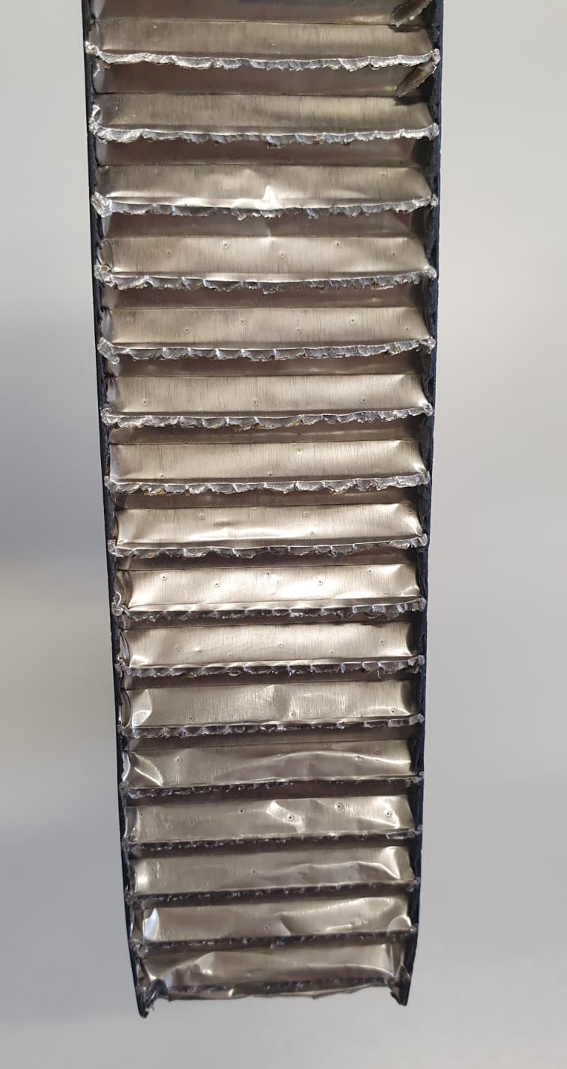
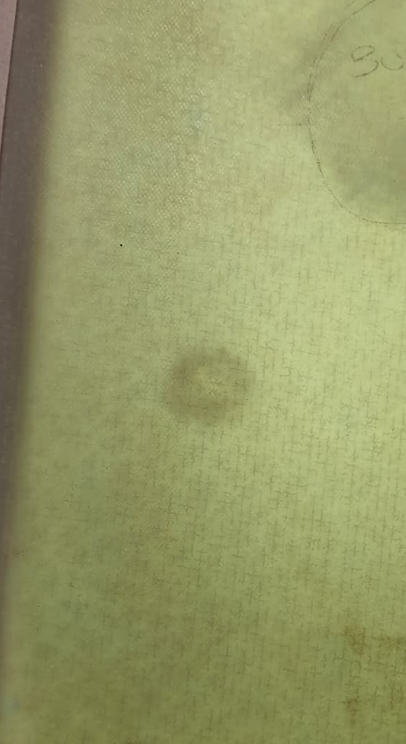
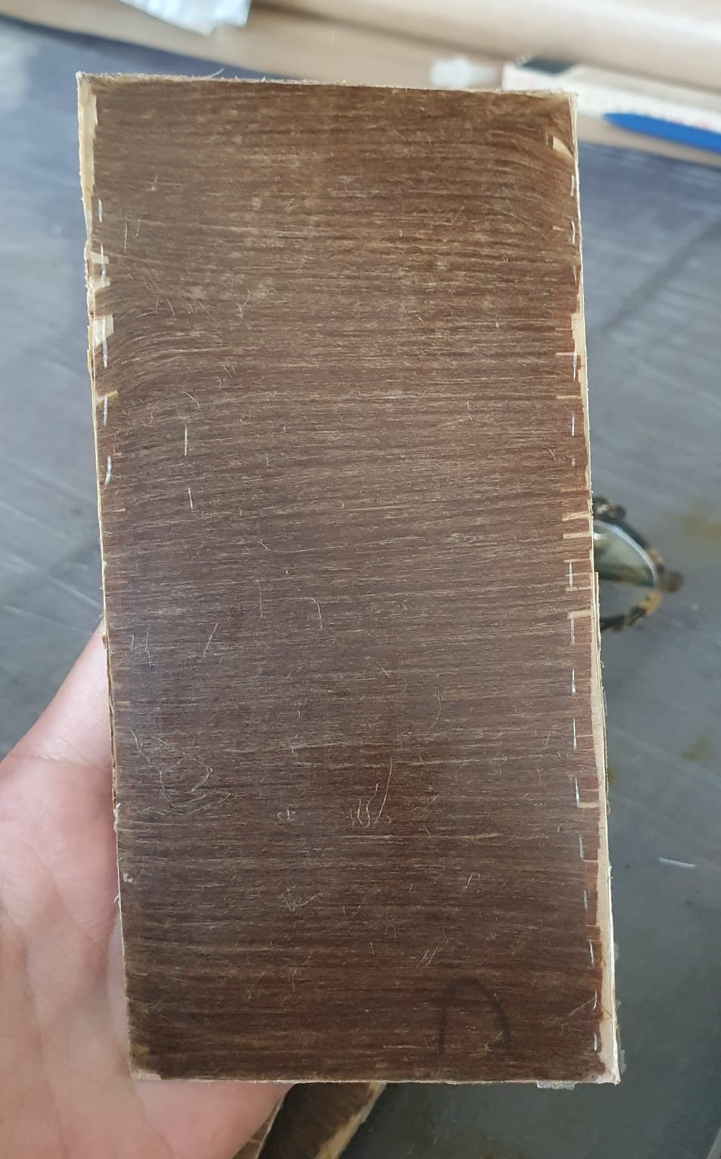
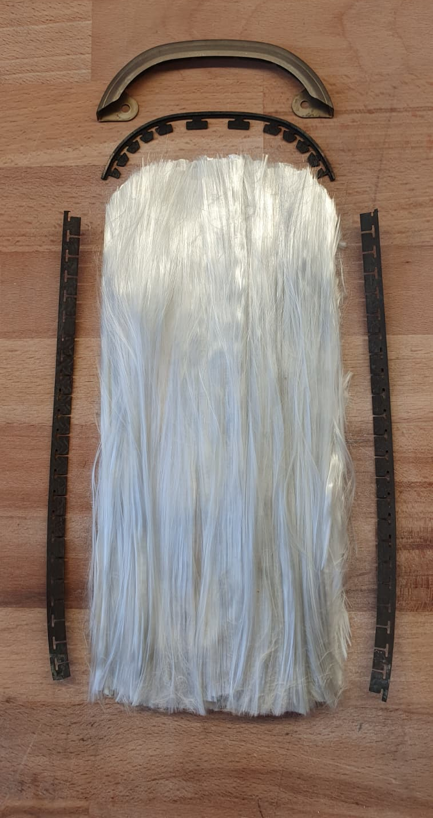
Previous experiences and projects
Cocured panel for space application
Impact assessement on healable composites
Plasma treated flax fiber composite
Thermal recycling of ski

Slide 6
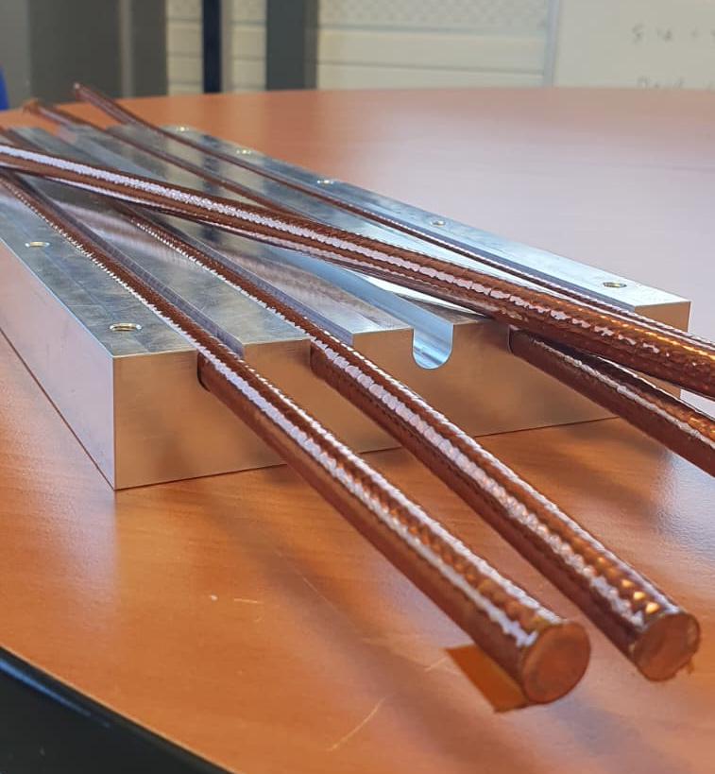
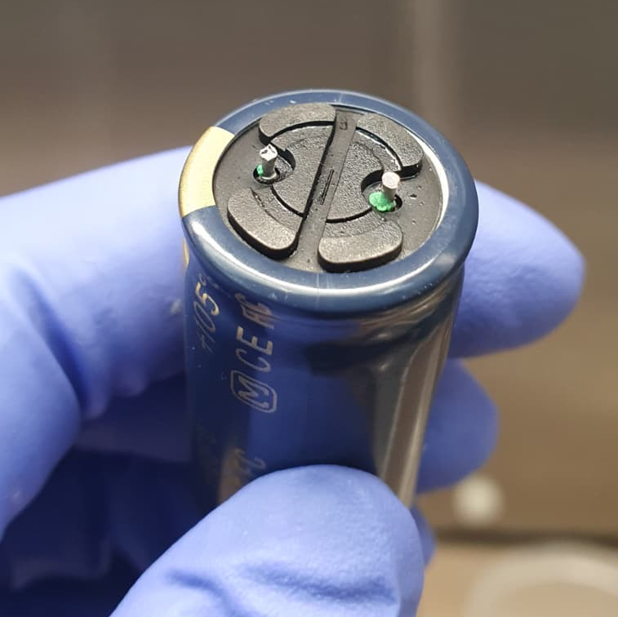
Ongoing projects at POLAB
  SHiP putty – Develop a putty “recipe* for the EESD tailored to meet various requirements (cryo resistance, thixotropy, etc…)
  Butyl sealant ageing - Study the long-term ageing behaviour of butyl sealants in capacitors
  Leak rate definition - Define the acceptable leak rate to have the mold epoxy tight in the TELSTAR
  Continue the legacy and development on the superconducting cable desizing project
  Define post processing parameter for 3D printed parts in PEEK and Ultem
SHiP MgB2 cables and grooves
Butyl sealant on capacitor

