Slide 1
LHCb Installation
Expert Review
LHCb TC team

Slide 2
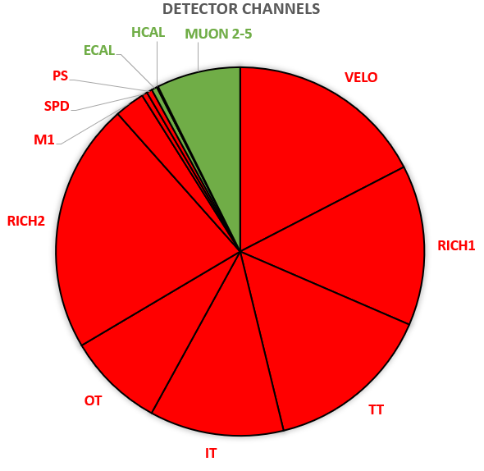
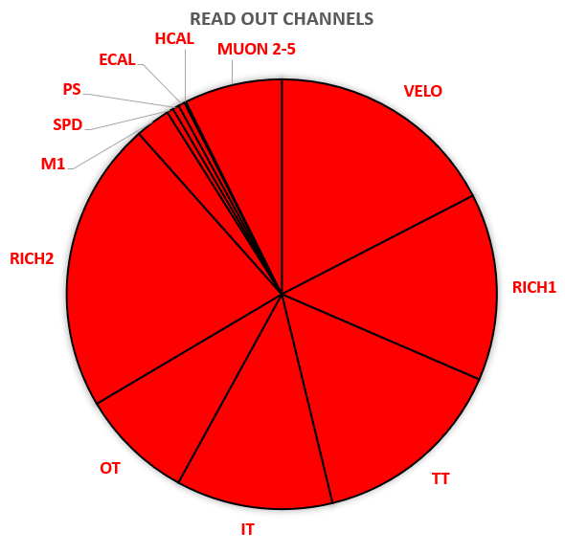
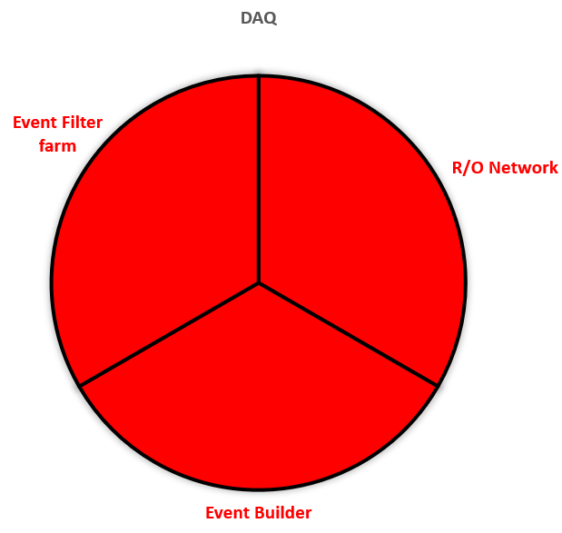
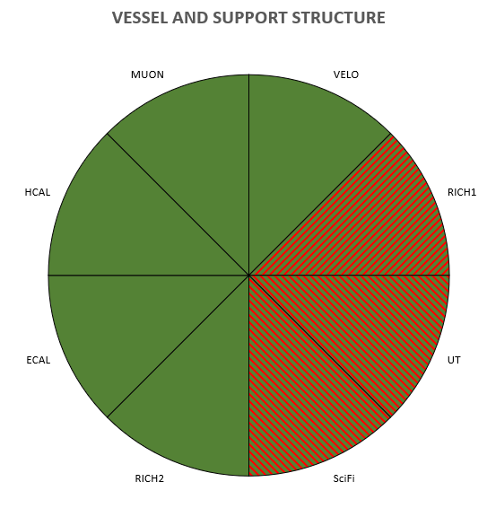
Upgrade I and Upgrade II comparison
Kept
New
UI
In addition to UI:
Muon chambers and ECAL modules will be replaced/modified
Most of Vessels and Detector support structures will be dismounted / replaced / modified
Middle Scenario: 2 new systems (TORCH and Magnet Stations)
UII

Slide 3
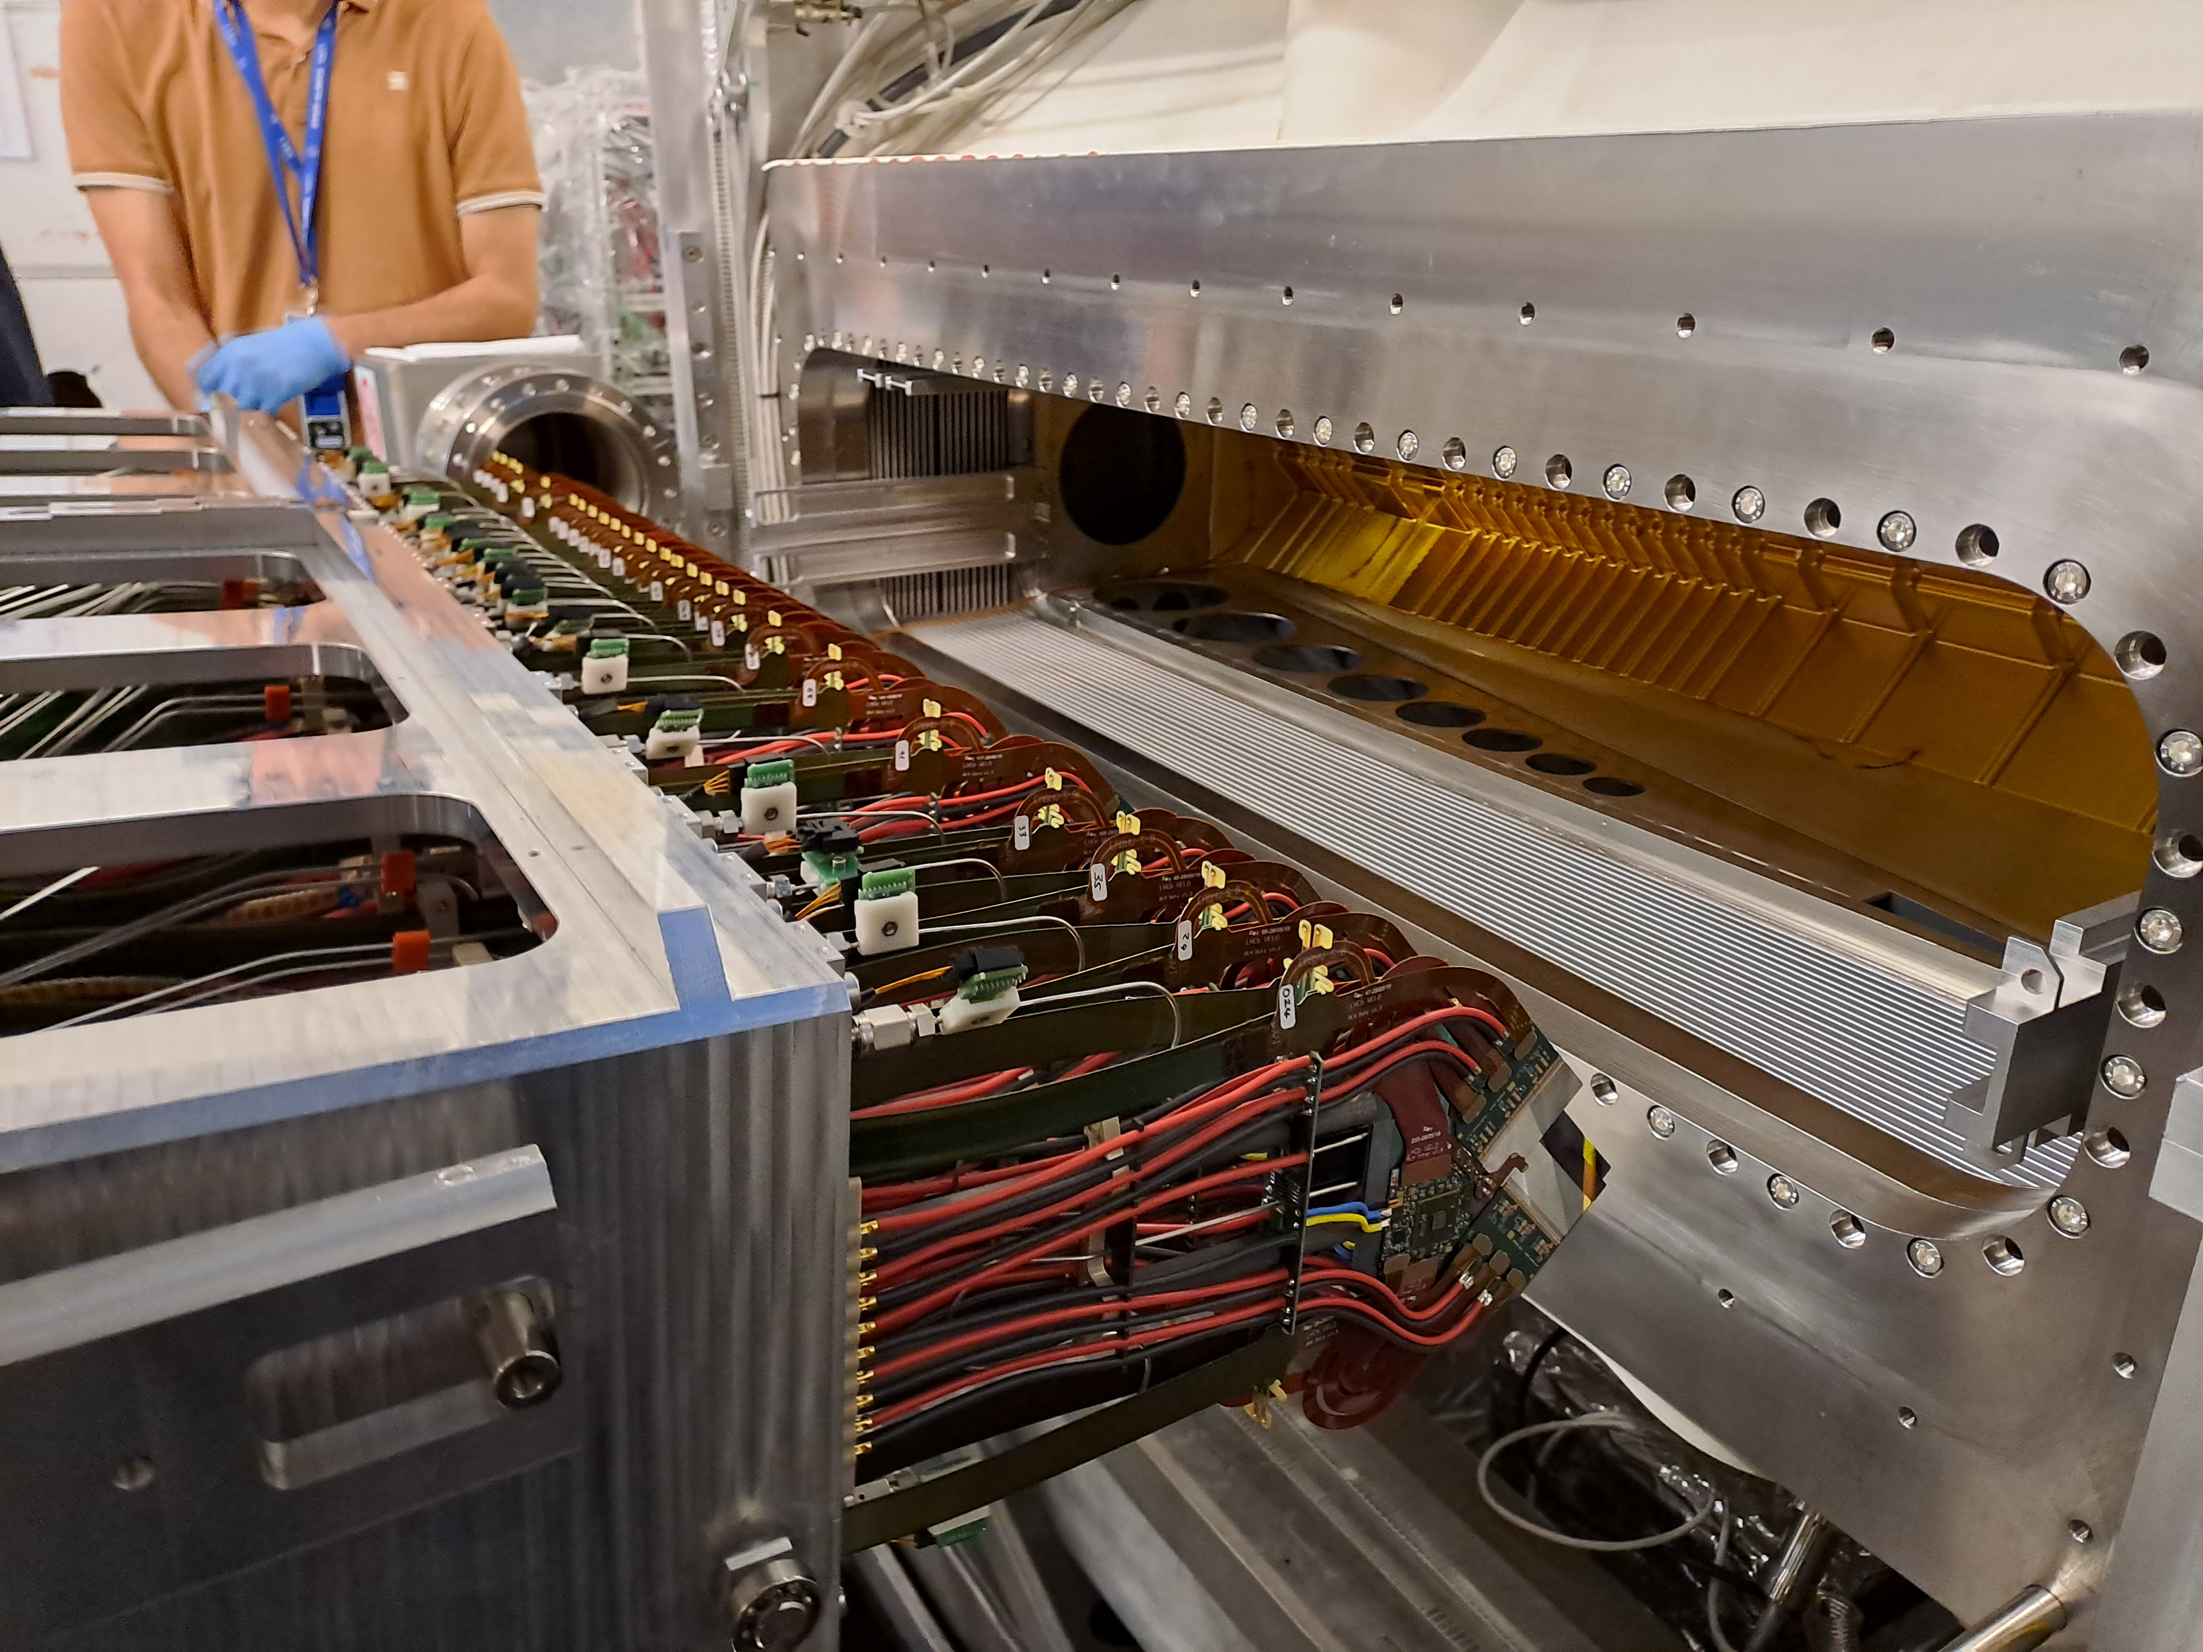
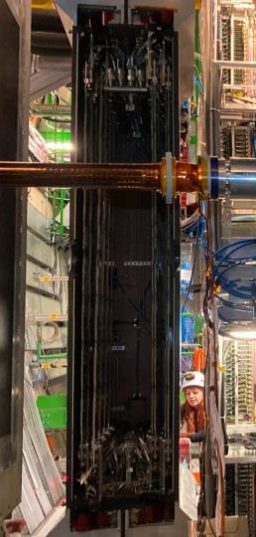
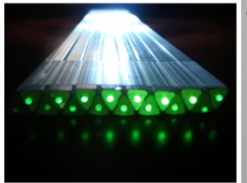
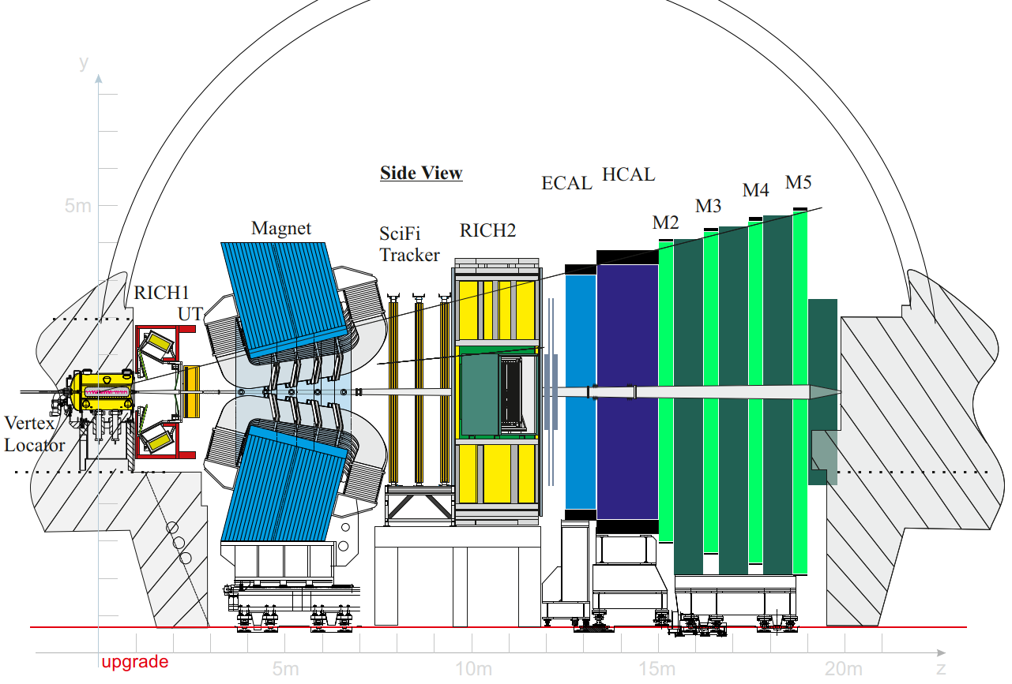
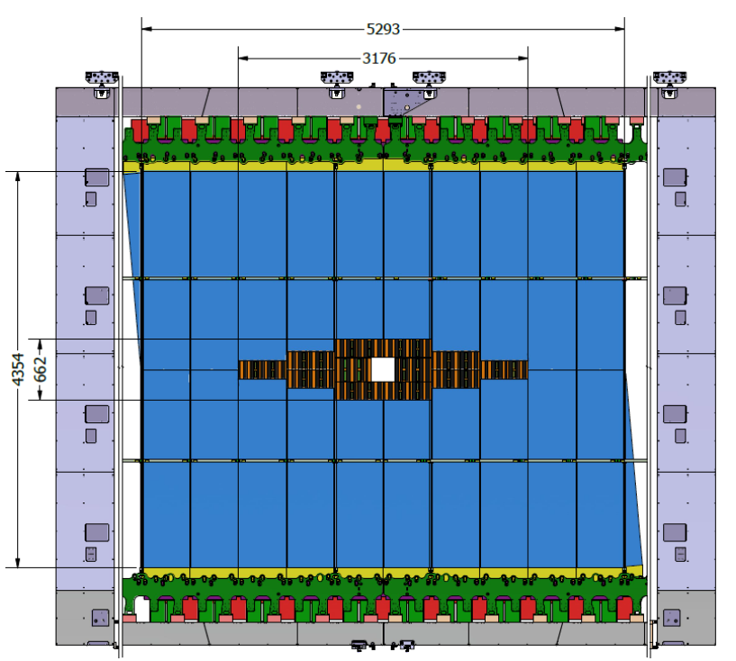
LHCb Upgrade II TRACKING (Upgrade I)
LS4
New Magnet Station
New UP ( CMOS, pixel)
New Mighty Tracker
Scintillating Fiber
Si Pixel
Modified or new support structure
New VELO (pixel)
New rf-foil
New Vessel and Motion System

Slide 4
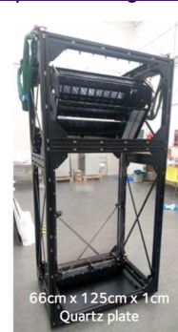
LS4
Upgrade II : PID
NEW RICH1
Photon detector
Optics Mirror
Gas Enclosure
Shielding
NEW RICH2
Photon detector
Optics Mirror
Gas Enclosure / structure
New TORCH
Install Detector( 12 Quartz bar)
Support structure

Slide 5
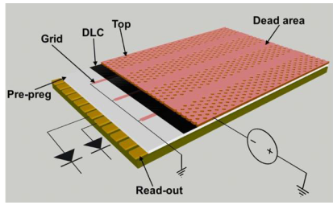
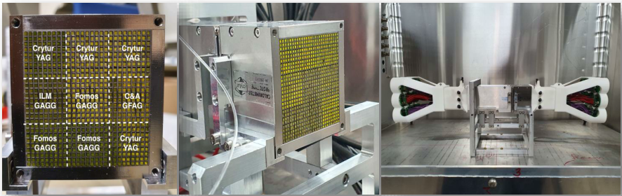
LS4
Upgrade II : CALO & MUON
New PicoCal
Remove Ecal module
Modify Ecal modules
Reinstall 2864 Sashlik
Reinstall SpaCal
Remove all MWPS (4x276)
Reinstall new Muon μrwell in R1 and R2
Reinstall modified MWPC in R3 and R4)
REPLACE HCAL by
Iron-concrete shielding (LS3)

Slide 6
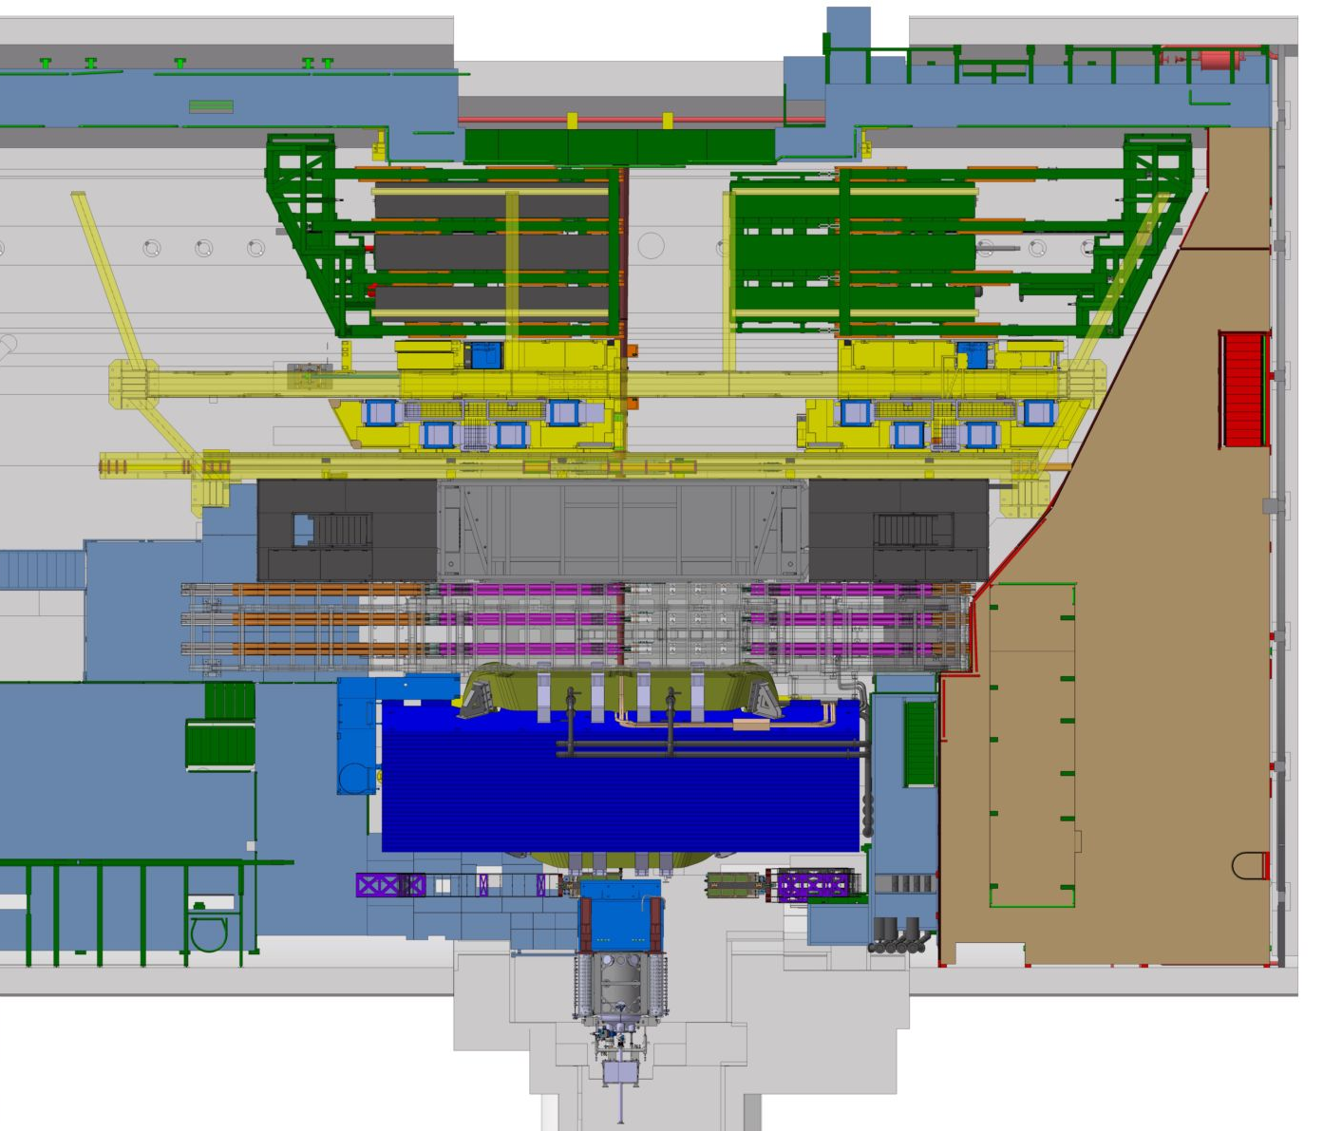
Installation: Boundary Conditions & Features
Detectors can be open/closed/accessed independently
Installation/dismantling sequence to be respected
2 Worksites: Upstream and downstream (wrt to dipole). Connected via Beam Pipe
Limited or No access from Cryo (C) side
Service Cavern and Detector are separated by a Shielding wall (4m of concrete blocs).
A
C

Slide 7
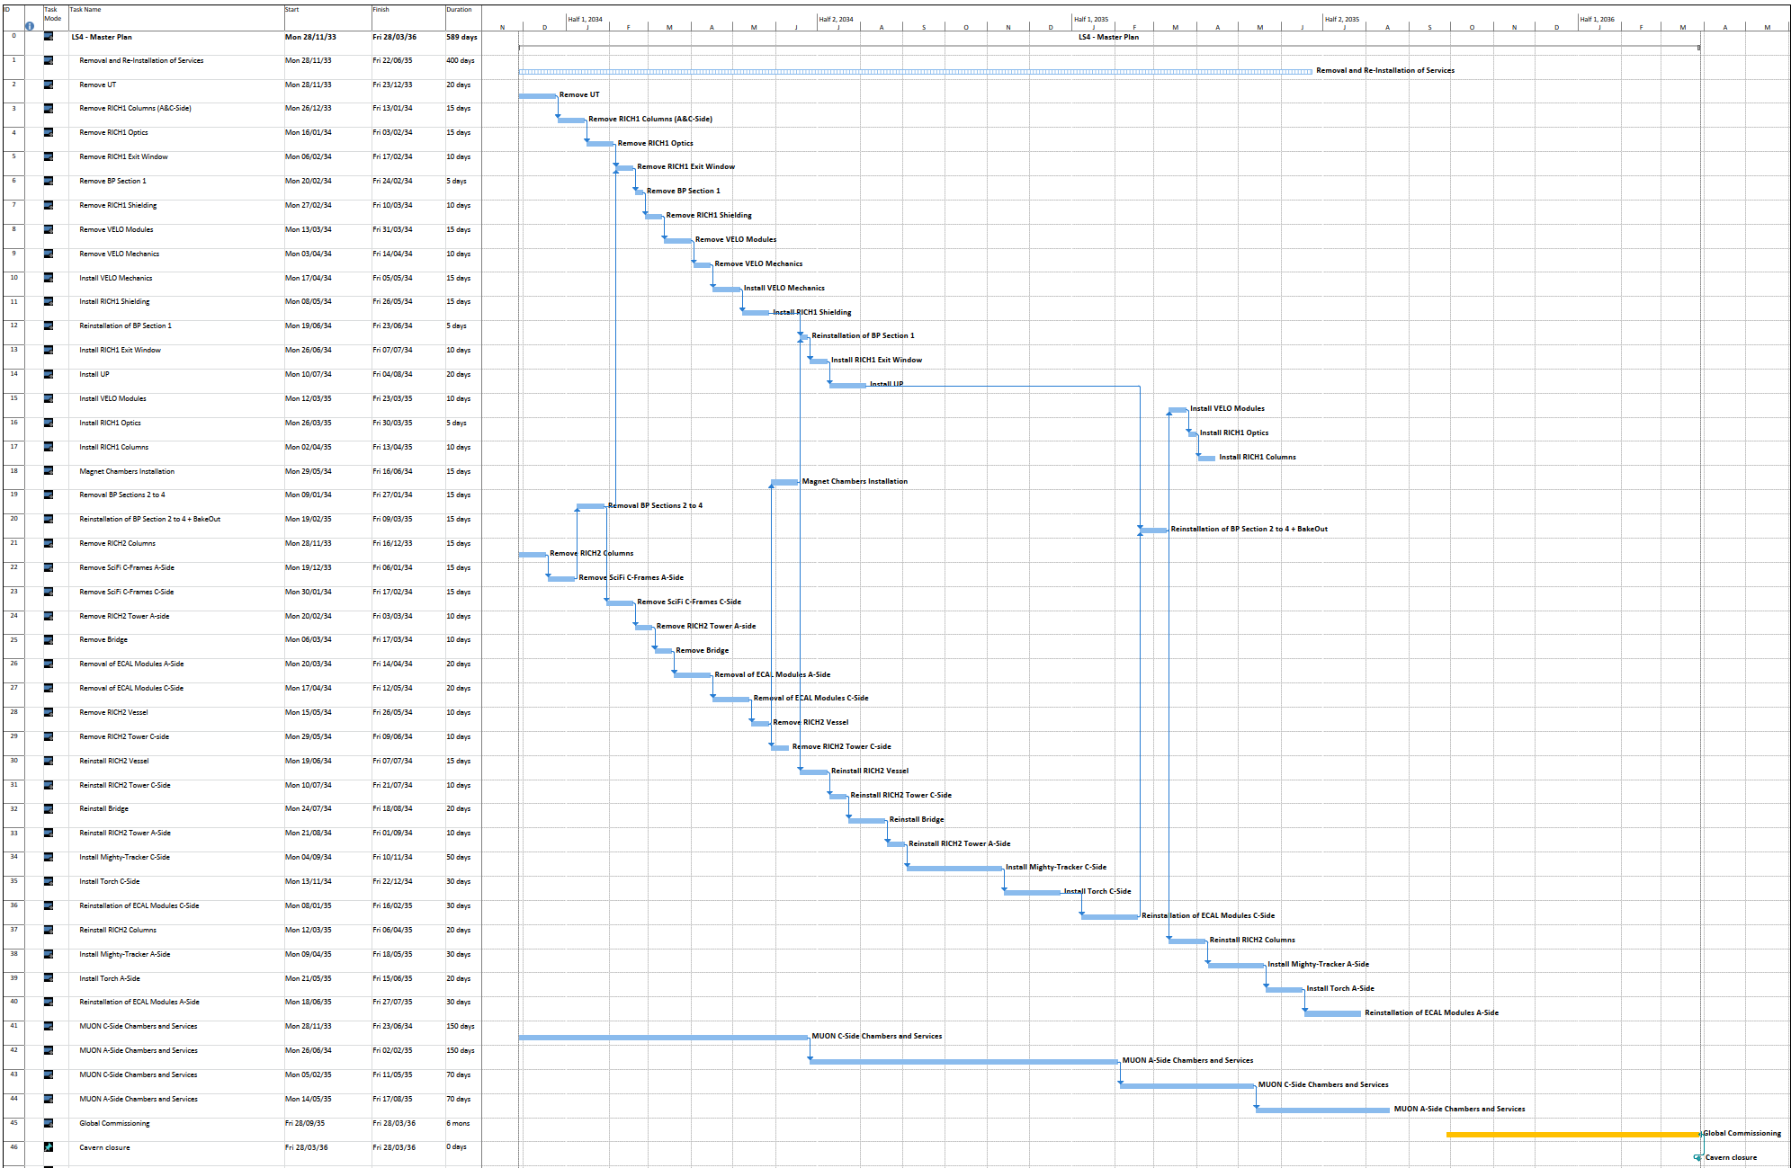
LS4 planning
(middle scenario)
Upstream
Dismantling phase
Downstream
THIS IS NOT CONTINGENCY
ECAL Modules Modifications

Slide 8
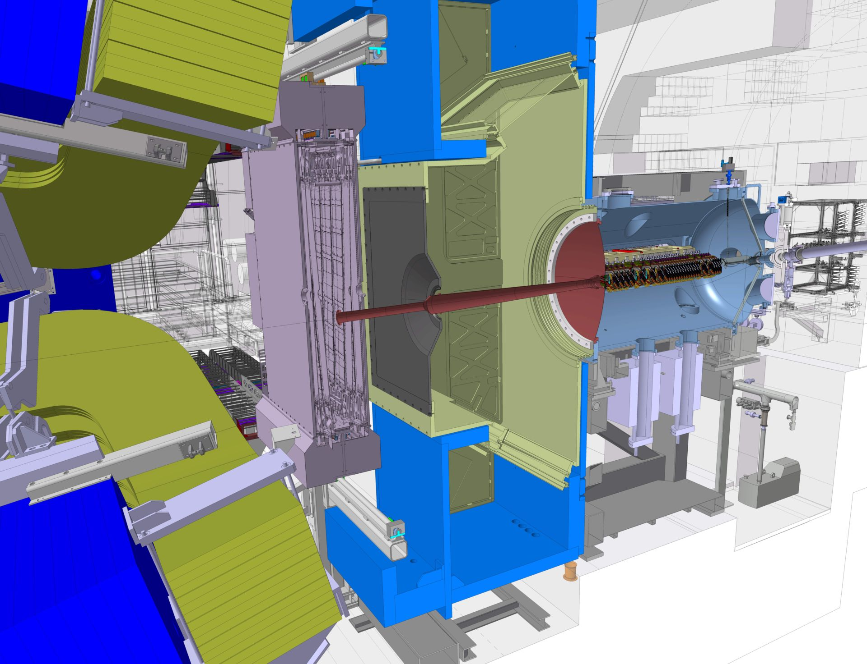
Critical Path Upstream (Installation Phase)
1 Velo Tank
2 RICH1 Gas enclosure
3 UP Side C
4 Beam Pipe sect 1 (and 2-4)
5 Beam Pipe Bake out
6 RICH 1 Exit window and optics
7 Velo Pixel Modules
2
1
3
7
4&5
6

Slide 9
Critical Path Downstream (Dismantling Phase)
1 Remove beam Pipe Sect 2-4
2 Remove SciFi stations A and C side
3 Remove SciFi support structure
4 Remove RICH 2
5 Open ECAL, start dismantling
3
2
4
5

Slide 10
Dismantling/installation scenario study for LS4
LHCb Design Office

Slide 11
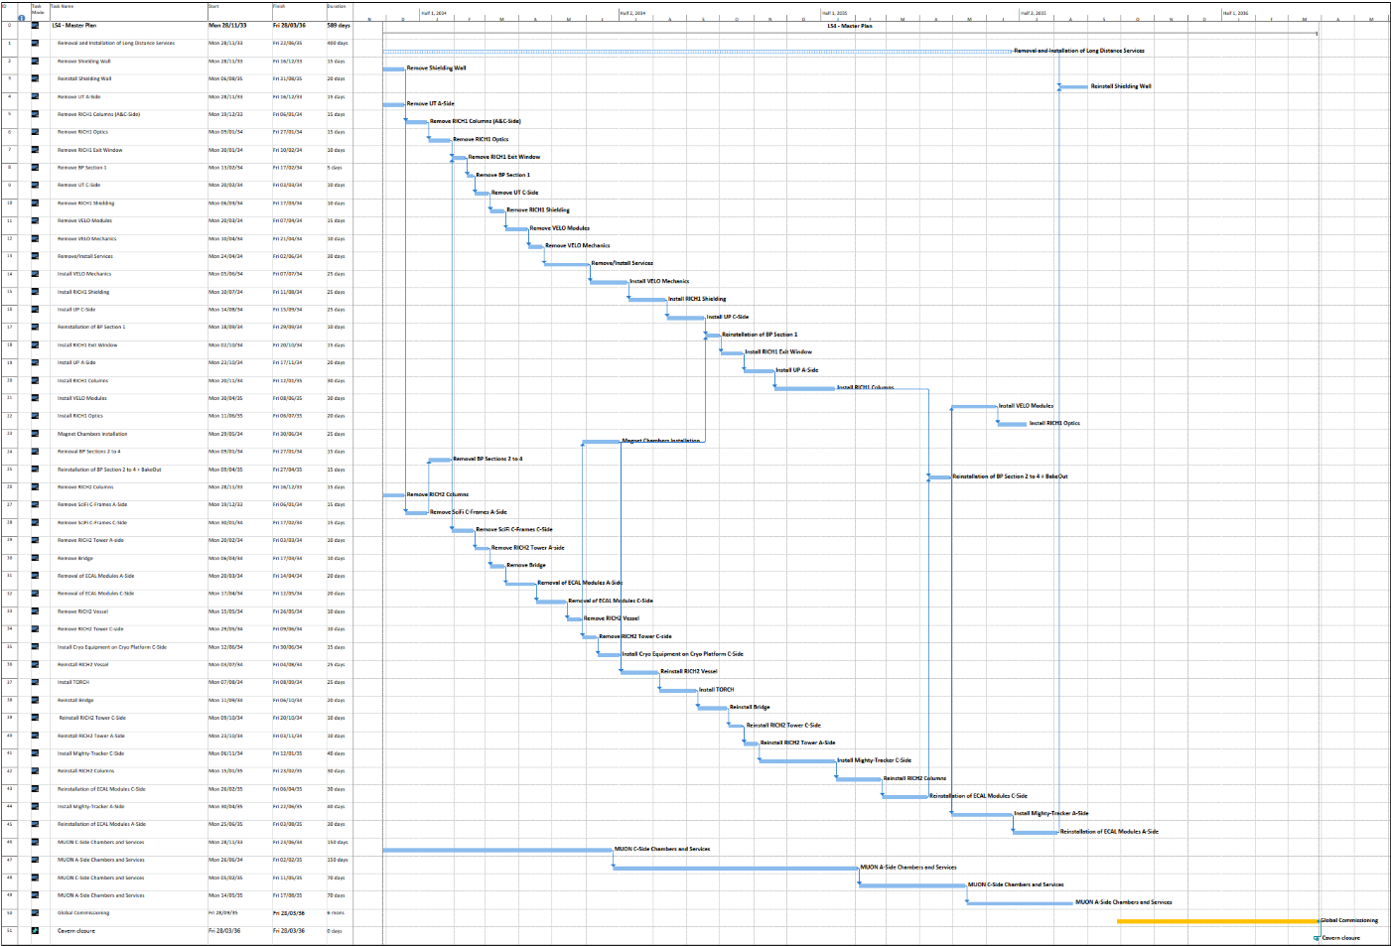
Phase 1
Activities :
Upstream :
Remove UT A side - 15d
Downstream :
Remove RICH2 columns -15d
Muon C side chambers & Services - 150d
Infrastructure
Remove shielding wall – 15d

Slide 12
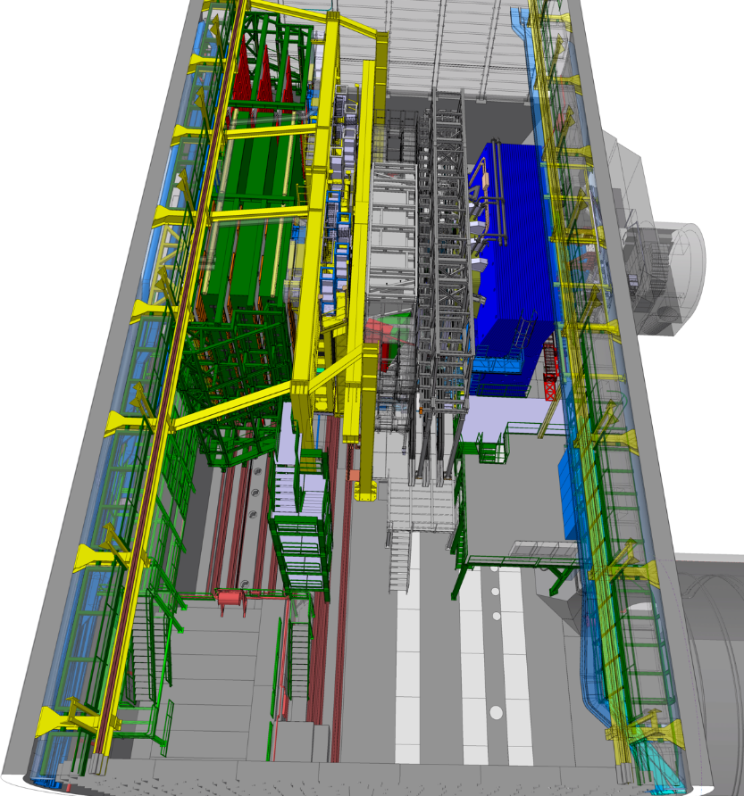
Phase 1
Activities :
Upstream :
Remove UT A side - 15d
Downstream :
Remove RICH2 columns -15d
Muon C side chambers & Services - 150d
Infrastructure
Remove shielding wall – 15d
HCAL & ECAL must remain closed

Slide 13
Phase 2
Activities :
Upstream :
Remove RICH1 columns (A&C side)- 15d
Downstream :
Remove SciFi C-Frame A side – 15d

Slide 14
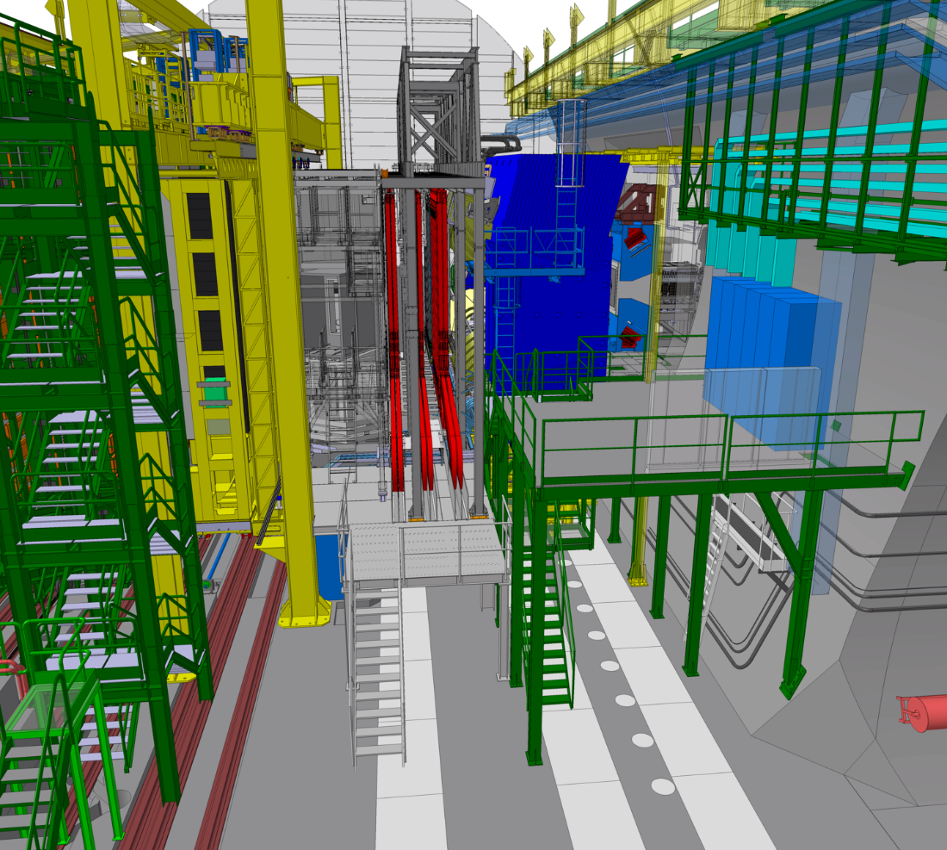
Phase 2
Activities :
Upstream :
Remove RICH1 columns (A&C side)- 15d
Downstream :
Remove SciFi C-Frame A side – 15d

Slide 15
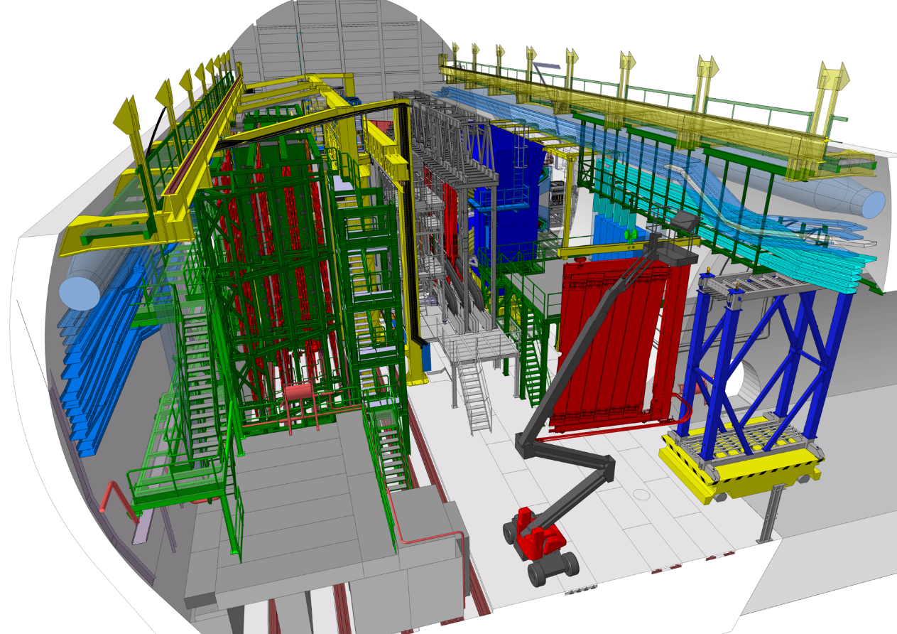
Phase 2
Removal of SciFi C-Frame A side

Slide 16
Phase 3
Activities :
Upstream :
Remove RICH1 optics - 15d
Downstream :
Remove Beam Pipe sections 2 to 4 – 15d

Slide 17
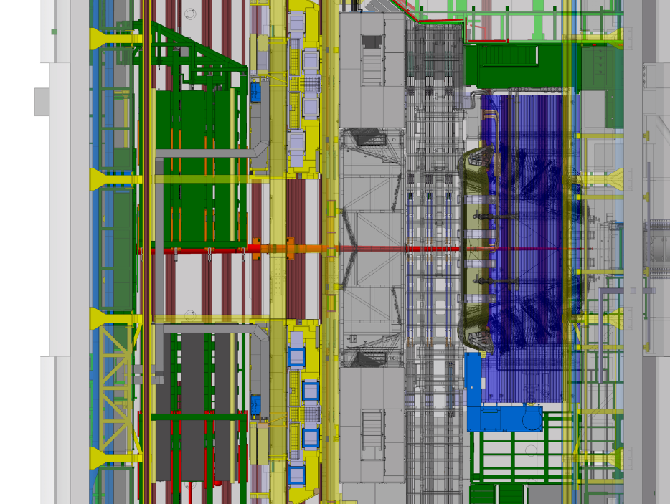
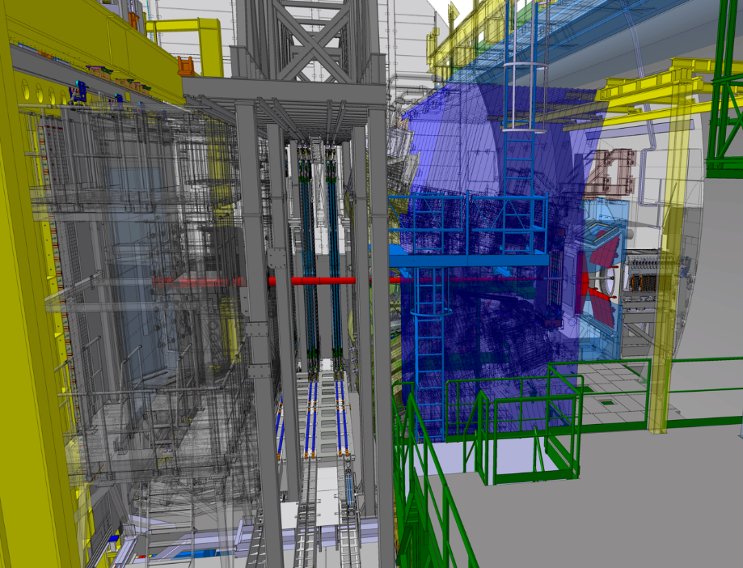
Phase 3
Upstream :
Remove RICH1 optics - 15d
Activities :
Downstream :
Remove Beam Pipe sections 2 to 4 – 15d
Muon Shielding A-side, HCAL, ECAL, Neutron Shielding & SciFi C-side must be open

Slide 18
Phase 4
Activities :
Upstream :
Remove RICH1 exit window – 10d
Remove BP section 1 – 5d
Downstream :
Remove SciFi C-Frame C side – 15d

Slide 19
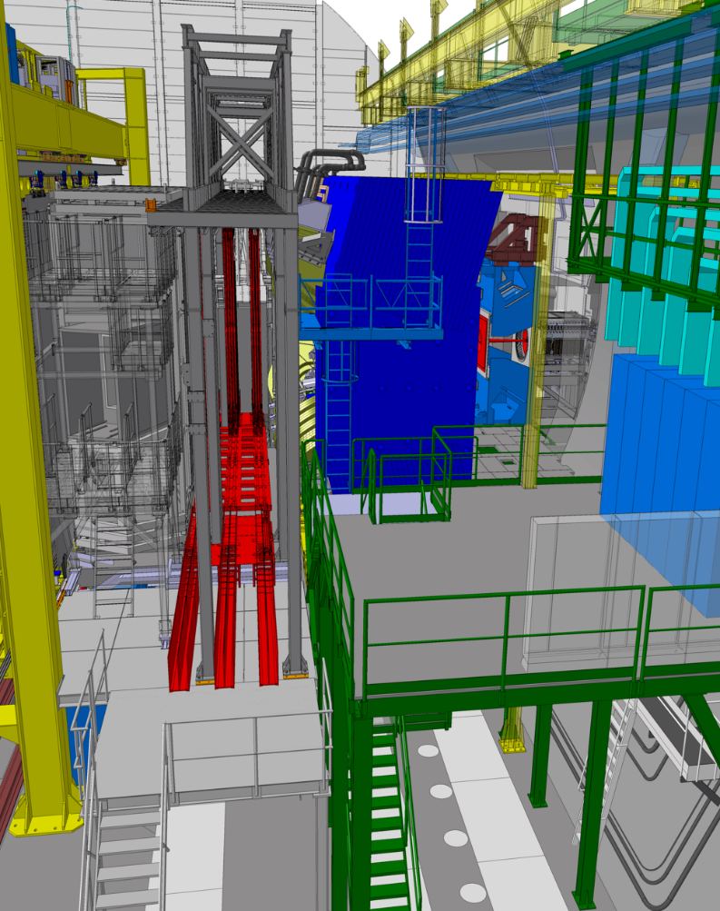
Phase 4
Activities :
Upstream :
Remove RICH1 exit window – 10d
Remove BP section 1 – 5d
Downstream :
Remove SciFi C-Frame C side – 15d

Slide 20
Phase 5
Activities :
Upstream :
Remove UT C side – 10d
Downstream :
Remove RICH2 tower A side – 10d
Can be the good moment to remove gantry tower

Slide 21
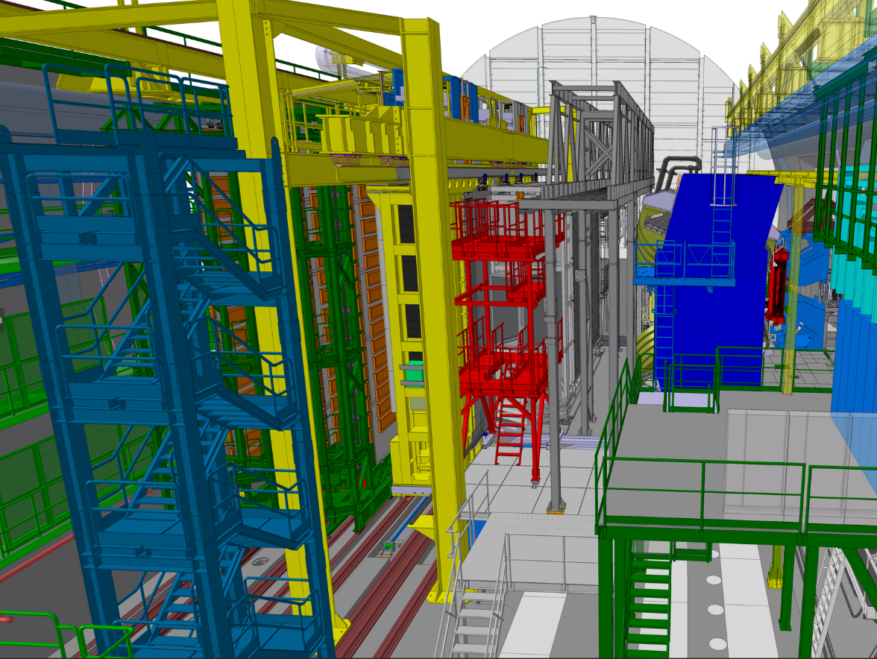
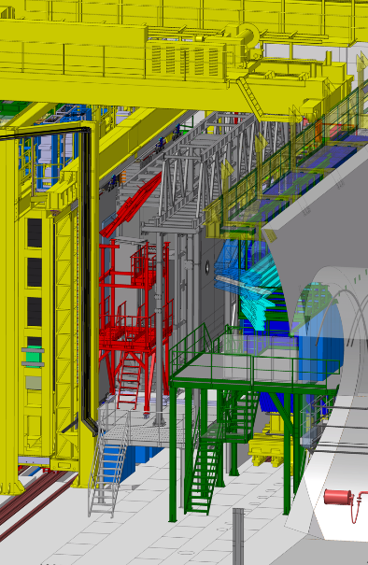
Phase 5
Activities :
Upstream :
Remove UT C side – 10d
Downstream :
Remove RICH2 tower A side – 10d
Gantry tower to remove
Removal piece by piece

Slide 22
Phase 6
Activities :
Upstream :
Remove RICH1 shielding -10d
Downstream :
Remove Bridge – 10d

Slide 23
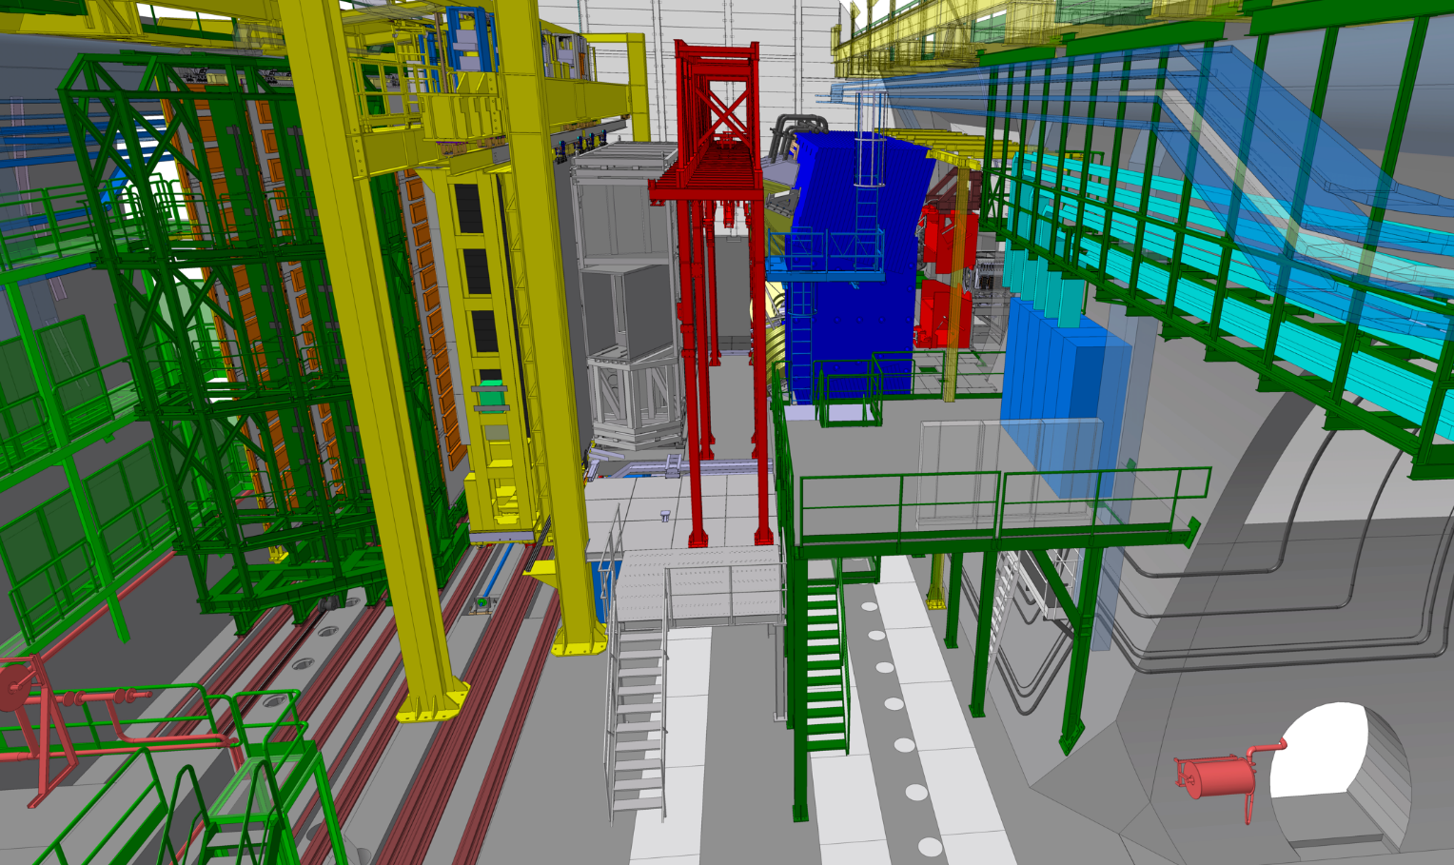
Phase 6
Activities :
Upstream :
Remove RICH1 shielding -10d
Downstream :
Remove Bridge – 10d

Slide 24
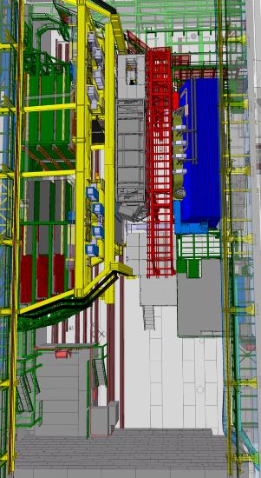
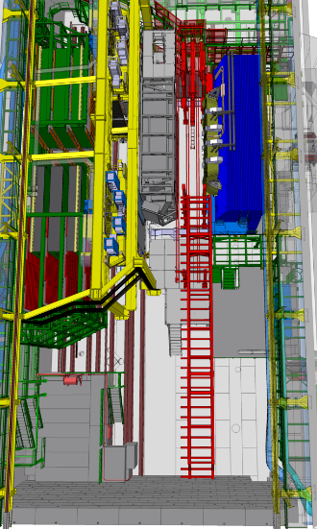
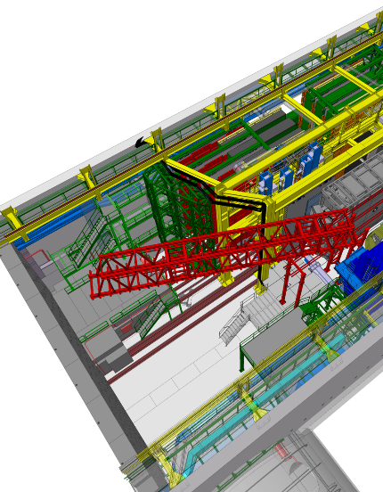
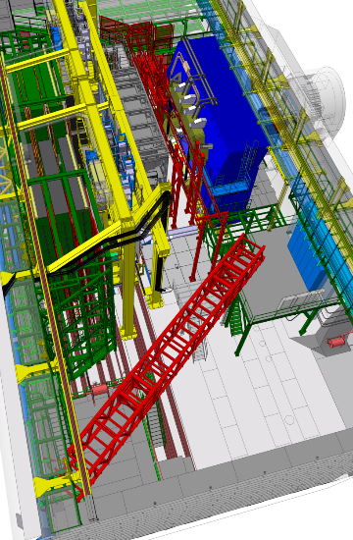
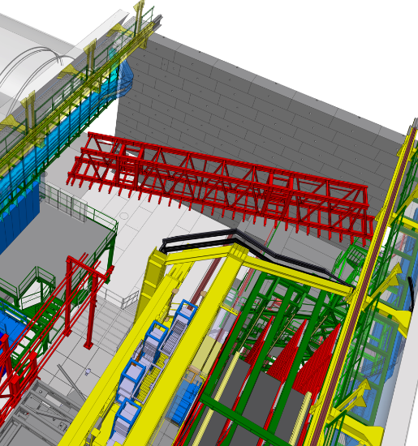
Phase 6
Bridge removal possible sequence

Slide 25
Phase 7
Activities :
Upstream :
Remove VELO modules – 15d
Start of remove VELO mechanics – 10d
Downstream :
Remove ECAL modules A side – 20d

Slide 26
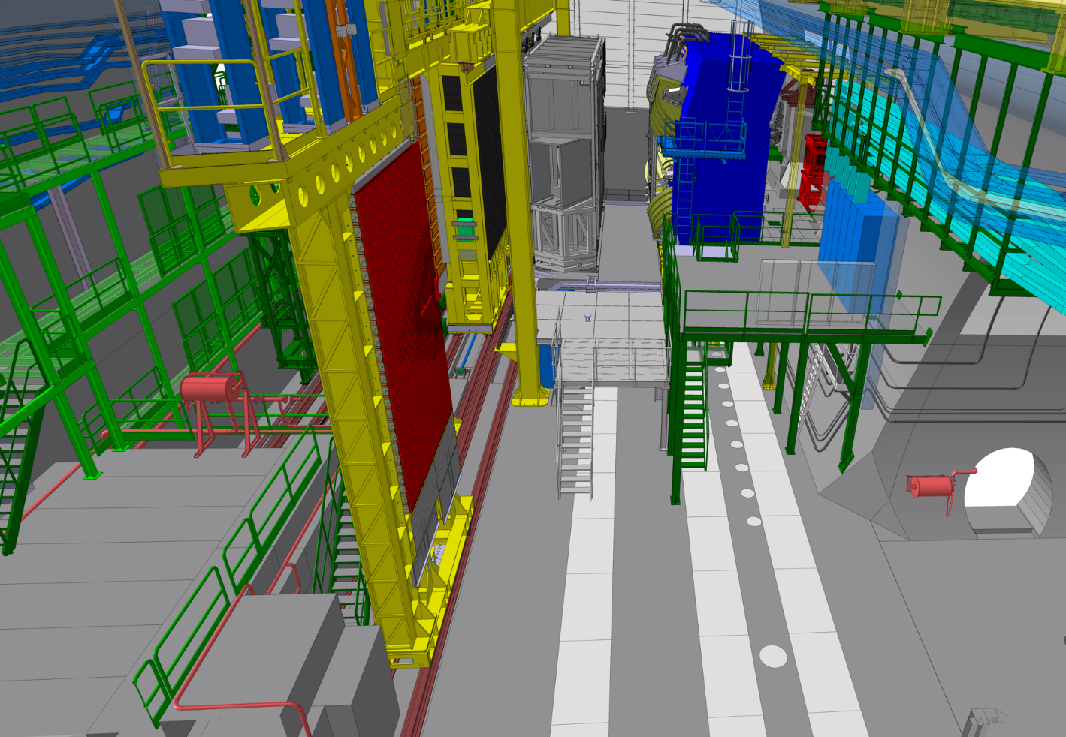
Phase 7
Activities :
Upstream :
Remove VELO modules – 15d
Remove VELO mechanics – 10d
Downstream :
Remove ECAL modules A side – 20d

Slide 27
Phase 8
Activities :
Upstream :
Start of remove/install services (upstream) – 30d
Downstream :
Remove ECAL modules C side – 20d

Slide 28
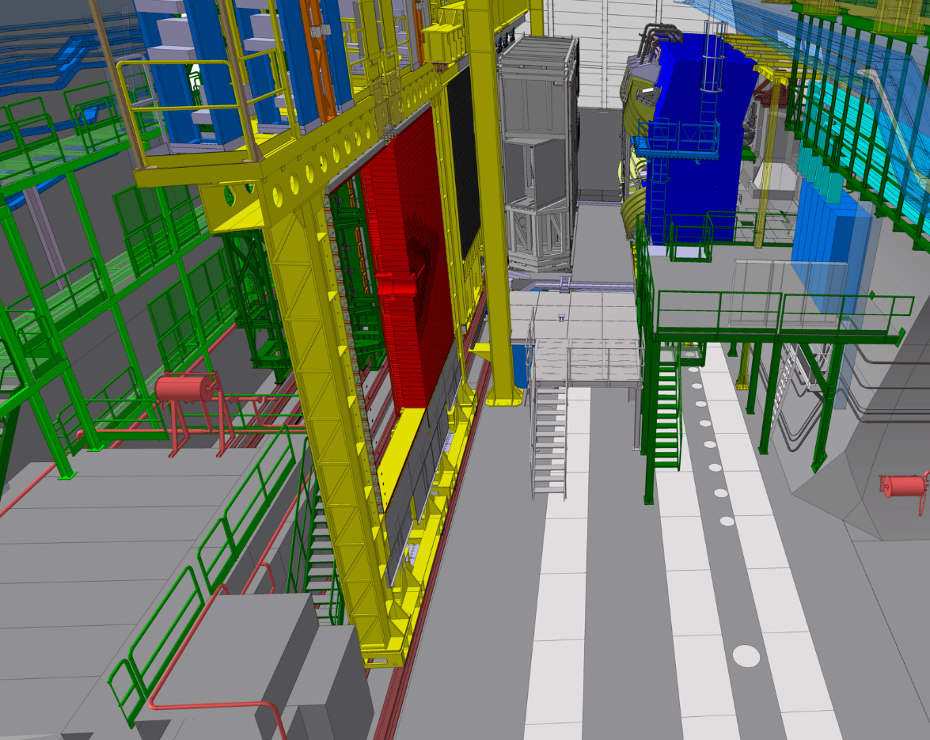
Phase 8
Activities :
Upstream :
Start of remove/install services (upstream) – 30d
Downstream :
Remove ECAL modules C side – 20d

Slide 29
Phase 9
Activities :
Upstream :
finish of remove/install services (upstream) – 30d
Downstream :
Remove RICH2 vessel – 10d

Slide 30
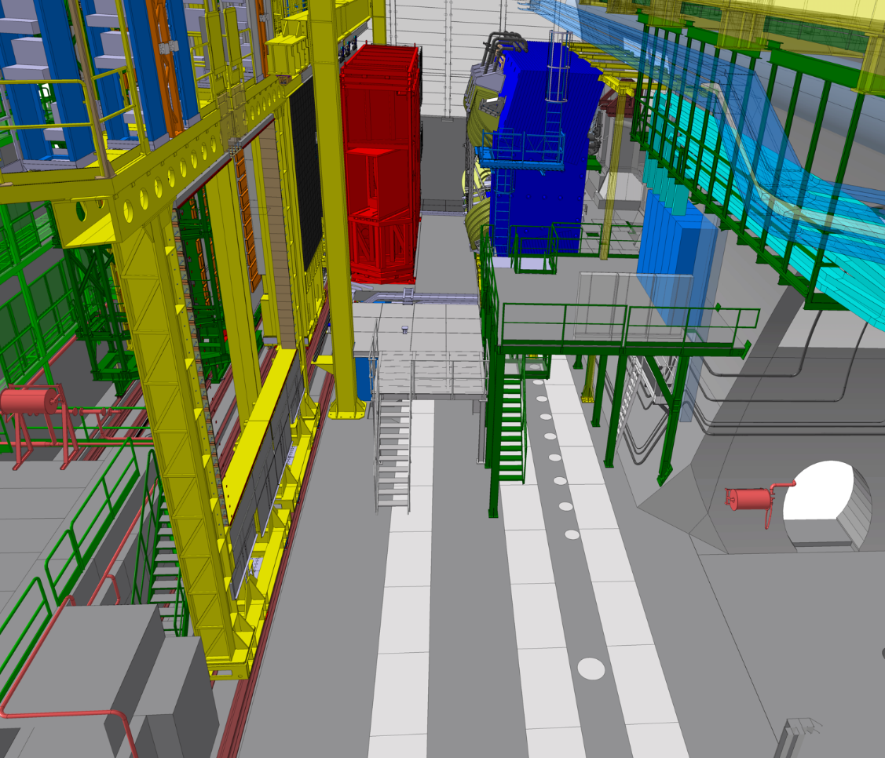
Phase 9
Activities :
Upstream :
finish of remove/install services (upstream) – 30d
Downstream :
Remove RICH2 vessel – 10d

Slide 31
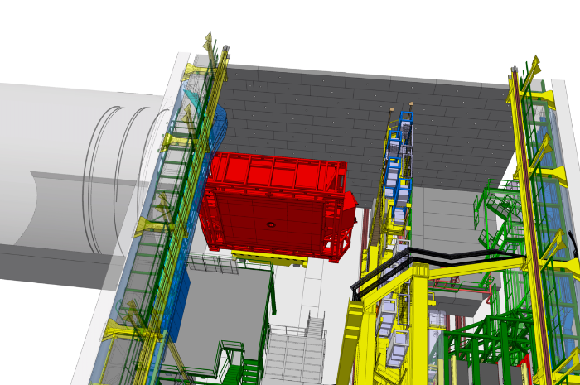
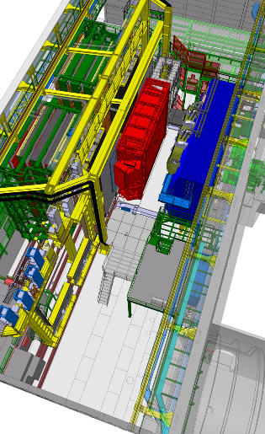
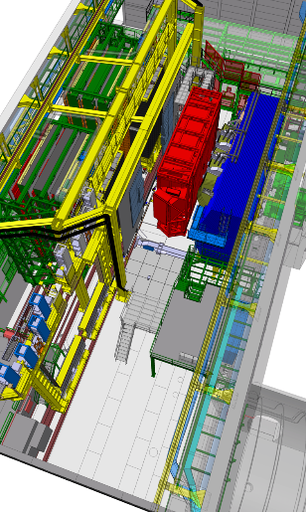
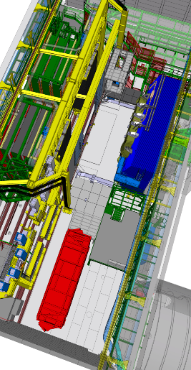
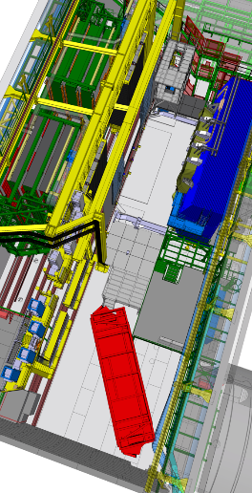
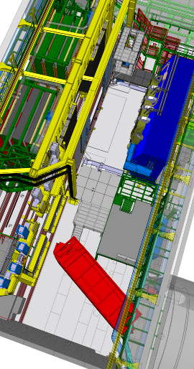
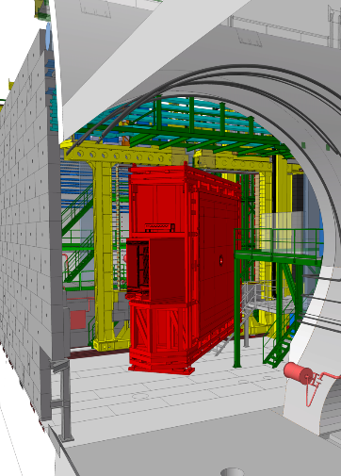
Phase 9
RICH2 vessel removal possible sequence

Slide 32
Phase 10
Activities :
Upstream :
Start of install new VELO mech. – 25d
Downstream :
Remove RICH2 tower C side – 10d
Start of install Magnet Stations – 25d

Slide 33
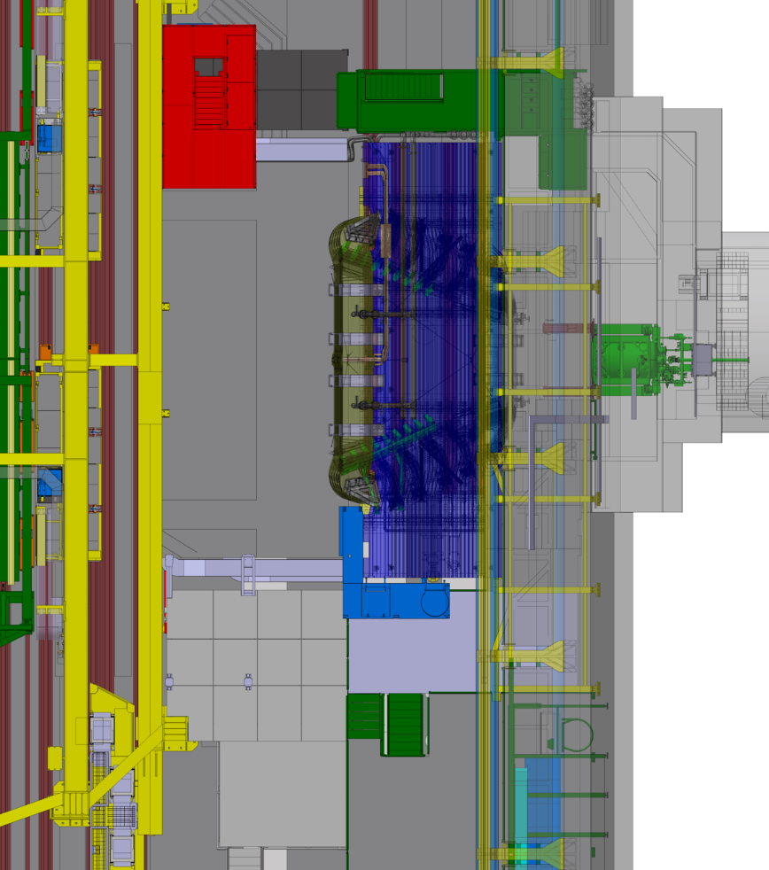
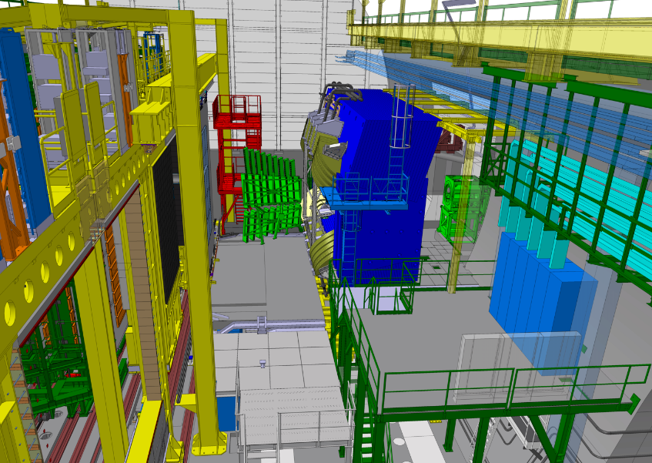
Phase 10
Activities :
Upstream :
Start of install new VELO mech. – 25d
Downstream :
Remove RICH2 tower C side – 10d
Start of install Magnet Stations – 25d

Slide 34
Phase 11
Activities :
Upstream :
Finish of install new VELO mech. – 25d
Downstream :
Install cryo equip. on platform C side – 15d
Finish of install Magnet Stations – 25d
Start Muon A side chambers & Services - 150d

Slide 35
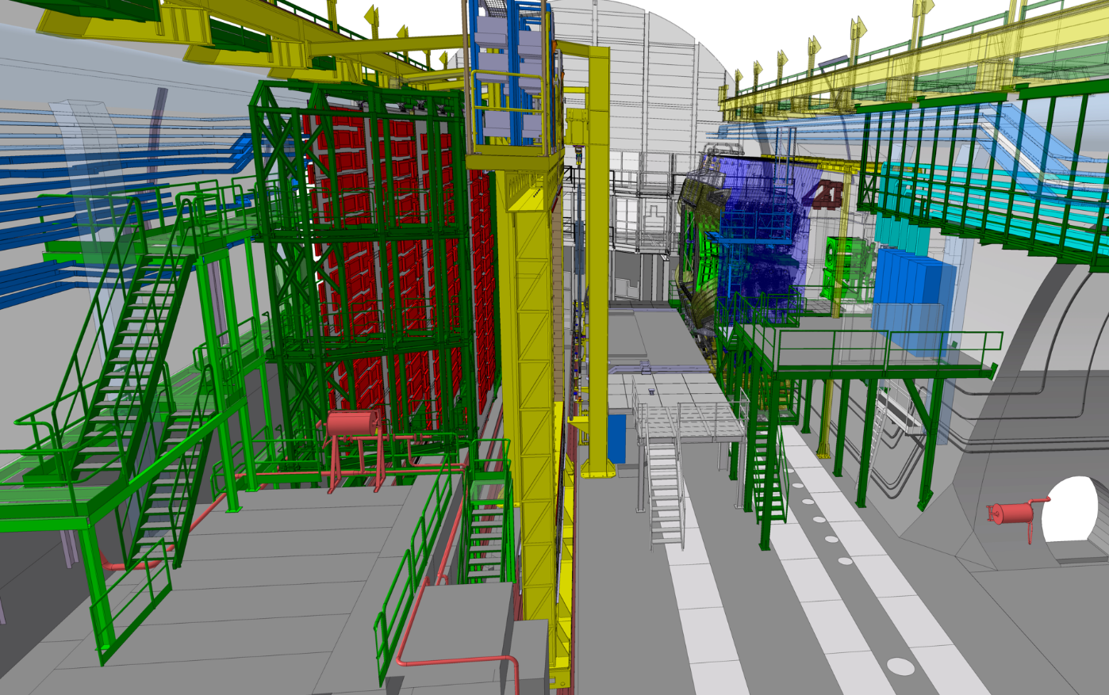
Phase 11
Activities :
Upstream :
Finish of install new VELO mech. – 25d
Downstream :
Install cryo equip. on platform C side – 15d
Finish of install Magnet Stations – 25d
Start Muon A side chambers & Services - 150d
Cryo equip. passage

Slide 36
Phase 12
Activities :
Upstream :
Install new RICH1 shielding – 25d
Downstream :
Install new RICH2 vessel – 25d

Slide 37
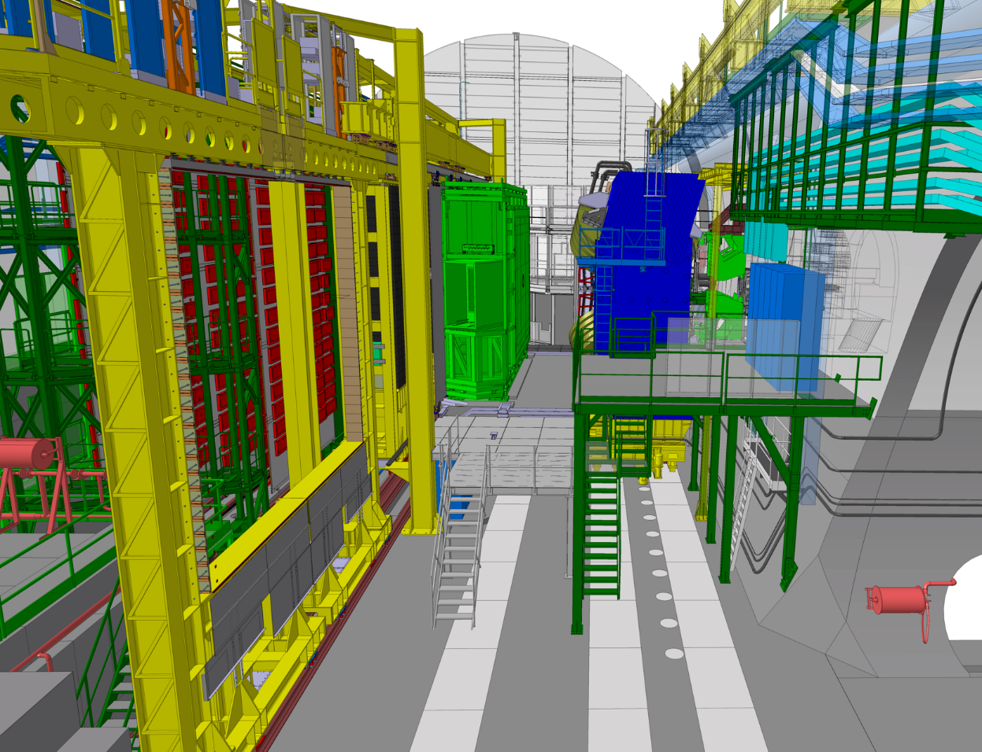
Phase 12
Activities :
Upstream :
Install new RICH1 shielding – 25d
Downstream :
Install new RICH2 vessel – 25d

Slide 38
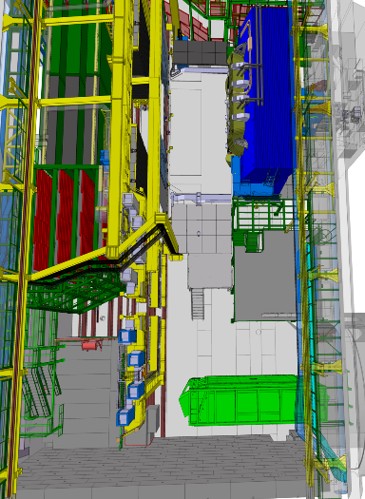
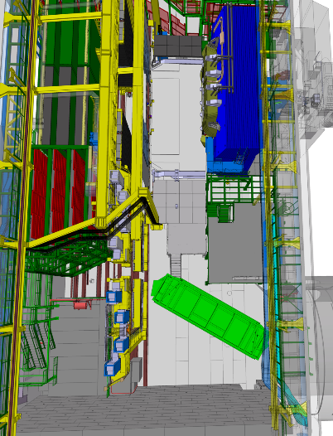
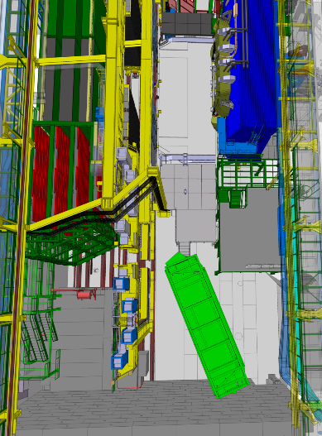
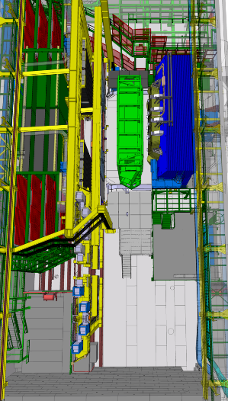
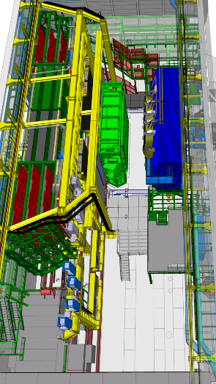
Phase 12
New RICH2 vessel installation possible sequence

Slide 39
Phase 13
Activities :
Upstream :
Install UP C side – 25d
Downstream :
install TORCH – 25d

Slide 40
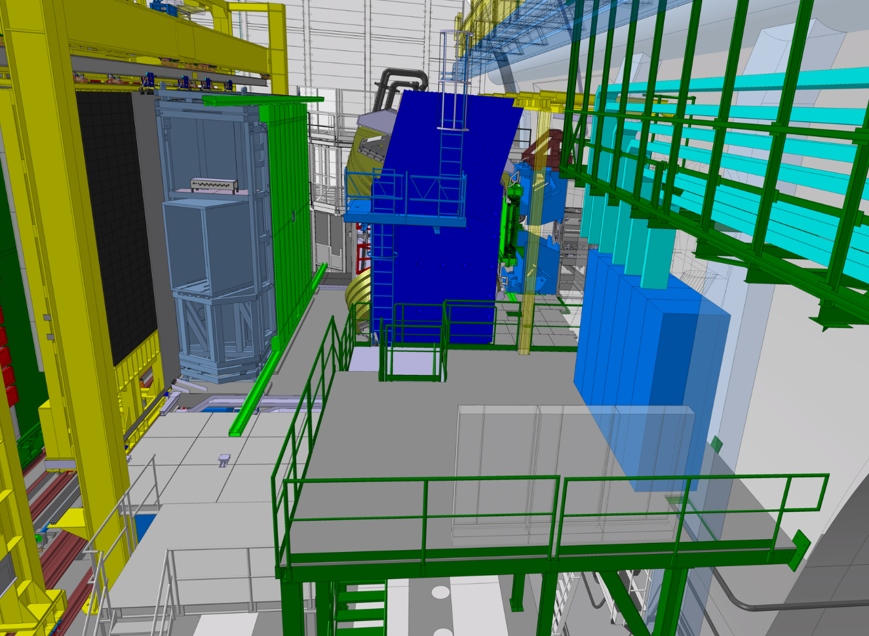
Phase 13
Activities :
Upstream :
Install UP C side – 25d
Downstream :
install TORCH – 25d

Slide 41
Phase 14
Activities :
Upstream :
Reinstall BP section 1 – 10d
Downstream :
install new Bridge – 20d

Slide 42

Phase 14
Activities :
Upstream :
Reinstall BP section 1 – 10d
Downstream :
install new Bridge – 20d

Slide 43




Phase 14
New Bridge top frame in 2 parts possible sequence

Slide 44
Phase 15
Activities :
Upstream :
Reinstall new RICH1 exit window – 15d
Downstream :
reinstall RICH2 tower C side – 10d

Slide 45

Phase 15
Activities :
Upstream :
Reinstall new RICH1 exit window – 15d
Downstream :
reinstall RICH2 tower C side – 10d

Slide 46

Phase 15
Activities :
Upstream :
Reinstall new RICH1 exit window – 15d
Downstream :
reinstall RICH2 tower C side – 10d

Slide 47
Phase 16
Activities :
Upstream :
Start of install UP A side – 20d
Downstream :
reinstall RICH2 tower A side – 10d

Slide 48

Phase 16
Activities :
Upstream :
Start of install UP A side – 20d
Downstream :
reinstall RICH2 tower A side – 10d

Slide 49
Phase 17
Activities :
Upstream :
Finish of Install UP A side – 20d
Install new RICH1 columns – 30d
Downstream :
Install mighty tracker C side – 40d

Slide 50

Phase 17
Activities :
Upstream :
Finish of Install UP A side – 20d
Install new RICH1 columns – 30d
Downstream :
Install mighty tracker C side – 40d

Slide 51


Phase 17
Activities :
Upstream :
Finish of Install UP A side – 20d
Install new RICH1 columns – 30d
Downstream :
Install mighty tracker C side – 40d

Slide 52
Phase 18
Activities :
Downstream :
Install new RICH2 columns -15d
Muon C side chambers & Services - 70d

Slide 53

Phase 18
Activities :
Downstream :
Install new RICH2 columns -15d
Muon C side chambers & Services - 70d

Slide 54

Phase 18
Activities :
Downstream :
Install new RICH2 columns -15d
Muon C side chambers & Services - 70d
Neutron shielding must be closed

Slide 55
Phase 19
Activities :
Downstream :
reinstall ECAL modules C side – 30d

Slide 56

Phase 19
Activities :
Downstream :
reinstall ECAL modules C side – 30d

Slide 57
Phase 20
Activities :
Downstream :
Reinstall BP section 2-4 – 15d

Slide 58


Phase 20
Activities :
Downstream :
Reinstall BP section 2-4 – 15d

Slide 59
Phase 21
Activities :
Upstream :
Install new VELO modules – 30d
Downstream :
Start install Mighty Tracker A side – 40d
Muon A side chambers & Services - 70d

Slide 60

Phase 21
Activities :
Upstream :
Install new VELO modules – 30d
Downstream :
Start install Mighty Tracker A side – 40d
Muon A side chambers & Services - 70d

Slide 61
Phase 22
Activities :
Upstream :
Install new RICH1 optics – 20d
Downstream :
Finish install Mighty Tracker A side – 40d
Reinstall ECAL modules A side

Slide 62

Phase 22
Activities :
Downstream :
reinstall ECAL modules A side – 30d

Slide 63
Phase 23
Activities :
Downstream :
Finish Muon A side chambers & Services - 70d
Infrastructure
Reinstall shielding wall – 20d

Slide 64

Phase 23
Activities :
Downstream :
Finish Muon A side chambers & Services - 70d
Infrastructure
Reinstall shielding wall – 20d
Gantry tower
Visitor platform

Slide 66

Detector Readiness

Slide 67

Lessons Learnt from UI (1/4)
The detectors readiness was driving the installation planning in LS2, not the installation time itself
Mitigation:
Enhance follow-up and monitoring of progress though U2IG
Include contingency in planning, not to be confused with extra time.
CERN-LHCC-2024-010

Slide 68
Lessons Learnt from UI (2/4)
Near detector services* design, integration, and installation work was largely underestimated in UI
(*) Services from the detector to the up to nearest connecting point (Patch panel, valve …)
Mitigation:
Raise awareness, enhance coordination between sub-detector and TC team, strengthen design office and installation teams.

Slide 69

Lessons Learnt from UI (3/4)
Logistics and assembly facilities were a bottleneck in UI. There is only 1 medium-sized assembly hall at P8. UII will be much more demanding, given the additional work on large detectors (PicoCal, Muon, RICH2, TORCH, Mighty Tracker, support structures).
Mitigation:
It is a necessary condition for success to have sufficient and adequate laboratory, test and assembly space available, from the end of LS3.
A detailed task-oriented facility inventory has been made and documented.
A large Assembly Hall, Laboratory space to work on activated material and Clean Room are missing. Support from hostlab is necessary.

Slide 70

Lessons Learnt from UI (4/4)
Final detector assembly, test (and of course installation) could only be done at CERN.
Attracting key technical manpower to work at CERN is a necessary condition.
Mitigation:
Raise awareness among participating institutes and FA .
Decent working conditions, work area, and offices shall be provided to users.

