Slide 2
Introduction
On-schedule installation in LS4 requires
suitable facilities for detector assembly and pre-commissioning at CERN,
efficient logistics chain for dismantling and installation (including storage and buffer areas),
where possible, anticipating preparatory work in LS3,
upfront integration of detectors, support structures and services in the overall CAD model,
…
Service/infrastructure related challenges for Upgrade II include
increased scale and complexity of low-temperature cooling systems (and associated auxiliary systems),
routing of services (cables, optical fibres, transfer lines):
limited space in existing passages between detector and service cavern;
design/integration of near-detector services requires close collaboration between subdetector groups and central team (need strong design/integration office).
2

Slide 3
Detector cooling
Low-temperature cooling needs of Upgrade II detectors can be met by
evaporative CO₂ cooling (for silicon vertex and tracking detectors), and
cryogenic (nitrogen) cooling (for SiPM photon detectors of SciFi and RICH).
Run 1/2
Run 3/4
Run 5 and beyond

Slide 4
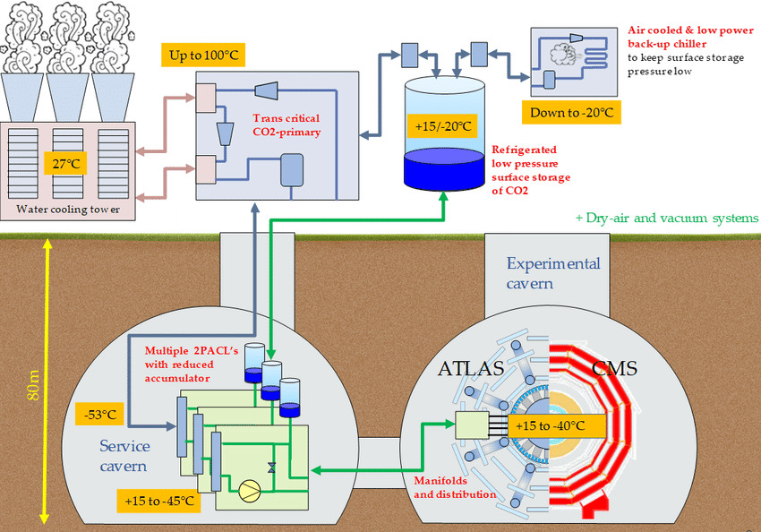
Detector cooling: CO₂
Blueprint follows closely the ATLAS/CMS Phase-II systems (at reduced scale):
Combined load of Mighty Pixel Tracker, UP and VELO can be covered by 3+1 slices of ATLAS/CMS 2PACL plants (preferably with backpressure regulation to enable different detector temperature setpoints), to be placed in the service cavern (UX85A). Design, construction and operation by EP-DT.
The 2PACL plants are connected to a primary CO₂ (R744) chiller, located on the surface. Design, construction and operation by EN-CV.

Slide 5
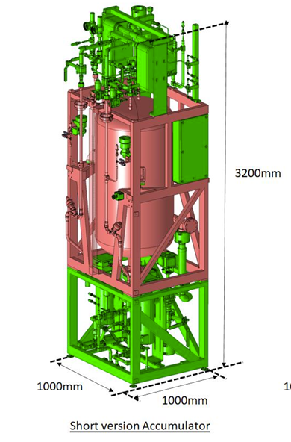
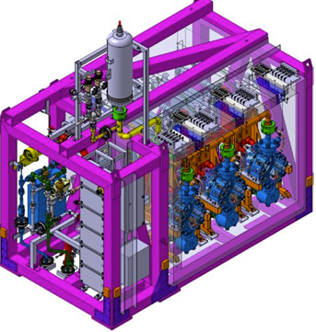
Detector cooling: CO₂
2PACL transfer lines
Accumulators
2PACL plant(s)
Primary CO₂ circuit

Slide 6
Detector cooling: CO₂
Following the ATLAS/CMS Phase-II model, we expect the primary system (and associated infrastructure) to be part of a future HostLab 3 project.
Existing experience with CO₂ cooling systems among all stake-holders (LHCb, EP-DT, EN-CV) helps to minimize risk.
To ensure readiness of the systems for LS4, construction of 2PACL plants and chiller need to start mid 2031; expected to be compatible with the resource load of EP-DT and EN-CV.
What work can/needs to be done in LS3/Run4?
Long-distance transfer lines between surface and underground (connection between 2PACL plants and chiller and, if needed, lines to surface storage).
Window of opportunity in the second half of LS3.
Construction of a new technical building to host the chillers.
Prepare connection to cooling towers.
Installation of additional safety systems (e. g. CO₂ detection), if needed.

Slide 7
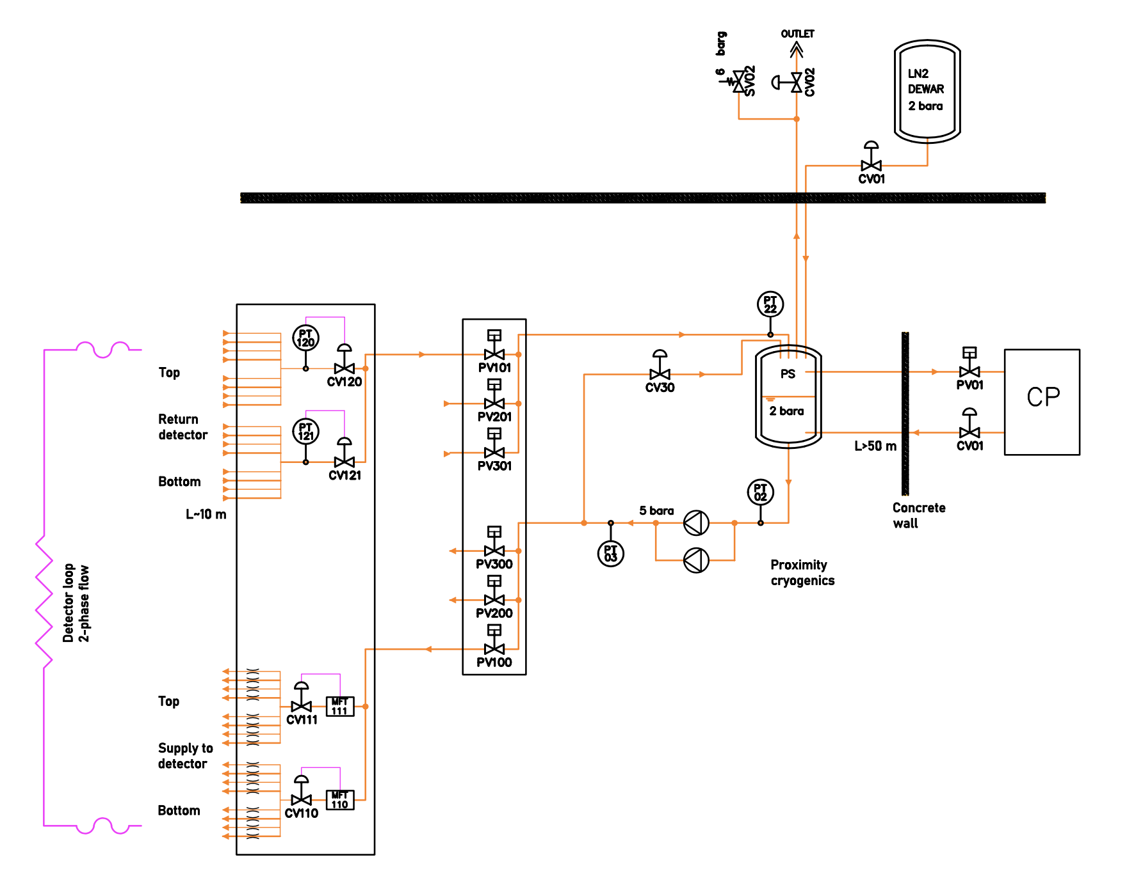
Detector cooling: cryogenic cooling
Main components:
primary (water) cooling (HostLab),
Turbo-Brayton subcooler,
transfer lines,
proximity cryogenics (phase separator, valve boxes),
manifolds and on-detector piping,
backup system (LN2 dewar),
auxiliary systems (insulation vacuum etc.).
Risk mitigation:
Use of off-the-shelf components (Turbo-Brayton).
Extensive experience in TE-CRG (including ATLAS LAr).
Finish pre-commissioning of surface systems (Turbo-Brayton subcooler) before the start of LS4.
Install surface-underground lines in (second half of) LS3?

Slide 8
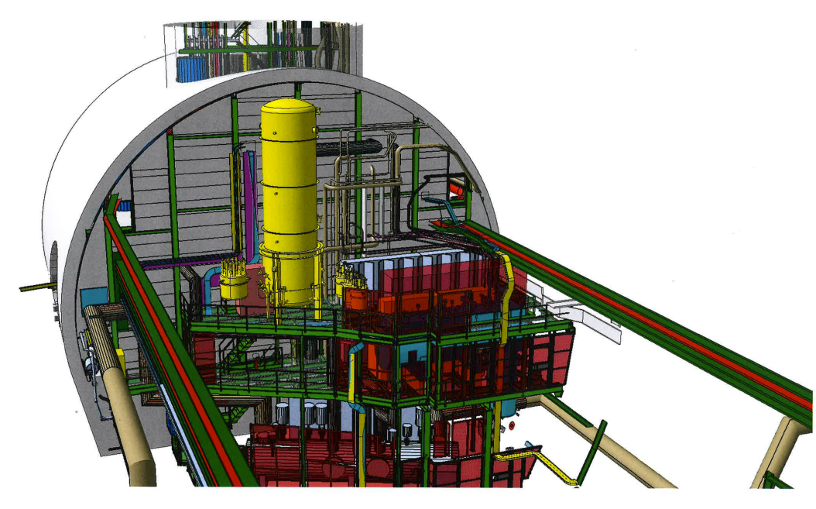
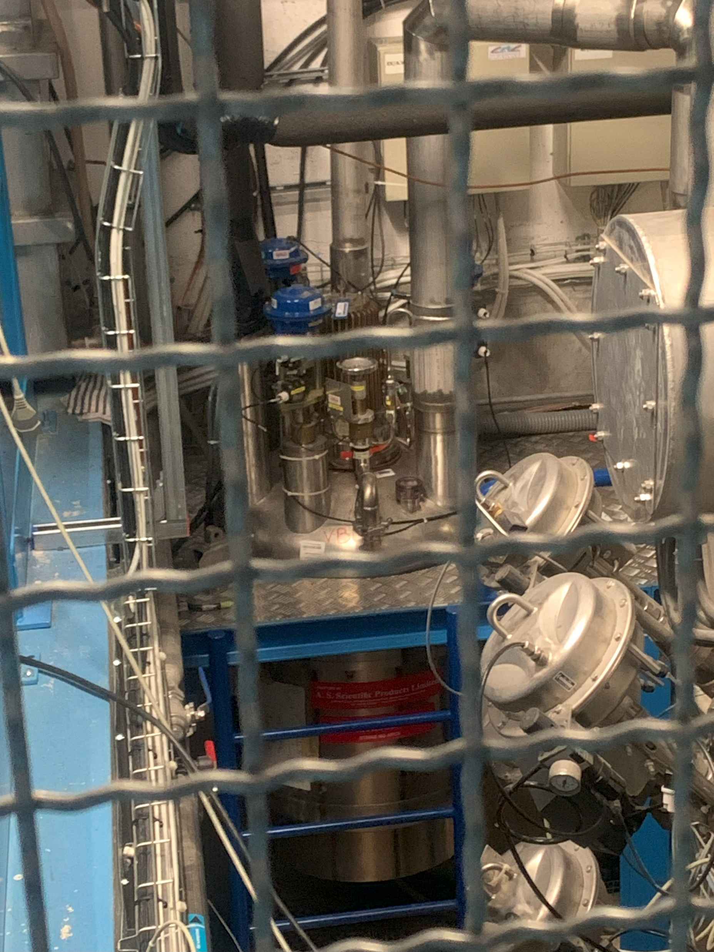
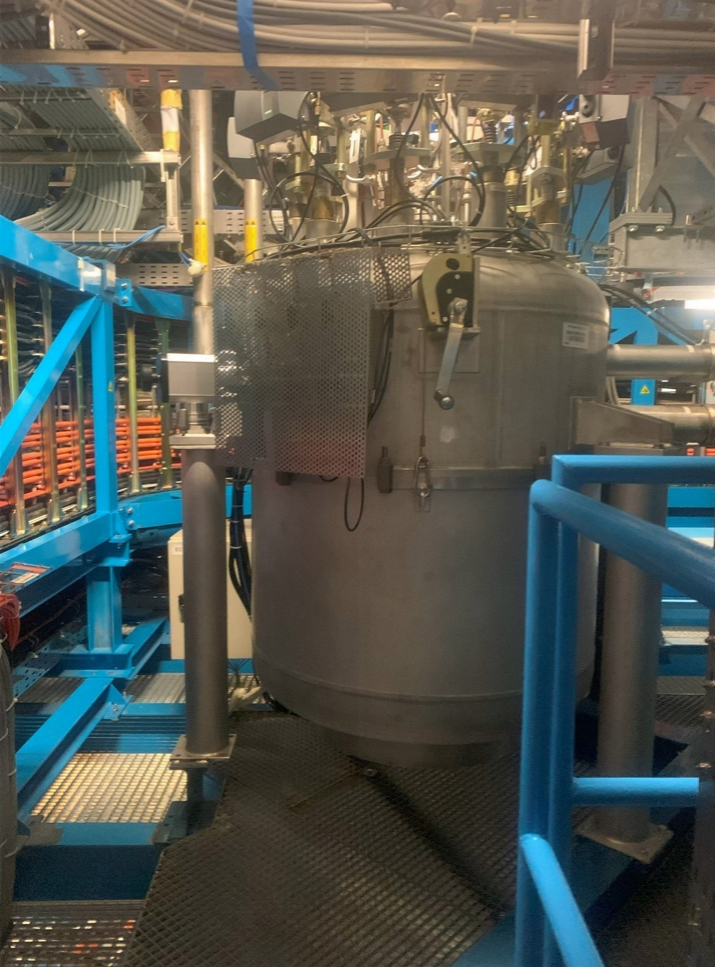
Detector cooling: cryogenic cooling
Pumps
Phase separator
supply lines
backup supply line
vent line
Regulation valve boxes
Primary circuit (subcooler – phase separator)
Preliminary conceptual design

Slide 9
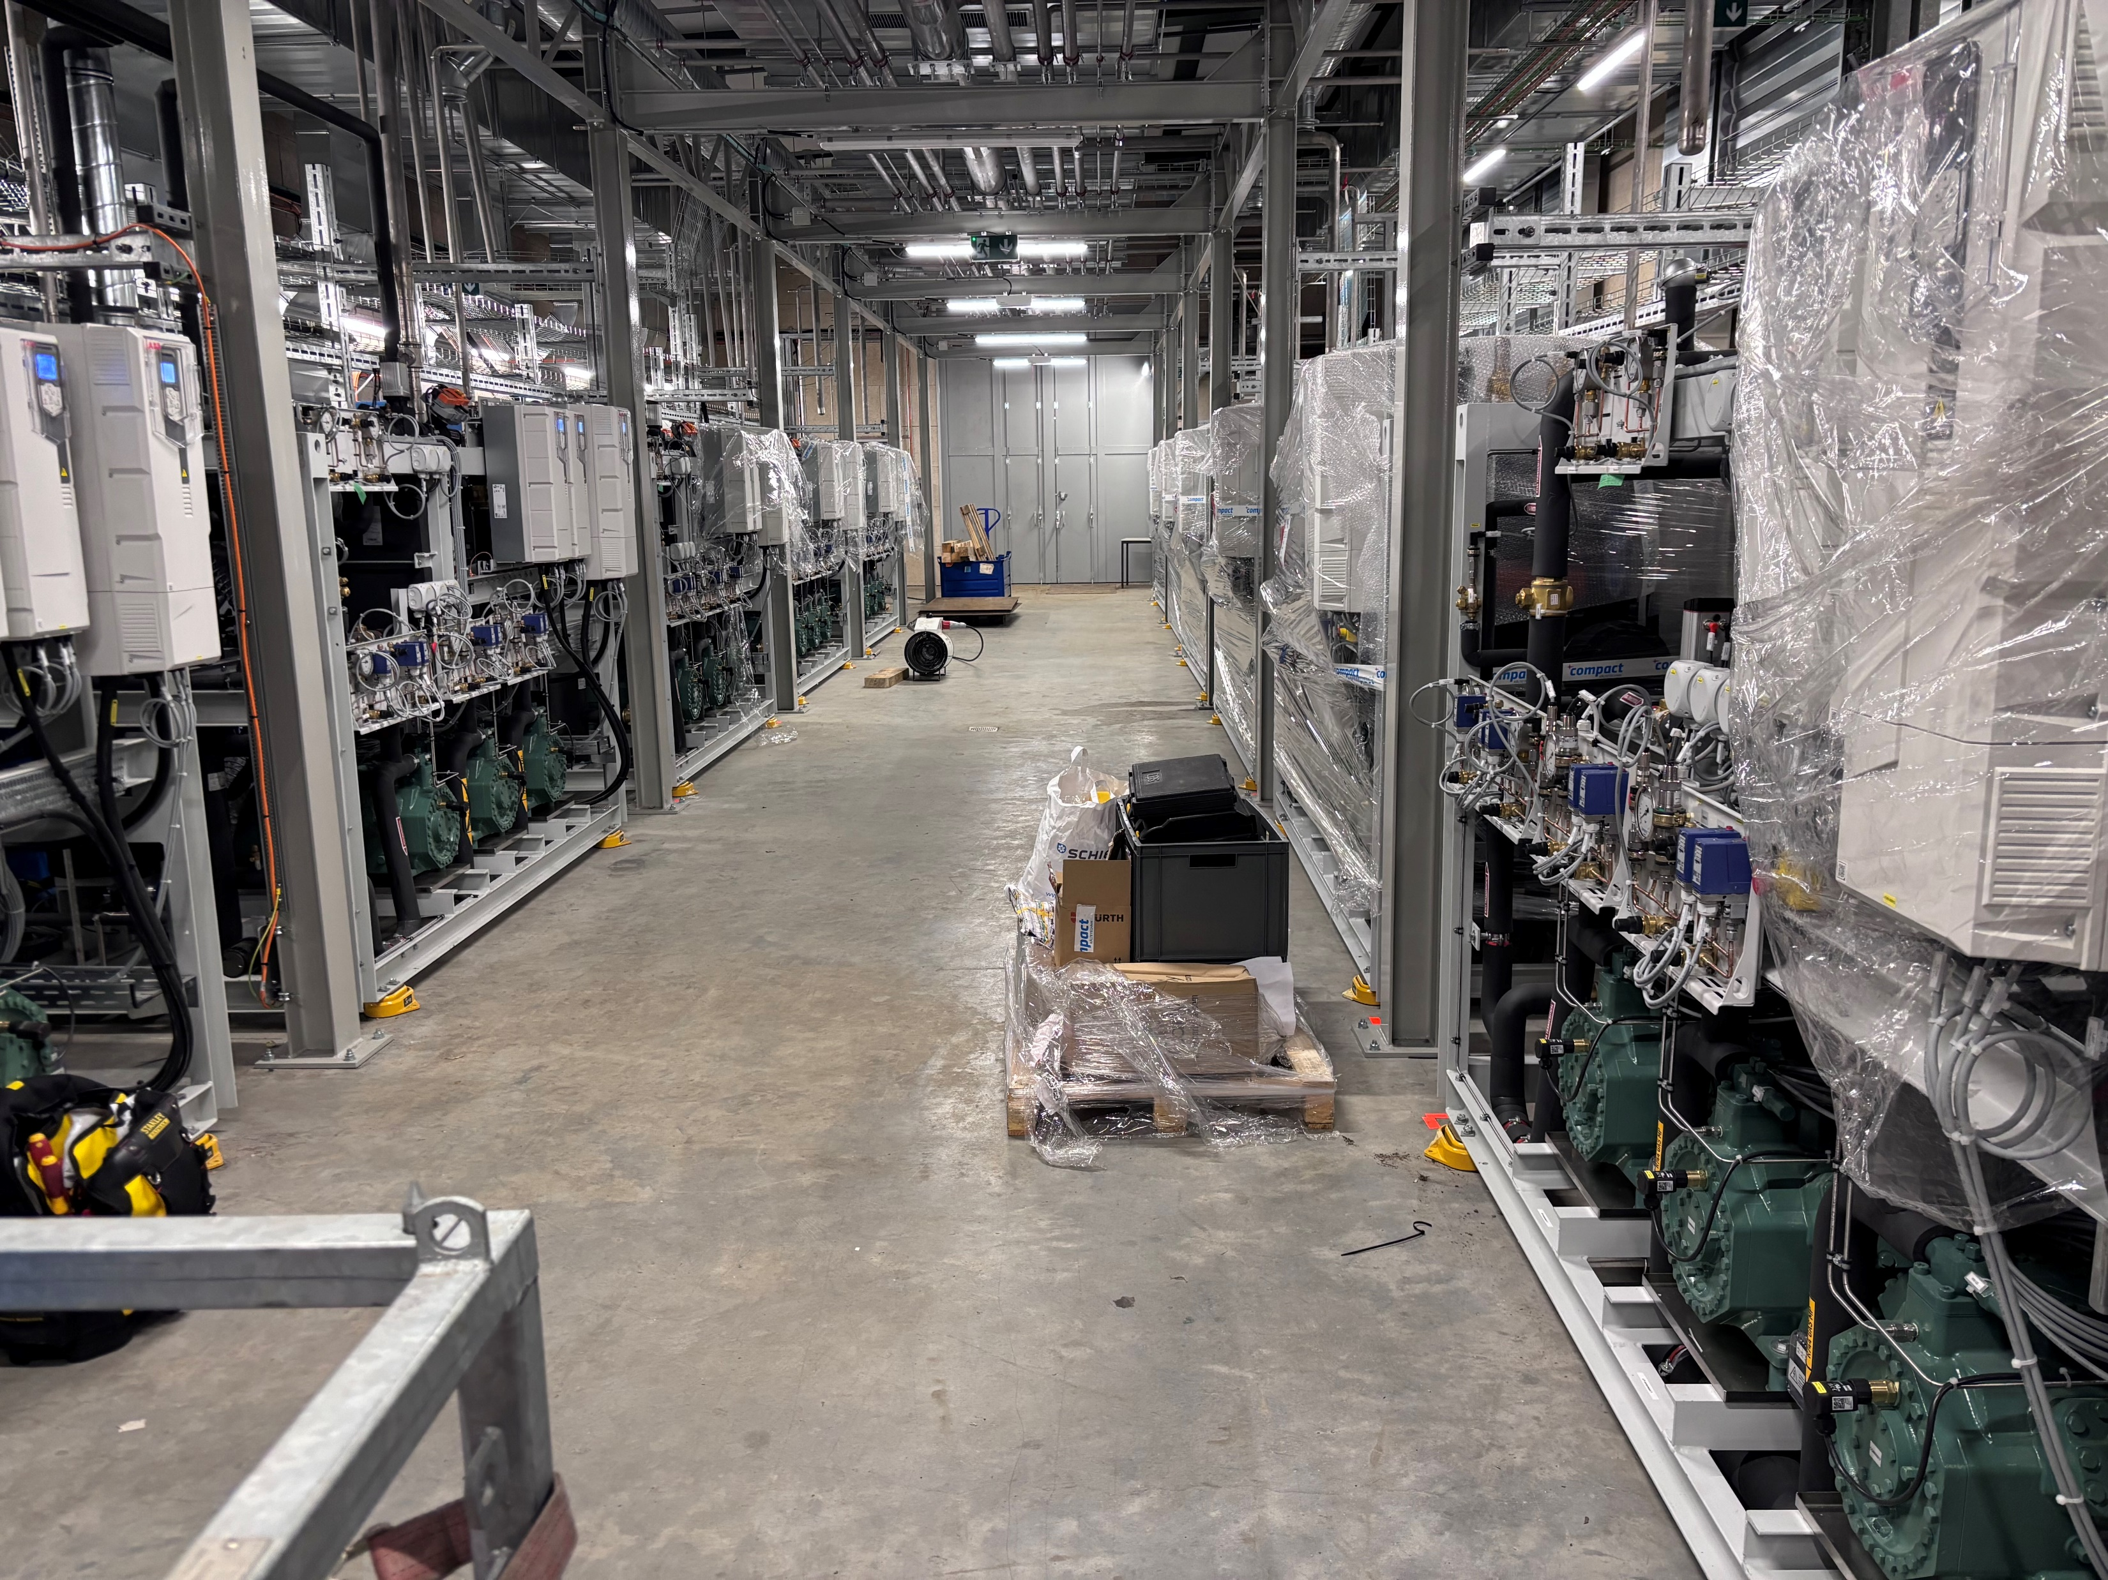
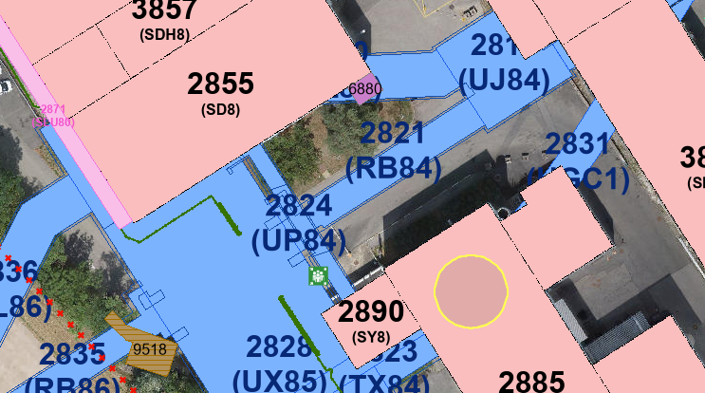
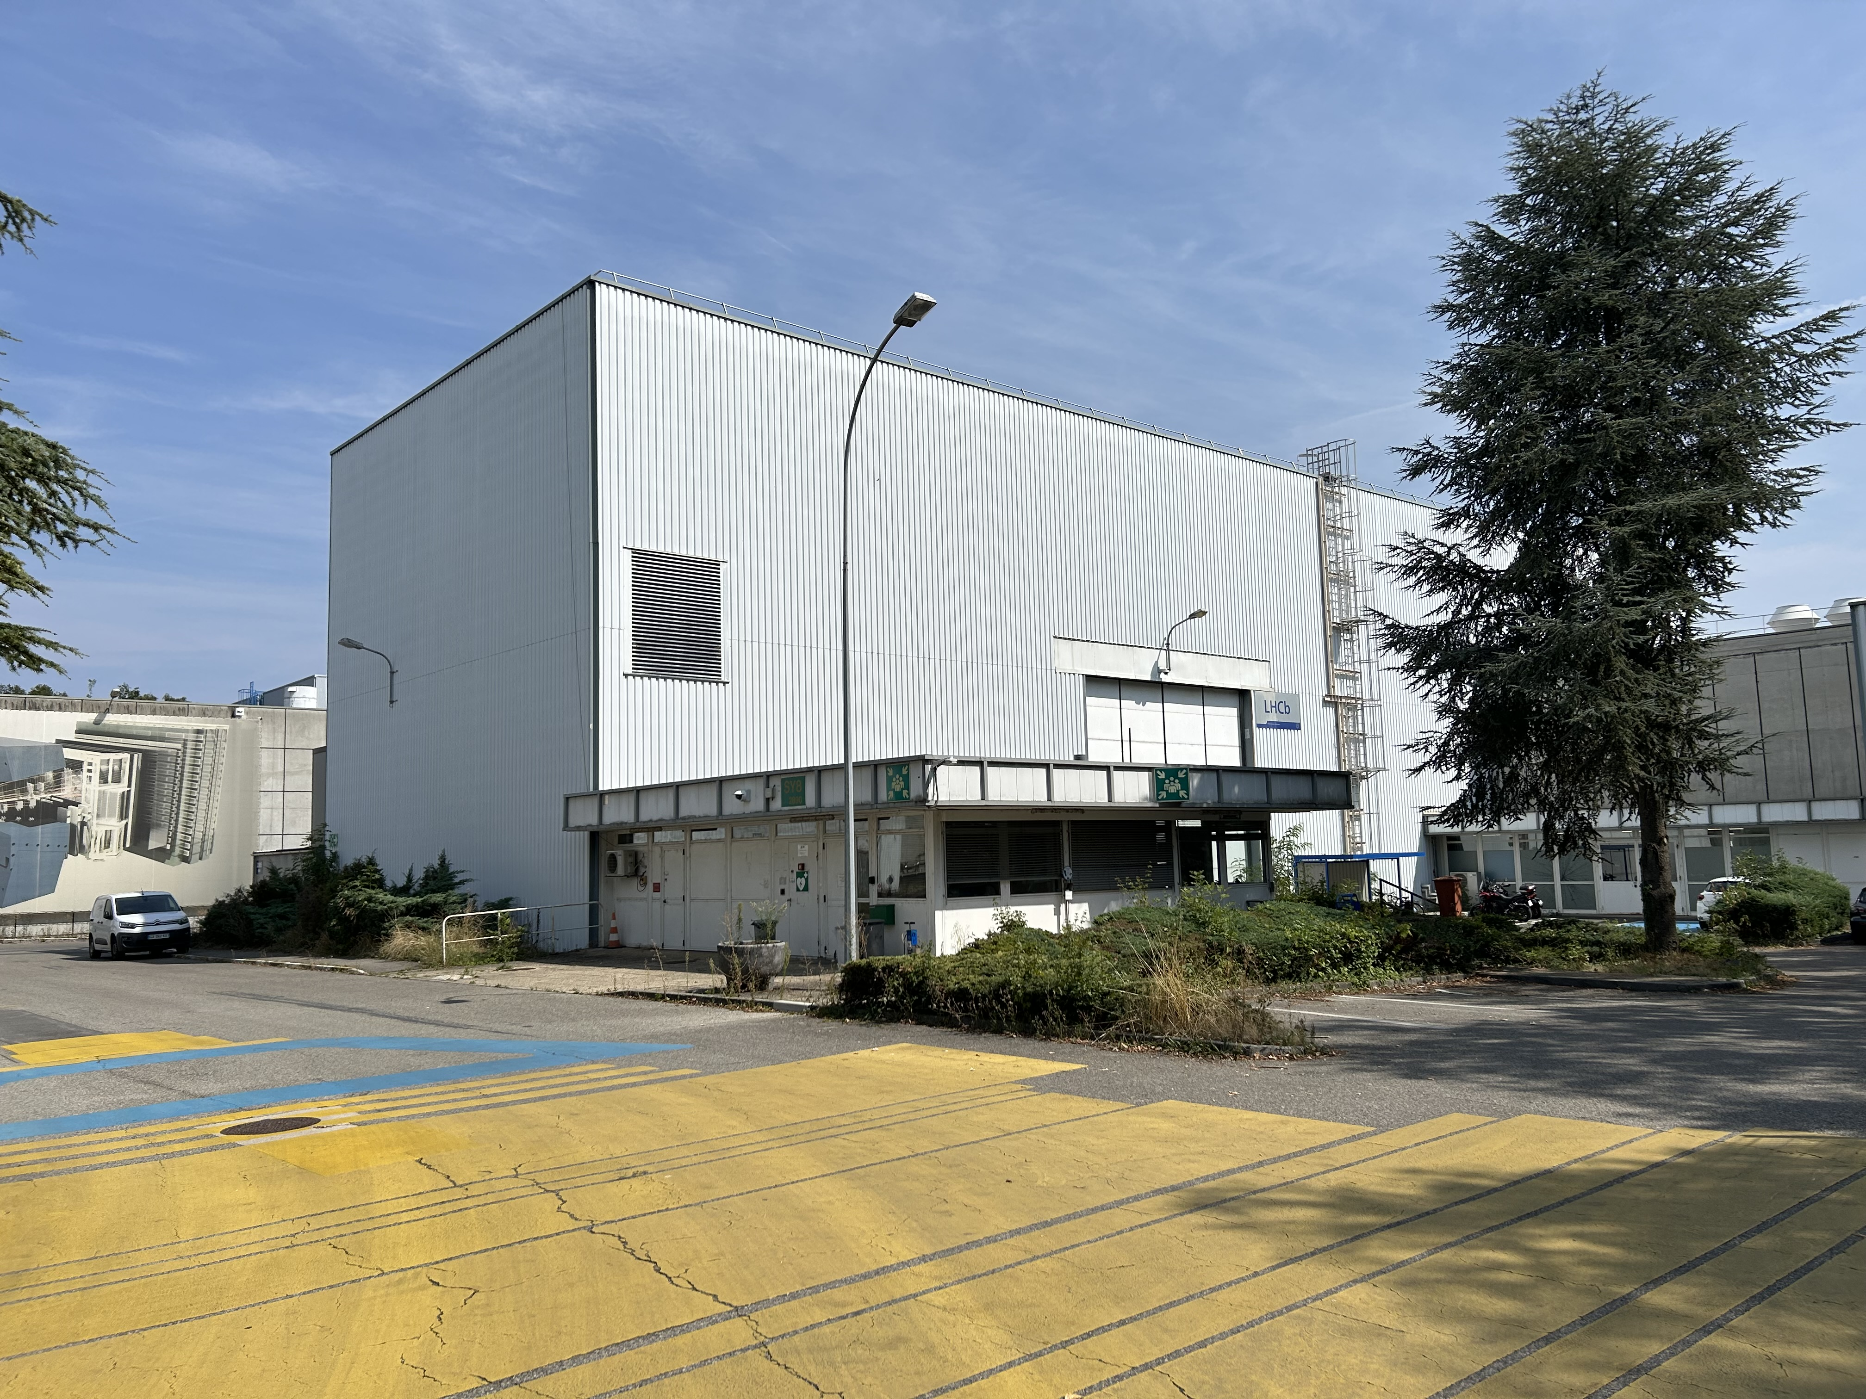
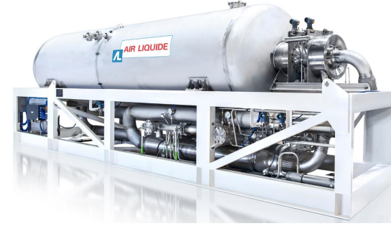
Detector cooling
Potential location for new technical building hosting primary CO2 system and Turbo-Brayton subcooler.
The construction of this building is expected to be part of a HostLab 3 project.

Slide 10
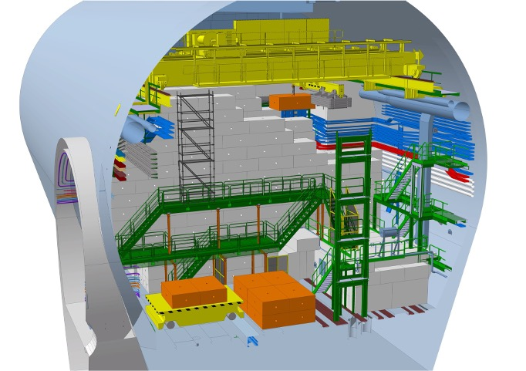
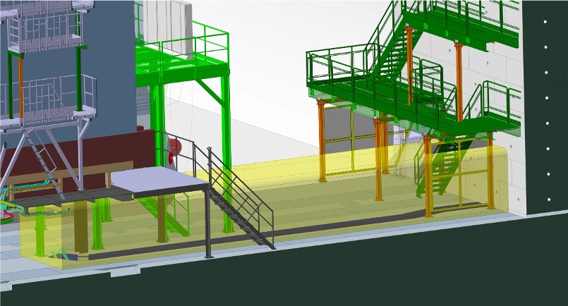
Long-distance cables and optical fibres
Existing long-distance cables, fibres, and transfer lines between detector and service cavern are routed through “chicanes” on RB84 and RB86 side of the shielding wall, and through a groove underneath the shielding wall.
Upgrade II detectors will require a total of ~37 000 long-distance optical fibres. An additional groove under the shielding wall and a new platform for optical patch panels will be constructed in LS3.
RB86 side of the shielding wall will be opened in LS3 to remove “left-over” optical fibres from Run 1/2 and install new cables for ECAL enhancement.
Plan to use the opportunity to install all long-distance cables/fibres for Upgrade II Muon system, ECAL and RICH detectors already in LS3.
RB86 chicane
Additional trench

Slide 11
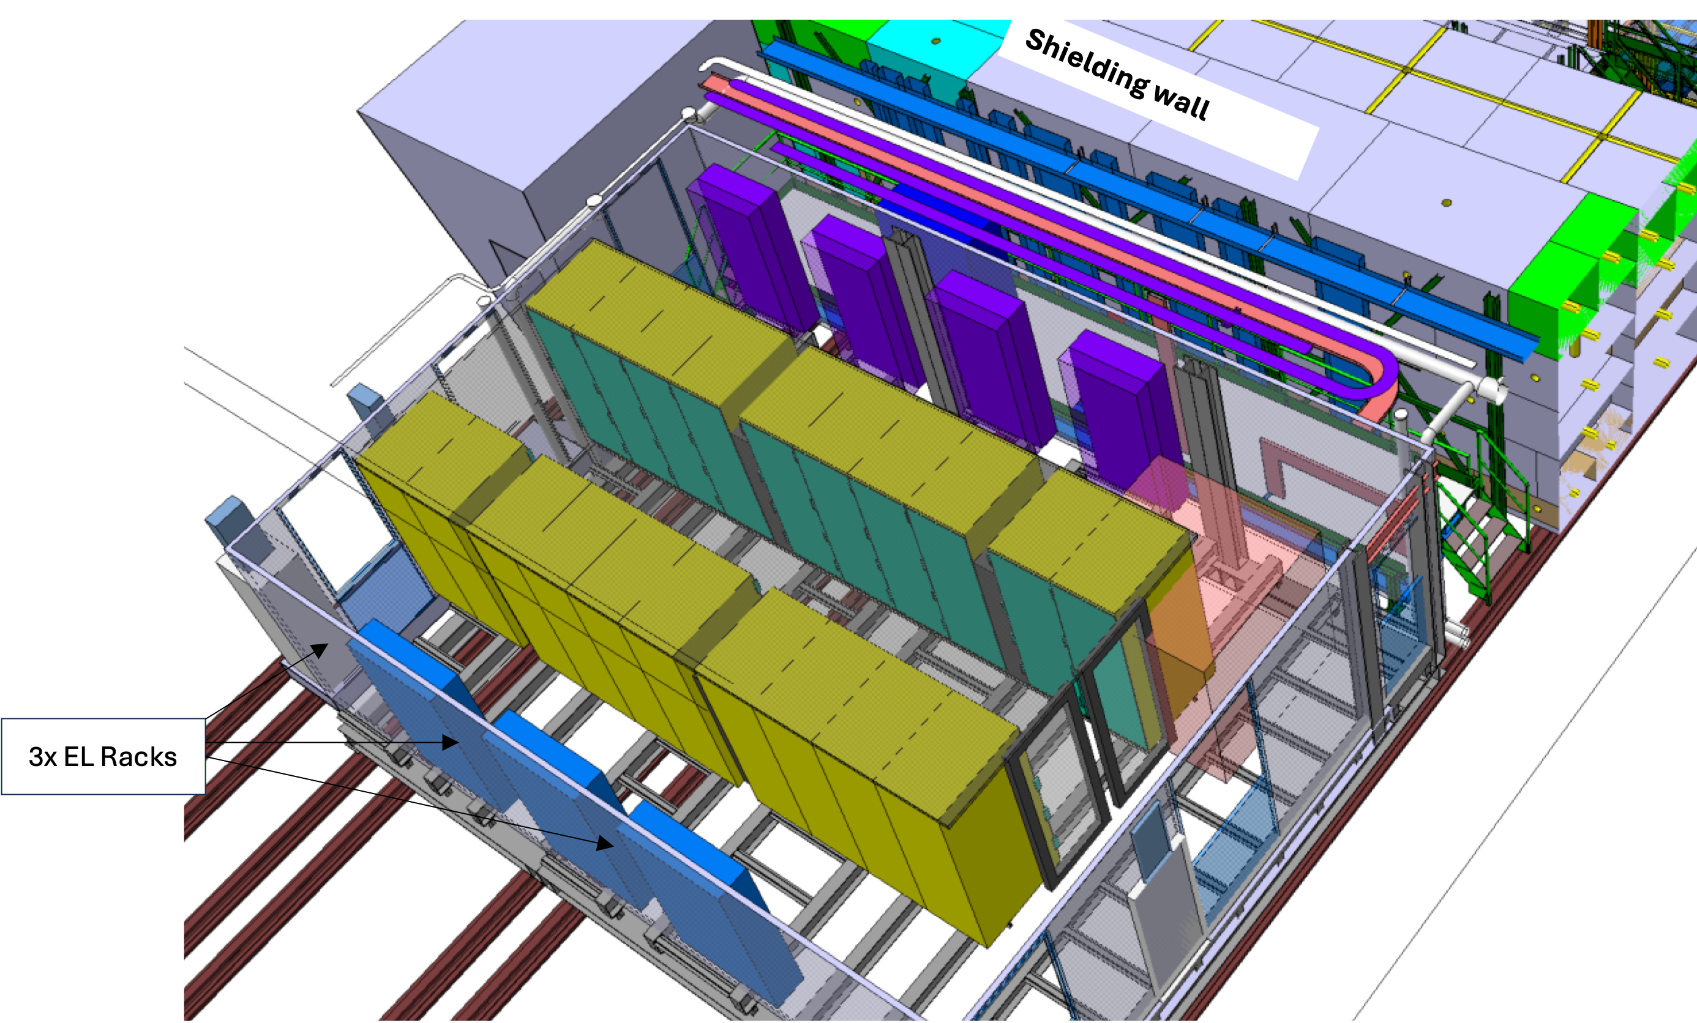
Data acquisition infrastructure
In Run 3, the event-builder system and HLT are hosted in the modular data centre on the surface of Point 8 (the construction of the data centre was part of the HostLab 1 project).
Due to reach limitations of the lpGBT link, the readout system for Upgrade II needs to be relocated to the underground.
This requires a comprehensive refurbishment of the D1/D2 counting rooms in the service cavern (UX85A), which will take place in LS3: new electrical distribution, racks, optical distribution frames and cooling (direct liquid + in-row cooling).
Online links between D1/D2 counting rooms and surface datacentre (~500 fibres) will also be installed already in LS3.
For Run 5, a refurbishment (and adaption for increased power density) of the surface data centre will be needed.

Slide 12
Power distribution
Existing mains distribution relies on Hazemeyer TDM panels which were inherited from DELPHI. The replacement of these panels is part of a refurbishment campaign planned for LS3.
Maraton LV supplies will not be supported beyond Run 4. Plan to replace the AC/DC component of the system in LS3.

Slide 13
Assembly
In the Upgrade I construction and pre-commissioning phase, the assembly facilities at Point 8 (SXL8 hall, SX8 gray room) were (more than) fully used by SciFi and UT.
For Upgrade II, the existing LHCb facilities will not be sufficient.
Modification of ECAL modules and Muon chambers during LS4 requires a space for work on radioactive equipment. Such a facility will already be needed/useful for LS3 (inspection/modification of ECAL cables), and during operation (repair and re-testing of irradiated components).
Mighty Tracker will need space for assembly/testing of both SciFi and CMOS Pixel C-frames. All frames need to be ready for installation (sitting in transport cages) at the beginning of LS4 (no “staging”).
Upstream and Mighty Pixel detectors will need additional cleanroom space.
In the middle and baseline scenario, additional assembly space will be needed for TORCH and the new RICH2.
Additional lab space will also be needed on the Meyrin site, in particular for the production of G-μRWELL chambers.

Slide 14
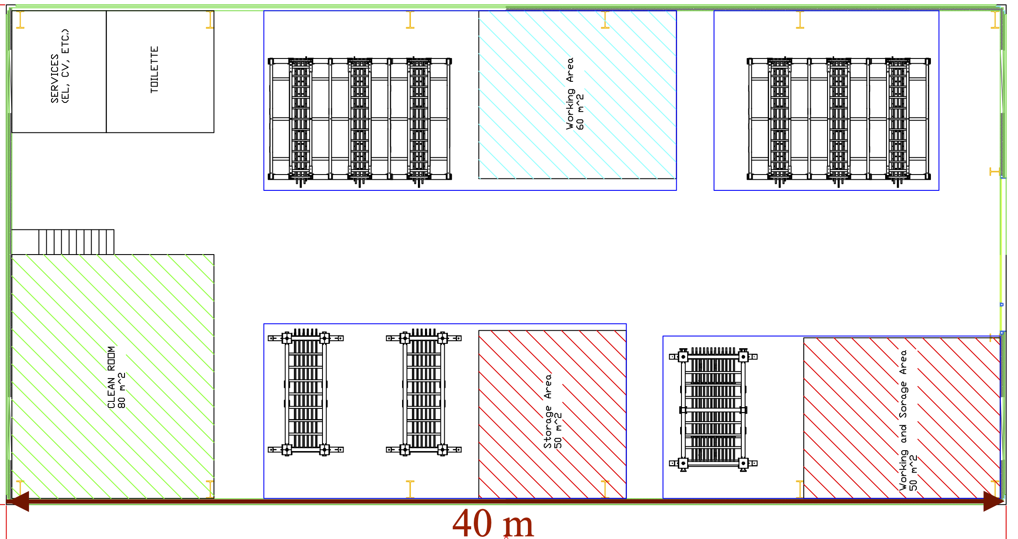
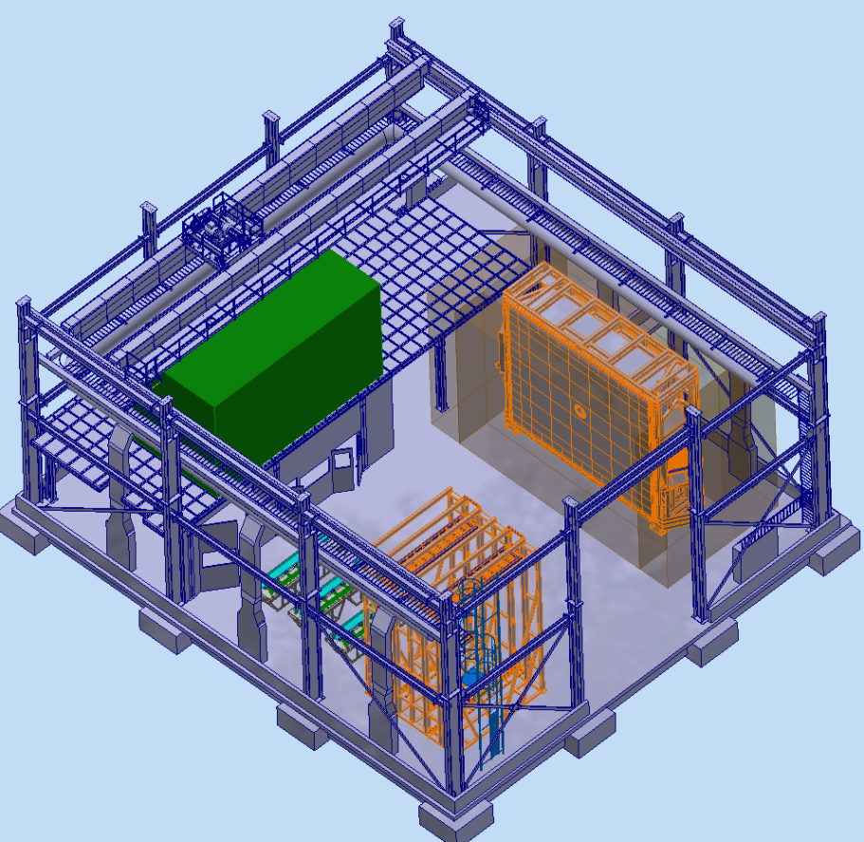
Assembly
Potential scenario for RICH2 and TORCH assembly/pre-commissioning in SXL8.
Potential layout of a new assembly hall for Mighty Tracker and UP.

Slide 15
Assembly
Assembly activities at CERN to start ~3 years before the end of Run 4 (the example below shows the Mighty Tracker construction schedule).
This implies that the new facilities (including services, e. g. cooling systems) must be available at the beginning of Run 4.

