Slide 1
PhD tandem program @CERN
All the Ws
Camila Pedano
10th of September, 2025

Slide 2
Big questions first: WHAT IS THIS?
This is an initiative meant to cover a very important gap in PhD studies at CERN
This is not a university setting: often the PhD network is limited – isolation
Colleagues in different life stages – difficult peer support
Together is sometimes better

Slide 3
WHY?
We could just go to OB for this, but this aims to be a bit towards learning, where the main goals are:
  Support each other in research challenges
  Exchange knowledge (methods, tools, tricks)
  Build community and collaboration
I have never been to a CERN PhD meeting
WHY is better explained by the survey results

Slide 4
The community
Survey launched during summer: 45 responses
50 people joined our Mattermost channel
Very diverse

Slide 5
The community

Slide 6
Skills
Thesis writing
Presentations
Coding
Monte Carlo simulations
Medical physics
RF
ML
PCB design
Theory
Optics
Characterization of silicon sensors
Robotics
Gas detectors
Accelerator physics
FEM simulation
Nuclear physics
Paper writing
Emotional support
Beam physics
Communication and outreach
Electronics

Slide 7
“I think this is a great idea and cannot wait for it to become a reality!”
“I am excited to see this initiative! I would love to become a volunteer. Let's start with a social event (let's make it periodic). When we get to know each other we could learn how we can exchange. Then let's launch topic-oriented exchnage discussions.”

Slide 8

hoW?
1:1 tandems
  Just match people
  Skill exchange
Small discussion groups focused around methods/challenges
In-between talks:
  What is a beam
  How does a robot actually work
  Why do we use what we use for detection
Work sprint or focus group
93405829305893405 more things

Slide 9
Engagement
This is not an official CERN project, it is something we build together
Very good because we can tailor to our own needs
But ideas only become real if someone is willing to commit to trying them out
If you suggest something and people like it – you are the driver! But you have support from IdeaSquare for space and organisation

Slide 10
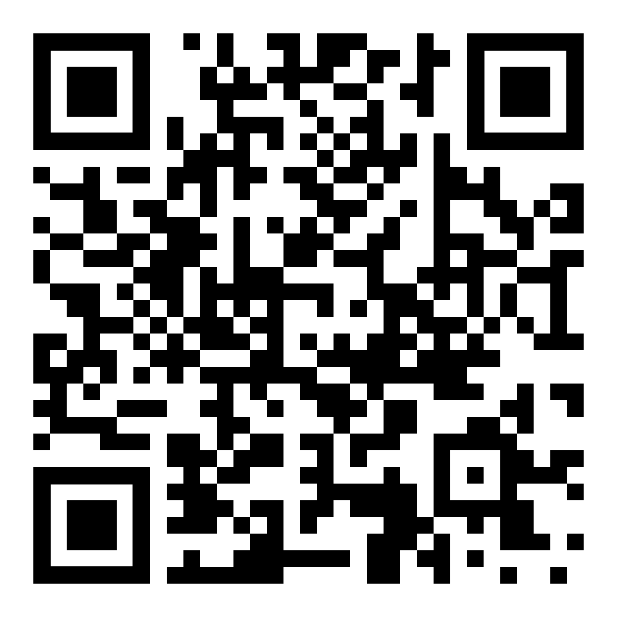
Today’s agenda
Project introduction: this is me now
Roundtable: individual slides
Suggestion time – call for next meeting
Link to Mattermost channel

Slide 11
Outcome of today
Getting to know each other
Setting up next meeting topic
Link to Mattermost channel

Slide 12
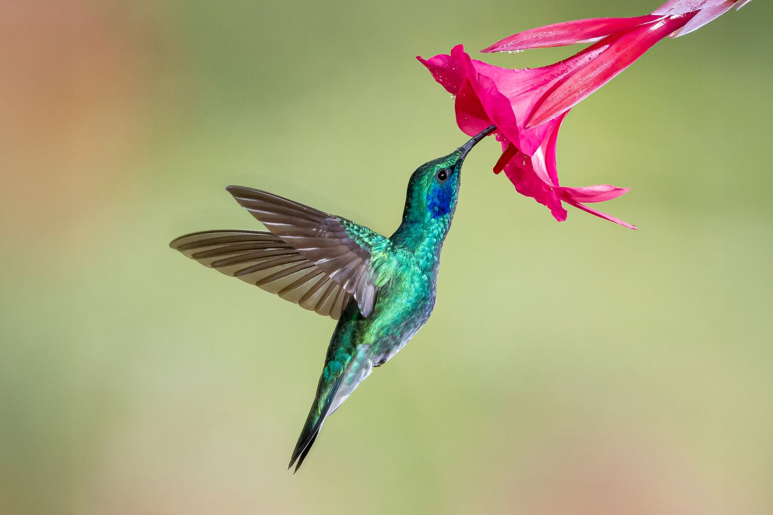
CAMILA PEDANO-MEDINA
My research interests
1) Heat transfer and fluids
2) Mechanics
3) Everything else
Favorite topics or activities
1) Reading/writing thoughts / poetry
2) Sports! Yoga, powerlifting, squash
3) Building or making things
3b) Playing drums
4) żurek and baba ganoush
I am joining these PhD get-togethers because:
I want to know what others work on (and why) (and all the interesting stuff around it)
I want to learn things that people want to teach me
Nice to meet other science friends!
I like coding but I suck
A picture of your spirit animal

Slide 13
Matej Repik
My research interests
1) Silicon detectors
2) Scintilatiors
3) Gas detectors
Favorite topics or activities
1) Making Art
2) Dancing
3) Sports
4) Svieckova na smotane
I am joining these PhD get-togethers because:
I want to get to know other PhD Students at
CERN and maybe find someone to talk detector
physics with
|--------------------------------------|
| |
| ¯\_(ツ)_/¯ |
| |
|--------------------------------------|

Slide 14
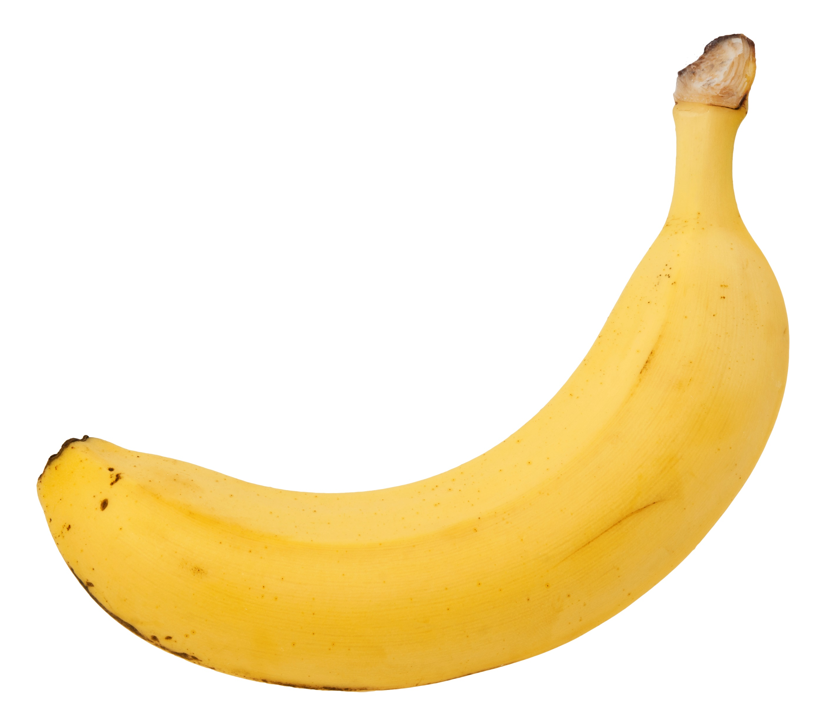
Benedict Kamoni Njoki
My research interests
1) Scientific Instrumentation
2) Nuclear Spectrometry
3) Machine Learning
Favorite topics or activities
1) AI
2) LHCb
3) Biology
4) Favorite food here: Meat
I am joining these PhD get-togethers because I want to know other PhD students, what they are working on,
their experiences, and how I can contribute through collaboration and friendship.
_____________________________________

Slide 15
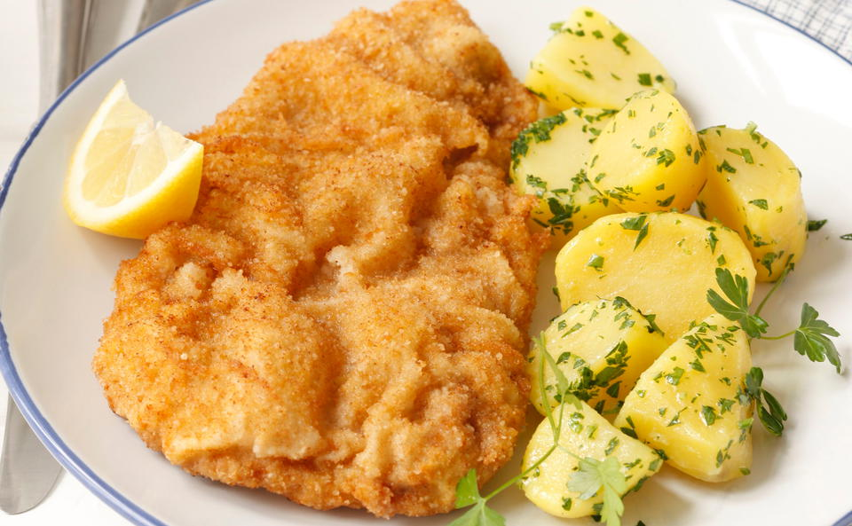
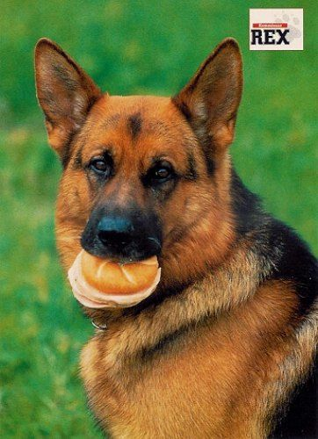
Elias Sandner
My research interests
1) Systematic Review Automation
2) LLM
3) Scientific Process Automation
Favorite topics or activities
1) Snowboarding
2) Hiking
3) Squash
4) Wiener Schnitzel
German Shepherd:
Steady, reliable and
loyal team player.
Picture: Inspector Rex
I am joining these PhD get-togethers because:
I expect them to be a great opportunity to connect with
fellow PhD students, exchange experiences and build
a supportive network.

Slide 16
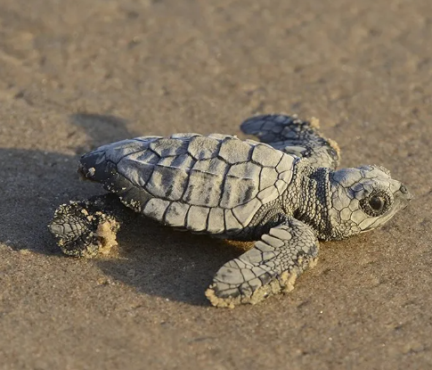
Asar AH JARADAT
My research interests
Laser nuclear physics
2) Ion sources
3) mechanics
Favorite topics or activities
1) Nabatean languages etymology
2) Anthropology
3) Hot yoga
4) Dawali (Palestinian cuisine) ☺
I am joining these PhD get-togethers because:
It is nice to meet others with similar experience ☺
_____________________________________

Slide 17
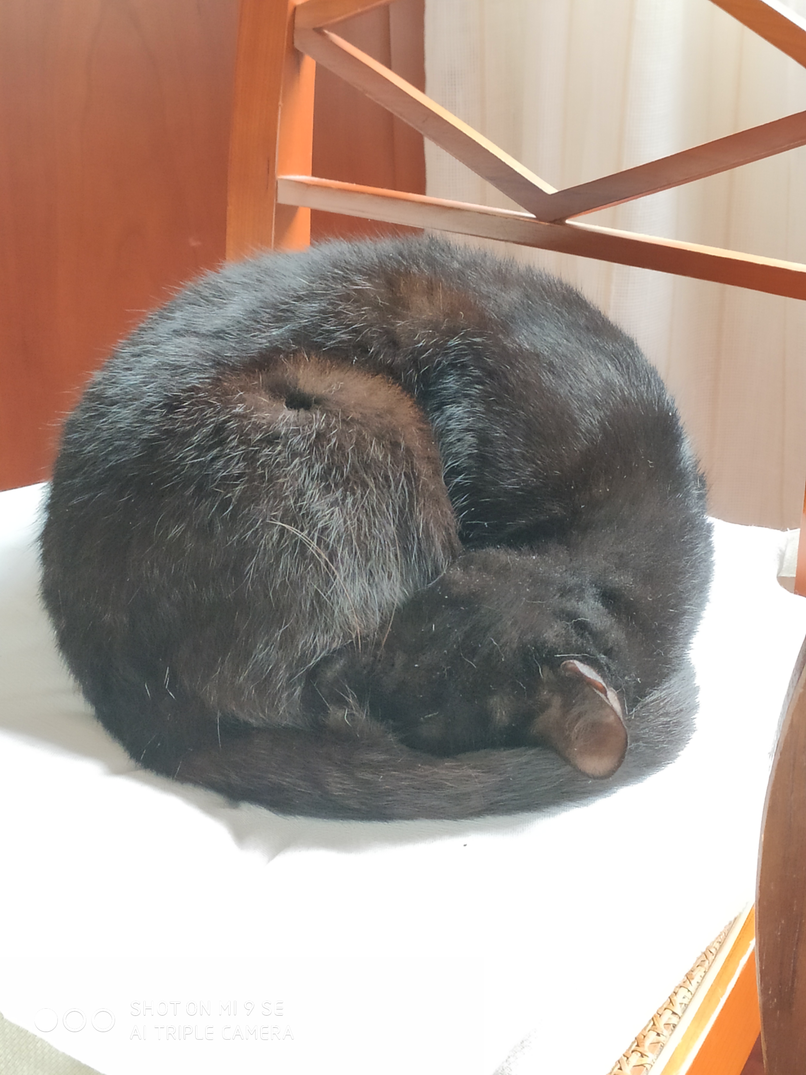
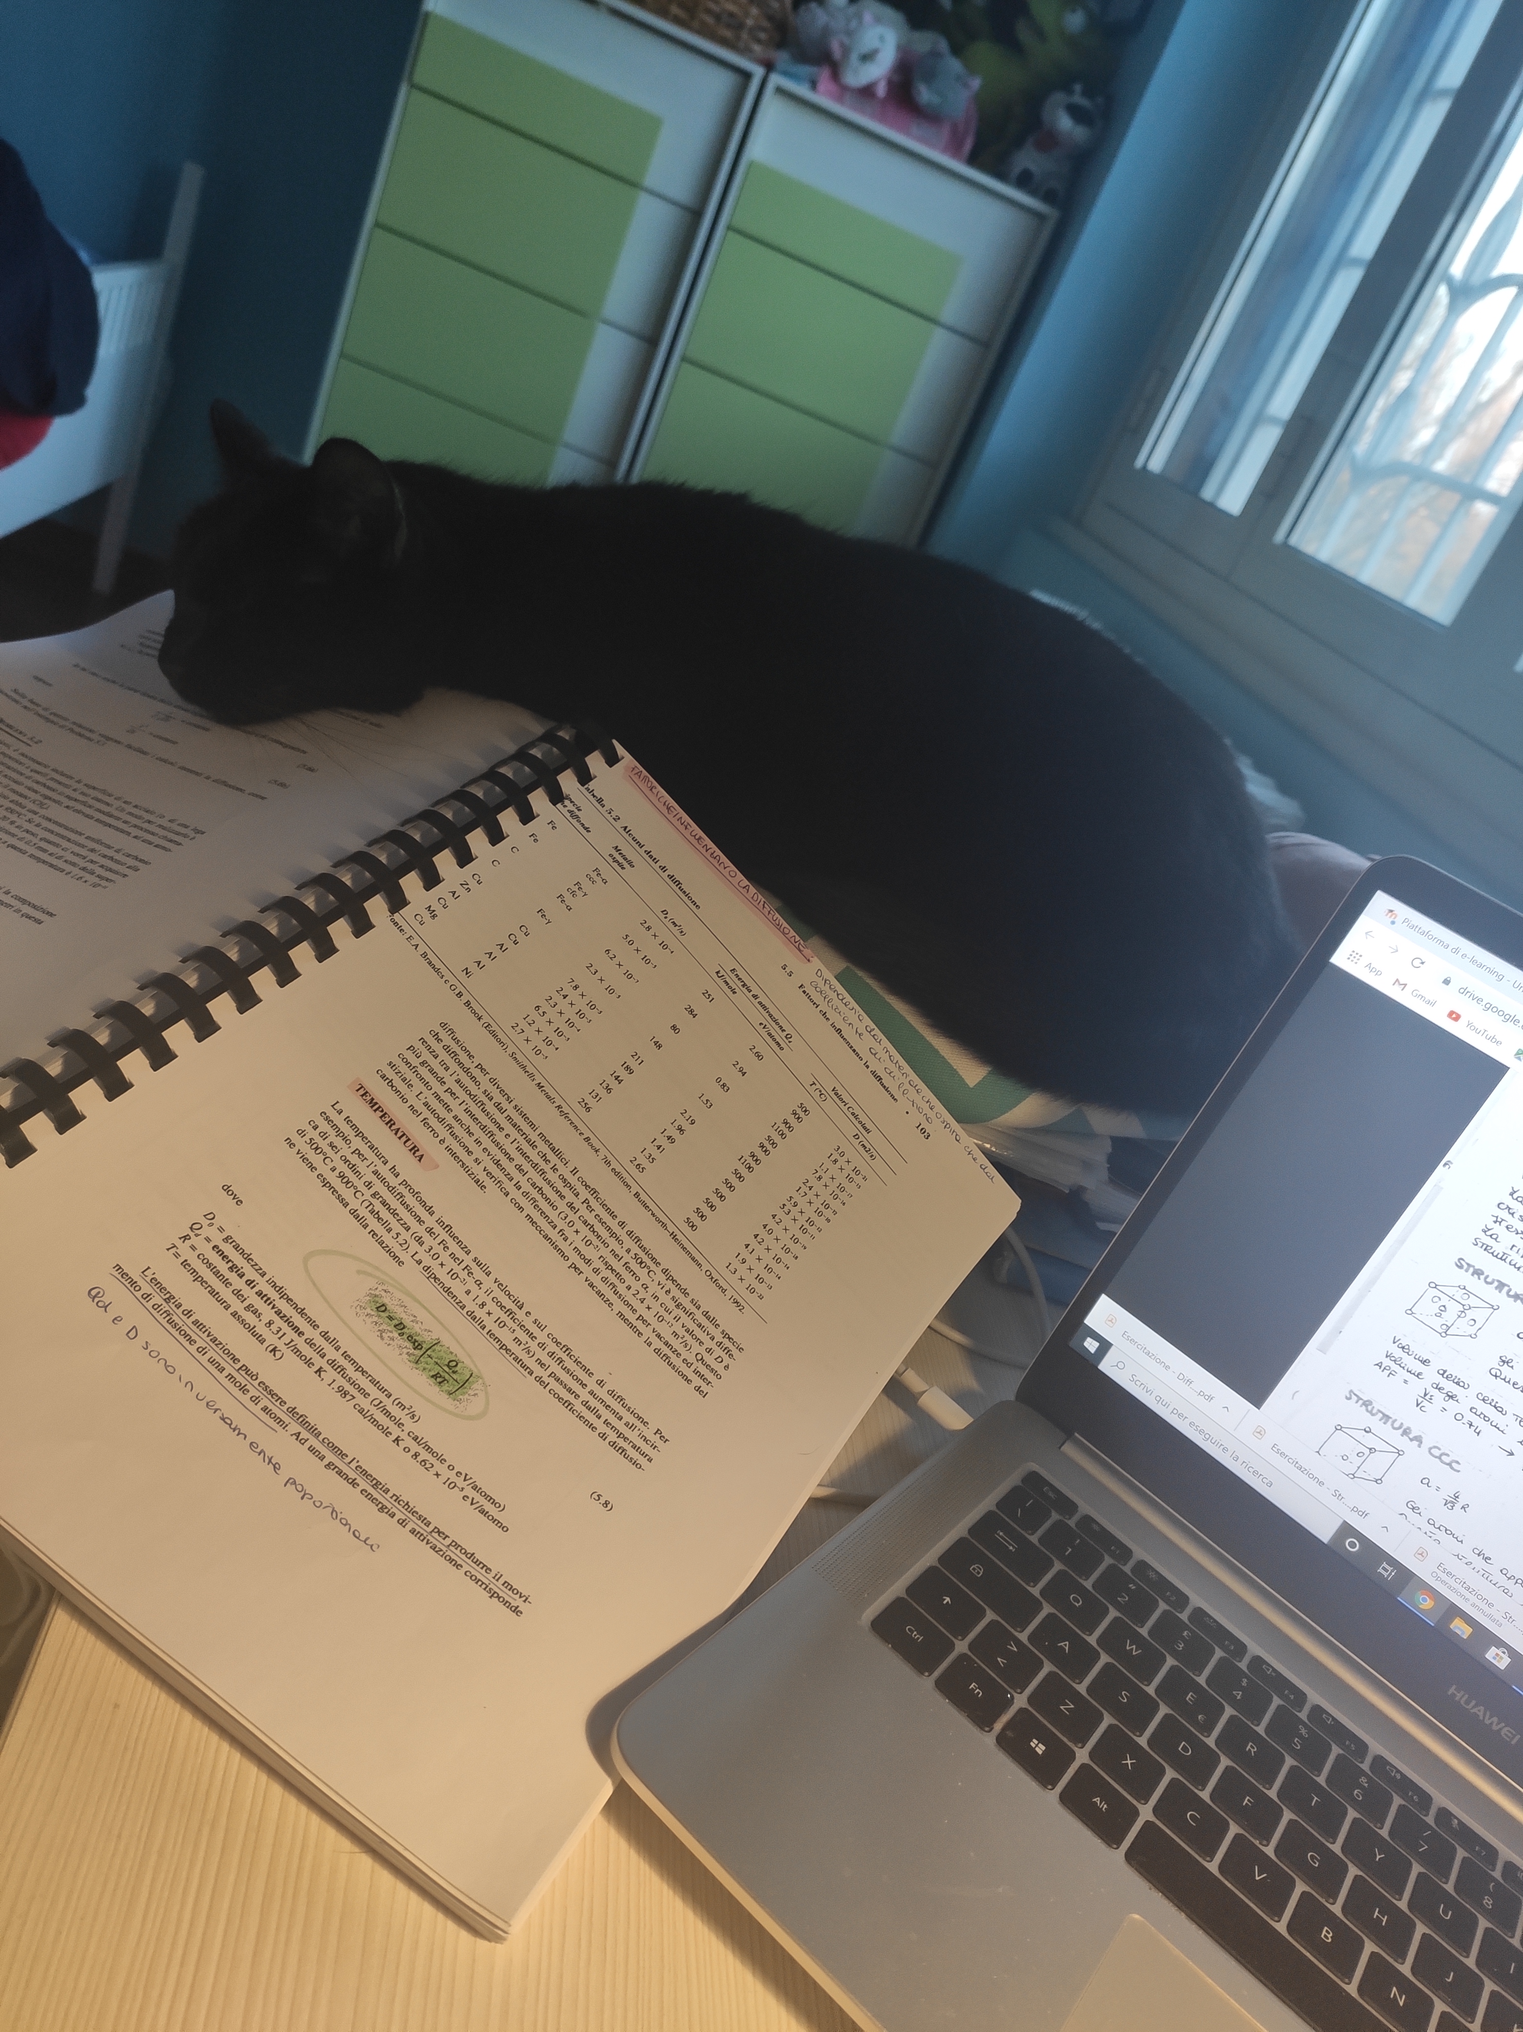
Francesca Schettino
My research interests
1) Contactless monitoring of physiological parameters
2) Robotics and biorobotics
3) Medical applications
Favorite topics or activities
1) Public outreach
2) Painting and drawing
3) Theatre
I am joining these PhD get-togethers because:
I am happy to get to know other students to share
our experiences and knowledge.

Slide 18
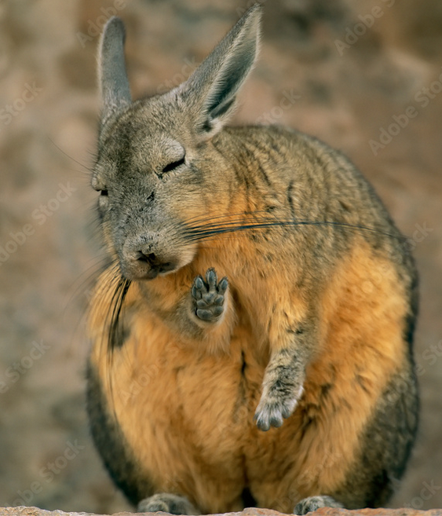
Hendrik Buker
My research interests
1) Laser-Physics
2) Photonics
3) Electrical Engineering
(I am bad at it)
Favorite topics or activities
1) Climbing / hiking
2) Starting funny projects
and never finishing them
3) cooking
4) Roesti with applesauce
I am joining these PhD get-togethers because:
It sounds like a cool idea and I’m curious how it will work in the end

Slide 19
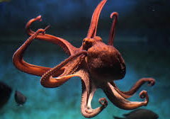
Dávid Lucsányi
My research interests:
1) Monte Carlo simulations of particle transport (FLUKA, Geant4)
2) Radiation effects in electronics (Single Event Effects)
3) Particle detector physics, Radiation-matter interactions
4) CMOS image sensors as detectors, space and ground applications
Favorite topics or activities:
1) Lunar exploration & missions
2) Neurodiversity
3) LEGO
4) Movies
5) Playing music
6) All GOOD food
I am joining these PhD get-togethers because:
I would like to help others and find support at the same time,
I am curious and open-minded, and
I would like to network with other PhD students.

Slide 20
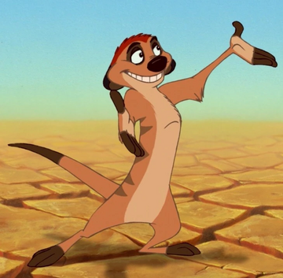
Harald Minde Hansen
My research interests
1) Soft robotics
2) Nonlinear control
3) Robotic manipulators
Favorite topics or activities
1) Climbing
2) Skiing
3) Ball sports favoring tall people
4) Picanha
I am joining these PhD get-togethers because:
Meeting other PhD students,
hearing about other people’s projects
A picture of your spirit animal

Slide 21
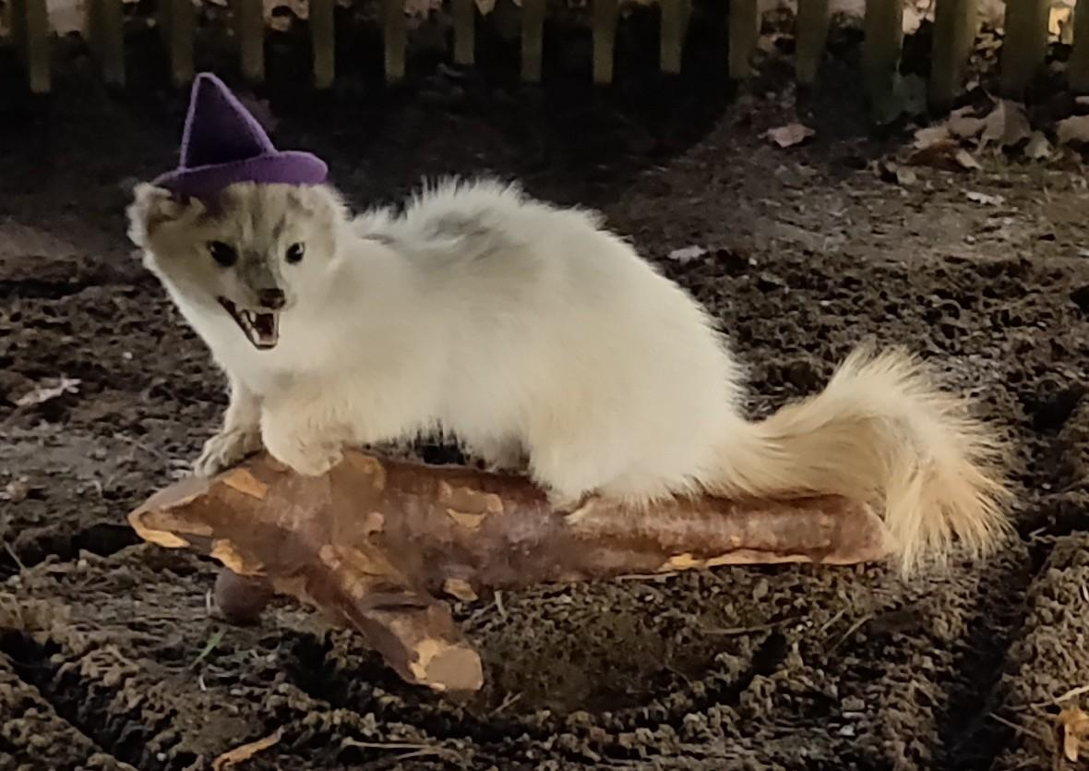
Mikkel Møller Mødekjær
My research interests
1) Computing and Machine Learning
2) Accelerators and Detectors
3) Physics
Favorite topics or activities
1) Games (Board and Video)
2) 3D Printing / Technology
3) Manga
4) I don't have a favorite food, but my go to is Thai style curry
Spirit Animal: Mink
I am joining these PhD get-togethers because:
_____________________________________
A picture of your spirit animal
“Networking”

Slide 22
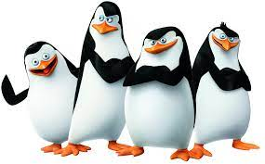
Krzysztof Kawa
My research interests
Mechanical & materials engineering
FEA
Mech. vibration (calc., numerical, measurements)
AI, ML, Digital Twins and data analysis
Programming
Favorite topics or activities
1) Skiing
2) Bouldering
3) Hiking
I am joining these PhD get-togethers because:
I would like to meet other PhD students and exchange knowledge/experience!

