Slide 2
Welcome to the 2nd School of Computing on IT Services
Alberto Pace, school director

Slide 3
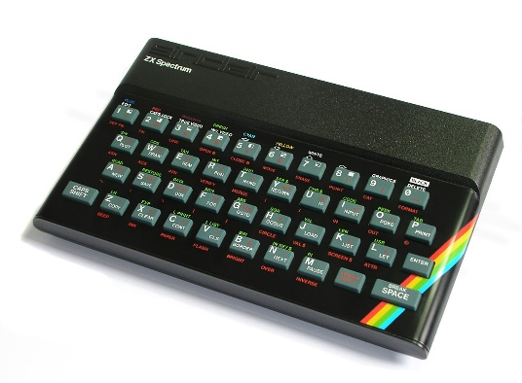

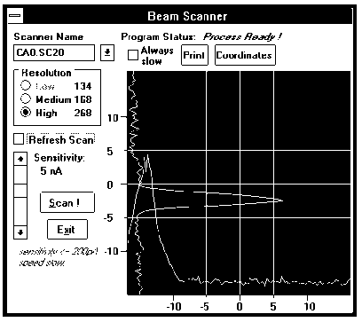
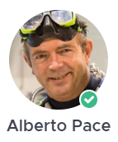
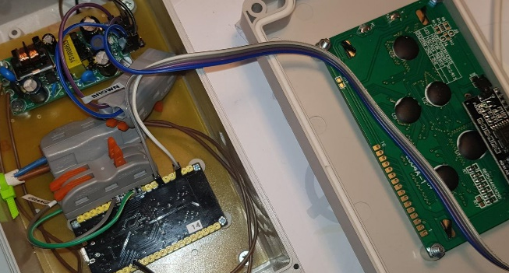

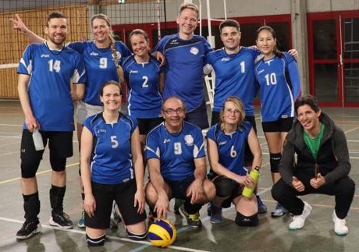

Who am I ? Alberto – your school director
Electronic Engineering (Politecnico di Milano), at CERN since 1986
I have led 5 groups (IT-IS, IT-DM, IT-DSS, IT-ST, IT-CD) and various sections at CERN, currently head of IT education. I have many years experiences in computing services, infrastructure, software engineering, accelerator control and accelerator operation.
I am passionate of mathematics, electronics, volleyball, scuba diving and sailing
Cryptography, Encryptions, Algorithms, Optimal Controls

Slide 4
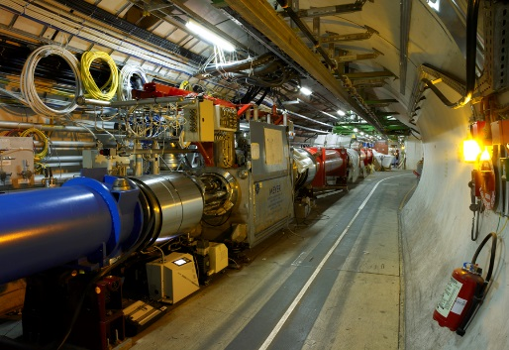
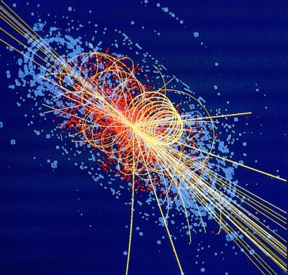

CERN’s mission
Innovation
Education
CERN
uniting people
The CERN School of Computing is here …
Research
?
Discovery
Computing is everywhere
Accelerating beams
(accelerators)
Detecting particles
(experiments)
Large-scale computing (Analysis)

Slide 5
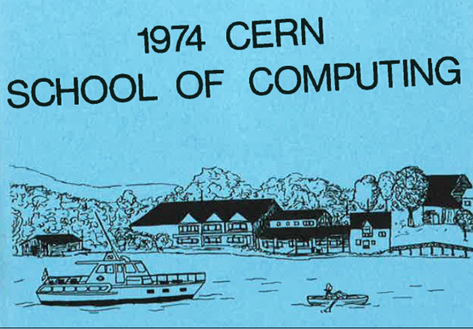
A school with a long history
The school was created in 1970, 2026 will be the 47th and the 48th editions, we also had 18 editions of Thematic School
This is the 2nd edition of the school on IT services
The school has visited 23 countries
88 different nationalities
More than 4000 students have followed the school
This year we are organizing 7 schools

Slide 6
Mandate and mission
Create a common culture in scientific computing among young scientists and engineers involved in particle physics or other sciences, as a strategic direction to promote mobility and to facilitate the development of large computing-oriented transnational projects.
http://cern.ch/csc
Participants come from worldwide laboratories and universities with typically 20 to 30 different nationalities (61 different nationalities in the past 10 years).
http://cern.ch/csc/alumni

Slide 7
Bridging science and computing
The unprecedented technological evolution in computing has profited directly to several scientific research projects, in particular in high energy physics
Computing is today the main strategy for many sciences to boost their research productivity
It is nowadays essential that:
Scientists master computing technologies as the main tool for their research
Computer scientists understand the scientific domain of the investigation to deliver computing services that meet the needs of the research project

Slide 8
An additional side effect …
… knowledge transfer of (CERN) skills and (CERN) know-how in computing to academic, national laboratories, research institutes, institutional and industrial circles in Member States and other countries
With direct or potential applications up to all spheres of the society.

Slide 9




The CERN Schools of computing
The Main School
Two weeks, ~ 60 participants (58 - 82 in last years)
Multiple topics on scientific computing
This school: 69 participants
The Thematic schools
Goes more in depth on a particular topic
Smaller participation, shorter duration (one week), clear goals
This year, three schools 38, 42, 29 participants
(New) Regional Schools
in Santiago, Chile (January 2026)
This School on IT services (November 2025)
The Inverted school
It is frequent to find among students real experts on specific topics, and the cumulated knowledge of the students exceeds the one of lecturers.
At the end of each school, we invite students to propose some lectures, and we organize an “inverted” school. “Where students turn into teachers”
In 2025, the 16th edition had 16 lecturers and hundreds participants

Slide 10
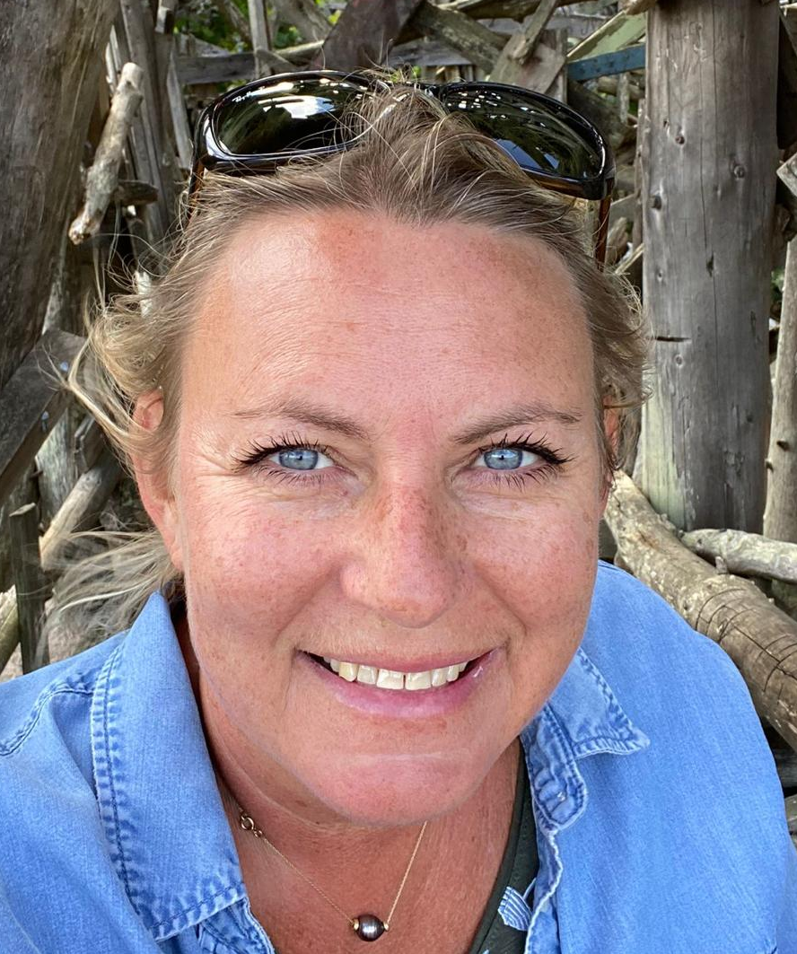
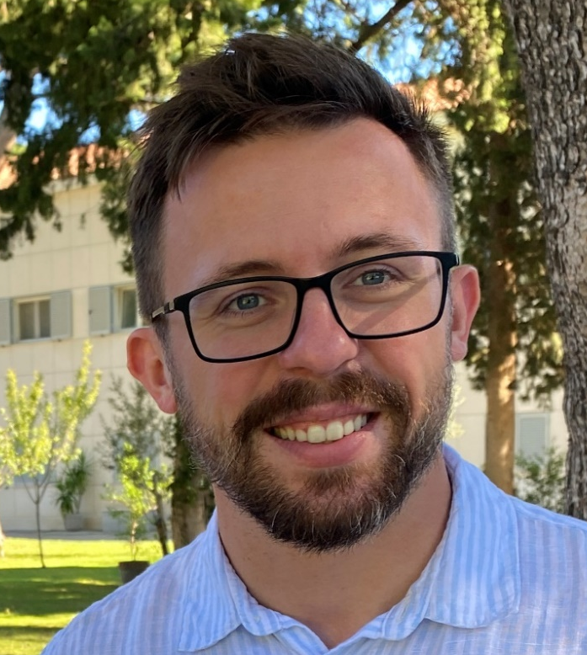
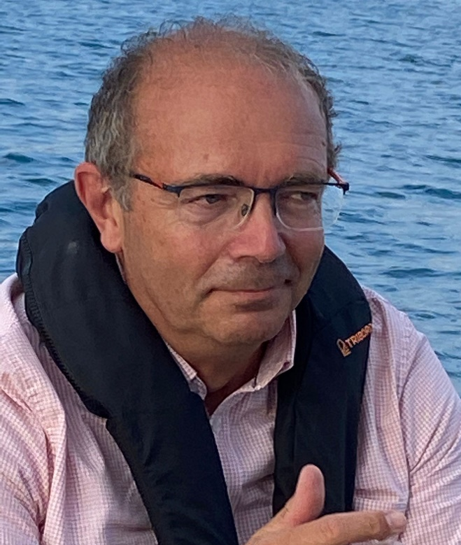
CSC Organizers
Kristina Gunne Administrative Manager
Andrzej Nowicki Technical Manager
Alberto Pace School Director

Slide 11
The school governance
… is discussed at the School Advisory Committee
Includes several fulltime university professors from different countries
Two meetings per year

Slide 12
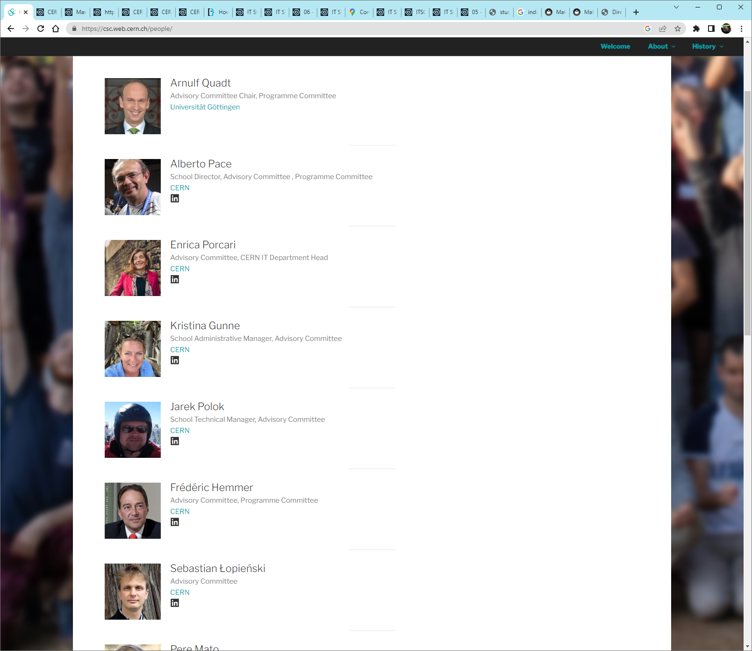
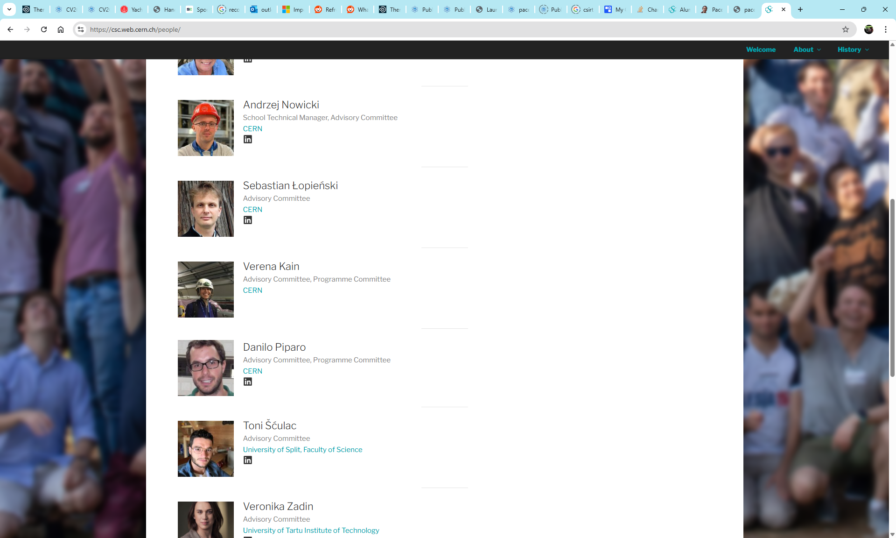
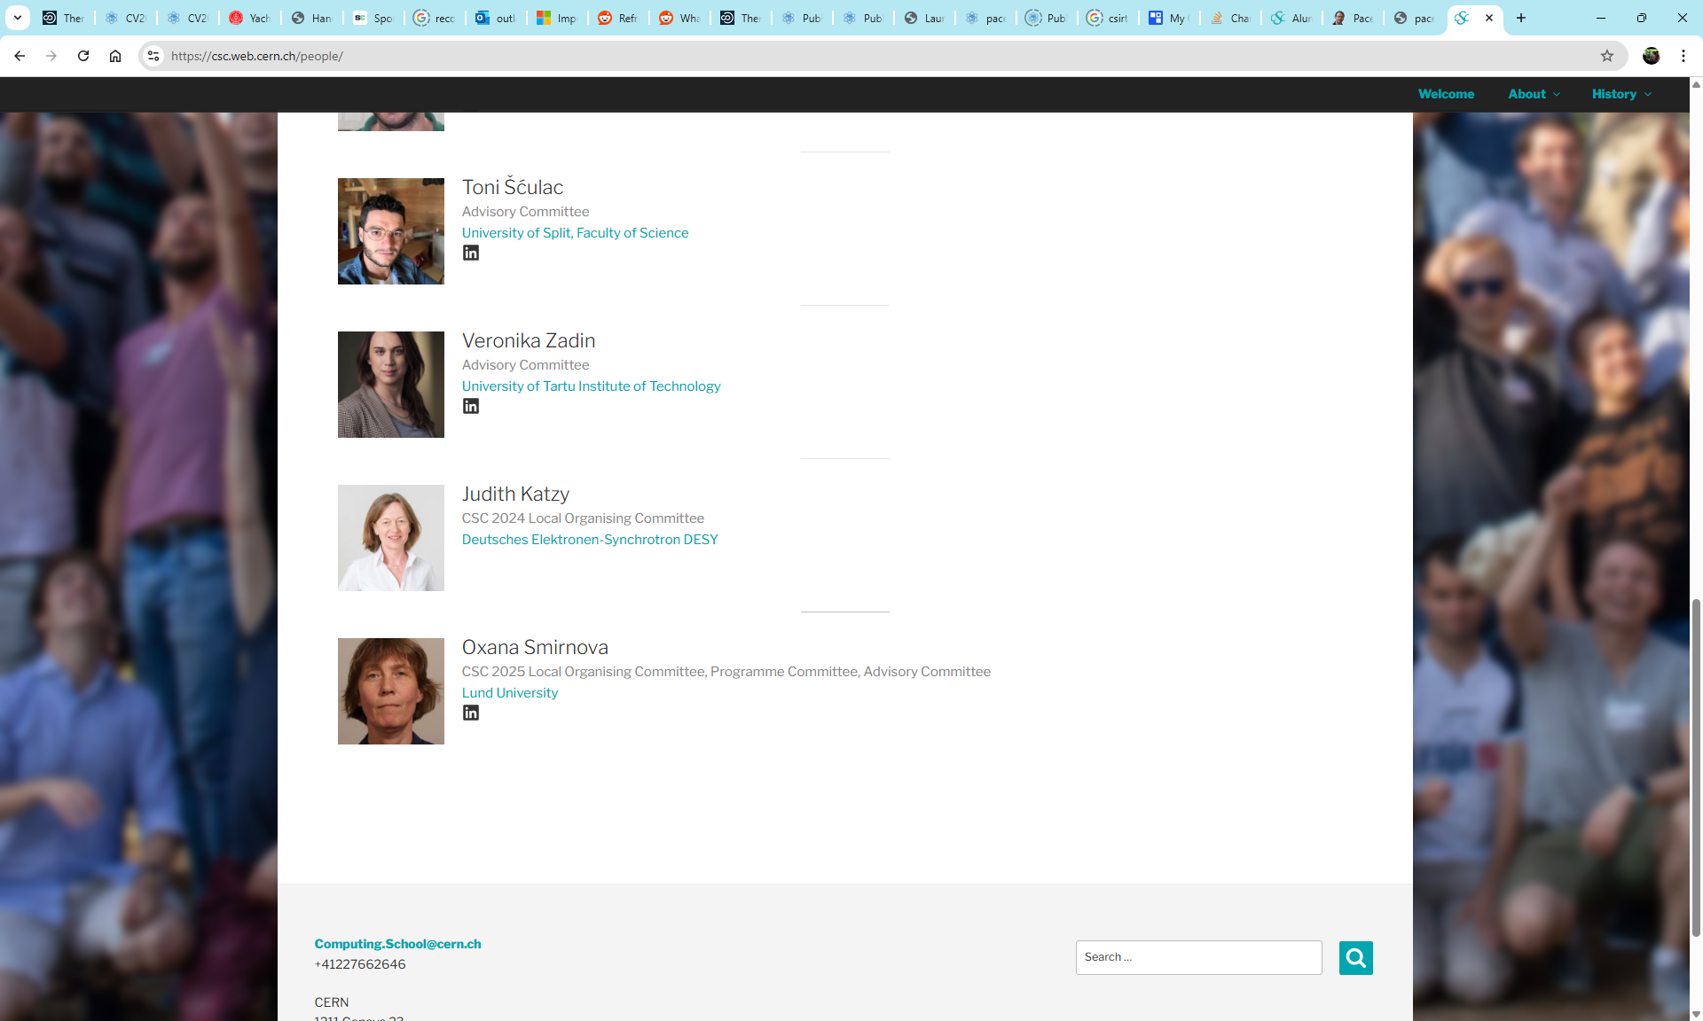
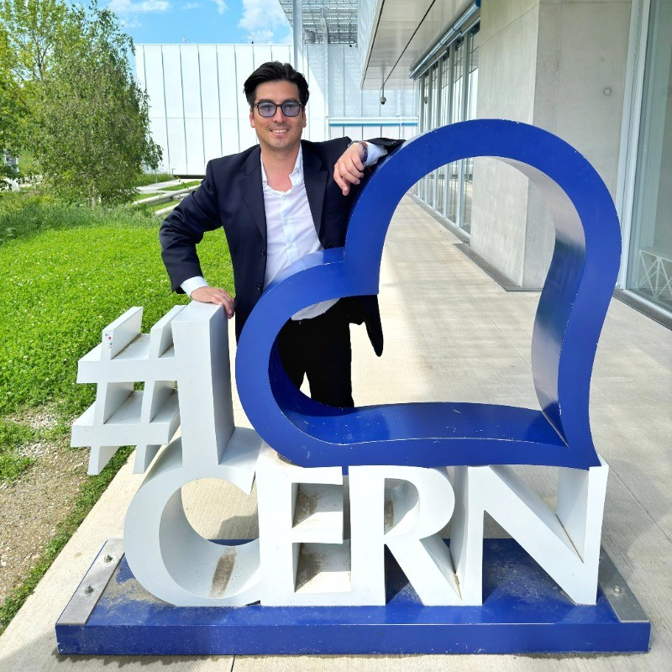
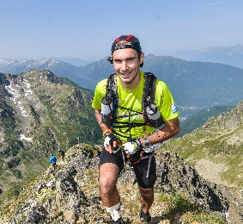
The School Advisory Committee
Chairman: Arnulf Quadt, Georg-August-University of Göttingen
Ex-officio members:
Enrica Porcari, Head of CERN IT department
Alberto Pace, School Director
Kristina Gunne, School Administrative Manager
Andrzej Nowicki, School Technical Manager
Members:
Toni Šćulac, Faculty of Science Split
Veronika Zadin, Tartu University
Judith Katzy, Berlin Humboldt University
Members representing the Local Organizing Committee
Oxana Smirnova, Lund University
Felipe Olivares, Instituto Saphir, Santiago Chile
Members representing the program committee of thematic schools:
Danilo Piparo, CERN (School heterogeneous computing)
Sebastian Lopienski, CERN (School on Computing Security)
Verena Kain, CERN (School on Machine Learning)
Sebastien Ponce, CERN (School on IT Services)
Toni Šćulac, Faculty of Science Split (Regional School in Latin America)

Slide 13
The 2025 School on IT Services

Slide 14
The School on IT Services
The school on IT Services aims to empower CERN members of personnel (including Students, Fellows, Origin, Quests, Staff, and Users) to get the most out of the computing services delivered by the CERN IT Department to the community.
for any person that use CERN IT services to deliver information, or analyzes data, or automates tasks or works in engineering projects
for active users who would like to be more proficient and newcomers that would like to discover and get an introduction to the ecosystem of computing services available to CERN users

Slide 15
This is the second school on IT Services
After last year pilot school
Your feedback will be extremely important
Everything can be changed
Location: At CERN or outside ?
Topics: basic IT Services or advanced IT Services
Speakers: More speakers on shorter presentations or less speakers fovering services in depth ?
Exercises: Hands-on (need time) ? Demos ? Interactive ?

Slide 16
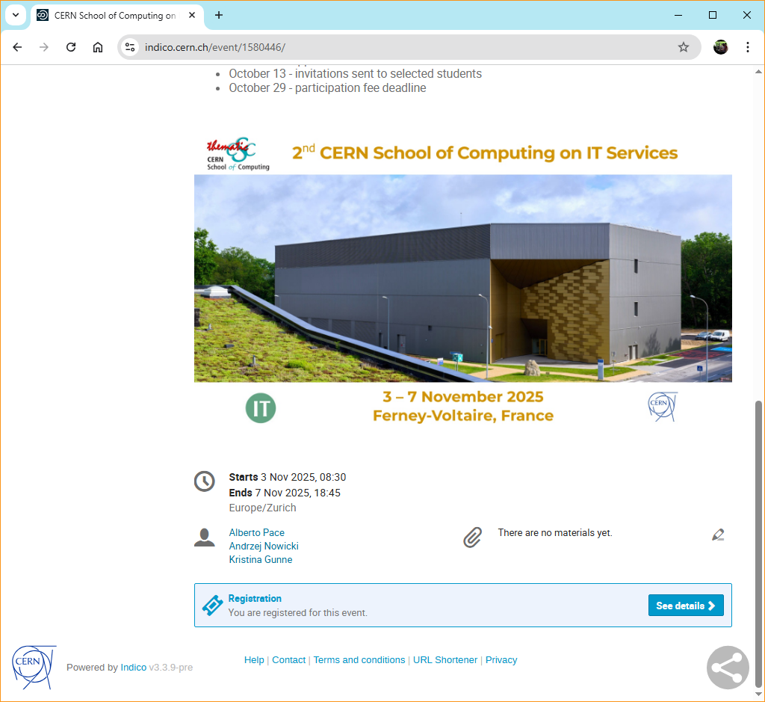
The School site is on indico
https://indico.cern.ch/event/1580446/
Check it regularly for updates

Slide 17
The school learning process
Mandatory
Learning process
Lectures
Exercises
Exam (Self Evaluation)
Meet special persons, build trust with colleagues
Lunches, dinners, coffee breaks, (evenings)
Excursions
(Music events)
(Sport programme)
Optional

Slide 18
The school learning process
Mandatory
Learning process
Lectures
Exercises
Exam (Self Evaluation)
Meet special persons, build trust with colleagues
Lunches, dinners, coffee breaks, (evenings)
Excursions
(Music events)
(Sport programme)
Optional

Slide 19
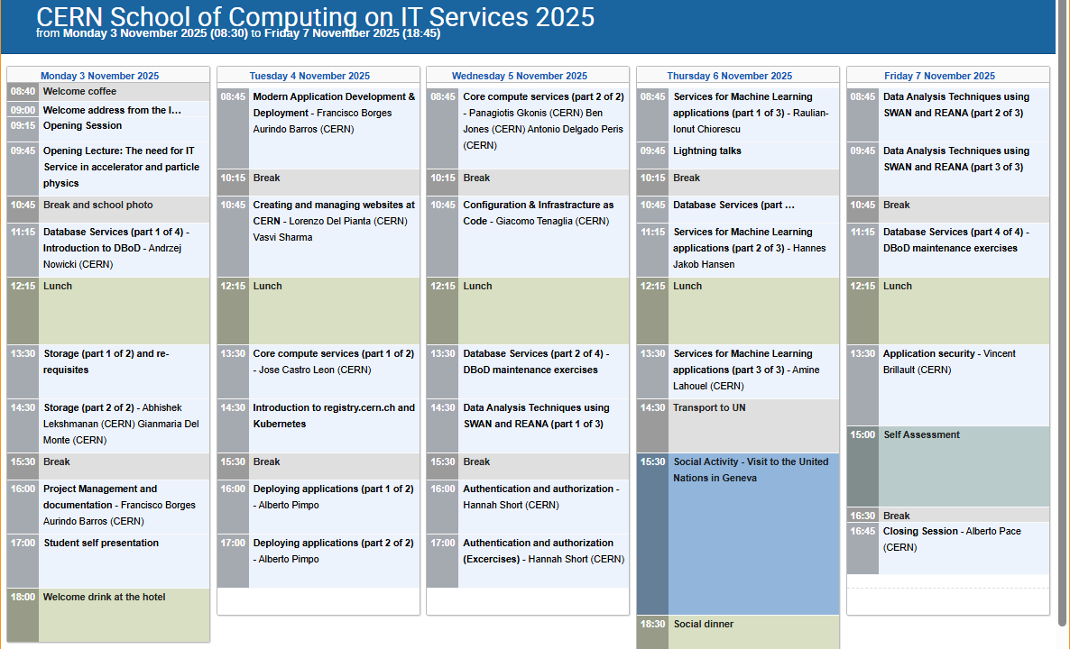
The Programme – 26 hours of lectures
Storage
Web content
Databases
Application Development
Security and authentication
Services for data analysis
Services for machine learning projects

Slide 20
We will have 25 (!) lecturers
Raulian-ionut Chiorescu
Abhishek Lekshmanan
Jose Castro Leon
Cameron Duncan
Francisco Borges
Nils Hoimyr
Antonio Delgado Peris
Sebastian Lopienski
Alberto Pace
Tibor Simko
Pedro Maximino
Giacomo Tenaglia
Hannah Short
IT-CD-PI
IT-SD-PDS
IT-CD-CLI
IT-CA-OSI
IT-PW-WA
IT-CD-CC
IT-CD-CC
IT-PW-WA
IT-FTI
IT-CA-OSI
IT-DA-ASM
IT-CD-CC
IT-PW-IAM
Diogo Castro
Gianmaria Del Monte
Andrzej Nowicki
Alberto Pimpo
Jack Charlie Munday
Sebastien Ponce
Diana Gaponcic
Vincent Brillault
Ben Dylan Jones
Ricardo Rocha
Panagiotis Gkonis
Vasvi Sharma
IT-SD-GSS
IT-SD-PDS
IT-DA-DB
IT-PW-AH
IT-CD-PI
EP-LBC
IT-CD-PI
IT-PW-IAM
IT-CD-CC
IT-CD-PI
IT-CD-CC
IT-PW-WA

Slide 21
The school learning process
Mandatory
Learning process
Lectures
Exercises
Exam
Meet special persons, Build trusts with colleagues across the world
Lunches, dinners, coffee breaks, evenings
Excursions
(Music events)
(Sport programme)
Optional

Slide 22
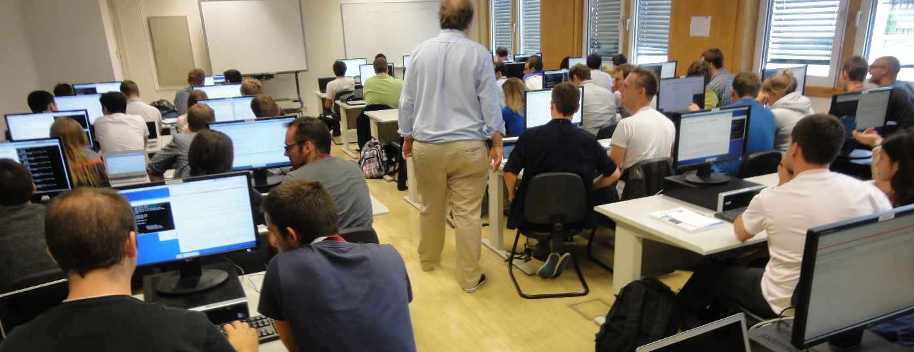
The School culture in “exercises” and “demoes”
The school will use the CERN-IT computing infrastructure for exercises.
Accessible to all participants
You should try to work in pair (2-student teams). If possible:
1 student with physics background
1 student with computing background
Or at least: 1 student from the IT department with one student outside the IT department

Slide 23
The school learning process
Mandatory
Learning process
Lectures
Exercises
Exam (Self Evaluation)
Meet special persons, build trust with colleagues
Lunches, dinners, coffee breaks, (evenings)
Excursions
(Music events)
(Sport programme)
Optional

Slide 24
The exam
The CSC has a tradition to have a final, serious and difficult exam, which delivers the diploma
This school will have a “Self evaluation” game towards the end ...
(Kahoot)

Slide 25
The “self evaluation” is part of the learning process
The test statistic is usually a single number whose value ...
... reflects an agreement between the data and the hypothesis.
... is equivalent to the mean value of the data sample.
... must be equal to the most probable value of the distribution in question.
... is never larger than the difference between values of variances of two competing hypotheses.

Slide 26
The “self evaluation” is part of the learning process
The test statistic is usually a single number whose value ...
... reflects an agreement between the data and the hypothesis.
... is equivalent to the mean value of the data sample.
... must be equal to the most probable value of the distribution in question.
... is never larger than the difference between values of variances of two competing hypotheses.

Slide 27
The “self evaluation” is part of the learning process
In the process of hypotheses testing, we often define the null and the alternative hypotheses. The most robust final results are obtained for ...
... the acceptance of the alternative hypothesis.
... the rejection of the difference between null and alternative hypothesis.
... the acceptance of the ratio of null and alternative hypothesis.
... the rejection of the null hypothesis.

Slide 28
The “self evaluation” is part of the learning process
In the process of hypotheses testing, we often define the null and the alternative hypotheses. The most robust final results are obtained for ...
... the acceptance of the alternative hypothesis.
... the rejection of the difference between null and alternative hypothesis.
... the acceptance of the ratio of null and alternative hypothesis.
... the rejection of the null hypothesis.

Slide 29
The school learning process
Mandatory
Learning process
Lectures
Exercises
Exam (Self Evaluation)
Meet special persons, build trust with colleagues
Lunches, (dinners), coffee breaks, (evenings)
Excursions
(Music events)
(Sport programme)
Optional

Slide 30
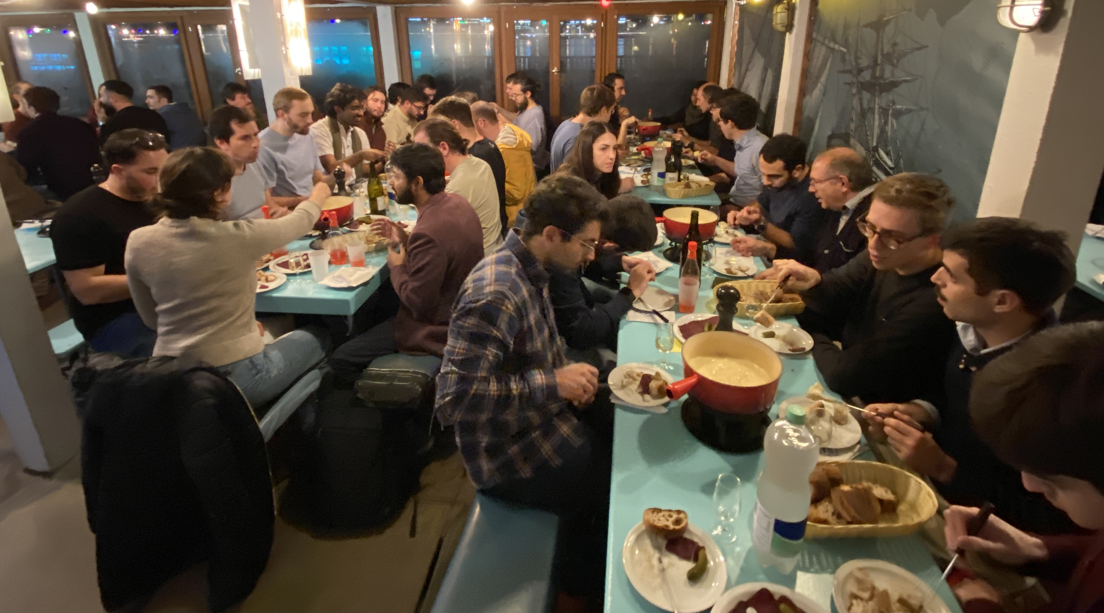
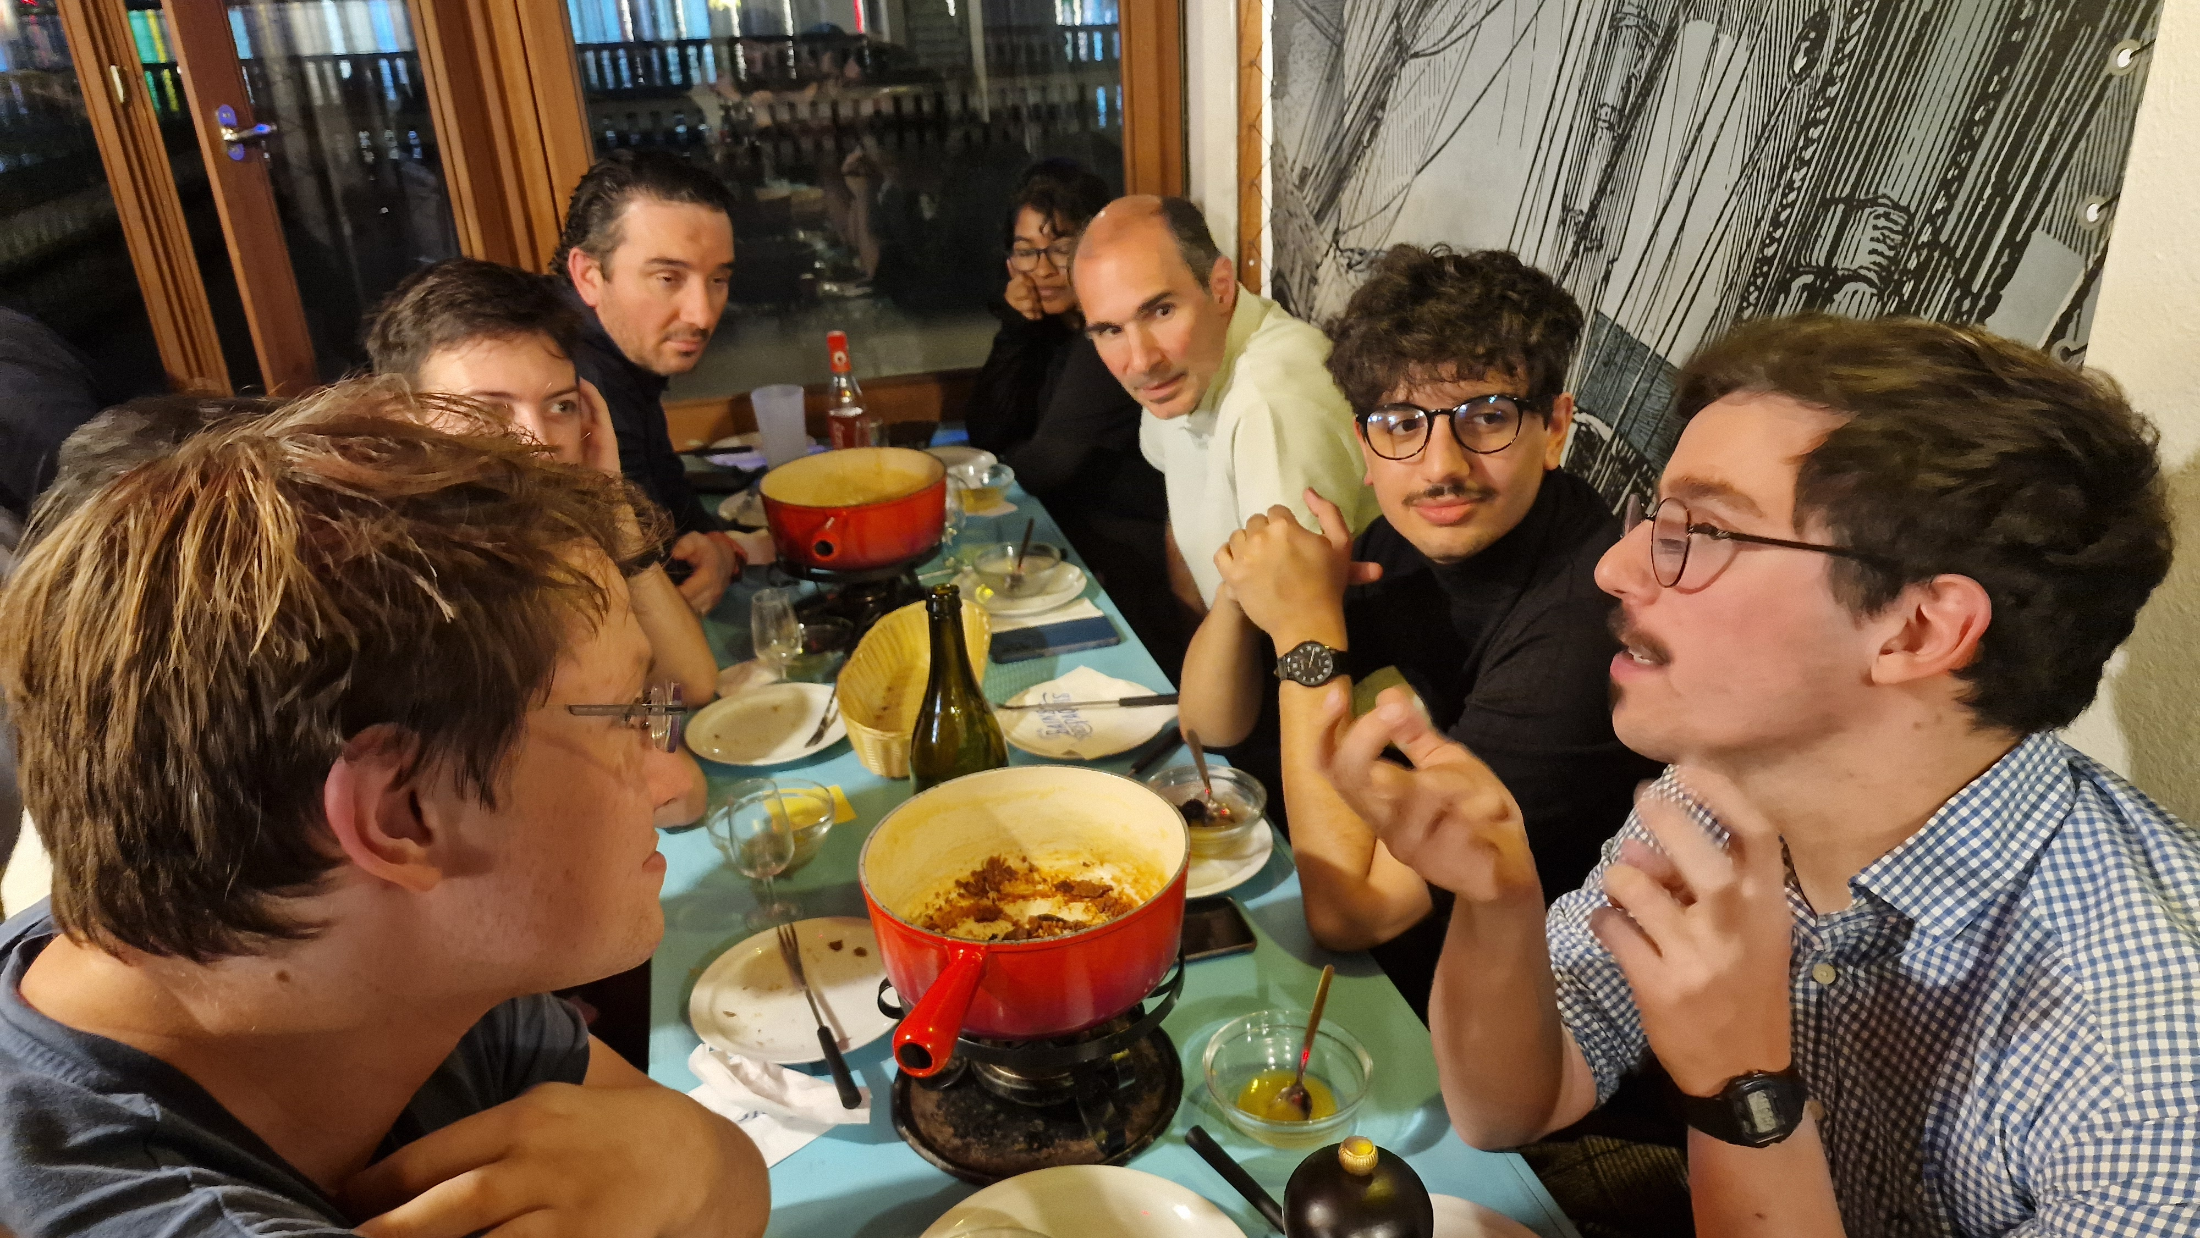
Lunches and Coffee breaks (and Thursday Dinner)
We will always have some lecturers with us
Lectures are your IT colleagues
You are allowed and encouraged to harass them with your questions
Unique opportunity, better now and here than later at CERN

Slide 31
School rules …

Slide 32
School rule #1
Participate
Attendance at all lectures and exercises is mandatory
You should attend all meals and coffee breaks
Taking part in social events is optional
You must let us know whether you participate or not

Slide 33

School rule #2
Be on time
Check what the schedule says:
“Lecture starts at 9:00” => You must be in the room before 9:00
(Sign the presence sheet beforehand – it will be removed at 9:00)
(“The bus leaves at 18:00” => It will leave at 18:00)
If you’re late, we won’t wait
https://www.youtube.com/watch?v=1dZveoBfiww
Spaceballs, Mel Brooks, 1987

Slide 34
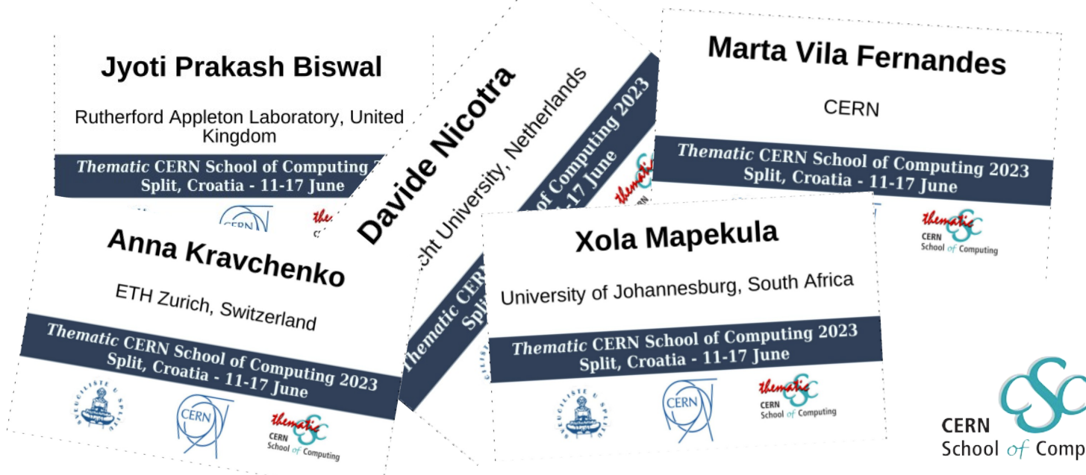
School rule #3
Wear your badge
Lecturers need to learn all your names !

Slide 35
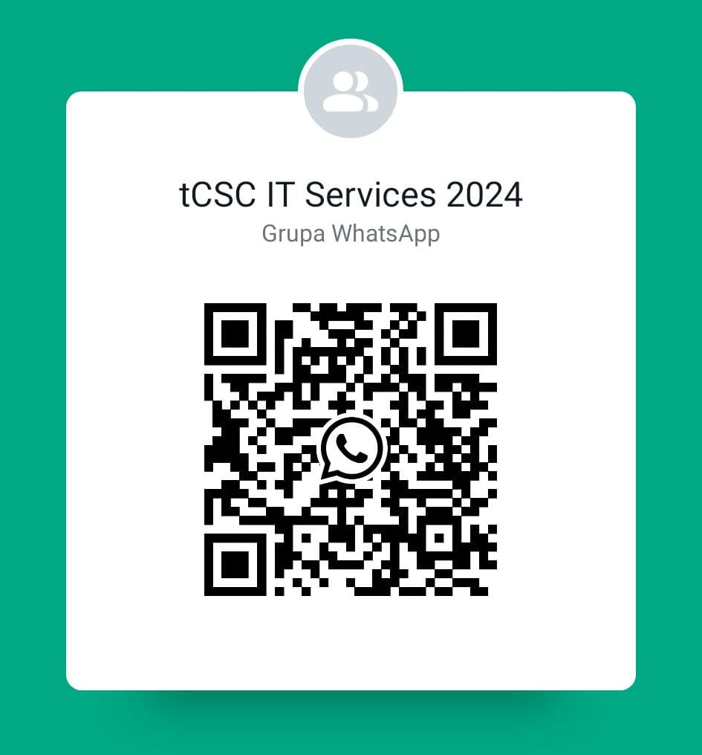

WhatsApp group
Unofficial communication channel
We recommend you to join the group
Autojoin link:
https://chat.whatsapp.com/CTcwgba8LnC2sw6d0lVgrT

Slide 36
Why a School on IT Services ?

Slide 37
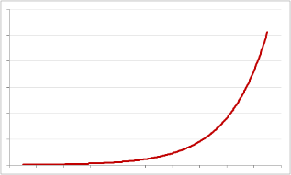
The need for computing in research
Scientific research in recent years has exploded the computing requirements
Computing performance has progressed exponentially (Moore's law)
At constant cost, exponential growth of performances

Slide 38
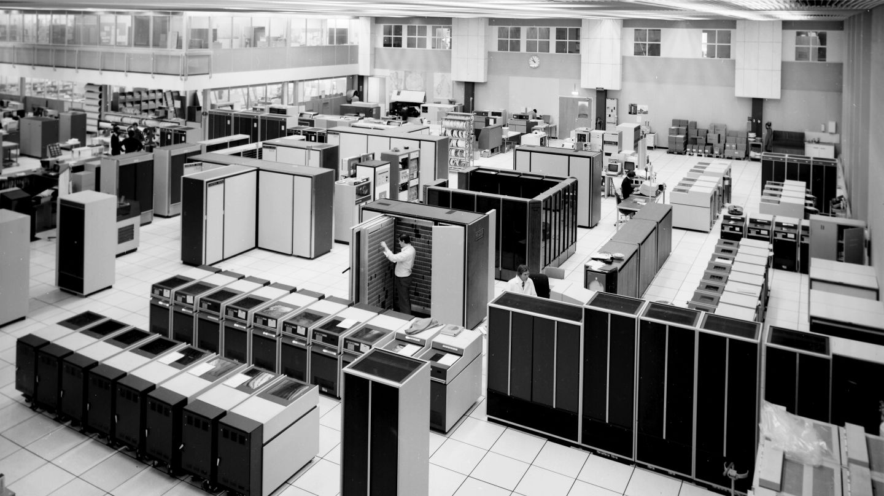
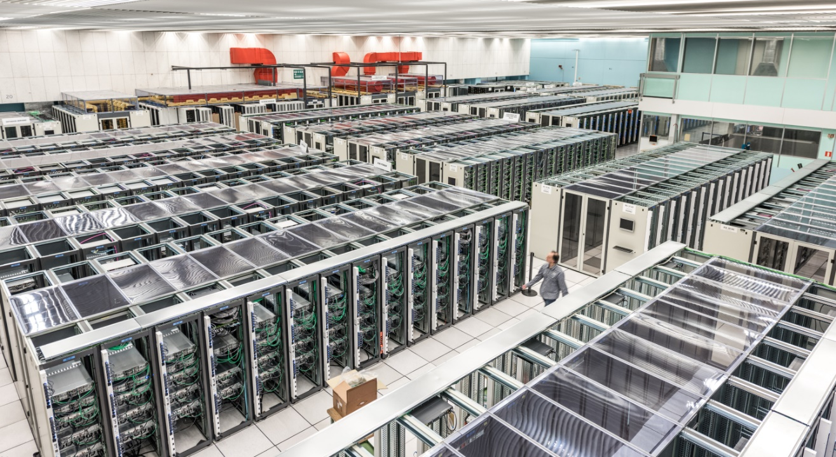
Computing performance has grown exponentially
If exponential growth was enough …no need to expand the data centre
1980
Today

Slide 39
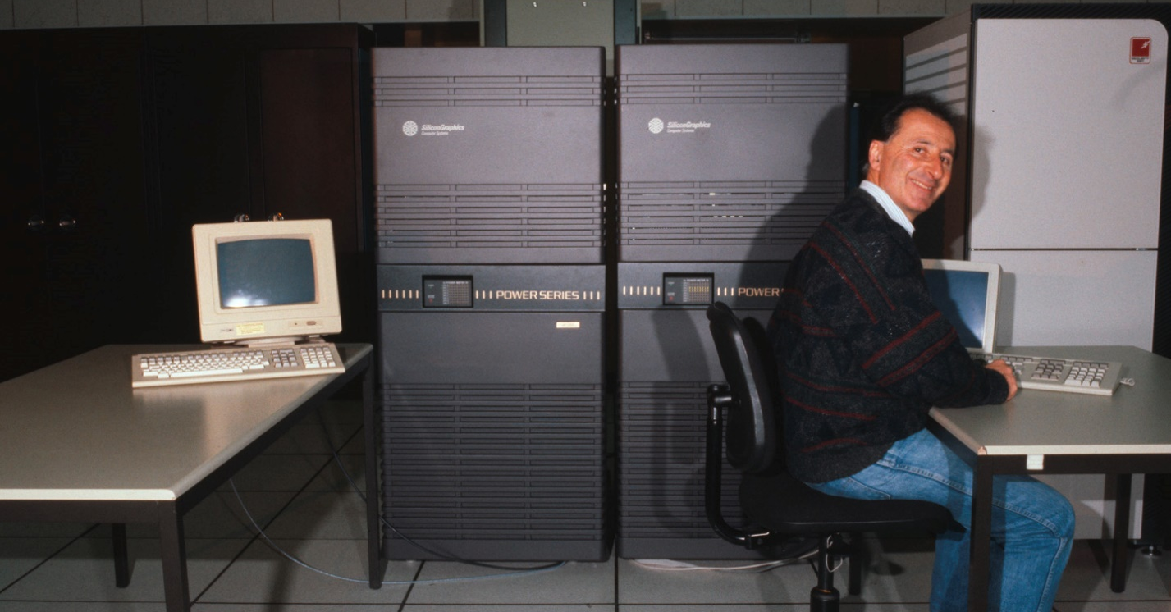
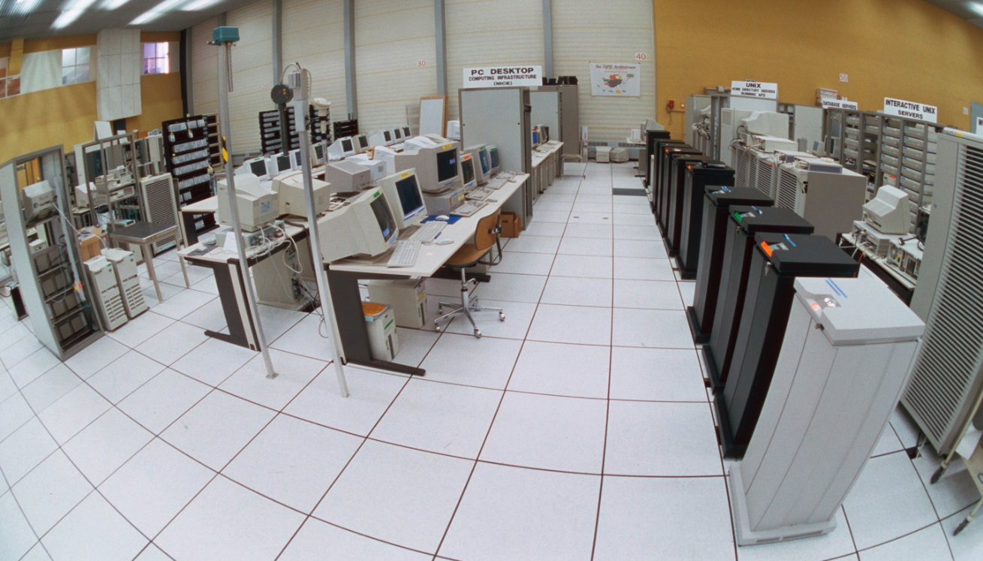
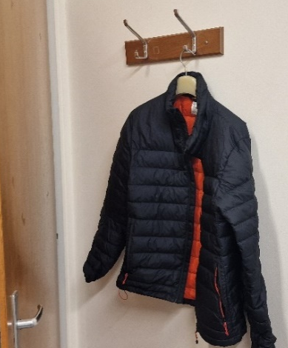
Computing performance has grown exponentially
Timeline of growth … one floor
1990
1998

Slide 40
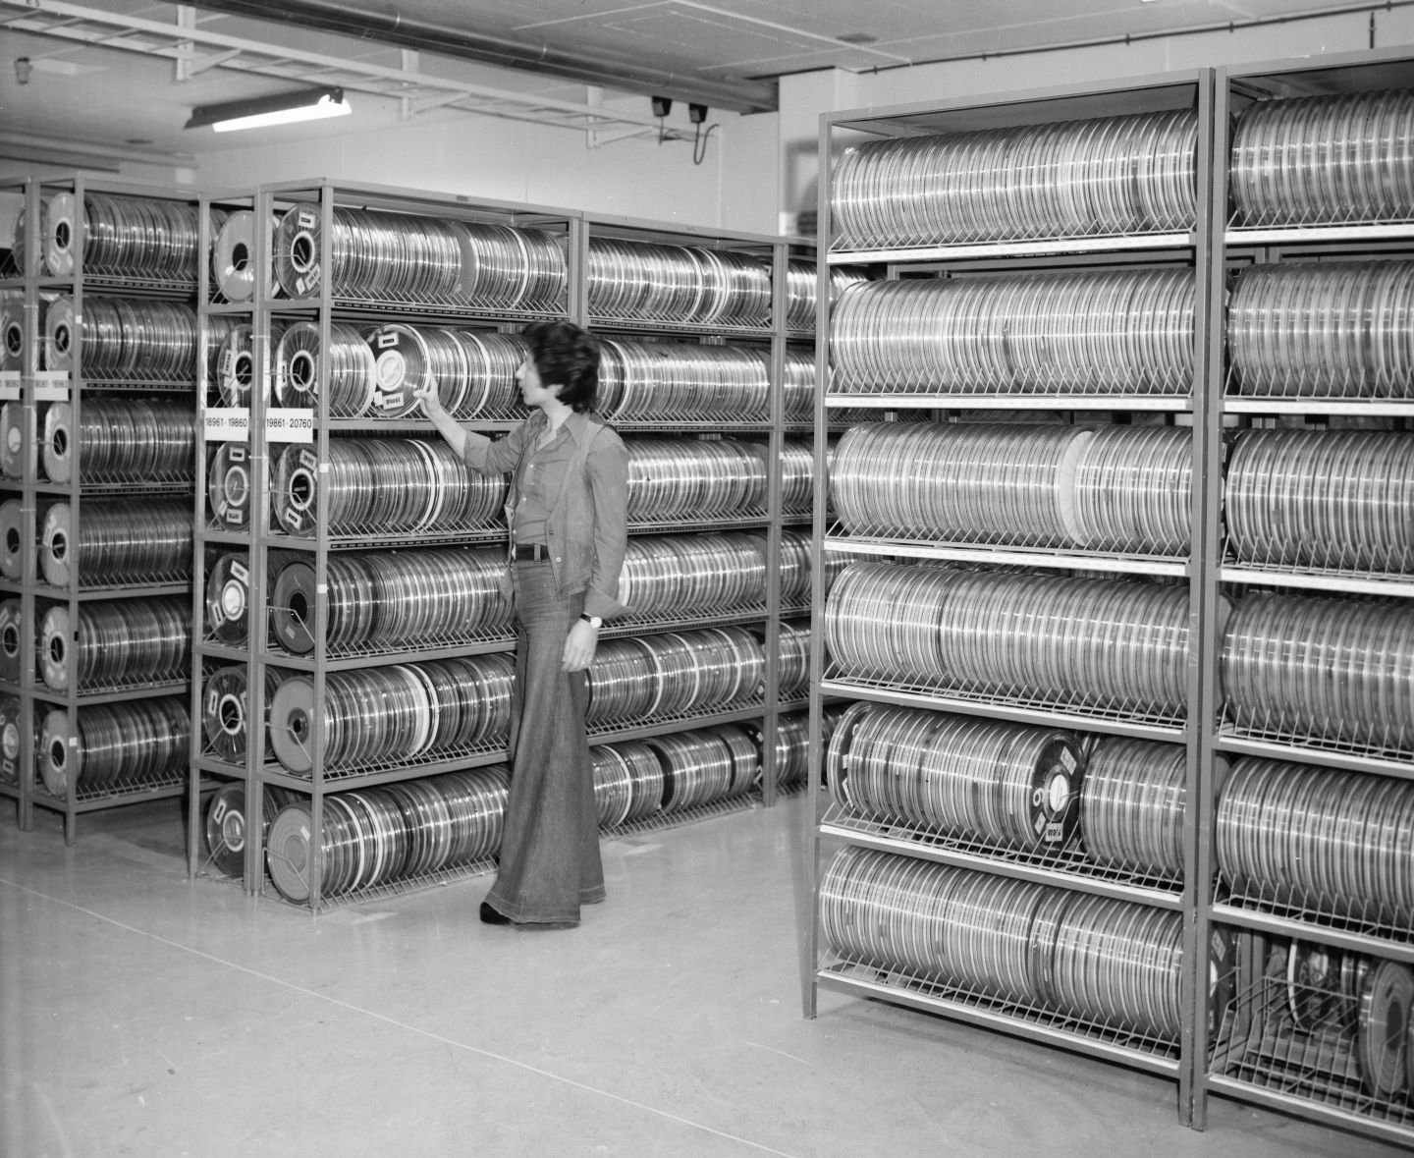
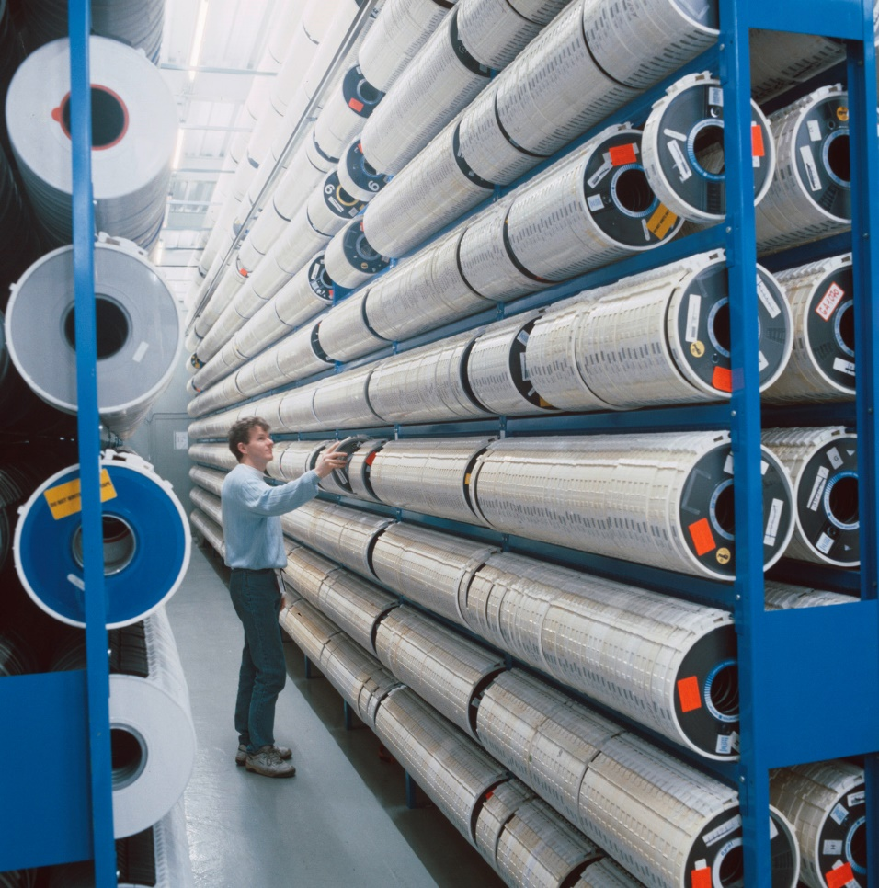
Computing performance has grown exponentially
Lower floor – no computers, only tapes
1978
1989

Slide 41
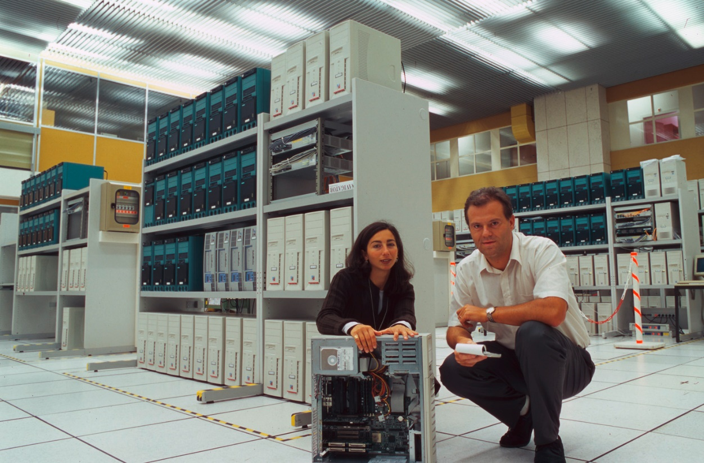
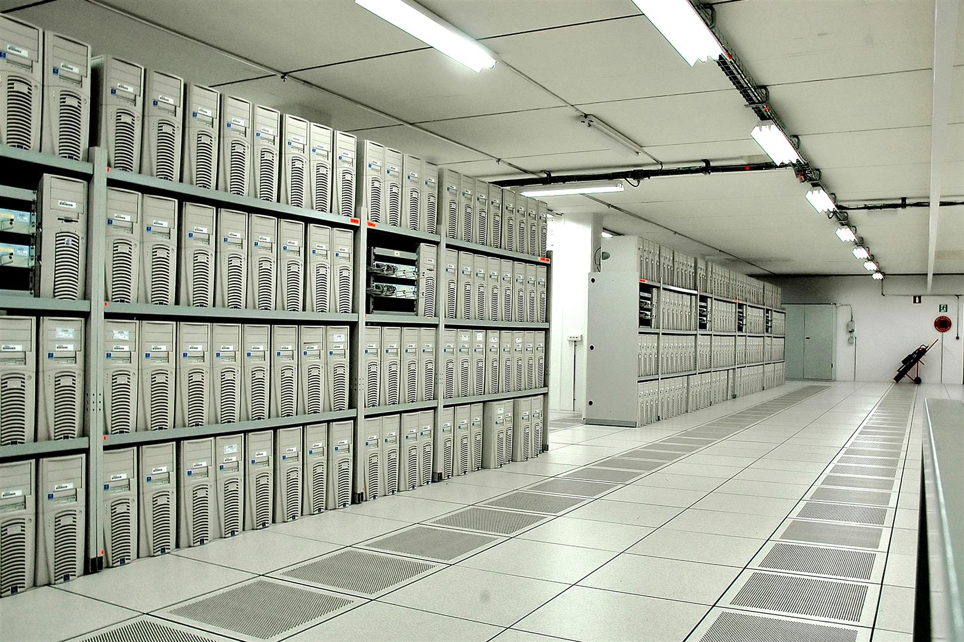
Computing performance has grown exponentially
need to expand the data centre to the lower floor of building 513
2001
2005

Slide 42
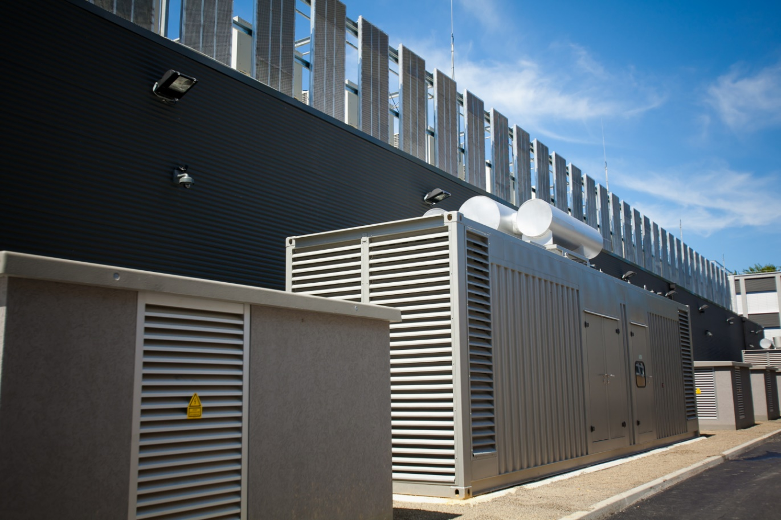
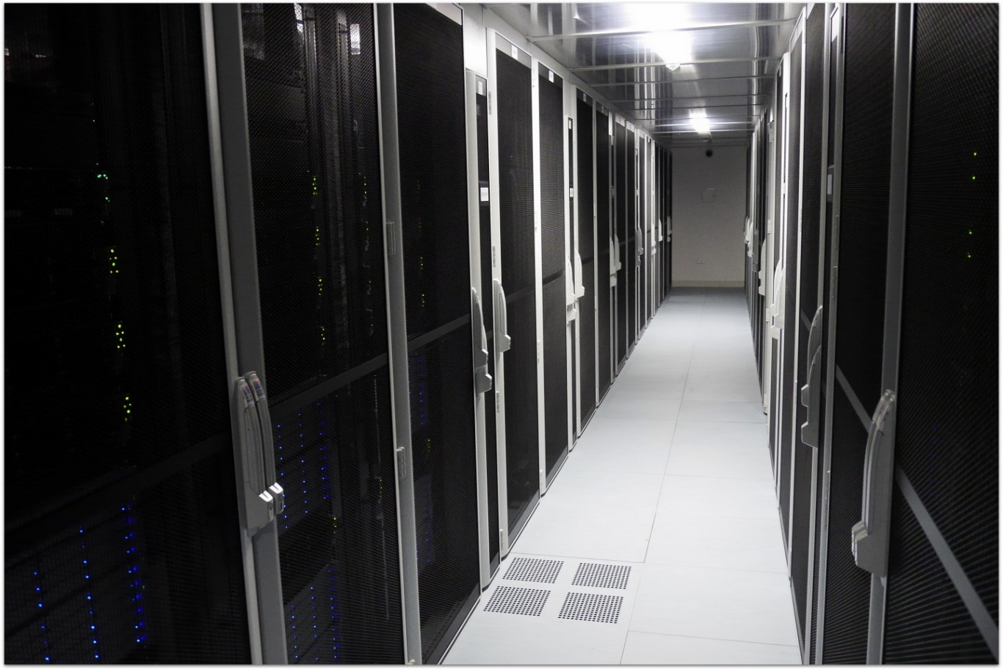
Computing performance has grown exponentially
need to expand the data centre to Wigner (Hungary)
2013

Slide 43
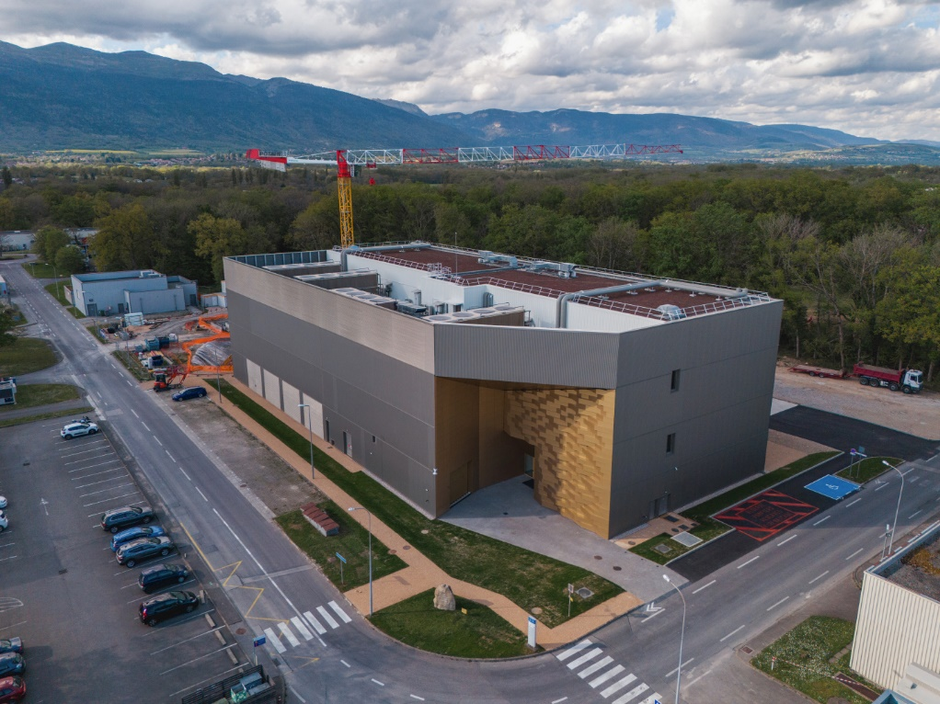
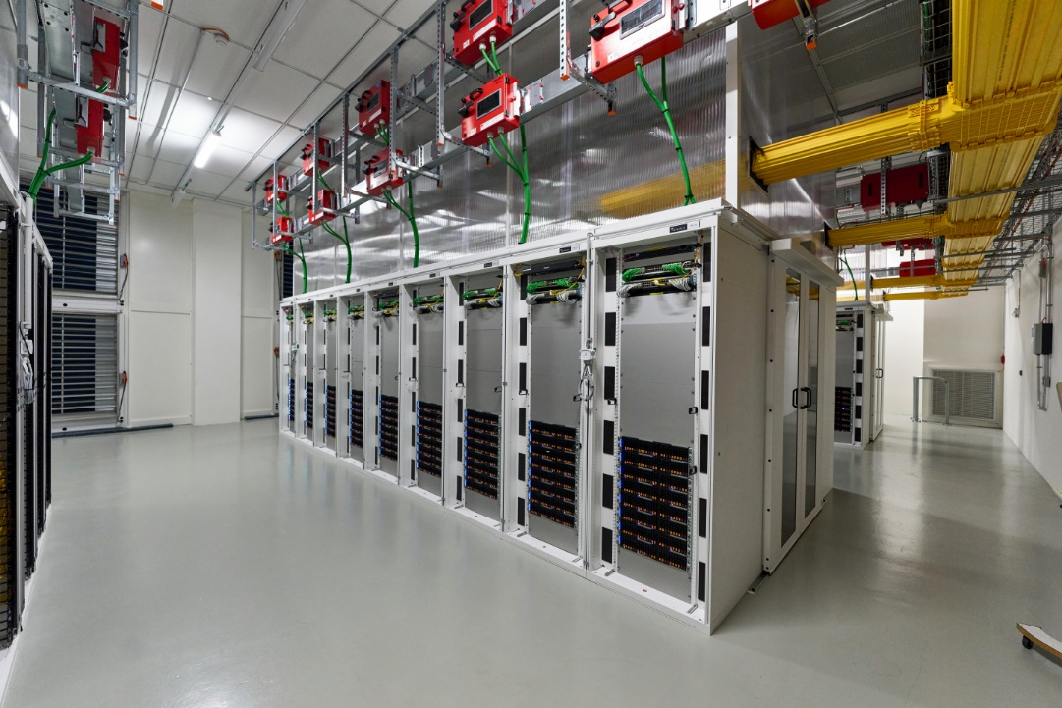
Computing performance has grown exponentially
need to build a 2nd data centre (Prevessin Data Centre)
2024

Slide 44
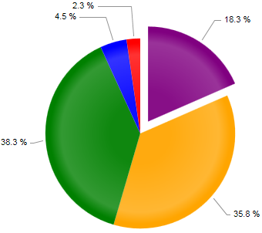
The need for computing in research
Scientific research in recent years has exploded the computing requirements
Computing has been the strategy to reduce the cost of traditional research
Computing has opened new horizons of research
At constant cost, exponential growth of performances
Return in computing investment higher than other fields: Budget available for computing increased, growth is more than exponential

Slide 45
What is a scientific computing infrastructure ?
Scientific computing requires a complex infrastructure
One or more data centres
Several pillars
Storage
Files, disks, databases, …
Computing
CPUs, GPUs, FPGAs, …
Networking
In the Data Centre, on campus, Wide Area, …
... and services !
Applications, workflows, monitoring, support, security, ….
Scientific Computing
DATA
CPU
NET

Slide 46
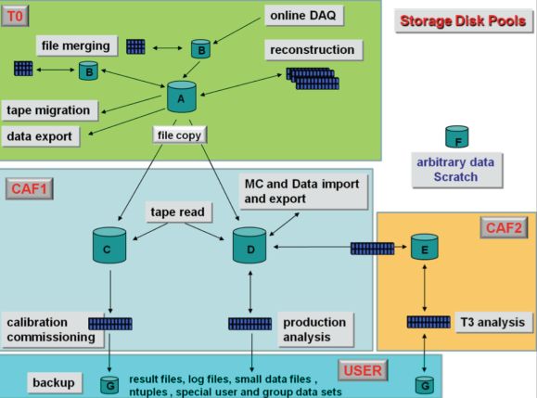
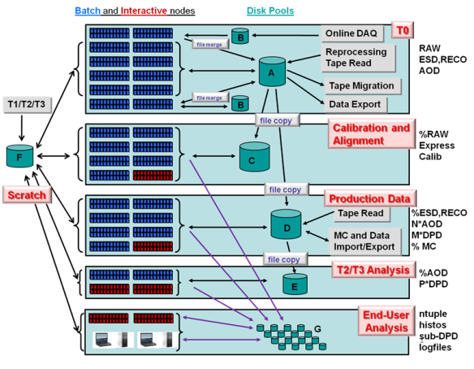
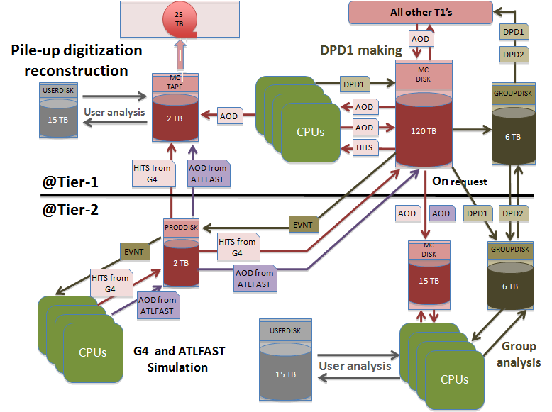
Why services ?
Examples from LHC experiment data management models
Two building blocks to empower data processing
Data pools with different quality of services
Tools for data transfer between pools

Slide 47
Example of Storage services
Data Management ensure the following solutions
Data reliability
Access control
Data distribution
Data archives, history, long term preservation
In general:
Empower the implementation of a workflow for data processing

Slide 48
In general we need to find compromises
For all services, where do you position the service ?
With thousands of users …
Do you provide the best to everyone ?
Do you provide the cheapest to everyone ?
One size fits all is too simplistic
This is the main reason why complexity is constantly increasing
Different quality of services is needed
High performance,
Highly available
Expensive
Slow, unreliable, cheap

Slide 49
But finding the right balance is not as simple
Many ways to define performance and cost
Performance has many sub-parameters
Speed, throughput, latency, reliability, availability
Cost has many sub-parameters
Purchase cost, amortization, electricity consumption, manpower
Electrical consumption
Performance
Cost
Ops Cost
(manpower)
Reliability
HW cost

Slide 50
Reality is more complicated than models
Key requirements for IT services: Simple, Scalable, Consistent, Reliable, Available, Manageable, Flexible, Performing, Cheap, Secure.
Aiming for “à la carte” services with on-demand “quality of service”

Slide 51

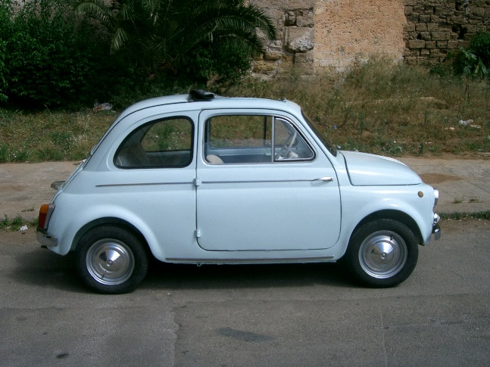
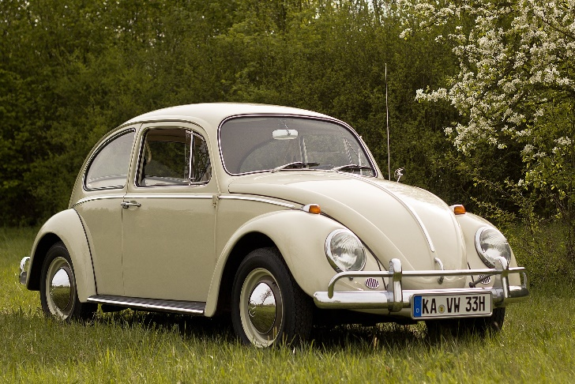



Same as in normal industry ...
In 1960 ... One size fits all
Today ... Try to find two equal cars or two identical Harley-Davidson

Slide 52
Computing industry is following
Early 2000
Fixed size Virtual Machines
Cloud Storage
Network
Today:
Virtual Machines, Containers, Application
Ram, CPU, GPUs, ...
Storage
Online, Offline, Multiple replicas, ...
Network
Bandwith, Roundtrip times, Routes, redundancy ...

Slide 53
Where are we heading ?
Good Software + Cheap hardware can provide “Arbitrary Performance” (for any service)
Expensive
Expensive
Flash, Solid State Disks
Mirrored disks
Software defined service
+
cheap hardware
Tapes
Disks
Slow
Unreliable
Slow
Unreliable

Slide 54
What has recently changed ?
Computers can do a lot more than few years ago:
The explosion of data processing possibilities
CPU performance (10³ increase) and number of CPUs available (10³ increase)
New storage possibilities
From few GB to many PB (10⁶ increase) – Big Data
The possibility of collect / transfer / store these data in a distributed environment
From few Mbit/s to Gbit/s (10⁴ increase)
Imagine if trains would travel at 100’000 Km/h (10³ increase) or at the speed of light (10⁵ increase)
The general population is unaware of this change
We are just at the beginning

Slide 55
Has something changed, recently ?
Hard sciences do not change frequently
Mathematics, Statistics, Chemistry, Physics … laws still applies. Little has changed.
But computers have never improved so fast in the last decades:
The explosion of data processing possibilities
CPU performance (10³ increase) and number of CPUs available (10³ increase)
New storage possibilities
From few GB to many PB (10⁶ increase) – Big Data
The possibility of collect / transfer / store these data in a distributed environment
From few Mbit/s to 100s of Gbit/s (10⁵ increase)
Scientific Computing
CPU
DATA
NETWORK
Notes:
In this fast changing world, .... while sciences progress slowly, progress in computing has never be so fast as in recent times.
To give you some numbers, in the last 20 or 30 years CPU performance have increased by 6 order of magnitude.
Storage possibilities reached multiple petabytes, again 6 order of magnitude increase which has opened plenty of new opportunities for big data and research
Also Networking performance increased by 5 order of magnitudes, opening the possibility to process and transfer data form remote locations in a completely distributed environment across the planet

Slide 56
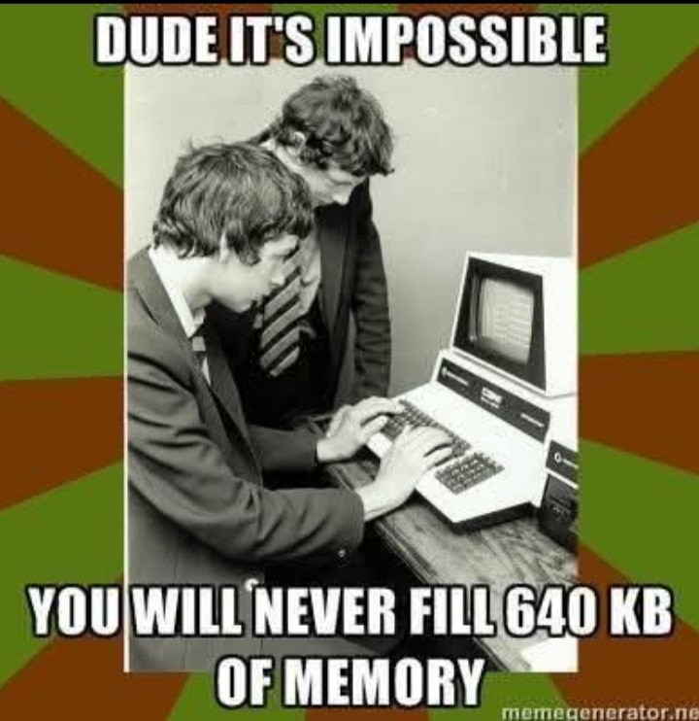
Has something changed, recently ?
Hard sciences do not change frequently
Mathematics, Statistics, Chemistry, Physics … laws still applies. Little has changed.
But computers have never improved so fast in the last decades:
The explosion of data processing possibilities
CPU performance (10³ increase) and number of CPUs available (10³ increase)
New storage possibilities
From few GB to many PB (10⁶ increase) – Big Data
The possibility of collect / transfer / store these data in a distributed environment
From few Mbit/s to 100s of Gbit/s (10⁵ increase)
Scientific Computing
CPU
DATA
NETWORK
Notes:
In this fast changing world, .... while sciences progress slowly, progress in computing has never be so fast as in recent times.
To give you some numbers, in the last 20 or 30 years CPU performance have increased by 6 order of magnitude.
Storage possibilities reached multiple petabytes, again 6 order of magnitude increase which has opened plenty of new opportunities for big data and research
Also Networking performance increased by 5 order of magnitudes, opening the possibility to process and transfer data form remote locations in a completely distributed environment across the planet

Slide 57
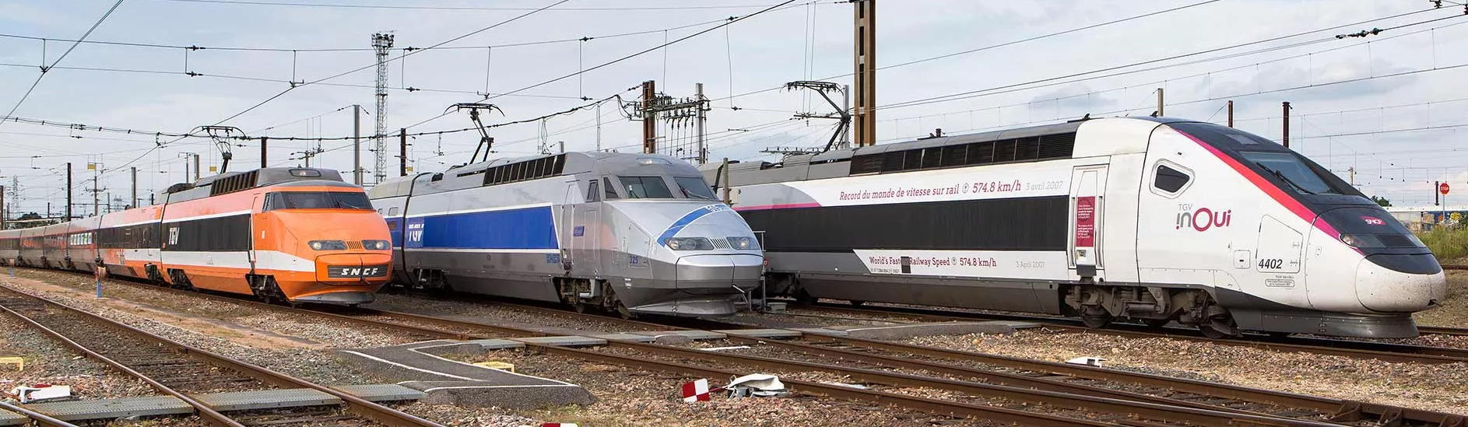
Has something changed, recently ?
Imagine having similar gains in other fields of technologies…
… trains would travel at 100’000 Km/h (10³ increase) or near the speed of light (10⁵ increase)
The general population is unaware of the progress in computing
We are just at the beginning
Notes:
In this fast changing world, .... while sciences progress slowly, progress in computing has never be so fast as in recent times.
To give you some numbers, in the last 20 or 30 years CPU performance have increased by 6 order of magnitude.
Storage possibilities reached multiple petabytes, again 6 order of magnitude increase which has opened plenty of new opportunities for big data and research
Also Networking performance increased by 5 order of magnitudes, opening the possibility to process and transfer data form remote locations in a completely distributed environment across the planet

Slide 58
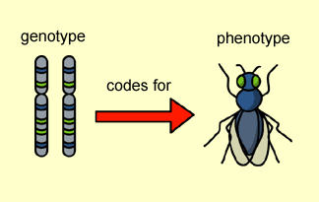

Where will we see most spectacular changes ?
High Energy Physics has been profiting, because the community is historically organized, but all other sciences can expect similar benefits:
Biology, Medicine, Climate and Weather forecast, …
Finance and market analytics
Insurances, loans, derivatives, forex, … anywhere there is a contract or a risk
Marketing, targeted advertisements, lobbying, identifying markets
from data collected worldwide

Slide 59
Take home message:
All hard sciences learnt during your studies are still valid:
Sciences do not change, but play increased roles in daily life
But … computers and networks can do more today than a few years ago
Computationally unsolvable problems of the past can be solved today in the blink of an eye.
Owning data is strategic
Cannot fight progress
Many of these approaches can bring significant improvements to everyone's life
plenty of new business opportunities, ethical consequences must be understood and handled
Education is of the utmost importance

Slide 60
Statement from the past chair of the school advisory board …
https://www.facebook.com/1334424117/posts/10232249117833997/?mibextid=rS40aB7S9Ucbxw6v
“Another reason for your optimism is the fact that you go to school every day to learn something new. I know you are usually not exactly thrilled about going and being in school, but consider the following arguments. For thousands of years, millions of people have tried to understand various things about nature and society. Some of them spent their entire lives trying to understand the basic laws of nature, what our planet looks like, how the universe looks like, how stars, planets, people etc were created. You learn most of these things in a few hours of teaching and working at school or at home. From that perspective you know more after a few years of school than some of the greatest scientists in human history. And you find out more and more every day.”

Slide 61
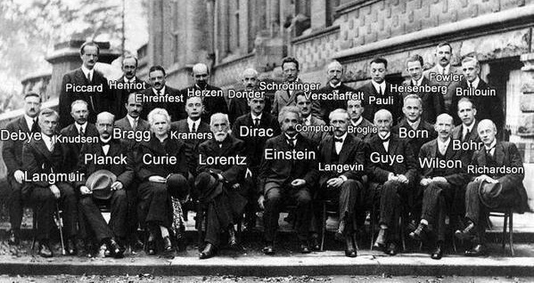
It is a small world …
All top scientists knows each other very well

Slide 62
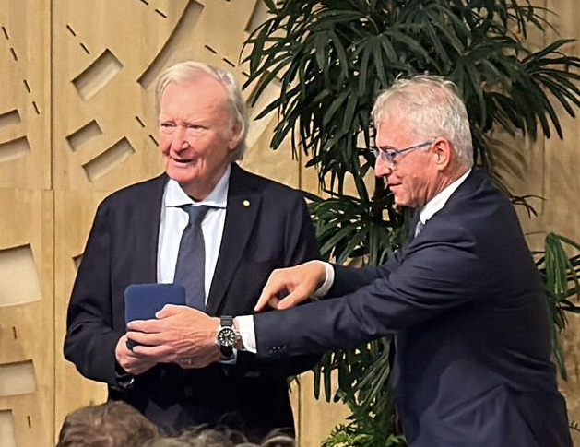
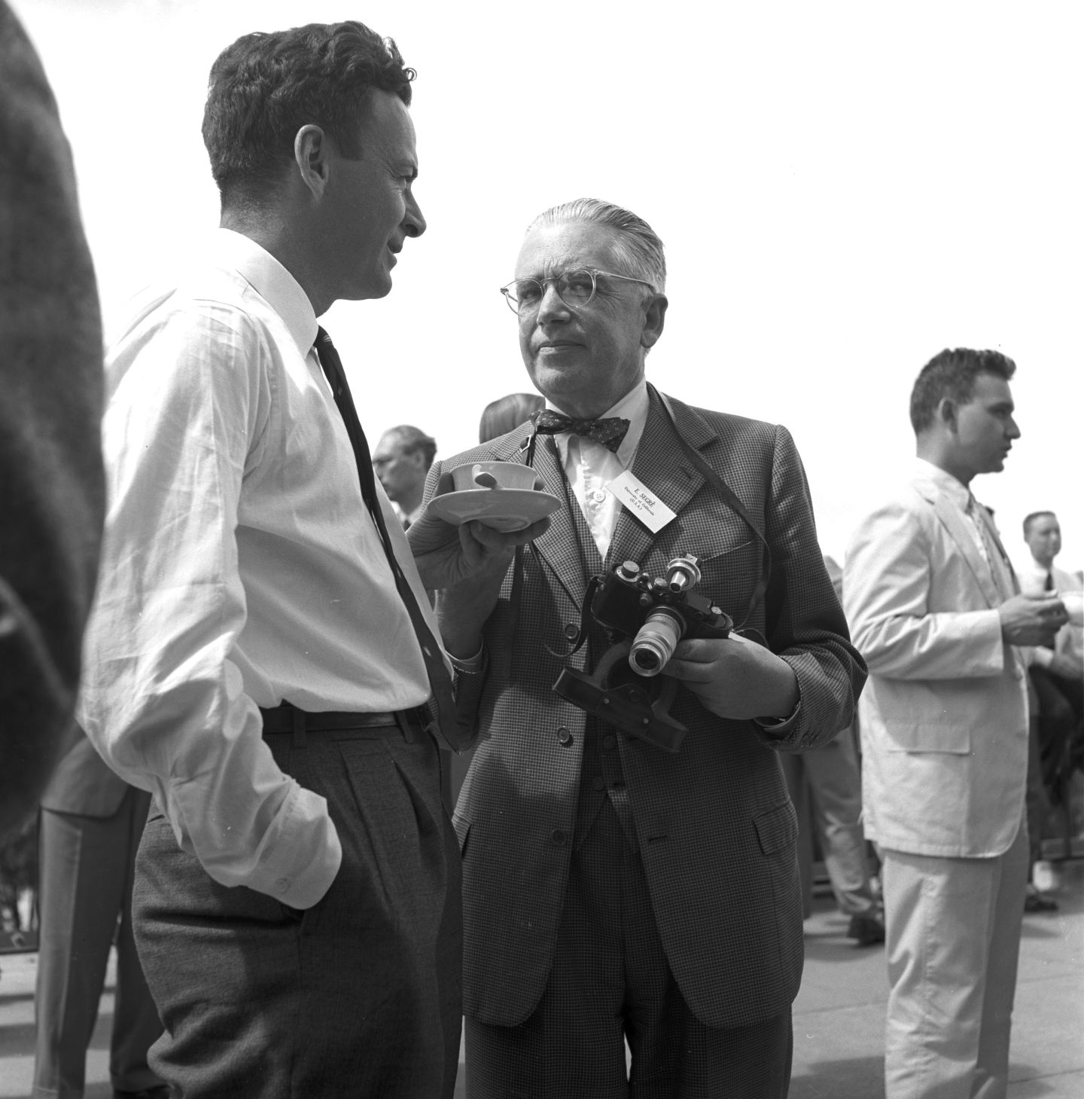
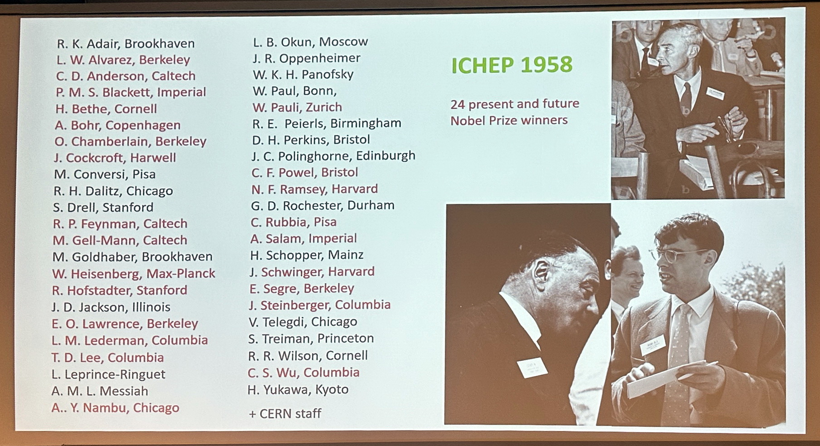

It is a small world …
All top scientists knows each other very well

Slide 63

CSC 2025, Lund, Sweden

Slide 64

CSC 2025 on IT Services
Are you ready to write history ?
School photo:
Today, after the
opening lecture
@ ~ 10:45

