Slide 1
Update on PID studies for ITS upgrade
S.Bufalino, F.Prino
INFN-Torino
and S.Piano
INFN-Trieste

Slide 2
ITS CONFIGURATIONS
“Fast” tool:
ITS with 7 layers: Generated 100K events: π⁺, K⁺, p (0.040 GeV/c < mom < 2 GeV/c) with relative abundances equal 1/3 for π⁺, K⁺, p
7 SPD with different thickness: 10 μm, 15 μm and 18 μm
Study of the particle separation and ITS resolution for each configuration with different number of ADC bit
Study of efficiency and contamination for 7 silicon layers of 15 μm using an ADC with 10 bit and three value of noise : 10 e⁻, 20 e⁻ and 40 e⁻

Slide 3
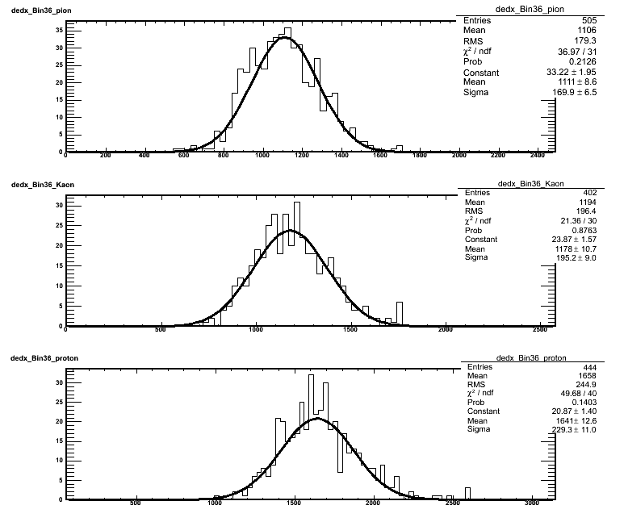
Reminder on some definitions
Parametrization for 7 layers
Fit with a Gaussian function in a momentum bin for each particle type
2 x 3 Parameters extracted:
  Mean value (mv) x π,K,p
  Gaussian Width (σ) x π,K,p
Calculation of BetheBloch(βγ) parameters by fit of mv values
Parameterization of σ_{part}(βγ)
Identity: the lowest
|DE/DX - BetheBloch(βγ, M_{part})|/σ_{part}(βγ)
Efficiency = Right MCID/Identity
Contamination =
Wrong MCID/(Right MCID+WrongMCID)
pion
Kaon
proton

Slide 4
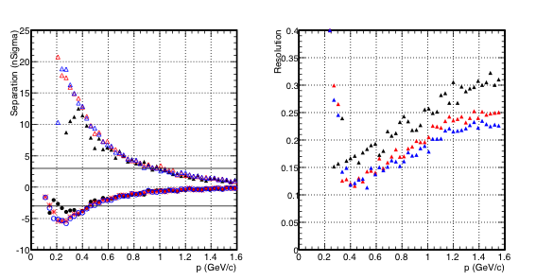
7 layer 20 μm for comparison
p – K separation = (mv_{p}– mv_{K})/ σ_{K}
Protons
3σ_{K}
-3σ_{K}
π – K separation = (mv_{π}– mv_{K})/ σ_{K}
Resolution=σ_{p}/mv_{p}
Particle mix: abundances equal to 1/3 for π⁺, K⁺, p
Blu 8 bit ADC
Red 6 bit ADC
Black 4 bit ADC

Slide 5
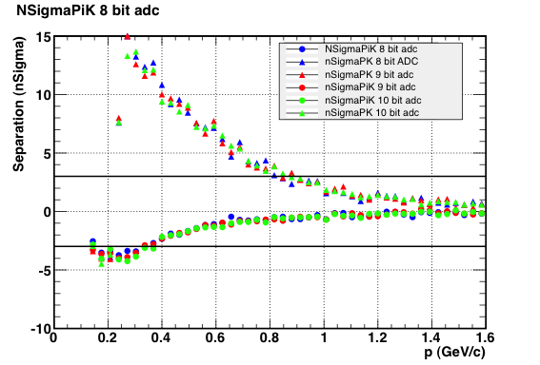
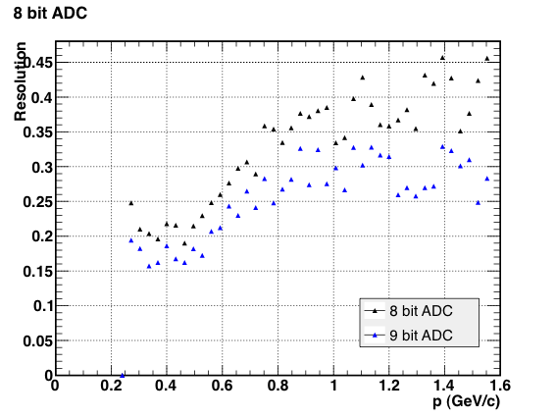
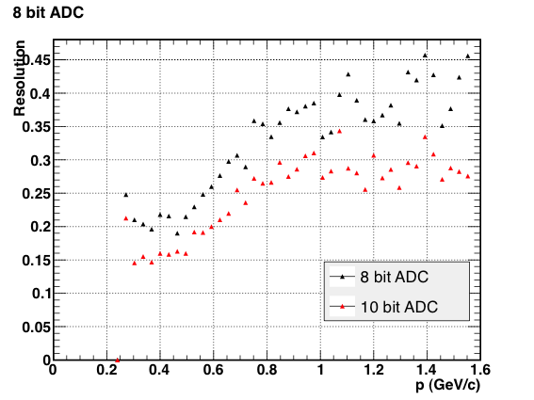
nSigma separation and resolution
for 7 layers of 10 μm
p – K separation = (mv_{p}– mv_{K})/ σ_{K}
PROTONS
3σ_{K}
-3σ_{K}
Resolution=σ_{p}/mv_{p}
PROTONS
π – K separation = (mv_{π}– mv_{K})/ σ_{K}
Particle mix:
Abundances equal to 1/3 for π⁺, K⁺, p
Noise gaussian distributed of 20 e⁻

Slide 6
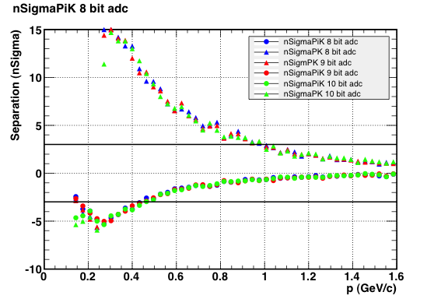
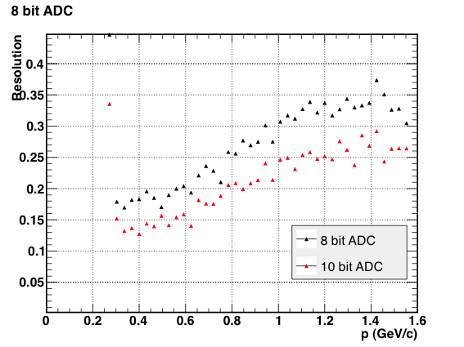
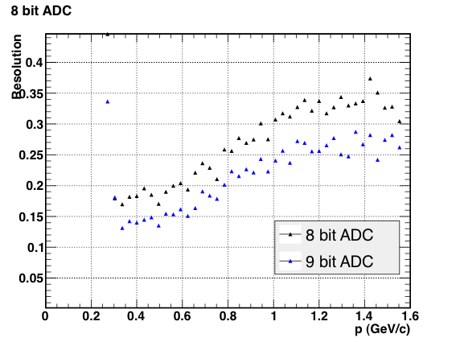
nSigma separation and resolution
for 7 layers of 15 μm
p – K separation = (mv_{p}– mv_{K})/ σ_{K}
PROTONS
3σ_{K}
-3σ_{K}
Resolution=σ_{p}/mv_{p}
PROTONS
π – K separation = (mv_{π}– mv_{K})/ σ_{K}
Particle mix:
Abundances equal to 1/3 for π⁺, K⁺, p
Noise gaussian distributed of 20 e⁻

Slide 7
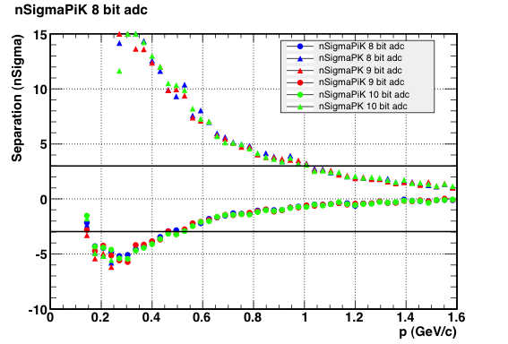
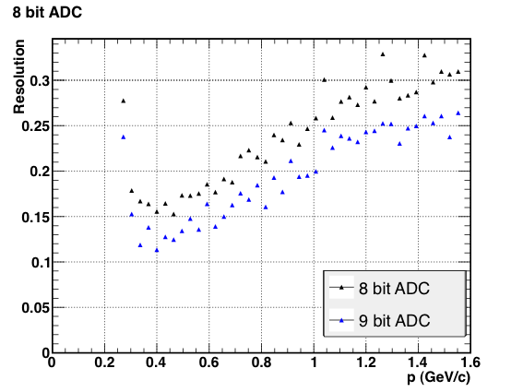
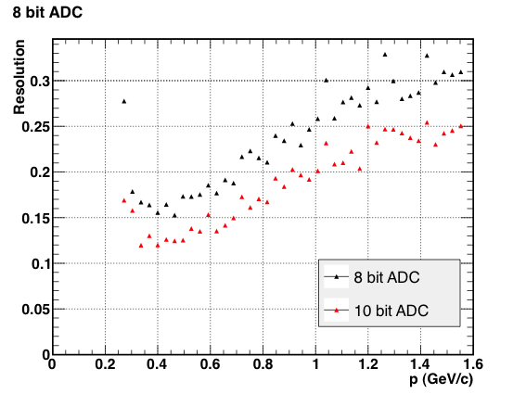
nSigma separation and resolution
for 7 layers of 18 μm
p – K separation = (mv_{p}– mv_{K})/ σ_{K}
PROTONS
3σ_{K}
-3σ_{K}
Resolution=σ_{p}/mv_{p}
PROTONS
π – K separation = (mv_{π}– mv_{K})/ σ_{K}
Particle mix:
Abundances equal to 1/3 for π⁺, K⁺, p
Noise gaussian distributed of 20 e⁻

Slide 8
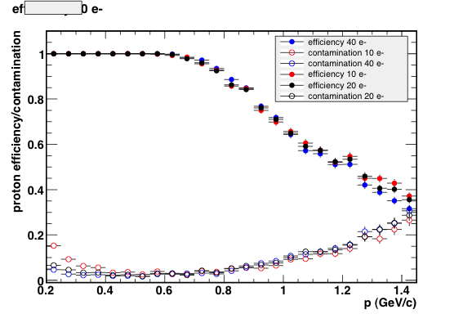
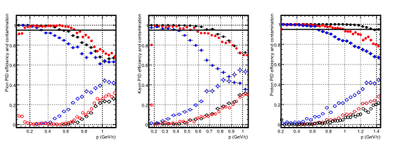
Efficiency and Contamination
[15 μm, 10 bit ADC]
PROTON
From chap. 3 of CDR
Efficiency
95%
95%
Contamination
Blue symbols: 7 x 20 μm thick layers with 8 bit ADC
15 μm, 10 bit ADC
Relative abundances=1/3 for π⁺, K⁺, p

Slide 9
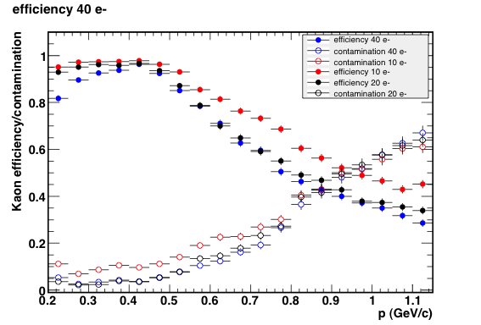
Efficiency and Contamination
[15 μm, 10 bit ADC]
KAON
From chap. 3 of CDR
Efficiency
95%
95%
Contamination
15 μm, 10 bit ADC
Relative abundances=1/3 for π⁺, K⁺, p
Blue symbols: 7 x 20 μm thick layers with 8 bit ADC

Slide 10
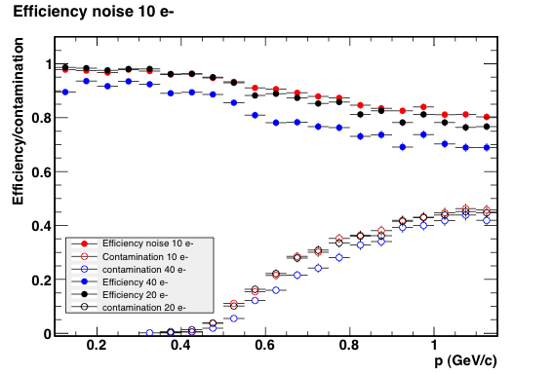
Efficiency and Contamination
[15 μm, 10 bit ADC]
PION
From chap. 3 of CDR
Efficiency
95%
95%
Contamination
15 μm, 10 bit ADC
Relative abundances=1/3 for π⁺, K⁺, p
Blue symbols: 7 x 20 μm thick layers with 8 bit ADC

Slide 11
…to do
Study of contamination and efficiency for the ITS configurations with 7 layers of 10 μm and 18 μm
Generetion with particle mixes taken from pp data @ 900 GeV and PbPb data @ 2.76 TeV

