Slide 1
POLAR-2 Weekly Meeting
29-Sep-2025
(week 40)

Slide 2
WP0 - Management
Pol LOE: Polish budget/CN officially approved?
Discussions in progress with Tübingen and IHEP for PLAN-B
Documentation:
  SoW: SoW_v9 produced and sent to CSU
  ICD:
    ICD_v7 document drafted and sent to CSU meeting

Slide 3
WP0 - Management
ICD Summary:
  Mechanical Design of POLAR-2 well documented
  Thermal Design of POLAR-2 well documented
  Communication interface of ICD sent to CSU (no response about it)
  Communication interface information is accepted
  Add 'Annex' with qualification requirements

Slide 4
WP0 - Management
Beidou:
  Nicolas will have discussion with CSU about wifi
  Nicolas will have discussion with HERD people about Beidou (how to share, wifi?, special cable? FCAE1553 message?)

Slide 5
WP1 – Detector Module
10 Carbon Fiber sockets are delivered from Composite Design company (CD)
Target insertion looks OK so far... (inner size checked)
  GO/NoGO gauge : received at DPNC for outer dimension check, will be sent to CD for final production
  Production for all sockets sent (approved this morning by CERN)
~260 bars have been wrapped by Coralie (TBC on a bi weekly basis) (+??)
167 bars have been wrapped by Johannes in 202 (+20)
4 targets assembled (in 202) (+1)
x50 (all) CITIROCs received​ and given to Yannick
CITIROC will stop production by early 2026 (currently 1000 units in stock)

Slide 6
WP1 – Detector Module Production

Slide 7
WP2 - FEE
Check again the voltage generation circuit and HK circuit. To understand the correctly how is behaving the FEE with the temperature correction → Will use FEE009.
FEE gain pulse calibration tests.
FEE V1 #4 presents HV high current consumption. Probe station tests show that at least 2 SiPM channels are not working.
  Now we see problems with HV distribution, still under investigation.
Production of 25 ordered .
One FEE sent to Tübingen

Slide 8
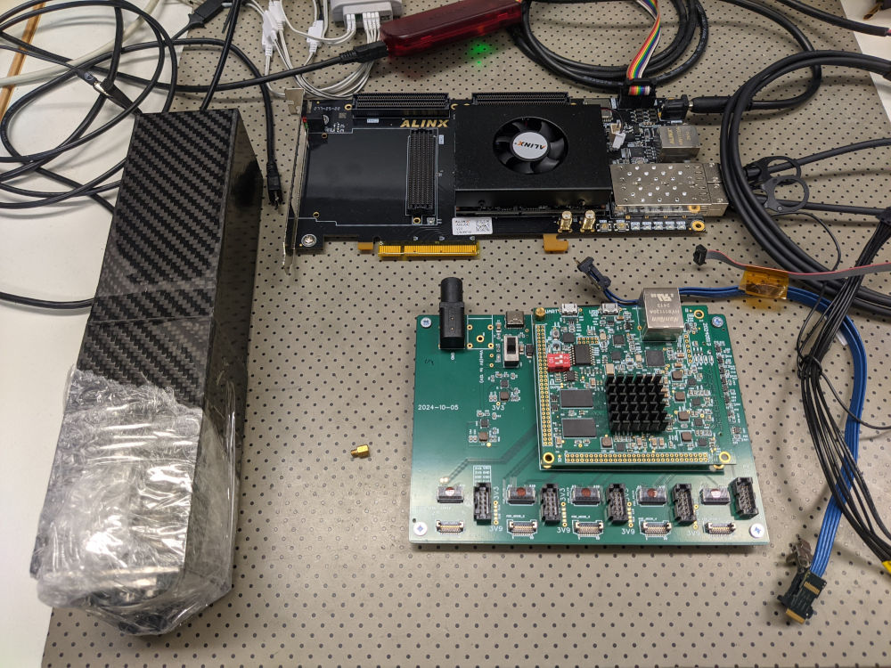
WP3– BEE (Tübingen)
              FEE & Zynq 7000 DAQ-Board arrived:
                Set-up is operating and seems to be properly working (thanks Vishal!)
                Looking into the FEE interface issues now
                Up to now it was not possible to compile the firmware as it is in the SVN
              Working on BEE inter-FPGA interface
                Physical & protocol layer have to be defined

Slide 9
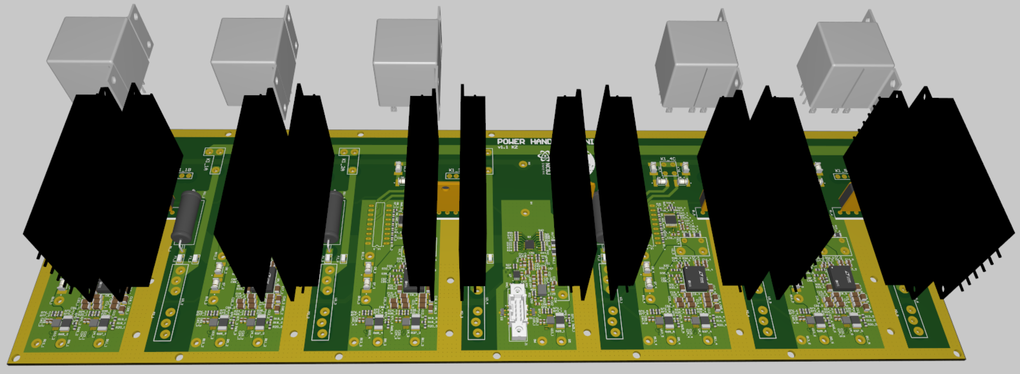
WP4 – PHU – LVPS First Stage
              LVPS First Stage Review Report – to be finished
              Corrections after LVPS First Stage review – implemented
              Manufacturing and assembly documentation - ready

Slide 10
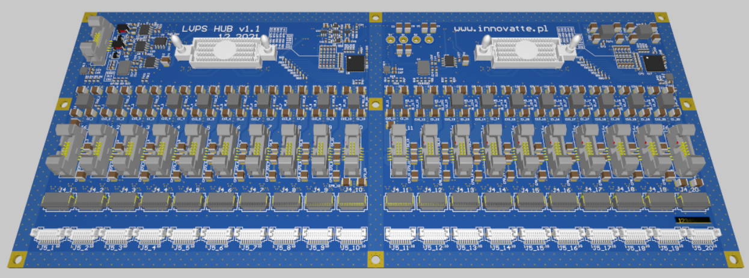
WP4 – PHU - LVPS Hub
              Designed and manufactured by external company
              Modifications to be done:
                FEE connector change
                Startup delay circuit to be modified
                New requirement is > 3.9V (was 3.8V), require a change of resistor setting
                Voltage for Peltier is 9V
                One pin changed from Peltier to GND
                Other known problems were not corrected by Dominik at least in the version received

Slide 11
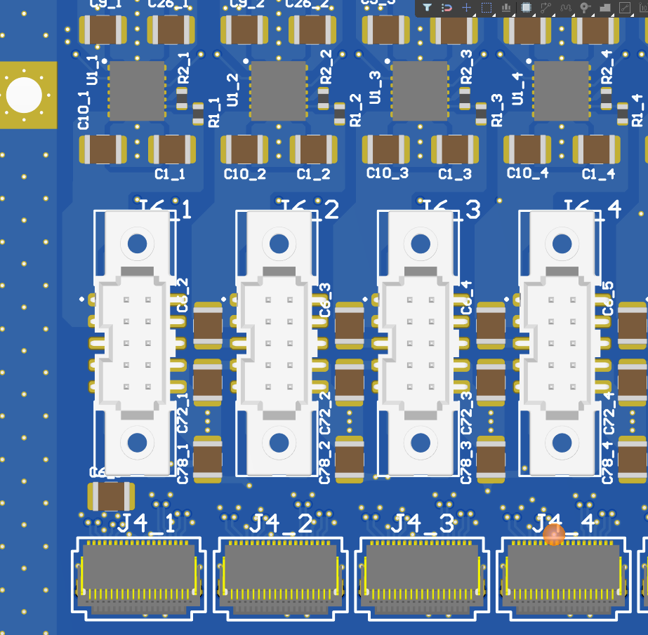
WP4 – PHU + LVPS (Tübingen)
              FEE power connectors are replaced:
                Footprint & position optimized
                Paste-In-Hole process:
                it seems you are using it on the FEE
                → What is your experience?
                → Are there any special requirements necessary?
                Pinout changed according to new design
                → pin #6 is now GND (was Vpeltier)
                A few optimizations still needed
                → but looks good now
              Several questions are still open

Slide 12
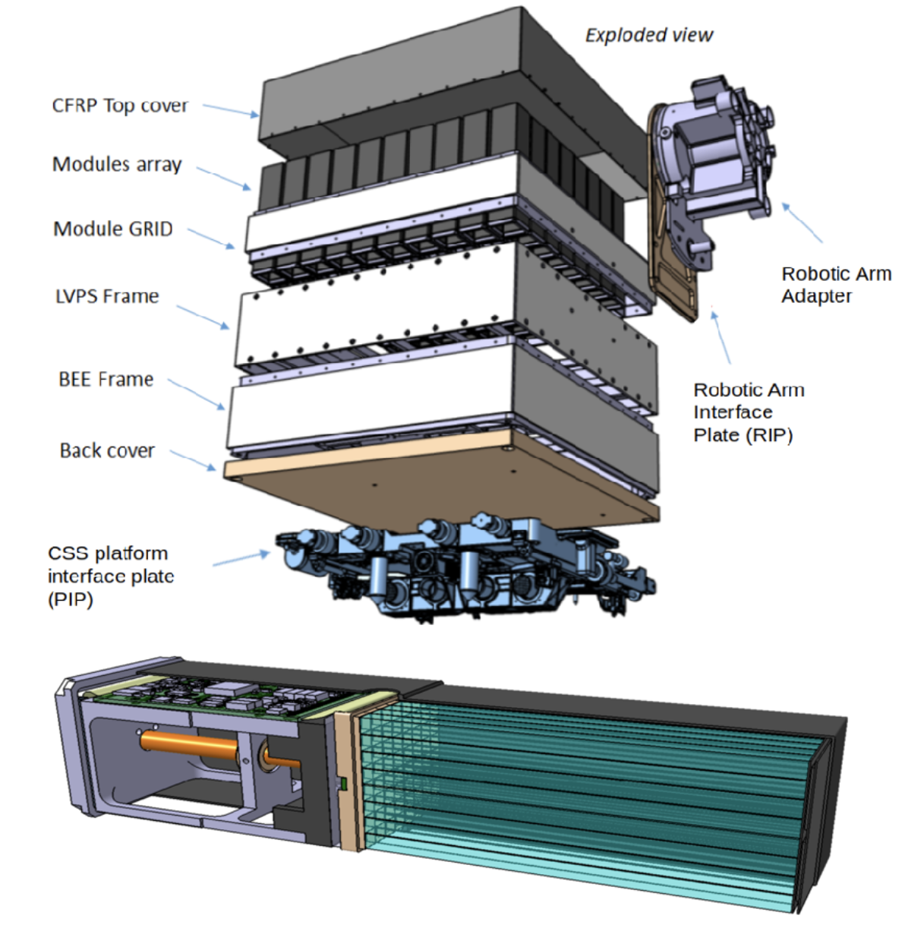
WP5 – Payload Thermo-Mechanical Structure (PTMS)
Instrument stacked in pieces:
Polarimeter will be assembled and delivered to China. RAA and PIP will be assembled on CSS
Full instrument will weigh <160kg (including RAA and adapter plate)... Weight to be updated (modules are being optimized after thermal studies)
ToDo:
  Tungsten plate thickness will updated to 10mm (now 1mm) -> what is impact on weight??
  3x3 top hat to be painted in white paint (after discussing with CSU)
  Final report by to be sent to CSU after finishing 1-2 simulations where adapter plate is 15degrees (not 10)

Slide 13
WP6 – Qualification and Verification
Radiation requirements for BEE and LVPS
  Conditions by UniGe: 1kRad (10 Gray)
  Conditions by CSU: None. But test must be performed. Performance metrics decided by UniGe
Mechanical Modules (MM)
  Quote received for 'heating PCBs' ~600EUR
  Missing input: cost of mechanics (interface plate + alu. module frame + plastic targets) -> waiting for input from Franck
  Expected total cost will be roughly ~30kEUR

Slide 14
WP7 – Flight Model Acceptance
Vibration Test Document still being drafted by Johannes
Need to contact UniBe for space qualification.
  For TV, we should prepare the list of components with their mass and outgassing properties.
  For vibration, we have to get from CSU the vibration levels during launch (considering POLAR-2 will be in a transportation box).
  Preliminary design document of the payload packaging transmitted by Jianchao.

Slide 15
WP8 – POLAR-2 Onboard Software System
Still framing problem with ZYNQ., Tübingen started to look into HDL.
I will have an engineer designing a FMC PCB for ALINX with firefy to read some FEE for another project. Can be done in collaboration with Tübingen. Start in October.
Triggering firmware: next neighbor algorithm can be implemented as 100 equation of 9 terms. Need Monte Carlo to see of one module distance is enough. If next neighbor then 100 equation of 25 terms. Looks feasible. Nicolas can provide a first draft.

Slide 16
WP8 – POLAR-2 Onboard Software System
Plan for visit to China (~1/Nov):
  Test communication with ALINX AXU9EGB board
    Idea: Create initial framework to send data packet. Return to Geneva to write all other surrounding codes. 2nd visit to China to test full framework.
    China: IP core ready. Will assist with firmware and software driver after contract signed
  Test dummy power load
Price for testing the firmware is 30K$ (initial cost) + 10K$ per FPGA. We have to find this money now!
Note: Nicolas will retire Aug/2026!

Slide 17
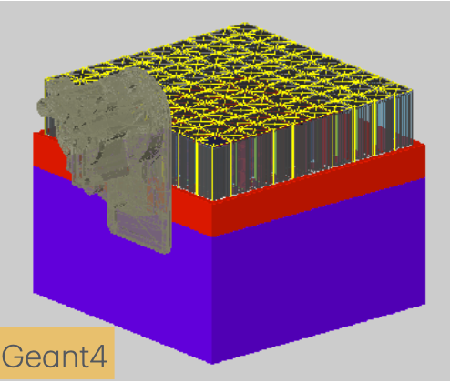
Simulations
Working on Analysis software to unify all scripts we have
  Status: all routines included (to be fully tested this week with Mobin)
  Goal: Full module characterization with a single command
Mobin:
  POLAR2Sim and sim_digitizer updated after cleanup of deprecated code (works now)
  Zynq setup complete to take data for sim_digitizer
Open tasks
  Improved CSS position
  Impact of shadow cast by RAA
  Updated implementation of response in framework

Slide 18
ESRF
Request accepted
  15 shifts
  Beamline ID19
  Week 6 in 2026 proposed (MD day used to setup)
Tasks to complete before ESRF
  Procurement of components for 10 modules (9+1 reserve)
    CITIROCS + SiPMs to be delivered 1 month in advance.
    Mechanical structures (end cap, alu support structure, etc.)
    cables
  Wrapping 640 bars (~420 done)
  Readout (Nicolas, Dominik, Uni. Tuebingen)

Slide 19
EQM

Slide 20
EQM milestones

Slide 21
Conferences/Paper/Misc.
ICRC proceeding deadline 19/Sep (final version)
  NP: no contribution by POLAR-2 (still!). Very disappointed.
More??

